Slide 1


Multi-Task Bayesian Optimisation and
Acquisition Functions
Michael Pearce
Complexity Science, University of Warwick
Juergen Branke
Warwick Business School
Notes:
I am Michael from Warwick in my 3rd year PhD student working with Juergen Branke. I am working on various forms of black box optimisation using Gaussian processes or kriging. and one of those applications today.

Slide 2
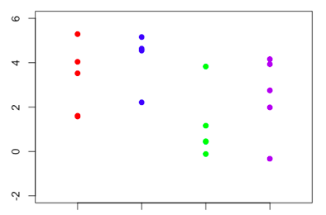
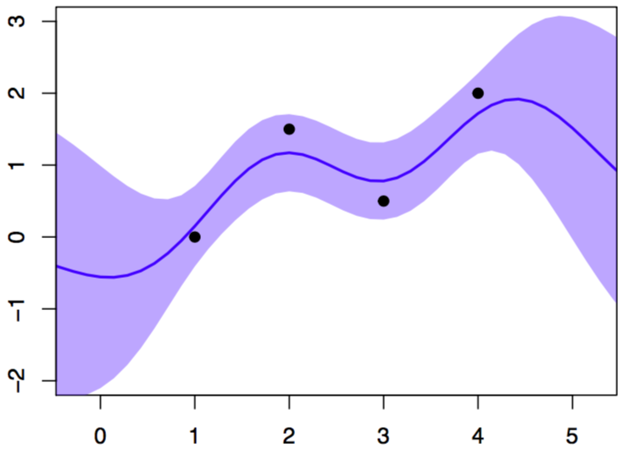
Noisy Optimization
Ranking and Selection
Global Optimization
Discrete independent alternatives
Continuous ‘alternatives’ with similarity
Notes:
Juergen’s work is in noisy optimization, or optimization in uncertain environments and two simple forms of the problem ae as follows, finding the best solution from a small number of possible solutions, ranking and selection, and finding the best continuous setting of a solution over a continuous range of possible solutions.

Slide 3
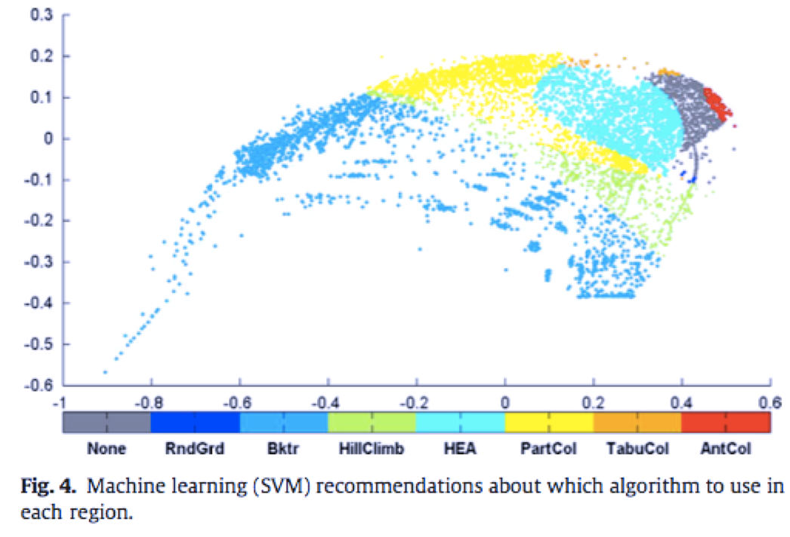
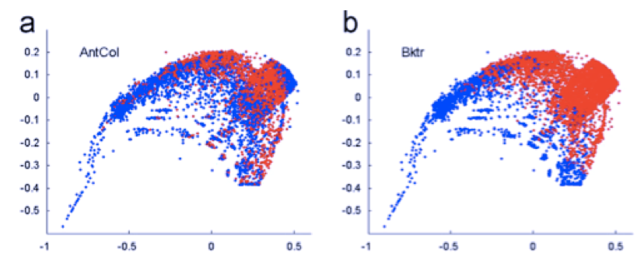
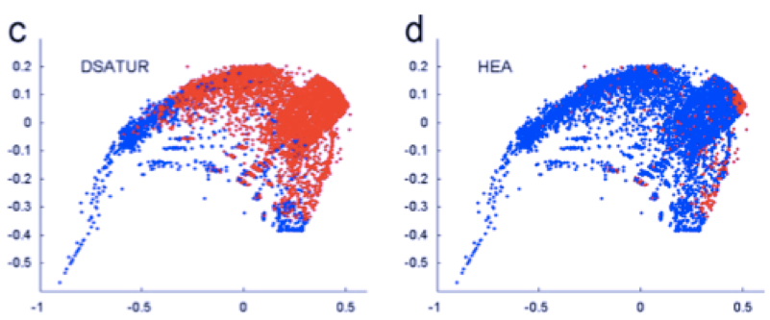
Algorithm Selection Problem
Notes:
The original motivation for this work was taking these methods and extending them to when a user has a range spectrum of optimization problems and similarity between problems can boost the optimizartion processs, finding how good a solution is one task can help a user learn about other tassk. In this case we have multiple ranking and selection problems, learning about the red soliution

Slide 4
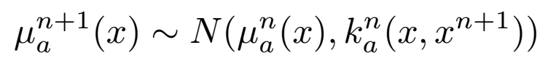
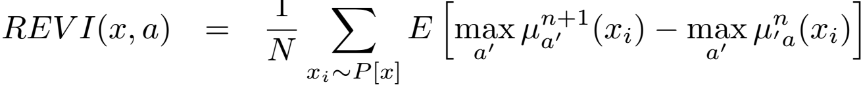
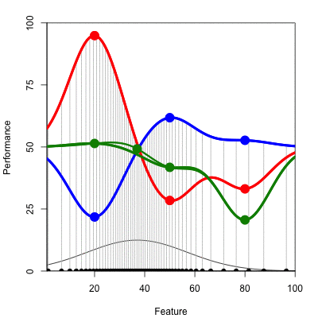
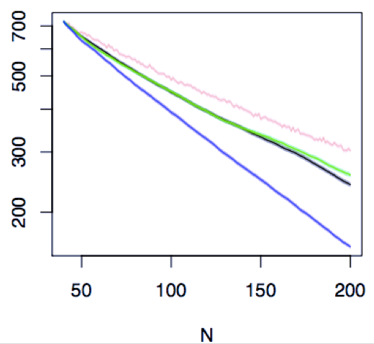
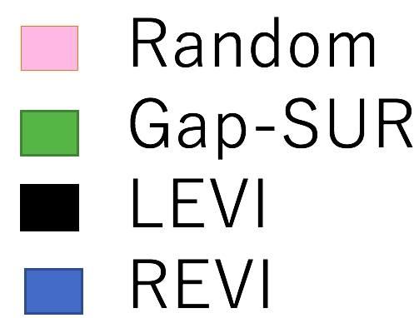
Multiple R&S Acquisition Function
Notes:
For this purpose we use gaussin process to predict unseen tasks based on beasured tasks and it is possoble to measure exactly how much a new sample will change what is the current prediction of the best solution and where that chnge is likely to be graateest we collect the next sample.

Slide 5
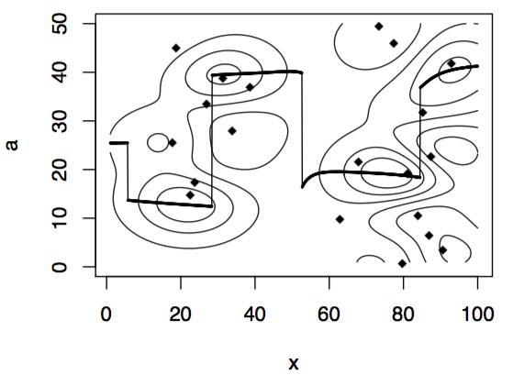
Algorithm Tuning Problem
Notes:
When there is a range of continuous optimisation problems, optimizin one problem can help warm start the otpimizatoin of other problems. Find the unique optimal setting for each vertical slice.

Slide 6
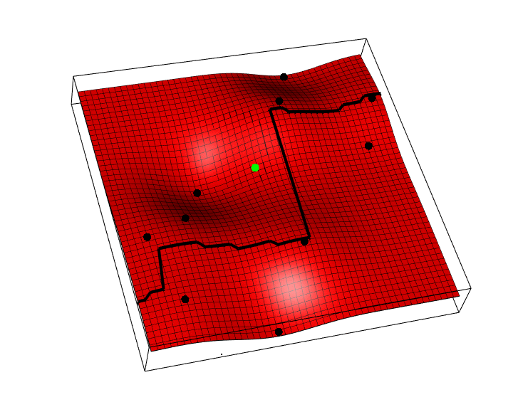
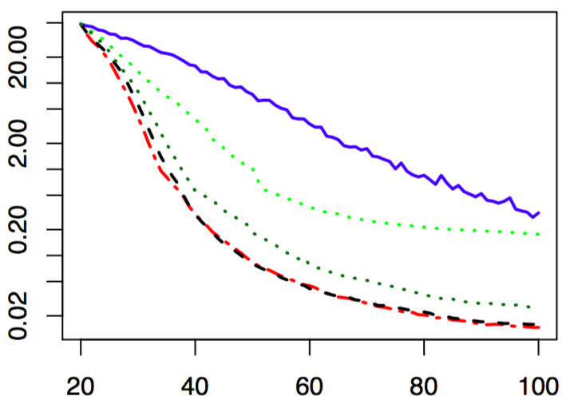
Multiple Global Optimization
Acquisition Function
Random Sampling
SCoT
KG SCoT
LEVI
REVI
Notes:
Again for this we made some sampling preoceudre that looks at how many slices can benefit from the new sample and collects samples such that as many problems as possible benefit from it. We ran some benchmarks on synthetic funcitons and it works pretty well, it bets all other methds we could find however it is more computationally intensive.

Slide 7
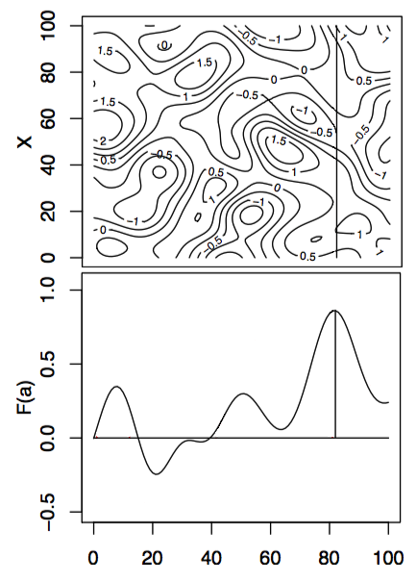
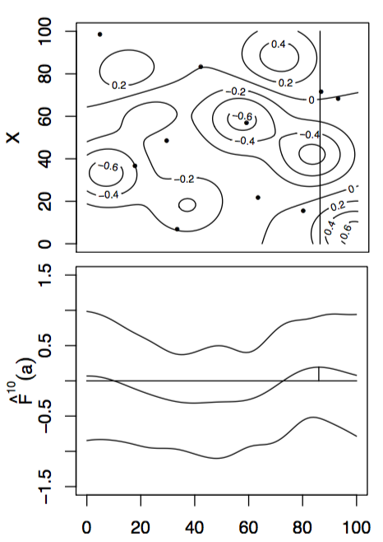
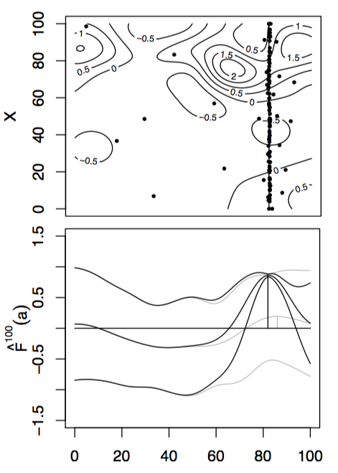
Optimisation with Input uncertainty
Notes:
As a special case of the previous scenario, imagine a user was forced to use only a single setting for all problems, like finding a robust algorithm seting that is best on average over a range of tasks, the task is an uncertain input and we can collect data to maximise the expected imrpovement in the integral over the unceratin input. And we adapted the standard EGO algortihm and Knowledge Gradient for this purpose.

Slide 8
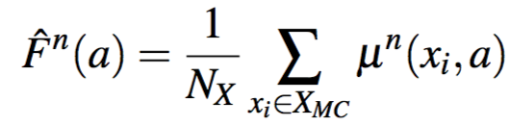
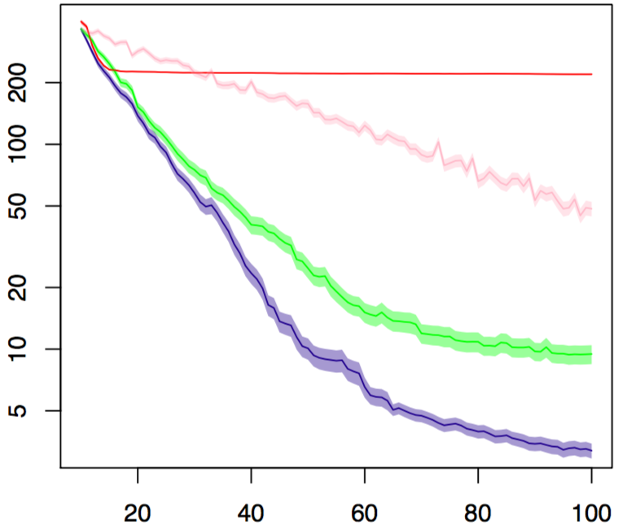
Input Uncertainty Acquisition Function
EGO (fixed mean input)
Random Sampling
EGO with input uncertainty
KG with input uncertainty

