Slide 1
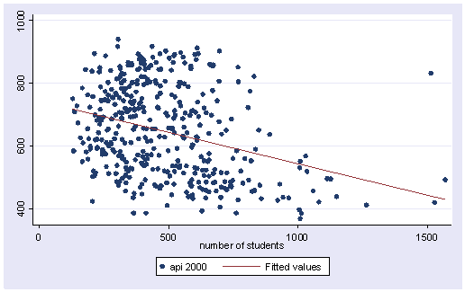
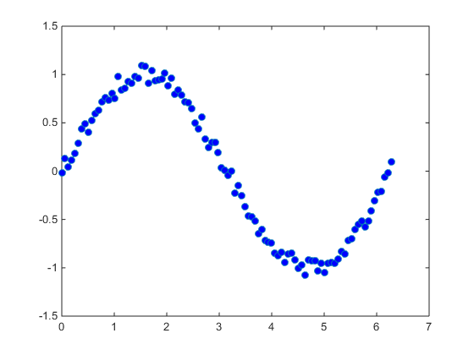
Deep Linear Regression and Wide Learning

Slide 2
Linear Regression
X₁
X₁
X₂
X₃
X₄
X₅
X₆
W₁
W₂
W₃
W₄
W₅
W₆
.
X₂
w₁
X₃
w₂
+ c = y_{pred}
w₃
X₄
w₄
Y_{pred}
X₅
w₅
w₆
X₆
c
1
Sum (ypred-y_i)^2
Notes:
We have a dataset of vectors x with y values that we want to predict. So we assume y is normally distributed with a mean that depends on a weighred sum of the x values.

Slide 3
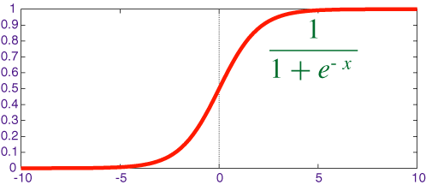
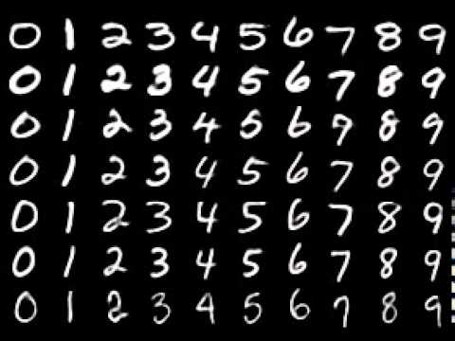
Binary Logistic Regression
X₁
X₂
w₁
X₃
w₂
w₃
X₄
w₄
Y_{pred}
X₅
w₅
w₆
X₆
c
1
Guessing ones 97% correct!
Notes:
Logistic regression is the same however we assume the data is bernoulli distributed, 0s and 1s and the mean of those 0s and 1s is a weighted sum of the inputs. So we can use this to differentiate 1s from other numbers, bear in mind that by just guessing not one every time you can get 90% accuracy.

Slide 4
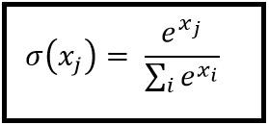
Multiple Logistic Regression
X₁
Y₀
X₂
Y₂
X₃
Y₃
X₄
Y₄
X₅
Y₃
Guessing 0,..,9:
92% correct!
X₇₈₄
Y₉
1
Notes:
Lets use 10 logisstic regeesions and intead of predicitving a single probability of 1-not 1 we predict 0, 1, … we do a linear regression for each number and put all the results though a 10D filter.

Slide 5

Deep Multiple Logistic Regression
X₁
X₂
h₀
Y₀
h₀
h₀
Y₀
Y₀
Guessing 0,..,9:
99.2% correct!
X₃
h₂
Y₂
h₂
h₂
Y₂
Y₂
X₄
h₃
Y₃
h₃
h₃
Y₃
Y₃
X₅
h₄
Y₄
h₄
h₄
Y₄
Y₄
h₃
Y₃
h₃
h₃
Y₃
Y₃
X₇₈₄
h₉
h₉
h₉
Y₉
Y₉
Y₉
1
Notes:
Human centipede
These are contraversial, they’re Deep dark mysterious, they get the job done but some don’t like the way they do it, a bit like a well known superhero

Slide 6
Wide Learning
h₀
h₀
h₀
h₀
X₁
h₂
Y₀
X₂
h₃
Y₂
Guessing 0,..,9:
96% correct!
X₃
h₂
X₄
h₃
Y₃
h₉
Y₄
X₅
h₄
X₇₈₄
Y₃
h₄
h₃
Y₉
1
h₃
h₉
h₉
h₃
h₉
h₂
h₂
Notes:
Learn a high dim rep

Slide 7
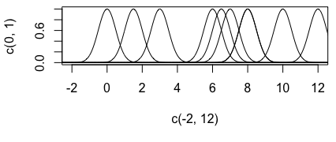
Skinny Learning
Y₀
X₁
Y₂
X₂
X₃
Y₃
h₀
Y₄
X₄
Y₃
Guessing 0,..,9:
41% correct ☹
X₅
X₇₈₄
Y₉
1
Notes:
Linear regresion can have any “link” function put on the end to adapt it to binary/posative only/

Slide 8

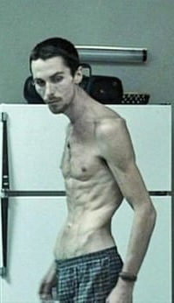



Generalized CB Learning
h₀
h₀
h₀
X₁
h₀
h₂
h₀
Y₀
Y₀
h₀
h₀
h₀
Y₀
Y₀
h₀
h₀
X₂
h₃
Y₀
Y₀
h₂
Y₂
Y₂
????% correct
h₂
h₂
h₂
Y₂
Y₂
h₂
h₂
X₃
h₂
Y₂
Y₂
h₀
h₃
Y₃
Y₃
h₃
h₃
h₃
Y₃
Y₃
h₃
h₃
X₄
h₃
Y₃
Y₃
h₉
h₄
Y₄
Y₄
h₄
h₄
h₄
Y₄
Y₄
h₄
h₄
X₅
Y₄
Y₄
h₀
h₄
h₃
Y₃
Y₃
h₃
h₃
h₃
Y₃
Y₃
h₃
h₃
X₇₈₄
Y₃
Y₃
h₄
Y₉
h₉
h₉
h₉
Y₉
Y₉
h₉
h₉
h₉
1
h₃
Y₉
Y₉
Y₉
h₃
h₉
h₉
h₃
h₉
h₂
h₂
+
+
=
Notes:
Linear regresion can have any “link” function put on the end to adapt it to binary/posative only/

Slide 9
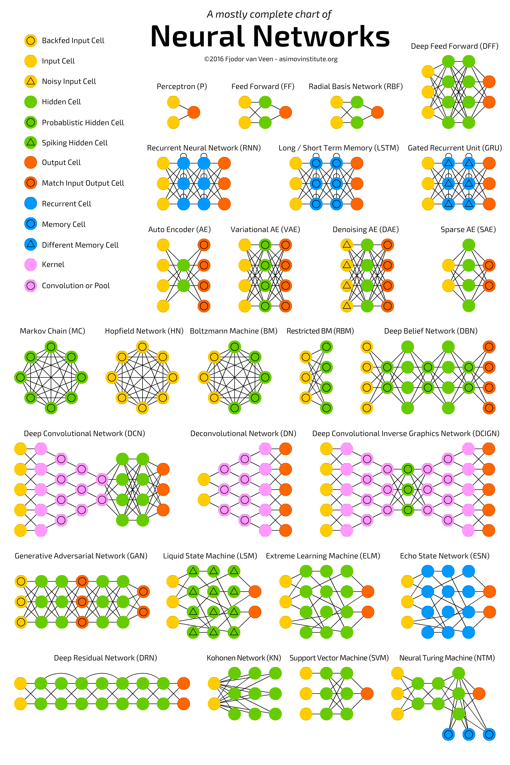
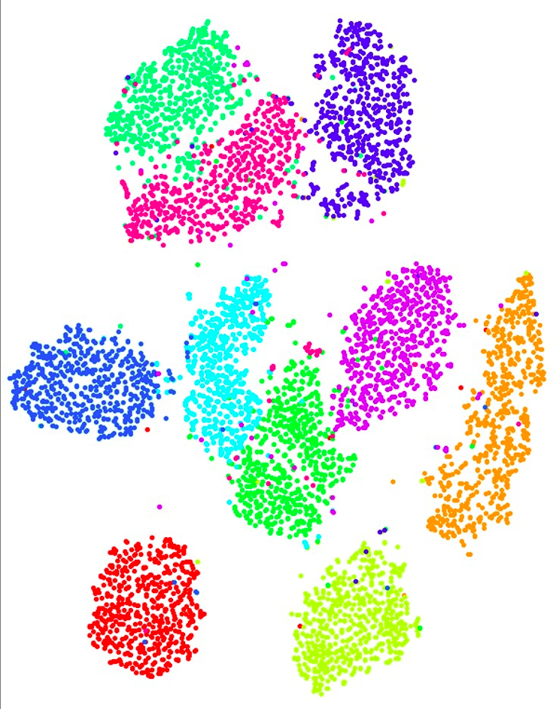

Slide 10
Thank you
Questions?

Slide 11
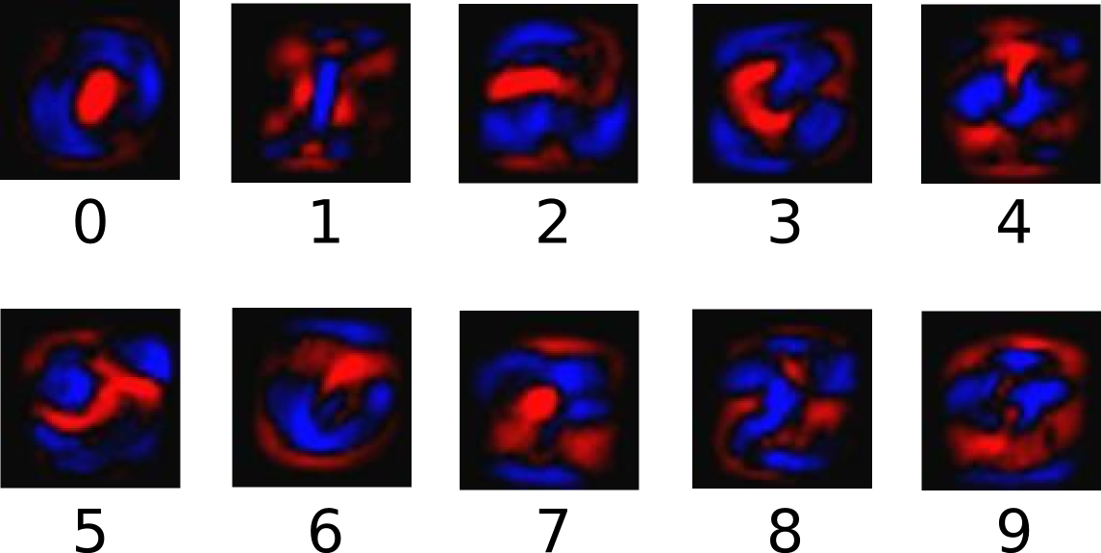
Multiple Logistic Regression
X₁
Y₀
X₂
Y₂
X₃
Y₃
X₄
Y₄
Guessing 0,..,9: 92% correct!
X₅
Y₃
X₇₈₄
Y₉
1
Notes:
Lets use 10 logisstic regeesions and intead of predicitving a single probability of 1-not 1 we predict 0, 1, … we do a linear regression for each number and put all the results though a 10D filter.

