Slide 1
We don’t buy crime: measuring public confidence in policing
Professor Jacqueline Hodgson
Co-Director, Centre for Operational Policing Research
Director, Criminal Justice Centre
School of Law, University of Warwick

Slide 2
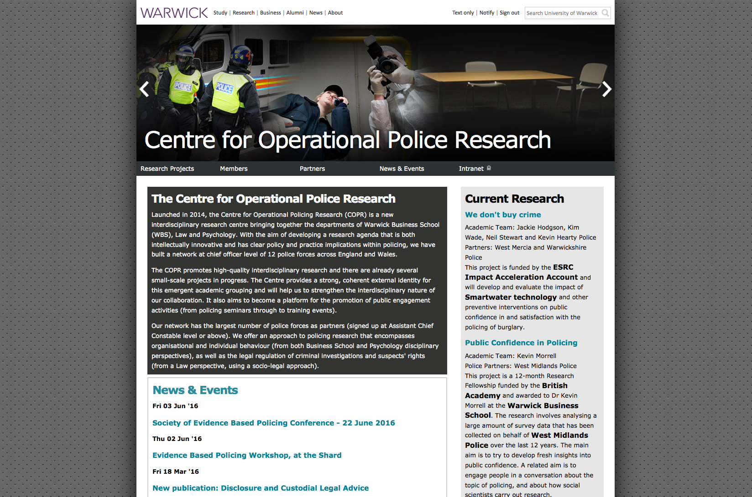
copr

Slide 3
What we do
Interdisciplinary, Cross-Faculty Centre (Law, Psychology and WBS, WMG)
Conducting several research projects in collaboration with police force areas
Having an individual officer involved in the research design and operation is vital to the success of a project. Advising on where and how to best obtain data and sorting out the day-to-day tasks eg DCI Tom Harding (assisted by Mick Simpson) has driven the Smartwater project forward on the policing side
Doctoral students
Workshops and seminars (academic and practitioner)
Aim to build strong links with police and bring different disciplinary perspectives to bear on projects

Slide 4
We don’t buy crime
An example of a small scale project involving Law and Psychology researchers and Warwickshire & West Mercia Police (Warwick: Me+ Kim Wade, Neil Stewart, Kevin Hearty & Edika Quispe Torreblanca + student assistance from both depts West Mercia/Warwickshire: DCI Tom Harding)
To evaluate the impact of Smartwater technology and other crime prevention interventions on public confidence in and satisfaction with police
Public confidence always important, but doubly so given financial cuts and need to ensure interventions are effective and so good use of resources
Funded by the Economic and Social Research Council’s Impact Acceleration Account

Slide 5
The research
5 sites with different levels of intervention
Initial survey before any intervention; second wave 4-6 weeks after intervention; third wave 6 months after intervention
FGI with residents from each site after second wave. Recruited from those providing email contact and indicating willingness to participate on their survey responses
FGI with prolific offenders after second wave
Modest financial incentive – prize draw for surveys; travel for FGIs

Slide 6
Questionnaires
Survey questions similar to British Crime Survey/Crime Survey for E&W to allow for wider contextual comparison.
Access to existing data on public confidence in West Mercia/Warwickshire to provide some baseline data
Preliminary analysis of survey question responses and the freetext comments – compare within and across sites
Response rate of 10-14% (still coming in), 5,000+ surveys

Slide 7
What did we ask? Fear of crime
Most of us worry at some time or other about being the victim of a crime. How worried you are about the following? (Please circle)
1 = Very worried 2 = Fairly worried 3 = Not very worried 4 = Not at all worried
having your home broken into and something stolen? ...being mugged and robbed? ...having things stolen from your car? ...being raped? ...being physically attacked by strangers?...being subject to a physical attack because of your skin colour, ethnic origin or religion?...having your personal items stolen from you while you are out and about?...having things stolen from outside your home (e.g.,shed, garden, communal area)?

Slide 8
Policing
We would like to ask you what you think about the police in your area. You don’t need to have actually had contact with the police to answer these questions, we are just interested in your general opinion about the police in this area.
They (the police in this area) can be relied on to be there when you need them…They (the police in this area) would treat you with respect if you had contact with them for any reason…The police in this area treat everyone fairly regardless of who they are…The police in this area understand the issues in this community…The police in this area are dealing with the things that matter to people in this community…Taking everything into account I have confidence in the police in this area

Slide 9
Local crime problems
Can you tell us how much of a problem these things are in your area. By your area we mean within 15 minutes walk from your home.
- noisy neighbours or loud parties?
- teenagers hanging around on the streets?
- rubbish or litter lying around?
- vandalism, graffiti and other deliberate damage to property or vehicles?
- People using or dealing drugs?
- People being drunk or rowdy in public places?
- Abandoned or burnt out cars?
- Speeding traffic?

Slide 10
Crime victims
We are now going to ask you about things that may have happened over the last 12 months, that is since November last year, in which you may have been the victim of a crime or offence. We are only concerned with incidents that have happened to you personally or to other people who are members of your household.
We don't just want to know about serious incidents – we want to know about small things too.
Have you been the victim of a crime or offence? Yes No
Did the police come to know about the matter? Yes No
Do you think the police treated you fairly? Yes/ Not entirely /Not at all
Did the police treat you with respect? Yes /Not entirely /Not at all
Overall, were you / the victim satisfied or dissatisfied with the way the police handled this matter?
Very satisfied/A bit satisfied/A bit dissatisfied/Very dissatisfied/Too early to say

Slide 11
Victims of crime: satisfaction with the police
Victims of crime had less confidence in the police, were less satisfied with the police and were more fearful of crime.
Perhaps unsurprising, but of some concern that victims of crime do not have a positive experience of the police.
Comments suggested inadequate response to reported crime
Will be interesting to see if this changes in second wave, after interventions

Slide 12
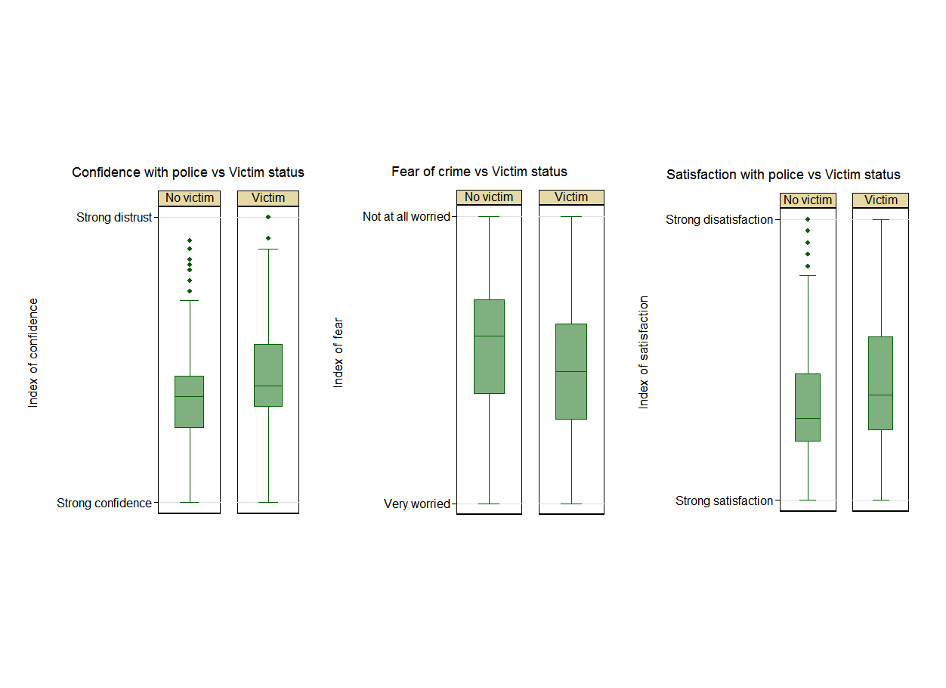
Average scores on indices of confidence with police, satisfaction with police and fear of crime according to the victim status..

Slide 13
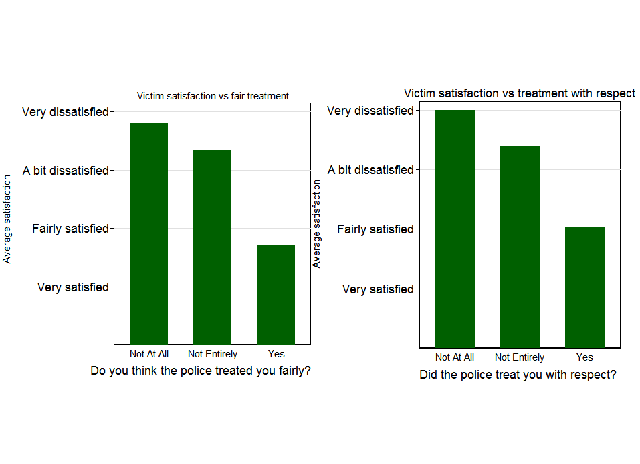
Average victim satisfaction according to treatment received (fair or with respect) by the police
We know from the work of Tom Tyler et al, that the way that police treat individuals has a major impact on their perception of the fairness and legitimacy of police actions. (Their work has centred on suspects).Victims of crime who felt they were not treated fairly or with respect were most dissatisfied with the police.

Slide 14
Patterns across sites
Site A had:
- the LEAST confidence in police
- the HIGHEST LEVEL OF DISAGREEMENT with the statement that “the police are dealing with things that matter to people in this community” and “the police can be relied upon to be there when you need them” and “the police can be trusted to make decisions that are right for this neighbourhood”
It had the lowest levels of fear of serious crime
Sites C and D were the reverse, being consistently positive despite having a higher fear of crime than site A.
Sites A, C & D did not report high level of crime problems. Site E had the highest levels of problem crime, notably drugs, but also high levels of police confidence/satisfaction.

Slide 15
Confidence & visibility
“What policing?? I would imagine we can only respond to our views based on when there were police here. A survey on 'policing' seems rather futile in an area which effectively has no obvious policing.” [Site A]
Concerns on this issue were recorded across the sites.
3 strands of argument
1) there is no police presence
2) what presence there is is limited and ineffective
3) this has caused a disconnect between the community and the police that has had a detrimental impact on policing and crime in the area.

Slide 16
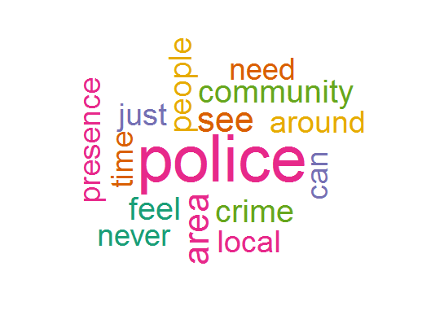
Most common words in respondents’ comments

