Slide 1
Public confidence and crime reduction: the impact of forensic property marking
COPR team
Jackie Hodgson (Law), Kim Wade (Psychology), Neil Stewart (WBS), Kevin Hearty (Law), Natalie Kyneswood (Law), Edika Quispe Torreblanca (Psychology), Tim Mullett (Psychology)

Slide 2
Welcome & introduction
Professor Jackie Hodgson
Co-Director, COPR

Slide 3
Welcome
Informal presentation of preliminary findings; discussion
Working collaboratively with police to contribute to evidenced based practices
Challenges of using academic results in practical & effective ways to assist police decision-making around resources and actions
COPR study – growing interdisciplinary research centre https://www2.warwick.ac.uk/fac/cross_fac/copr/
Enabled by ESRC IAA at Warwick, West Mercia police cooperation and a large team of researchers

Slide 4
Introduction
Burglary prevention interventions across 4 sites – SmartWater, We Don’t Buy Crime, street signage, plus cocooning & a 5th control site
Impact on public confidence in & victim satisfaction with police, as well as crime reduction
The Met have used & impressed by impact of SmartWater
Independent empirical basis, taking account of alternative factors. Longitudinal mixed method approach
Cost-efficient alternatives? Displacement?
Broader context of delivering with less resources as well as evidence base for value for money

Slide 5
The police-designed interventions
A SmartWater – semi-rural area, older population, affluent, community-driven intervention
B SmartWater – urban, social housing, working class, younger population, high unemployment
C SmartWater – large area, urban with green space, mix of social and privately owned housing
D WDBC – more affluent, mix of social and privately owned housing, higher employment & older population than B,C & E
E control – very similar to B. No intervention, but cocconing.

Slide 6
Implementing interventions
Major resource-intensive operation for police - delivering, explaining and then registering property marking schemes
Even WDBC requires personal visit
Site A made use of police cadets and special constables – positive community initiative
Practical difficulties eg permissions for erecting street signage

Slide 7
Research overview
Surveyed sites before, shortly after, then 6 months after interventions
Modelled questions from BCS + space for comments
Interviews with prolific offenders through probation services
Interviews with police officers in key roles, PCSOs and a community representative from Site A

Slide 8
Research challenges
Promotions and internal moves mean good to have more than one person in organisation who can progress things & has necessary authority
Logistics of getting 6,000 surveys and envelopes to Telford, then delivering them to specified areas
Gathering information about areas, timescales, crime data etc when knowledge & resourcing spread across personnel, & info initially gathered for a different purpose
Access – ethics permissions; NOMS; low public response for FGIs
Royal Mail destroying surveys

Slide 9

West Mercia Police Acquisitive Crime Project Seeking an evidence base to identify & continuously improve best practice
Project Lead: Superintendent Tom Harding
West Mercia & Warwickshire Police

Slide 10
WDBC – The Message
We are aware that acquisitive crime, including burglary, robbery and theft harms our communities. A person’s home and possessions often carry an emotional attachment and when a criminal interferes with this it can have a long lasting impact on victims.
West Mercia Police are committed to protecting people from these crimes AND improving how safe they feel and their level of confidence in policing. But HOW?
‘We Don’t Buy Crime’ is a project seeking to utilise innovative approaches to reducing and disrupting the market for stolen goods, protecting homes and possessions and simply establishing what works.

Slide 11
Innovative Approach?
We are forming partnerships with local business and communities with a common goal of disrupting acquisitive crime. We have worked with a local business, SmartWater, to make use of technology to fight crime and protect and reassure our communities.
Together we have created the UK’s first:
Second-hand dealers database, where every trader in second-hand goods adopts best practice in the retail of such goods and commits to working with its local Police to tackle crime (ISA etc).
‘We Don’t Buy Crime’ towns and villages, where every residential property has the opportunity to mark their possessions with either UV marking pens or SmartWater free of charge and then display associated window stickers and supported by street signage.

Slide 12

The UK’s First Second-Hand Goods Retailer Database

Slide 13
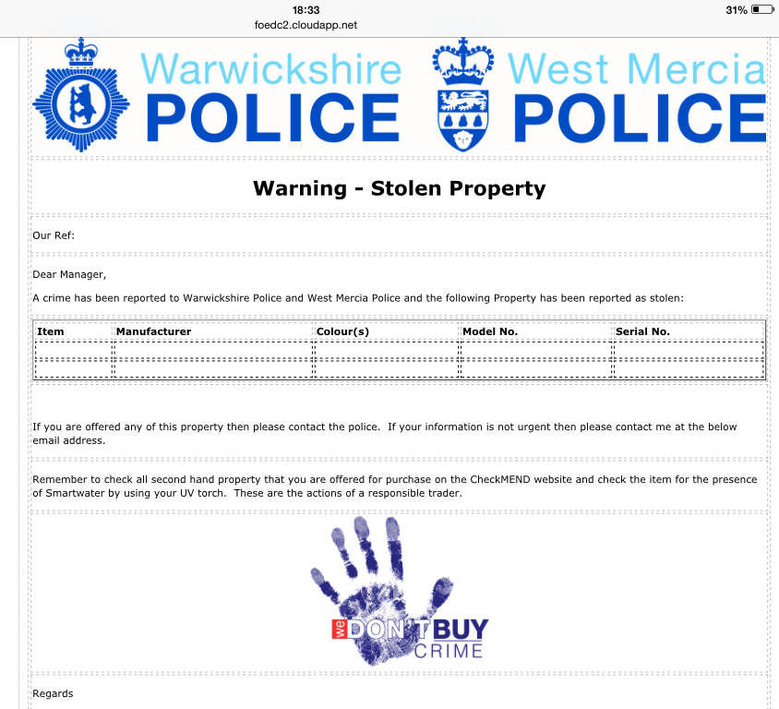
Facility for investigating officers to immediately alert an registered second-hand goods retailers across the Alliance of stolen property.

Slide 14

We Don’t Buy Crime Towns, Villages & Hotspots
SmartWater or UV pen marking available to all houses (Does Smatwater add value or is it the strategy of marking or just doing something?)
Bespoke signage to support the message
Funded by partnerships with communities
Response to persistent ‘hotspots’?
Provide reassurance?
Protect communities?
Improve Confidence?
BUT DOES IT???

Slide 15

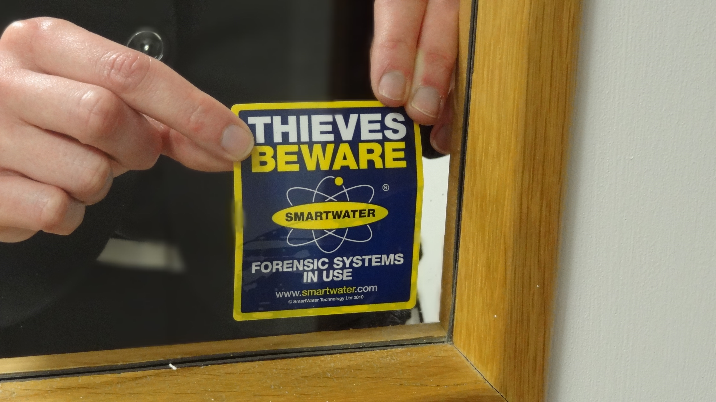



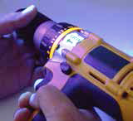
Home security tips flyer
SmartWater marked home window sticker
WDBC window sticker
SmartWater marked items under UV light

Slide 16
Example of We Don’t Buy Crime street sign

Slide 17
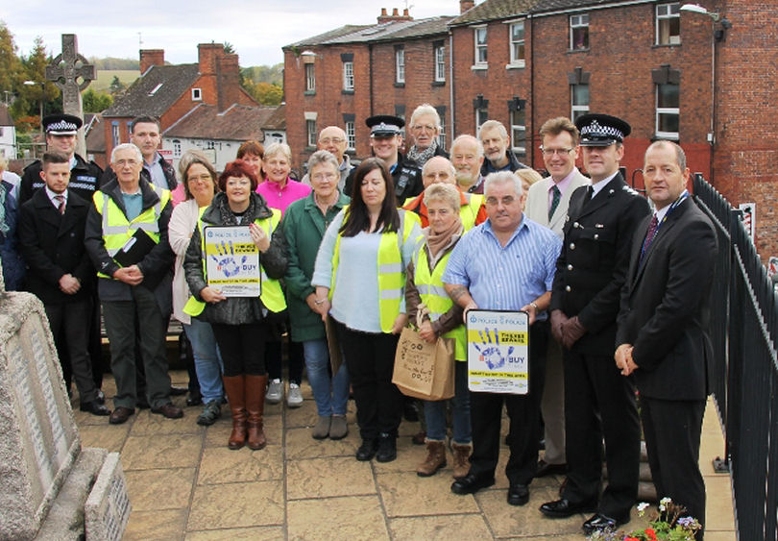
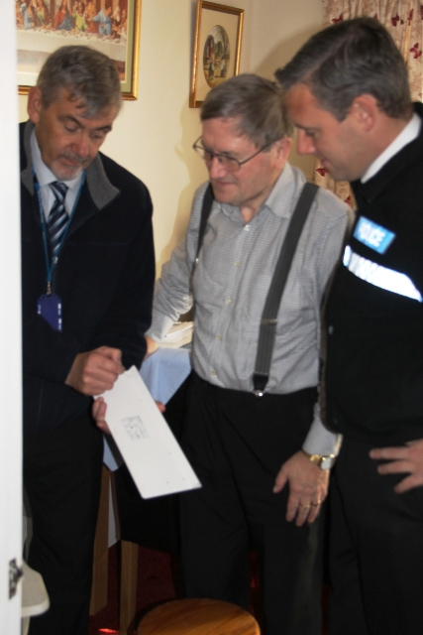
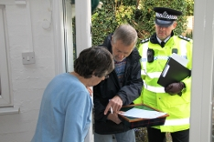
SITE A – WDBC Implementation
First We Don’t Buy Crime Town
Population of 7,500
1,400 properties to be marked
1,200 completed in two weeks
Funded by Parish Council and other partners with the support of the West Mercia PCC

Slide 18
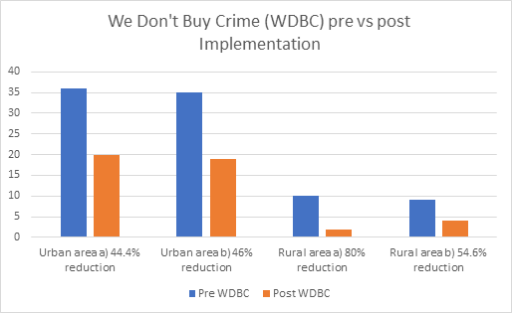
Impact on Burglary Dwelling Offences

Slide 19
Why work with academia?
If we in policing are honest with ourselves, we do not have the requisite skills nor resources to conduct compressive multi-disciplined research into the impact of such initiatives
Unconscious/ Conscious bias
Other factors i.e. increased police presence
Benefits of understanding our local communities as a consequence of research into such a project
It was imperative for me that having been entrusted with funding from John Campion the West Mercia Police and Crime Commissioner that I am able to provide a detailed evaluation of the impact of this work on not just crime rates but fear of crime and community confidence in policing. This evidence base will be the basis for future funding decisions

Slide 20
Learning to date
Working in partnership with the community is more efficient and effective than going alone
Analysis is not easy. Much joint work to do over the coming weeks re: crime data and evaluation
Time consuming – patience of the PCC is vital
No miracles but incremental improvements possible
Lack of true evidence based decision making
Necessity to establish cost benefit analysis to make increasing difficult funding decisions (£1,000 per burglary)
Impact of related Covert work to tackle crime/ problem solve

Slide 21
What do the public want?
Professor Jackie Hodgson
Director, COPR

Slide 22
Public confidence & policing
Studies show fear of crime generated through signs of neighbourhood crime and disorder
Reassurance gap - belief that - crime & disorder ⬆ - capacity of CJC & police to tackle crime ⬇
Public confidence in police = better relationships with public re reporting, offending, co-operation
Public confidence in & satisfaction with police centres on communicative interaction: police effectiveness; fairness of treatment; police engagement with local community; local levels of disorder
Notes:
Fear of crime when disorder: I Brunton-Smith and P. Sturgis, ‘Do Neighbourhoods Generate Fear of Crime?: An Empirical Test Using the British Crime Survey’, Criminology, 49.2 (2011): 331-369
Public confidence + better relationships: E Stanko and B Bradford, ‘Beyond Measuring ‘How Good a Job’ Police Are Doing: The MPS Model of Confidence in Policing’, Policing, 3 (4) (2009), pp. 322 – 330; J Fleming and E McLaughlin, ‘’The Public gets what the public wants’: Interrogating the ‘Public Confidence’ agenda’, Policing, 4(3) (2010), pp. 199 – 202; T R Tyler, ‘Enhancing police legitimacy’, The annals of the American academy of political and social science, 593(1), pp. 84 – 99; L Ren et al., ‘Linking confidence in the police with the performance of the police: Community policing can make a difference’, Journal of Criminal Justice, 33 (1) (2005), pp. 55-66.

Slide 23
What survey respondents told us
30% of 1,666 responses included free text comments
7% of responses were to praise the efforts of local police (all in sites B-E)
Almost half (49%) of respondents mentioned the absence of police presence (also connected to P/S closures).
15% responses unhappy at nature or lack of police response
Vehicles cannot replace trust & intelligence gathering of beat officer. Lack of presence makes people feel police do not care

Slide 24
Police visibility and the reassurance gap
Too little police presence in the area leads to more crime. This is often dismissed as being not serious. This leads to the community not reporting issues as they lose confidence that anyone will deal with it. (Site A, victim of criminal damage)
It would be good to see friendly neighbourhood police walking their beat. This would improve relations with the public and help with the fight against crime. Prevention rather than cure. (Site C, no police contact)
Notes:
A (w1 prior intervention) victim of criminal damage to cars and property reported to police, aged 40+, no 373

Slide 25
The value of local beat officers
Trust: Community PC is GREATLY missed. Our old local PC knew everyone/thing in the area, and provided an excellent point of contact. He regularly called to talk/listen to our concerns and gain intelligence on local area. (Site E, victim of criminal damage to car)
Geography: If we could just have one pair of officers walking through the estate on a regular basis, that would help - and I don't just mean walking down the spinal path, I would like to see a patrol walking through as much of the estate as they can, all the little alleys etc (Site E, witness to a crime)

Slide 26
Low police visibility attributed to lack of concern
Police are so thin on the ground now. We never see a bobby on the beat anymore. They are not interested in any crime other than serious situations like murders or fatal accidents. This leaves the general public to fend for themselves… (Site D witness to crime)
In general, the only police officers I see are waiting to stop people committing traffic offences. I do not see police officers walking around this area. This area has two prolific drug dealers, streams of people collecting drugs etc. If I see this, why can't the police see it and stop it? I now have CCTV recording 24/7 because I don't feel particularly safe leaving my home to go to work. (Site B witness to crime)

Slide 27
Visibility attributed to lack of time & resources
There are loud abusive arguments from drink/ drugs usually at 2 am etc. but not something you'd bother police with. Unless it was very dangerous I wouldn't call the police as they wouldn't have the time to come out. (Site B, victim of criminal damage)
I think cuts in funding by the government have affected the priorities of the police in my area. They now have too much to do with very little money. All in all they do their best in a bad situation due to financial constraints. (Site E, victim of verbal abuse)
It’s not the police themselves fault it is the bureaucrats and their cuts that is turning a lot of mainly city areas into no-go places
(Site C, no police contact)

Slide 28
Views on interventions
See others have had forensic property marking, UV pens etc and would like same.
Also favour better lighting, more for young people to do (especially youth clubs) and more CCTV
Police visibility & treatment of crime most important concerns

Slide 29
Different expectations
Confidence in policing is not a reflection of (i) levels of crime, or (ii) fear of crime
Site A reported lowest levels of crime, lowest fear of crime, but also lowest satisfaction with police
This dilemma was recognised by police:
It’s not necessarily that another area is getting a better level of service, it’s just that they are the ones with the victims…how much effort do you then have to put into an area where there is no need to respond, to purely increase their public confidence? (Officer A)

Slide 30
The impact of police interventions on public confidence
Dr Kim Wade
Deputy Director, COPR

Slide 31

Residents of Telford were surveyed prior to interventions, immediately after, and 5-6 months after
40 items related to fear of crime, attitudes towards policing, local levels of crime, performance of local police, and demographic information
Modelled on Crime Survey for England & Wales
The Survey

Slide 32
Confidence in policing (1= strongly agree, 4 = strongly disagree)
“You should do what the police tell you, even if you disagree”
“The police can be trusted to make decisions that are right for this neighbourhood”
Fear of crime (1 = very worried, 4 = not at all worried)
“Being physically attacked by strangers”
“Having things stolen from outside your home”
Problems in the area (1 = a very big problem, 4 = not a problem at all)
“Speeding traffic”
“Noisy neighbours or loud parties”
Satisfaction with policing (1= strongly agree, 5 = strongly disagree)
“The police can be relied on to be there when you need them”
“The police are dealing with the things that matter to people in this community”
Awareness of interventions (1 = aware of intervention, 2 = unaware of intervention)
“The distribution of free SmartWater packs and crime deterrent stickers to local residents”
“Signs in the area advertising the ‘We don’t buy crime’ campaign”
Sample items

Slide 33


Survey sample across sites
Site | Women | Men | Unreported | TOTAL
E | 164 | 94 | 38 | 296
A | 155 | 137 | 49 | 341
C | 279 | 146 | 39 | 464
D | 156 | 88 | 25 | 269
B | 169 | 111 | 16 | 296
TOTAL | 923 | 576 | 167 | 1666
~330 respondents in each site. Overall, at least 55% were women.

Slide 34
Distribution (%) of people across sites by age
Site | <30 | 30s | 40s | 50s | 60s | 70s | 80+ | TOTAL
E | 12 | 16 | 14 | 15 | 29 | 12 | 3 | 100
A | 9 | 12 | 10 | 14 | 23 | 23 | 9 | 100
C | 4 | 7 | 15 | 19 | 33 | 15 | 7 | 100
D | 8 | 11 | 16 | 23 | 24 | 13 | 4 | 100
B | 9 | 11 | 11 | 16 | 27 | 19 | 6 | 100
TOTAL | 8 | 11 | 14 | 17 | 28 | 16 | 6 | 100
68% over 50 years, but sampled across broad age-range

Slide 35
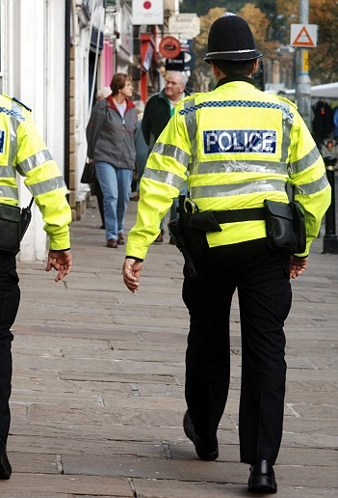
Themes
Confidence in policing
Fear of crime
Satisfaction with policing
Problems in area
Awareness of interventions

Slide 36
General perceptions across SITES
E – Control, A – SmartWater, C – SmartWater, D - We don’t buy crime, B - SmartWater

Slide 37
General perceptions across SITES
Biggest concern across all sites (except A) was having one’s home broken into and something stolen
Least threatening issues were physical attack because of ethnic origin (20%) or being raped (40%)
E – Control, A – SmartWater, C – SmartWater, D - We don’t buy crime, B - SmartWater

Slide 38
General perceptions across SITES
Despite variability across sites, over 70% respondents reported that the police will treat them with respect if they had to contact them for any reason.
E – Control, A – SmartWater, C – SmartWater, D - We don’t buy crime, B - SmartWater

Slide 39
General perceptions across SITES
Sites E and B: similar concerns about antisocial behaviour
E – Control, A – SmartWater, C – SmartWater, D - We don’t buy crime, B - SmartWater

Slide 40
General perceptions across SITES
E – Control, A – SmartWater, C – SmartWater, D - We don’t buy crime, B - SmartWater

Slide 41
General perceptions across WAVES
Awareness of the intervention changed across waves, but no immediate evidence that public perceptions, overall, experienced a relative improvement

Slide 42

Is there a relationship between feelings of vulnerability to crime and confidence/satisfaction with policing?
Local problems linked to low confidence:
noisy neighbours (-6%)
people using or dealing drugs (-5%)
people being drunk or rowdy (-4%)
Local problems linked to low satisfaction:
noisy neighbours (-8%)
people using or dealing drugs (-9%)
people being drunk or rowdy (-9%)
Fears linked to low confidence:
being attacked b/c ethic origin (-6%)
having things stolen from car (-4%)
physically attacked by strangers (-3%)
Fears linked to low satisfaction:
having things stolen from car (-6%)
having home broken into (-4%)
having things stolen from outside your home (-4%)
48%

Slide 43
The interventions and their relationship with fear of crime, confidence in policing, and satisfaction with policing
(Bogus intervention)

Slide 44
The interventions and their relationship with fear of crime, confidence in policing, and satisfaction with policing
Key findings:
No statistical evidence that interventions were associated with reduced fear of crime, improved confidence, or improved satisfaction
However, the distribution of free SmartWater packs and crime deterrent stickers to local residents did show a relationship: When people were aware of the SmartWater intervention, they reported, on average, lower levels of fear of crime (-6%), higher levels of confidence (+4%), and higher levels of satisfaction with policing (5%)

Slide 45
When respondents are aware of the SmartWater intervention, which problems are perceived as less threatening?
-11%
-11%
-9%
-8%
-7%

Slide 46
Four our of five interventions did not show any correlation with fear of crime, confidence in policing, or satisfaction with policing
But, the distribution of free SmartWater packs and crime deterrent stickers to local residents did correlate with slightly lower levels of fear of crime, and slightly higher levels of confidence and satisfaction with policing
Evidence that people report ~10% less fear of certain crimes (e.g., being physically attacked by stranger, house broken into) when they are aware of the SmartWater intervention
Conclusions

Slide 47
The impact of police interventions on recorded crime
Edika Quispe Torreblanca and
Neil Stewart Co-Director, COPR
Notes:
NS “On” recorded crime
NS Did you make any progress on the comparison to Rachael’s analysis?

Slide 48
Methodology
Data Sources
Incidents of crime geolocated for the period 2012-2017
Postcodes/addresses of specific intervention places
Identification Strategy
Difference in Difference (comparison against the rest of Shropshire County)
Control Site E was subject of treatment and so it cannot be used as reference site for comparison purposes.

Slide 49
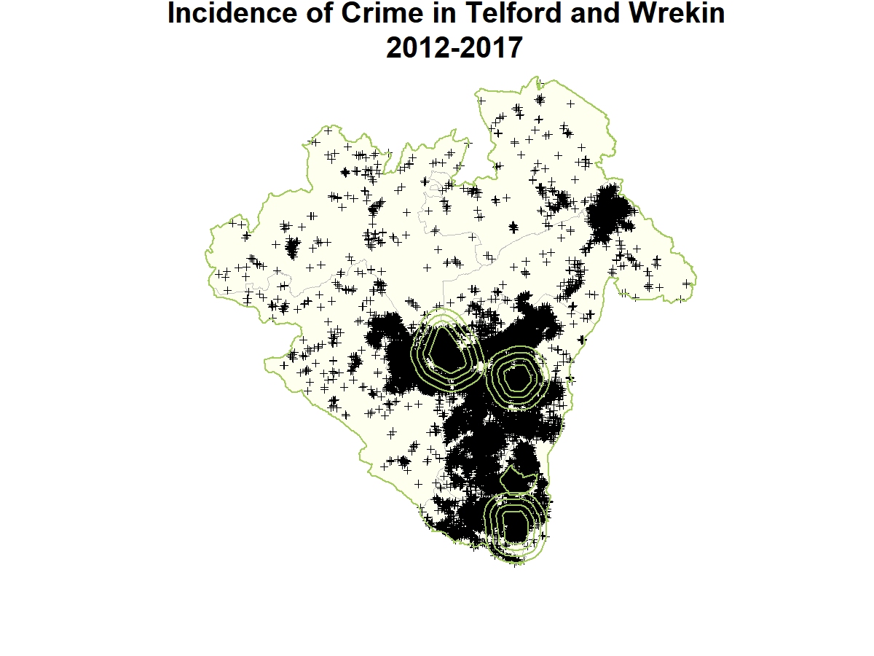
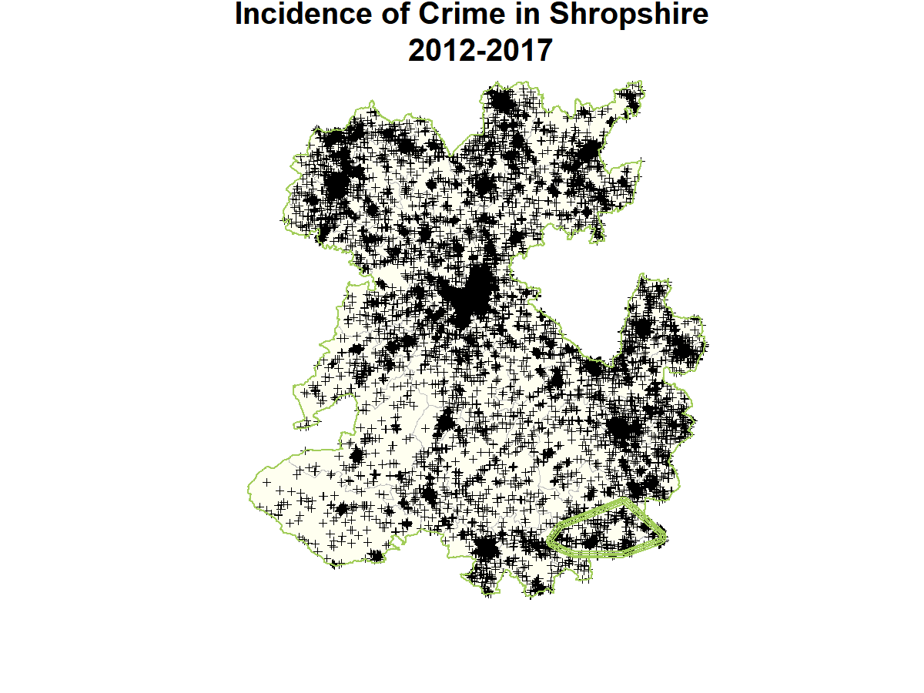
Crimes

Slide 50
Difference in Difference
(1) Difference between the crime rates in the three quarters that followed the interventions with the rates in the preceding year for each site.
(2) Difference between the intervention site’s deviation from the preceding year average crime rate and the control site’s deviation from the preceding year average crime rate.
Control site: The rest of Shropshire County.
Post intervention periods
In B, C and D, the Quarter 1 of the WDBC/SW is from August to October 2016.
In A, the Quarter 1 of the SW is from January to March 2016
(For comparison, police estimates compare August 2015 to July 2016 against August 2016 to July 2017)
Notes:
Recalling short names and interventions:
Brookside (E) - Control
Cleobury Mortimer (A) - SW
Leegomery (C) - SW
St George's (D) - WDBC
Sutton Hill (B) - SW

Slide 51
Difference in Difference
Y_{it} = β₀ + β₁T_{it} + β₂Q1_{it} + β₃Q2_{it} + β₄Q3_{it} + β₅Q1_{it}T_{it} + β₆Q2_{it}T_{it} + β₇Q3_{it}T_{it} + ε_{it}
Y_{it} = log(Crime rate/Km²) for site i at time t
Q1_{it} = quarter 1 after the intervention
Q2_{it} = quarter 2 after the intervention
Q3_{it} = quarter 3 after the intervention
T_{it} = treated group
Diff-in-diff estimates are β_{5,} β₆ and β₇
Y=Crime
Y_{c1}
Treatment effect=
(Y_{t2}-Y_{t1}) – (Y_{c2}-Y_{c1})
Y_{c2}
Y_{t1}
Control Site
Key assumption: time trends in the absence
of the intervention are the same in both sites. Otherwise, estimates will over/under estimate the treatment effect. To reduce the bias in the estimates, Time₁ is the average rate during the year preceding the intervention
Y_{t2}
Treatment Site
Time₁
Time₂

Slide 52
Crime Rates: Dwelling Burglaries
Crime rates do not show consistent seasonal changes. They also do not expose parallel patterns with Site E and the Rest of Shropshire County.
Notes:
NS: Y axis to “Number of crimes”

Slide 53
Crime Rates: Dwelling Burglaries
Notes:
NS: Why is “Rest of Shropshire” different from on previous slide?

Slide 54
Crime Rates: Burglary other than Dwelling
Crime rates do not show consistent seasonal changes. They also do not expose parallel patterns with Site E and the Rest of Shropshire County

Slide 55
Crime Rates: Burglary other than Dwelling

Slide 56
Notes:
Y_{it} = β₀ + β₁T_{it} + β₂Q1_{it} + β₃Q2_{it} + β₄Q3_{it} + β₅Q1_{it}T_{it} + β₆Q2_{it}T_{it} + β₇Q3_{it}T_{it} + ε_{it}
For quarter 1:
Exp(Rate Ratio post-pre treatment) for treated=exp(B0 + B1 + B2 +B5 -B0 –B1) = exp(B2+ B5)
Exp(Rate Ratio post-pre treatment) for control=exp(B0 + B2 -B0)= exp (B2)
RATIO OF RATE RATIOS: exp(B2 + B5 –B2)= exp(B5)
NS: X axis needs log labels, so label means multiplier from before to after
NS: Rate ratio is already on a log scale?
NS: Are estimates averaged over quarters more precise?

Slide 57
Notes:
Y_{it} = β₀ + β₁T_{it} + β₂Q1_{it} + β₃Q2_{it} + β₄Q3_{it} + β₅Q1_{it}T_{it} + β₆Q2_{it}T_{it} + β₇Q3_{it}T_{it} + ε_{it}
For quarter 1:
Exp(Rate Ratio post-pre treatment) for treated=exp(B0 + B1 + B2 +B5 -B0 –B1) = exp(B2+ B5)
Exp(Rate Ratio post-pre treatment) for control=exp(B0 + B2 -B0)= exp (B2)
RATIO OF RATE RATIOS: exp(B2 + B5 –B2)= exp(B5)

Slide 58
Alternative Methods
Time series analysis analysing within site variation and exploiting the autoregressive structure in the data
Propensity score matching to create a counterfactual group
Notes:
Recalling short names and interventions:
Brookside (E) - Control
Cleobury Mortimer (A) - SW
Leegomery (C) - SW
St George's (D) - WDBC
Sutton Hill (B) - SW

Slide 59
View from Police, PCSOs and Offenders
Natalie Kyneswood
COPR researcher, School of Law

Slide 60
Overview of interviews: Who?
2 police officers involved in oversight of interventions
7 PCSOs (at least 1 from each of 5 sites)
1 community representative from Site A
4 prolific offenders (2 from control group; 2 from Telford) still under supervision of probation
Comments from probation officer (Telford)

Slide 61
Overview of interviews: What?
Deterrent value of SmartWater
Implementation of interventions
Impact of interventions on public confidence

Slide 62
Deterrent Effect: Awareness
SmartWater research suggests property marking is no 1 deterrent (Perpetuity Research and Consultancy, ‘An Evaluation of SmartWater: Offender’s Perspectives’ (2008))
‘What kind of things would deter you from targeting property?’ and ‘What security feature or gadget has the most impact?’
house alarms, window alarms, CCTV, dogs, internally beaded windows, cars on the drive and lay of the land
none independently mentioned stickers, signage, or SmartWater specifically – including an offender who reported previously been caught with SmartWater on them (Offender 3)
However, all 4 had heard of SmartWater when specifically asked

Slide 63
Deterrent Effect: Assumptions
Assumption that property marking is a deterrent because burglars ‘don’t want to be caught’ (Officer B)
“…obviously when I was on drugs before and that, nothing would really deter me… you don’t think about things, all you’re thinking about is getting money to get more…” (Offender 1)
“When I’ve been arrested I’ve been tested for it at police stations before and it’s been found to be on my person. But with me it wasn’t… a deterrent. I wasn’t like ‘I’m not going to do it because of this…I didn’t care about the repercussions…because I didn’t care if I got caught or not.” (Offender 3)

Slide 64
Deterrent Effect: Assumptions
Offender 3 said that they were in such a destructive cycle of offending that they wanted to get caught:
“You might think I’m a bit mad now when I tell you this, but I used to cut myself deliberately so the police would know it was me…so somebody with that mentality is not going to care about …SmartWater …” (Offender 3)
Probation Officer: criminological need of all of the prolific offenders under his supervision was treatment for alcohol or drug dependency - none of them were particularly motivated by security interventions.

Slide 65
Deterrent Effect: Assumptions
2 types of burglar – only one type deterred?
“So you’ve got the ones that are doing it for their drugs or alcohol, they’re the ones that aren’t going to be calculated, they’re the sloppy burglars who are probably caught very easy. But you’ve got to think about the ones that do it for trade, to order, they do it, they sell, nothing to do with a dependency for drugs or alcohol, purely for cash. They’re the ones that are thinking outside the box, it’s almost like a business …They’re the ones that are going to do their research and understand SmartWater and research alarm systems.” (PCSO Site B)

Slide 66
Deterrent Effect: Assumptions
It’s hard to remove and ‘very difficult to send on property that is SmartWatered’ (PCSO Site E)
PO: prolific offenders evade detection by selling stolen goods on at very low value to people who are aware goods are stolen, rather than using pawn/antique/second-hand shops.
Perception that it is possible to remove SmartWater from goods or clothing: using nail varnish remover (PCSO Site B) or by changing their clothes (Offender 2):
“…if they’ve got cameras and that there’s no denying it’s you because you’re there it’s on CCTV. SmartWater I suppose you can get it off, I don’t know if that’s true or not you know.” (Offender 1)

Slide 67
Deterrent Effect: Assumptions
“I’m seeing stickers on people’s doors that are still getting burgled because all SmartWater will do, and people know this, is identify the property back to the owner, it doesn’t mean someone is getting caught because if they’re not caught with SmartWater on them then there’s no way we can prosecute them for it. And they are quite aware of getting SmartWater off, it’s a tiny little dot on the back that people use, they can use a UV light to find it and they’ll probably find some sort of solvent to get rid of it. So we are still having them…”
(PCSO Site B)
SmartWater property marking dries instantly cf. industrial SmartWater that sprays the offender.

Slide 68
Deterrent Effect: Assumptions
Culture of buying and selling in Site B – difficult to keep track on legitimate ownership of marked goods: ‘that item is assigned to a certain property but by the time we come to finding it, it could be seven people on…That has happened’ (PCSO Site B).
Police had arrested a suspect for theft of a power tool on the basis of SmartWater only to find out later that the tool had legitimately changed hands (Officer A).
Use by vindictive people?
Selling vials?

Slide 69
2. Implementation
Labour intensive, utilising the community (Site A)
Multiple visits strain on resources (Officer A; PCSO 1 Site C)
Inconsistencies in implementation – police and residents:
‘…some houses with the stickers up, some streets without them’ (Officer A)
“…it’s only ever as good as the people who are putting it on so you know if they just say thank you for the package and don’t bother to use it and then a crime occurs it’s likely the property won’t have been marked.” (PCSO 1 Site C)

Slide 70
2. Implementation
“…we were delivering SmartWater to a lot of elderly people that were getting really confused by it, we were trying to tell them how to do it at the time but I’m not even sure if 50% of the SmartWater kits we gave out were marked up.” (PCSO Site B)

Slide 71
3. Impact on public confidence
SmartWater Sites
“It’s been received very well by the public, they’ve all been very grateful and didn’t know the item was out there and accessible to the public, it was just something that business and shops had.” (PCSO 1 Site C)
“…it’s been a very positive intervention that’s taken place and if you walk around Site C you’ll see most of the SmartWater stickers in people windows. (PCSO 2 Site C)
“…we can’t be everywhere all the time, and it does make them feel generally safer that they’ve got something in the house that they can put on their products and a sticker in the window…” (PCSO Site B)

Slide 72
3. Impact on public confidence
SmartWater Sites
Indirectly improved relations with community through face-to-face contact (PCSO 1 & 2, Site C):
“…it just pulls everything together really, we’re giving advice, reassurance and we’re engaging with our community.” (PCSO Site E – delivering SmartWater as part of the cocooning initiative)
Why ‘minority’ decided not to take part:
“Some of the elderly didn’t understand what it was all about and didn’t see the need for it. Other people’s excuses were they’ve already got house insurance and other people just didn’t think they were going to get burgled…” (PCSO 2 Site C)

Slide 73
3. Impact on public confidence
We Don’t Buy Crime Sites
Irelevant? “…the issues that most people seem to be raising with us at the moment are ones that SmartWater would have no effect on” (PCSO 1 Site D).
Fixed views? “…there are some people who like the police and want to speak to them and some people dislike the police and don’t want to speak to them, I don’t think that’s changed; that’s just the nature of the beast in my job.” (PCSO 2 Site D)

Slide 74
3. Impact on public confidence
Community-led Initiative Site A
SmartWater intervention organised by Crime Reduction Group - police, local councillors, residents working together to improve morale in policing after closure of local police station
Community Representative Site A: intervention = increase public confidence in policing but nature of intervention not necessarily important; fact police are seen to be trying to help/public awareness police are doing their best with scarce resources: visibility
Since SmartWater, CRD in Site A has funded other interventions, including sourcing and fitting 12 CCTV cameras as a deterrent
community participation model (Site A) now being considered by parish council in Site E (looking to part-fund SmartWater, working with police and local charity (PCSO Site E).

Slide 75
3. Impact on public confidence
Managing Expectations
More involvement of volunteers - more pro-active, preventative policing? “…one thing I’ve learnt from this is that the volunteer aspect, including police cadets and special constables is more persuasive and much more effective because we don’t have a huge level of resource. (Officer A)
More reliance on private security interventions?
“… with the cuts we have seen… we are literally inundated with work. It’s so much harder to give people constant time that they need. To have something under our belts to say this is not just a quick fix it’s a fantastic fix, you know, it enables us to be out there basically doing other things as well as reassure.”
(PCSO Site B)

Slide 76
Summary
Disparity between assumptions about SmartWater, its deterrent effect & evidential value cf. grass-roots data
Association of thief with stolen goods may be problematic
Relies on residents’ understanding, buy-in & implementation
PCSOs more positive about effect of property marking on public confidence in SmartWater sites compared to We Don’t Buy Crime site – cf. surveys.
Demand for SmartWater from other villages in area
Managing Expectations – more community-led interventions, reliance on private security interventions, citizen-led policing?

Slide 77
From research evidence to police practice around prevention
Dr Frank Pike
College of Policing

Slide 78
From research evidence to police practice around prevention
Three broad themes to cover:
Context
Mechanisms
Opportunities

Slide 79
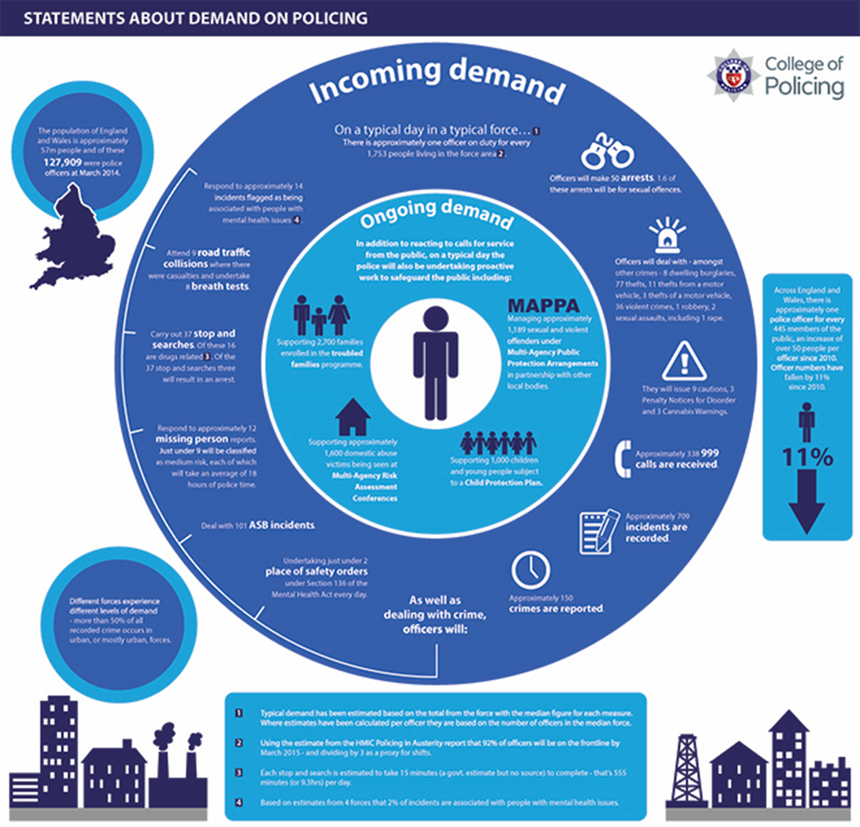
Context

Slide 80
Some Responses…
HMIC (2014) Core Business: an inspection into crime prevention, police attendance and the use of police time
NPCC (2015) National Policing Crime Prevention Strategy
Home Office (2016) Modern Crime Prevention Strategy
HMIC (2017) PEEL – Effectiveness
How effective are police forces at preventing crime, tackling anti- social behaviour and keeping people safe?

Slide 82
National Policing Crime Prevention Strategy
Endorsed by NPCC in October 2015
Intended outcomes of the strategy:
Fewer offences
Fewer victims
Less demand on policing
Key messages:
Take prevention into areas of high demand (eg, cyber, safeguarding)… Build on – and go beyond – ‘traditional’ areas
Achieved by mainstreaming prevention through problem solving and partnership working.
The strategy is a framework rather than a dictat
Seeks cultural change… and doesn’t need to start from scratch

Slide 83
Evidence! Exhibit A…
Commitment to prevention from senior officers (including chief officers)
Adequate resources to service dedicated prevention efforts
Explicit emphasis on prevention by local commanders
Systems that hold staff accountable for prevention
Incentives to encourage prevention work
Specific responsibility for developing and implementing prevention strategy in force
Prevention viewed as expert profession for specialists
Appropriate education and training
Integration of prevention across functions
Prevention is a key part of everybody’s role
When?

Slide 84

Clue:
1998 – Hough and Tilley

Slide 85
Evidence! Exhibit B…
Problem solving – subject to systematic review and shown to be an effective policing strategy
Key factors:
SARA
Effective implementation/strategic buy in:
Encouraging creativity
Working in partnership
Ensuring effective assessment takes place
Providing sufficient and proper training at the right levels
Giving officers/staff time and support to problem solve properly.
Providing suitable resources for collecting, compiling, analysing and disseminating data
Source: College of Policing - The effects of problem-oriented policing on crime and disorder: What Works Briefing

Slide 86


How? Part 1

Slide 87
Six evidence-use mechanisms
The Science of Using Science
Mechanism | Description
Awareness | Building awareness and positive attitudes to evidence use
Agree | Building mutual understanding and agreement on policy-relevant questions and the evidence needed to answer them
Access and Communication | Providing communication of and access to evidence
Interact | Facilitating interactions between decision makers and researchers
Skills | Supporting decision makers to develop skills accessing and making sense of evidence
Structure and Process | Influencing decision making structures and processes
Capability + Opportunity + Motivation

Slide 88
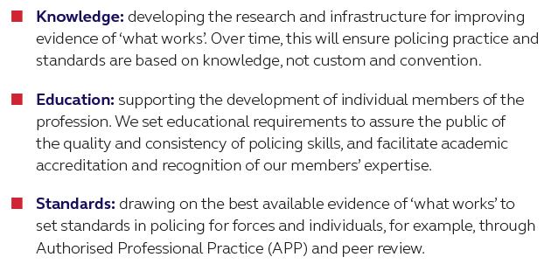
The role of the College…

Slide 89
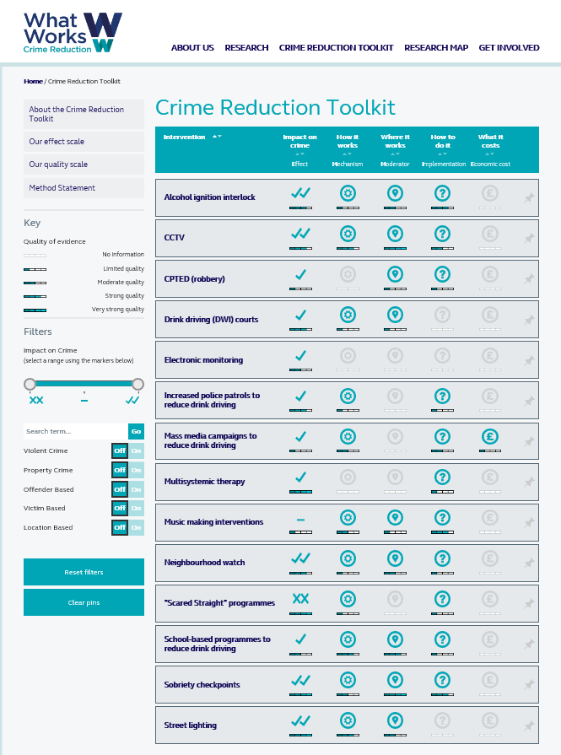
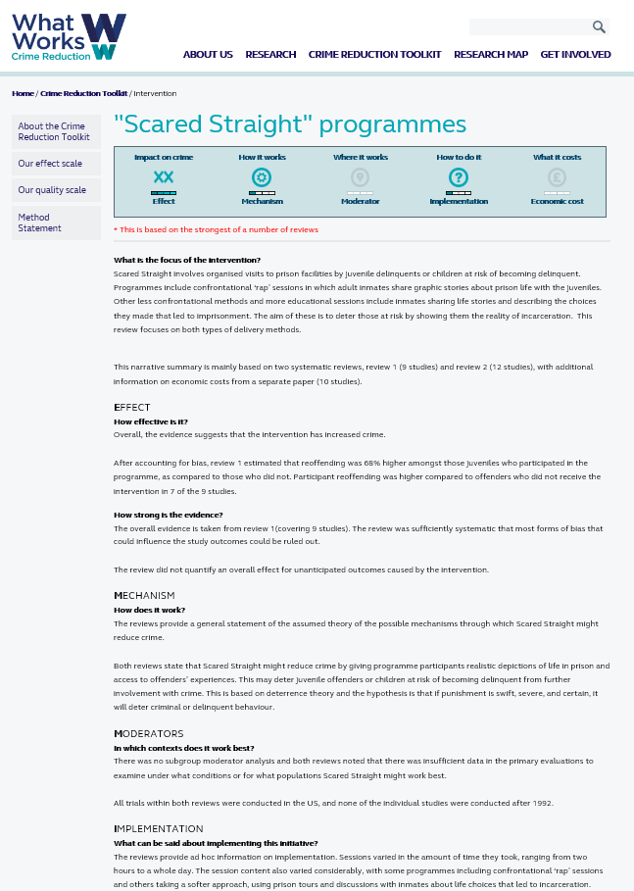
Best available what works evidence

Slide 90
Police Knowledge Fund
Building Partnerships through….
To support the development of sustainable education & research collaborations between police forces & academic institutions.
Build sustained capability amongst officers and staff to understand, critique and use research
Embed or accelerate understanding of crime and policing issues, and evidence based problem-solving approaches
Demonstrate innovation in building the research evidence base and applying it through knowledge exchange and translation across all levels of policing.
1
2
3
http://www.college.police.uk/en/20878.htm

Slide 91
How? Part 2
Considerations:
Behavioural Crime Prevention: Using Nudges, Tugs & Teachable Moments In Crime Prevention Communications (Universities’ Police Science Institute)
Aka – the Copcat research!
Messenger – who is providing advice
Mechanism – the behaviour change trigger being invoked
Message – information content being conveyed

Slide 92
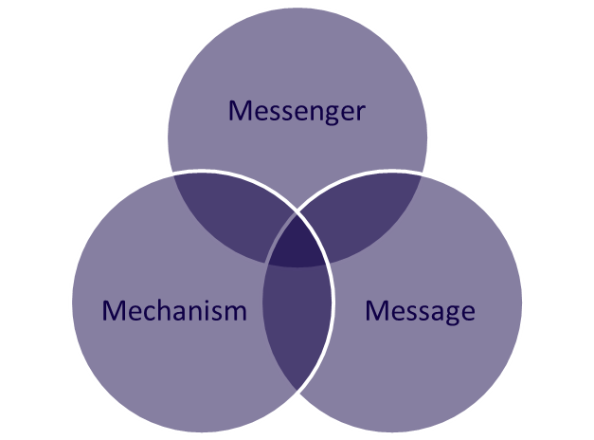
An example… measuring impact of an intervention
Capability
Opportunity
Motivation
The Practice!
Individual and the Organisation

Slide 93
Opportunities for Prevention into Practice…
Back to basics – how and why is information and practice generated, shared and accessed? From anecdotes to ‘what works’… cultural/ICT implications?
Incentivise prevention?
The role of government (coordination and/or legislation)?
Building and increasing the networks (pooling and coordinate talent and enthusiasm, in policing and with partners)
The role of research:
Process evaluation – what is ‘good’ and why (force perspective)?
What does problem solving and prevention look like in other sectors
Further innovation (including measuring impact) – both on local problems and national thematic areas…
How?
Fingers Crossed – PTF PR069-2017: Reducing crime and the demand for service: Transforming problem solving and partnership working in the Police Service.
Notes:
In addition to everything already raised (solid ‘infrastructure’ foundations)

Slide 94


