Slide 1
Oblivious Routing for the L_{p}-norm
Matthias Englert
Harald Räcke

Slide 2
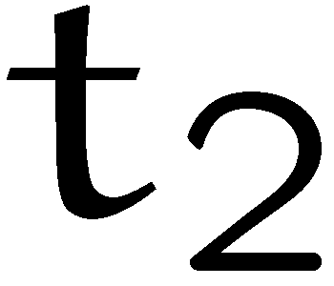
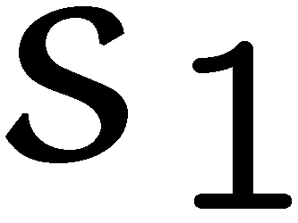
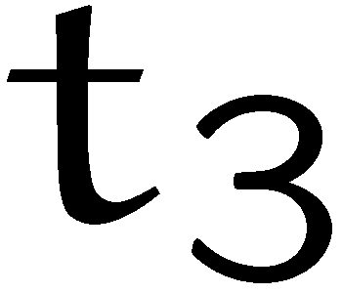


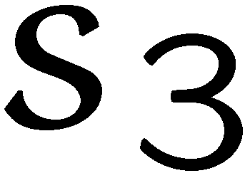
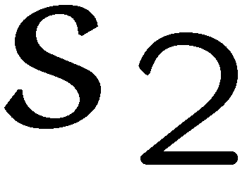
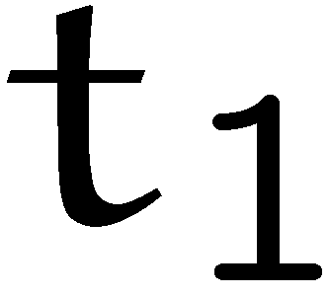
Routing in Networks
Input:
  undirected network G = (V, E)
  source/target pairs (s_{i}, t_{i})
  for every source/target
  pair (s, t) a demand d_{st}
  and a type/commodity
Output:
  a flow of value d_{st} for
  every pair
  minimize cost

Slide 3
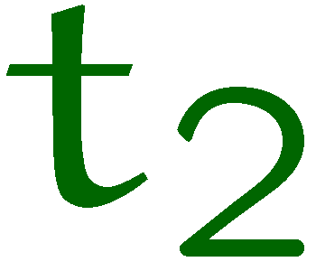
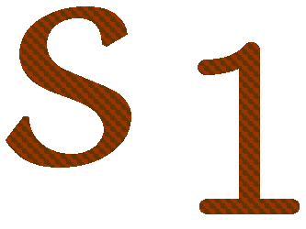
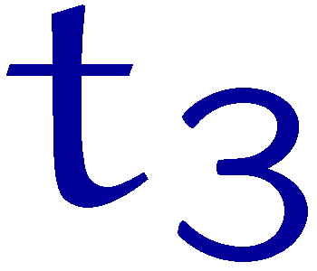
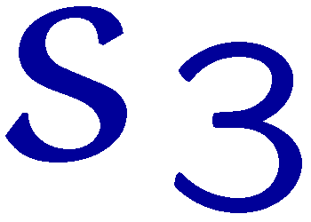
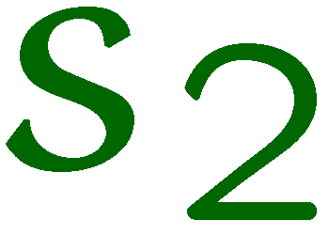

Routing in Networks
Input:
  undirected network G = (V, E)
  source/target pairs (s_{i}, t_{i})
  for every source/target
  pair (s, t) a demand d_{st}
Output:
  a flow of value d_{st} for
  every pair
  minimize cost

Slide 4
Oblivious Routing
Problem:
Algorithm cannot be implemented in a distributed fashion.
  ideally you want an algorithm that is independent of demands
routing
algorithm
demands
path system with
close to optimum
cost
?
network

Slide 5
Oblivious Routing
Oblivious Routing:
  specifies a probability distribution over s-t paths for every
  source-target pair without knowing any demands
  when a message has to be routed a random path according
  to the distribution is chosen
Advantage:
  very simple, good to implement

Slide 6
Oblivious Routing
Oblivious Routing:
  specifies a unit flow from s to t for every source target
  without knowing any demands
  when demands appear the unit flow between s and t is
  scaled by the demand d_{st} to fulfill the routing requirement
Advantage:
  very simple, good to implement

Slide 7
Oblivious Routing
Oblivious Routing:
  specifies a unit flow from s to t for every source target
  without knowing any demands
  when demands appear the unit flow between s and t is
  scaled by the demand d_{st} to fulfill the routing requirement

Slide 8
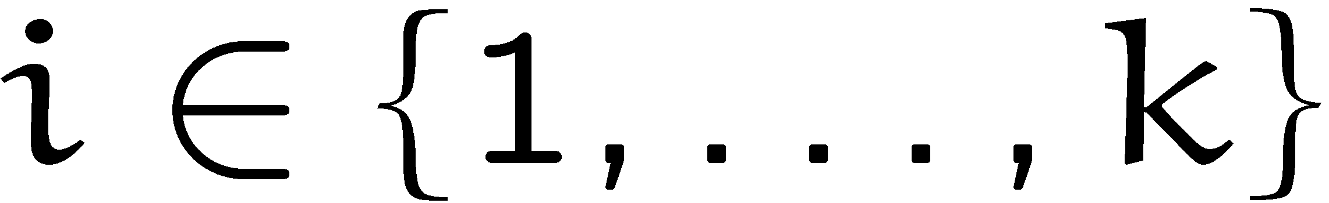
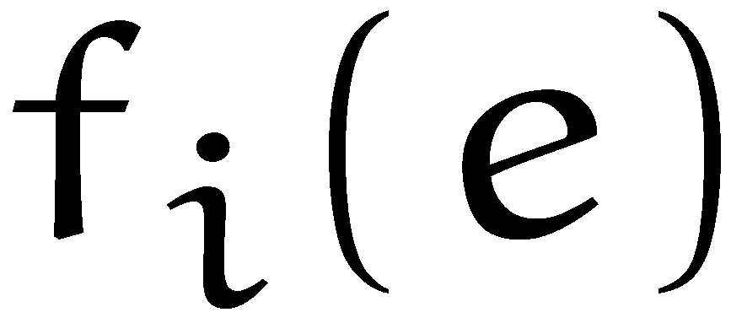


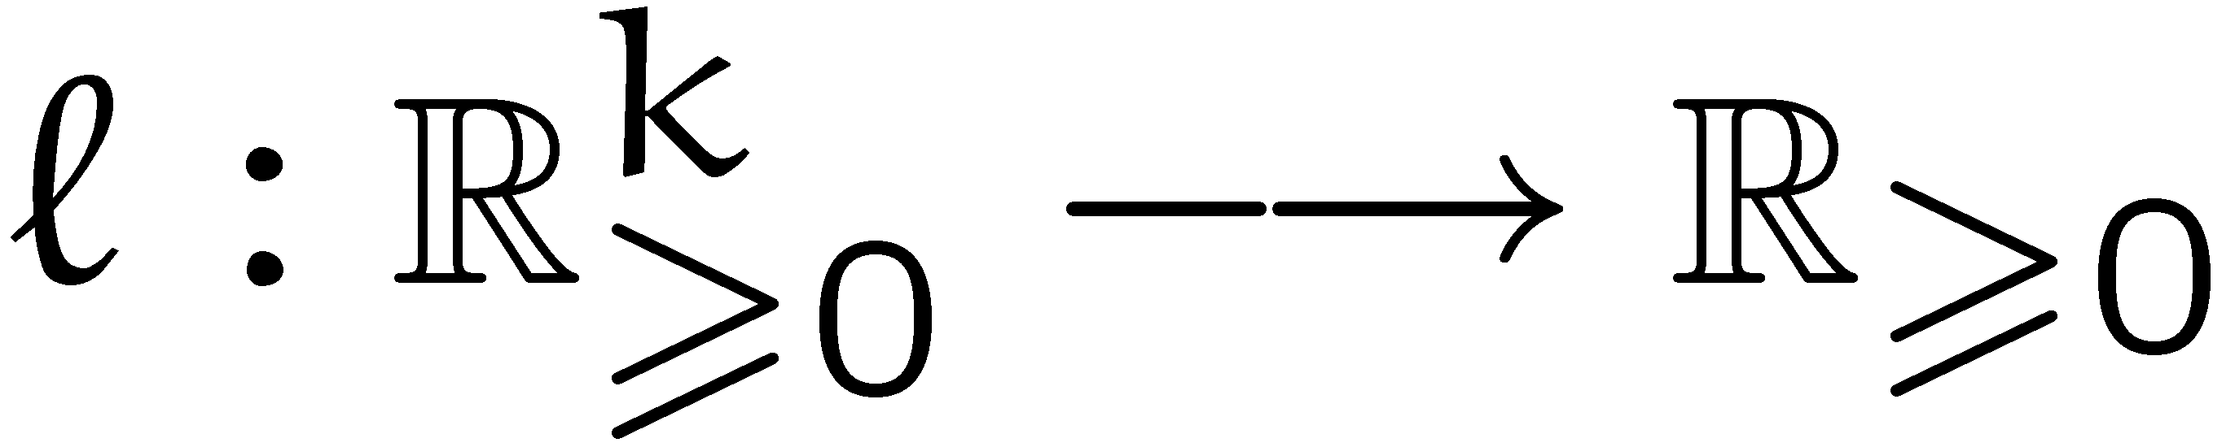
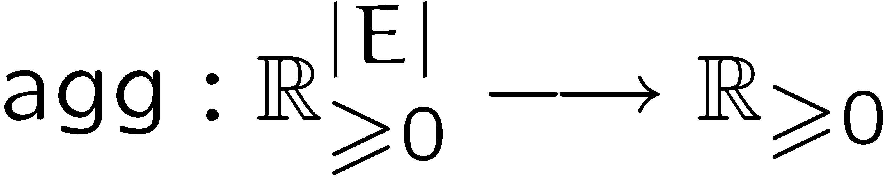
Cost
Our Cost Model:
  flow of different types/commodities
  denotes flow of type along edge
Load function:
Aggregation function:
assigns load to
every edge
aggregates edge
loads to cost

Slide 9
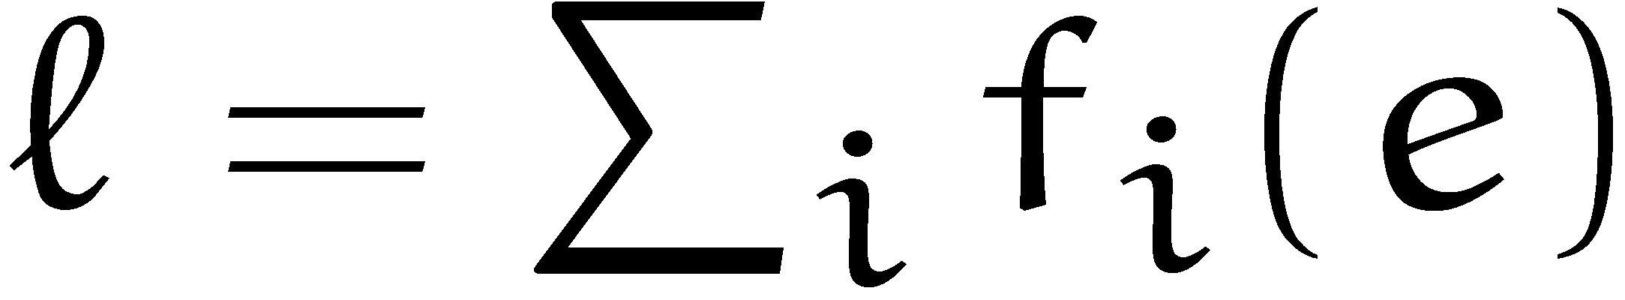
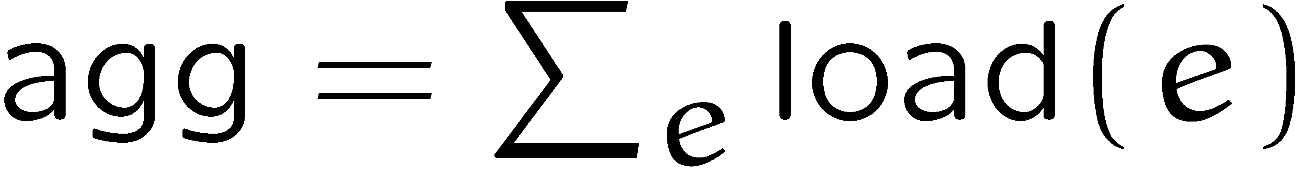
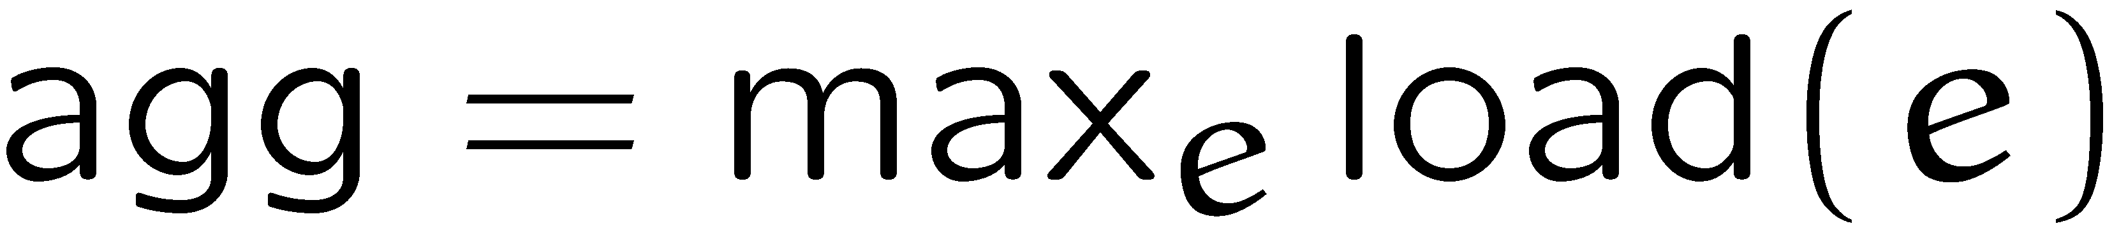
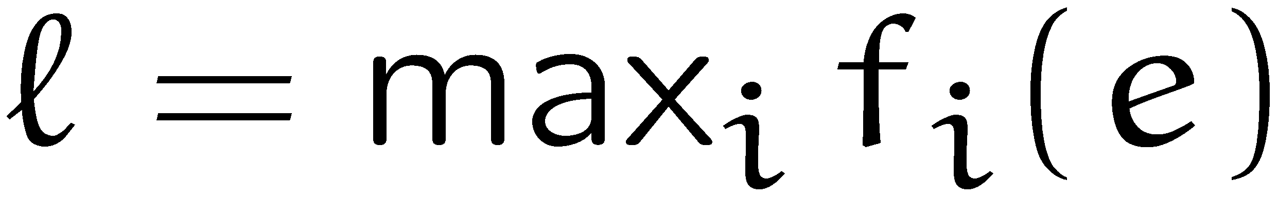
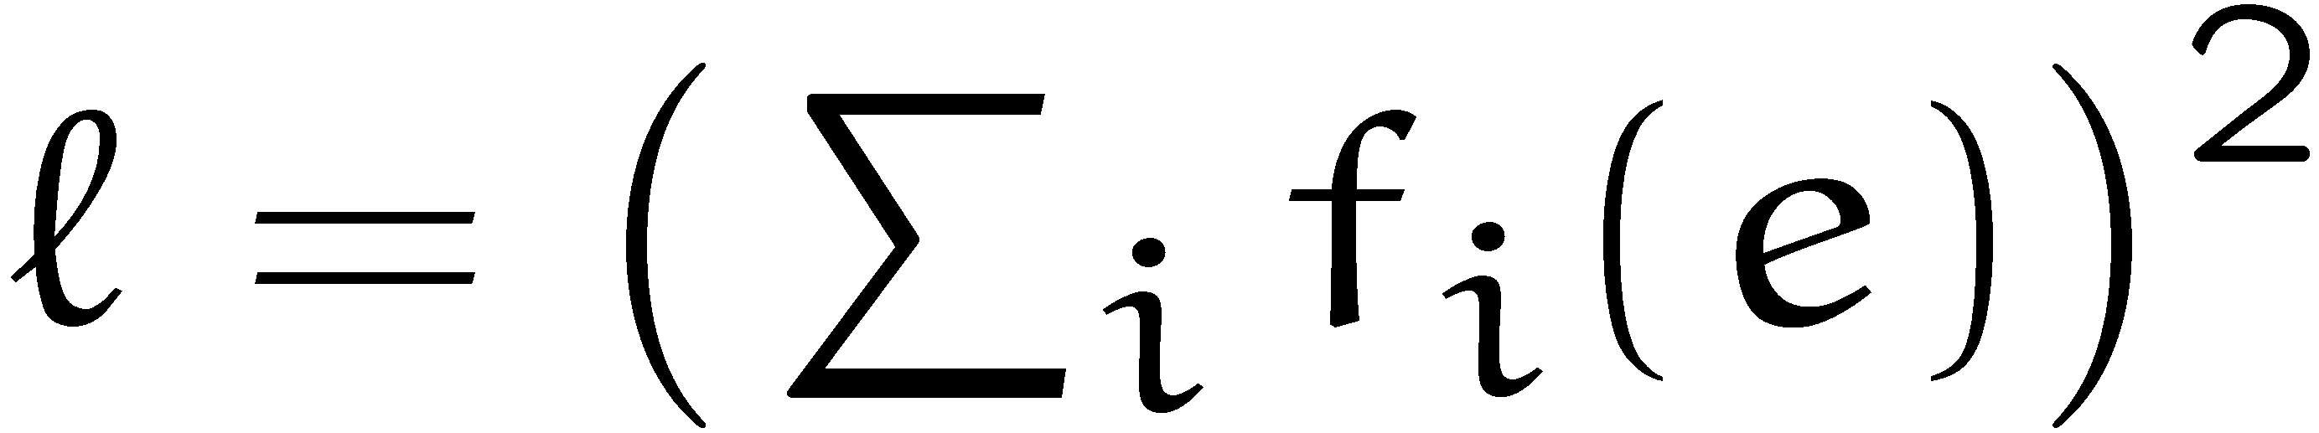
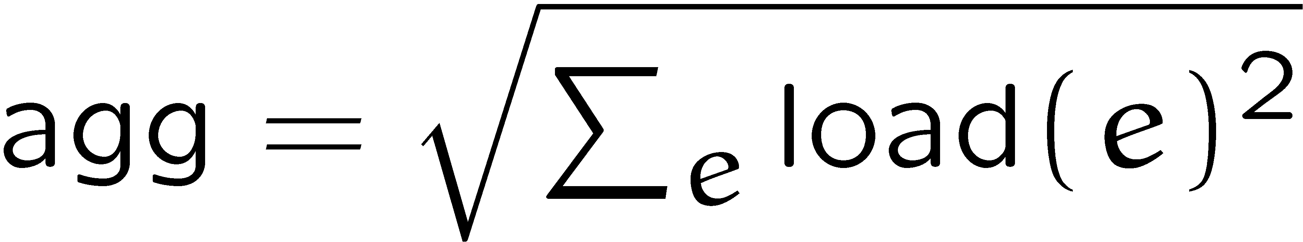
Examples
total flow in the network
congestion
fractional Steiner network
average latency

Slide 10
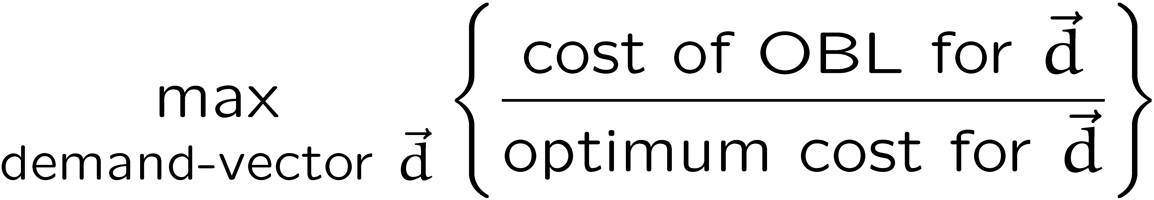
Competitive Analysis
How to measure performance?
  The oblivious algorithm should obtain close to optimum
  congestion on any set of demands.
  minimize:
competitive ratio

Slide 11
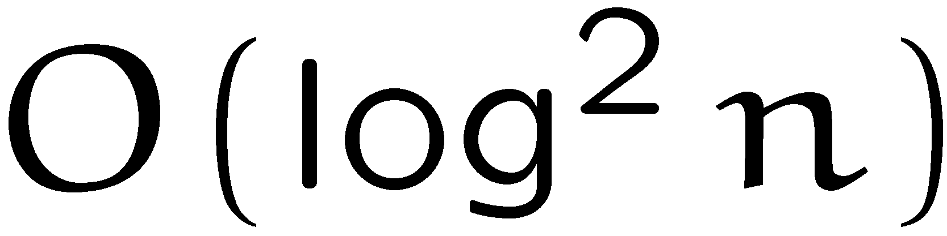
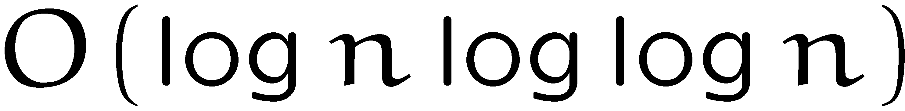
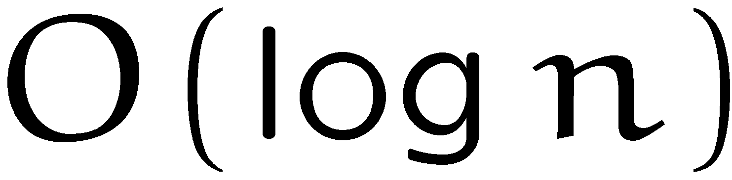
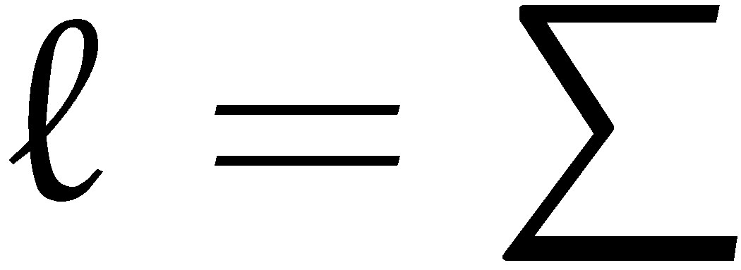


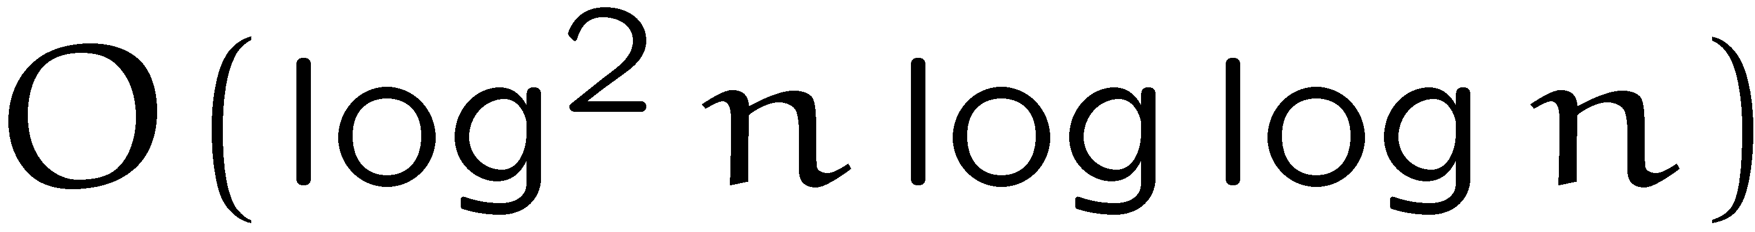

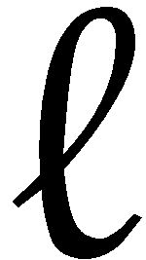
Previous Work
[Bartal 1996], [Bartal 1998], [Fakcharoenphol, Rao, Talwar 2003]
  tree-based oblivious algorithms with competitive ratio
  , , , respectively,
  for the case that and .
[R 2002], [Harrelson, Hildrum, Rao 2003], [R 2008]
  tree-based oblivious algorithms with competitive ratio
  , , , respectively,
  for the case that and .
[Gupta, Hajiaghayi, R 2006]
  extend above results to the case where load function is a norm.
  algorithms are function-oblivious w.r.t. the load function.

Slide 12
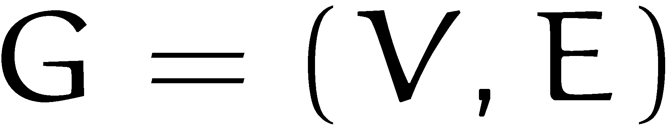

Tree-based Routing
Tree Routing:
  for a graph
  take a tree with node
  set .
  embed this tree into the
  graph (edges and nodes).
  choose routing paths
  according to this tree.
a
b
i
h
c
d
g
j
e
f
a
b
c
d
e
f
g
h
i
j

Slide 13
Tree-based Routing
Tree Routing:
  for a graph
  take a tree with node
  set .
  embed this tree into the
  graph (edges and nodes)
  choose routing paths
  according to this tree.
Tree-based Routing:
  use a convex combination
  of trees.
a
b
i
h
c
d
g
j
e
f
i
c
e
d
a
b
c
d
e
f
g
h
i
j

Slide 14
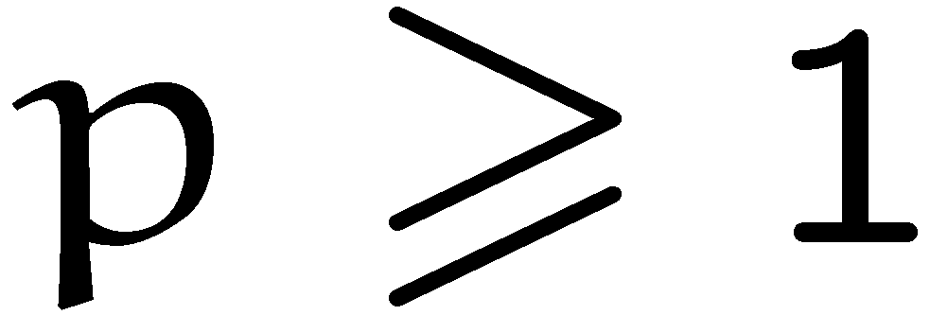
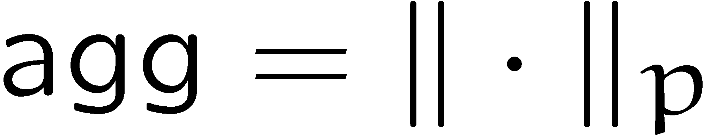
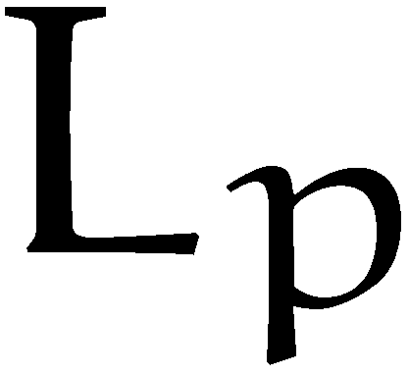
Our Results
  Theorem: For any there is a tree-based oblivious
  routing algorithm that is -competitive for the
  case that the aggregation function is an
  -norm, and the load function is any norm.

Slide 15
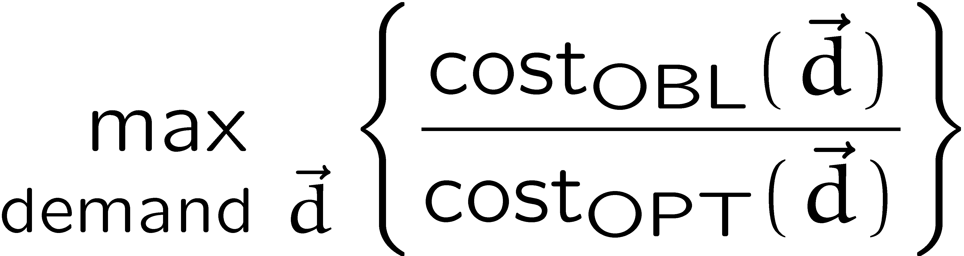


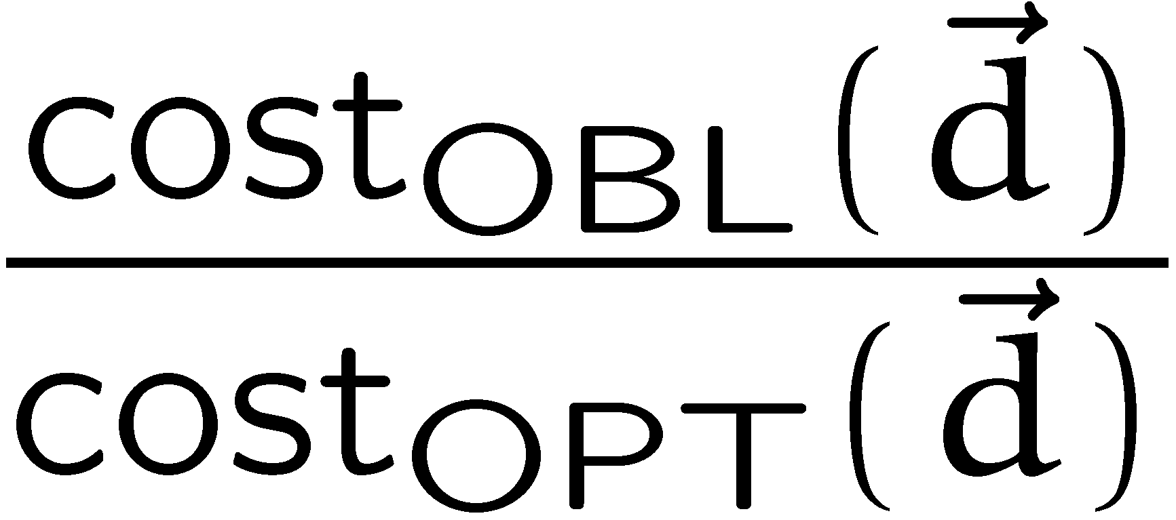
Analysis
Goal:
Zero-sum Game:
  min-player plays a tree-based oblivious
  routing algorithm .
  max-player plays a demand-vector .
  payoff is

Slide 16

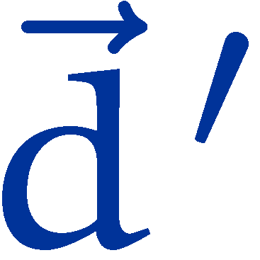
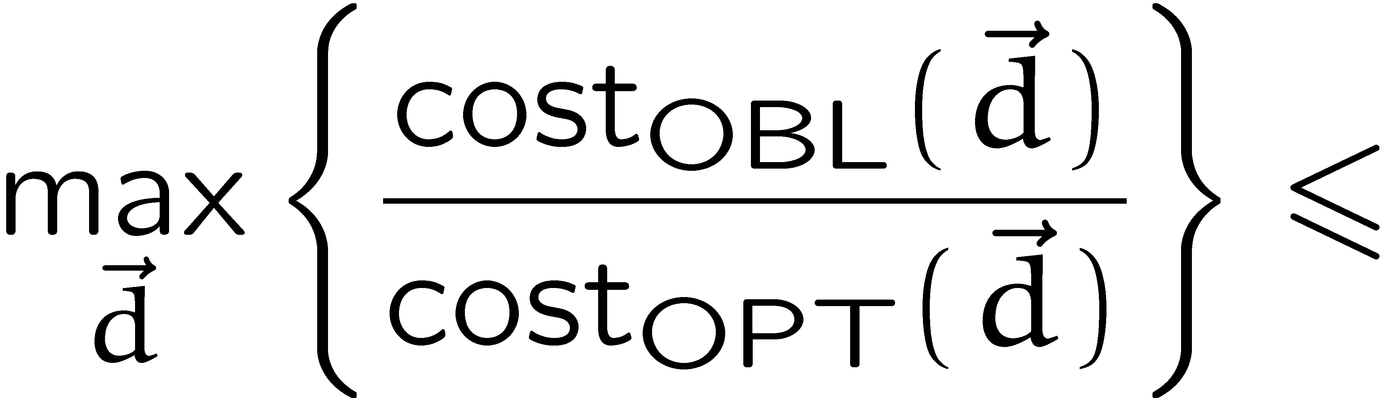
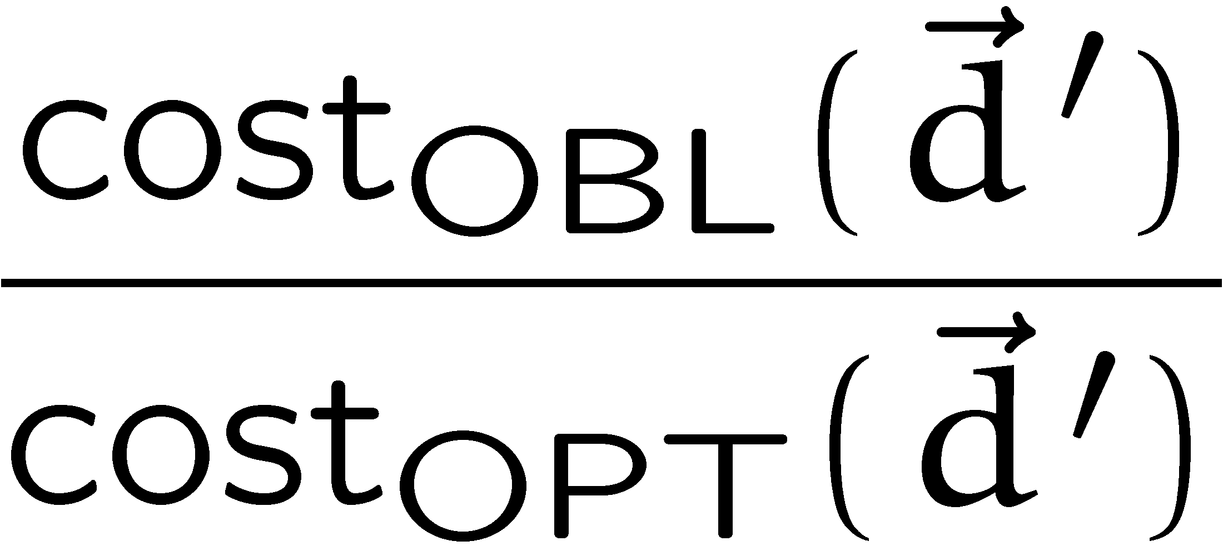
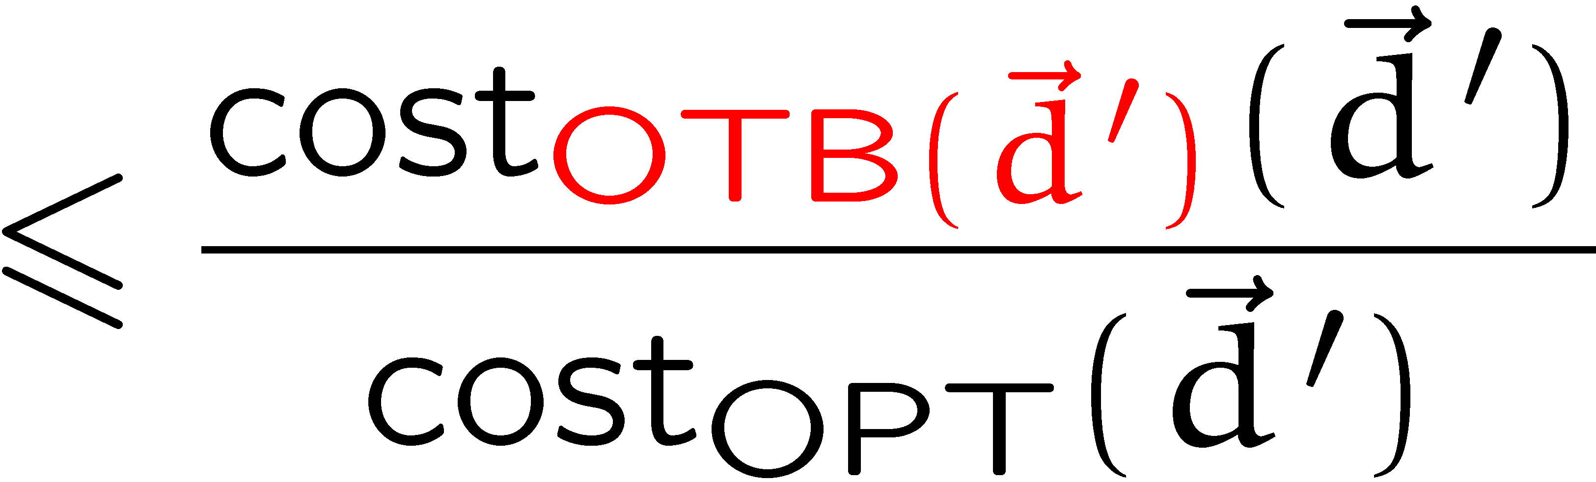
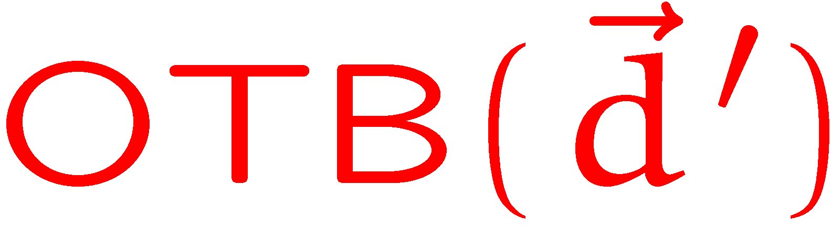
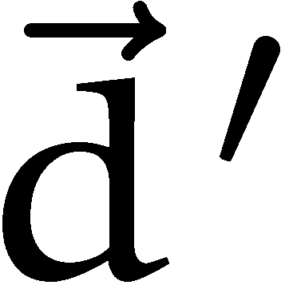
Analysis
Assume that the game has a pure Nash equilibrium, in which
the min-player plays and the max-player plays .
  then
  is the best tree-based routing scheme for .
Approach:
  Show that for any demand there is a tree-based routing,
  that only looses a factor of compared to OPT.
  Show that the game has a pure Nash equilibrium.

Slide 17
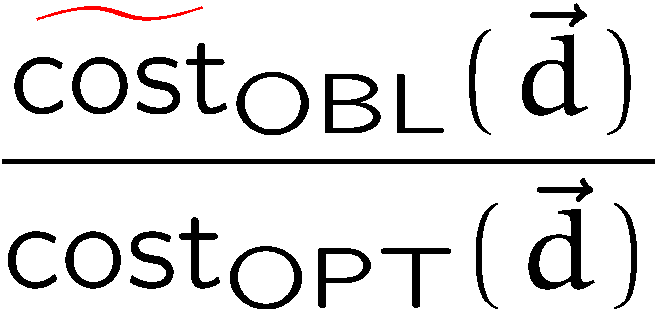
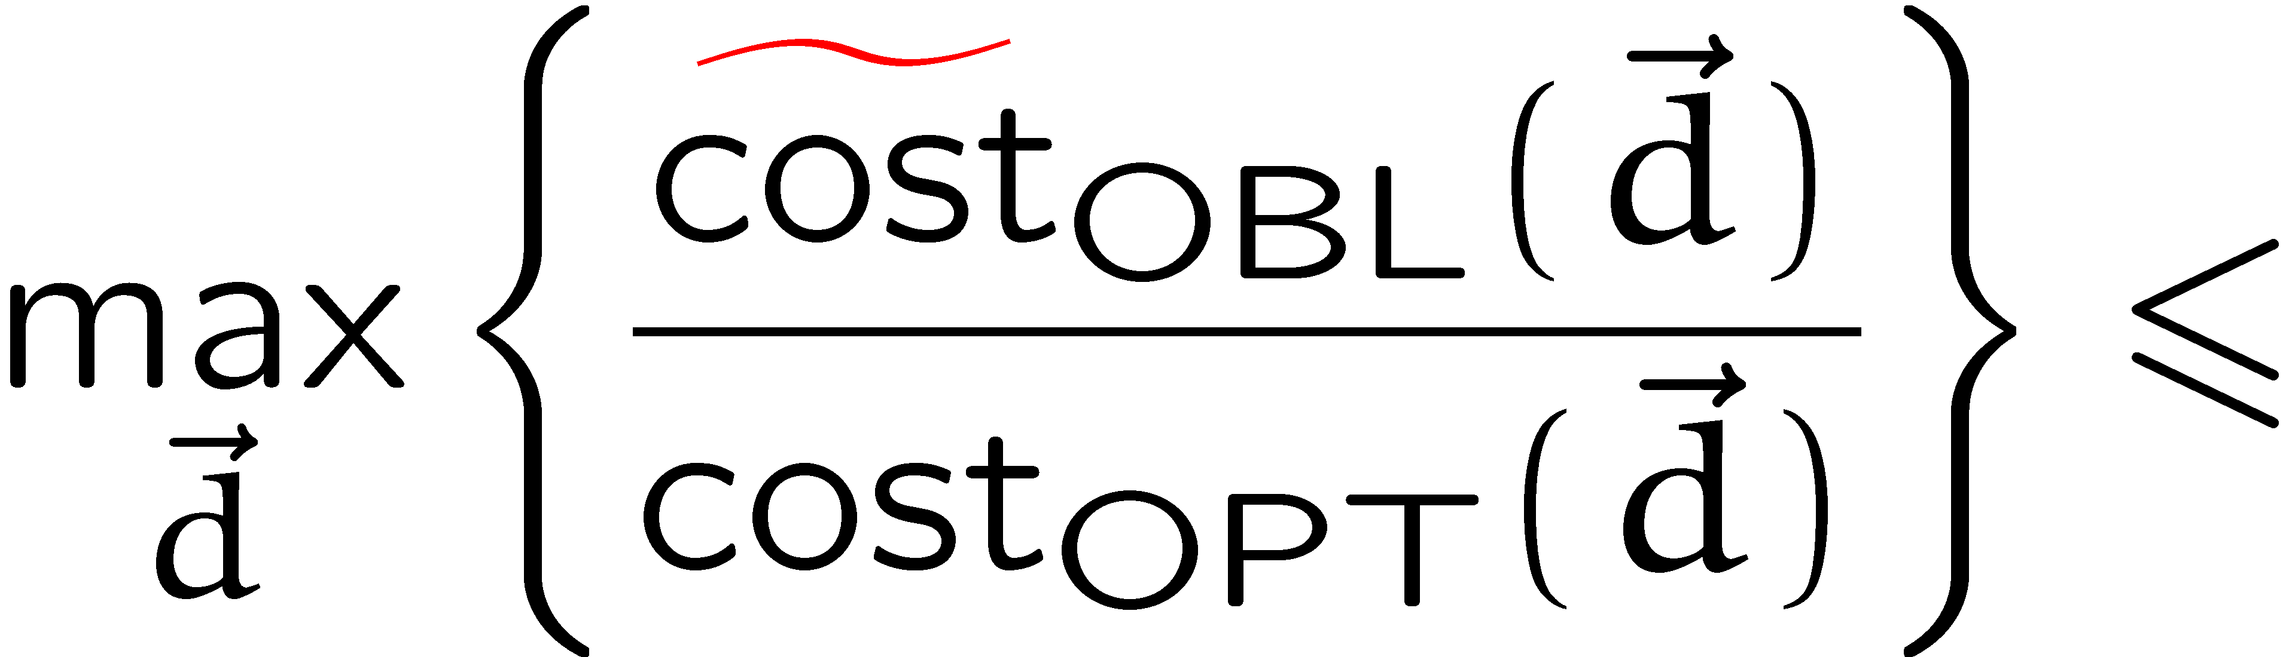
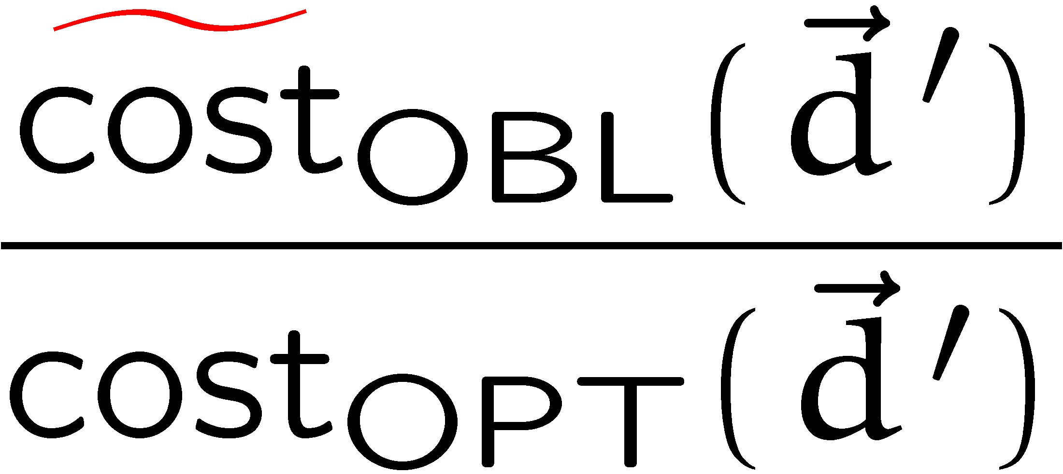
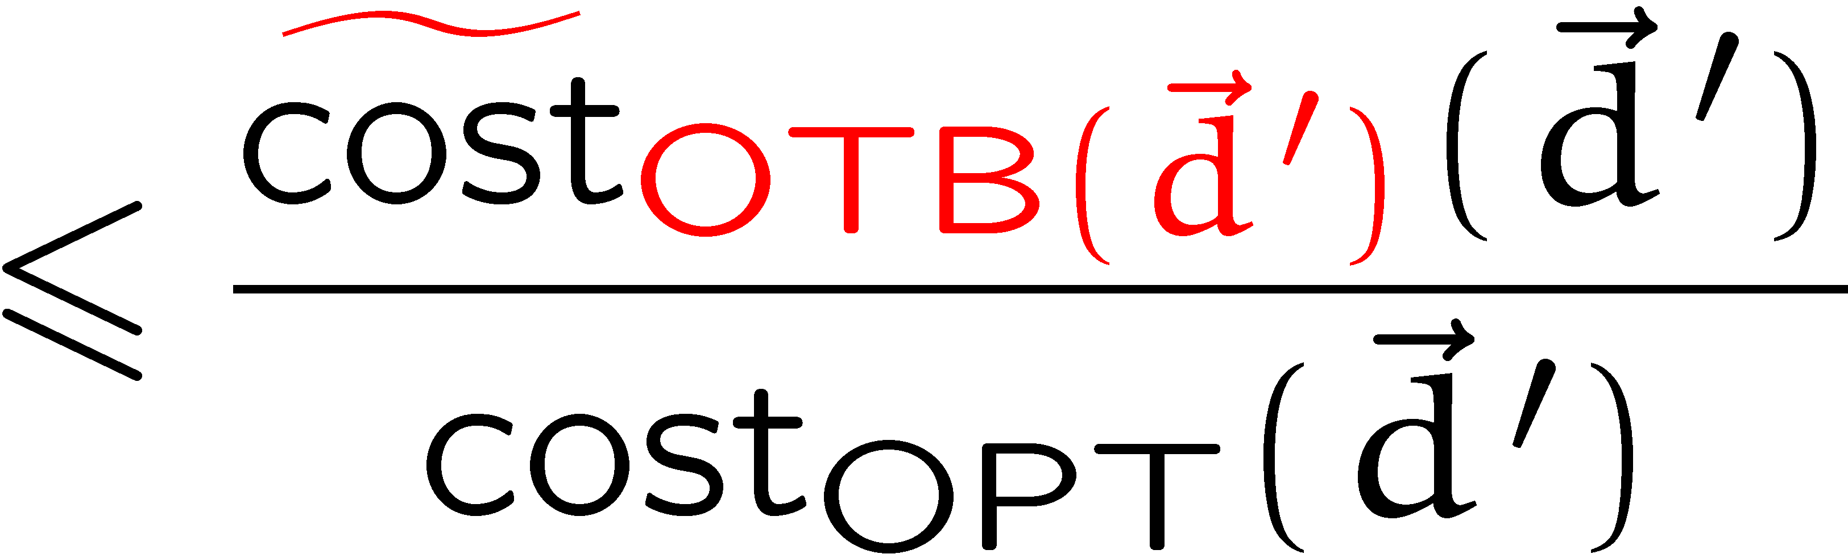

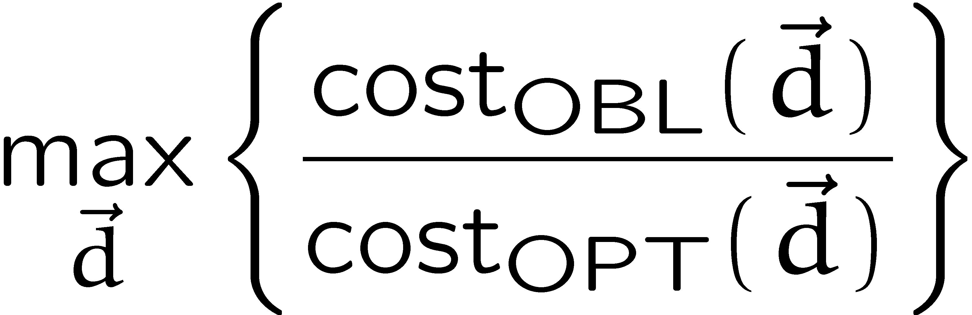
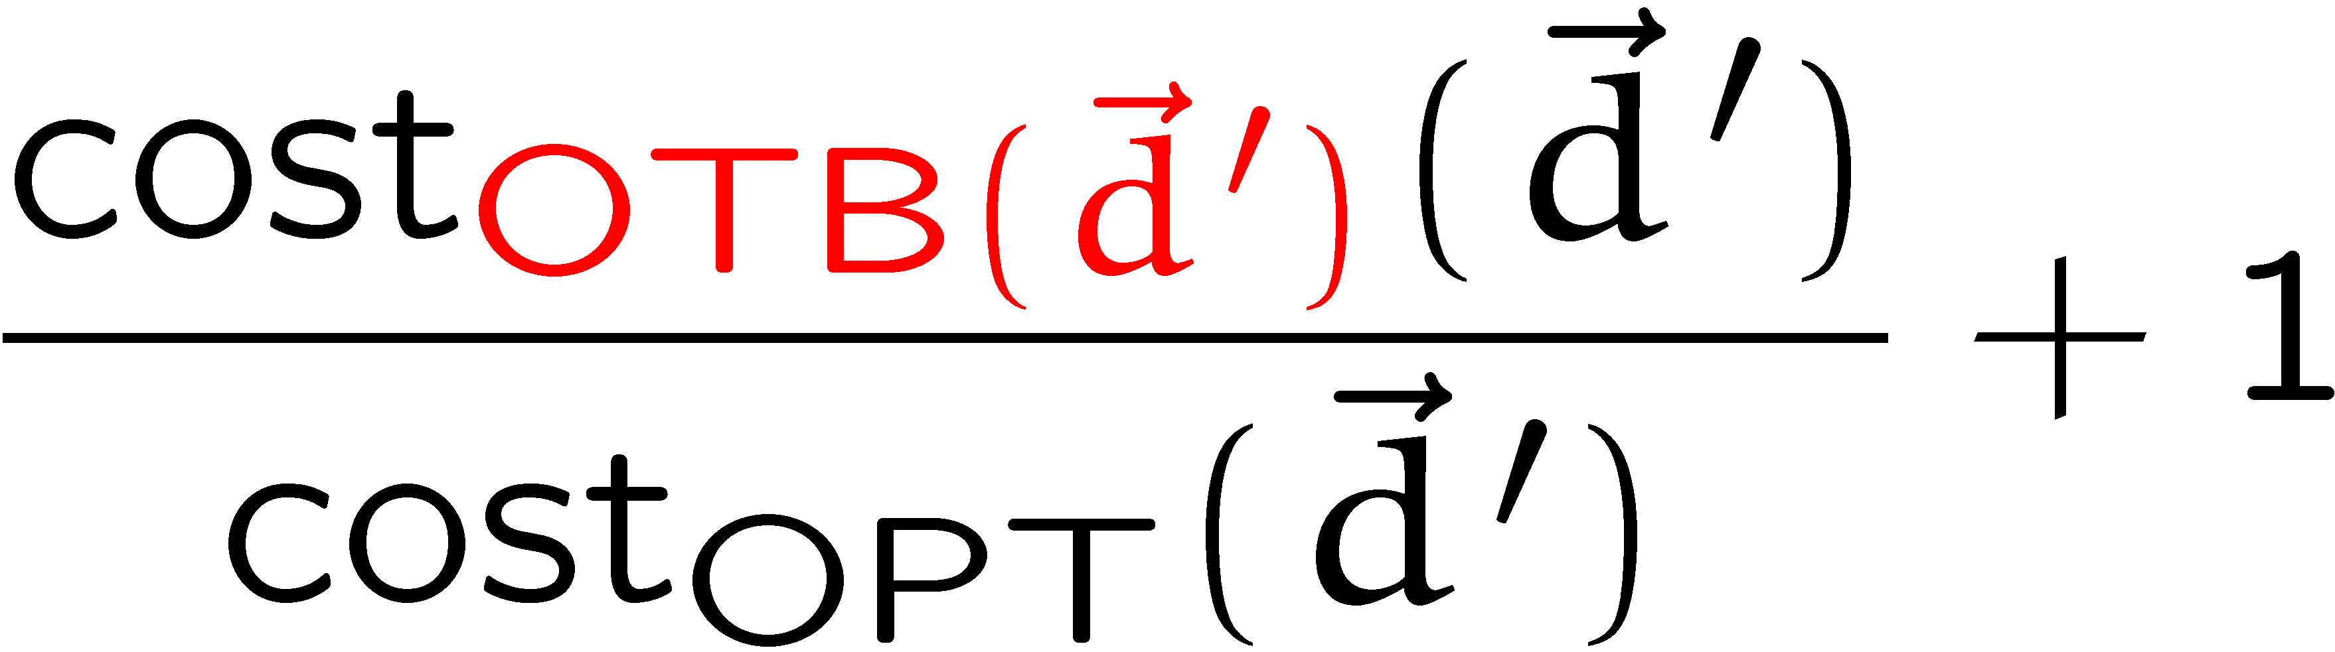
Analysis
Technical Note:
  This approach still works if we change the payoff of the game
  to
  with

Slide 18
Analysis
Technical Note:
  This approach still works if we change the payoff of the game
  to
  with

Slide 19
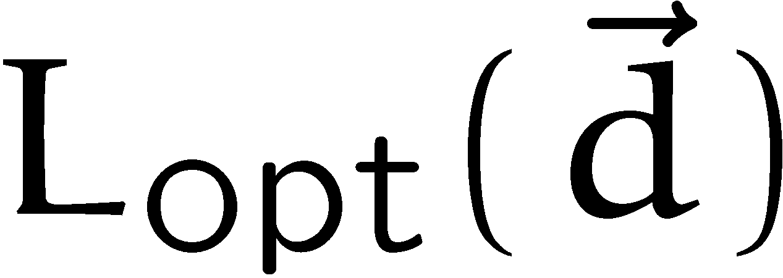
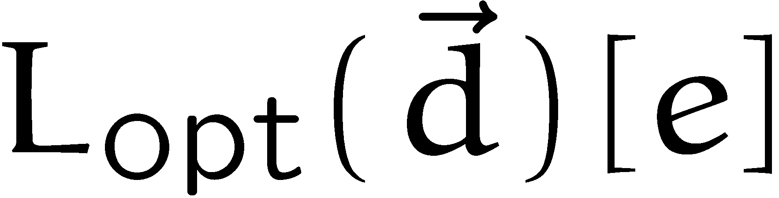




Good Response for Min-player
  Let be a demand vector, and let denote the
  load vector of an optimal solution.
  Generate a new graph by assigning a capacity of to every edge .
  This means that in this new graph for (congestion)
  the vector has an optimum routing with cost at most 1.
  The result for min-congestion tree-based routing guarantees a tree-based routing with maximum load .
  Using this routing in the original graph we guarantee that we don’t increase the load on any edge by more than a factor of
  compared to OPT.
  Hence, we don’t increase the cost by more than
  since is a norm.

Slide 20

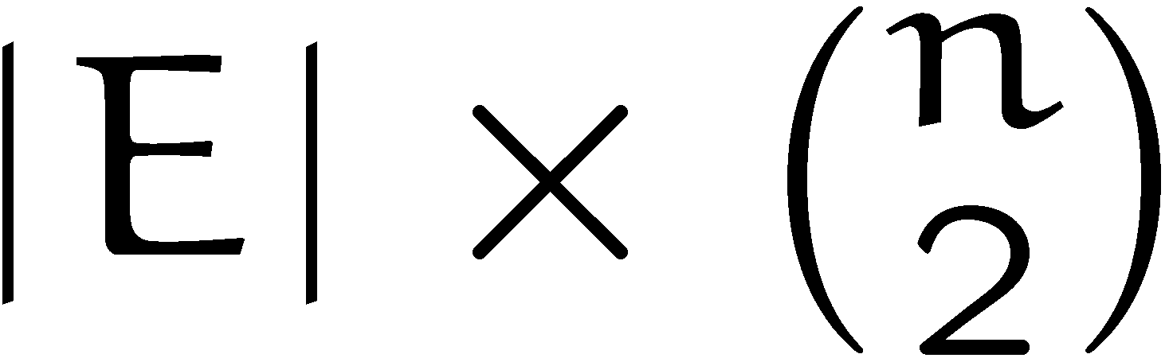

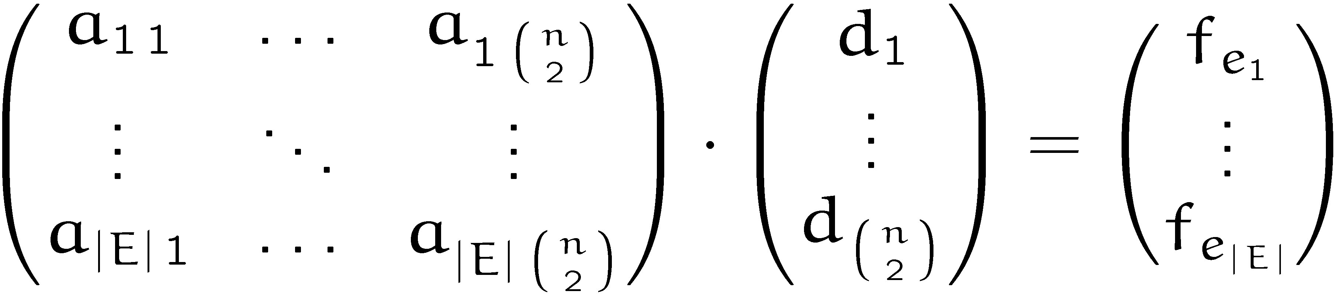




Pure Nash Equilibrium (k = 1, = id)
  An oblivious routing scheme can be represented by
  an -dimensional matrix :
  The competitive ratio is:
routing matrix
demand
flow

Slide 21

Pure Nash Equilibrium (k = 1, = id)
Lemma:
If is tree-based, there is a vector maximizing the expression
that is routed by OPT with single-hop routing.
Proof (for tree-routing):
  the proof easily generalizes to convex combinations of trees
b
OPT
a
i
h
c
d
g
OBL
j
e
f

Slide 22


Pure Nash Equilibrium (k = 1, = id)
Consequence:
The competitive ratio of a tree-based oblivious scheme given by matrix is
which is sometimes called the p-norm of the matrix .
If we show that for any tree-based routing matrix
the expression
has a unique maximizing vector (up to scaling), then the game has a pure equilibrium.

Slide 23







Pure Nash Equilibrium (k = 1, = id)
Proof:
Suppose that the min-player (matrix-player) plays strategy with probability , and the max-player plays with probability
payoff:
The min-player doesn’t worsen his payoff by moving to regardless
of the strategy of the max-player.
Therefore, there is a Nash in which the min-player plays pure.
But for this Nash the max-player needs to play pure, as well, as
he has a unique vector maximizing the payoff-function.

Slide 24



Pure Nash Equilibrium (k = 1, = id)
Change the payoff function of the game function slightly:
where is a matrix in which every entry is .

Slide 25



Pure Nash Equilibrium (k = 1, = id)
Lemma:
  Let , and let be a matrix with strictly positive entries. Then the vector in the positive orthant that maximizes the expression
  is unique up to scalar multiplication.

Slide 26





Pure Nash Equilibrium (k = 1, = id)

Slide 27
Open Problems
How to extend the technique to norms?

