Slide 1
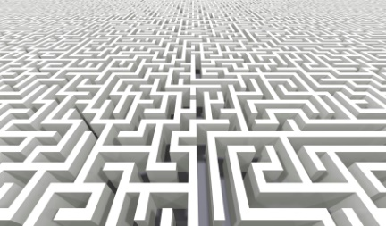
Can a natural number be negative?
Iddo Tzameret
Joint work with
Yaroslav Alekseev, Dima Grigoriev and Edward Hirsch
Notes:
1

Slide 2
yes

Slide 3
The Conceptual Framework

Slide 4
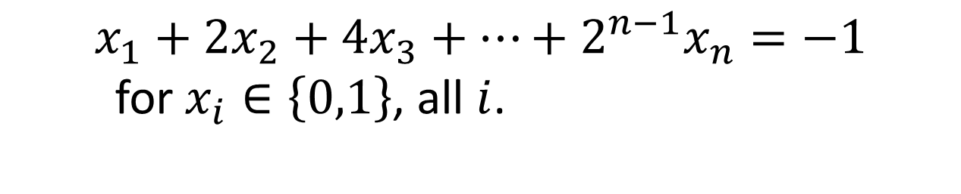
The Binary Value Principle
$$x_{1}+2x_{2}+4x_{3}+…+2^{n−1}x_{n}=−1$$
for $x_{i}∈\left\{0,1\right\}$, all $i$.
Notes:
Subset sum instance

Slide 5
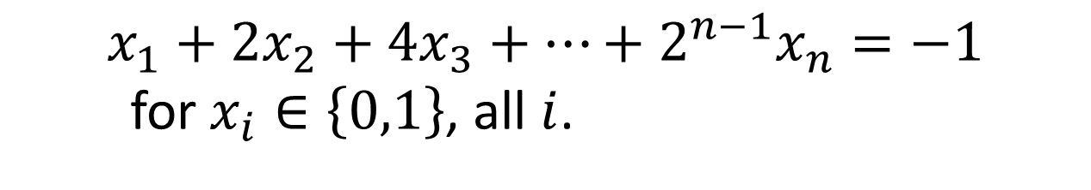
The Binary Value Principle
$$x_{1}+2x_{2}+4x_{3}+…+2^{n−1}x_{n}=−1$$
for $x_{i}∈\left\{0,1\right\}$, all $i$.

Slide 6
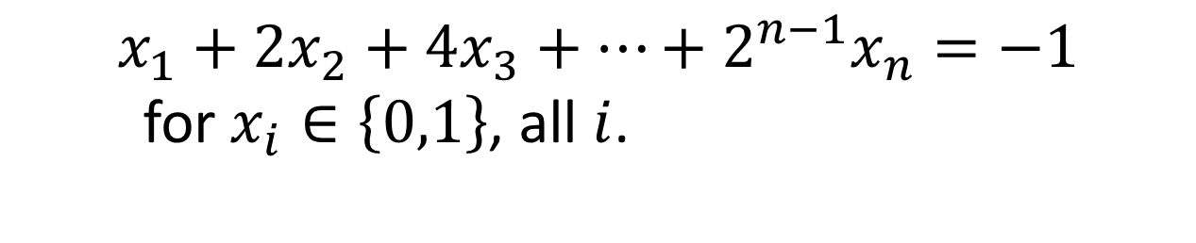
The Binary Value Principle
$$x_{1}+2x_{2}+4x_{3}+…+2^{n−1}x_{n}=−1$$
for $x_{i}∈\left\{0,1\right\}$, all $i$.
Algebraic and
Semi-Algebraic proofs
Algebraic Circuit Complexity
6

Slide 7
The Context: Proof Complexity
Proof systems:
  A way to analyse algorithms run-time:
    Each proof-line is a step in the algorithm
  A way to approach NP vs coNP (hence P vs NP) problem:
    Size lower bounds against proofs of UNSAT rule out that certain kind of witnesses can establish NP=coNP.
  IPS: circuit representation of algebraic proofs (like circuit vs sparsity measure)
IPS
non-commutative IPS/PC over formulas (GH03)
Extended Frege
“Dynamic” Positivstellensatz
Frege
s
s
Positivstellensatz
s
constant depth Frege
SoS
s
Polynomial Calculus
s
s
Nullstellensatz
resolution

Slide 8
Motivation 1
Are semi-algebraic proofs stronger than algebraic ones?

Slide 9
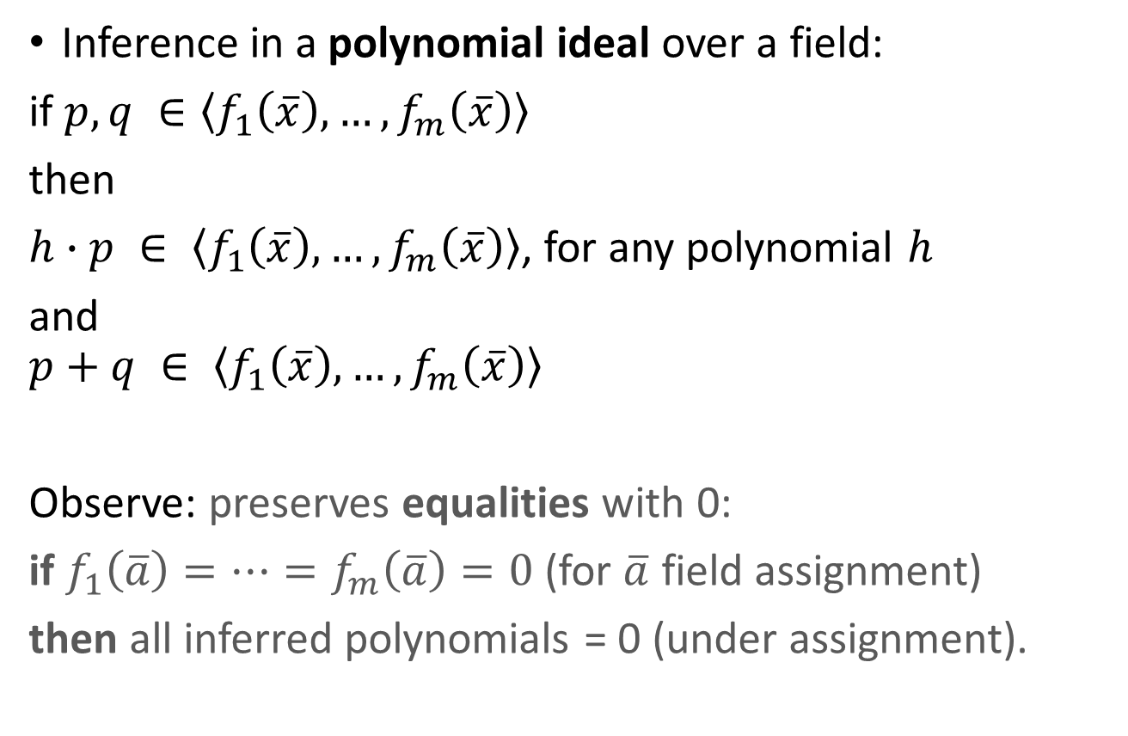
Algebraic Proofs
Inference in a polynomial ideal over a field:
if $p,q ∈\left\langle f_{1}\left(\overline{x}\right),…,f_{m}\left(\overline{x}\right)\right\rangle$
then
$h∙p ∈ \left\langle f_{1}\left(\overline{x}\right),…,f_{m}\left(\overline{x}\right)\right\rangle$, for any polynomial $h$
and
$$p+q ∈ \left\langle f_{1}\left(\overline{x}\right),…,f_{m}\left(\overline{x}\right)\right\rangle$$
Observe: preserves equalities with 0:
if $f_{1}\left(\overline{a}\right)=…=f_{m}\left(\overline{a}\right)=0$(for $\overline{a}$ field assignment)
then all inferred polynomials = 0 (under assignment).

Slide 10
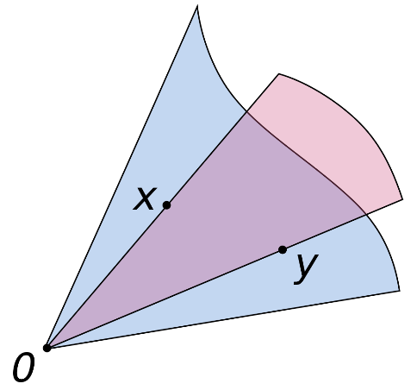
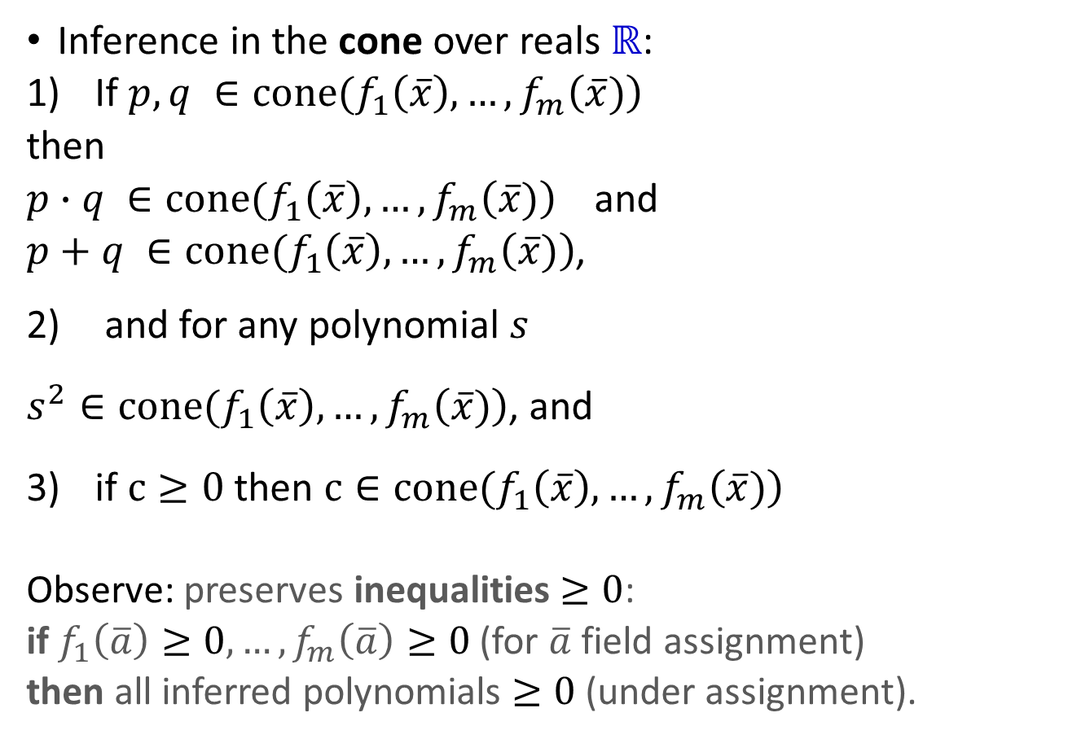
Semi-Algebraic Proofs
Inference in the cone over reals ℝ:
If $p,q ∈cone(f_{1}\left(\overline{x}\right),…,f_{m}\left(\overline{x})\right)$
then
$p∙q ∈cone(f_{1}\left(\overline{x}\right),…,f_{m}\left(\overline{x})\right)$ and
$p+q ∈cone(f_{1}\left(\overline{x}\right),…,f_{m}\left(\overline{x})\right)$,
and for any polynomial $s$
$s^{2}∈cone(f_{1}\left(\overline{x}\right),…,f_{m}\left(\overline{x})\right)$, and
if $c≥0$ then $c∈cone(f_{1}\left(\overline{x}\right),…,f_{m}\left(\overline{x})\right)$
Observe: preserves inequalities $≥0$:
if $f_{1}\left(\overline{a}\right)≥0,…,f_{m}\left(\overline{a}\right)≥0$(for $\overline{a}$ field assignment)
then all inferred polynomials $≥0$(under assignment).

Slide 11
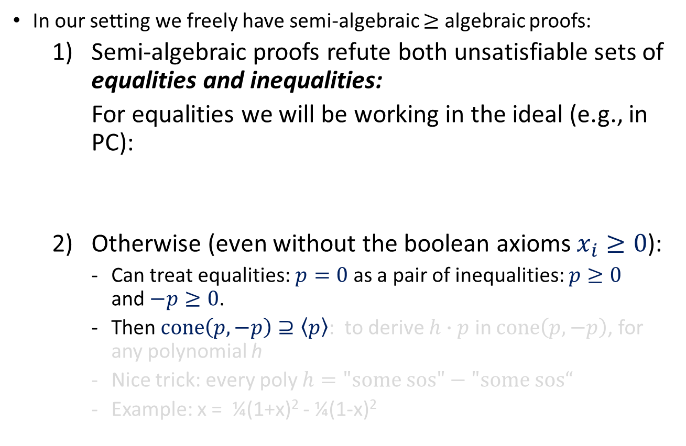
What’s Stronger: Algebraic or Semi-Algebraic Proofs?
In our setting we freely have semi-algebraic $≥$ algebraic proofs:
  Semi-algebraic proofs refute both unsatisfiable sets of equalities and inequalities:
  For equalities we will be working in the ideal (e.g., in PC):
  Otherwise (even without the boolean axioms $x_{i}≥0$):
    Can treat equalities: $p=0$ as a pair of inequalities: $p≥0$ and$−p≥0$.
    Then $cone\left(p,−p\right)⊇\left\langle p\right\rangle$: to derive $h∙p$ in $cone\left(p,−p\right)$, for any polynomial h
    Nice trick: every poly $h=\text{"}\text{some} \text{sos}\text{"}−\text{"}\text{some} \text{sos}“$
    Example: x = ¼(1+x)² - ¼(1-x)²
polynomials in the ideal of equalities
+
polynomials in the cone of inequalities

Slide 12
Motivation 2
(Conditional) lower bounds on strong proof systems.
Unknown for e.g. Frege and beyond.

Slide 13
Our Results

Slide 14
Our Results
1. Algebraic proofs weaker than semi-algebraic ones (under complexity assumptions)
Formulate the Cone Proof System (CPS)
  A proof system that characterises very strong semi-algebraic reasoning
  Cone Proof System = Positivstellensatz over algebraic circuits
    Semi-algebraic analogue of IPS (GP14)
CPS is strictly stronger than IPS (under complexity assumptions)
  Even the strongest algebraic proof system (IPS) cannot simulate the “weakest” semi-algebraic proof system (under complexity assumptions)

Slide 15
Expressivity
Semi-Algebraic Proofs
Systems for sets of polynomial equations and inequalities over a field with 0-1 variables
Algebraic Proofs
Systems for sets of polynomial equations over a field with 0-1 variables
Systems for propositional logic
Very
Strong
Systems
Strong
Systems
Proof Complexity Strength
Weak to
Medium
Strength
Systems

Slide 16
Expressivity
Semi-Algebraic Proofs
Systems for sets of polynomial equations and inequalities over a field with 0-1 variables
Algebraic Proofs
Systems for sets of polynomial equations over a field with 0-1 variables
Systems for propositional logic
Very
Strong
Systems
Strong
Systems
Proof Complexity Strength
Positivstellensatz
constant depth Frege
SoS
s [Gri01]
Weak to
Medium
Strength
Systems
Polynomial Calculus
s
s
Nullstellensatz
resolution

Slide 17
Expressivity
Semi-Algebraic Proofs
Systems for sets of polynomial equations and inequalities over a field with 0-1 variables
Algebraic Proofs
Systems for sets of polynomial equations over a field with 0-1 variables
Systems for propositional logic
Very
Strong
Systems
non-commutative IPS/PC over formulas (GH03)
Extended Frege
Strong
Systems
“Dynamic” Positivstellensatz
Frege
Proof Complexity Strength
s
s
Positivstellensatz
s
constant depth Frege
SoS
s
Weak to
Medium
Strength
Systems
Polynomial Calculus
s
s
Nullstellensatz
resolution

Slide 18
Expressivity
Our Results
Semi-Algebraic Proofs
Systems for sets of polynomial equations and inequalities over a field with 0-1 variables
Algebraic Proofs
Systems for sets of polynomial equations over a field with 0-1 variables
Systems for propositional logic
CPS
Formulate the Cone Proof System (CPS)
  A proof system that characterises very strong semi-algebraic reasoning
CPS is strictly stronger than IPS (under complexity assumptions)
Strictly stronger assuming Shub-Smale hypothesis
Very
Strong
Systems
s
Very
Strong
Systems
IPS
non-commutative IPS/PC over formulas (GH03)
Extended Frege
Strong
Systems
“Dynamic” Positivstellensatz
Frege
s
s
Positivstellensatz
s
constant depth Frege
SoS
s
Weak to
Medium
Strength
Systems
Polynomial Calculus
s
s
Nullstellensatz
resolution

Slide 19
Expressivity
Our Results
Semi-Algebraic Proofs
Systems for sets of polynomial equations and inequalities over a field with 0-1 variables
Algebraic Proofs
Systems for sets of polynomial equations over a field with 0-1 variables
Systems for propositional logic
CPS
Even the strongest algebraic proof system (IPS) cannot simulate the “weakest” semi-algebraic proof system (under complexity assumptions)
Strictly stronger assuming Shub-Smale hypothesis
Very
Strong
Systems
s
Very
Strong
Systems
IPS
non-commutative IPS/PC over formulas (GH03)
Extended Frege
Strong
Systems
“Dynamic” Positivstellensatz
Frege
s
s
Positivstellensatz
s
constant depth Frege
SoS
s
Weak to
Medium
Strength
Systems
Polynomial Calculus
s
s
Nullstellensatz
resolution

Slide 20
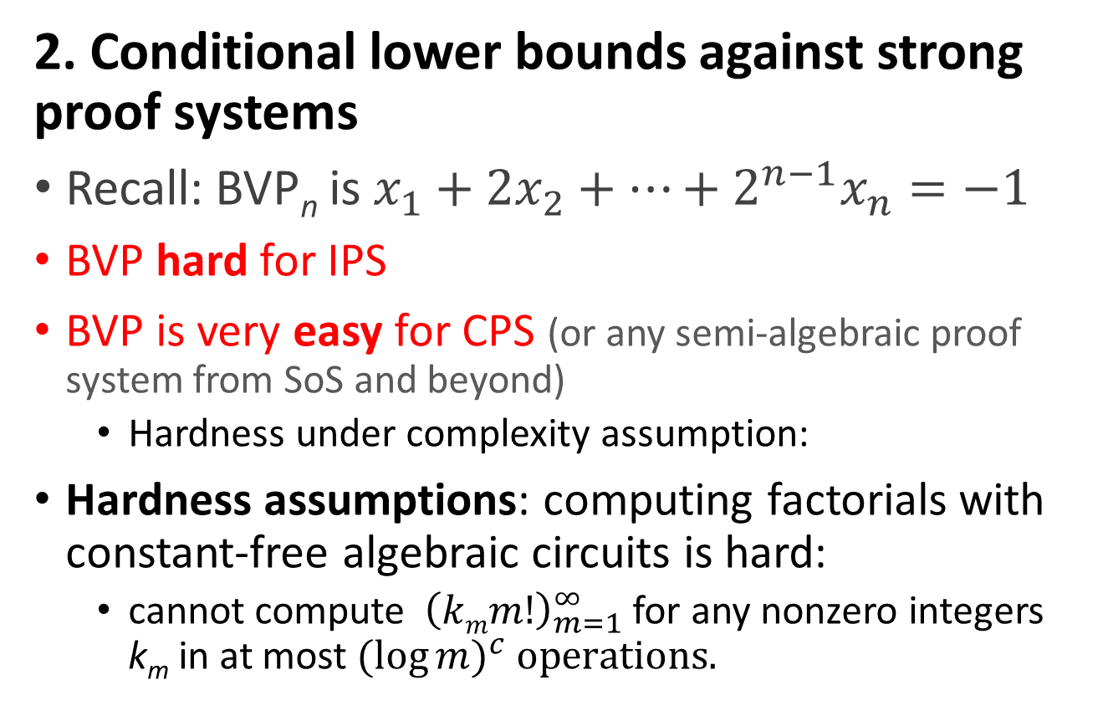
Our Results
2. Conditional lower bounds against strong proof systems
Recall: BVP_{n} is $x_{1}+2x_{2}+…+2^{n−1}x_{n}=−1$
BVP hard for IPS
BVP is very easy for CPS (or any semi-algebraic proof system from SoS and beyond)
  Hardness under complexity assumption:
Hardness assumptions: computing factorials with constant-free algebraic circuits is hard:
  cannot compute ${ \left(kmm!\right)}_{m=1}^{∞}$ for any nonzero integers k_{m} in at most${(log{m})}^{c} operations.$

Slide 21
Our Results
2. Conditional lower bounds against strong proof systems (cnt.)
Recall IPS refutation is “a single circuit that computes the algebraic refutation”.
Our lower bound extends (Forbes, Shpilka, T., Wigderson 2016) functional lower bounds approach to IPS
  Can’t get better without actually showing VP≠VNP

Slide 22
Our Results
3. Characterising the advantage of semi-algebraic proofs over algebraic ones
BVP characterises semi-algebraic proofs:
  IPS + BVP = CPS
Assume an algebraic proof system P is strong enough to do efficient bit-arithmetic. Then, P simulates semi-algebraic proofs (of the “corresponding complexity”) iff it refutes BVP efficiently.

Slide 23
Moral
One can do interesting things with coefficients of relatively large magnitudes (though their size is still polynomial!)

Slide 24
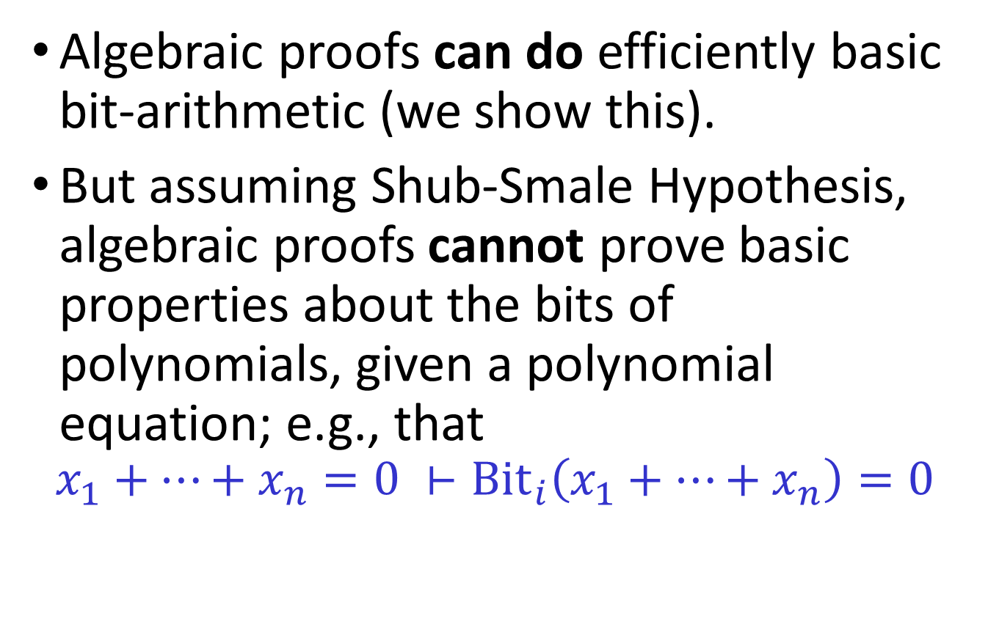
Moral
Algebraic proofs can do efficiently basic bit-arithmetic (we show this).
But assuming Shub-Smale Hypothesis, algebraic proofs cannot prove basic properties about the bits of polynomials, given a polynomial equation; e.g., that
$$x_{1}+…+x_{n}=0 ⊢{Bit}_{i}\left(x_{1}+…+x_{n}\right)=0$$

Slide 25
The Technical Part

Slide 26
Algebraic circuits
Fix a field 𝔽
  An algebraic circuit over 𝔽
  computes a formal polynomial
  over 𝔽
  Size = # of nodes
  (x₁+x₂)∙(x₂+3)= x₁x₂+x₂²+3x₁+3x₂
output
˟
+
+
x₁
x₂
3
Notes:
14’
These statements can be encoded in the obvious way as n^2 equations
Hard= super-polynomial size lower bounds
Conj 2 also yields a quasipolynomial Frege proof

Slide 27
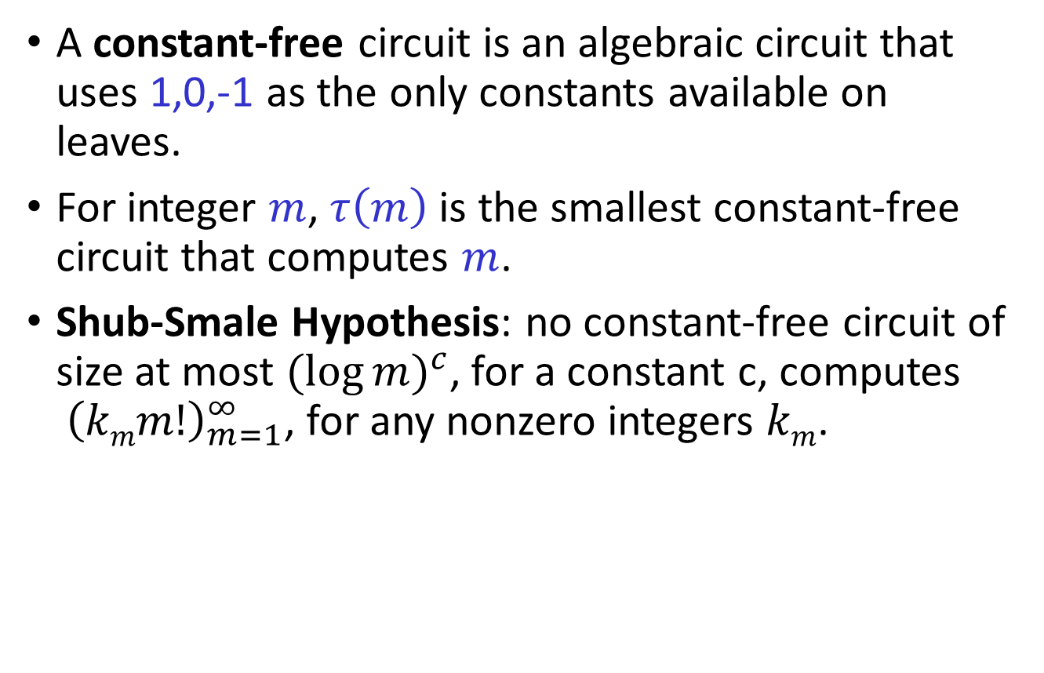
Shub-Smale Hypothesis
A constant-free circuit is an algebraic circuit that uses 1,0,-1 as the only constants available on leaves.
For integer $m$, $τ\left(m\right)$ is the smallest constant-free circuit that computes $m$.
Shub-Smale Hypothesis: no constant-free circuit of size at most ${(log{m})}^{c}$, for a constant c, computes ${ \left(kmm!\right)}_{m=1}^{∞}$, for any nonzero integers $km$.

Slide 28
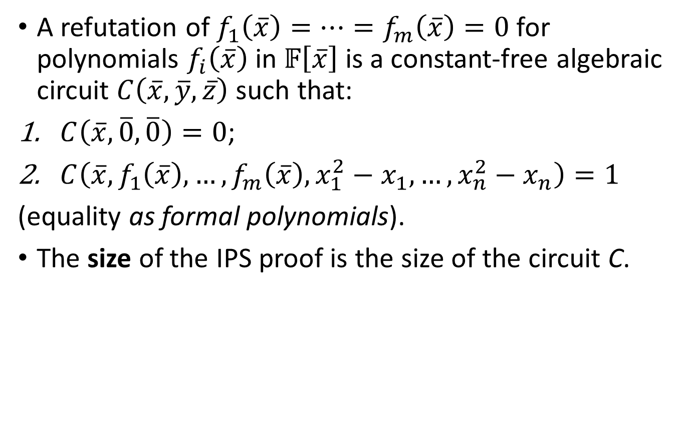
Ideal Proof System (IPS)
A refutation of $f_{1}\left(\overline{x}\right)=…=f_{m}\left(\overline{x}\right)=0$ for polynomials $f_{i}\left(\overline{x}\right)$ in $𝔽\left[\overline{x}\right]$ is a constant-free algebraic circuit $C\left(\overline{x},\overline{y},\overline{z}\right)$ such that:
$C\left(\overline{x},\overline{0},\overline{0}\right)=0$;
$C\left(\overline{x},f_{1}\left(\overline{x}\right),…,f_{m}\left(\overline{x}\right), x_{1}^{2}−x_{1},…,x_{n}^{2}−x_{n}\right)=1$
(equality as formal polynomials).
The size of the IPS proof is the size of the circuit C.

Slide 29
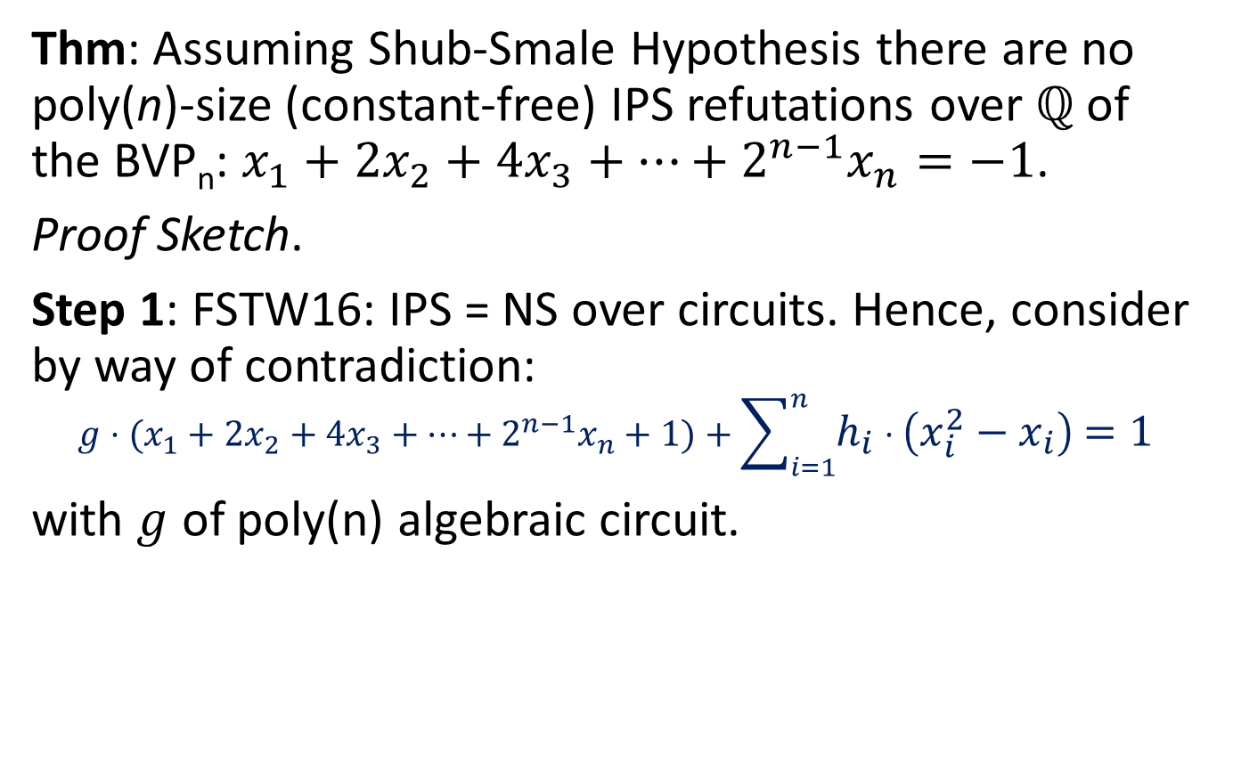
IPS Conditional Lower Bounds
Thm: Assuming Shub-Smale Hypothesis there are no poly(n)-size (constant-free) IPS refutations over ℚ of the BVP_{n}: $x_{1}+2x_{2}+4x_{3}+…+2^{n−1}x_{n}=−1$.
Proof Sketch.
Step 1: FSTW16: IPS = NS over circuits. Hence, consider by way of contradiction:
$${g⋅(x}_{1}+2x_{2}+4x_{3}+…+2^{n−1}x_{n}+1)+\sum_{i=1}^{n}{h_{i}⋅\left(x_{i}^{2}−x_{i}\right)=1}$$
with $g$ of poly(n) algebraic circuit.

Slide 30
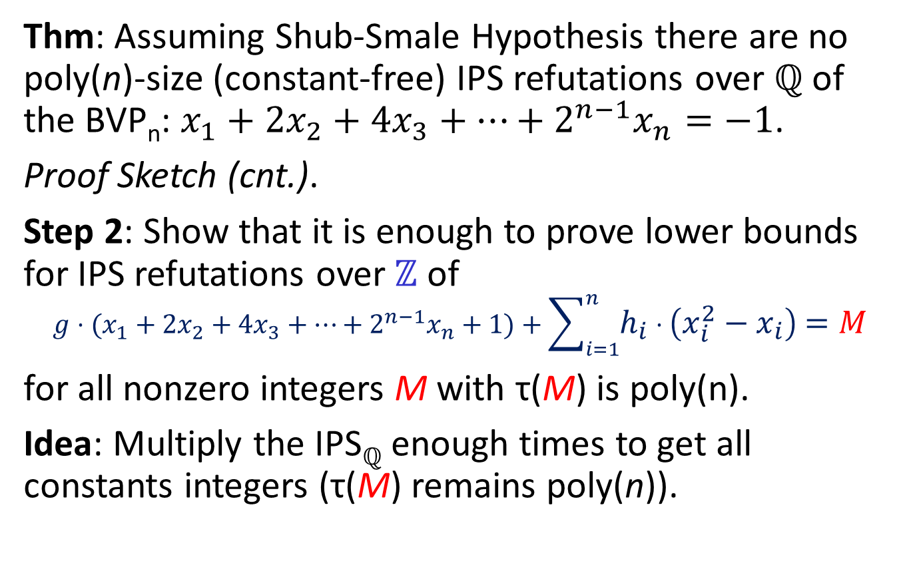
IPS Conditional Lower Bounds
Thm: Assuming Shub-Smale Hypothesis there are no poly(n)-size (constant-free) IPS refutations over ℚ of the BVP_{n}: $x_{1}+2x_{2}+4x_{3}+…+2^{n−1}x_{n}=−1$.
Proof Sketch (cnt.).
Step 2: Show that it is enough to prove lower bounds for IPS refutations over ℤ of
$${g⋅(x}_{1}+2x_{2}+4x_{3}+…+2^{n−1}x_{n}+1)+\sum_{i=1}^{n}{h_{i}⋅\left(x_{i}^{2}−x_{i}\right)=M}$$
for all nonzero integers M with τ(M) is poly(n).
Idea: Multiply the IPS_{ℚ} enough times to get all constants integers (τ(M) remains poly(n)).

Slide 31
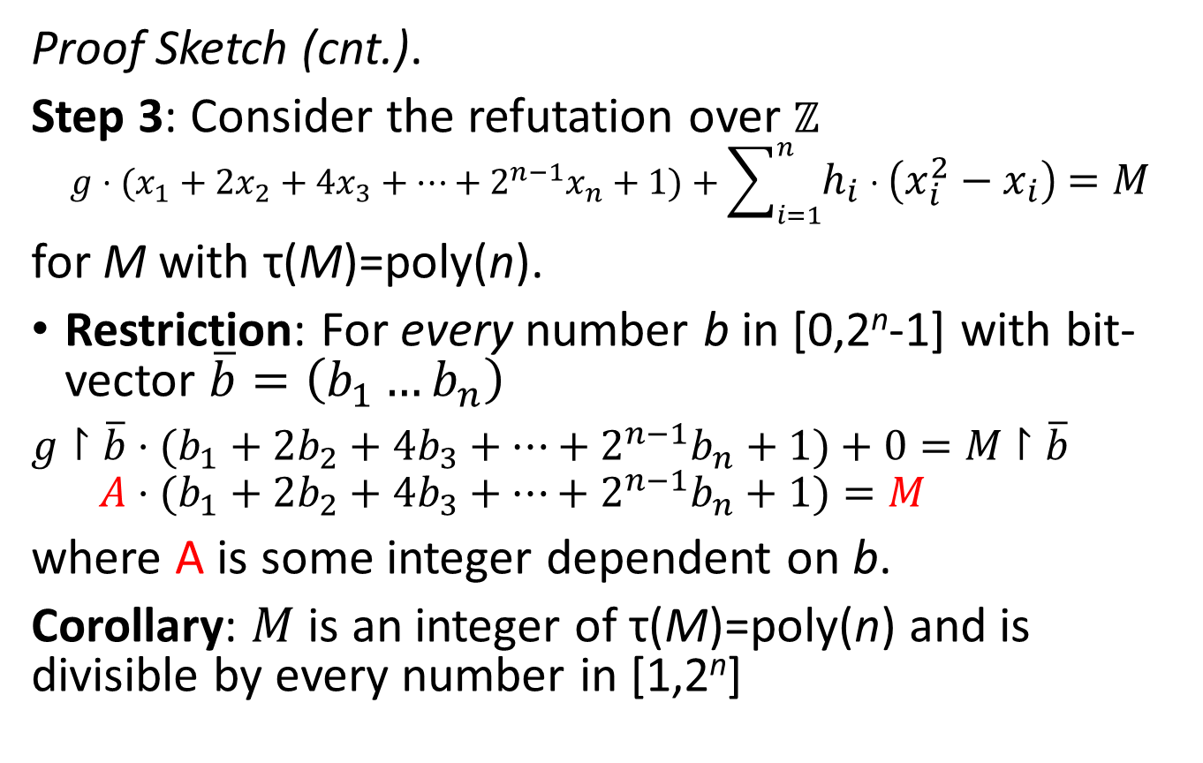
IPS Conditional Lower Bounds
Proof Sketch (cnt.).
Step 3: Consider the refutation over ℤ
$${g⋅(x}_{1}+2x_{2}+4x_{3}+…+2^{n−1}x_{n}+1)+\sum_{i=1}^{n}{h_{i}⋅\left(x_{i}^{2}−x_{i}\right)=M}$$
for M with τ(M)=poly(n).
Restriction: For every number b in [0,2^{n}-1] with bit-vector $\overline{b}=\left(b_{1}…b_{n}\right)$
${g↾\overline{b}⋅(b}_{1}+2b_{2}+4b_{3}+…+2^{n−1}b_{n}+1)+0=M$ $↾\overline{b}$
$${A⋅(b}_{1}+2b_{2}+4b_{3}+…+2^{n−1}b_{n}+1)=M$$
where A is some integer dependent on b.
Corollary: $M$ is an integer of τ(M)=poly(n) and is divisible by every number in [1,2^{n}]

Slide 32
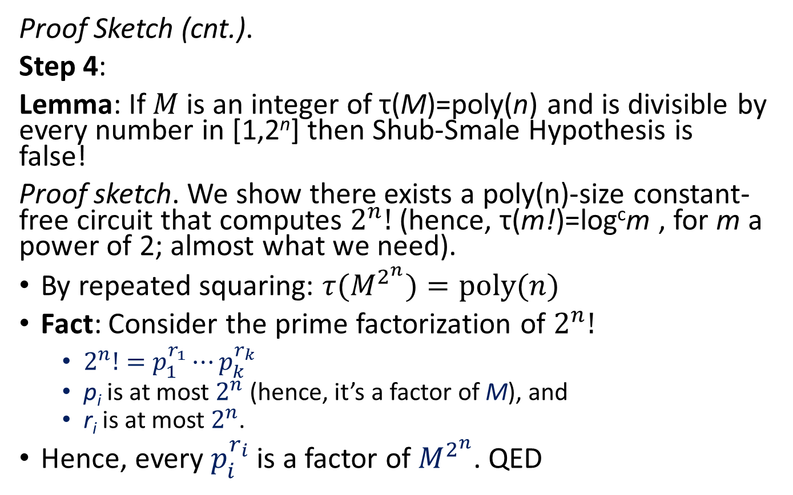
IPS Conditional Lower Bounds
Proof Sketch (cnt.).
Step 4:
Lemma: If $M$ is an integer of τ(M)=poly(n) and is divisible by every number in [1,2^{n}] then Shub-Smale Hypothesis is false!
Proof sketch. We show there exists a poly(n)-size constant-free circuit that computes $2^{n}!$ (hence, τ(m!)=log^{c}m , for m a power of 2; almost what we need).
By repeated squaring: ${τ(M}^{2^{n}})=poly(n)$
Fact: Consider the prime factorization of $2^{n}!$
  $2^{n}!=p_{1}^{r_{1}}⋯p_{k}^{r_{k}}$
  p_{i} is at most $2^{n}$ (hence, it’s a factor of M), and
  r_{i} is at most $2^{n}$.
Hence, every $p_{i}^{r_{i}}$ is a factor of $M^{2^{n}}$. QED
Notes:
Almost: shows Shub Smale is false for power of 2’s.

Slide 33

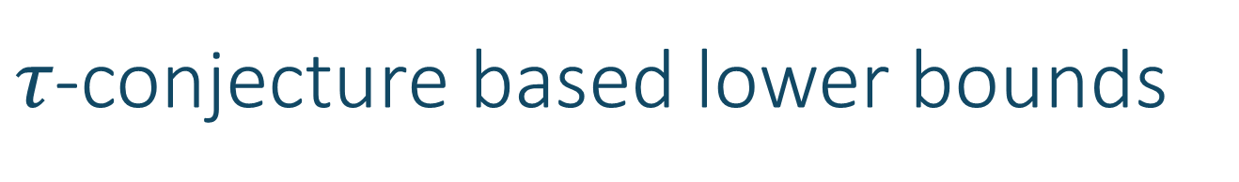
$τ$-conjecture based lower bounds
Under the $τ$-conjecture we can establish IPS lower bounds over the field of rational functions in the indeterminate single variable y.

Slide 34
The Cone Proof System

Slide 35
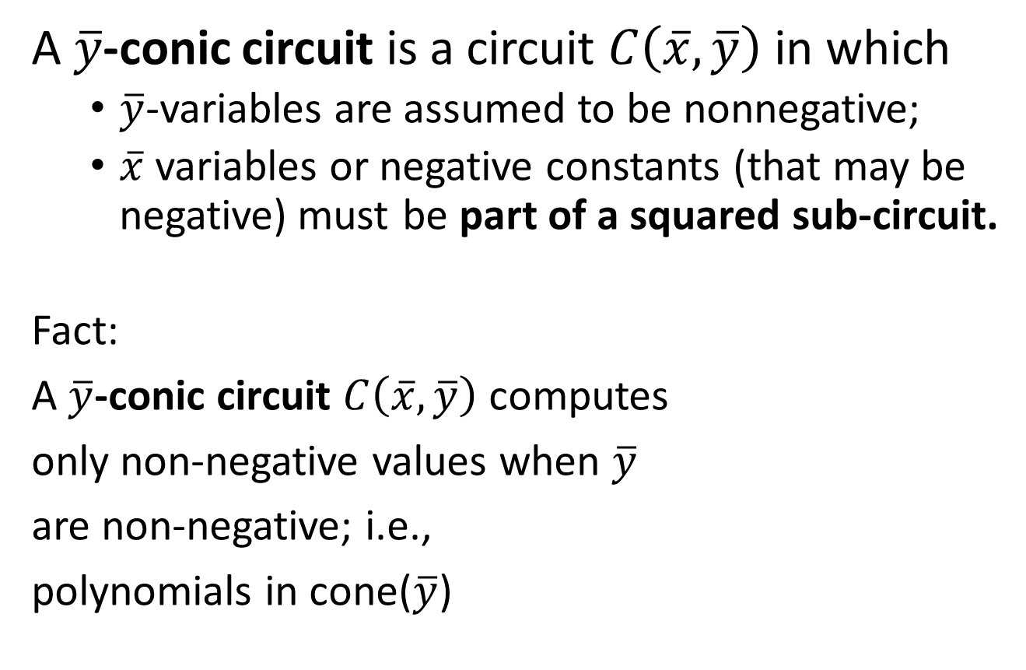
Cone Proof System (CPS)
A $\overline{y}$-conic circuit is a circuit $C\left(\overline{x},\overline{y}\right)$ in which
  $\overline{y}$-variables are assumed to be nonnegative;
  $\overline{x}$variables or negative constants (that may be negative) must be part of a squared sub-circuit.
Fact:
A $\overline{y}$-conic circuit $C\left(\overline{x},\overline{y}\right)$ computes
only non-negative values when $\overline{y}$
are non-negative; i.e.,
polynomials in cone($\overline{y}$)
+
output
+
X
X
y₂
-3
+
x₁
x₁
y₂

Slide 36
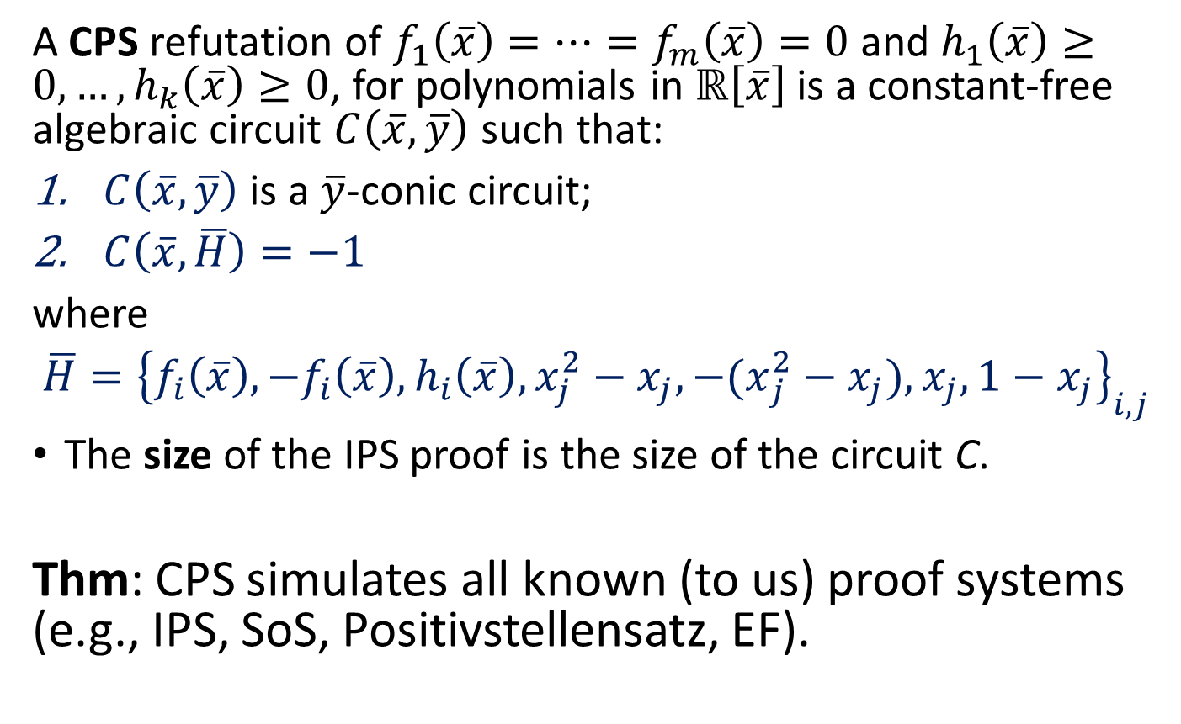
Cone Proof System (CPS)
A CPS refutation of $f_{1}\left(\overline{x}\right)=…=f_{m}\left(\overline{x}\right)=0$ and $h_{1}\left(\overline{x}\right)≥0,…, h_{k}\left(\overline{x}\right)≥0$, for polynomials in $ℝ\left[\overline{x}\right]$ is a constant-free algebraic circuit $C\left(\overline{x},\overline{y}\right)$ such that:
$C\left(\overline{x},\overline{y}\right)$ is a $\overline{y}$-conic circuit;
$C\left(\overline{x},\overline{H}\right)=−1$
where
$\overline{H}={\left\{f_{i}\left(\overline{x}\right), −f_{i}\left(\overline{x}\right),h_{i}\left(\overline{x}\right),x_{j}^{2}−x_{j},{−(x}_{j}^{2}−x_{j}), x_{j},1−x_{j}\right\}}_{i,j}$
The size of the IPS proof is the size of the circuit C.
Thm: CPS simulates all known (to us) proof systems (e.g., IPS, SoS, Positivstellensatz, EF).

Slide 37
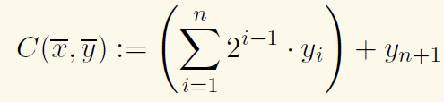


CPS Upper Bounds
Proposition: CPS admits linear size refutations of the binary value principle BVP_{n}.
Proof. Idea: because we have the boolean axioms for the $\overline{x}$ variables

Slide 38
CPS = IPS+Binary Value Principle
IPS* and CPS*:
  IPS and CPS over ℚ, where: possible values that are computed along the IPS or CPS proofs (as circuits) are not super-exponential (for 0-1 input variables).
Theorem: IPS* = CPS* iff IPS* admits poly(n)-size refutations of the Binary Value Principle.

Slide 39
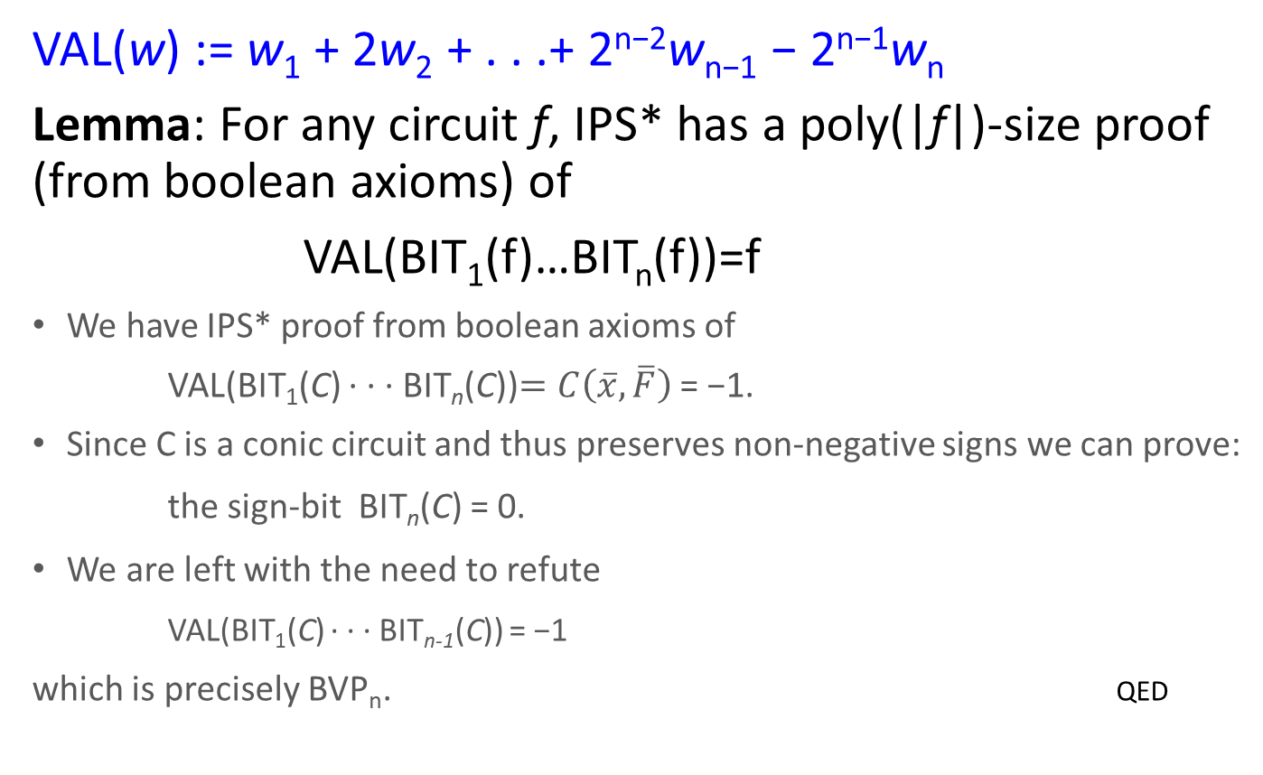
Thm: CPS* = IPS*+BVP_{n} (over ℤ, for simplicity)
VAL(w) := w₁ + 2w₂ + . . .+ 2^{n−2}w_{n−1} − 2^{n−1}w_{n}
Lemma: For any circuit f, IPS* has a poly(|f|)-size proof (from boolean axioms) of
VAL(BIT₁(f)…BIT_{n}(f))=f
We have IPS* proof from boolean axioms of
VAL(BIT₁(C) ∙ ∙ ∙ BIT_{n}(C))$=C\left(\overline{x},\overline{F}\right)$ = −1.
Since C is a conic circuit and thus preserves non-negative signs we can prove:
  the sign-bit BIT_{n}(C) = 0.
We are left with the need to refute
VAL(BIT₁(C) ∙ ∙ ∙ BIT_{n-1}(C)) = −1
which is precisely BVP_{n}. QED

Slide 40
Thanks for listening!
Notes:
41

Slide 41
Appendix

Slide 42

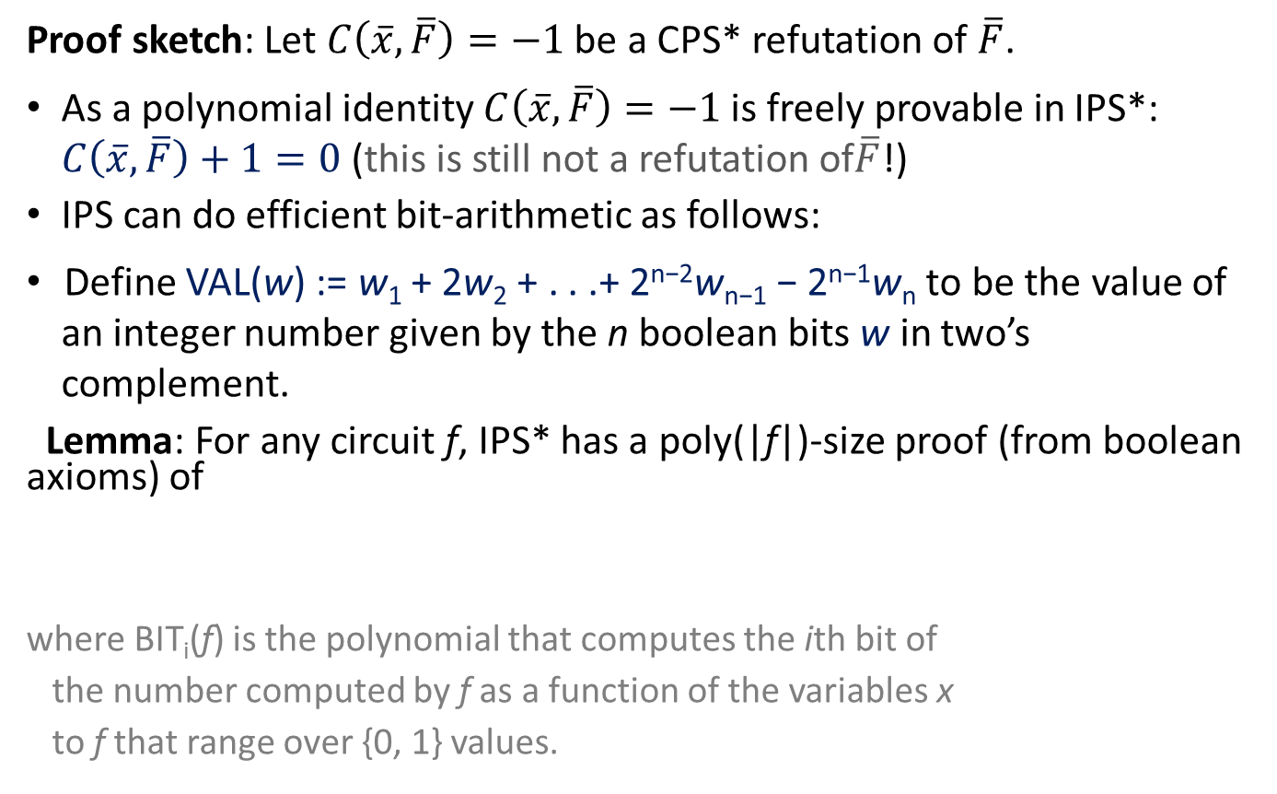
Thm: CPS* = IPS*+BVP_{n} (over ℤ, for simplicity)
Proof sketch: Let $C\left(\overline{x},\overline{F}\right)=−1$ be a CPS* refutation of $\overline{F}$.
As a polynomial identity $C\left(\overline{x},\overline{F}\right)=−1$ is freely provable in IPS*: $C\left(\overline{x},\overline{F}\right)+1=0$ (this is still not a refutation of$\overline{F}$!)
IPS can do efficient bit-arithmetic as follows:
Define VAL(w) := w₁ + 2w₂ + . . .+ 2^{n−2}w_{n−1} − 2^{n−1}w_{n} to be the value of an integer number given by the n boolean bits w in two’s complement.
Lemma: For any circuit f, IPS* has a poly(|f|)-size proof (from boolean axioms) of
where BIT_{i}(f) is the polynomial that computes the ith bit of
the number computed by f as a function of the variables x
to f that range over {0, 1} values.
IPS proofs A=B means: from boolean axioms we can prove A-B

Slide 43
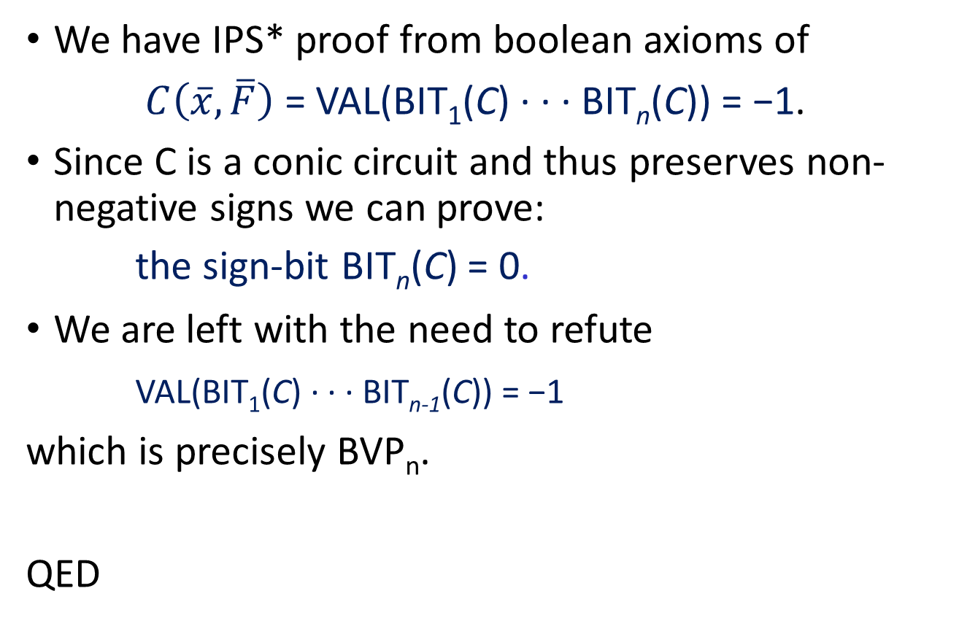
Proof (cnt.)
We have IPS* proof from boolean axioms of
$C\left(\overline{x},\overline{F}\right)$ = VAL(BIT₁(C) ∙ ∙ ∙ BIT_{n}(C)) = −1.
Since C is a conic circuit and thus preserves non-negative signs we can prove:
  the sign-bit BIT_{n}(C) = 0.
We are left with the need to refute
VAL(BIT₁(C) ∙ ∙ ∙ BIT_{n-1}(C)) = −1
which is precisely BVP_{n}.
QED

Slide 44
IPS_{ℤ} ≥_{p} IPS_{ℚ}
Prop: Size-s constant-free IPS_{Q} from F of H, for F a set of assumptions (F, H written as constant-free algebraic circuits over Z) then there exists a size ≤ 4s constant-free boolean IPS_{ℤ} proof of M ∙ H, for some M in ℤ\{0}, such that τ(M) ≤ 4s.
Proof. Multiply the IPS_{ℚ} enough times to get all constants integers.

