Slide 1
Deterministic Rounding of Dynamic Fractional Matchings
Sayan Bhattacharya
(University of Warwick)
Joint work with Peter Kiss.

Slide 16
Warm Up: A Naïve Dynamic Algorithm

Slide 32
Existing Literature

Slide 33
Different Aspects to Optimize
Incremental/Decremental/Fully Dynamic Setting
Amortized/Worst-case update time
Bipartite/general graphs
Approximation Ratio
Randomized/deterministic
Weighted/unweighted graphs

Slide 34

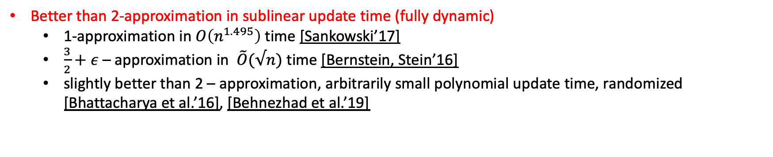
Current State-of-the-art
$\tilde{O}$ hides poly-log(n) and poly $\frac{1}{ε}$ factors.
Better than 2-approximation in sublinear update time (fully dynamic)
1-approximation in $O\left(n^{1.495}\right)$ time [Sankowski’17]
$\frac{3}{2}+ε$ – approximation in $\tilde{O}(√n)$ time [Bernstein, Stein’16]
slightly better than 2 – approximation, arbitrarily small polynomial update time, randomized [Bhattacharya et al.’16], [Behnezhad et al.’19]

Slide 35
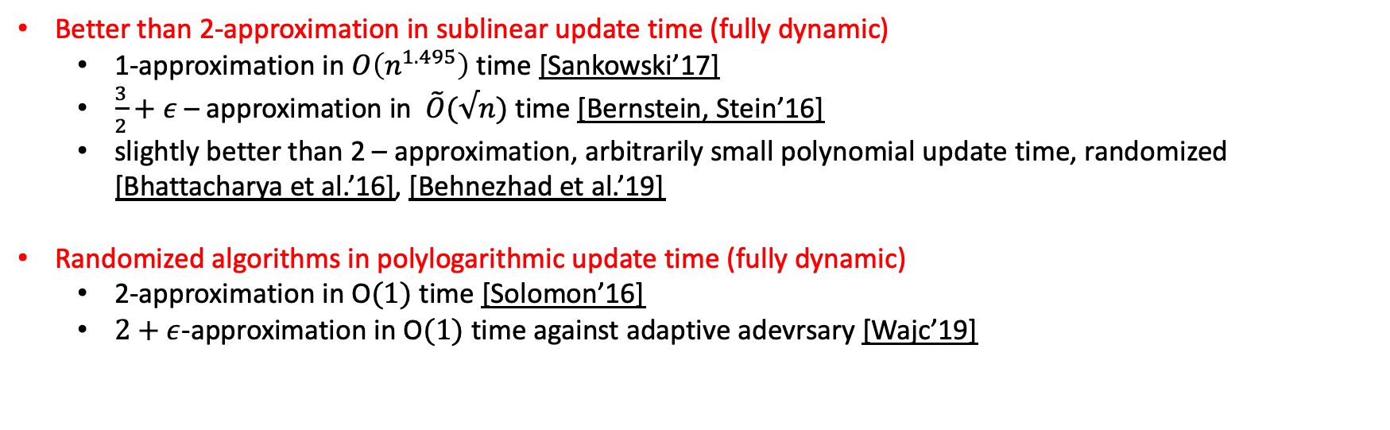
Current State-of-the-art
$\tilde{O}$ hides poly-log(n) and poly $\frac{1}{ε}$ factors.
Better than 2-approximation in sublinear update time (fully dynamic)
1-approximation in $O\left(n^{1.495}\right)$ time [Sankowski’17]
$\frac{3}{2}+ε$ – approximation in $\tilde{O}(√n)$ time [Bernstein, Stein’16]
slightly better than 2 – approximation, arbitrarily small polynomial update time, randomized [Bhattacharya et al.’16], [Behnezhad et al.’19]
Randomized algorithms in polylogarithmic update time (fully dynamic)
2-approximation in O$(1)$ time [Solomon’16]
$2+ε$-approximation in O$(1)$ time against adaptive adevrsary [Wajc’19]

Slide 36
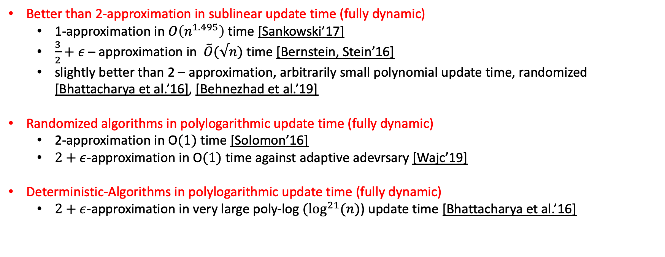
Current State-of-the-art
$\tilde{O}$ hides poly-log(n) and poly $\frac{1}{ε}$ factors.
Better than 2-approximation in sublinear update time (fully dynamic)
1-approximation in $O\left(n^{1.495}\right)$ time [Sankowski’17]
$\frac{3}{2}+ε$ – approximation in $\tilde{O}(√n)$ time [Bernstein, Stein’16]
slightly better than 2 – approximation, arbitrarily small polynomial update time, randomized [Bhattacharya et al.’16], [Behnezhad et al.’19]
Randomized algorithms in polylogarithmic update time (fully dynamic)
2-approximation in O$(1)$ time [Solomon’16]
$2+ε$-approximation in O$(1)$ time against adaptive adevrsary [Wajc’19]
Deterministic-Algorithms in polylogarithmic update time (fully dynamic)
$2+ε$-approximation in very large poly-log $(\log^{21}{(n)}$) update time [Bhattacharya et al.’16]

Slide 37
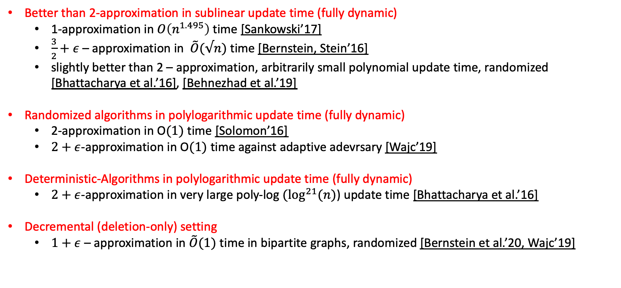
Current State-of-the-art
$\tilde{O}$ hides poly-log(n) and poly $\frac{1}{ε}$ factors.
Better than 2-approximation in sublinear update time (fully dynamic)
1-approximation in $O\left(n^{1.495}\right)$ time [Sankowski’17]
$\frac{3}{2}+ε$ – approximation in $\tilde{O}(√n)$ time [Bernstein, Stein’16]
slightly better than 2 – approximation, arbitrarily small polynomial update time, randomized [Bhattacharya et al.’16], [Behnezhad et al.’19]
Randomized algorithms in polylogarithmic update time (fully dynamic)
2-approximation in O$(1)$ time [Solomon’16]
$2+ε$-approximation in O$(1)$ time against adaptive adevrsary [Wajc’19]
Deterministic-Algorithms in polylogarithmic update time (fully dynamic)
$2+ε$-approximation in very large poly-log $(\log^{21}{(n)}$) update time [Bhattacharya et al.’16]
Decremental (deletion-only) setting
$1+ε$ – approximation in $\tilde{O}(1)$ time in bipartite graphs, randomized [Bernstein et al.’20, Wajc’19]

Slide 38
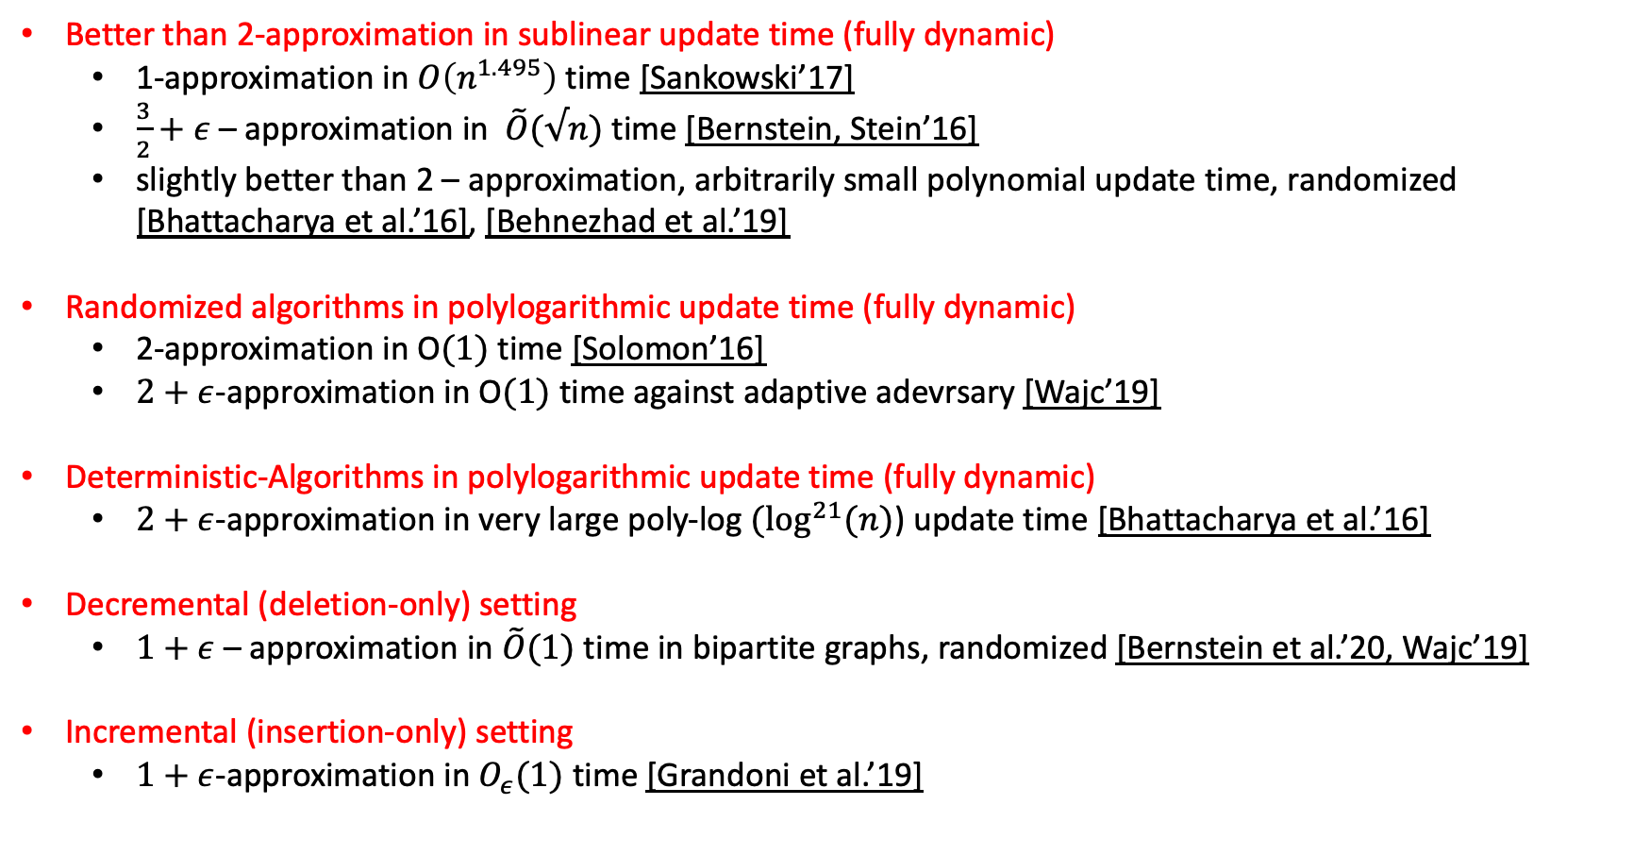
Current State-of-the-art
$\tilde{O}$ hides poly-log(n) and poly $\frac{1}{ε}$ factors.
Better than 2-approximation in sublinear update time (fully dynamic)
1-approximation in $O\left(n^{1.495}\right)$ time [Sankowski’17]
$\frac{3}{2}+ε$ – approximation in $\tilde{O}(√n)$ time [Bernstein, Stein’16]
slightly better than 2 – approximation, arbitrarily small polynomial update time, randomized [Bhattacharya et al.’16], [Behnezhad et al.’19]
Randomized algorithms in polylogarithmic update time (fully dynamic)
2-approximation in O$(1)$ time [Solomon’16]
$2+ε$-approximation in O$(1)$ time against adaptive adevrsary [Wajc’19]
Deterministic-Algorithms in polylogarithmic update time (fully dynamic)
$2+ε$-approximation in very large poly-log $(\log^{21}{(n)}$) update time [Bhattacharya et al.’16]
Decremental (deletion-only) setting
$1+ε$ – approximation in $\tilde{O}(1)$ time in bipartite graphs, randomized [Bernstein et al.’20, Wajc’19]
Incremental (insertion-only) setting
$1+ε$-approximation in $O_{ε}(1)$ time [Grandoni et al.’19]

Slide 39
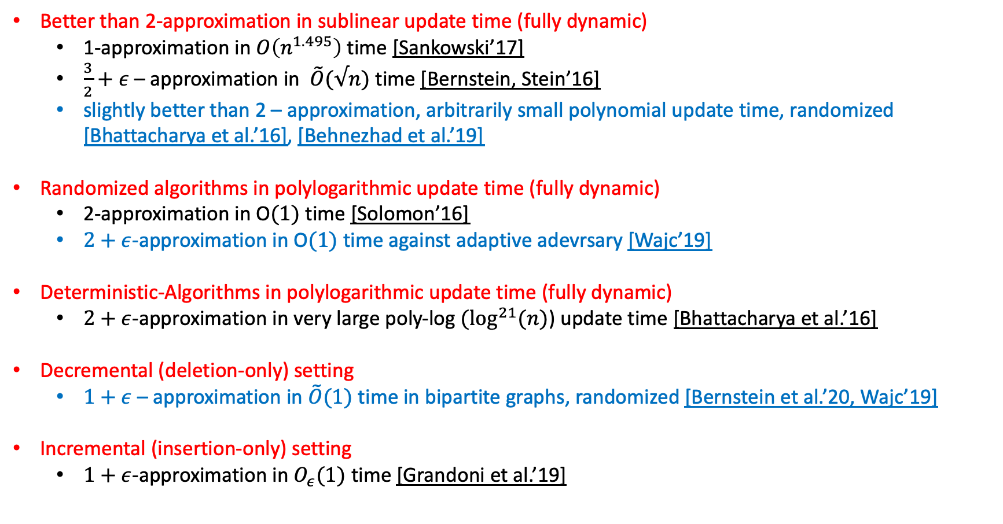
Current State-of-the-art
$\tilde{O}$ hides poly-log(n) and poly $\frac{1}{ε}$ factors.
Better than 2-approximation in sublinear update time (fully dynamic)
1-approximation in $O\left(n^{1.495}\right)$ time [Sankowski’17]
$\frac{3}{2}+ε$ – approximation in $\tilde{O}(√n)$ time [Bernstein, Stein’16]
slightly better than 2 – approximation, arbitrarily small polynomial update time, randomized [Bhattacharya et al.’16], [Behnezhad et al.’19]
Randomized algorithms in polylogarithmic update time (fully dynamic)
2-approximation in O$(1)$ time [Solomon’16]
$2+ε$-approximation in O$(1)$ time against adaptive adevrsary [Wajc’19]
Deterministic-Algorithms in polylogarithmic update time (fully dynamic)
$2+ε$-approximation in very large poly-log $(\log^{21}{(n)}$) update time [Bhattacharya et al.’16]
Decremental (deletion-only) setting
$1+ε$ – approximation in $\tilde{O}(1)$ time in bipartite graphs, randomized [Bernstein et al.’20, Wajc’19]
Incremental (insertion-only) setting
$1+ε$-approximation in $O_{ε}(1)$ time [Grandoni et al.’19]

Slide 40
Our Contribution

Slide 41
Our Contribution

Slide 42
Our Contribution

Slide 43
Interlude: Dynamic Fractional Matchings

Slide 44
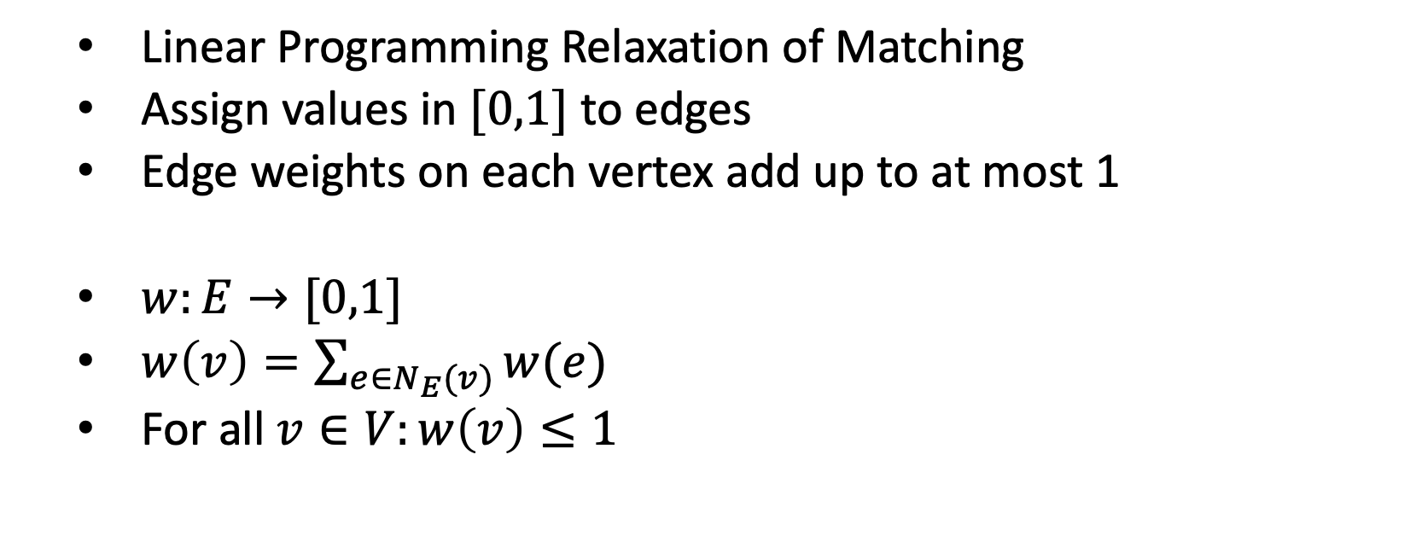
Fractional Matching
Linear Programming Relaxation of Matching
Assign values in $[0,1]$ to edges
Edge weights on each vertex add up to at most 1
$w:E→[0,1]$
$w\left(v\right)=\sum_{e∈N_{E}(v)}{w(e)}$
For all $v∈V:w\left(v\right)≤1$
1
0
0
1/2
1/2
1/2

Slide 45
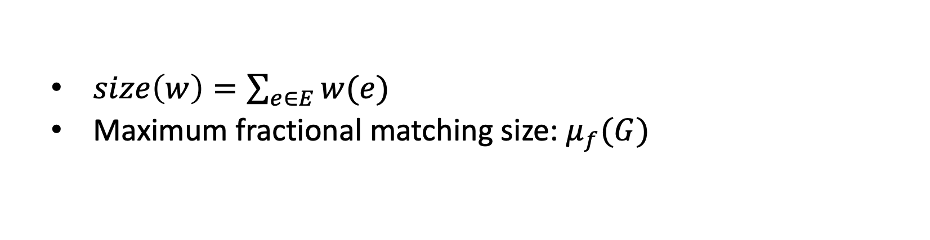
Fractional Matching
$size\left(w\right)=\sum_{e∈E}{w(e)}$
Maximum fractional matching size: $μ_{f}(G)$
1
0
0
1/2
1/2
1/2

Slide 46
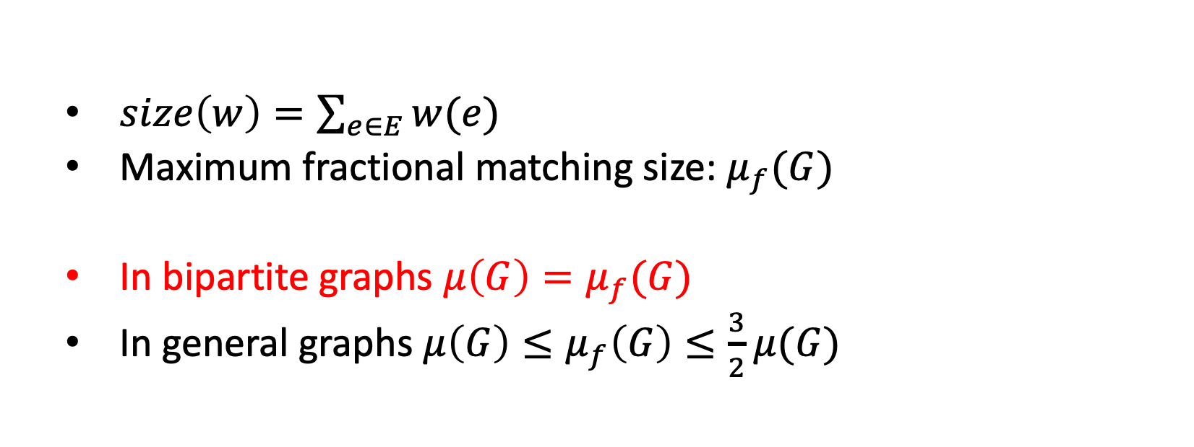
Fractional Matching
$size\left(w\right)=\sum_{e∈E}{w(e)}$
Maximum fractional matching size: $μ_{f}(G)$
In bipartite graphs $μ\left(G\right)=μ_{f}(G)$
In general graphs $μ\left(G\right)≤μ_{f}\left(G\right)≤\frac{3}{2}μ(G)$
1
0
0
1/2
1/2
1/2

Slide 61
Dynamic Matching Algorithms: A Common Template

Slide 62
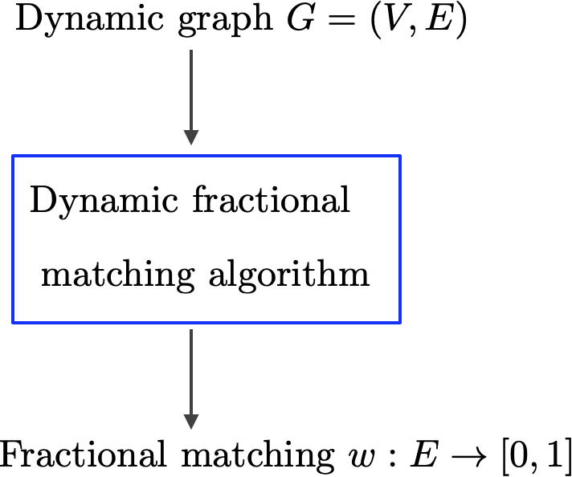

Slide 63
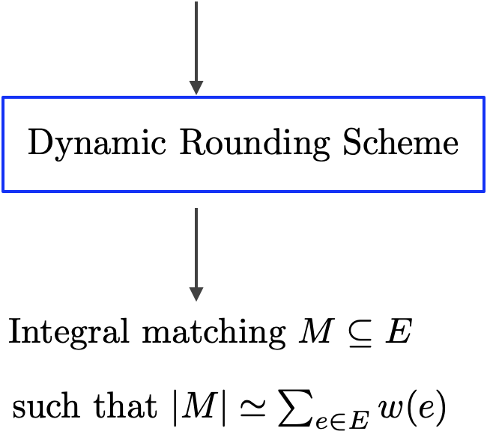

Slide 66
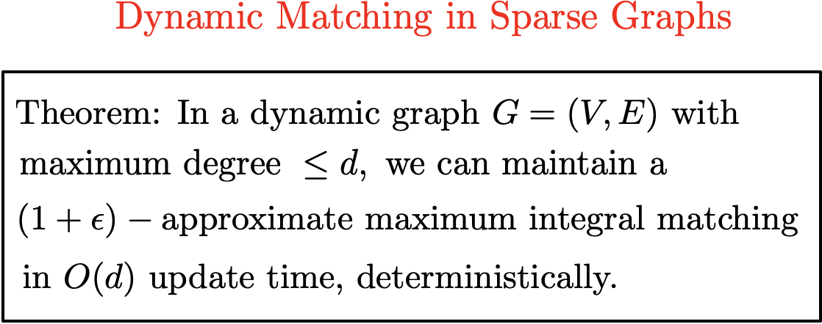

Slide 69
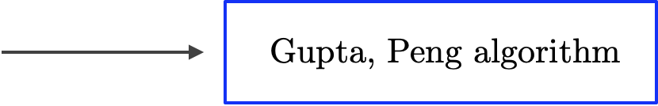
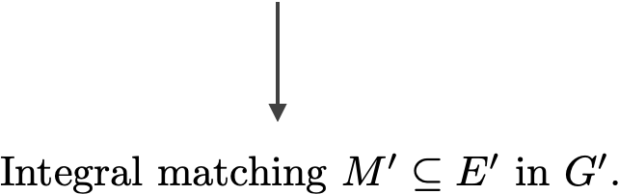

Slide 82
Our Result

Slide 95
Our Techniques

Slide 108
A Static Algorithm for Sparsifying a Uniform Fractional Matching

Slide 203
Making It Dynamic

Slide 205


Slide 208


Slide 215


Slide 222
Conclusion

Slide 226
Thank you!

