Slide 1
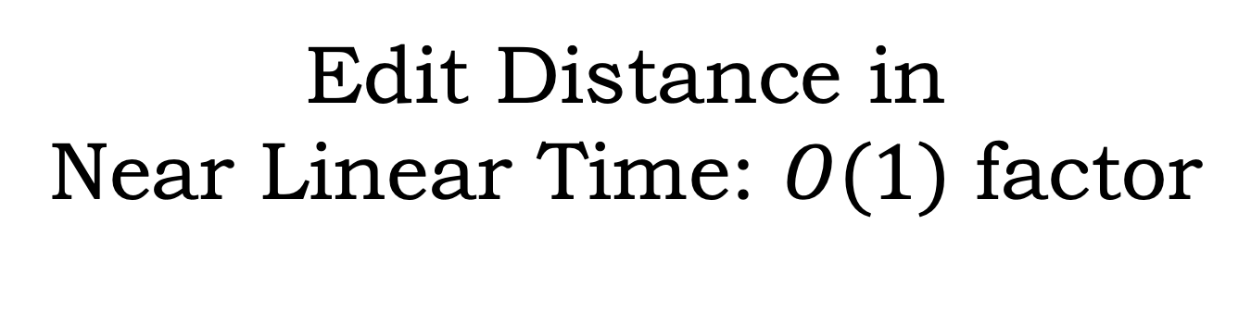
Edit Distance in
Near Linear Time: $O(1)$ factor
Alex Andoni
Negev Shekel Nosatzki
(Columbia University)
https://arxiv.org/abs/2005.07678

Slide 2
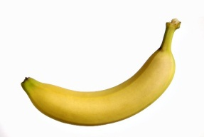
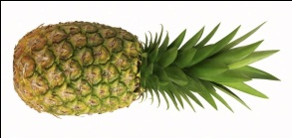
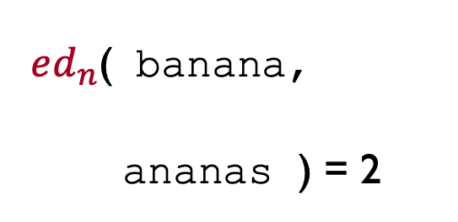

Edit distance (Levenstein)
Strings $x,y∈Σ^{n}$
$ed_{n}(x,y)$ = minimum number of insertions/deletions/ substitutions to transform $x$ into $y$
$ed_{n}$( banana,
ananas ) = 2
Applications:
bioinformatics
natural language processing

Slide 3









Crucially: A classic dynamic programming
Computing $ed_{n}(x,y)$:
  $O(n^{2})$ time [Wagner-Fischer’74]
 | b | a | n | a | n | a
a
n
a
n
a
s
$$D(i,j) = ed( x[1:i], y[1:j] )$$
1
1
2
3
4
5
Speed-up dynamic programming?
2
2
1
2
3
4
$D(i−1, j−1)$, if $x\left[i\right]=y[j]$
3
2
2
1
2
3
$$D(i,j)=min$$
$$D(i−1,j)+1$$
4
3
2
2
1
2
$$D(i, j−1)+1$$
5
4
3
2
2
1
6
5
4
3
3
2

Slide 4
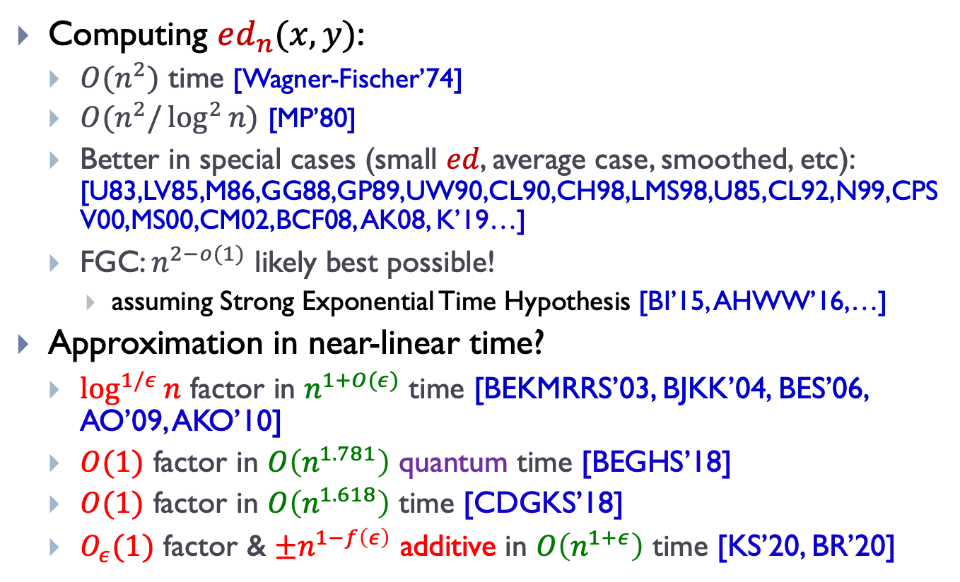
Faster Algorithms?
Computing $ed_{n}(x,y)$:
  $O(n^{2})$ time [Wagner-Fischer’74]
  $O(n^{2}/\log^{2}{n})$ [MP’80]
  Better in special cases (small $ed$, average case, smoothed, etc): [U83,LV85,M86,GG88,GP89,UW90,CL90,CH98,LMS98,U85,CL92,N99,CPSV00,MS00,CM02,BCF08, AK08, K’19…]
  FGC: $n^{2−o(1)}$ likely best possible!
    assuming Strong Exponential Time Hypothesis [BI’15, AHWW’16,…]
Approximation in near-linear time?
  $\log^{1/ε}{n}$ factor in $n^{1+O(ε)}$ time [BEKMRRS’03, BJKK’04, BES’06, AO’09, AKO’10]
  $O(1)$ factor in $O\left(n^{1.781}\right)$ quantum time [BEGHS’18]
  $O(1)$ factor in $O\left(n^{1.618}\right)$ time [CDGKS’18]
  $O_{ε}(1)$ factor & $±n^{1−f\left(ε\right)}$ additive in $O\left(n^{1+ε}\right)$ time [KS’20, BR’20]

Slide 5





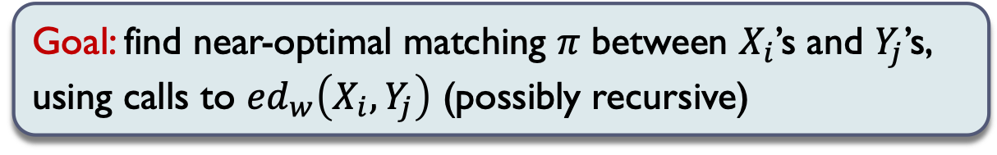
Main result
Approach setup:
  $ed_{n}(x,y)$ ⬄ an optimal alignment $π:\left[n\right]→\left[n\right]∪\{⊥\}$
  $X_{i}, Y_{j}$ : substrings starting at $i/j$ of length $w$ (think $w=n^{1−δ}$)
  Then $\sum_{i}{\frac{ed_{w}\left(X_{i},Y_{π\left(i\right)}\right)}{w}}≈ed_{n}(x,y)$
Can compute $ed\left(x,y\right)$ with $O_{ε}(1)$ approx. in $n^{1+ε}$ time
Goal: find near-optimal matching $π$ between $X_{i}$’s and $Y_{j}$’s, using calls to $ed_{w}\left(X_{i},Y_{j}\right)$ (possibly recursive)
$$X_{i}$$
$$x$$
banaaanas
$$y$$
ananas
$$Y_{j}$$

Slide 6

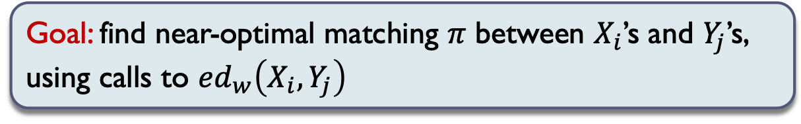

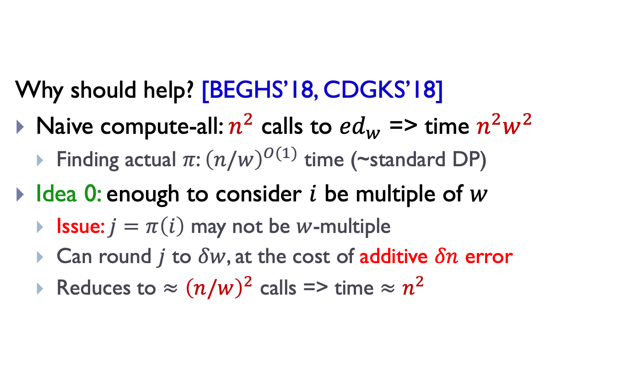


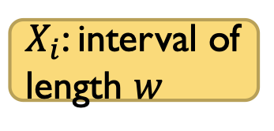

Past approaches
Goal: find near-optimal matching $π$ between $X_{i}$’s and $Y_{j}$’s, using calls to $ed_{w}\left(X_{i},Y_{j}\right)$
Why should help? [BEGHS’18, CDGKS’18]
Naive compute-all: $n^{2}$ calls to ${ed}_{w}$ => time $n^{2}w^{2}$
  Finding actual $π$: ${\left(n/w\right)}^{O(1)}$ time (~standard DP)
Idea 0: enough to consider $i$ be multiple of $w$
  Issue: $j=π\left(i\right)$ may not be $w$-multiple
  Can round $j$ to $δw$, at the cost of additive $δn$ error
  Reduces to $≈{\left(n/w\right)}^{2}$ calls => time $≈n^{2}$
$X_{i}$: interval of length $w$
$$X_{1}$$
$$X_{w}$$
$$X_{2w}$$
$$x$$
$$y$$

Slide 7

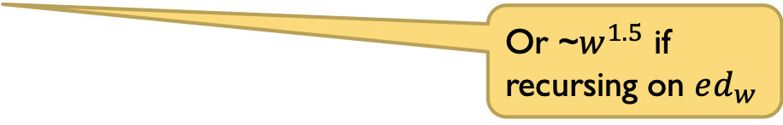
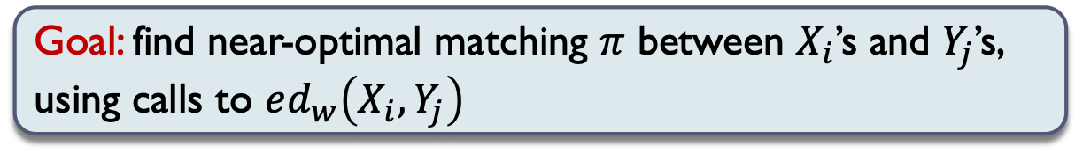
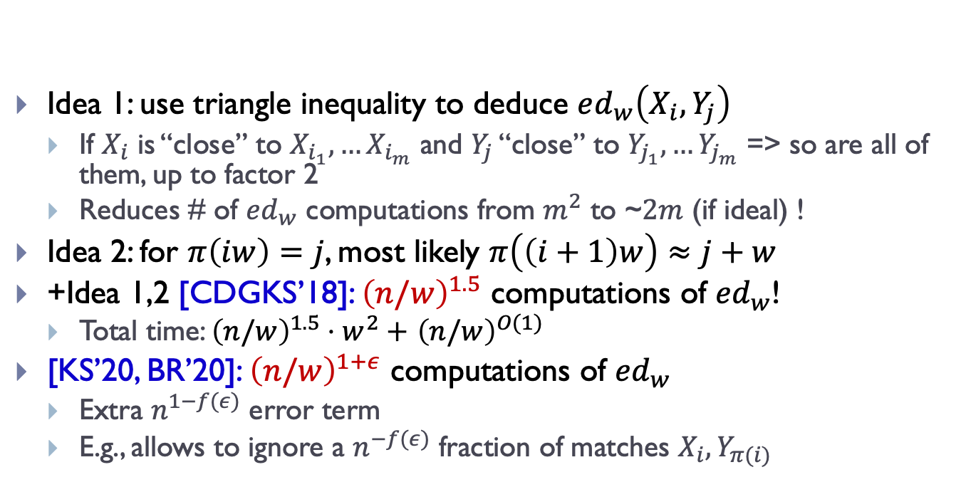
Reducing # of calls to $ed_{w}\left(X_{i},Y_{j}\right)$
Goal: find near-optimal matching $π$ between $X_{i}$’s and $Y_{j}$’s, using calls to $ed_{w}\left(X_{i},Y_{j}\right)$
Idea 1: use triangle inequality to deduce $ed_{w}\left(X_{i},Y_{j}\right)$
  If $X_{i}$ is “close” to $X_{i_{1}},…X_{i_{m}}$ and $Y_{j}$ “close” to $Y_{j_{1}},…Y_{j_{m}}$ => so are all of them, up to factor 2
  Reduces # of $ed_{w}$ computations from $m^{2}$ to ~$2m$ (if ideal) !
Idea 2: for $π\left(iw\right)=j$, most likely $π\left(\left(i+1\right)w\right)≈j+w$
+Idea 1,2 [CDGKS’18]: ${\left(n/w\right)}^{1.5}$ computations of ${ed}_{w}$!
  Total time: ${\left(n/w\right)}^{1.5}⋅w^{2}+$ ${\left(n/w\right)}^{O(1)}$
[KS’20, BR’20]: ${\left(n/w\right)}^{1+ε}$ computations of ${ed}_{w}$
  Extra $n^{1−f(ε)}$ error term
  E.g., allows to ignore a $n^{−f(ε)}$ fraction of matches $X_{i},Y_{π(i)}$
Or ~$w^{1.5}$ if recursing on $ed_{w}$
$$X_{1}$$
$$X_{w}$$
$$X_{2w}$$
$$x$$
$$y$$

Slide 8







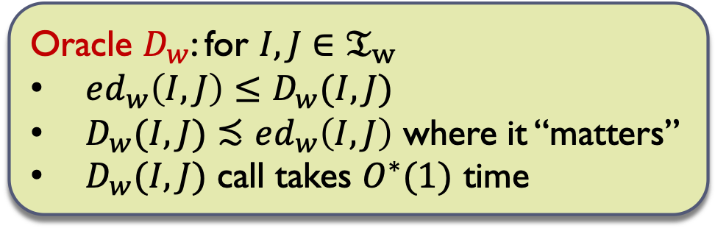

Our high-level approach
For each $w=1,n^{ε},n^{2ε},…n$,
build a distance oracle $D_{w}$ for the metric ($𝔗_{w}, ed_{w}\left(⋅, ⋅\right))$ where $𝔗_{w}=$ all $2n$ substrings of length $w$
Oracle $D_{w}$: for $I,J∈$ $𝔗_{w}$
$ed_{w}\left(I,J\right)≤D_{w}(I,J)$
$D_{w}(I,J)≾ed_{w}\left(I,J\right)$ where it “matters”
$D_{w}(I,J)$ call takes $O^{∗}(1)$ time
$$D_{n}(X_{1},Y_{1})$$
Hamming
$$=$$
$$D_{1}$$
$$D_{n^{ε}}$$
$$D_{n^{2ε}}$$
…
$$D_{n}$$
New goal: given $D_{w/n^{ε}}$, compute $D_{w}$, in $n^{1+O(ε)}$ time

Slide 9
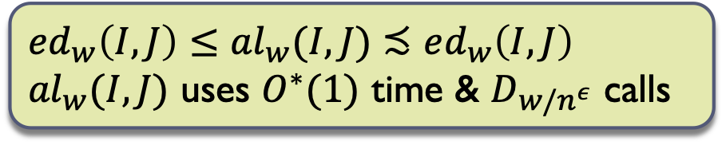

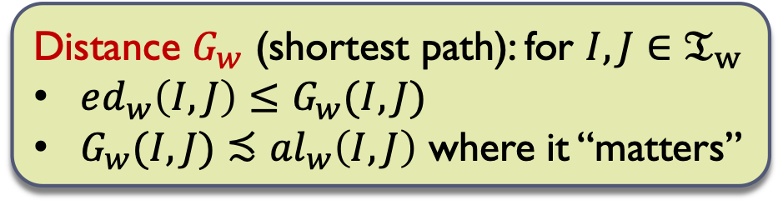

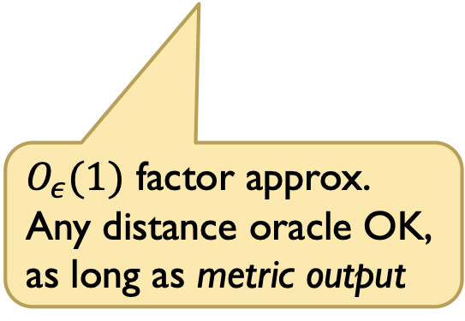

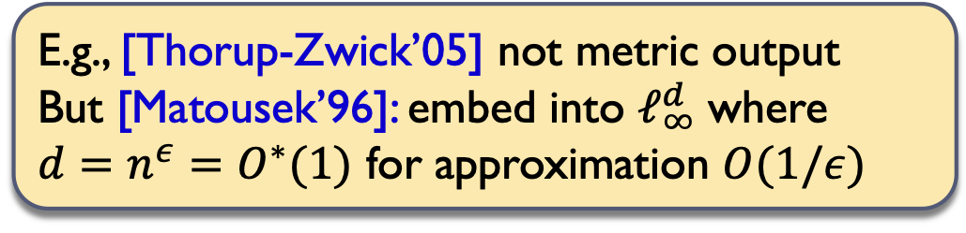


2 components:
$ed_{w}\left(I,J\right)≤{al}_{w}(I,J)$ $≾ed_{w}\left(I,J\right)$
${al}_{w}(I,J)$ uses $O^{∗}(1)$ time & $D_{w/n^{ε}}$ calls
1. Alignment algo: oracle ${al}_{w}(I,J)$
2. Matching algo: building $D_{w}$ from $al_{w}$
Matching
algorithm
Distance oracle
data structure
$$al_{w}$$
$$D_{w/n^{ε}}$$
$$D_{w}$$
$$G_{w}$$
Distance $G_{w}$ (shortest path): for $I,J∈$ $𝔗_{w}$
$ed_{w}\left(I,J\right)≤G_{w}(I,J)$
$G_{w}(I,J)≾{al}_{w}\left(I,J\right)$ where it “matters”
$O_{ε}(1)$ factor approx.
Any distance oracle OK, as long as metric output
E.g., [Thorup-Zwick’05] not metric output
But [Matousek’96]: embed into $ℓ_{∞}^{d}$ where
$d=n^{ε}=O^{∗}(1)$ for approximation $O(1/ε)$

Slide 10




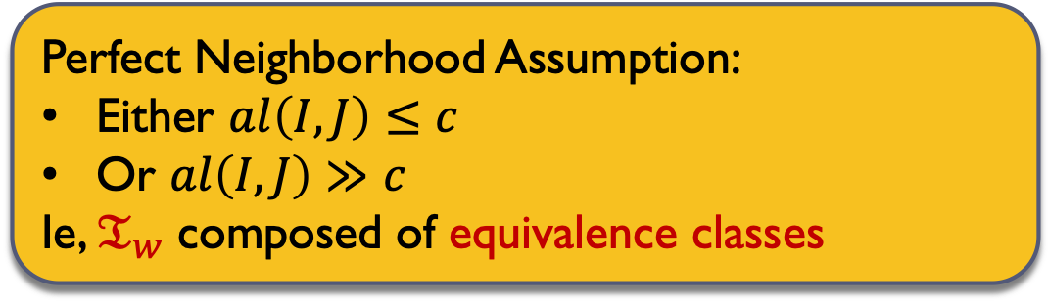
Matching Algorithm
$$al_{w}$$
Enough to build graph $G$ for one scale $c$:
  Edge $\left(I,J\right)$ implies $al\left(I,J\right)≤O_{ε}(c)$
  For any alignment $π$, for $i∈\left[n\right]$:
    If $al\left(X_{i},Y_{π\left(i\right)}\right)≤c$, there is a 2-hop path in $G$
    Can miss O(error): ie $≾$ number of pairs where $al\left(X_{i},Y_{π\left(i\right)}\right)>c$
  $O^{∗}(n)$ time and calls to $al$
$$G_{w}$$
BIG simplification…
Perfect Neighborhood Assumption:
Either $al\left(I,J\right)≤c$
Or $al\left(I,J\right)≫c$
Ie, $𝔗_{w}$ composed of equivalence classes
Instead of triangle inequality
$X_{i}$’s
A
C
AAB
D
C
C C
$Y_{j}$’s
A
C
AAB D
C C C

Slide 11
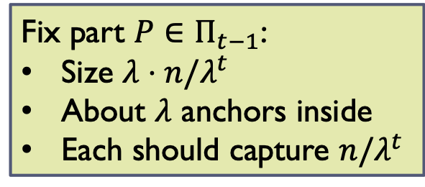
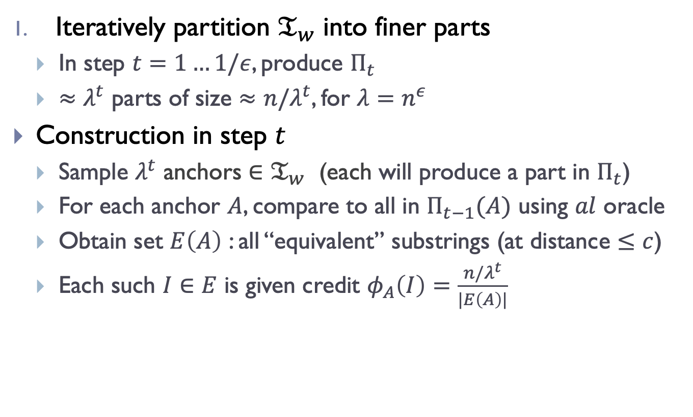
Main loop
Iteratively partition $𝔗_{w}$ into finer parts
  In step $t=1…1/ε$, produce $Π_{t}$
  $≈λ^{t}$ parts of size $≈n/λ^{t}$, for $λ=n^{ε}$
Construction in step $t$
  Sample $λ^{t}$ anchors $∈𝔗_{w}$ (each will produce a part in $Π_{t}$)
  For each anchor $A$, compare to all in $Π_{t−1}(A)$ using $al$ oracle
  Obtain set $E\left(A\right)$ : all “equivalent” substrings (at distance $≤c$)
  Each such $I∈E$ is given credit $φ_{A}\left(I\right)=\frac{n/λ^{t}}{|E\left(A\right)|}$
Fix part $P∈Π_{t−1}$:
Size $λ⋅n/λ^{t}$
About $λ$ anchors inside
Each should capture $n/λ^{t}$
A
C
AAB
AD
C
C E
A
CC
AAB D
C C E

Slide 12


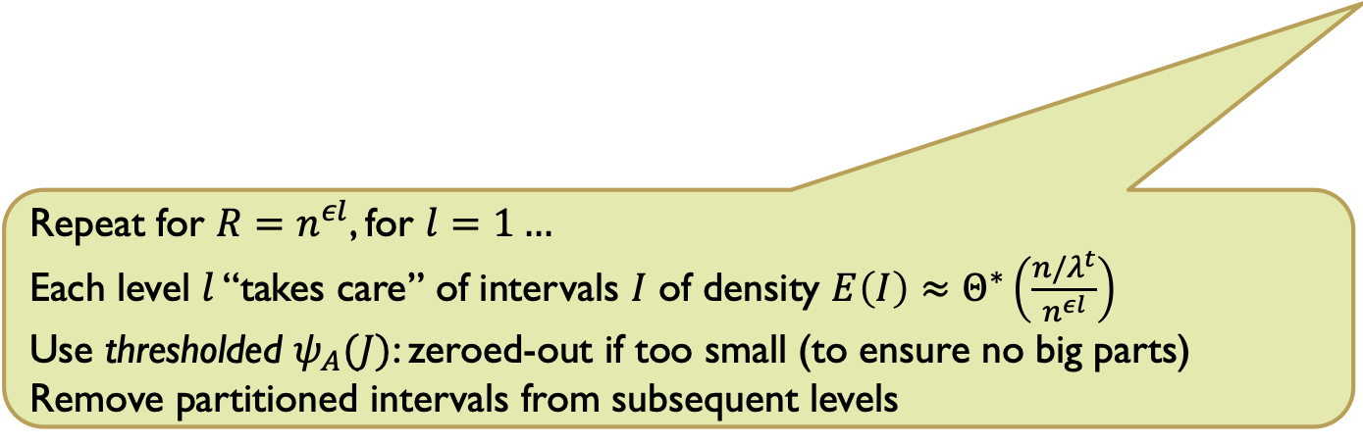

Partition via proximity
Fix part $P∈Π_{t−1}$:
Size $λ⋅n/λ^{t}$
About $λ$ anchors inside
Each should capture $n/λ^{t}$
$I∈E(A)$ is given credit $φ_{A}\left(I\right)=\frac{n/λ^{t}}{|E\left(A\right)|}$
Proximal extension of $I∈E(A)$:
  Distribute $φ_{A}(I)$ to “nearby” $J$’s
  $R$ intervals $J∈P_{t−1}(I)$ to left/right
  Defines $ψ_{A}(J)$
New partition $Π_{t}$of $𝔗_{w}$:
  Consider vectors $ψ\left(J\right)∈ℜ_{+}^{λ^{t}}$
  Partition using (weighted) minhash $h:2^{\left[λ^{t}\right]}→\left[λ^{t}\right]$:
    $J$ assigned to part $h\left(ψ\left(J\right)\right)$
    $Pr⁡[X_{i}$ and $Y_{π(i)}$ separated$]≈||ψ\left(X_{i}\right)−ψ\left(Y_{π\left(i\right)}\right)||_{1}≈$ “local error”
Issues:
1) Value of $R$?
2) Need to group non-proximal sparse substrings together
Intervals partitioned according to their proximity
Repeat for $R=n^{εl}$, for $l=1…$
Each level $l$ “takes care” of intervals $I$ of density $E\left(I\right)≈Θ^{∗}\left(\frac{n/λ^{t}}{n^{εl}}\right)$
Use thresholded $ψ_{A}(J)$: zeroed-out if too small (to ensure no big parts)
Remove partitioned intervals from subsequent levels
A
C
AAB
AD
C
C E
A
CC
AAB D
C C E

Slide 13

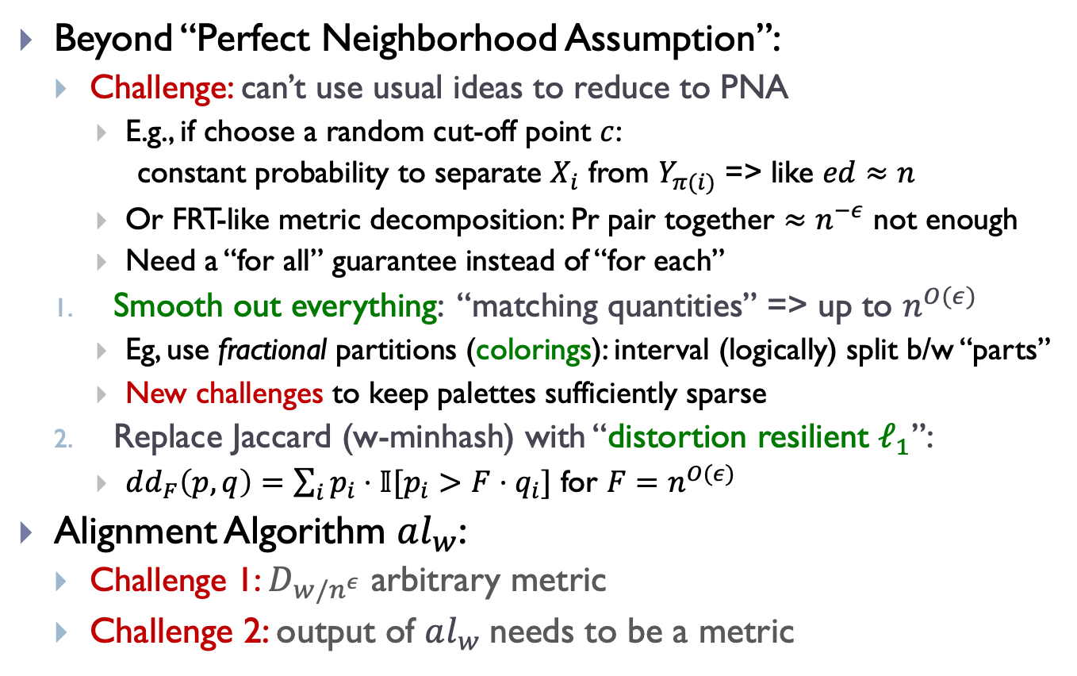
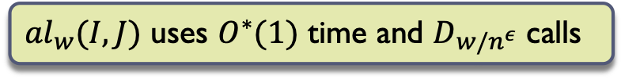
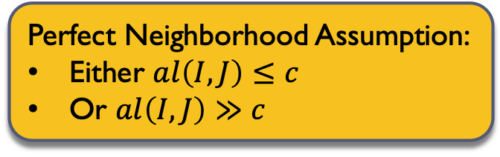

A sample of the rest
Perfect Neighborhood Assumption:
Either $al\left(I,J\right)≤c$
Or $al\left(I,J\right)≫c$
Beyond “Perfect Neighborhood Assumption”:
  Challenge: can’t use usual ideas to reduce to PNA
    E.g., if choose a random cut-off point $c$:
    constant probability to separate $X_{i}$ from $Y_{π(i)}$ => like $ed≈n$
    Or FRT-like metric decomposition: Pr pair together $≈n^{−ε}$ not enough
    Need a “for all” guarantee instead of “for each”
  Smooth out everything: “matching quantities” => up to $n^{O(ε)}$
    Eg, use fractional partitions (colorings): interval (logically) split b/w “parts”
    New challenges to keep palettes sufficiently sparse
  Replace Jaccard (w-minhash) with “distortion resilient $ℓ_{1}$”:
    $dd_{F}\left(p,q\right)=\sum_{i}{p_{i}⋅𝕀[p_{i}>F⋅q_{i}]}$ for $F=n^{O(ε)}$
Alignment Algorithm $al_{w}$:
  Challenge 1: $D_{w/n^{ε}}$ arbitrary metric
  Challenge 2: output of $al_{w}$needs to be a metric
$$al_{w}$$
$$D_{w/n^{ε}}$$
${al}_{w}(I,J)$ uses $O^{∗}(1)$ time and $D_{w/n^{ε}}$ calls

Slide 14
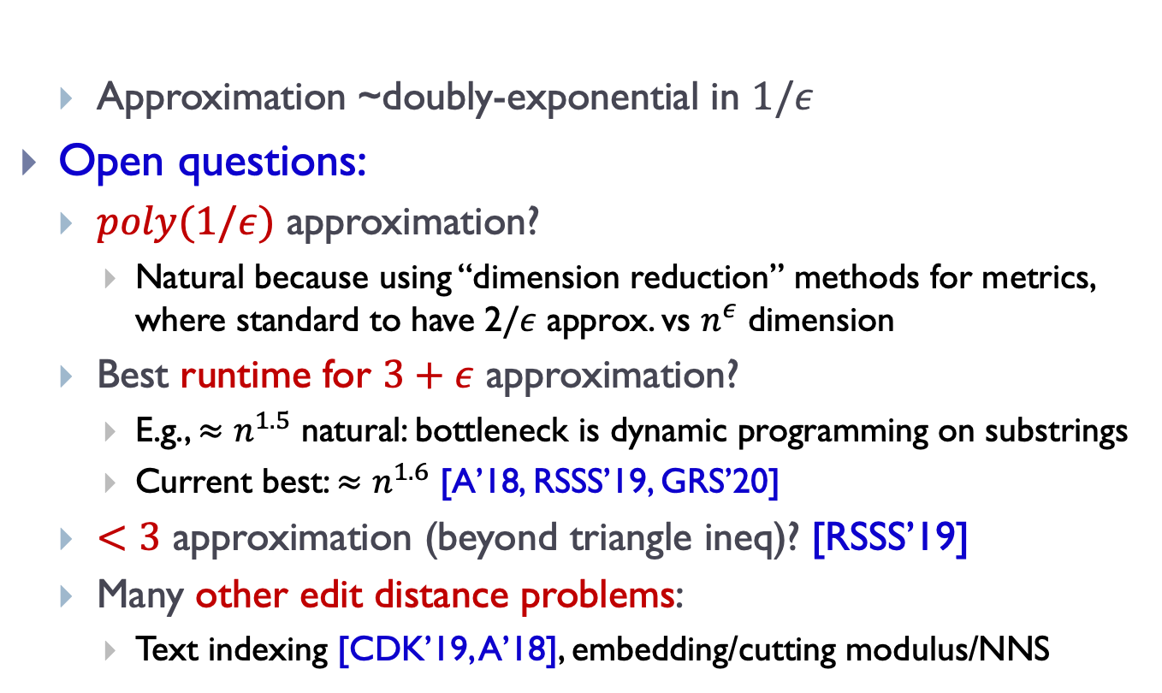
Finale
Can compute $ed\left(x,y\right)$ with $O_{ε}(1)$ approx. in $n^{1+ε}$ time
  Approximation ~doubly-exponential in $1/ε$
Open questions:
  $poly(1/ε)$ approximation?
    Natural because using “dimension reduction” methods for metrics, where standard to have $\text{2}/ε$ approx. vs $n^{ε}$ dimension
  Best runtime for $3+ε$ approximation?
    E.g., $≈n^{1.5}$ natural: bottleneck is dynamic programming on substrings
    Current best: $≈n^{1.6}$ [A’18, RSSS’19, GRS’20]
  $<3$ approximation (beyond triangle ineq)? [RSSS’19]
  Many other edit distance problems:
    Text indexing [CDK’19, A’18], embedding/cutting modulus/NNS

