Slide 1
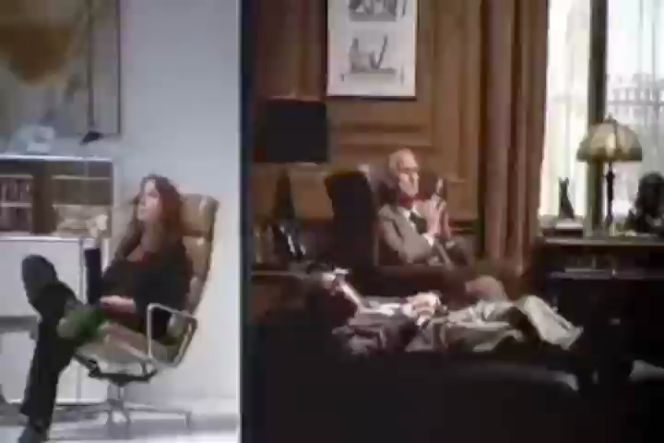
DTC Qualitative Methods
Nick Llewellyn

Slide 2
Today’s class…
An overview of the module
What is qualitative research?
Then, a practical exercise.

Slide 3
Exercise 1: ‘order everywhere’
In a moment, when I say, please find out the time by asking the person sitting on your left.
Then, could you record in writing, as precisely as you can, what was said. The question and the response. Please do this independently.

Slide 4
Practices for asking
Do you know time?
What’s the time?
Do you have the time?
1 and 3 don’t presume other knows the time? 1 and 3 are ‘requests’. 2 is an ‘imperative’. 1 and 3 are ‘indirect speech acts’.

Slide 5
Practices for telling the time
Four practices…
‘The exact time’, e.g., ‘two seventeen and ten seconds’. n=
‘Rounding to the nearest minute’, e.g., ‘seventeen minutes past’. n=
‘Rounding to the nearest five’, e.g., ‘twenty past two’. n=
‘Ignoring the hour’, e.g., ‘twenty past’. n=
Any others? n=

Slide 6
Time in Context
When would it be normal/weird to use a particular practice - exact time, inexact time, or ignoring the hour?
 | Normal | Weird
Rounding / inexact | Mundane inquiries (‘when will she be back’, ‘about five minutes’) | Train times (‘the train will arrive around 4 o’clock’)
Exact | ‘Usain Bolt wins in 9.75s’ | Romantic dates (‘I’ll meet you at 7.33.15pm’)
Ignoring the hour | Lectures (‘ok it’s five past, let’s start’) | ‘The film starts tomorrow at twenty past’.

Slide 7
Time in Context
When would it be normal/weird to use a particular practice - exact time, inexact time, or ignoring the hour?
 | Normal | Weird
Rounding / inexact | Mundane inquiries (‘when will she be back’, ‘about five minutes’) | Train times (‘the train will arrive around 4 o’clock’)
Exact | ‘Usain Bolt wins in 9.75s’ | Romantic dates (‘I’ll meet you at 7.33.15pm’)
Ignoring the hour | Lectures (‘ok it’s five past, let’s start’) | ‘The film starts tomorrow at twenty past’.

Slide 8
Time in Context
When would it be normal/weird to use a particular practice - exact time, inexact time, or ignoring the hour?
 | Normal | Weird
Rounding / inexact | Mundane inquiries (‘when will she be back’, ‘about five minutes’) | Train times (‘the train will arrive around 4 o’clock’)
Exact | ‘Usain Bolt wins in 9.75s’ | Romantic dates (‘I’ll meet you at 7.33.15pm’)
Ignoring the hour | Lectures (‘ok it’s five past, let’s start’) | ‘The film starts tomorrow at twenty past’.

Slide 9
Time in Context
When would it be normal/weird to use a particular practice - exact time, inexact time, or ignoring the hour?
 | Normal | Weird
Rounding / inexact | Mundane inquiries (‘when will she be back’, ‘about five minutes’) | Train times (‘the train will arrive around 4 o’clock’)
Exact | ‘Usain Bolt wins in 9.75s’ | Romantic dates (‘I’ll meet you at 7.33.15pm’)
Ignoring the hour | Lectures (‘ok it’s five past, let’s start’) | ‘The film is on tomorrow at twenty past’.

Slide 10
Telling the time
How many actions can ‘Do you know the time?’ perform?

Slide 11
Summary of exercise one…
The subject matter of qualitative research is often solid, orderly and robust. We search for definable practices, that are social and moral.
“It isn’t a matter of the style of a person, or a free choice of which to pick. And there are clearly things that seem hardly different, which one wouldn’t dream of doing. They might be polemically similar, but not at all equivalent”
Sacks, Harvey. (1992). Lectures in Conversation, Vol.1, p.741. Oxford: Blackwell.

Slide 12
Overview of the Module
http://www2.warwick.ac.uk/fac/cross_fac/socialsciencesdtc/currentstudents/ct201314/quals/

Slide 13
What is Qualitative Research?
It’s a social movement bound-up with a critical and contested question: how should society develop knowledge about itself.
Forerunners, such as field work in anthropology (Malinowski, 1922); the ‘Chicago school’ in the early twentieth century; political economy/critique (‘The Condition of the Working Class’, Engels, 1844) even literature and journalism (‘The Road to Wigan Pier’, George Orwell, 1937).
Jovanovic (2011: 17, see posted reading) describes conditions of possibility for the ‘return to qualities’ from the 1960’s onwards. Intellectual, social, political and cultural shifts.

Slide 14
What is Qualitative Research?
It’s one way of doing science. Some scientific questions are not easily/usefully reduced to quantities. Qualitative research is not straightforwardly bound-up with one or other movement or philosophical position.
As Halfpenny (1979, see posted reading) argues, qualitative data features in positivism, interpretivism, ethnomethodology and structuralism (realism). Each understands the nature, uses and problems of ‘qualitative’ data in its own way. It is used in diverse ways, oral history, marketing, interrogation, etc.

Slide 15
What is Qualitative Research?
It’s what we are going to be doing on the module…
We’ll be looking at interviews, ethnography, documentary analysis, conversation analysis, discourse analysis and action research.

Slide 16
Exercise 2
In a moment, when I ask, please turn to the person on your right and ask them ‘three things they did last weekend’?
Please record, as faithfully as you can, what they say.

Slide 17
What did you do? Quantities
‘Going out in the evening’ – pub, club, cinema, food, etc. n=
‘Staying in for the evening’ – watching TV, reading n=
Ph.D work n=
Shopping n=
Visiting friends n=
Traveling somewhere n=
Other

Slide 18
Characterise the accounts: qualities
Were they produced for a researcher?
Were they like ‘normal ones’?

Slide 19
Summarising exercise two
Talking about social experience (what you did last weekend) is itself a social experience. Data is an artefact of an interaction, between you and someone else in a setting.
Such data is not individualistic or idiosyncratic, but socially controlled and ordered.

Slide 20
Summarising exercise two
  For example, how many people mentioned they (1) washed their face, (2) used the letter ‘k’, (3) walked up some stairs, (4) breathed in, (5) looked at the sky, (6) saw a car driving past, (7) turned over in bed, (8) chewed food, (9) used the word ‘because’ seventeen times, (10) heard the sound of a door shut, (11) consumed milk…
  The report-ability of phenomena – what we say and how – is socially regulated and thus (itself) amenable to systematic analysis. So, data collection/analysis is something we have to do knowledgeably and reflexively.

Slide 21
What links ‘Qual’ approaches?
A concern with collective meanings and social experience.
A concern with seemingly ‘unremarkable’ things (Silverman, chapter 1, posted readings).
An appreciation of depth and complexity in everyday life.
The researcher is the instrument of data collection and analysis; data is ‘social’ and we do not apologise about this.

Slide 22
An example
Fred Davis (1959, ‘The Cabdriver and his Fare: Facets of a Fleeting Relationship’. American Journal of Sociology, 65(1): 158-165), working in the Chicago school, describes how taxi drivers would tell fares…
‘hard luck stories…a catalogue of economic woes, e.g., long and hard hours of work, poor pay, insulting and unappreciative passengers’. By telling such stories, the ‘fare’ is framed as sympathetic, someone who can ‘appreciate [the drivers] circumstances and act accordingly’

Slide 23
What differentiates them?
They are all concerned with meaning, but they mean different things by this. The (qualitative) researcher has to commit, theoretically and philosophically (see Halfpenny p.811-20).
Researchers ‘go abstract’ in different ways, invoking ‘themes’, ‘repertoires’, ‘mechanisms’, ‘methods’, ‘discourses’, etc.
Whether they claim to be doing science; whether/how quantification sneakily enters (or does not) the analysis.

Slide 24
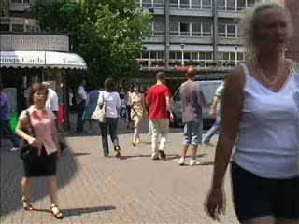
Exercise 3
Watch this clip a few times. Start by simply saying what happens.

Slide 25
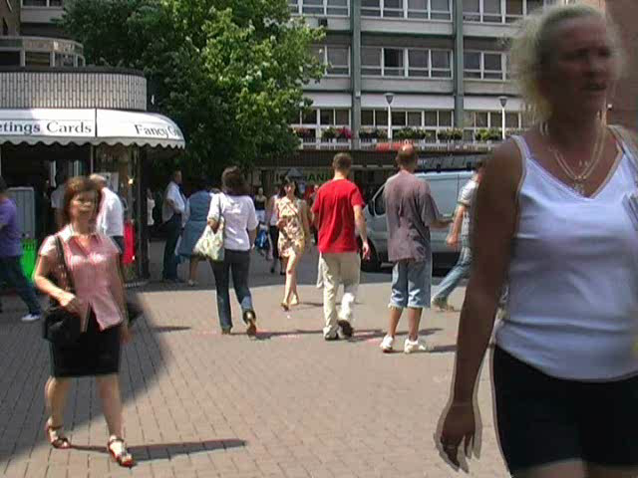

Slide 26
S: hello:. the big ↑issue
(1.2)
C: (no) change
(.2)
S: >I get- I’ve got some
change<
(3.6)
C: [[↑oh I have (got) some
S: [[(yes’I have)]
C: c:hange ( )
(.)
S: have you okay

Slide 27
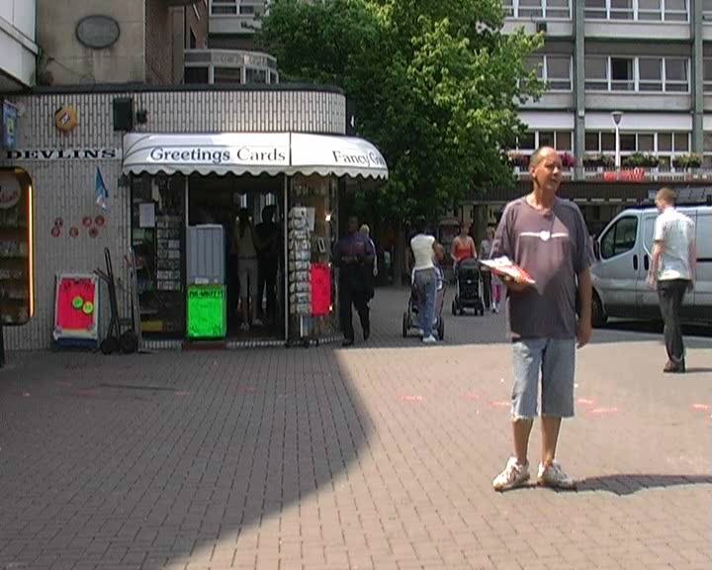

Slide 28
The exercise
Discourses, practices and experiences

Slide 29
Summary
Across the module there will be common themes, and common differences.
We hope you’ll approach the materials with an open mind. If you are a ‘numbers person’, and find it frustrating, tell us why.
Keep checking the website for materials and readings.

