Slide 1
Documentary Analysis
Extracting Knowledge & Meaning from Documents Content Analysis & Grounded Theory
Dr David C Arnott
Principal Teaching Fellow – WBS
David.Arnott@wbs.ac.uk

Slide 2
How many of you anticipate using documentary analysis as a primary research methodology?
How many of you are required to include a literature review in your thesis?

Slide 3
Analyze / Interpret this!
Mary had a little lamb, its fleece was white as snow
And everywhere that Mary went, the lamb was sure to go
It followed her to school one day, which was against the rule;
It made the children laugh and play, to see a lamb at school.
And so the teacher turned it out, but still it lingered near,
And waited patiently about ‘til Mary did appear.
“Why does the lamb love Mary so?” the eager children cry;
“Why, Mary loves the lamb, you know” the teacher did reply.

Slide 4
Questions
What was your starting point?
From what perspective did you approach the problem?
At what interpretations / conclusions did you arrive?
How?

Slide 5
One Possible Interpretation
This is a child’s nursery rhyme in which an image of innocent devotion is depicted in a story of a lamb’s inseparability from its mistress. The strength of “devotion” is indicated by repetition (“everywhere”, “sure to go”, “lingered near”, “waited patiently”), thus stressing the lamb’s consistency. The concept of “innocence” is presented in the image of “a young lamb” and “white as snow”, both being western images related to purity and innocence. By presenting the linkage as something natural and good, “innocent devotion” or loyalty is conveyed as a positive relationship.
Reciprocal and unconditional love as a key theme is indicated also by a willingness to break the rules, by lingering (despite the implied danger) and by patience (despite the uncertainty), and in the last two lines of the verse.
If the socialisation of children is affected by what they hear in their early years then such rhymes may have a positive effect on a child’s interaction with its social groups and so parents and teachers should be encouraged to use such rhymes.
Of necessity, this sets up a possible counterpoint, in that some rhymes have a darker or more sinister theme (e.g. Oranges & Lemons, which concludes with the line “here comes the headsman to chop off your head”). The question of how such rhymes affect the psychological development of children may be worth investigating.
Etc., etc..

Slide 6
And another (simpler, non academic?) comment
“… The words of the American nursery rhyme Mary had a little lamb would appeal to a small children and introduces imagery of similes (white as snow) as part of use of the English language. The words also convey the hopeful adage that love is reciprocated! No specific historical connection can be traced to the words of Mary had a little lamb but it can be confirmed that the song Mary had a little lamb is American as the words were written by Sarah Hale, of Boston, in 1830. An interesting historical note about this rhyme - the words of Mary had a Little Lamb were the first ever recorded by Thomas Edison, on tin foil, on his phonograph …”
(Source: Nursery Rhyme Lyrics, Origins & History, http://www.rhymes.org.uk)

Slide 7
Session Overview
What is a Document and ‘Document(ary) Analysis’?
Foundations of Document(ary) Analysis
Approaches to Coding Document(ary) Data
Exercises:
Content Analysis approach
Grounded Theory approach

Slide 8
Document Analysis
Is not, normally, concerned with basic linguistic structure!
It is concerned with the classification of content into themes (or categories) and the extraction of concepts and constructs … (Prior, 2003)
“… the purpose of document analysis is to arrive at an understanding of the meaning and significance of what a document contains …”(Scott, 1990, p28)
Scott’s approach is broader, and implies needing skills in palaeography and philology if examining historical documents!

Slide 9
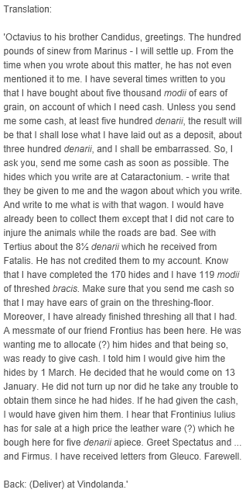
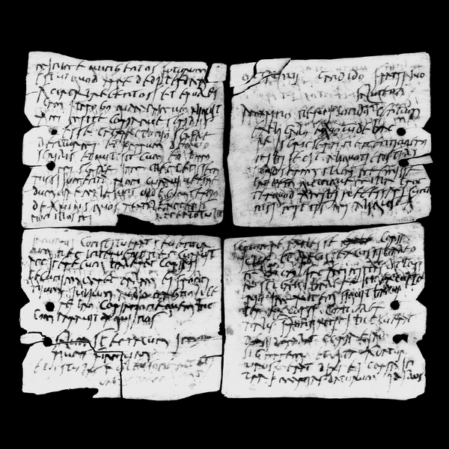
Tablets from Vindolanda
(circa 100 a.d.)
(Source: British Museum)

Slide 10
Translation from the Domesday Book, 1086
“… In Ferncumbe Hundret …
… The same count [Meulan] holds Claverdone. Boui [or Bovi] held it, and was a free man. There are three hides. There is land for 5 ploughs. In the demesne is 1 [plough]; and 12 villeins with a priest and 14 bordars have 5 ploughs. There are 3 serfs and 18 acres of meadow. And 1 league of wood when it bears … is worth 10 shillings [per annum] …

Slide 11
A document is…
“… the traces which have been left by the thoughts and actions of men [sic] of former times …” (Langlois & Seignobos, 1908)
“… an artefact which has as its central feature, an inscribed text …” (Scott, 1990)

Slide 12
… and Text, in this context, is …
Script, Pictorial, ANY representation of a spoken language
Therefore, excludes
Natural objects, artefacts,
Coins, clocks, etc.,
Questionnaires, Interview transcripts (unless historic)
??? Stamps, cheques/stubs, ticket stubs, gravestones, etc.

Slide 13
Proximate access to data
Two dimensions
Channel (Visual, Aural & Feeling – but last rare or of little value)
Reactivity: Reactive, non reactive
1: Non-reactive/Aural
Everyday conversation
2: Non-reactive/Visual
Non-verbal behaviour (deportment, manner, mannerisms, etc.)
3: Reactive/Aural
Observer questions subjects (e.g. interviews)
4: Reactive/Visual
Eliciting written responses (e.g. questionnaire)

Slide 14
Mediate access to data
Evidence is fixed in some material form
Nature of medium highly variable
Solid/substantial: Houses, clay tables, dead bodies
Less substantial: parchment, paper
Insubstantial: e-mails, blogs
Physical traces; fingerprints on a magazine, contents of dustbin
MOST archaeological evidence is unintentional
Intentional evidence = document

Slide 15
Two Classes of Text (Scott, 1990)
Documents:
Exclusively for the purposes of action
Express purpose = basis of or assist the activities of an individual, community or organisation
Contemporary Literature
Catchall for everything else!
Treatises, sermons, newspapers, poems, biographies, novels, etc., etc.
Both are of use (e.g. literature may add colour to facts)
Both are purposive
Purpose = that of the AUTHOR, i.e. their intent
Meaning = that of the READER, i.e. their interpretation

Slide 16
The Communication Process
Sender
NOISE
Encoding
Media
& Message
Feedback
Decoding
Receiver
Communication: “… who said what, to whom, why, how, and with what effect …”
(Berelson, 1952, p1)

Slide 17
The Real Communication Process
E
M&M
E
S
E
M&M
M&M
D
D
D
NOISE
D
D
D
M&M
M&M
E
R
E
M&M
E

Slide 18
Basic Linguistic Structure
Typically, in the English language, elements of theme precede elements of rheme and form a thematically progressive structure.
Theme (or topic)
Part of a sentence, usually relating to previous discourse or shared knowledge, that is developed or elaborated upon in the remainder of the sentence; Parts related in some way to the preceding text or to the environment in which the discourse takes place; what the writer is going to talk about …”
Rheme
‘… information that is in some way ‘new’ to the hearer or reader or which is otherwise unpredictable from what has been said or written already … what the [writer] wishes to say about it”

Slide 19
For example …
The man (from Coventry) (sold (a car)) (to the student)
man
Agentive
(indicating the agent of the verb)
sell
Objective (indicating the object of the verb)
car
Locative
(indicating place or direction)
Receptive
(indicating recipient of act or object)
Coventry
student
Notes:
agentive [ˈeɪdʒəntɪv], agential [eɪˈdʒɛnʃəl] Grammar adj
1. (Linguistics / Grammar) (in some inflected languages) denoting a case of nouns, etc., indicating the agent described by the verb
2. (Linguistics) (of a speech element) indicating agency ``-er'' in ``worker'' is an agentive suffix
n (Linguistics / Grammar) a. the agentive case
locative [ˈlɒkətɪv] Grammar adj
1. (Linguistics / Grammar) (of a word or phrase) indicating place or direction
2. (Linguistics / Grammar) denoting a case of nouns, etc., that refers to the place at which the action described by the verb occurs
b. a word or element in the agentive case

Slide 20
Simple Thematic Progression
T₁
R₁ [= T₂]
Linear
T₂
R₂ [= T₃]
The student was reading a book. It was about documentary analysis. This is a term with many possible meanings
T₃
R₃
Parallel
T₁
R₁
T₁
R₂
The student was reading a book. She had borrowed it from the library. She was studying at Warwick.
T₁
R₃

Slide 21
More typical thematic progression
Hybrid
T₁
R₁ =
[R’₁ (=T₂)]
+ [R’’₁ (=T₂₎)]
T₂
R₂
T₂
R₃
T₃
R₄
In the social sciences, the epistemological spectrum ranges from realism to social constructionism. Realism is … Social constructionism is …
T₃
R₅

Slide 22
Themes and Rhemes
Mary had a little lamb, its fleece was white as snow
And everywhere that Mary went, the lamb was sure to go
It followed her to school one day, which was against the rule;
It made the children laugh and play, to see a lamb at school.
And so the teacher turned it out, but still it lingered near,
And waited patiently about ‘til Mary did appear.
“Why does the lamb love Mary so?” the eager children cry;
“Why, Mary loves the lamb, you know” the teacher did reply.

Slide 23
Documentary Analysis is …
… the analysis of ‘text’, where ‘text’:
Can exist in any medium of communication
Can be verbal, non-verbal or both
Is an assemblage of signs
Is recorded
Is constructed (by its sender) and interpreted (by its receiver) within the conventions of its context, culture, genre and medium
Is physically independent of sender or receiver! AND (IDEALLY) OF RESEARCHER!
Notes:
(mass: internet, TV, radio, press, books, film, etc.; interpersonal: letter, e-mail, fax, e-mail, video-conferencing, social network sites, etc.)
(words, images, sounds, gestures)
(written, audio, video, graphical, etc.)

Slide 24
Underlying Assumptions
Documents are authored and/or created
The author(s)/creator(s) had an audience in mind
The description and analysis of communication (content) is both meaningful and useful in developing concepts and theories
The study of message or communication (content) and of the linguistic tools used in relation to its antecedents, creation, encoding, distribution, decoding, and consequences (especially within context) is meaningful
Inferences about a relationship between intent and content or content and effect can be made and/or that the relationship actually exists.

Slide 25
Forms of Documentary Analysis
Topic | What it is | Originating authors
Semantics | What ‘signs’ mean | ???
Semiotics | How ‘signs’ mean and come to mean | Saussure, 1900s
Discourse analysis | Understanding of natural language usage in relation to genre, dimensions, syntactics, power, context, cognition, memory, meaning, etc. | Leo Spitzer, 1928; Zellig Harris, 1952
Conversation analysis | How ‘talk’ makes things happen | Harvey Sacks, 1960’s
Narrative analysis | The ways in which people make and use stories (as social constructions) to interpret and make sense of the world | Propp, 1968; Labov, 1973

Slide 26
Forms of documentary analysis (cont)
Topic | What it is | Originating authors
‘traditional’ content analysis | “… the statistical semantics of political discourse …” (Kaplan, 1943) “… who says what, to whom, why, how, and with what effect …” (Berelson, 1952) “… a summarizing, quantitative analysis of messages that relies on the scientific method … and is not limited to the types of variables … or context in which the messages are created or presented …” (Neuendorf, 2002) | Laswell, 1930’s; Kaplan, 1943; Berelson, 1952
Qualitative content analysis | “… a research method for the subjective interpretation of the content of text data through the systematic classification process of coding and identifying themes or patterns …” (Hsieh & Shannon, 2005) | Ritsert, 1972; Mostyn, 1985; Wittkowski, 1994; Altheide, 1996.
Grounded theory | The systematic generation (development, discovery) of representations of reality (theory, models, concepts, frameworks, etc.) via analysis of data (induction). | Laswell, 1930’s; Glaser & Strauss, 1967

Slide 27
Types of documents (examples only)
 |  | Authorship
 |  | Personal | Official - Private | Official – State
Access | Closed | Letters, diaries, household a/c | Medical records | Official Secrets Act documents
 | Restricted | Records of landed estates | Internal company memos, reports | British Royal Family papers (need Monarch’s permission)
 | Open - archived | Wealthy family documents, modern records libraries | Companies house | Public Records Office, Library of Congress, GRO
 | Open - published | Diary, memoir, (auto) biography | Annual reports | Hansard, Acts of Parliament, Census, Statistics
(Adapted from Scott, 1990)

Slide 28
Some absolutes and essentials
There are NO shortcuts;
There is NO substitute for complete familiarity with your data; hence no substitute for several readings of your data!
There are NO preset formulae for content (or any qualitative) analysis
The unit of analysis must be suitable (large enough to be considered as a whole; small enough to be kept in mind as a context for meaning)
Manifest &/or latent (silence, sighs, posture, laughter, reticence, etc.) content?
Analysis, simplification and categorisation that reflect phenomenon in a reliable way
Categories that are conceptually and empirically grounded (Dey, 1993).
Defensible inferences can only be based on valid and reliable data (Weber, 1990)
Link between results and data must be demonstrable

Slide 29
Pros and Cons of Documentary Analysis
PRO
Unobtrusive
Non-reactive
Unaffected by researcher
Basis for:
Triangulation
Comparison
Contrast
Encourages ingenuity
Permits longitudinal studies
CON
Selection of what to analyse
No or little influence on methods/methodology
Difficulties in identifying provenance &/or authors
Identifying possible biases
Establishing validity/reliability
Access to key works
Ethics (if works are ‘private’ – e.g. medical records)

Slide 30
Generic Stages Of Documentary Analysis
Define problem/question being investigated
Define population of type ‘documents’ to be analysed
Decide on unit of analysis (word, phrase, paragraph, document, meaning, explicit/implicit, relationships, etc.)
Define sampling strategy and assemble sample for analysis
Determine coding strategy (from the data or pre-defined categories)
Develop coding dictionary/scheme
[Train 2 or more independent coders]
Code material
[Assess inter-coder comparators and recode if necessary]
Analyse and interpret the coded material
Write up findings

Slide 31
Analysis is a Search for Themes
Opler’s (1945) view of themes
Theme’s are manifestations of expressions (what is visible or audible)
Corollary: Expressions are meaningless without themes
Themes might be:
Obvious and culturally agreed (e.g. red traffic light means stop); OR
Subtle, symbolic, idiosyncratic
Cultural systems are sets of interrelated themes, e.g.
How often; How pervasive; How people react to violation; Degree to which number, force, variety of expressions are controlled by social context
Notes:
Opler, M. E. 1945. Themes as dynamic forces in culture. American Journal of Sociology 5:198–206.

Slide 32


What themes are evident in these images?

Slide 33
More recent views on expressions and themes
Expressions referred to as:
Incidents (Glaser & Strauss, 1967)
Thematic units (Krippendorf, 1980)
Units (Guba & Lincoln, 1985)
Concepts (Strauss & Corbin, 1990)
Segments (Tesch, 1990)
Data-bits (Dey, 1993)
Chunks (Miles & Huberman, 1994)
Etc., etc.
Themes referred to as:
Categories (Glaser & Strauss, 1967)
Labels (Dey 1993)
Codes (Miles & Huberman, 1994)
“... abstract ...fuzzy constructs that link ... expressions found in texts ... images, sounds and objects ...” (Ryan & Bernard, 2005, p87)
Etc., etc.

Slide 34
Themes …
… range from broad sweeping generalizations that categorize many kinds of expressions to narrow and focussed linkages between specific expressions
… may be derived from a researcher’s understanding of the phenomenon being studied (cf content analysis) OR via induction from empirical data (cf grounded theory) (or a combination)
… answers the question “Of what is this expression an example?” (How might we categorise this expression)

Slide 35
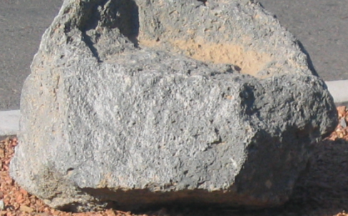






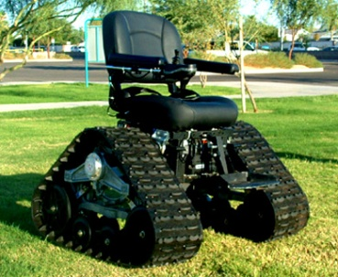



Of what is this expression an example?
…so when is a chair not a chair?

Slide 36
Sources of themes
A priori
Researchers understanding of the phenomena
Professionally agreed definitions in literature
Local and common sense constructs
Values, orientations and experiences of the researcher
Induction from empirical data via:
latent coding (e.g. content analysis)
open coding (e.g. grounded theory)

Slide 37
Two basic approaches
Analysis for Content (content analysis)
Assumes content (what is included and excluded, repetitions, structure, etc.) have something to say about the documents themselves and their intended meaning
Analysis for Meaning (narrative and/or discourse analysis)
Assumes documents were authored and created deliberately with an audience in mind and how things are said has something to say about the author and/or the audience

Slide 38
Identifying Themes: Scrutiny
Repetitions/regularities/patterns
Indigenous typologies (unfamiliar terms)
Metaphors/analogies
Transitions (breaks in communications)
Similarities/differences (phrase, paragraph, whole)
Linguistic connectors (causal, conditional, taxonomic, temporal, negation)
Missing data (what and why)
Theory related material (data linked to key questions in your field – e.g. conflict, contradiction, control, status, problem solving, etc.)

Slide 39
Identifying themes: Scrutiny techniques
Repetitions
Reoccurrences, regularities, patterns, synonyms, antonyms, frequency
Indigenous typologies:
Terms that sound strange or are unfamiliar
Jacob’s Feast, Jacob’s Join, Bring & share, Potluck supper
Metaphors/Analogies
Occidental argument = war; oriental argument = dance
A marriage as: ‘solid as the Rock of Gibraltar’, ‘ a ball and chain’

Slide 40
Scrutiny techniques (cont)
Transitions = ‘naturally occurring shifts’
Paragraph breaks, pauses, turn taking, hesitations, interruptions, etc.
Similarities/differences (cf GT ‘constant comparison’)
What is sentence/phrase about; how is it similar to/different from preceding/following sentence/phrase
Pairs of expressions (same or different respondents); How is one different from the other?
Whole texts. How do they differ? What if they were written by a different author (e.g. Female, Aborigine, …)?

Slide 41
Scrutiny Techniques (cont)
Linguistic connectors (e.g.)
Causal (because, therefore, since, hence, as a result, …)
Conditional (if, then, instead, …)
Taxonomic (= ‘is’; A is a kind of B)
Time (before, then, after, next, later, latterly, …)
Negation (no, non-, im-, un-, il-, …)
Many other possible listings: see Casagrande & Hale, 1967; Lindsay & Norman, 1972; Werner & Schoepfle, 1987; etc.

Slide 42
Scrutiny Techniques
Missing data (what is omitted/reason for omission)
Deliberate or unintentional?
Everyone knows, assumptions, cultural norms, givens, etc. Try translation into a different world view; gaps = possible themes.
Lack of trust in researcher?
Reticence in presence of others?
Misunderstanding the question?
Unwilling to say vs Assuming researcher knows?

Slide 43
Scrutiny techniques (cont.)
Theory related materials
How does data relate to key questions in social science
Social conflict; Cultural contradictions; Informal methods of social control ; Management of impersonal social relationships; Acquisition and maintenance of achieved and ascribed status or power; How people solve problems
Setting & context; Informant’s perspective; Informant’s ways of thinking about people, objects, processes, activities, events, realtionships.
Etc

Slide 44
Identifying Themes: Processing
Cut and sort (literally)
Word lists and Key words in context (KWIC)
Word co-occurrence/co-location
Metacoding (looking at a prior themes for new themes – needs fixed data and fixed a priori themes)

Slide 45
Data vs Technique
Text data: All applicable
Graphic, sounds, objects: only half applicable
Repetitions, Similarities, Missing data, Theory related; & Cut and sort, Metacoding
Field notes: already filtered by researcher so careful
Rich data: All except metacoding
Short texts: Transitions, metaphors, linguistic connectors & theory related NOT useful
Short open ended questions: Missing data NOT good

Slide 46
Document Analysis: Choosing a theme-identification technique
Textual data?
Scrutiny techniques
1: Repetition
2: Indigenous typologies
3: Metaphor/analogy
4: Transitions
5: Similarity/difference
6: Linguistic connectors
7: Missing data
8: Theory-related material
Processing techniques
9: Cutting & sorting
10: Word list/KWIC
11: Word co-occurrence
12: Metacoding
No
Yes
Easy: 1;5;9
Hard: 7;8;12
Verbatim text?
No
Yes
Easy: 1;5;9
Rich narrative?
No
Brief descriptions?
(1-2 paragraphs)
Yes
Yes
No
Easy: 1;4;5;9
Hard: 2;3;6;7;8, 10;11
Easy: 1;5;9
Hard: 2;3;7;8; 10;11;12
Easy: 1;5;9
Hard: 2;10;11
(Adapted from: Ryan & Bernard, 2005)

Slide 47
Assessing Quality of Documentary Evidence
Authenticity
Is it genuine? Of unquestionable origin?
No authenticity = impossibility of informed judgement!
Representativeness
Is it typical of its kind?
Typicality is not the key; Knowing how typical is key!
Credibility
Is it free from error, bias, distortion
Error, evasion = Cannot convince secondary analysis
Meaning
Is it clear and comprehensible?
Is ‘hooliganism’ ritualised aggression or real violence
(Scott, 1990)

Slide 48
Authenticity: Soundness & Authorship
Is it sound (original or copy)?
If copy is it accurate or modified?
If modified, how and why?
Authenticate names, dates, places
Internal evidence
Vocabulary, style
External evidence
Chemical tests on ink/paper
Examination of hand writing
Matching known facts to claims
Plausibility (of author having knowledge, relative to authors known views, etc.)
Validations (by/vs other analysts)

Slide 49
Representativeness: Survival & Availabilty
Survival
Requires depositing in survivable form in survivable storage
Everything subject to accidental or deliberate loss/destruction (e.g. official ‘weeding’ of files; accidental misfiling)
Time = aging, deterioration, decay, destruction
Availability
Who controls archive? How public is archive?
How many and what type of original documents were there?
Is the catalogue/index complete?
How was the archive constructed (systematic, ad hoc)?
How do you sample when no listing of documents exists?

Slide 50
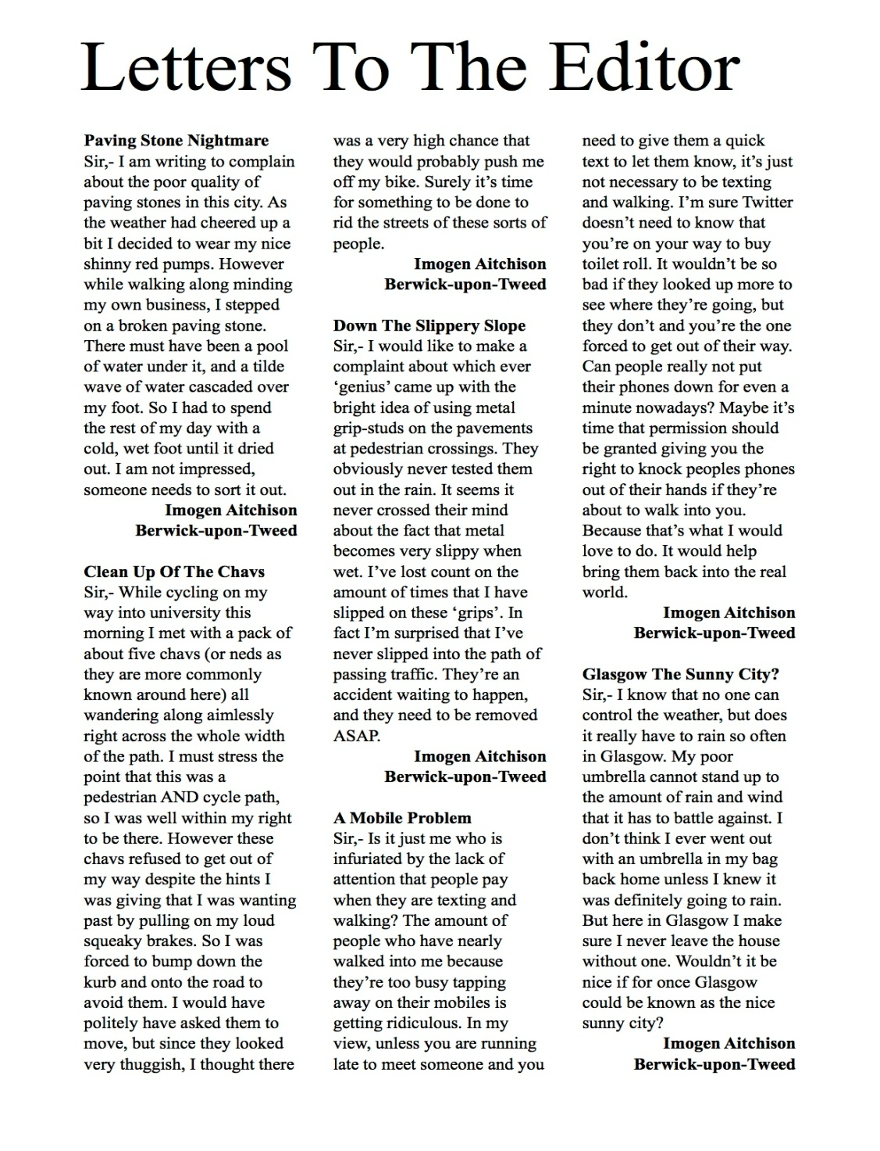
Representative or not representative?
Why? Why not?

Slide 51
Representativeness
“… a single reference to a phenomenon may indicate the start of a trend, or the existence of a pattern, but it may be just historically idiosyncratic …” (Scott, 1990, p28)

Slide 52
Credibility: Sincerity and Accuracy
ALL social accounts contain distortions!!!
Approach all document analysis with academic scepticism = distrust everything unless there is a reason to believe it
Sincerity
What is the author’s purpose? Why was it written?
What is the author’s material interest in producing the document?
What, if any, practical advantage might the author achieve by deceipt?
Accuracy
Spatial and temporal proximity to events being reported
Lapses in memory; time lapse between event and recording
Inadequate records/sources; How recorded; Expertise in data handling
Even primary and proximate sources can be inaccurate

Slide 53
Meaning: Literal & Interpretive
Literal
What words designate ⇒ translate to more precise contemporary usage
Dates: Julian, Gregorian, Regnal
21st February 1750 (Julian) = 21st February 1751 (Gregorian) = 21st February 24GeorgeII (regnal)
Interpretive
Hermeneutic process (relating literal meaning to context)
Individual concepts; social & cultural contexts; judgement re significance
Definitions (e.g. changes in unemployment figures)
Recording practices (what is recorded – e.g. census data)
Genre (e.g. Official Reports vs Party Manifesto’s vs Personal Diary)
Stylisation (conscious/unconscious use of literary forms and embellishments; use of allegory, allusion, irony, etc.)

Slide 54
Hermeneutic Circle
“… the comprehension of a text by understanding the framework of reference from which it is produced, and appreciating that frame of reference by understanding the text …”
Competing approaches:
Barthes (1967): Coherence of interpretation
Althusser (1969): Use of appropriate ‘scientific’ tools
Scott (1990): “… the text is an objective cultural entity, … is ephemeral and must be reunited with the intention of the author and the perspective of its audience …”

Slide 55
Qualitative Data Construction, Sampling & Measurement
Data construction
Methods and procedures for derivation of data from evidence of known quality
Sampling
Sampling theory is well established and approach does not differ in a qualitative context
Measurement
No single, widely accepted theory for the ‘measurement of meaning’
= coding and classifying source materials into theoretically defined categories required fro the researcher’s purposes
Coding = ways of operationalising theoretical constructs
Categories (ideally) = exhaustive and mutually exclusive.

Slide 56
Coding Process for Qualitative Data: (Tesch, 1990, pp142-145)
Read all. Get a sense of the data set. Jot down initial thoughts
Pick one (any one). Read in detail. Answer “What is this about?”. Look for ‘underlying meaning’.
Repeat 2 for several sources. List all identified topics. Cluster similar topics. Group into ‘major’, unique’, ‘leftovers’.
Abbreviate topics to ‘codes’. Write appropriate code next to each section of text. Do new categories or codes emerge?
Identify most descriptive wording for your topics. Turn them into categories. Look for ways of reducing categories.
Decide on final abbreviation for each category. Alphabetize.
Assemble data/material for each category into one place. Do preliminary analysis of all remaining data.
If necessary, recode all your existing data.

Slide 57
Coding Process for Qualitative Data: (Bogden & Bicklen, 1992, p166-172)
Seek to assign (code) data to:
Settings & contexts
Perspectives held by subjects
Subjects ways of thinking about people and objects
Processes
Activities
Strategies
Relationships and social structures
Pre-assigned coding scheme
Note: these categories are not mutually exclusive

Slide 58
Coding process for documentary data
Other possible coding categories:
Topics that you expect from:
Prior research
Common sense
Surprising/unanticipated
Unusual or of conceptual interest
Address a larger theoretical perspective

Slide 59
Should we …
Code only on emergent information and themes?
Code only on predetermined codes?
Use a hybrid?
The traditional approach = A (especially if adopting an interpretive stance)

Slide 60
Reliability and validity in qualitative research
Reliability:
Check for obvious transcription errors
Ensure no ‘drift’ in meaning of codes
With teams, use regular meetings and share analyses
Look at/for inter-coder consistency
Validity
Triangulate
Check interpretation with subjects
Use rich, thick description (avoid short cuts/abbreviations)
Clarify areas of possible bias
Present –ve and +ve
Spend long enough in the field
Use peer debreifing and external auditors (to check your logic)

Slide 61
Content Analysis

Slide 62
Content Analysis: Qualitative or Quantitative?
IF knowledge of phenomenon is:
Based on prior knowledge/models, Theory testing
THEN Quantitative (deductive) approach
= General and conceptual to specific and contextual
IF knowledge of phenomenon is:
Fragmented, Incomplete, or Non-existent
THEN Qualitative (inductive) approach
= Specific and contextual to general and conceptual

Slide 63
The three CA ‘objects of enquiry’
Message (content of the material)
E.g. Disability or gender portrayal in advertising
Sender (what is interesting about the author)
E.g. Beliefs, Political stance, Commonalities, Differences
Receiver/audience (for whom was the message intended, what is interesting about the audience)
E.g. Effectiveness of advertising in key time slots

Slide 64
Coding Process for Content Analysis: After theorising, conceptualising, and hypothesising
Identify sources and collect sample
Specify ‘unit’ of analysis (word, line, sentence, paragraph, whole)
Select one source (any one)
Identify ‘categories’ items and characteristics of the text of relevance to the research purpose
(Repeat 2 and 3 until an exhaustive listing is developed)
Create ‘coding dictionary’ (definitions of and synonyms for each and every category)
Train and use independent coders to code sub-sample of data
Check for inter-coder reliability; explore reasons for differences
Review and revise coding scheme and retest
Apply to whole sample, recheck intercoder reliability, interpret the data

Slide 65
Typical Traditional Content Analysis Process?
Theory & Rationale
Conceptualisation
Operational ‘measures’
Coding scheme (human or computer)
Training & initial reliability
Full coding
Final reliability testing
Analysis, Tabulation and Reporting
Adapted from: Neuendorf, 2001
Notes:
Theory & Rationale
What content, Why, Relevant theories or concepts, Conceptual or Relational,
What are the research questions, What are the Hypotheses
Method: Library search
Conceptualisation:
You’re the boss, no one right way.
What variables, how are variables defined (conceptually)
Method: Screen/check examples to ensure scope of variables are covered
Operationalisation:
What measures, What unit of analysis, What categories, What level of measurement,
Are units exhaustive and mutually exclusive, Develop a coding scheme
Coding scheme
Human: Complete and detailed code book & coding forms
Computer: Complete coding dictionary – extant or original

Slide 66
What is Content Analysis?
“… the statistical semantics of political discourse …” (Kaplan, 1943, p230)
“… a research technique for the objective, systematic, and quantitative description of the manifest content of communication …” (Berelson, 1952, p18)
“… a multipurpose research method developed specifically for investigating any problem in which the content of the communication serves as the basis for inference …” (Holsti, 1969, p2)
“… is a summarising, quantitative analysis of messages that relies on the scientific method (including attention to objectivity, intersubjectivity, a priori design, reliability, validity, generalizability, replicability, and hypothesis testing) and is not limited as to the types of variables that may be measured or the context in which the messages are created or presented …“ (Neuendorf, 2002, p10)
Notes:
Assumptions about Content Analysis
Inferences about a relationship between intent and content or content and effect can be made or the relationship actually exists.
The study of content is meaningful
The description communication content is meaningful

Slide 67
What is content analysis?
“... a research method for making replicable and valid inferences from data to their context, with the purpose of providing knowledge, new insights, a representation of facts and a practical guide to action (Krippendorff, 1980) ...” (Elo & Kyngas, 2007)
“... content analysis is codified common sense, a refinement of ways that might be used by laypersons to describe and explain aspects of the world about them ...” (Robson, 2011)

Slide 68
Why Use Content Analysis?
Directly analyses communication via texts or images
Allows for both quantitative and qualitative operations
Can provide historical/cultural insights over time
Allows a closeness to text
Permits alternation between categories and relationships
Allows statistical analysis of coded form of the text
Can be used to interpret texts for (e.g.) expert systems (knowledge and rules can both be coded)
Unobtrusive analysis of interactions
Provides insight into complexities of thought and language use

Slide 69
Some Reasons For Avoiding Content Analysis
Can be extremely time consuming
Subject to increased error as relational inferences becomes more abstract
Is (too) often devoid of any theoretical underpinning
Often used to make too liberal inferences about relationships
It is inherently reductive
Far too often it simply consists of word counts
Frequent disregard of the context that produced the text &/or the post production usage context
Can be difficult to automate esp for non-verbal or non-content (i.e. omitted or implicit)

Slide 70
What Problems Suit Content Analysis?
Five Basic Categories
Communication characteristics (substance, form)
Issues relating to producers of content
Issues relating to consumers of content (audience)
Effects or consequences of communication
Non-verbal communication

Slide 71
Purpose | Comparison | Typical question | Typical research problem
Describing characteristics of the document(s) | Message source A: Variation of X over time Variation of X over situations Variation of X over audiences Variation of X and Y within sample | What? | Trends Relate source characteristics to message Audit content against standards
 | Message source type A vs message source type B | How? | Persuasion techniques Style analysis
 | Standard message: A priori; Content; Non-content | To whom? | Relate audience to intended message Patterns of communication
Inferences re antecedents of the documents’ creation | Message vs non-symbolic behavioural data Direct Indirect | Why? | Political/military intelligence Psychological traits Cultural differences Legal evidence
 |  | Who? | Disputed authorship Beliefs/intentions of sender
Inference re effects of document on recipient or society | Message sent vs message received Message sent vs recipient behaviour | With what effect | Readability Information flow Response to communication
(Adapted from Holsti 1969)

Slide 72
Purpose | Research focus | Question | Uses
Inferences about antecedents | Source | Who | Disputed authorship
 | Encoding process | Why | Political and military intelligence Individual traits/beliefs Cultural differences and change Legal and evaluative evidence
Inferences about the message itself | Channel | How | Persuasion techniques Analysis of style
 | Message | What | Trends in content Relating characteristics of source to message produced by source Compare content with a standard
 | Recipient | To whom | Relate characteristics of target audience to the message aimed at them Establish patterns
Inferences about consequences | Decoding process | With what effect | Readability Information flow Responses to message
(Sources: Berelson, 1952; Holsti, 1969; Krippendorf, 1971; Neuendorf, 2002)

Slide 73
 | Quantitative/Traditional | Qualitative/Ethnographic
Research goal | Verification | Discovery, verification
Reflexive research design | Seldom | Always
Emphasis | Reliability | Validity
Progression (data - analysis -interpretation) | Serial | Reflexive, circular
Primary researcher involvement | Analysis & interpretation | All phases
Sampling | Random or stratified | Purposive & theoretical
Pre-structured categories | All | Some or none
Training required to collect data | Little | Substantial
Type of data | Numerical | Numerical, Narrative
Data entry points | Once | Multiple
Narrative comments | Seldom | Always
Concept emerging during research | Seldom | Always
Data analysis | Statistical | Textual, Statistical
Data presentation | Tabular | Tabular, Textual, Graphical
(Adapted from Altheide 1987)

Slide 74
Leise (2005) 11 Website Analysis Heuristics
Collocation
Differentiation
Completeness
Information scent
Bounded horizons
Accessibility
Multiple access paths
Appropriate structure
Consistency
Audience-relevance
Currency

Slide 75
Conceptual vs Relational Analysis
Conceptual analysis
Relational analysis
Decide
Level of analysis.
how many concepts need coding.
whether to code for existence or frequency of a concept.
how you will distinguish among concepts.
Develop rules for coding
What do you do with "irrelevant" information.
Code the text
Analyze results
Identify the question.
Select sample for analysis.
Determine type of analysis needed.
Reduce the text to categories and code for words or patterns.
Explore the relationships between categories or concepts (i.e. strength, sign, direction).
Code the relationships.
Perform analysis.
Map out the results
Source: http://writing.colostate.edu

Slide 76
Types of qualitative content analysis
Type of Content Analysis | Study begins with … | Timing of defining codes or keywords | Source of codes or keywords
Conventional | Observation | During analysis | Data
Directed | Theory | Before and during analysis | Theory and other relevant research
Summative | Keywords | Before (and during) analysis | Researcher’s interest &/or literature review
(Hseih & Shannon, 2005, p1286)

Slide 77
Typical (?Erroneous) CA Approach
Hello All, I am beginning a project that involves a content analysis of articles about various firms. These articles are retrieved by running a search in an article database that produces the relevant articles. Once they are retrieved, I need to copy/paste them onto a word file that can be edited and then fed into a content analysis software program. I would appreciate any ideas about how to structure this sequence, in particular the conversion of the articles from web based docs to word docs. Is there a program that does this automatically?
This is a real example of a query from a PhD student via a content analysis discussion forum.

Slide 78
And Here’s One Reply …
In which format are the articles coming out of the data base? Plain text, RTF, HTML? … there are a few filters for converting HTML into different formats, and your goal - content analysis - requires that you have plain text files. You can edit these with an editor (e.g. NotePad WordPad, TextPad or the like) easily. You also make up your mind how to structure your data:
what is the text unit? (e.g. line,sentence, article) which external variables are necessary? (e.g. date, source, author)
Then you can select the appropriate software, for an overview consult http://www.textanalysis.info if you haven't done so. A few MS-DOS based programs are free or public domain (e.g. vb-pro, INTEXT).
My response would have been: FOFO

Slide 79
Grounded Theory

Slide 80
What about Grounded Theory?
Derives ‘theory’ from data (i.e. classic induction)
Appropriate only when little or no theory exists
Typically uses ethnographic, interview, or similar data sources (i.e. high researcher involvement)
Seeks to conceptualise and understand the world from the subject’s point of view.

Slide 81
Coding Process in Grounded Theory
Analysis is a 3 stage process:
Open coding
Assigning of individual or multiple codes to selected elements of the text (words, phrases, sentences, paragraphs, sections)
Coding commences with and continues throughout data collection
Sample size dependent on theoretical sampling (no more new ideas emerging)
Requires slavish adherence to an iterative, constant comparison of codes and coding for consistency, coherence, sense-making, understandability, communcability, etc., etc.

Slide 82
Coding in Grounded Theory (cont)
Axial coding
The grouping of open coded text to subjectively inter-related constructs or concepts and by apparent levels of importance
Selective coding
Selection of the constructs and concepts of relevance to the research objects and modelling of the reality being investigates
Interpretation, modelling conceptual relationships, writing up (see your Binder & Edwards reading)

Slide 83
Final Thought: Faced with Big Data created by online messaging, ICT professionals and companies are seeking ways of using ‘natural language processing’, ‘textual analysis’ and ‘computation linguistics’ for document analysis but not yet perfected (not even close?) Questions?

Slide 84
Exercise 1: Content Analysis
Central Hypothesis
Oriental and occidental businesses adopt different approaches when communicating to shareholders.
The approaches adopted relate to their respective cultural norms
Sample: Chairperson’s statements to shareholders in annual reports, Automotive industry.

Slide 85
Exercise 2: Grounded Theory
Central Question
How do statements by senior management of large commercial businesses affect non-institutional investors perceptions of those businesses?
Is there an underlying conceptual framework for what needs to be said, by whom, how and when?
Sample: Chairperson statements to shareholders appearing in annual reports

