Slide 1
Ethnography: Is it for Me?
An information session
Davide Nicolini

Slide 2
What are we going to talk about?
What is ethnography?
The stages of an ethnographic project
Is it for me? A conversation with two people who are doing it for a PhD

Slide 3
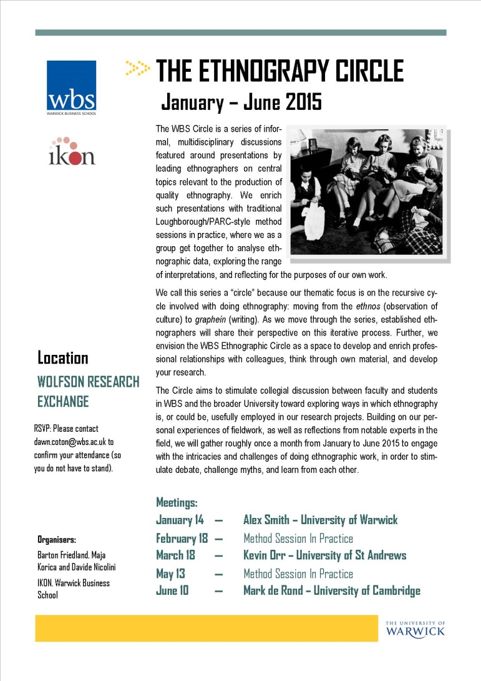
Why this title?

Slide 4
In a nutshell
Ethnographers are in the “reality reconstruction business.”
Schwartz and Jacobs 1979, p.2

Slide 5

Ethnography?

Slide 6
What is ethnography? Procedural definition (1)
“The direct observation of the activity of members of a particular social group, and the description and evaluation of such activity, constitute ethnography.”
Abercrombie, Hill and Turner 1984, p. 90

Slide 7
What is ethnography? Procedural definitions
“Ethnography involves a long period of intimate study and residence in a well-defined community employing a ide range of observational techniques including prolonged face-to-face contact with the members of local groups, direct participation in some of the group's activities, and a greater emphasis on the intensive work with informants than on' the use of documentary or survey data.”
Conklin 1968, p.172

Slide 8
What is ethnography? Methodological definitions
“…a particular method or set of methods. In its most characteristic form it involves the ethnographer participating, overtly or covertly, in people’s daily lives for an extended period of time, watching what happens, listening to what is said, asking questions.”
Hammersley and Atkinson, 1995, p. 1

Slide 9
What is ethnography? Methodological definitions
“ [ethnography] bears a close resemblance to the routine ways in which people make sense of the world in everyday life.”
Hammersley & Atkinson, 1995, p. 6

Slide 10
What is ethnography? A working definition
Ethnography is the study of people in naturally occurring settings or 'fields' by methods of data collection which capture their social meanings and ordinary activities, involving the researcher participating directly in the setting, if not also the activities, in order to collect data in a systematic manner but without meaning being imposed on them externally.
John Brewer, 2000, p.10

Slide 11
Ethnographic Methods family
Participant observation
Covert
Overt
Informal interviews
Life histories
Diaries
Field notes/research diary
Video ethnography
Auto ethnography
…

Slide 12
Distinctive features
People's behaviour is studied in everyday contexts rather than under unnatural or experimental circumstances created by the researcher;
Data are collected by various techniques but primarily by means of observation;
Data collection is flexible and unstructured to avoid pre-fixed arrangements that impose categories on what people say and do;
The focus is normally on a single setting or group and is small-scale; the analysis of the data involves attribution of the meanings of the human actions described and explained
(Atkinson and Hammersley 1998: 110-11).

Slide 13
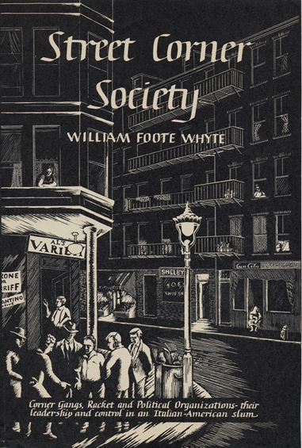
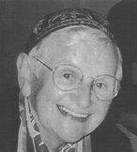
The Origins of Ethnography
Anthropological Ethnography
Malinowski
Geertz
The Chicago School of Sociology
Urban sociology – Whyte; Anderson
The British Ethnographic tradition
Charles and Beatrice Webb
Community Studies
Meg Stacey study of Banbury

Slide 14
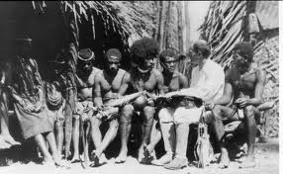
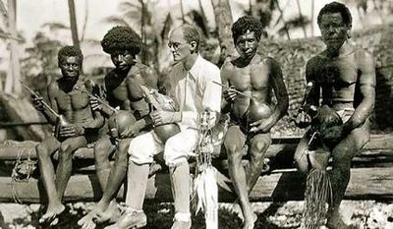
Bronislaw Malinowski (1922) Argonauts of the Western Pacific
In this volume I give an account of one phase of savage life only, in describing certain forms of inter-tribal, traditional relations among the natives of New Guinea. This account has been culled, as a preliminary monograph, from Ethnographic material, covering the whole extent of the tribal culture of one district…
I have lived in that one archipelago for about two years, in the course of three expeditions to New Guinea, during which time I naturally acquired a thorough knowledge of the language. I did my work entirely alone, living for the greater part of the time right in the villages. I therefore had constantly the daily life of the natives before my eyes, while accidental, dramatic occurrences, deaths, quarrels, village brawls, public and ceremonial events, could not escape my notice.

Slide 15
In search of the rules of the Kula
The Kula is a system of socio-economic ceremonial exchange centered on two kinds of valuables, armshells (mwali) and necklaces (soulava).
"an extremely big and complex institution" in which "every movement of the Kula articles, every detail of the transactions is fixed and regulated by a set of traditional rules and conventions." (p.81)

Slide 16
What is ethnography
"The goal of ethnographic field-work must be approached through three avenues:" (24)
"The organisation of the tribe, and the anatomy of its culture must be recorded in firm, clear outline. The method of concrete, statistical documentation is the means through which such an outline has to be given."
"Within this frame, the imponderabilia of actual life, and the type of behaviour have to be filled in. They have to be collected through minute, detailed observations, in the form of some sort of ethnographic diary, made possible by close contact with native life."
"A collection of ethnographic statements, characteristic narratives, typical utterances, items of folk-lore and magical formulae has to be given as a corpus inscriptionum, as documents of native mentality."
"The final goal" of the Ethnographer = "to grasp the native’s point of view, his relation to life, to realise his vision of his world." (25)

Slide 17
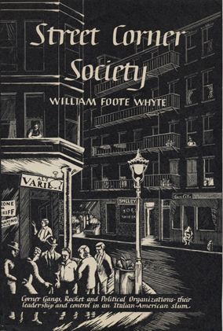
W.F. Whyte: Street Corner Society (1943)
Cornerville (Boston's North End) was home to first and second-generation Italian immigrants. Many were poor and lived economically precarious lives. Popular wisdom in Boston held that Cornerville was a place to avoid: a poor, chaotic slum inhabited by racketeers.
Street Corner Society describes various groups and communities within the district. The author depicts Cornerville as a highly organised community with a distinctive code of values, complex social patterns and particular social conflicts.

Slide 18
Street Corner Society
The first part of the book contains detailed accounts of how local gangs were formed and organized. The opening reads like a novel with a first person narrative as Whyte begins his description of the Nortons, a gang he is 'studying‘.
Whyte differentiated between "corner boys" and "college boys": The lives of the former men revolved around particular street corners and the nearby shops. The college boys, on the other hand, were more interested in good education and moving up the social ladder.

Slide 19
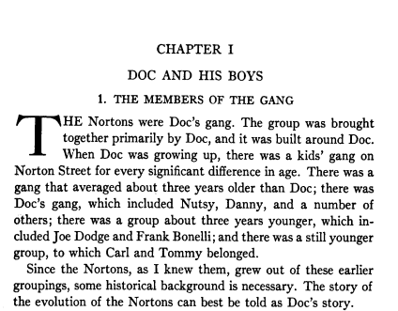

Slide 20
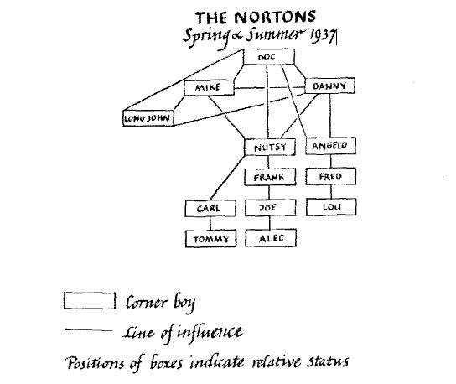
Street Corner Society
Whyte sets up the class struggle in the Italian Community Club as represented by the bowling match between the college boys and the Norton boys. Bowling drew the gang together even more than usual. Whyte is especially concerned about not only describing the game but also the mental landscape of the game for its participants especially in his discussion of confidence which I can only presume he got from his long nights of bowling with the boys.
The second part of the book describes the relations of social structure, politics, and racketeering in that district. It is also a testament to the importance of WPA jobs at the time.
The second part of the book describes the relations of social structure, politics, and racketeering in that district. It is also a testament to the importance of WPA jobs at the time.

Slide 21

Karen Ho: Liquidated: An Ethnography of Wall Street (2009)

Slide 22
C. Geertz: Deep Play: Notes on the Balinese Cockfight (1972)
Despite being illegal, cockfighting is a widespread and highly popular phenomenon in Bali, at least at the time.
Although gambling is a major and central part of the Balinese cockfight, Geertz argues that what is at stake is much more fundamental than just money, namely, prestige and status.
The fight, according to Geertz, is not between individuals but is rather a simulation of the social structure of kinship and social groups.
People never bet against a cock from their own reference group. Fighting always takes place between people (and cocks) from opposing social groups (family, clan, village etc.) and is therefore the most overt manifestation of social rivalry, and a way of addressing these rivalries.
The Balinese cockfight is, as Geertz puts it, a way of playing with fire without getting burned.
https://www.youtube.com/watch?v=KiODahxbux0&playnext=1&list=PL5D075925CCCCB9F1&feature=results_video
https://www.youtube.com/watch?v=7NUkYt5spVk

Slide 23
C. Geertz: Deep Play: Notes on the Balinese Cockfight (1972)
The "deep play" of the Balinese cockfight is like artworks which illustrate an essential insight into our very existence. It is a symbolic manufactured representation of something very real in our social life. It channels aggression and rivalry into an indirect symbolic sphere of engagement.
Geertz shows how the Balinese cockfight serves as a cultural text which embodies, at least a portion of, what the real meaning of being Balinese is. The fights both represent and take part in forming the social and cultural structure of the Balinese people which are dramatized through the cockfight.
Rituals such as the Balinese cockfight are a form of text which can be read. It is a society's manner of speaking to itself about itself, and is therefore of prime interest for the anthropologist.

Slide 24
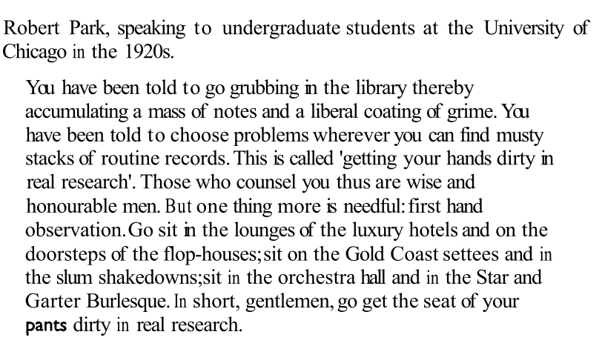
Doing ethnography

Slide 25
Participant Observation
But we cannot escape the social world in order to study it:
“it is not a matter of methodological commitment, it is an existential fact.” (Hammersley and Atkinson, 1983: 15)
“An observer is under the bed. A participant observer is in it.”
(John Whiting, age 80-something, to an undergraduate class when he was a guest lecturer at UC Irvine)

Slide 26
Observation - Central and defining feature of ethnography
“The recording of careful watching; an interested spectator“
(Oxford Dictionary of Current English, 1984: 505)
An interest in the micro/meso not the macro
“Social science observation is fundamentally about understanding the routine rather than what appears to be exciting. Instead, the good observer finds excitement in the most everyday, mundane kings of activities.” (Silverman, 1993: 31)

Slide 27

Doing ethnography
https://www.youtube.com/watch?v=I0Oan6gGnVI
7.20 -18.34;
21.26-24.40

Slide 28
Stages of Ethnographic Research
Gaining access and positioning yourself
Spy, voyeur, learner and traitor
First entry to the setting
“What is going on here? What do people in this setting have to know (individually and collectively) in order to do what they are doing? How are skills and attitudes transmitted and acquired, particularly in the absence of intentional efforts at instruction?” (Woolcott, 1990: 32)

Slide 29
Stages of Ethnographic Research
Writing field notes
Key words to aid memory, hastily scribbled lines
Looking as well as listening
“Each fieldwork contact is thus sponsored by someone in authority over those you wish to study, and relationships between ‘sponsors’ and research cannot be broken if the research is to continue.” (Walker, 1980: 49)

Slide 30
More Stages
5. Framing your data collection
Concepts and questions that guide observation
Comparison between different but parallel groups
Looking for negative or deviant cases
Ensuring there is enough data
Avoid championing some groups at the expense of others

Slide 31
More Stages
6. Making broader links
Data collection, hypothesizing and theory testing are all part of the same activity
Ethnographic observation is like a funnel
Develop initial categories that illuminate the data
Saturate these categories with appropriate cases
Develop categories into more general analytical framework

Slide 32

Types of Observation
Observation
The recording of careful watching; an interested spectator
(Oxford Dictionary of Current English, 1984: 505)
Participant Observation
Covert/clandestine
Overt
Systematic Observation
Bars – Cavan (1966); Sulkenen (1985)
Hospitals – Strong (1979); Zaman (2005)
Schools - Hargreaves (1967); Lacey (1970); Willis (1977); Ball (1981)
Deviance – Becker (1953); Foster (1990); Mendoza-Denton (2008)

Slide 33
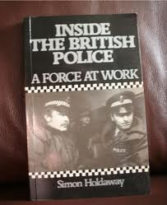
Covert/Clandestine Research
Justified in certain circumstances
Where knowledge of being studied is likely to change behavior being studied
Only acceptable when all other methods are impossible
Holdaway, S. (1983) Inside the Police: A Force at Work.
Only way to access ‘depth’ of data
On the side of the underdog
Violates principle of informed consent
Invasion of privacy
Post hoc informed consent
Approval from other professional colleagues

Slide 34
Characteristics of Observation
‘Thick’ Description
“attending to mundane detail…to help us to understand what is going on in a particular context and to provide clues and pointers to other layers of reality.”
Contextualism
“we can understand events only when they are situated in the wider social and historical context.”
Process
“viewing social life as involving interlocking series of events.”
Flexible research designs
“a preference for an open and unstructured research design which increases the possibility of coming across unexpected issues.”

Slide 35
Observational Pitfalls
Focusing on the present may blind researcher to important events that occurred before their arrival
Informants may be entirely unrepresentative of the ‘inhabitants’ of the social setting
“The observer has to enter into the group and find the right distance between him/herself and the group. There is a close relationship here between the observer’s presentation of him/herself (to enter the field and throughout the study), and the place accorded to the observer by the other.” (Silverman, 1997: 12)
The risk of going ‘native’: Over-identifying with the observed

Slide 36
Systematic Observation
List of categories of action
Table with types of action vs. key participants
Record the duration of behaviour
Or frequency in a given time period
Predetermined list of types of behaviour
Theoretically driven
May be added to during the course of the study
Tension between objectivity and subjectivity
Choosing what not to record
Ambiguities of categories
Too busy counting to think
What about meaning?

Slide 37

Recording Observation
Taking notes
Must be overt
But not too overt
Implications on the action in the setting
Ethnographer’s bladder (Barker, 1984)
Research Diary
What you saw, heard and felt
Systematic observation
Observation schedules
Observation counts

Slide 38

How do we analyze ethnographic data?
Biggest problem is the amount of data
Analysis is about filtering
Separating what is important from what is not
Throwing stuff away
“The critical task in qualitative research is not to accumulate all the data you can but to ‘can’ (get rid of) most of the data you accumulate. This requires constant winnowing. The trick is to discover essences and then reveal those essences in sufficient context, yet not become mired to try to include everything that could possible be described. Audiotapes, and not computer capabilities entreat us to do jus the opposite…we have to be careful not to get buried in avalanches of our making.”
(Wolcott, 1990: 35)

Slide 39
Analysing your data
An integral part of the research process
Not a particular time or stage
You are constantly thinking about your data
Dynamic relationship with research questions
Steadily focusing your enquiry
Processual analysis – Ongoing engagement with data as it is collected
Collected data informs subsequent data collection
Provides momentum for the research
Summative analysis - After the majority of the data has been collected
Relies on previous analytical stages
Brining order to your data and findings
Putting the whole back together
Relating your findings to the literature

Slide 40




Problems of Contextualiation
The impact of coding
Identifying a section of narrative as interesting
Marking a quotation and assigning it a code
Removes it from its context
Seeing through the analysis
Separate different parts
What are they?
What do they do?
How do the fit together to explain a whole?
Separately different parts imply different wholes

Slide 41
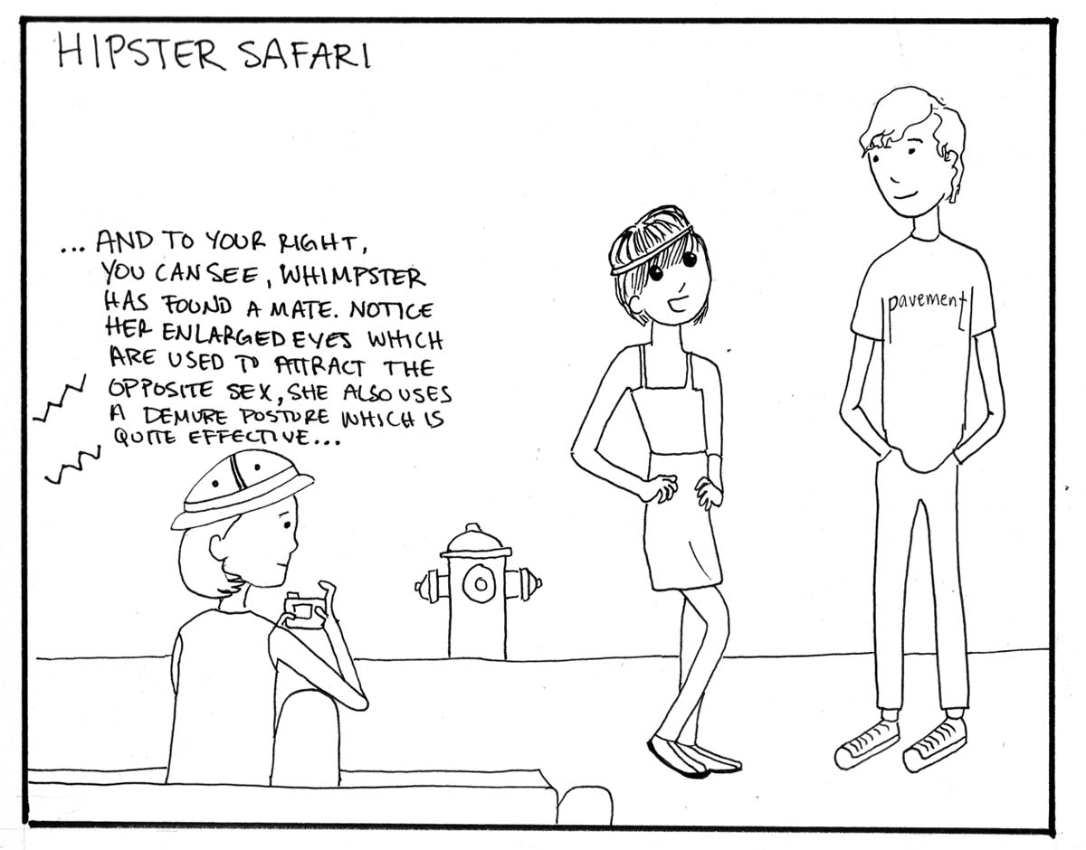
Ethical issues for Field Studies
Increased vulnerability of the researcher
Impact on the lives of those researched
Typically on somebody else’s ‘turf’
Ignorant outsider

Slide 42
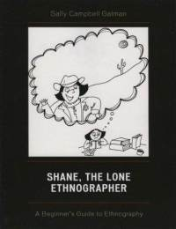
Personal Ethical Issues
Not putting yourself at risk
Physically
Emotionally
Legally
Professionally Ethics - your relationship with your study
Reflexivity is one way of keeping track of the ethical implications of your research
Can you live with the consequences?
How would you feel if you were the research subject?

Slide 43
Is ethnography a scientific method?
Practising science is one of the many ways of exploring social worlds. Practising art and religion are other ways. Why learn research methods and why practice science? One reason is to be able to predict correctly how people and nations will behave, to foresee the future. Another reason is to understand how the social world works by discovering the causal connection. We understand how something works when we can both predict what will happen and explain why. A third reason is to control events and produce intended effects.
Louise Kidder, Selltiz, Wrightsman and Cook's Research Methods in Social Relations, 4th edition (New York, Holt-Saunders, 1981), p. 13

Slide 44
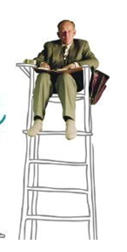
Responses
Make ethnography “scientific”

Slide 45
Responses
Assert alternative humanistic model of social research because people are 'meaning endowing
My immediate object in doing fieldwork was to try to learn about the social world of the hospital inmate, as this world is subjectively experienced by him. It was then, and still is, my belief that any group of persons - prisoners, primitives, pilots or patients - develop a life of their own that becomes meaningful, reasonable and normal once you get close to it, and that a good way to learn about any of these worlds is to submit oneself in the company of the members to the daily round of petty contingencies to which they are subject. Desiring to obtain ethnographic detail, I did not gather statistical evidence.
Erving Goffman, Asylums , 1968 pp. 7-9.

Slide 46
Responses
Transcend the difference; question the idea of naturalism
Make ethnography reflexive (put ethnographer firmly back into the picture)
Science itself does not match the criteria it sets for others)

Slide 47
Ethography
Ethnos + graphos

Slide 48
Writing: ethnography as an outcome
Ethnography is a text
Different genres
What is reported
Which/whose perspective
Whose interpretation (who has the last word)

Slide 49

Thick or Thin – a wink or a twitch?
Centrality of ‘thick description’ (Ryle 1971)
The wink vs. the twitch
Rapidly contracting an eyelid (thin description)
Making a conspiratorial sign to another (thick description)
Deliberate
To someone in particular
To impart a particular message
According to a socially established code
Without cognizance to the rest of the company
Connecting method to theory
Connecting the observation to the meaning of the wink

Slide 50
Exercise: reconstructing reality in the text
How would you call the two genres/ styles?
What do they focus upon?
What is the narrative unit? (activity, scene of action, sequence, etc.)
Where is the researcher? What is her/his position?
What strategy are used to make the text persuasive? How is naturalness obtained?
Other notable differences?

Slide 51
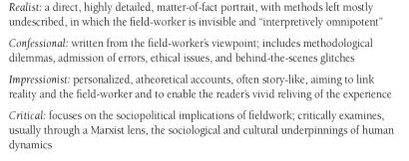
Speaking to the reader: genres and stances

Slide 52
Van Maanen (1988/2010)
REALIST | IMPRESSIONIST | CONFESSIONAL
Focus on mundane things and routine reported “as is”. | Focus is on dramatic moments. Relive the experience of the field worker | Focus is personal experience, surprise and bewilderment in encountering ‘the other’
Details, details and more details presented in flat self-evident mode | Scenes and stories (main plot and sub plots) Often detective story like | Anecdotes
Researcher absent Third person ‘The police turned and ’ | Researcher present as a ‘position’ ‘At his point the policeman turned while the …” | Researcher explicitly present ‘‘I saw the policeman turning and’
Native point of view reproduced | Places audience in the middle of the scene | Told from the perspective of researcher
Interpretive omnipotence (I describe them) field data as facts | Accounts open to multiple interpretations but objectivity in the story | Two or more interpretations always present

Slide 53
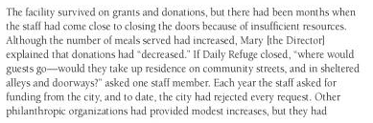

Example of the critical stance (advocacy)
Saldana, 2011

Slide 54
Appealing work: how ethnographic texts convince
Authenticity
Particularizing everyday life, delineating the relationship between the researcher and organization members, depicting the disciplined pursuit and analysis of data, and qualifying personal biases
Plausibility (findings make a distinctive contribution to issues of common concern)
Recruit the reader, smooth contestable assertions, build dramatic anticipation
Criticality
Re-examine the taken-for-granted assumptions that underly their work by carving out room to reflect, provoking the recognition
Golden, Biddle and Locke(1993)

Slide 55
The view of the researched
Who is she?
Who gave her permission to be here?
What have I been saying , for God’s sake?
Who is she working for?
What is she making of all this
What’s a fly on the wall like her doing in a place like this?
(Ibid)

Slide 56
Final Thoughts
“A way of seeing is a way of not seeing.” (Wolcott, 1995: 96)
It is “not necessary to know everything in order to understand something.” (Geertz, 1973: 20)
Consider the darker clandestine elements of fieldwork:
Voyeurism, seeing it all, full disclosure, scintillation, surreptitious, being a detective, spying, lurking.
Is everything fair game in observation?
“The description of the content serves as a prelude to analytical work.” (Silverman, 1993: 48)
We effect the field and doing research changes us

