Slide 1
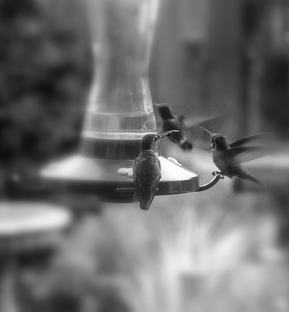
Why use HumBox?
An inspiring collection
of free teaching resources: informed by and for the Humanities community.
www.humbox.ac.uk
Notes:
HumBox is a new way of storing, publishing and sharing your Humanities teaching resources on the web. You can review and upload seminar activities, lecture slides, podcasts and assignments and download and adapt resources others have deposited.

Slide 2






Who’s involved?
HumBox is part of the JISC and Higher Education Academy’s Open Educational Resources (OER) Programme funded by HEFCE.
The OER Programme aims to make a wide range of learning
resources created by academics freely available, easily discoverable and routinely re-used by teachers
and learners.

Slide 3










And our project partners...
..leading the way in depositing resources.
The success of HumBox so far has been in forming the core of a community of Humanities lecturers who are actively involved in depositing and re-using learning resources.

Slide 4



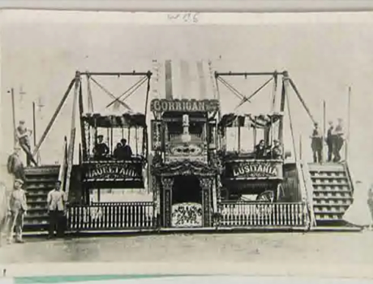
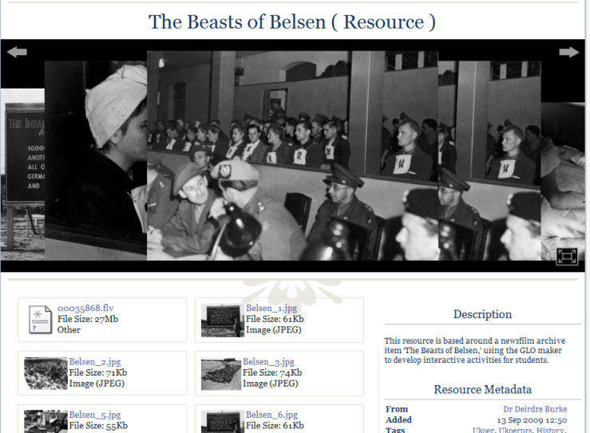
Why use HumBox?
Don’t reinvent the wheel – if someone else has already developed a learning resource similar to what you need, then download and adapt it.
Diversify your teaching repertoire – use approaches from your own and other subject areas to add variety to what you do.

Slide 5
Why use HumBox?
Review and comment on resources - add more to a resource by sharing how you have used it, and how its use could be improved
User profiles – reveal YOUR teaching profile and showcase the range of materials you use.

Slide 6
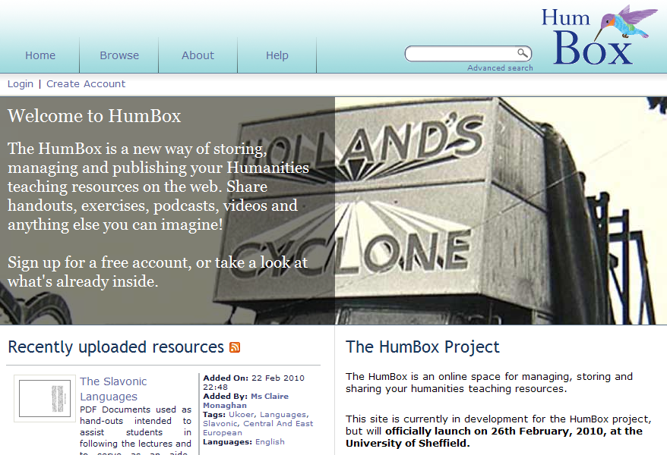
Searching for resources ...

Slide 7
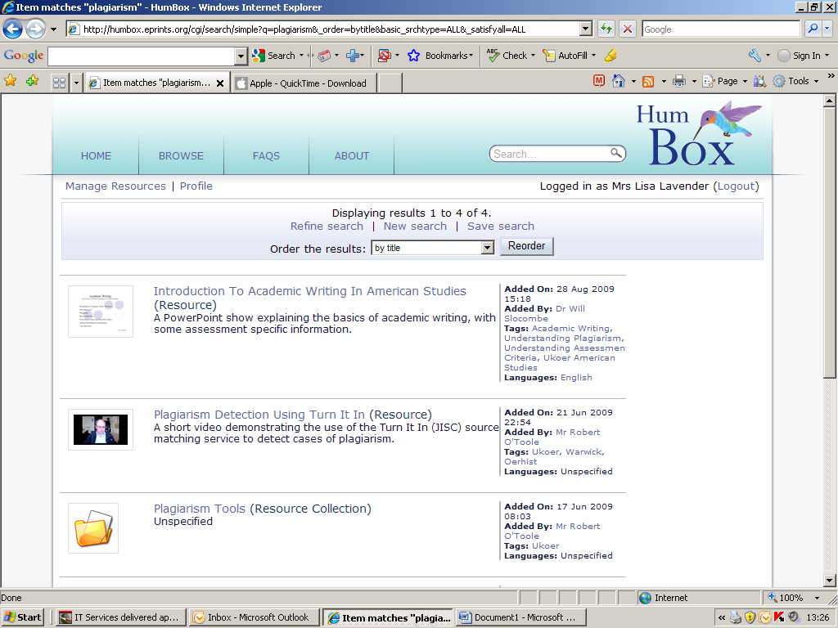

Slide 8
Broad range of resources on very specific subjects to more generic humanities topics ... Over 1000 items
Notes:
HumBox already includes over 900 resources on a range of subjects: some of quite specific interest, to others of more generic use.

Slide 9
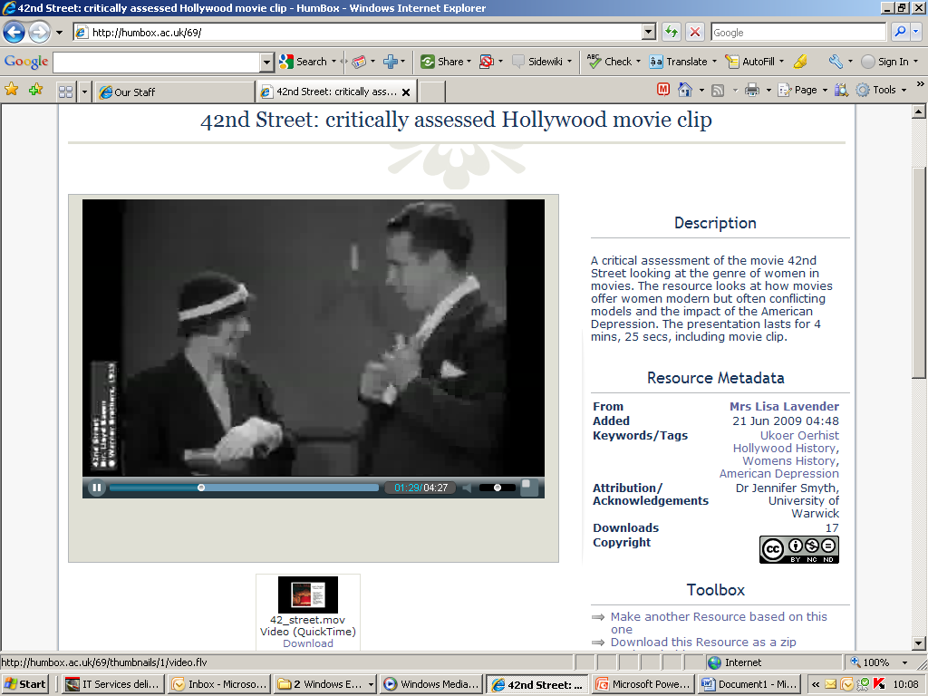
http://humbox.ac.uk/69/
Notes:
Over 570 rersources have been uploaded by the history partners

Slide 10
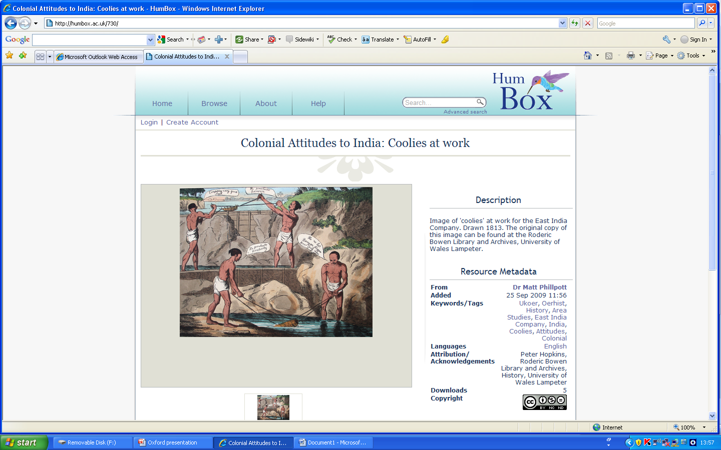
Notes:
Within this brief look at example resources we have also seen the great range of resource formats that have been uploaded. From podcasts to text-based documents and guides, and striking images to video demonstrations. This final example shows how even Hollywood movie clips can be included if they have been correctly contextualised to form a critique or review of a genre or era.

Slide 11
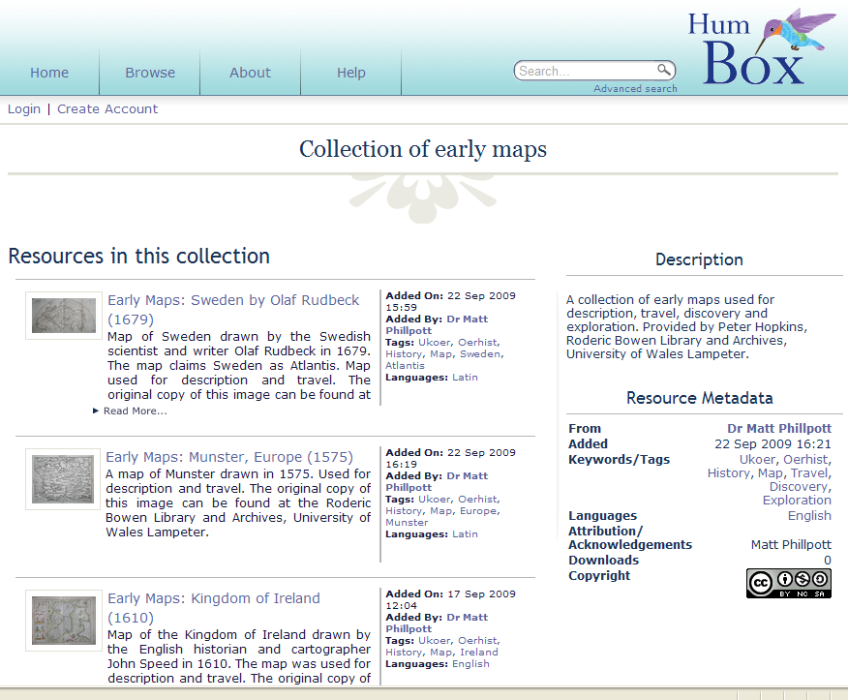
Notes:
Within this brief look at example resources we have also seen the great range of resource formats that have been uploaded. From podcasts to text-based documents and guides, and striking images to video demonstrations. This final example shows how even Hollywood movie clips can be included if they have been correctly contextualised to form a critique or review of a genre or era.

Slide 12
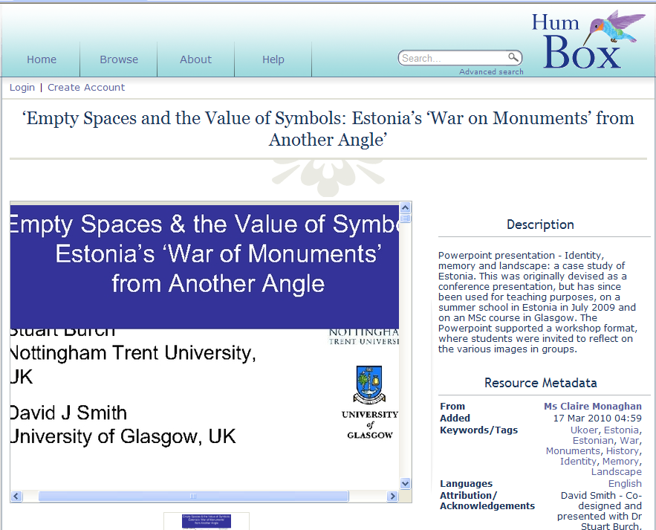

Slide 13
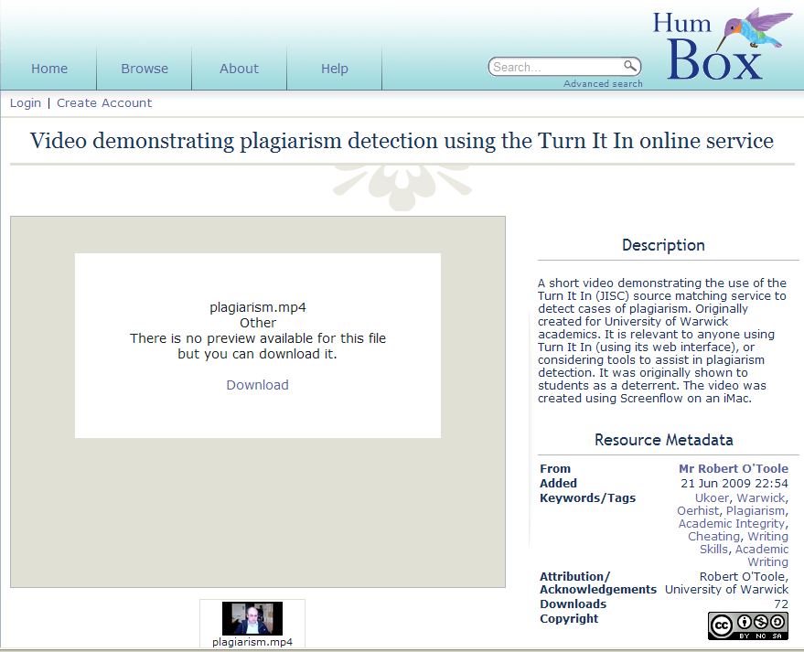
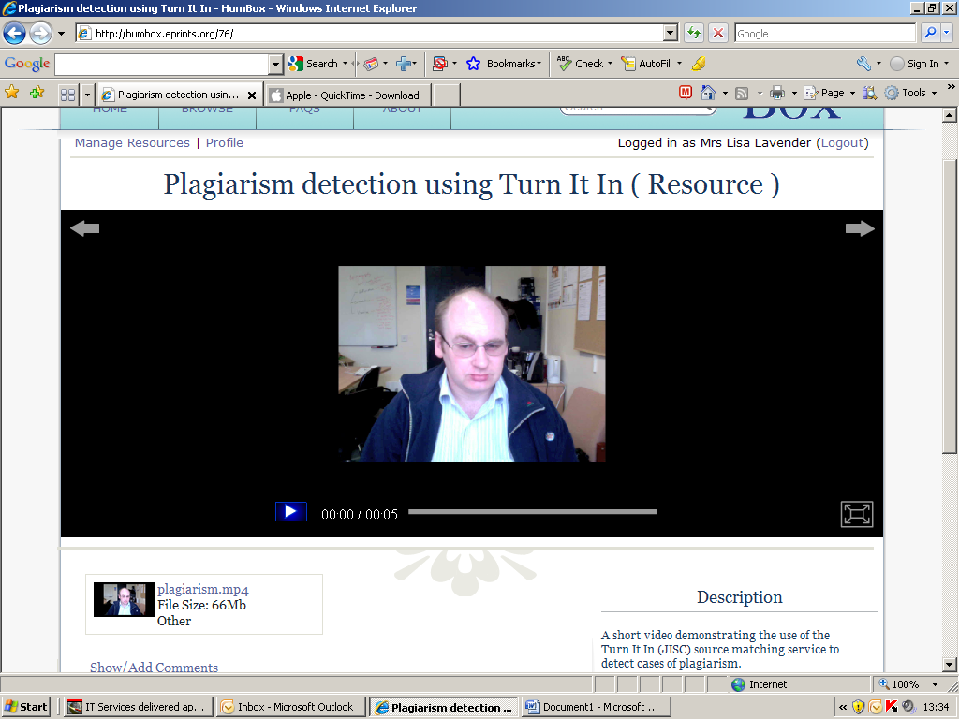

Slide 14
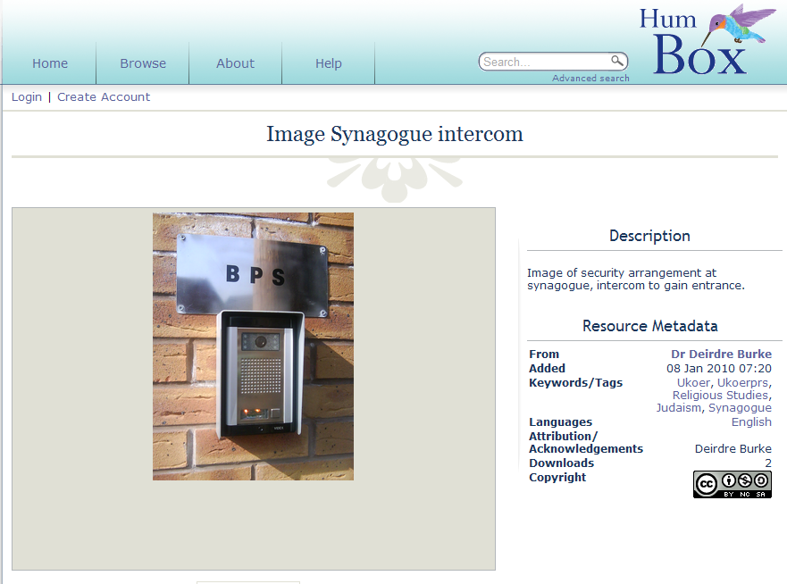

Slide 15
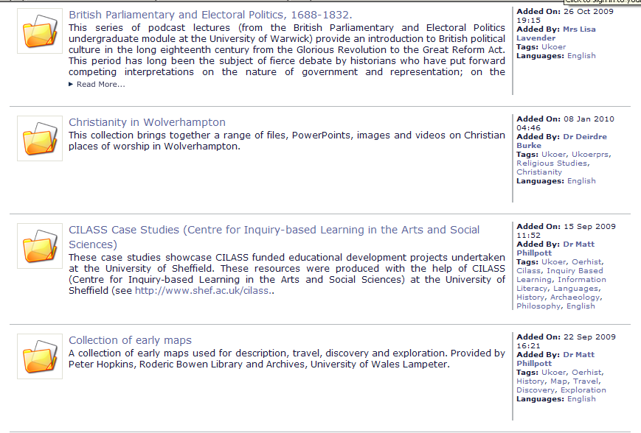
Over 100 collections
Notes:
With an ever-growing number of resources, the ability to find, access and group a series of themed material is a great advantage for you and other users. HumBox has the facility to bookmark items, but setting up collections goes a step further.

Slide 16
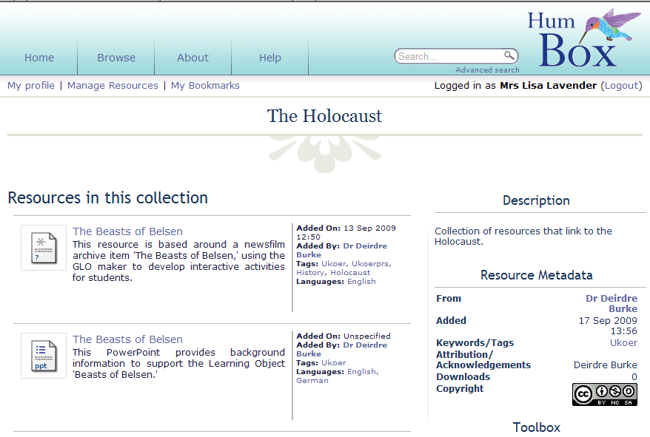
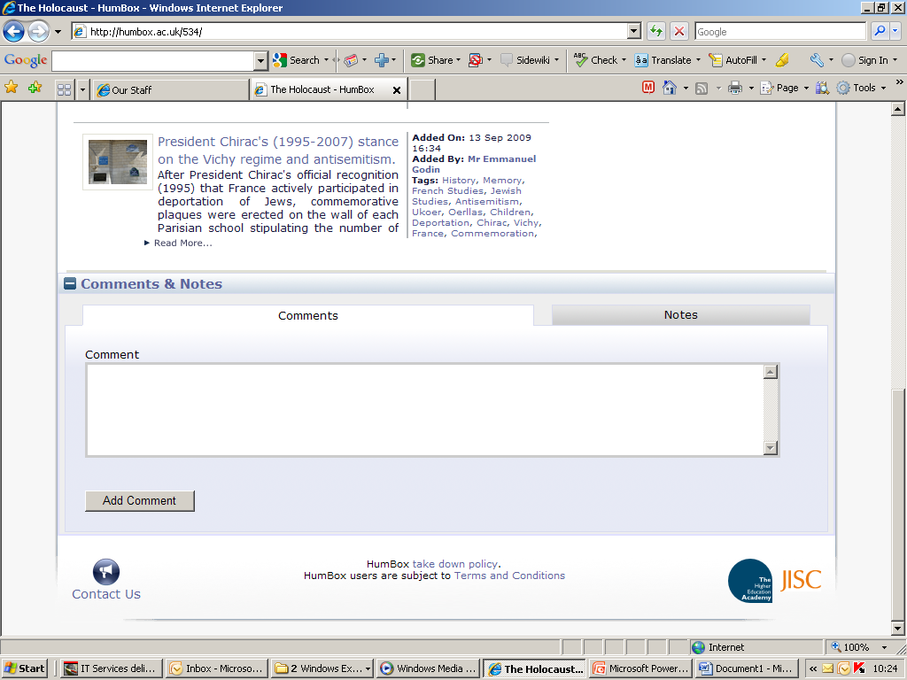
A resource uploaded by another user
Notes:
You can also set up collections of material found throughout HumBox with a common theme that is useful to you, and possibly to others.

Slide 17
Why use HumBox?
Considerations when reviewing...
How would you describe the potential quality of the resource as a student learning experience?
How would you assess the opportunities to share and re-use this resource?
What further information or editing of the resource, or its entry in HumBox, would enhance its ‘shareability’?
Notes:
In September we held a 2-day peer review workshop to go through the process and practise of reviewing: investigating partner perceptions by carrying out group reviews. These questions were the three over-arching areas that were focused on. But before we reveal some developments on reviewing, let’s take a look at how to add a comment, and some examples.

Slide 18
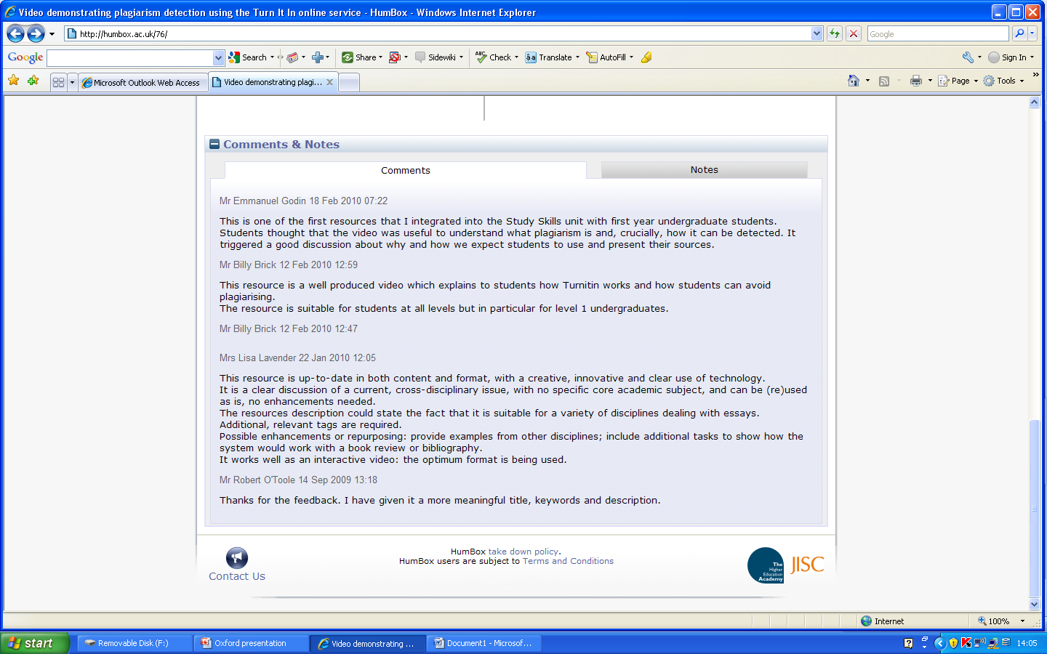

Slide 19
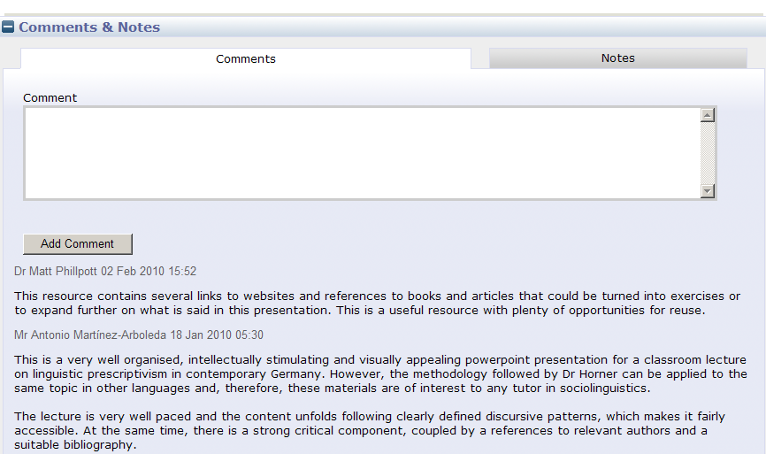
Simply type in a comment ...
Notes:
Simply scroll down the resource page type in your comments and click on add comment: the results will then be added to any that already exist.

Slide 20
Wow! I didn't expect to get some peer-review immediately after posting my first resource! Although I've been sharing my resources with the online community for the last 2 years, now, I’m more than convinced about the tangible value of peer-reviewing (elaborated elloquantly by Emmanuel Godin at the eL symposium today) and sharing. More similar resources to come soon.

Slide 21
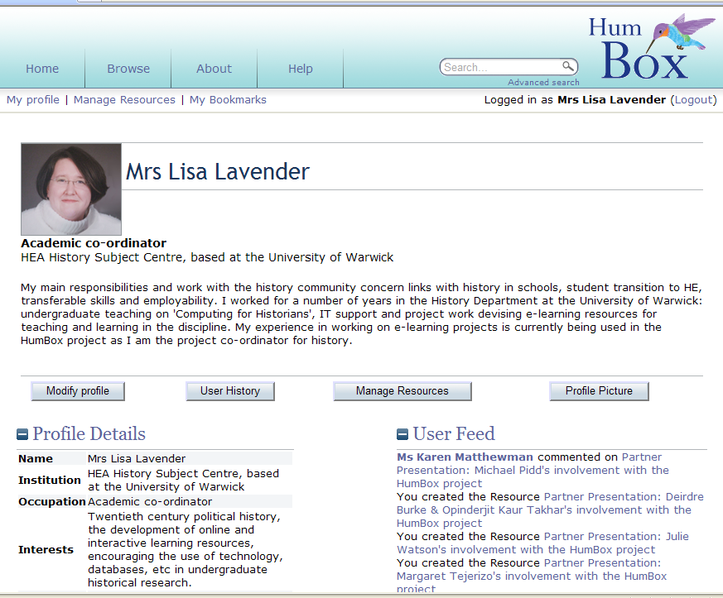
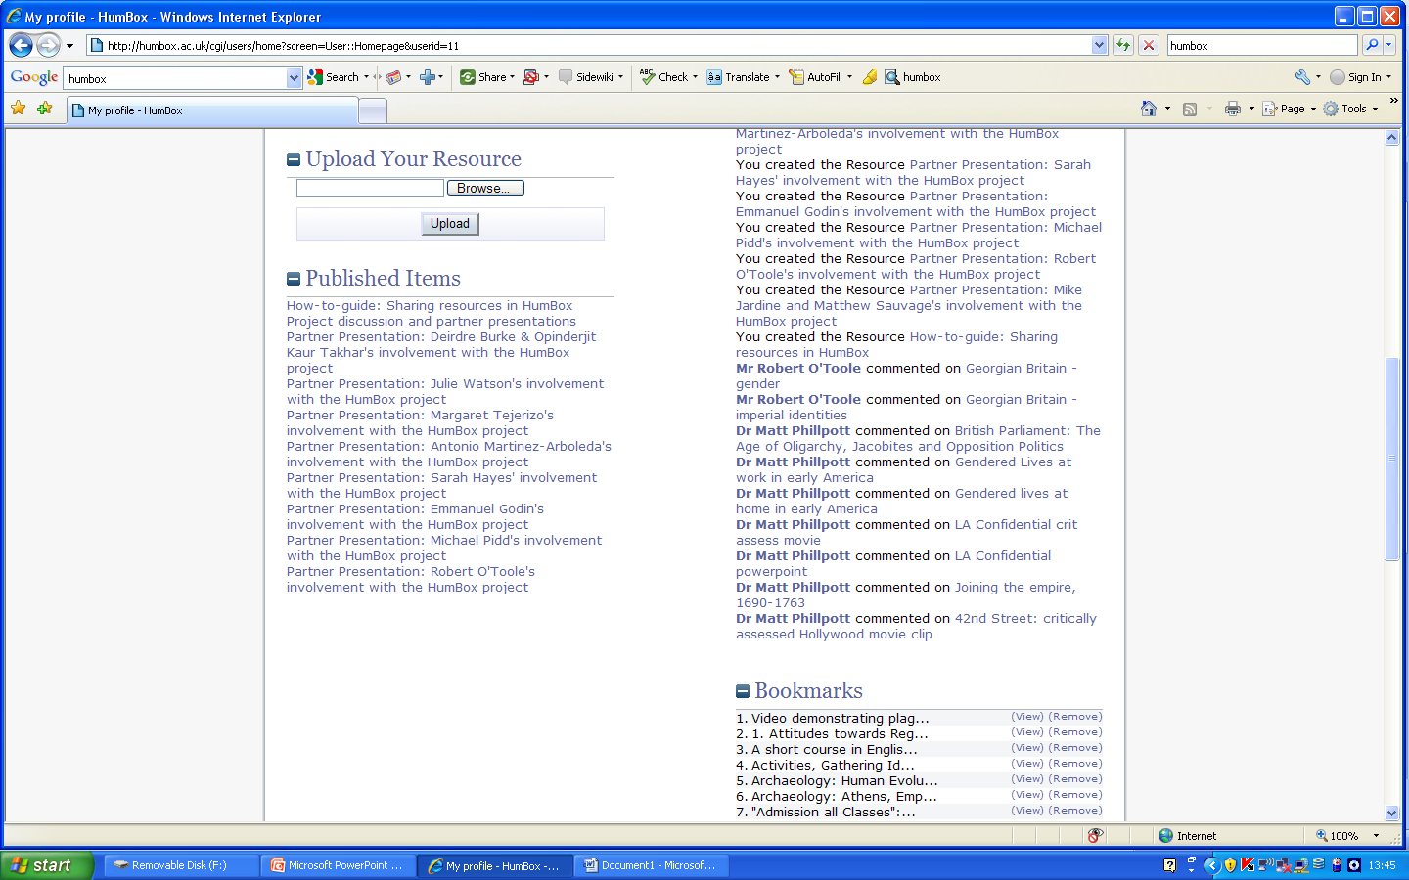
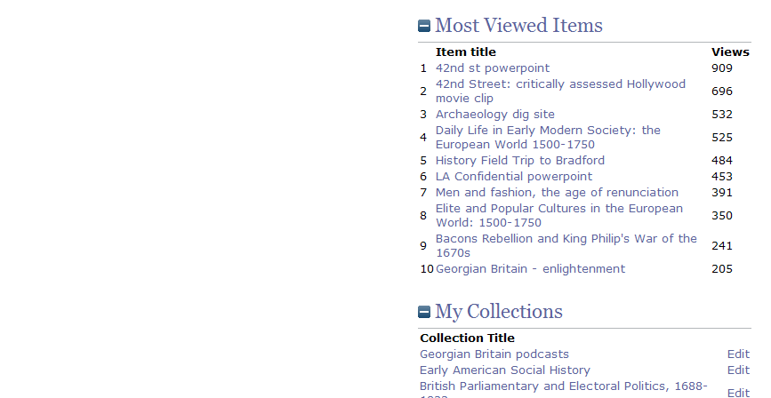
Why use HumBox?
Showcase your learning resources to the wider world in general and to your institution, colleagues and potential students in particular.

Slide 22
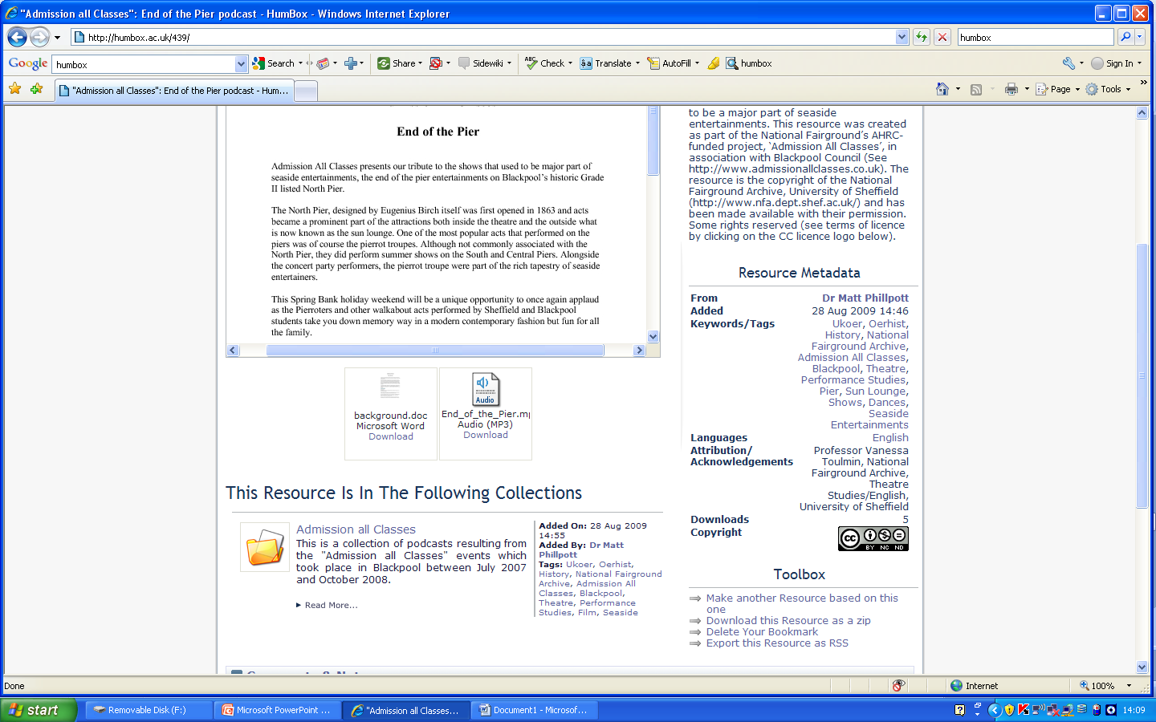
Why use HumBox?
Enhance the reputation of your institution and UK higher education generally by showing what we have to offer

Slide 23
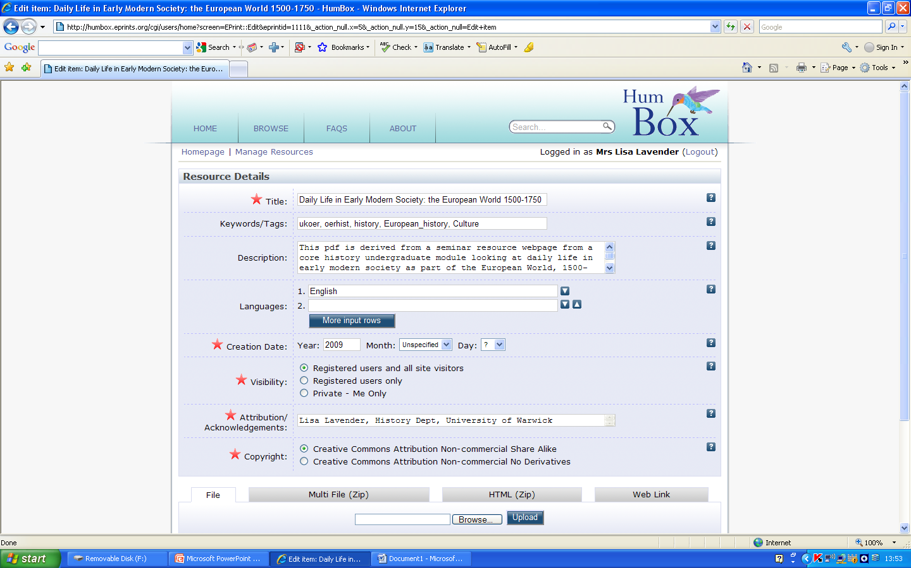
Uploading resources …

Slide 24
What comes next?
Sustainability through partner engagement with colleagues, and Subject Centre support and dissemination
HumBox is designed to build and maintain communities through direct user engagement
Ongoing funding ??
www.humbox.ac.uk

Slide 25
How do I get involved?
If you want to offer or use resources, simply sign up!
Visit the HumBox pages on the History Subject Centre’s website to find out more
Tell your colleagues about HumBox!
www.humbox.ac.uk

