Slide 1
The Assessment of Workplace Learning
Harvey Woolf
Student Assessment and Classification Working Group/Associate, Institute for Learning Enhancement, University of Wolverhampton
History Subject Centre
LMH
24 March 2010

Slide 2
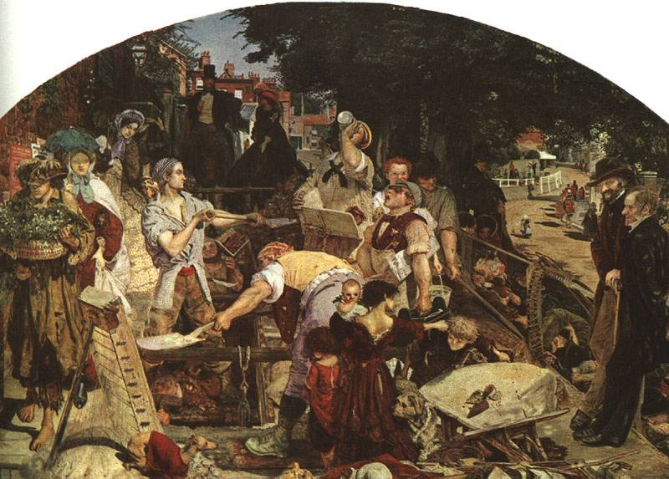
The Assessment of Workplace Learning
SACWG
History and WPL –
‘The historian's skills
and qualities of mind’
Assessment issues
Historians’ solutions?

Slide 3
SACWG
Administrators and academics
15 years of research on assessment
Raise issues based on empirical investigations
Currently projects on re-assessment and the assessment of wpl

Slide 4
Why workplace learning in History?
Revised History Subject Benchmark statement
‘acknowledge[s]…the growing number and importance of learning activities such as fieldwork, community-based projects, work placements and so on’.
Contribution to employability
Extends learning and teaching opportunities

Slide 5
Why the assessment of workplace learning?
‘Assessment is a critical element in the educational process and an essential element in effective learning.’ (History Benchmark Statement, 3)
Limited published work on assessment of wpl.

Slide 6
‘The historian's skills and qualities of mind’
Demonstrate the specialist skills necessary for some areas of historical enquiry
Work collaboratively and participate in groups
Acquire historical knowledge
Formulate appropriate questions and use evidence
Develop historical arguments in a variety of forms
Analyse and reflect critically and contextually on primary and secondary sources
Recognise the problematic and varied nature of historical evidence
Appreciate the complexity of reconstructing the past
Gather and deploy evidence and data to create new information or knowledge
Compare the histories of different countries, societies, or cultures
Be aware of theories of History and Historiography
Indentify continuity and change over extended time spans
Design, research, and produce a piece of sustained, independent writing
Write and speak with clarity, fluency and coherence

Slide 7
Assessing workplace learning
Some key questions

Slide 8
What’s being assessed?
Personal development?
Reflection on Subject?
Subject knowledge and skills?
Reflection on Practice?
Reflection on Learning?
Academic
Learning acquired?
Practical skills
Practice

Slide 9



Who’s assessing?
Workplace mentors?
Workplace managers?
Lecturers?

Slide 10
Who’s quality assuring?
Internal moderators?
External examiners?

Slide 11
Assessing workplace learning: some further challenges
Variability of workplaces
Mechanisms for identifying consistency of mentors’ judgements
Timing of assessment and feedback
Primacy of ‘academic’ achievement in grading of modules

Slide 12
Which assessment method(s)?
Contributions to group or individual blogs, wikis, online forums, bulletin boards
Creating learning packages
Critical incident or other reflective practice exercises
Direct observation of performance
Learning logs/ diaries
Orals and interviews
Portfolios
Poster sessions
Presentations
Projects, individual and group
Questionnaires and surveys devised by learners
Reports
Self-and peer-assessed exercises
For example, learners could be asked to summarise and assess the impact of the discussion on their work and thinking

Slide 13

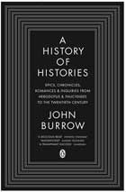
Historians’ solutions?
What outcomes would you assess in the workplace?
How would you assess workplace activities?

