Slide 1
"For now we see through a glass, darkly…”
...but then face to face"
Echo 360 grants project at Loughborough University
Tony Churchill London South Bank University
Marjahan Begum Loughborough University

Slide 2
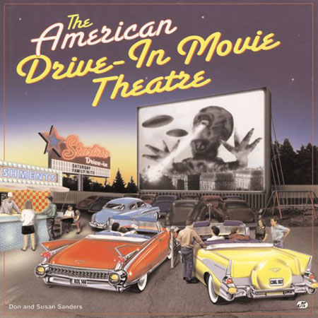
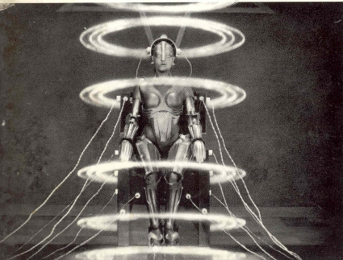
Concepts of teaching

Slide 3
Snapshot albums
Collections of snapshots or...
...reusable learning objects created using lecture capture software
The formats of snapshots used include:-
Mini-lectures
Podcasts

Slide 4
The Results

Slide 5
Examples of snapshot albums
Facebook induction
Scaffolding seminars
  Face-to-face
  Online
Structured revision

