Slide 1
‘Choose Your Own Adventure’:
Student-led Teaching in Large Lectures
Jolene Debert, University of Manchester

Slide 2

Options
Background
Objectives
Technical Bits
Examples
Outcomes

Slide 3
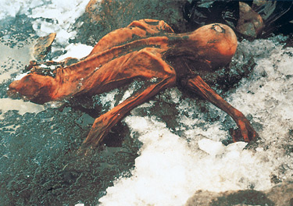
Background
Post: The place of finding: Embedding Enquiry Based Learning in Archaeology
Guest lecture: World Archaeology
100 first year students
Enquiry-Based lecture
Topic was completely open

Slide 4
Background
Otzi the Iceman
Set up a scenario: With students being experts
Given a set of objectives they needed to achieve
Students were then asked to take the lead and decide on what information they needed

Slide 5
Options
Objectives
Technical Bits
Examples
Outcomes
Conclusions

Slide 6
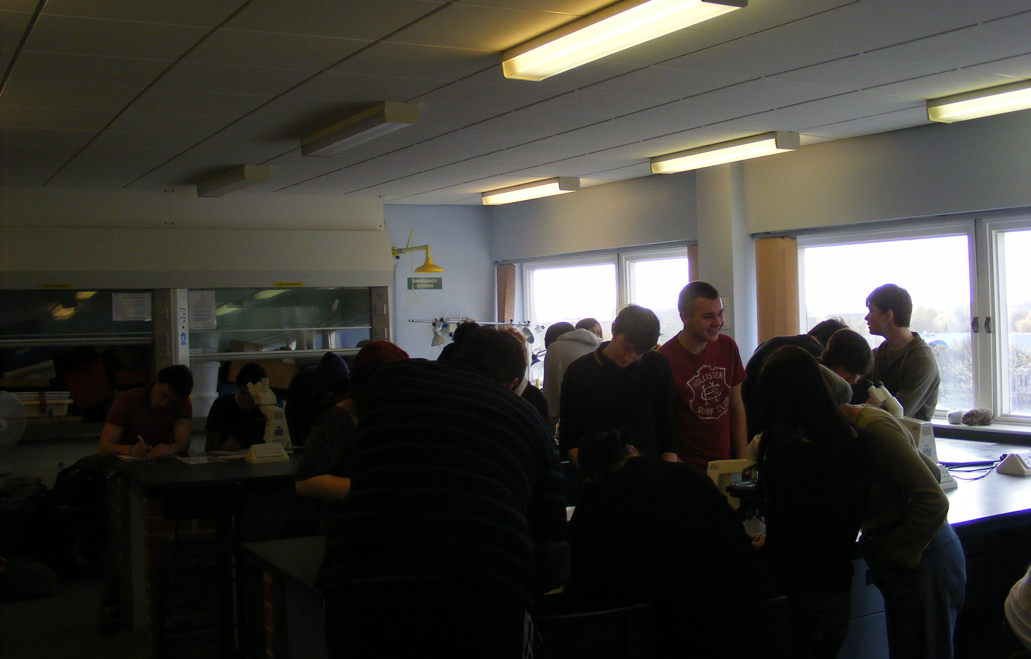
Objectives
Creation of a student-directed lecture
Students prioritize types of information
Students synthesized large amounts of information

Slide 7
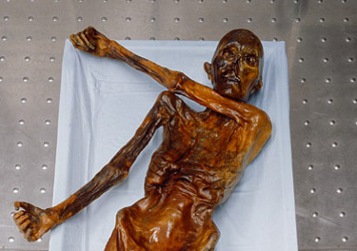
Objectives for Ozti
How did the individual die.
When did he die
Why did he die
What was his identity:
  Occupation
  Beliefs
  etc

Slide 8
Options
Background
Technical Bits
Examples
Outcomes
Conclusions

Slide 9
Technical Bits
Use of PPT hyperlinks
Use of Turning Point and Clicker Technology
Requires excellent time management
Links need to be included to take to summary page

Slide 10
Options
Background
Objectives
Examples
Outcomes
Conclusions

Slide 11
Examples

Slide 12
Examples

Slide 13
Examples

Slide 14
Options
Background
Objectives
Examples
Outcomes
Conclusions

Slide 15
Outcomes
Large discussion
Several Alternative suggestions
Positive student feedback
Positive staff feedback
Conversion of lecture to workshop (WP)

Slide 16
Outcomes
All classes should be like that
Most interesting lecture, ever
I didn’t even know I was learning
I liked arguing with the lecturer… and winning
Archaeology is cool
I transferred into the class after the lecture
Needed more options, but fun

Slide 17
Options
Background
Objectives
Technical Bits
Examples
Conclusions

Slide 18
Conclusions
Student- directed lectures are possible
Minimal extra prep time
Students respond positively to directing their lectures
Engagement with material was enhanced
In-class discussions were lively and had large participation

Slide 19
Future Activities
Lecture turned into a WP workshop
Workshop to be made into a GLO for online use
Development of other lectures in the same format but with different topics
Further collection of feedback

