Slide 1
Hacking the US Academic Job Market University of Warwick
Dr. Karen Kelsky
of The Professor Is In

Slide 2
A Word of Self-Introduction
I was on tenure track (UO, UIUC); Anthro and E. Asian Studies
Got tenure; became Department Head
Left the academy in 2009
In 2011 I started The Professor Is In (theprofessorisin.com)
My team and I work directly with clients from all over the world (over 5000 so far) on cover letters, CVs, teaching statements, postdoc applications, job talks, book proposals, grants, etc.; also interview preparation and negotiation help; I lead online webinars; I write a weekly advice column for Chronicle Vitae, I speak on campuses. I run a post-academic wing with a team of advisors, and I have written a book.

Slide 3

The Professor Is In: The Essential Guide to Turning Your Ph.D. Into a Job
Covers the competitive record, search committee psychology, job documents, interviews, campus visit, job talks, negotiating, as well as grant-writing, and the post-academic transition.

Slide 4
If You Live Tweet:
#ProfIsInWarwick

Slide 5
Core Requirement of Turning Your Ph.D. Into Job
Job-focused state of mind
Just say no to denial
Politely ignore advisors who peddle false hope and impose rigid expectations
Start job prep from day one (can include non-ac)

Slide 6
The Conditions of the US Market
Universities are in crisis
Causes are both economic and political
Economic: declining state and federal funding (most “state” universities get only 10% or less of their funding from the state)
Political: Business/corporate logic has taken over administrations and boards of trustees—leading to cost-cutting and downsizing

Slide 7
Shrinking Departments
“My dept has lost a net of 21 full time faculty since 2010. We might get to hire one next year.” (R1 Full Prof’s FB page, April 2016)
“We lost a net of 25 between 2000 and 2005, have never regained any of that, now half remaining faculty 65+ y.o.” (comment thread)
“We've gone from 18 in English to 10, and seven in ESL to 3. I couldn't even get authorization to replace somebody who died.” (comment thread)

Slide 8
Adjunctification
Tenure track faculty are now a minority on almost all US campuses.
Adjuncts, instructors, part-timers are 76% of university instructors. (Learn more at New Faculty Majority)
What does this mean for the job-seeker? “Vocation” and “calling” language is dangerous. Calculate ROI in all things.

Slide 9
Search Committee Stress
Loss of colleagues means more service and teaching burden on remaining faculty.
Desperate job market means each job gets 200-900 applications.
Bottom Line: Search Committee members are stressed, exhausted, and distracted.

Slide 10
The Search Committee Wants to Reject You
To get from a pool of 500 to a long short list of 25
“How fast can I cut this pile to 25 and go to bed?”
Their bias is to REJECT.
Bottom Line: If you don’t grab and hold them in the first 20 seconds, you’re toast.

Slide 11
The Qualities of Successful Candidates
Intensive productivity, looking forward not back
Professionalization
Autonomy and self-respect
Effective self-promotion/entrepreneurialism
Affable collegiality
Note: These qualities apply equally to ABD candidates

Slide 12
How To Not Get Rejected
Crucial Combination–
Your Record
Your Application Materials
Your Interview Skills

Slide 13
Your Record
Publish in major refereed journals
Get grants—preferably national, not campus
Be active in high prestige conferences
Cultivate well-known recommender

Slide 14
Graduate School As a Means To a Job
Write your dissertation with an eye to the publications that it will become. Plan out which chapters you can publish immediately. At least one refereed journal article while you are still A.B.D. is now required for shortlisting.
Remember that the best dissertation is a finished dissertation.
Strategize publications! Publications that date from before you accept your tenure-track job usually do not count toward tenure
If you are in a book field, have a book plan. Book mss. Cannot be more than half published in article form.

Slide 15
Graduate School As a Means To a Job
Be the sole instructor of at least one course but not more than about three. After about three, the benefit of additional teaching experience diminishes.
In the year before you go on the job market, organize and propose a high-profile panel for your national conference that is made up of young, up-and-coming assistant professors. Ask a well-known scholar to serve as discussant.
Cultivate a letter writer who is not from your Ph.D.-granting institution. Having all your recommendation letters come from your own committee or department is the sign of a relatively immature candidate.
Apply for all grants you can, especially national ones; in sciences have a 5-year grant plan.

Slide 16
Social Media Presence
Candidates are googled
Have a website/Vitae profile/Academia.edu page with research summary, papers, publications, sylllabi, etc.
Use only professional looking photos
Set your Facebook setting for privacy
Twitter is a very active and engaged space for academics

Slide 17
You’re Hired for Future Not Past
Your temptation is to look backward at what you’ve done
On the job market you are being evaluated for tenurability.
You need to look forward to what you’ll achieve in 5-year probationary period.

Slide 18
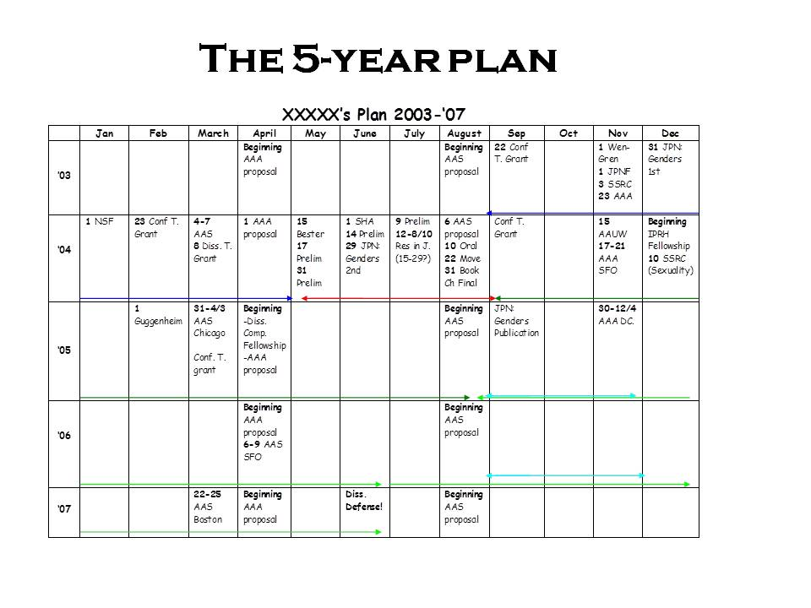

Slide 19
Types of Institutions
Ivy Leagues
“R1” Institutions (Public and Private) – Ph.D. level
“R2” institutions (Public and Private) – Masters level
State Comprehensive Universities – mostly BA level
Liberal Arts Colleges (SLACs) – Elite and non-elite
Small Teaching Colleges (Religious and non-religious)
Community Colleges

Slide 20
The Path of Your Application
The job is advertised in early Fall.
After the deadline, all viable applications considered (250-1000)
The search committee members will each choose their top 20-ish
They will meet to finalize the long short list mid-Fall
The long short list will be asked for writing samples, more info, perhaps a skype/conference interview in November-January
SC chooses a short-short list and presents to whole department: typically 3 invites, with 2 alternates
Whole department votes to approve
Short-short list candidates invited to campus in early Spring
Search committee/department votes ranking AND acceptable/unacceptable
Offer made and negotiated.

Slide 21
The Ethos of Effective Job Market Documents
Concise: 2 page CL, 1 page TS, 2 page RS (CV has no page limit normally)
Confident and focused exclusively on achievements, not gaps
Fact-based, not emotion-based
Focused on finished work, not on process getting there
No long, detailed, self-indulgent verbiage.

Slide 22
The Skepticism Principle
Academics—whether in Classics or Chemistry – are skeptical.
Academics expect, and respond to, reliable evidence and careful argumentation
The same principle applies in job docs and interviews

Slide 23
Managing Your Image: From Peon to Peer
You’ve spent 5-10 years as a graduate student, which means---subordinate status marked by deferential behavior
Suddenly, on the job market, you must comport yourself like a peer, authority, expert in your field, and professional scholar.

Slide 24
Ethos of Interviews
Appropriate dress and grooming (no backpack!)
Steady, level eye contact and firm handshake
Professorial, adult speech patterns
Prepared, concise answers to all major questions re teaching and research
Strong but brief statement of your contribution to your field(s)

Slide 25
Think About Your Language
In both job documents and interviews:
The space of translation between the record and the outcome is a space of tremendous creativity and meaning — it is a kind of self-making.

Slide 26
The Most Common Pitfalls
for Job Seekers
The self-discovery trap
Hyper-emotionalism
Telling, not showing
Excessive humility and pandering

Slide 27
The Self-Discovery Trap
Obsession with your own process:
Example: “I have always been fascinated by xxx, and that led me to pursue an inquiry into yyy for my dissertation. First I approached it from the angle of zzzz, but then I realized that a methodology that emphasized rrr would yield more insight. That recognition inspired me to suggest that pppp…. “
Vs. “My dissertation focused on yyy, using the rrr method. I argue pppp.”
Point: Nobody cares about your process. They want to know what you researched, concluded, and published, when. And what next.

Slide 28
Hyper-Emotionalism
I am fascinated by the question of xxx.
I firmly believe in the value of yy theory.
I yearn to teach students these skills.
I love being in the classroom.
I am passionate about teaching.
I desire to bring my findings to a wider…
Bottom Line: Facts, not emotions.

Slide 29
Hyper-Emotionalism II
Banish adjectives and adverbs - cheap efforts to artificially pump up the emotional punch of your letter. They are alienating.
“My work is an important and innovative exploration of a badly under-studied topic in the field, and it utilizes unique methodologies that have yielded remarkable new insights that will have wide impact.”
Vs.
“My work is the first to examine the topic of xxx using the methods of yy and zz. An examination of xxx in this manner has yielded the insight that in contrast to previous studies, xxx may be understood as qqq.”

Slide 30
Telling, Not Showing
“I am a passionate and committed teacher who always finds innovative ways to engage student interests.”
Vs.
“In the Introductory class I teach fundamentals of ethnographic research, and then assign mini-ethnographies that allow students to research a group in the community of their choice. At the end they present their research in a class ‘conference.’ Students in the course nominated me for the X teaching award twice.”

Slide 31
Excessive Humility/Pandering
I believe that my training in xxx makes me a qualified candidate for this position…
I was fortunate enough to have the opportunity to….
I trained under Prof. XXX and inspired by him I have attempted to explore…
I would strive/seek/aim/try/endeavor/attempt to become a teacher and scholar worthy of your illustrious department…
It would be an honor and a privilege to teach at….
Bottom Line: Make them want you. It is not unlike dating…

Slide 32
The Keys to Academic Interviewing
1. Concise
In a conference interview of 30 minutes…how much time do you really have to talk?
2. Properly Conceptualized and Organized
All answers must target the information THEY need for the position. Cast your work to FIT the job, with no digressions, or extraneous detail.
3. Well-Rehearsed
Bullet point roadmaps to all major questions and practice exhaustively ahead of time until second nature.

Slide 33
Interview Intervention Questions
Tell us about your dissertation, and its contribution to the field.
Tell us about your five year publishing/grant plan
How would you teach our Intro / Methods course?
Briefly describe two courses you would develop for us.
(How would you mentor graduate students?)
How do you deal with diversity in work/teaching?
How do you see your work fitting into the work we do here at the department?
Do you have any questions for us?

Slide 34
The Five Pitfalls of Interviewing
Rambling
Querulousness (ie, an insecure tone or manner)
Not Targeting the Specific Needs/Requirements of the Job
Being Caught Unprepared
Collapsing In the Face of Challenges
(learn the art of academic jiu jitsu)

Slide 35
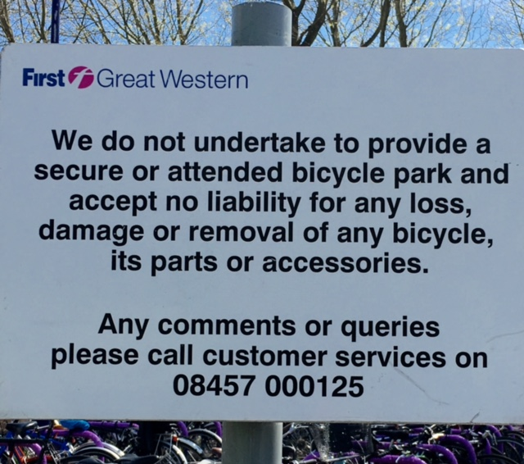

UK and US Style

Slide 36
In Conclusion: Don’t Be Yourself
As a junior academic, you are likely: insecure, verbose, defensive, paranoid, beset by feelings of inadequacy, pretentious, self-involved, communicatively challenged, and fixated on minutiae.
This isn’t your fault—you’ve been socialized this way.
Consequently, you are likely to come across in your job search as: rambling, obscure, petrified, subservient, cringing, disorganized, braggy, over-emotional, self-absorbed, defensive, and fixated on minutiae.
Jettison “yourself” (Don’t worry--your personality will still shine through)

Slide 37
Create Your Professional Persona
A tightly organized research program,
A calm confidence in a research contribution to a field or discipline,
A clear and specific trajectory of publications,
Innovative but concise, non-emotional ideas about teaching at all levels of the curriculum,
A non-defensive openness to the exchange of ideas,
A grasp of the real, as opposed to fantasy, needs of actual hiring departments.

Slide 38
It’s YOUR Career
Academia fosters dependency
You can reclaim autonomy, whether you stay in the academy or not.

Slide 39
Thank you. And, best of luck in your job search….

