Slide 1


WorldCUR-BCUR 2023
Spoken Presentation 101
Dr Fiona Farnsworth | Institute for Advanced Teaching and Learning |

Slide 2
Session Outline
Introductions
How are you feeling about your presentation?
Presentation Guidance
Q&A

Slide 3
Who am I? I’m Dr Fiona Farnsworth. I’m a Journal and Conferences Coordinator in the University of Warwick’s Institute for Advanced Teaching and Learning. My doctoral research was based across food studies, world literature, and environmental humanities; and I’ve previously taught across four different departments.
Who are you? Tell us in the chat! If you’re comfortable to do so, share your name and your subject or field of interest – and tell us where you’re joining us from today!

Slide 4
How are you feeling about your presentation?
Follow the link:
https://www.menti.com/al3edog3s8g7

Slide 5
What is research?
Research comprises ‘creative and systematic work undertaken to increase the stock of knowledge – including knowledge of humankind, culture and society – and to devise new applications of available knowledge.’
(OECD. 2015. Frascati Manual)

Slide 6
WorldCUR-BCUR 2023 is about communicating your original contribution to knowledge to an international, interdisciplinary audience.

Slide 7
https://padlet.com/fionafarnsworth/faioef2gj3tixvwq
You’ve chosen to do that via a spoken presentation – so what do you need to know?

Slide 8
WorldCUR-BCUR 2023 is about communicating your original contribution to knowledge to an international, interdisciplinary audience.
international
interdisciplinary

Slide 9

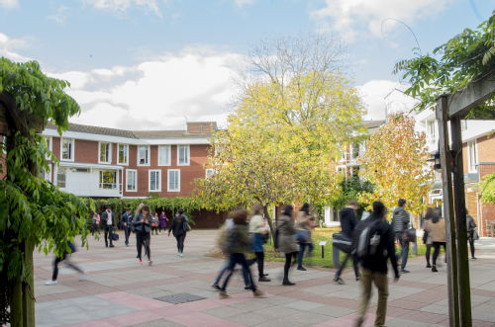

At WorldCUR and BCUR, you have an amazing opportunity to present your work to an audience of your peers from around the world – an audience of people who are smart and interested (and interesting!) but who don’t necessarily share your background or your knowledge base.
This isn’t a medical conference, or a literature conference, or a political conference.
It’s an interdisciplinary conference.

Slide 10
https://padlet.com/fionafarnsworth/faioef2gj3tixvwq
C
larity
C
ompassion
C
hill

Slide 11
C
larity
In your content.
Most of your audience won’t be from your subject area – so you might need to explain things a little more (or just differently). Can you break ideas down? Is there groundwork you need to lay?
In your speech.
Speaking too quickly or too slowly, overusing jargon and technical terms, not thinking about the structure of your presentation – these can all obscure your meaning and make your presentation less engaging. Summaries can be helpful at the end!
In your visuals.
Visual aids like slideshows can be really helpful in illustrating your research – but only if they’re easy to understand! Think about the visuals you’re using – are the images relevant and easy to understand? What’s the ratio of image to text?

Slide 12
C
ompassion
In your content.
Consider your audience always. Try not to alienate by making your presentation over-complicated or discipline-specific – and consider things like trigger warnings too, if your research requires it.
In your speech.
Think about tone and delivery – how you express yourself vocally is even more important than how you express yourself on your slides! Monotonous delivery can make people switch off; speaking too quietly will mean people miss information.
In your visuals.
Accessibility should be something you’re always thinking about. If you have a slideshow, is the text easy to read? (Think about font, font size, font colour…) Are the visuals easy to see? Is there a balance regarding detail?

Slide 13
C
hill
Remember – WorldCUR-BCUR 2023 is a supportive environment. Everyone wants to see you do well!
Prepare.
Pause.
Enjoy.
Practice.
Rephrase.

Slide 14
https://padlet.com/fionafarnsworth/faioef2gj3tixvwq
If you’re really nervous about presenting, sign up for our Confidence Building Masterclass, run by Warwick’s Wellbeing team:
www.warwick.ac.uk/worldcur-bcur2023/masterclass

Slide 15
In your abstract, we asked you to think about and answer four questions:
WHY?
SO WHAT?
NOW WHAT?
WHAT?
These are great starting points when you’re thinking about your presentation, too!

Slide 16
What are you looking forward to?
Follow the link:
https://www.menti.com/al3edog3s8g7

Slide 17
Q&A time!
If you have a question, please write it in the Teams chat.
We’ll answer as many as we can in today’s session…
… and if there are any left over, we’ll include them in an FAQ – and we’ll send that to you via the email address you signed up with.

