Slide 1
Using Machine Learning to Isolate and Clean Vocal Tracks
Harriet Rogers

Slide 2
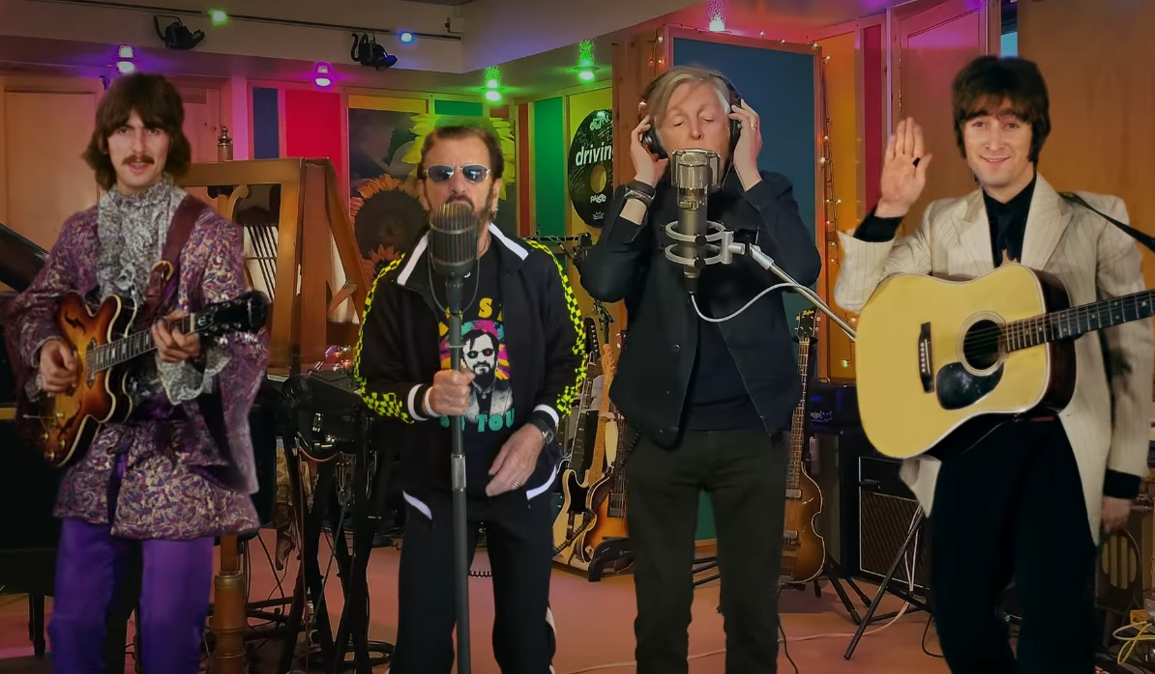
Why?
Inspired by “Now and Then” by The Beatles – using AI to posthumously finish Lennon’s song.
AI reconstruction software becoming increasingly prominent.

Slide 3
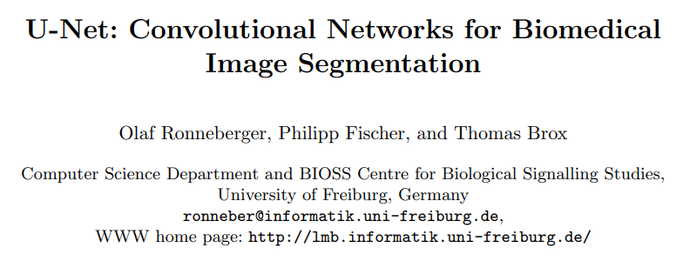

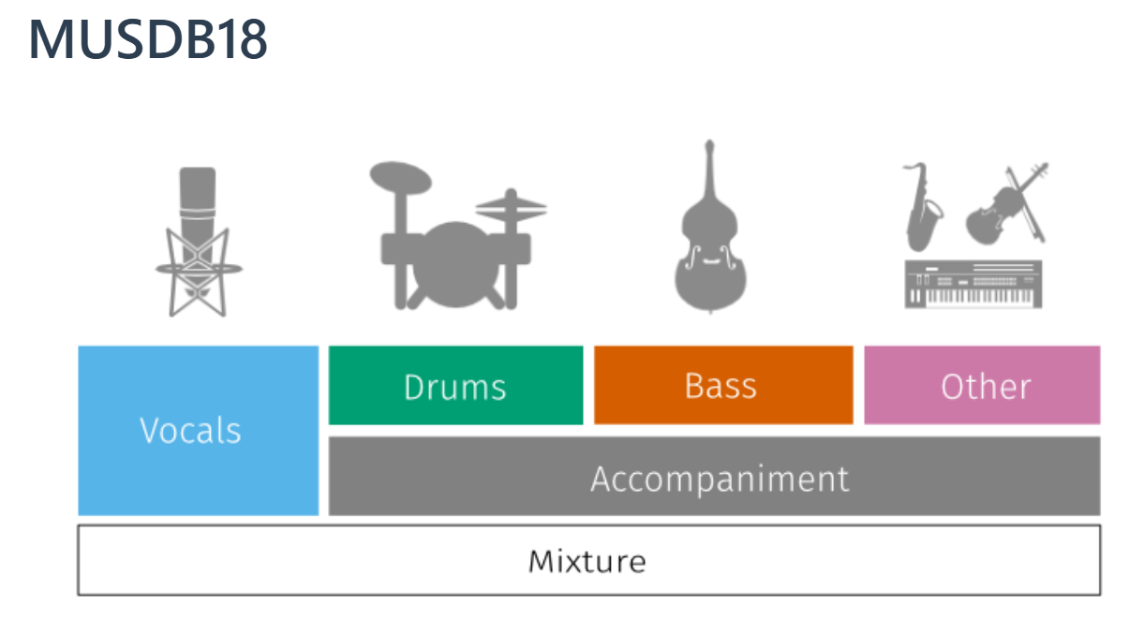
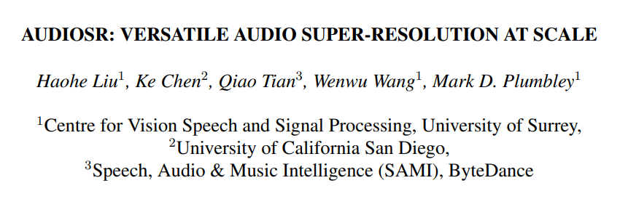
How it works

Slide 4
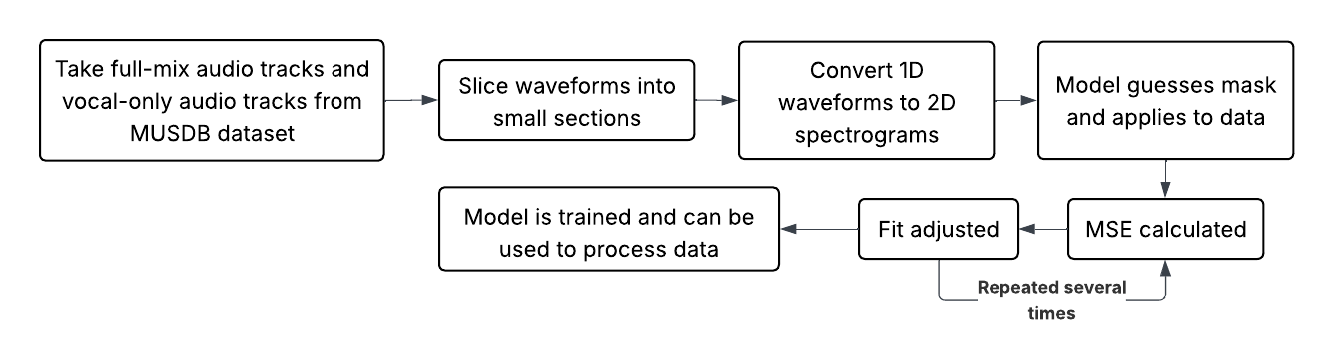
Training the algorithm

Slide 5
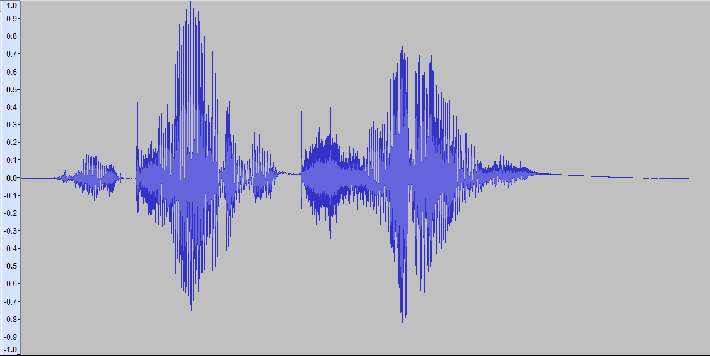
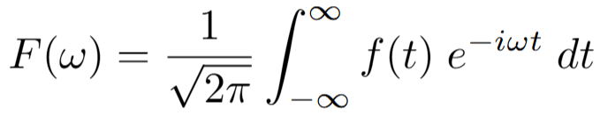
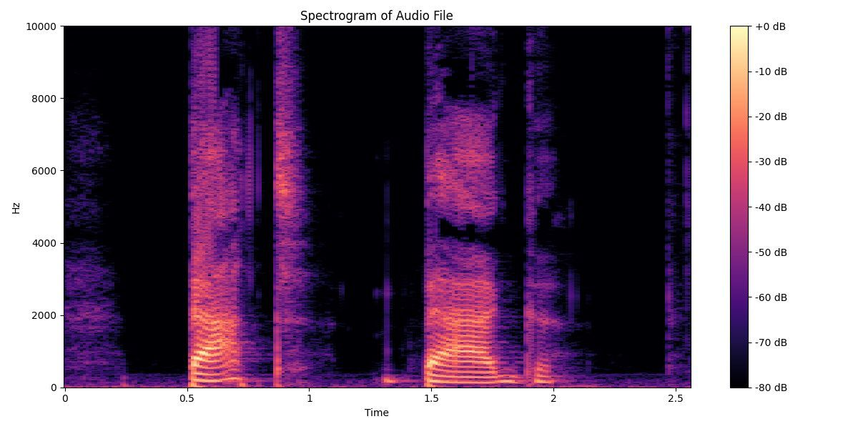
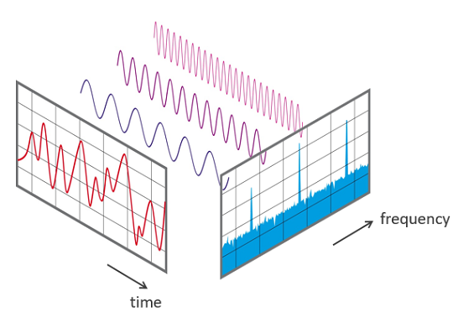
Fourier Transforms

Slide 6
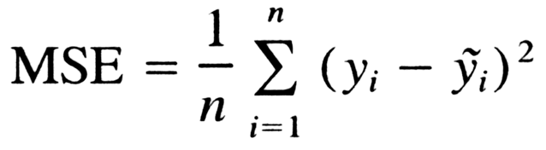
Training the algorithm
Notes:
Mean Squared Error (MSE) measures the average squared difference between estimated values (predictions) and the actual value

Slide 7
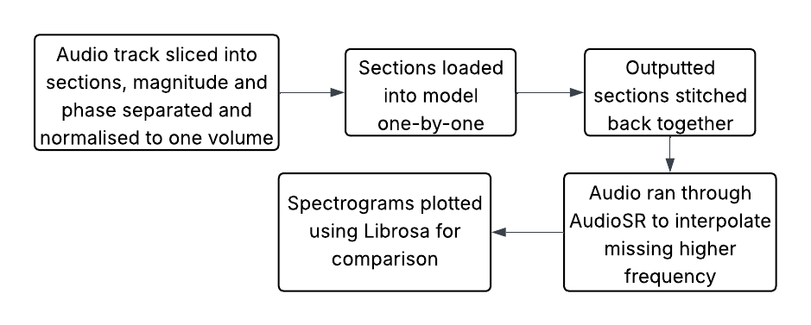
Producing an output

Slide 8
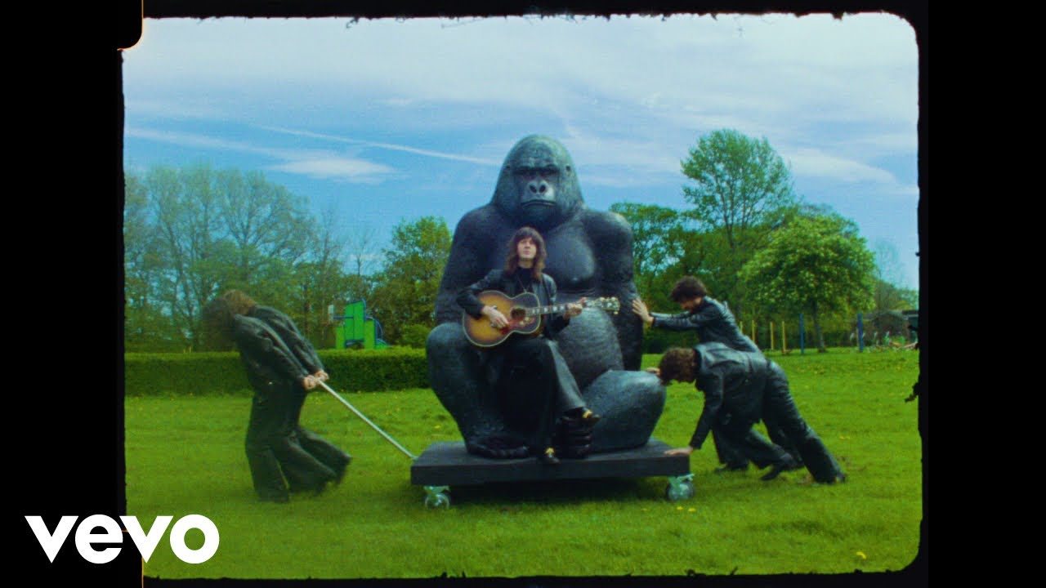

Results
Original Song
Algorithm Result

Slide 9
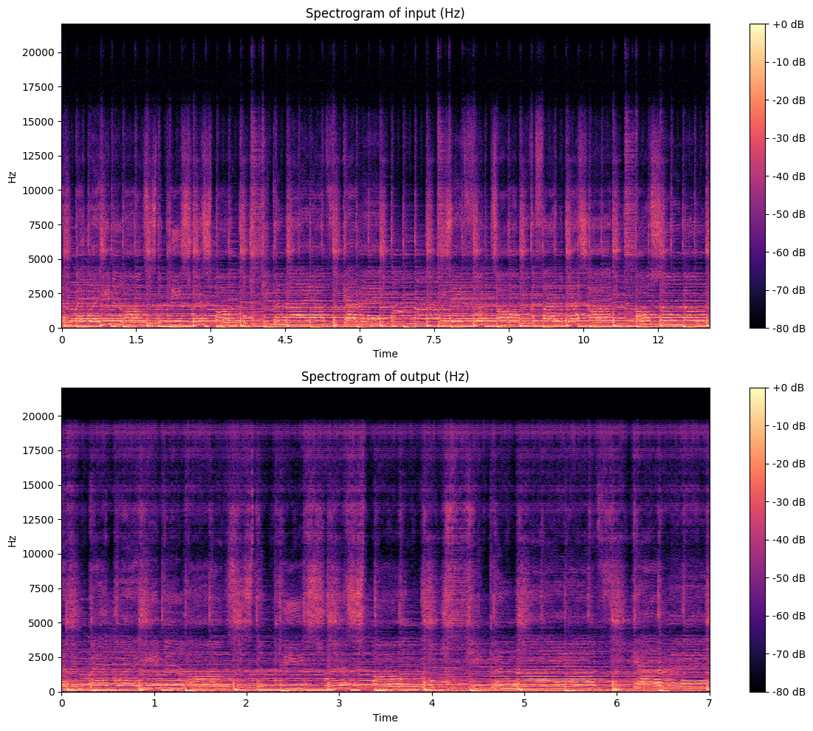
Notes:
To be finished

Slide 10
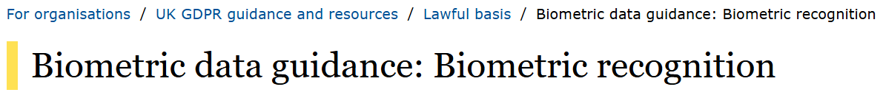
Ethical
Consent
Exploitation
Deepfakes
Fraud
Likeness
Digital Autonomy
Pristine audio to train Text-to-Speech (TTS) engines.
Isolated vocal tracts are classified as biometric data

Slide 11
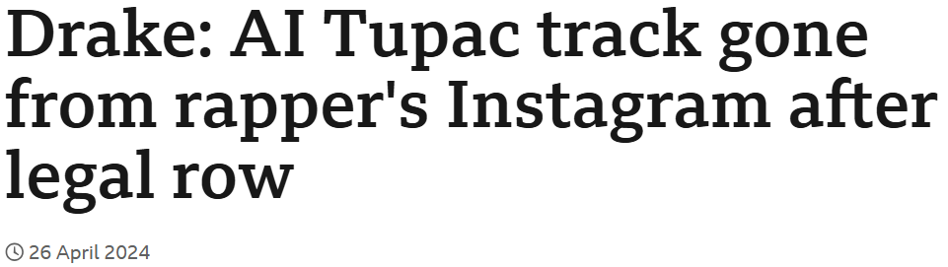
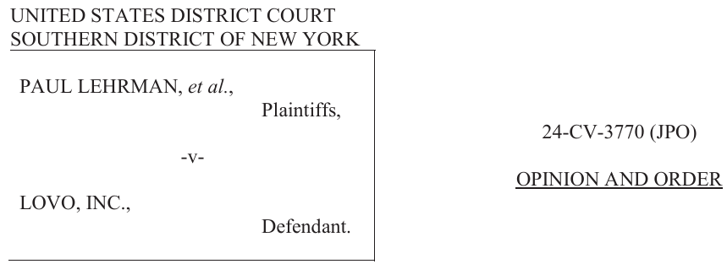
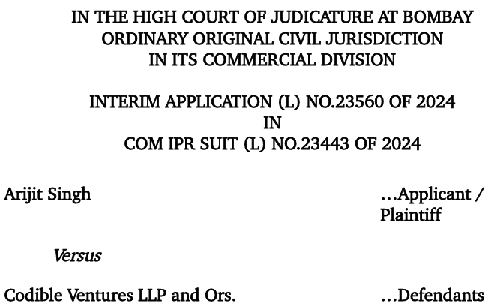
Legal
Commercialisation
Right of Publicity
Protectable Economic Asset
Unjust Enrichment

Slide 12

The code
Any questions?

