Slide 1

Obscenity, Literature & Law

Slide 2
Outline
History of censorship in English Law
Freedom of Expression, The Handyside Case
Obscene Publications Act 1959
The Lady Chatterley Trial: R v Penguin
Obscenity in contemporary law
Prison biographies about murder

Slide 3
Literature and Law
Authorship
Diversity of authorship
Judgment as a Literary Genre
How to read a judgment
Re-writing judgments
Writing Back

Slide 4
1. History of obscenity in English Law
Obscene Publications Act 1857
The Hicklin test
Obscene Publications Act 1959
R v Penguin

Slide 5
Repression of Sex
“If sex is repressed, that is, condemned to prohibition, nonexistence, and silence, then the mere fact that one is speaking about it has the appearance of a deliberate transgression. A person who holds forth in such language places himself to a certain extent outside the reach of power.” Michel Foucault, The History of Sexuality Vol.1, p. 6

Slide 6
2. Freedom of Expression
Everyone has the right to freedom of opinion and expression; this right includes freedom to hold opinions without interference and to seek, receive and impart information and ideas through any media regardless of frontiers. Article 19 UDHR 1948

Slide 7

Danish Cartoons Row 2015

Slide 8
Article 10 ECHR: Right to Freedom of Expression
Everyone has the right to freedom of expression. This right shall include freedom to hold opinions and to receive and impart information and ideas without interference by public authority and regardless of frontiers. This Article shall not prevent States from requiring the licensing of broadcasting, television or cinema enterprises.
The exercise of these freedoms, since it carries with it duties and responsibilities, may be subject to such formalities, conditions, restrictions or penalties as are prescribed by law and are necessary in a democratic society, in the interests of national security, territorial integrity or public safety, for the prevention of disorder or crime, for the protection of health or morals, for the protection of the reputation or rights of others, for preventing the disclosure of information received in confidence, or for maintaining the authority and impartiality of the judiciary.

Slide 9
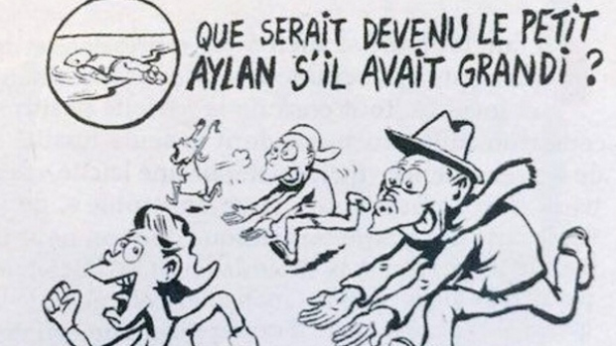
What are the limits to freedom of expression?

Slide 10
What are the limits to freedom of expression?
National security
Fair administration of justice
Protection of reputations
Protection of personal privacy
Obscenity
Protection of religious beliefs

Slide 11

Freedom of Expression, The Handyside Case
These observations apply, notably, to Article 10 para. 2 (art. 10-2). In particular, it is not possible to find in the domestic law of the various Contracting States a uniform European conception of morals. The view taken by their respective laws of the requirements of morals varies from time to time and from place to place, especially in our era which is characterised by a rapid and far-reaching evolution of opinions on the subject. By reason of their direct and continuous contact with the vital forces of their countries, State authorities are in principle in a better position than the international judge to give an opinion on the exact content of these requirements as well as on the "necessity" of a "restriction" or "penalty" intended to meet them

Slide 12
3. Obscene Publications Act 1959
Two stages
Test of Obscenity s 1(1): An article shall taken to be obscene if its effect…taken as a whole…such as to tend to deprave and corrupt persons who are likely, having regard to all relevant circumstances, to read, see or hear the matter contained or embodied in it” Prosecution must prove beyond reasonable doubt
Defence of public good s 4(1): …”a person shall not be convicted of an offence…if it is proved that publication of the article in question is justified as being for the public good on the ground that it is in the interests of science, literature, art or learning, or of other objects of general concern.” Defence must prove on balance of probabilities

Slide 13
1) Test of Obscenity s 1(1):
Article
Taken as a whole…
To deprave and corrupt
Persons who are likely…to read, see or hear the matter contained or embodied in it”
Jury must decide beyond reasonable doubt

Slide 14
Meaning of ‘Deprave and corrupt’
“To deprave means to make morally bad, to pervert, to debase or corrupt morally. To corrupt means to render morally unsound or rotten, to destroy the moral purity or chastity, to pervert or ruin a good quality debase, to defile” R v Penguin Books Ltd [1961] Crim LR 176 at 177
It is not sufficient that an article be “filthy, loathsome or lewd”
Sexual
Encourage experimentation with drugs: John Calder (Publications) Ltd v Powell [1965] 1 QB 509
Tends to induce violence: DPP v AB and C Chewing Gum [1968] 1 QB 159

Slide 15
John Calder (Publications) Ltd v Powell [1965] 1 QB 509 Cain’s Book
“The book – the less said about it the better – concerned the life, or imaginary life, of a junkie in New York, and the suggestion of the prosecution was that the book highlighted, as it were the favourable effects of drug-taking and so far from condemning it, advocated it, and that there was a real danger that those whose hands the book came might be tempted at any rate to experiment with drugs and get the favourable sensations highlighted by the book” Lord Parker at 515

Slide 16
2) Defence of public good s 4(1)
“for the public good on the ground that it is in the interests of science, literature, art or learning, or of other objects of general concern.”
Direction to Jury Balance between
Depravity and Corruption
The number of readers they consider would tend to be depraved or corrupted
Strength of the tendency to deprave and corrupt
Nature of depravity
Literary, Sociological or Ethical Merit

Slide 17
4. The Lady Chatterley Trial: R v Penguin [1961] Crim LR 176
Key turning point in the history of obscenity
Role of that class played in the trial: Justice
Lady Chatterley transgress class distinctions
Justice Byrne’s summing up mentions the price of the book says: “but shall I say high pocket-money to younger members of the community are the order of the day, 3s 6d, you might think, would be putting this book within the grasp of a vast mass of the population”

Slide 18
5. Obscenity in contemporary law CPS Guidelines: Often used to prosecute pornography
Bestiality
Realistic portrayals of rape
Sadomasochism goes beyond trifling injury
Torture with instruments
Bondage
Dismemberment or graphic mutilation
Activities involving perversion or degradation
Fisting

Slide 19
Principle Factors Influencing Prosecution
Degree and type of obscenity and form of presentation: impact of print may be less than film
Type and scale of any commercial venture
Publication made to a child or vulnerable adult
Likely to be accessed by children
Material can be readily seen by the general public…easily accessible to children
Defendant’s previous convictions

Slide 20
Should the Obscene Publications exclude literature outright?

Slide 21
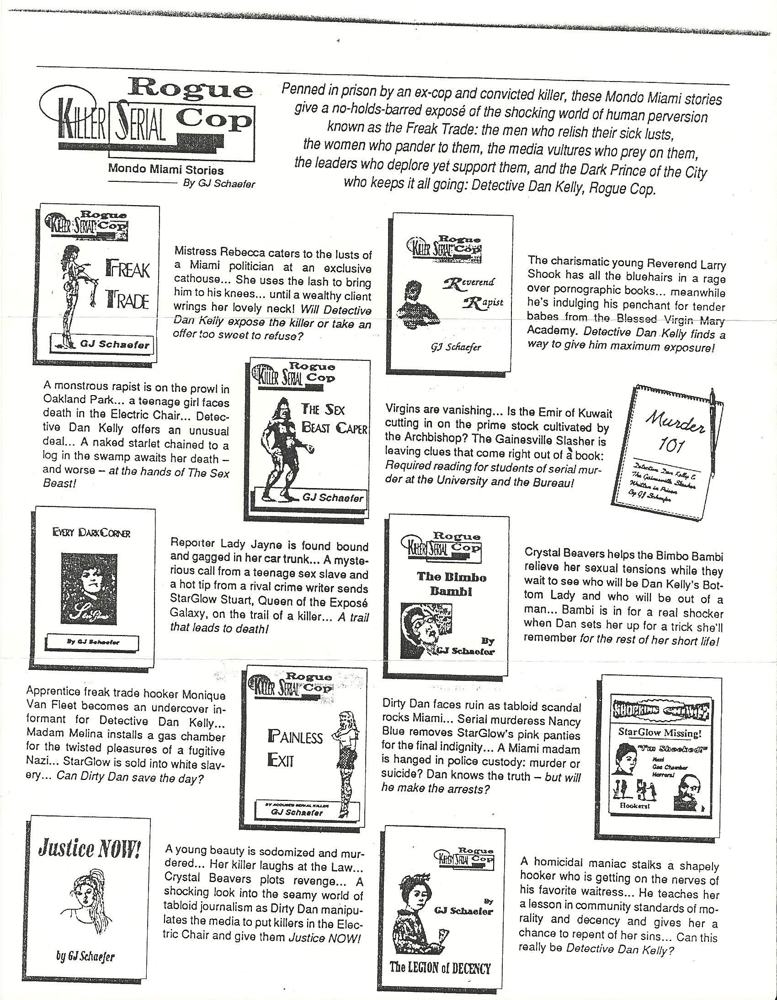
Notes:
Example of a website by the Jens Soering who murdered his girlfriend
http://jenssoering.com/home

Slide 22
6. Prison biographies: Freedom of expression or obscenity?
Should prisoners who are in jail for serious crimes such as murder and rape be able to publish literature on the crimes they committed?

Slide 23
7. Discussion about Lady Chatterley’s Lover: R v Penguin

Slide 24
Justice Byrne’s Summary of the Novel
The Judge attempted to summarise the plot of the novel, he said: “Is it right to say that the story is the story of a woman who first of all, before she is married, has sexual intercourse and then, after marriage, when her husband has met with disaster in the war and has become confined to a wheelchair, paralysed from the waist downwards, after marriage, she living with her husband in this dreary place of Wragby (I think it was called), commits adultery on two occasions with somebody called Michaelis while her husband is downstairs in the same house, and then proceeds to have adulterous intercourse with her husband’s gamekeeper? And that is described – it is for you to say; if you do not agree with what I am saying now you will pay no attention to it – that is described in the most lurid way, and the whole sensuality and passion of the various pieces of sexual intercourse is fully and completely described.” (231) Do you agree with this summary? Is anything missing? How would you summarise the novel? What does his summary tell us about him?

Slide 25
Christopher Hilliard
What is implied by Griffith-Jones for the prosecution asking whether the novel was “a book that you would ever wish your wife or your servants to read”? How would you respond to this? What does it tell us about the barrister for the prosecution? Why were women, young people, the working classes considered “intellectually and morally fragile” and vulnerable?

