Slide 1
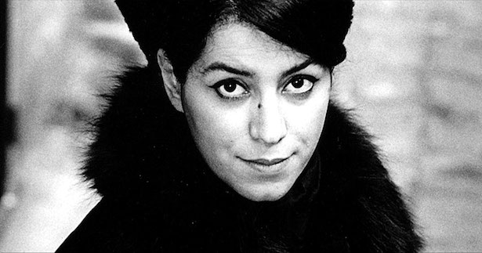
Marjane Satrapi’s Persepolis
Session aims:
To evaluate Satrapi’s portrayal of life in Iran for women and girls.
To analyse whether Satrapi succeeds in challenging or confirming stereotypes associating Iran with “fundamentalism, fanaticism, and terrorism”.
To critically engage with different theoretical interpretations of the Iranian women’s memoir genre.
To formulate an argument in response to the central themes explored in Persepolis.
Notes:
https://www.youtube.com/watch?v=x9ux4J17o8U https://www.youtube.com/watch?v=v9onZpQix_w
https://www.youtube.com/watch?v=eJbbU6AN2BY

Slide 2
Notices
Who wants to chair?
Door Access, Filming, Poster?
A vegetarian Lunch will be provided with tea and coffee.
All abstracts can be found on the ‘Teaching and Reading Materials’ page – please review these, particularly if you’re chairing.
Please review the new programme and check for any potential clashes. No changes will be possible after today!
If you would like to discuss your assessments after the conference, please email me. All office hours post conference will be by appointment only. We may need to correspond by email during the break.

Slide 3
PowerPoint
A Google Drive account has been created for the group, where the final presentations will be. I’ve started off both presentations with just with title slides.
You can work on your presentations on Google Slides or PowerPoint independently. Then, when you want to upload your slides to the Conference presentation, you click the link to the presentation for whichever day you are presenting and import your slides.
DAY 1 LINK: https://docs.google.com/presentation/d/1UKDu10IZKybrm9fX81QsMqdsXujT3Cr07VDFI_6MB9o/edit?usp=sharing
DAY 2 LINK: https://docs.google.com/presentation/d/1SLzxkKI8tGm8yS_9Yb0KiFAGQATChozvyQwFYfGQNDk/edit?usp=sharing

Slide 4
PowerPoint
If your presentation is a Google Slides presentation on your own Google Drive, go to your own presentation and:
Click ‘File’ —> ‘Download as…’ —> ‘Microsoft PowerPoint .ppt’
Follow the steps 2, 3, 4 and 5.
If your presentation is in PowerPoint:
Open the Conference presentation link that corresponds to your day
Go to the end of the presentation
Click ‘File’ —> ‘Import slides…’
Click the ‘Upload’ tab and upload your slides.
Any notes made on any of the slides will be retained throughout.
You can continue to edit/add anything to your slides after uploading. If you want to work on your presentation via the Conference presentation from the start so you don’t have to upload anything you can, but be aware that everyone will be able to see what you’re doing from the beginning in real time!

Slide 5
Last week
Central point: can we separate the Internet from the right to education?
When many historical archives and texts are digitalised and transferred to the Internet, learning and education is digitalised.
We can use this digitalisation to make learning and education more accessible and to ensure we establish the truth of the past and present.
This, therefore, connects or at least makes open access comparable to net neutrality, access to uncensored material of great importance.

Slide 6
What is censorship?
“a variety of processes are involved, formal and informal, overt and covert, conscious and unconscious, by which restrictions are imposed on the collection, display and dissemination, and exchange of information, opinions, ideas, and imaginative expression.”
Notes:
Censorship: A World Encyclopedia Edited by Derek Jones

Slide 7
John Milton 1644
“…books are not absolutely dead things, but do contain a potency of life in them to be as active as that soul was whose progeny they are; nay, they do preserve as in a vial the purest efficacy and extraction of that living intellect that bred them. I know they are as lively, and as vigorously productive, as those fabulous dragon’s teeth: and being sown up and down, may chance to spring up armed men. And yet, on the other hand, unless wariness be used, as good almost kill a man as kill a good book: who kills a man kills a reasonable creature, God’s image; but he who destroys a good book, kills reason itself, kills the image of God, as it were, in the eye.”

Slide 8
John Stuart Mill On Liberty
“it is not society that requires protection against the deviant individual but the individual whose rights need to be protected, not only against “the tyranny of the magistrate” but against “the tyranny of the prevailing opinion and feeling”, that is to say, the tendency of society to impose its own ideas and practices on rules of conduct for all”
Can we define sanctionable harms, and thus specify under what circumstances society may be justified in restricting the freedom of the individual?
Notes:
J M Coetzee Giving Offense: Essays on Censorship

Slide 9
The Three Functions of Freedom of Expression
“[I]t is one of the individual rights that most clearly reflects the virtue that marks – and characterizes – human beings: the unique and precious capacity to think about the world from our own perspective and communicate with one another in order to construct, through a deliberative process, not only the model of life that each one has a right to adopt, but the model of society in which we want to live. All our creative potential in arts, in science, in technology, in politics – in short, all our individual and collective creative capacity – fundamentally depends on the respect and promotion of the right to freedom of expression, in all its dimensions. This is therefore an individual right without which the first and foremost of our liberties would be denied: our right to think by ourselves and share our thoughts with others.”
“[F]reedom of expression is a fundamental international human right and a basic component of civil society based on democratic principles. Indeed, the full exercise of the right to express one’s own ideas and opinions, and to circulate all available information, as well as the possibility of deliberating in an open and uninhibited manner about the matters that concern us all, is an indispensable condition for the consolidation, functioning and preservation of democratic regimes. The formation of an informed public opinion that is aware of its own rights, citizen control over the conduct of public affairs and the accountability of public officials, would not be possible if this right was not guaranteed. […] the democratic function of freedom of expression deems it a necessary condition […] to ensure that “the mechanisms of citizen control and complaints” function.”
Notes:
The Inter-American Legal Framework regarding the Right to Freedom of Expression 30 December 2009

Slide 10
The Three Functions of Freedom of Expression
“freedom of expression is a key instrument for the exercise of all other fundamental rights. Indeed, it is an essential mechanism for the exercise of the rights to participation, religious freedom, education, ethnic or cultural identity and, needless to say, equality, understood not only as the right to be free from discrimination, but as the right to enjoy certain basic rights. Given the important instrumental role it fulfills, freedom of expression is located at the heart of the human rights protection system […] ‘lack of freedom of expression is a cause that ‘contributes to lack of respect for the other human rights.’”
Notes:
The Inter-American Legal Framework regarding the Right to Freedom of Expression 30 December 2009

Slide 11
Freedom
“Full and free discussion keeps a society from becoming stagnant and unprepared for the stresses and strains that work to tear all civilizations apart. A society that is to be free both today and in the future must engage openly in rigorous public debate about itself”
Notes:
The Inter-American Legal Framework regarding the Right to Freedom of Expression 30 December 2009

Slide 12
Direct and Indirect Censorship
There are three major means of direct censorship and they are all preventative in nature, to stop materials deemed unacceptable from appearing or prohibiting circulation.
Formal pre-publication review which is now mainly utilized in authoritarian societies where formal review boards or censors are assigned to determine whether material can be published.
Government or interest group monopolization of publication - where the censors are the producers (e.g. where the press and media are government controlled)
Licensing and registration – where the means of production and transmission of information may be limited to trusted groups who agree to self-censor in light of restrictions already imposed.
Notes:
Censorship and Secrecy, Social and Legal Perspectives Gary T Marx 2001

Slide 13
Indirect / Soft Censorship
Difficult to catalogue as these forms of censorship can be inventive, subtle and increasingly sophisticated, but could include:
Abuse of public funds and monopolies – such as direct cash payments to reporters to promote personal interests.
Abuse of regulatory and inspection powers – so this could translate into media owners being subject to regulatory regimes, media owners are often made to understand their businesses can only prosper if their media is friendly to the government in power.
Extra-legal pressure – powerful officials and politicians abuse their power to buy influence or muzzle dissent.
Notes:
The Growing Threat of Soft Censorship: A Paper on Indirect Restrictions on Freedom of Expression Worldwide – The Open Society Justice Initiative 12 December 2005

Slide 14
Four Problems with Freedom of Expression
Access to the Internet –
without censorship so we can discover a diversity and plurality of opinions, and
access to infrastructure, connectivity, software, hardware, so that every single person can benefit.
The use of the law to censor – defamation, libel, anti-terrorism efforts: “there are crimes against religion that are also considered a national security threat – defamation of religion in Islamic countries or blasphemy in European countries – which are also considered either against the culture, the traditions or the power of the state and therefore also become a threat.”
Technological forms of censorship, the monitoring, filtering and blocking” “slowly and without telling anyone they are creating their mechanisms in which they can monitor the communication, which is a breach to privacy and privacy rights, and within that monitoring, they can look at issues, they can censor, they can silence, they can filter and they can block”.
Professionalism and Neutrality of Press – Media and journalism is now a business creating a conflict of interest, “oftentimes the coverage they will have will be in favor of their economic interests”.
Notes:
Four Dangers for Freedom of Expression and the Internet: An Interview with Frank La Rue, UN Special Rapporteur on the Promotion and Protection of the Right to Freedom of Opinion and Expression.

Slide 15
Self-Censorship: Public and Private
Public self-censorship refers to a range of individual reactions to a public censorship regime. Individuals will internalise some aspects of the public censor and then censor themselves.
Private self-censorship is the suppression by an agent of his or her own attitudes where a public censor is either absent or irrelevant. Private self-censorship is a process of regulation between what an individual regards as permissible to express publicly, and that which he or she wishes to express publicly.
Notes:
Two Types of Self-Censorship: Public and Private – Philip Cook and Conrad Heilmann 2013

Slide 16
Is all self-censorship a response to a public censorship regime?
Is there only one type of self-censorship?
Is it possible to formulate your own conception of what is permissible to express without the intervention of a public censor?
Would reducing all cases of self-censorship to public self-censorship limit our understanding of the processes by which agents can regulate their behaviour?
Notes:
Two Types of Self-Censorship: Public and Private – Philip Cook and Conrad Heilmann 2013

Slide 17
Censorship Topics Covered
Sex, Obscenity and Immorality
Pornography
History
Law – The Right to Freedom of Expression
Education
Science and Censorship – Drug Laws
Internet
State Censorship

Slide 18
Identities
“I was a Westerner in Iran, an Iranian in the West. I had no identity. I didn’t even know anymore why I was living.“— Satrapi
Diasporic Iranian women’s literature has emerged as a response to the silences that have historically dominated Iranian women’s lives.
For many Iranian women, writing has become a means to regain a sense of identity and make themselves visible against the backdrop of negative imagery associating Iran with “fundamentalism, fanaticism, and terrorism”, which has rendered them silent and invisible.
We all have multiple identities. Please take two post-it notes and write down one identity that makes up who you are which is open, everyone can see it or everyone knows about it. Then on the other write down one identity that people don’t normally know of, a silent identity.
Place these two identities on the board.

Slide 19
Popular Narrative
There is a popular narrative about women’s lives in Iran over the last forty years. It goes something like this:
“During the Pahlavi Monarchy, women were on an upward trajectory. In a nation on the cusp of modernity, women actively participated. They were given the right to vote and were free to be in public without veils; they wore miniskirts on university campuses. Then came the Islamic Revolution in 1979, with Ayatollah Khomeini at the helm. The burgeoning freedoms for women were extinguished. The veil was required and institutions were segregated by gender. The Islamic Republic had thus achieved its goal of resurrecting the image of the traditional Muslim woman.”
This popular narrative presents half-truths, the real story is much more complicated, nuanced and less tidy.
Notes:
Jewels of Allah: The untold story of women in Iran by Nina Ansary

Slide 20
Misconceptions
Before the Pahlavi monarchy, it is often assumed that Persian women were always suppressed by the religious and political establishment.
It is often asserted that Iranian women did not advocate for their freedom until recently.
It is contended that during the Pahlavi era, all women were liberated.
Some argue that during Khomeini era, women were totally oppressed.
What misconceptions are there about you or your identity?
How does this effect you?

Slide 21
Social and Cultural Contextualisation
The declaration of the ‘war on terror’ after 9/11 has had a profound effect on the way in which Iranian women’s memoirs are constructed and consumed.
There is a demand in the global market place for a narrative trajectory of an oppressed Muslim woman being liberated from Iran and Islam by escaping to the West to experience ‘Western’ freedom.
Accordingly Iranian women writers have been accused of becoming “native informers”, “enlightened escapees”, and their memoirs “soft weapons”, because some critics believe they regurgitate the narrative of the oppressed woman liberated by their escape to the West, which can therefore be used to justify the need for colonial intervention.
They often play on the idea of being silent and then liberated by the freedom of speech available to them now they are in the West.
The question then becomes, what is the cost of “regaining” or RECLAIMING their identity?

Slide 22
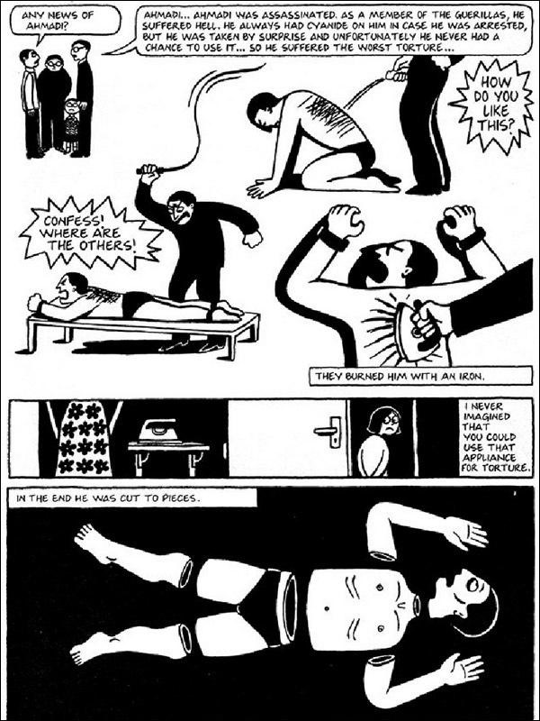
Censorship
In March 2013, the Chicago Public School district removed Persepolis from all seventh grade classrooms in the city. The school district defended its policy claiming it had not banned the book but removed it from the curriculum because it contained graphic language and images that were not appropriate for 12-13 year olds.
It has been banned in Iran, but in 2008 the animated film was screened a few times in Iran after sexual scenes were edited out.
Persepolis was initially banned in Lebanon after some clerics found it to be "offensive to Iran and Islam". The ban was later revoked after an outcry in Lebanese intellectual and political circles.

Slide 23
The currency of silence
Censorship has become part of the Iranian discourse of communication.
This is why proverbs such as:
‘hefz-e aberu [to save face]
Hefz-e zaher [to protect appearances]
Ba sili surat-o sorkh negah dashtan [to keep the face red with a slap]
Play a central role within Iranian family dynamics, even today.
Milani explains “ Iranian women upheld the social conventions of silence and segregation because they knew that ‘public disclosure of any […] aspects of a woman’s life was considered an abuse of privacy and a violation of societal taboos […] for which punishments […] were many and varied’”
Notes:
Milani, F. Veils and Words: the Emerging Voices of Iranian Women Writers. Syracuse University Press. p.46.

Slide 24
Paratextual reading
The French theorist Gerard Genette argues, all literary works consist of accompanying elements, beyond their actual words and content, that ‘mediate the book to the reader’. These elements, which he calls ‘paratexts’ are essentially influenced by the socio-political and cultural situation of the time in which a book becomes part of the public domain. According to Genette there are two elements of paratextual reading, and we will be focusing on a peritextual reading for our next exercise.
A peritextual reading will examine everything on the cover of the book. This reading will help readers to better situate and understand the book.
Make a peritextual reading of Persepolis in relation to some of the other covers on display in pairs.

Slide 25
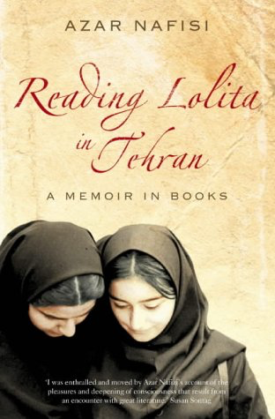
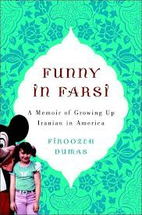
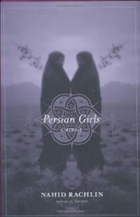
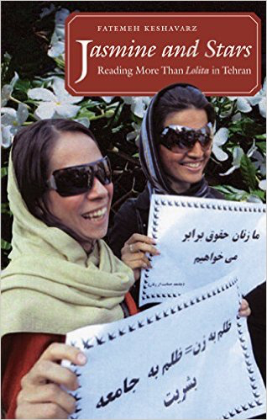

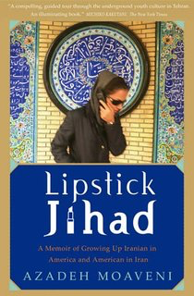
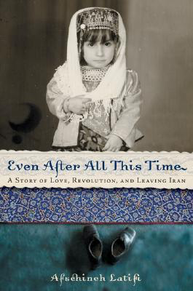
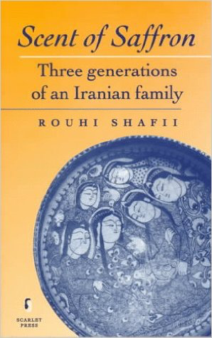

Slide 26
Article 10 ECHR: Right to Freedom of Expression
Everyone has the right to freedom of expression. This right shall include freedom to hold opinions and to receive and impart information and ideas without interference by public authority and regardless of frontiers. This Article shall not prevent States from requiring the licensing of broadcasting, television or cinema enterprises.
The exercise of these freedoms, since it carries with it duties and responsibilities, may be subject to such formalities, conditions, restrictions or penalties as are prescribed by law and are necessary in a democratic society, in the interests of national security, territorial integrity or public safety, for the prevention of disorder or crime, for the protection of health or morals, for the protection of the reputation or rights of others, for preventing the disclosure of information received in confidence, or for maintaining the authority and impartiality of the judiciary.

Slide 27
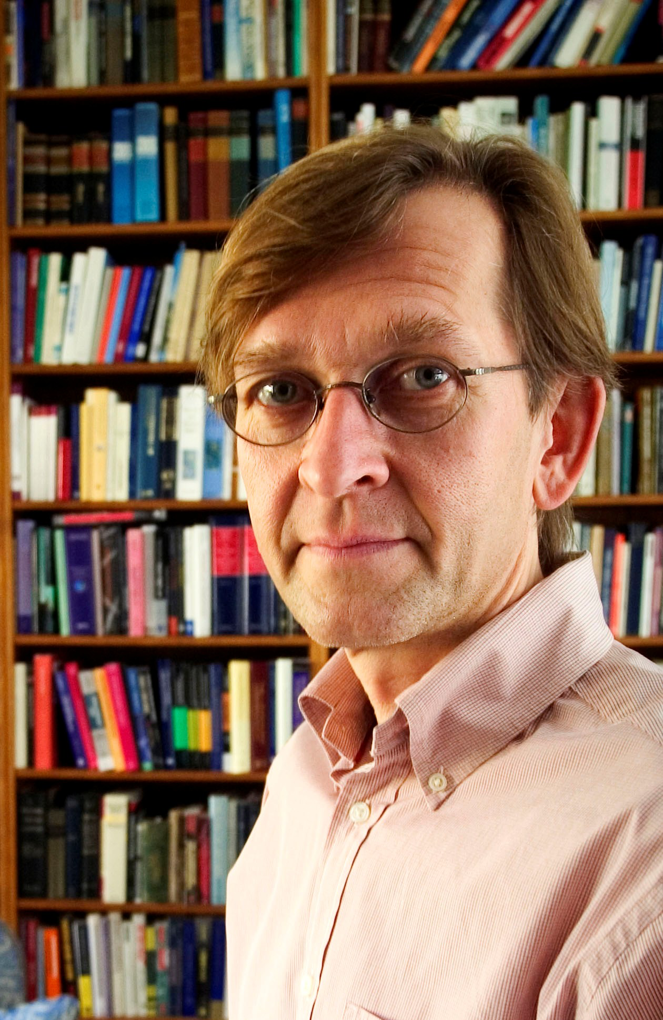
Critique of Human Rights:
“[W]hile the rhetoric of human rights has historically had a positive and liberating effect on societies, once rights become institutionalised as a central part of political and administrative culture, they lose their transformative effect and are petrified into a legalistic paradigm that marginalizes values or interests that resist translation into rights-language. In this way the liberal principle of the ‘priority of the right over the good’ results in colonization of political culture by a technocratic language that leaves no room for the articulation or realisation of conceptions of the good.” Discuss
M. Koskenniemi ‘The Effects of Rights on Political Culture’ in P. Alston (ed.) The EU and Human Rights (Oxford: OUP, 1999)

Slide 28
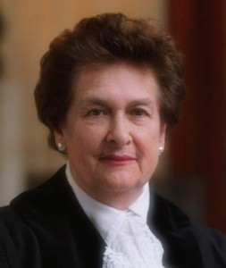
“…I believe, profoundly, in the universality of the human spirit. Individuals everywhere want the same essential things: to have sufficient food and shelter; to be able to speak freely; to practice their own religion or to abstain from religious belief; to feel that their person is not threatened by the state; to know that they will not be tortured, or detained without charge, and that, if charged, they will have a fair trial. I believe there is nothing in these aspirations that is dependent upon culture, or religion, or stage of development. They are as keenly felt by the African tribesman as by the European city-dweller, by the inhabitant of a Latin American shanty-town as by the resident of a Manhattan apartment.” Discuss
R. Higgins, Problems and Process: International Law and How We Use It (Oxford: Clarendon Press, 1994) 96

Slide 29
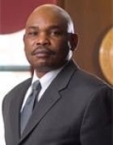
“As currently constituted and deployed, the human rights movement will ultimately fail because it is perceived as an alien ideology in non-Western societies. The movement does not deeply resonate in the cultural fabrics of non-Western states, except among hypocritical elites steeped in Western ideas. In order to ultimately prevail, the human rights movement must be moored in the cultures of all peoples.”
Do you agree with this statement? Give reasons for your response?
M. Mutua, ‘Savages, Victims and Saviors…’ 42 (2001) Harvard International Law Journal 201 at 208

Slide 30
Frank La Rue
“the international standards of human rights are the minimum not the maximum, are the minimum required to respect human life and human dignity for everyone in the world. And, there is no space for cultural relativism. It is really important that we understand that they cannot, as a principle, change from culture to culture – they have to be the same. In practice, the way that they are applied or exercised may change. I mean, the newspapers, the media may have a different format, a different form, but in all countries the principle of the freedom of expression has to be the same.”
Notes:
Four Dangers for Freedom of Expression and the Internet: An Interview with Frank La Rue, UN Special Rapporteur on the Promotion and Protection of the Right to Freedom of Opinion and Expression.

Slide 31
Why are we discussing universal human rights?
Does Satrapi’s life narrative become a valuable commodity?
When Satrapi reveals the human rights violations in Iran does she enable her text becoming a “soft weapon”?
What does Satrapi tell her readers about censorship?

Slide 32
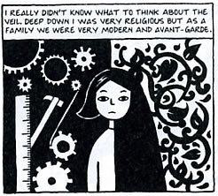
Consider Satrapi’s portrayal of the chador – is it a symbol of oppression?
British House of Lords Baroness Brenda Marjorie Hale in Begum v. Denbigh High School contends:
“If a woman freely chooses to adopt a way of life for herself, it is not for others, including other women who have chosen differently, to criticise or prevent her. Judge Tulkens, in Sahin v Turkey draws the analogy with freedom of speech. The European Court of Human Rights has never accepted that interference with the right of freedom of expression is justified by the fact that the ideas expressed may offend someone. Likewise, the sight of a woman in full purdah may offend some people, and especially those Western feminists who believe that it is a symbol of her oppression, but that could not be a good reason for prohibiting her from wearing it.”

Slide 33
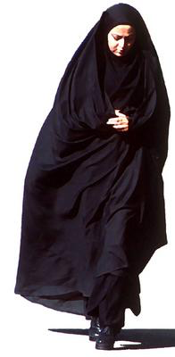
The Veil
A seminal Iranian women’s memoir Azar Nafisi’s Reading Lolita in Tehran has been accused of creating an image of veiled women that is nondescript and devoid of character. In her memoir, women become fully alive and human only when they cast the veil aside.
Persepolis incorporates the veil in cartoons that characterise girls and women as distinctive individuals and human agents. Differences of emotion, personality, and physique among veiled Iranian girls and women remain vivid, this is an important statement for gender politics.
How do you interpret the descriptions of the experience of Iranian girls and women wearing the veil in Iran?
How does Satrapi explore the censoring of the body in her memoir?

Slide 34
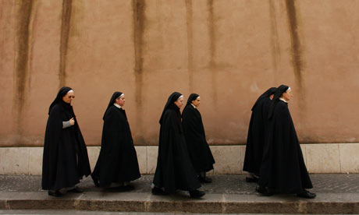
Life in a convent in Austria and Life in Iran
When Marji leaves Iran and goes to a convent in Austria we are invited to compare the veiled women and institutional surroundings of Catholicism with the Islamic Republic of Iran.
How do these black and white images influence your perceptions of the veil?
What political point is Satrapi making?
If we reduce Iranian women to a struggle over the veil, either for or against, we are simplifying and inappropriately reproducing the errors of fundamentalism, represented by Satrapi in the mirror-imaging of life in the convent.
How does Satrapi complicate our understanding of the veil?

Slide 35
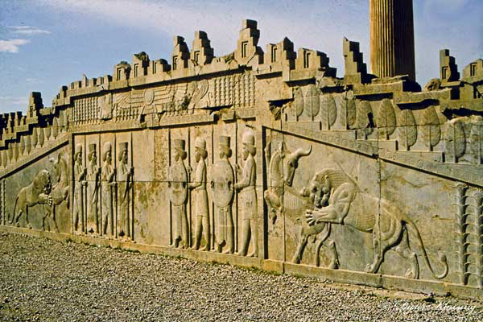
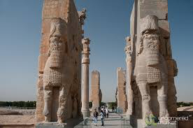
Persepolis
Persepolis was a name given by the Greeks for what Persians used to call Takht-e-Jamshid (Jamshid’s Throne). It means “the city of Persians”. It was the ceremonial capital of the Persian Empire in 550-330 BC until it was captured and destroyed by Alexander the Great in 330 BC when he invaded Persia. Centuries later, after the Arab conquest of the Persian Empire, Persepolis was eclipsed by the city of Shiraz. Although in ruins today, Persepolis remains a city central to Persian identity: it recalls a time when Iran was a powerful empire and when it was pre-Islamic. Since 1979, however, the Islamic Republic of Iran has tried to diminish Persepolis’ importance as part of a larger policy against Iran’s pre-Islamic heritage.
By Satrapi naming her memoir with the western name for this pre-Islamic city central to Iranian identity, Satrapi identifies her work as both ‘Western’ and truly Persian, a political gesture aimed at an Islamic regime which refuses Iran’s diversity of opinions and identities.

Slide 36
Group Activity – Applying Theory
There are eight theoretical responses to Iranian women’s memoirs – work as a team to establish:
how you might apply the theory to the text
what the problems might be in applying the theory
do you agree or disagree with the theory
explain any limitations
try to work out how you might extend or further this reading

Slide 37
Constructing an Argument
In your group work through as many of the theoretical interpretations we have discussed in this session and write a paragraph using a PEA:
Make a Point/argument
Provide Evidence from the text and theory
Analyse how the theory applies, how does it further your understanding, what might be the limitations, how might you extend this reading?
You will have colour coded post-it notes, use three post-it notes for each theory.

Slide 38
Marjane Satrapi introduces Persepolis, she begins “this old and great civilization has been discussed mostly in connection with fundamentalism, fanaticism, and terrorism. As an Iranian who has lived more than half of my life in Iran, I know that this image is far from the truth.” How does Satrapi go about challenging this myth? How does Persepolis dispel/CONFIRM these stereotypical views of Iran?

Slide 39
Explore Satrapi’s representation of the chador. Provide an example from the text to support your view.

Slide 40
Do you think life narratives circulate as exotic commodities with an economic exchange value, or do they carry in their economy of exchange emotional value and aesthetic value, that shape how we think about others, and ourselves, and how we understand what it means to be human?

Slide 41
“Every situation offered an opportunity for laughs” (Satrapi 97). Explore the creative forms of resistance Marjane Satrapi uses to challenge the oppression she experiences.

Slide 42
Student Conference
How does your presentation engage with debates surrounding censorship? Does your presentation engage with any of the content we have covered? Can you draw any interesting connections?
Focus on analysing rather than explaining and describing.
Create a distinct and independent argument that stands alone.
Consider delivery – speak clearly, emphasise your argument, try to do more than just read from a script, get creative!
Consider the questions and answers you would like and correspond with your chair.
Consider connections – this can take form of similarities and differences between your presentations or presentations delivered in other groups.
Support your argument with evidence – what scholarly references are you relying on and what makes your presentation unique, and important – what’s the point? Challenge what you read – avoid merely accepting what you read as the truth.
When referencing the work of others – ask yourself – how do you go beyond or further the argument – be careful in your presentation to find your voice and your argument – what makes your presentation new and original? What contribution are you making to your chosen topic?

Slide 43
Review your abstracts
Circulate the room and find someone you don’t normally speak to
Read each others abstracts
Offer some positive feedback
Consider:
What may be important to their presentation?
What would you include?
What arguments do they need to consider?
What research do you suggest they do?

Slide 44
Review your first blog posts in week 1
Has your opinion changed?
What is censorship?

Slide 45
Assessments
Any questions on your other assessments?

