Slide 1


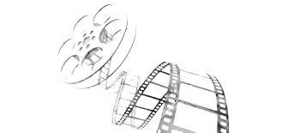
'Spider-man' and polymers (film, 2002)
The web with which Spiderman swings, slides and jumps through the streets of New York City is a long-chain polymer similar to nylon….
Science on Screen
Project

Slide 2
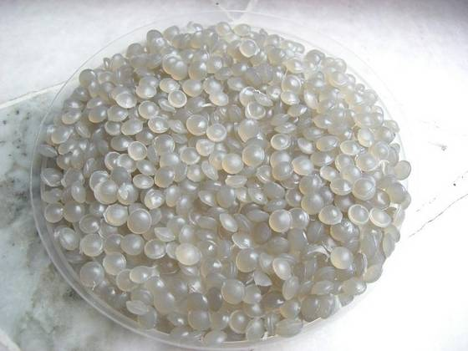
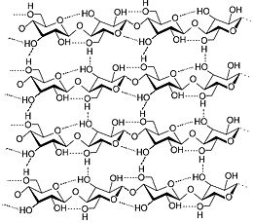
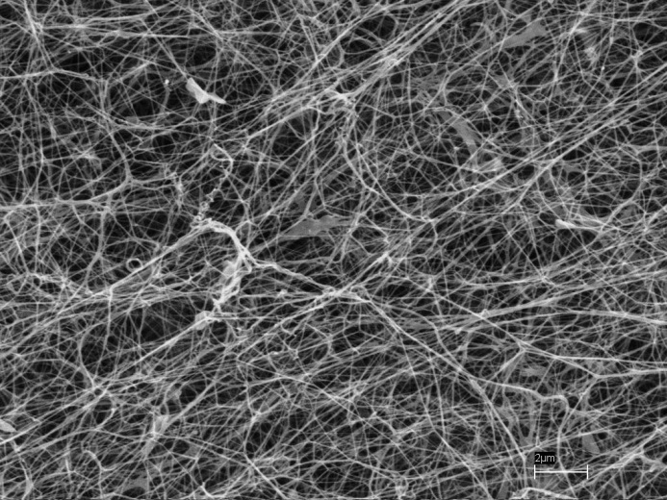
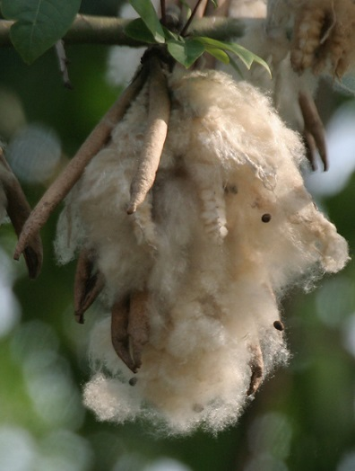
What is a Polymer?
Polymers are a large class of materials consisting of many small molecules (called monomers) that can be linked together to form long chains. A typical polymer may include tens of thousands of monomers. Because of their large size, polymers are classified as macromolecules.
Prior to the early 1920's, chemists doubted the existence of molecules having molecular weights greater than a few thousand.
Hermann Staudinger proposed that natural compounds such as rubber and cellulose were made up of macromolecules composed of 10,000 or more atoms.
He formulated a polymeric structure for rubber, based on a repeating isoprene unit (referred to as a monomer). For his contributions to chemistry, Staudinger received the 1953 Nobel Prize. The terms polymer and monomer were derived from the Greek roots poly (many), mono (one) and meros (part).

Slide 3
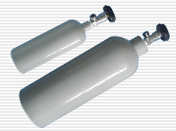
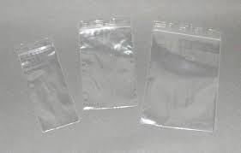
What is a Polymer?
Polymers are a large class of materials consisting of many small molecules (called monomers) that can be linked together to form long chains. A typical polymer may include tens of thousands of monomers. Because of their large size, polymers are classified as macromolecules.
Monomer
Polymer
Polymerisation
Gas
Solid

Slide 4
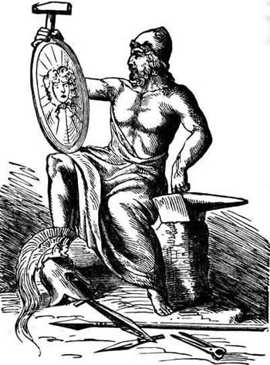
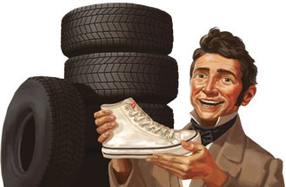
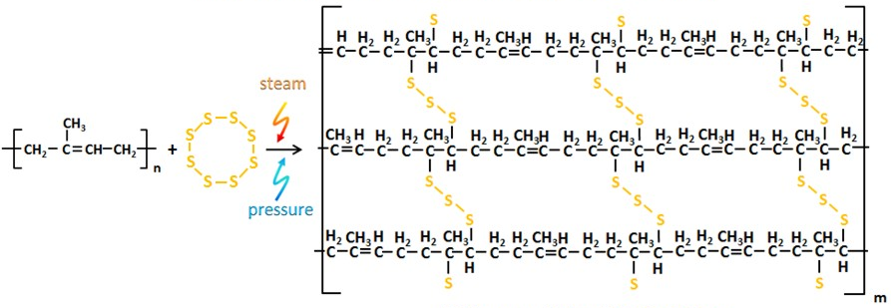
History of polymers
It was not until the industrial revolution that the modern polymer industry began to develop. In 1839, Charles Goodyear succeeded in producing a useful form of natural rubber through a process known as "vulcanization“ – vulcanized rubber. Vulcanization is a chemical process for converting natural rubber into more durable materials via the addition of sulfur or other equivalent additives.
These additives modify the polymer by forming cross-links (bridges) between individual polymer chains. At 2 to 3% crosslinking a useful soft rubber, that no longer suffers stickiness and brittleness problems on heating and cooling, is obtained.
Rubber, cross-linked polymer : Thermoset (once formed, cannot be reshaped by heating)
Notes:
Thermoset A polymer that has undergone crosslinking by chemical covalent bind formation via a cure chemical reaction

Slide 5


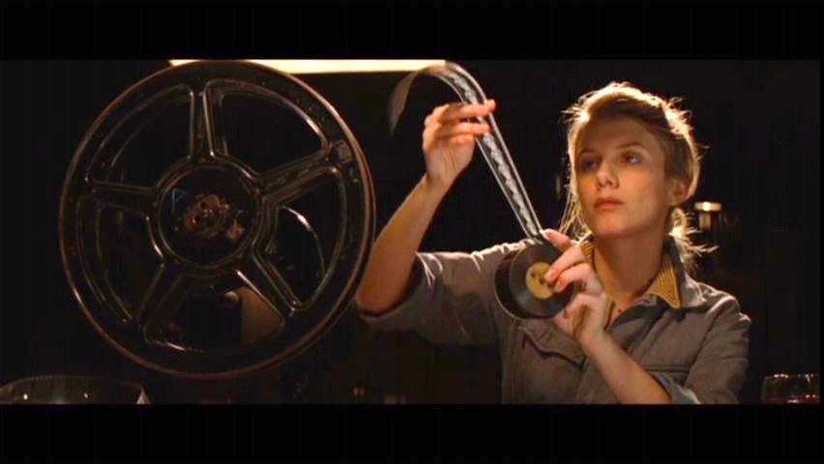
History of polymers
Toto’ and Alfredo
Nuovo Cinema Paradiso,
Giuseppe Tornatore, 1988
Shosanna
Inglourious Basterds,
Quentin Tarantino, 2009
40 years later, Celluloid (a hard plastic formed from nitrocellulose) was successfully commercialised.
Generally considered the first thermoplastic, it was first created as Parkesine in 1856 and as Xylonite in 1869, before being registered as Celluloid in 1870.
The main use was in movie and photography film industries, which used only celluloid films prior to acetate films that were introduced in the 1950s.
Notes:
Thermoplastic A polymer that softens and hardens reversibly on changing the temperature. Can be made to flow by the application of heat. Enables fabrication by processes such as injection moulding and extrusion

Slide 6
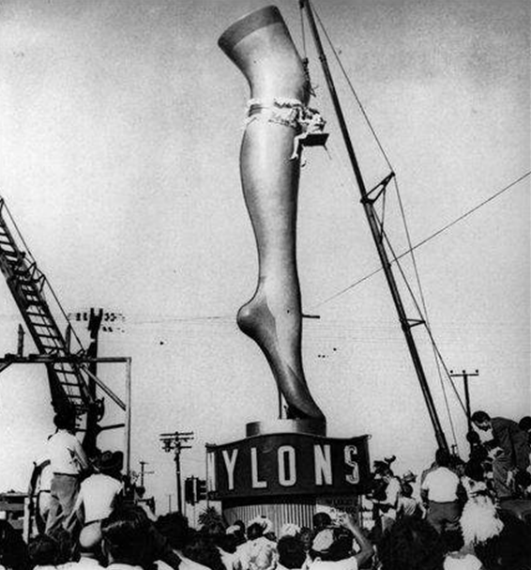
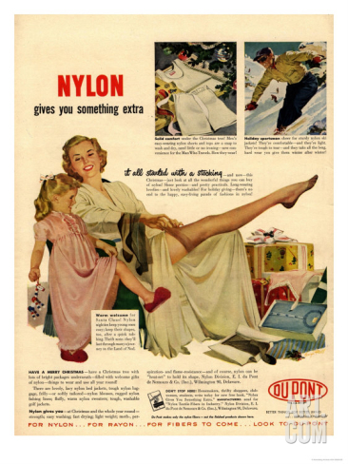
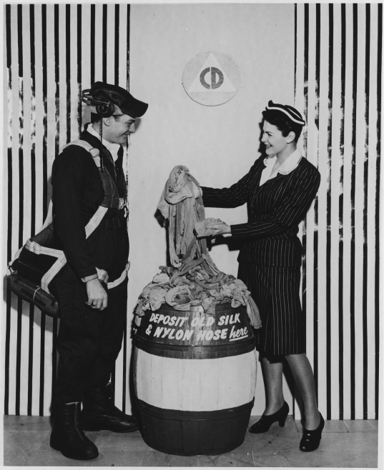

History of polymers
Nylon was first produced in 1935 by the American chemist Wallace Hume Carothers (1895 – 1937) – employed by DuPont Company with the aim of producing a polymer that could be a substitute for natural fibres.
Nylon was invented after one stroke of luck resulted from a lighthearted challenge in the lab – a member of the Carothers team noticed that he could form fibers if
he separated a portion of a soft polyester material using a glass stirring rod and pulled it away from the clump.
Nylon stockings were demonstrated at the 1939 New York World’s Fair and went on sale in the 15th of May 1940. The whole stock of 5 million pairs sold out in a single day.
The outbreak of the Second World War led to a more pressing demand for Nylon to
replace silk for the canopies of parachutes
- thermoplastic.
5.4 million tonnes of Nylon are currently manufactured each year worldwide.

Slide 7
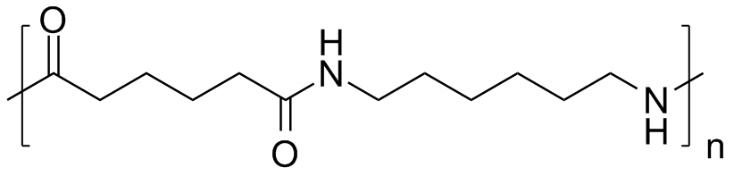
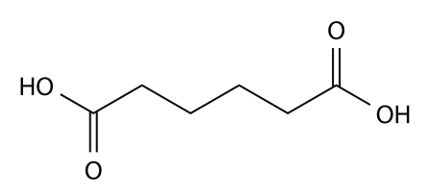

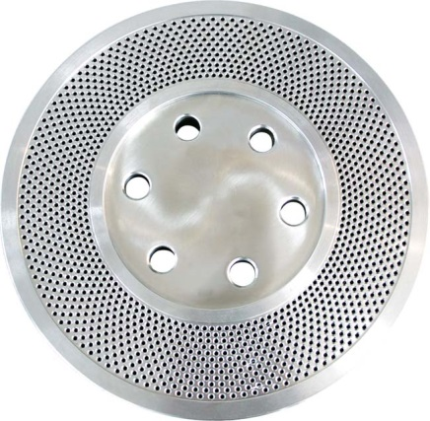
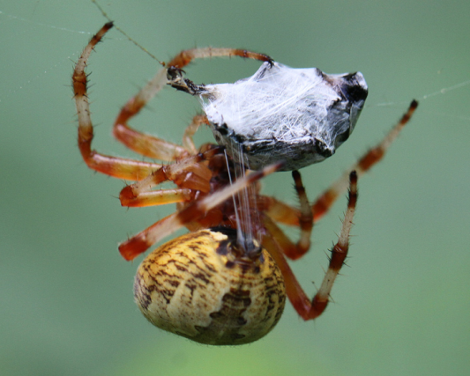
History of polymers
The nylon polymer (polyamide) is made by reacting together two fairly large molecules using moderate heat (roughly 285°C or 545°F) and pressure in a reaction vessel called an autoclave, which is a bit like an industrial-strength kettle. The starting molecules are adipic acid and hexamethylenediamine. When they combine, they fuse together to make an even larger molecule and give off water in a chemical reaction known as condensation polymerization (condensation because water is eliminated; polymerization because a big, repeating molecule is produced).
Removing water drives the reaction:
n + n → + 2n H₂O
toward polymerization through the formation of amide bonds from the acid and amine functions.
Thus molten nylon 66 is formed. When Nylon is mass produced, the polymer molecules are aligned as they pass through the tiny holes in the spinneret used to form the Nylon into fibres.

Slide 8
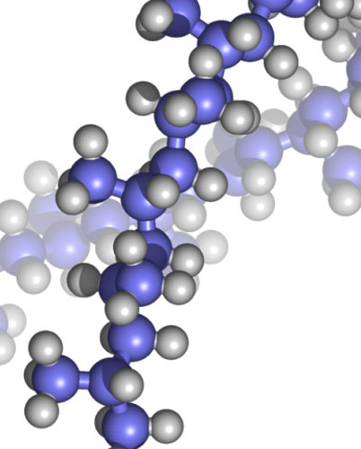
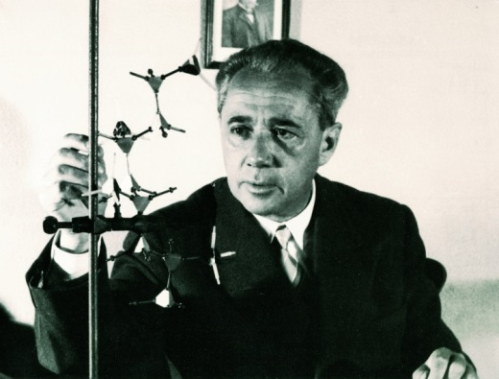

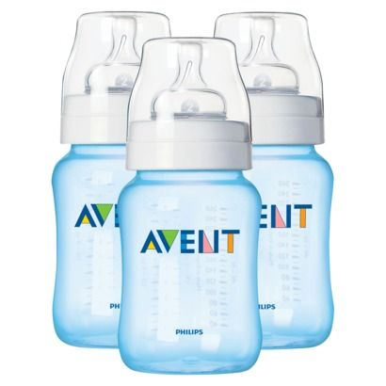
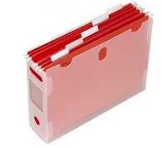
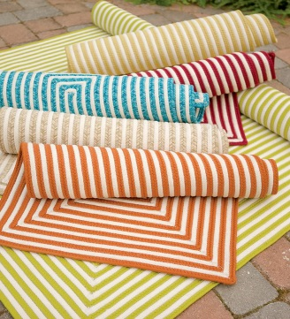
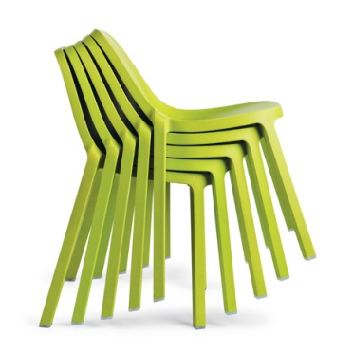
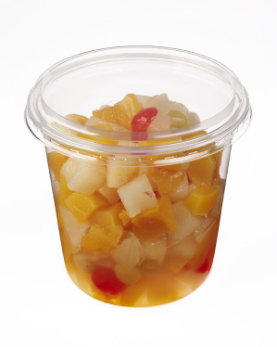
History of polymers
Despite these advances, progress in polymer science was slow until the 1930s, when materials such as vinyl, neoprene, and nylon were developed.
March 1954 – Discovery of isotactic polypropylene
by Giulio Natta (Nobel prize 1963)
Isotactic polypropylene is a thermoplastic polymer used in a wide variety of applications
The practical significance of tacticity rests on the effects on the physical properties of the polymer. The regularity of the macromolecular structure influences the degree to which it has rigid, crystalline long range order or flexible, amorphous long range disorder. Precise knowledge of tacticity of a polymer also helps understanding at what temperature a polymer melts, how soluble it is in a solvent and its mechanical properties.

Slide 9
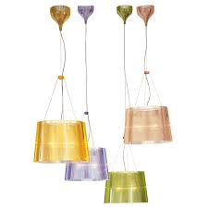
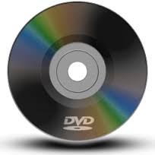
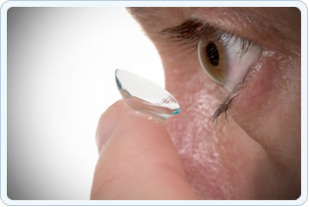
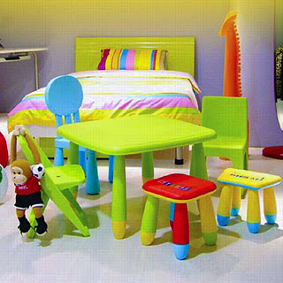
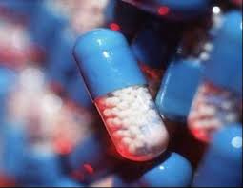
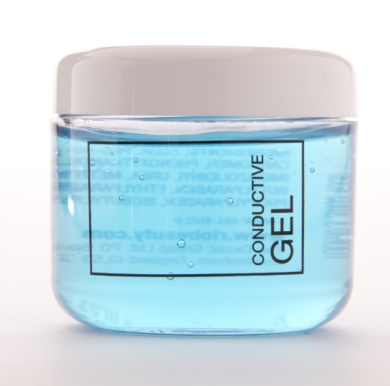
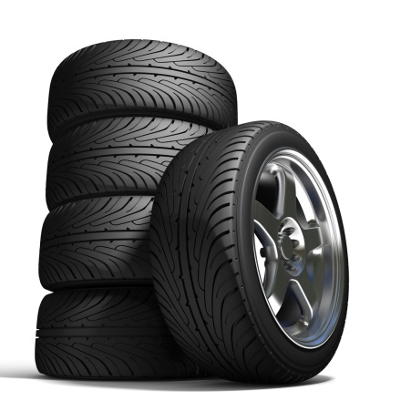
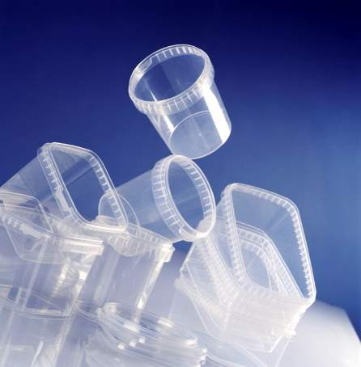
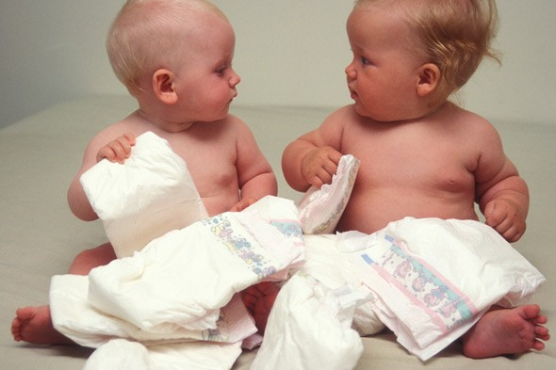
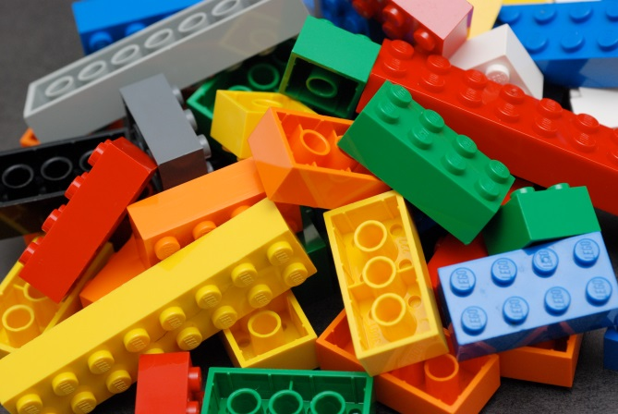
History of polymers - now

Slide 10
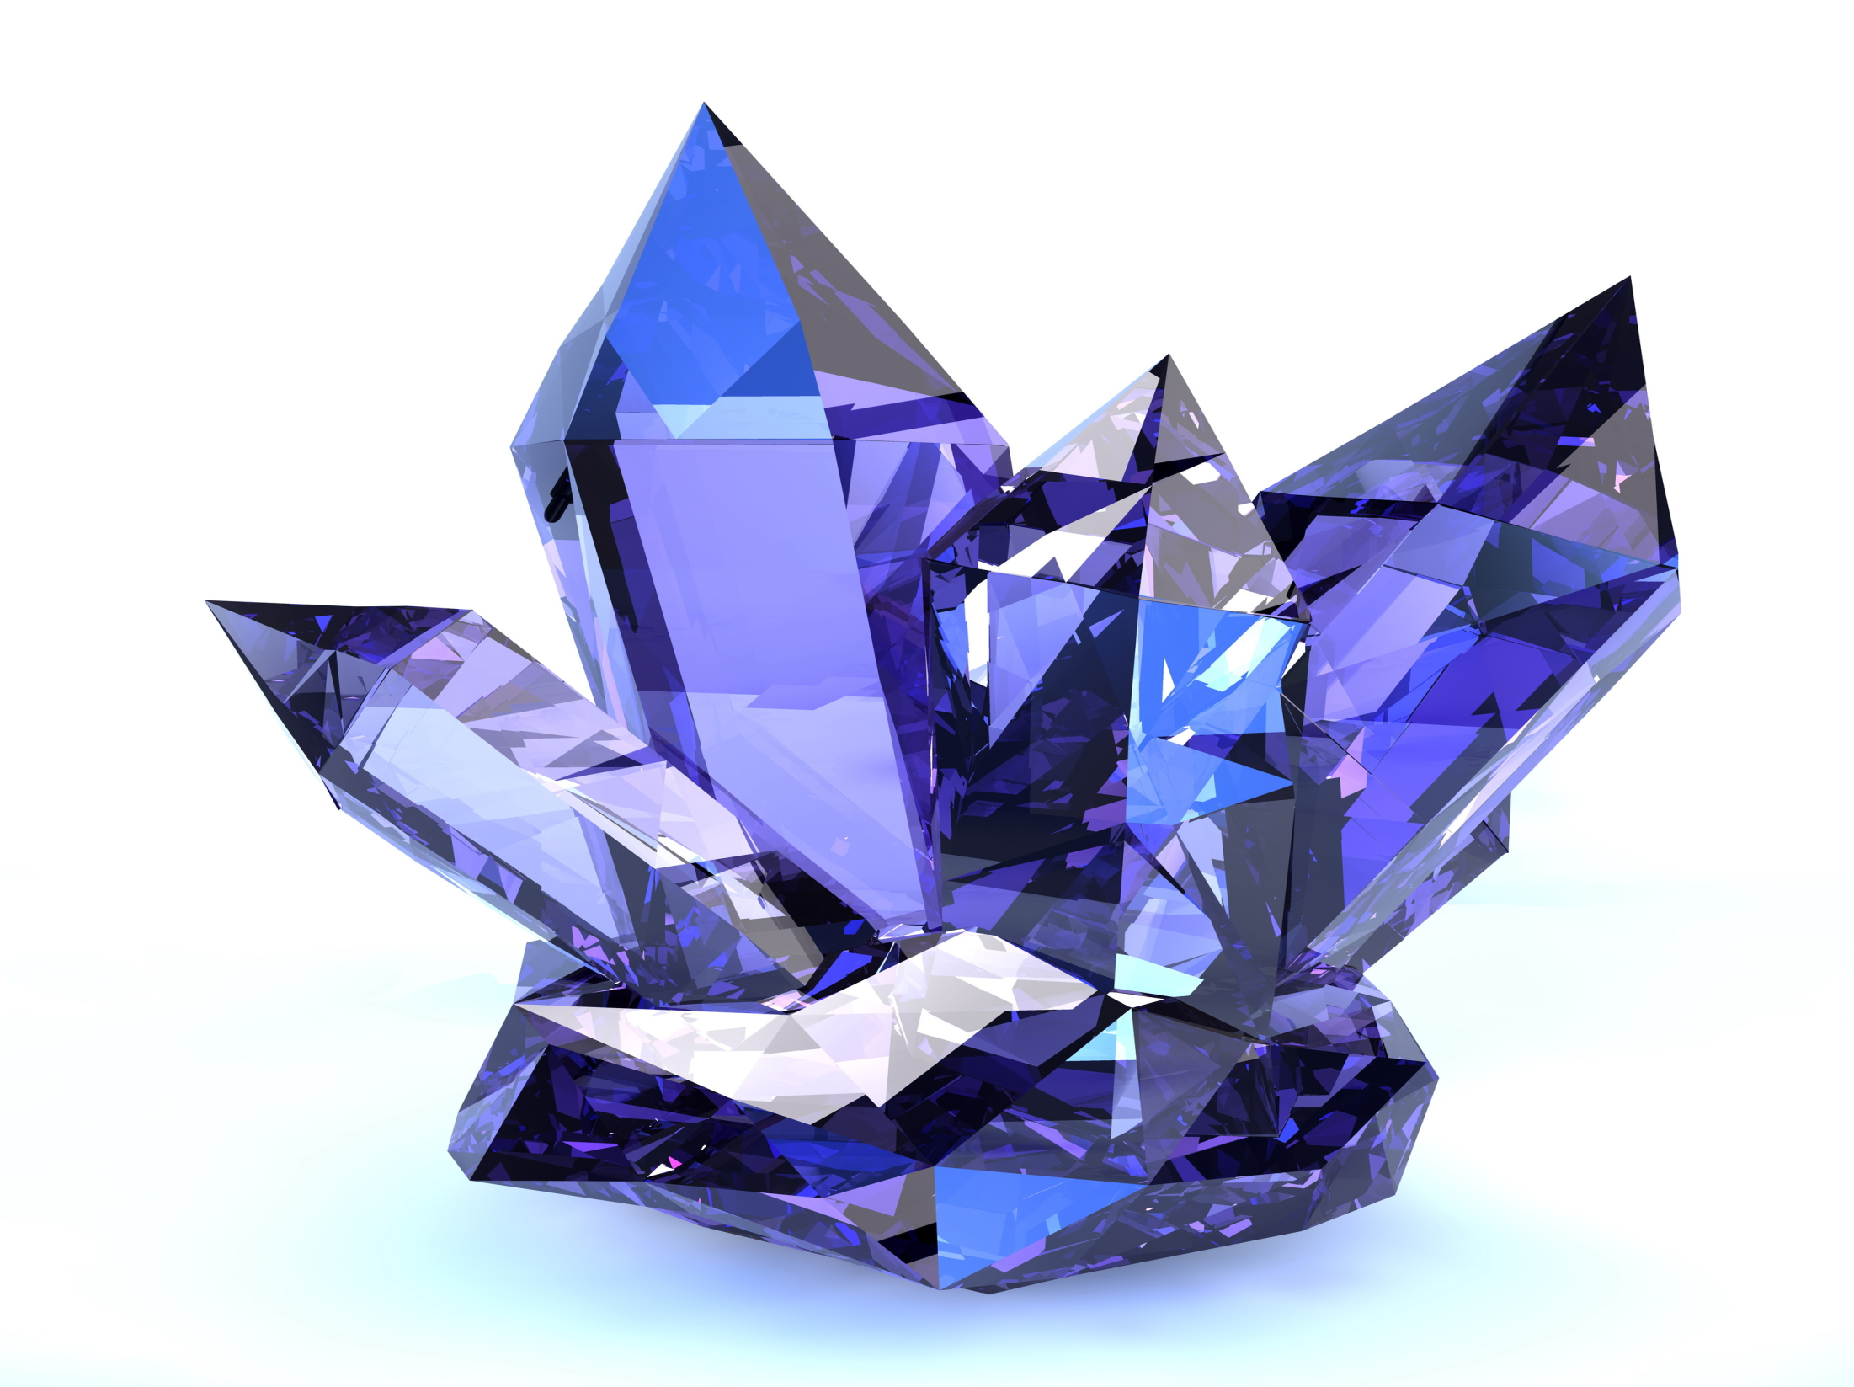
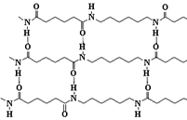
Crystal or not crystal?!
Polymers are different: different morphology.
Because polymer molecules are so large, they generally pack together in a non-uniform fashion, with ordered or crystalline-like regions mixed together with disordered or amorphous domains.
Crystallinity occurs when linear polymer chains are structurally oriented in a uniform three-dimensional matrix. Increased crystallinity is associated with an increase in rigidity, tensile strength and opacity (due to light scattering).
Amorphous polymers are usually less rigid, weaker and more easily deformed. They are often transparent.
Three factors that influence the degree of crystallinity are:
1) Chain length (LPDE, HPDE)
2) Chain branching (LPDE, HPDE)
3) Interchain bonding (Cellulose, Nylon, vulcanized rubber)
Temperature –Thermal transitions:
Melt transition T_{m} and the glass transition T_{g} .
Elastomers are amorphous polymers that have the ability to stretch and then return to their original shape at temperatures above T_{g} (gaskets and O-ring). At temperatures below T_{g} elastomers become rigid glassy solids and lose all elasticity. A tragic example of this caused the space shuttle Challenger disaster. The heat and chemical resistant O-rings used to seal sections of the solid booster rockets had an high T_{g} near 0ºC. The unexpectedly low temperatures on the morning of the launch were below this T_{g}, allowing hot rocket gases to escape the seals.
Notes:
T_{m} is the temperature at which crystalline domains lose their structure, or melt. As crystallinity increases, so does T_{m}.
T_{g} is the temperature below which amorphous domains lose the structural mobility of the polymer chains and become rigid glasses.
The heat and chemical resistant O-rings used to seal sections of the solid booster rockets had an unfortunately high T_{g} near 0 ºC. The unexpectedly low temperatures on the morning of the launch were below this T_{g}, allowing hot rocket gases to escape the seals.

Slide 11
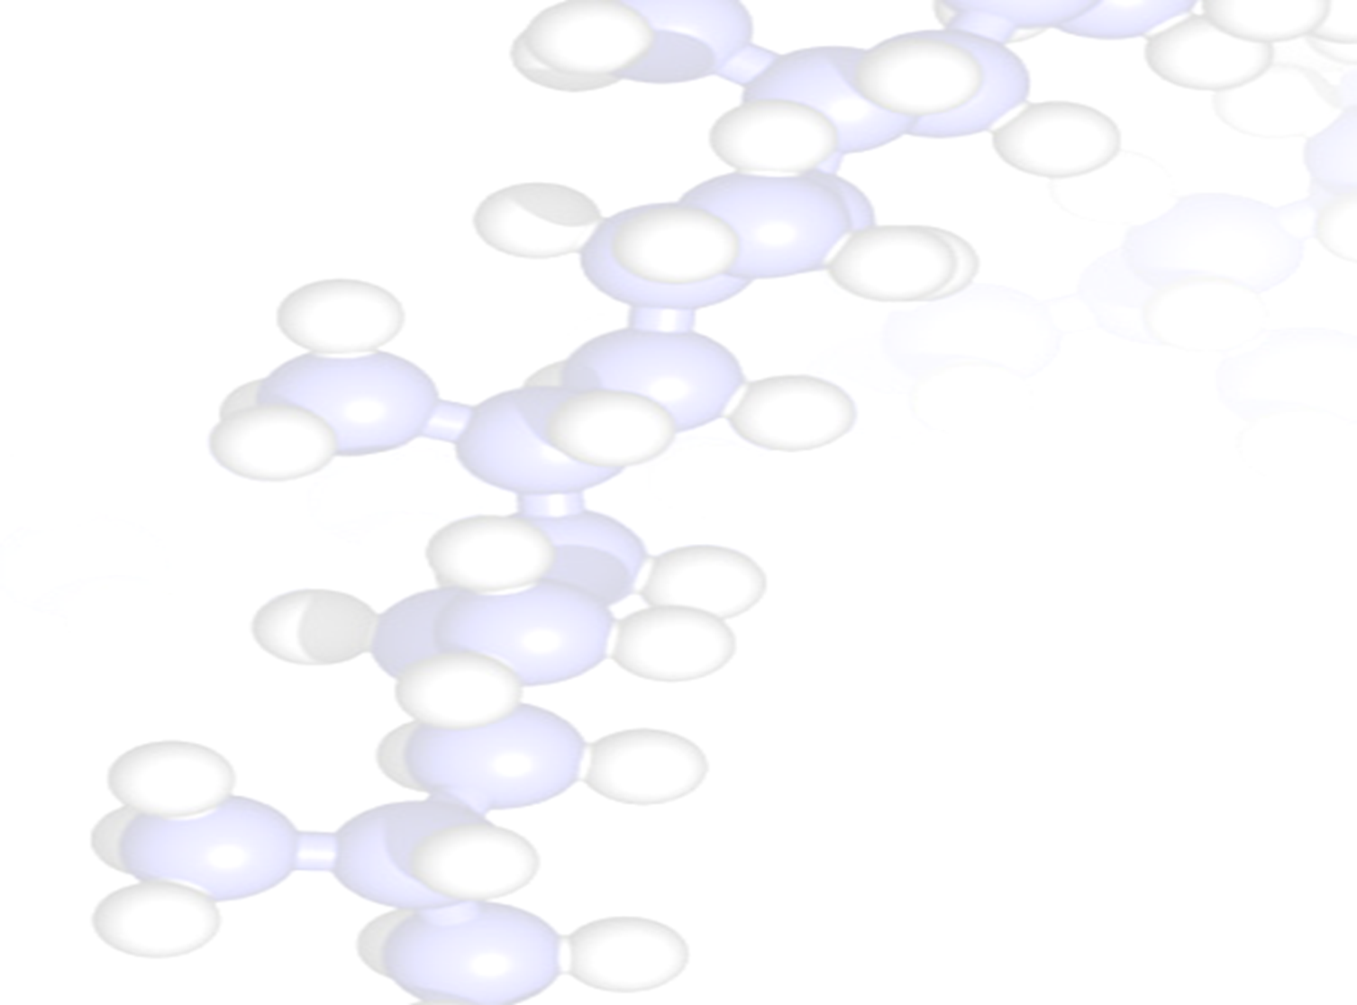
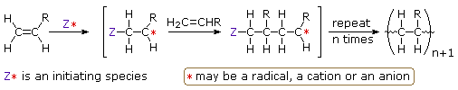
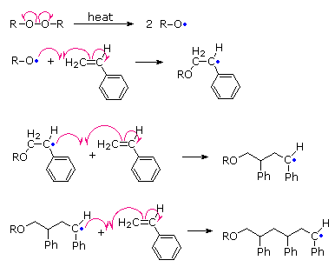
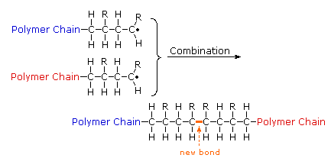
How to make polymers
Addition polymerization – Chain growth polymerisation
All the monomers from which addition polymers are made are alkenes or functionally substituted alkenes. Addition reactions are known to proceed in a stepwise fashion by way of reactive intermediates, and this is the mechanism followed by most polymerizations.
Start a chain growing
Initiation
Chain growth
Propagation
Chain stops growing
Termination
Initiation
Termination
Propagation
Radical Chain-Growth Polymerization of Vinyl Chloride

Slide 12
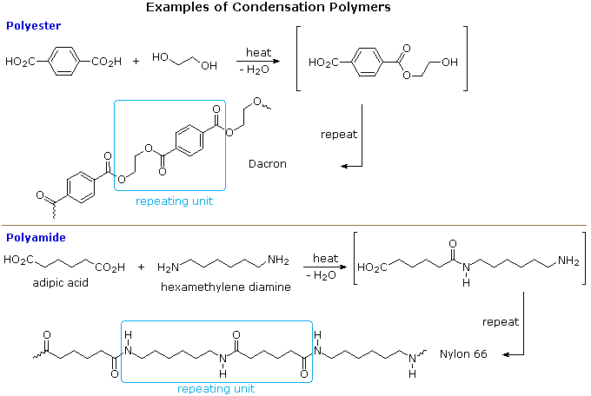
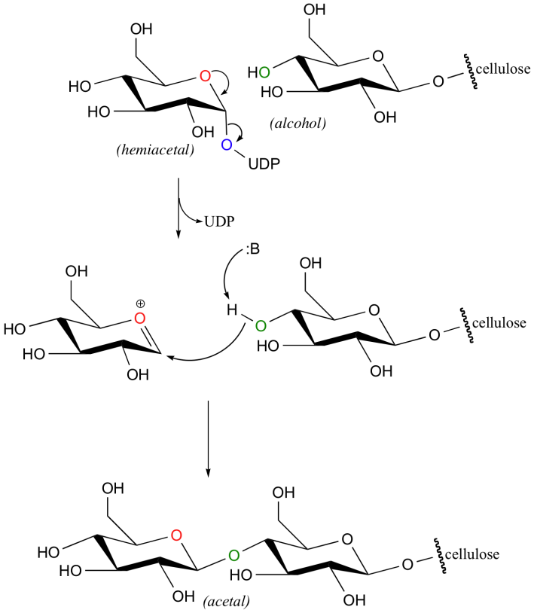
How to make polymers
Condensation Polymerization – Step growth polymerisation
A large number of important and useful polymeric materials are formed by conventional functional group transformations of polyfunctional reactants. These polymerizations often occur with loss of a small byproduct, such as water, and generally combine two different components in an alternating structure.
Examples of naturally occurring condensation polymers are cellulose, the polypeptide chains of proteins.

Slide 13
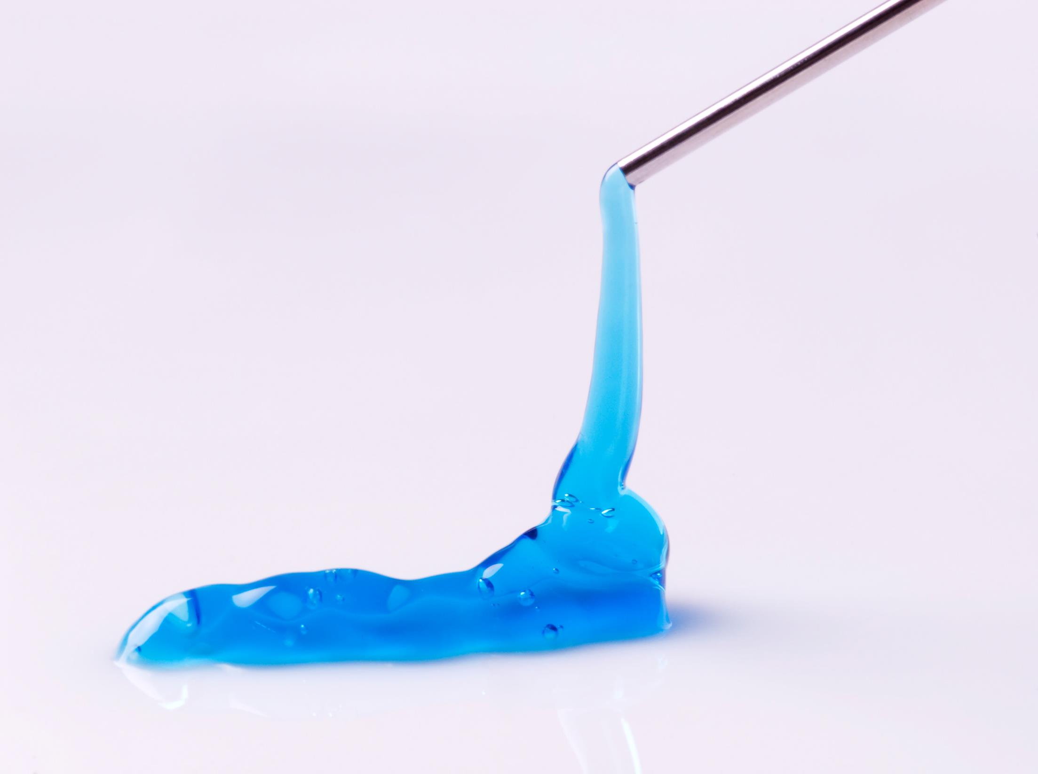


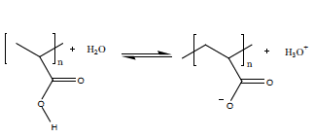
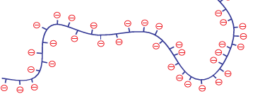
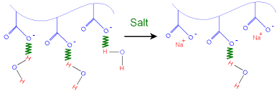
Hydrogels
What is the connection between soft contact lenses, disposable nappies, Fonzie, Elvis Presley and plant water crystals?
They all make use of substances called hydrogels.
Hydrogels are currently viewed as water insoluble, crosslinked, three-dimensional networks of polymer chains plus water that fills the voids between polymer chains.
Crosslinking facilitates insolubility in water and provides required mechanical strength and physical integrity.
The ability of a hydrogel to hold significant amount of water implies that the polymer chains must have at least moderate hydrophilic character : carboxylic acids – hydrogen of the acid group dissociate in water.
Negative charges:
• Repel each other. Polymer uncoiling.
• Attract water molecules. Hydrogen bonds formation.
The uncoiling of the polymer and its increased attraction to water causes swelling of the hydrogel.
Notes:
Gels are a dispersion of molecules of a liquid within a solid in which the solid is the continuous phase and the liquid is the discontinuous phase.

Slide 14
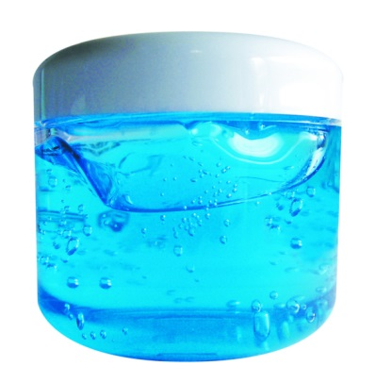

Hydrogels
Three-dimensional networks of hydrophilic polymer chains that do not dissolve but can swell in water.
Both solid like and liquid like properties.
High biocompatibility - not harm the body or stimulate an immune reaction (contact lenses).
Environmental stimuli respondent, ’smart’ or ‘stimulus responsive’ material : changes some properties (e.g. shape) in response to a change in environment (e.g. temperature, pH, light, specific molecules, ionic strength). Reversible changes.
More acid (lower pH) favors a neutral charge, and more alkali (higher pH) favors a negative charge. pH change results in a change in the shape of the polymer network.
coiled – not swollen
uncoiled – swollen
When sodium chloride is added to water, it dissociates to positive sodium ions and negative chloride ions. The positive sodium ions associate with negatively charged carboxylate ions: some water molecules are displaced and the negative charges along the polymer chain repel each other less.
uncoiled – swollen
coiled – not swollen

Slide 15
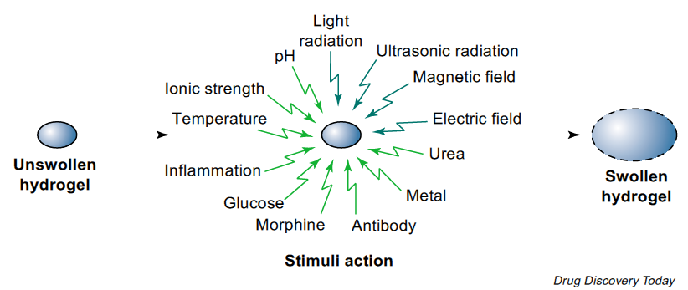
Hydrogels
Ideal for controlled drug delivery: stimuli-responsive drug delivery systems
Variations in pH are known to occur at several body sites (e.g. gastrointestinal tract, blood vessels..) and these can provide a suitable base for pH-responsive drug release. In addition, local pH changes in response to specific substrates can be generated and used for modulating drug release.
Change in pH for gel swelling
Drug-loaded gel
Change in temperature for gel collapse
Drug release through the swollen network
Drug release by the squeezing action
Benefits of controlled drug delivery
more effective therapies with reduced side effects
maintenance of effective drug concentration levels in the blood

Slide 16
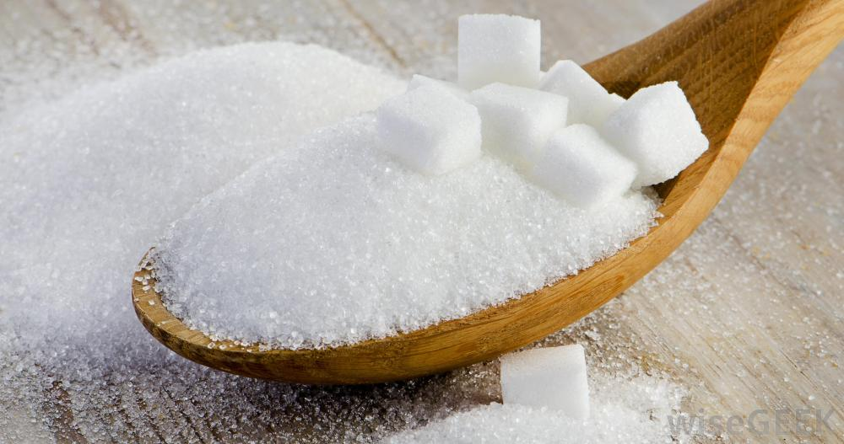



Carbohydrate Polymers
Polymers are widely found in nature. The human body contains many natural polymers, such as proteins and nucleic acids.
Monosaccharide monomers are linked together by condensation reactions to form disaccharides and polysaccharide polymers.
The formation of the glycosidic bond in cellulose and other carbohydrates is catalyzed by a class of enzyme called glycosyltransferases. In a glycosyltransferase reaction, the carbonyl oxygen does not leave as a water molecule, but rather as part of a uridine nucleotide diphosphate group. This represents another way to convert water into a better leaving group.

Slide 17




Carbohydrate Polymers
The glycosidic bond can be 1-4 or 1-6 (C links).
Glucose units contain a lot of bonds that can be broken down to release energy during respiration to create ATP. The breakdown occurs in a series of steps which are driven by shape-specific enzymes.
In plants and animals, only α glucose can be broken down in respiration.
STARCH - Starch is made by linking together α-glucose molecules:
- Amylose : Glucose units are bonded together forming (1→4) glycosidic bonds. The chain of α-glucose molecules is un-branched and forms a helix. Typically amylose is made up of 300-3,000 glucose units.
- Amylopectin : Branched carbohydrate chain - globular shape. The branches are formed when (1→6) glycosidic bonds occur. Due it’s branched nature amylopectin can be much larger consisting of 2,000-200,000 units.
Starch is only made by plant cells through the photosynthesis processes.
Alberto Sordi - Un Americano a Roma, 1954

Slide 18



Carbohydrate Polymers
GLYCOGEN
Glycogen chains of (1→4) linked glucoses are shorter than is starch, giving it a more highly branched structure.
Branching allows for the fast breakdown of the molecule during respiration - more ends which enzymes can start the process of hydrolysis from.
Glycogen is made by animals, humans and also some fungi.
Amylopectin
Glycogen
Starch and glycogen are too large to be soluble in water.
It is easy to add or remove extra glucose molecules to starch and glycogen.
Therefore starch and glycogen are useful in cells for glucose, and consequently energy, storage.
Human and animal digestion is a process of hydrolysis where the starch is broken into its glucose components.
The glucose that is not used immediately is converted in the liver and muscles into glycogen for storage.
Any glucose in excess of the needs for energy and storage as glycogen is converted to fat.
Δημήτηρ – Greek goddess of the harvest

Slide 19


Carbohydrate Polymers
CELLULOSE
Cellulose molecules are unbranched (1→4) chains of β-glucose (~10000 units).
Cellulose chains are stronger than in Amylose and are only found in plants.
Glucose subunits in the chain are oriented alternately upwards and downwards: cellulose molecule is a straight chain, rather than curved.
Cellulose is the most abundant polysaccharide found in nature and has a structural role.
Cellulose fibres are arranged in a very specific way: long cellulose chains bunch together (hydrogen bonds) to form microfibrils. Crystalline cellulose microfibrils are sheathed by hemicellulose and lignin to form macrofibrils. Macrofibrils have a very high mechanical strength (~ steel). In plant cell walls, they criss-cross over each, forming a cross-hatched structure.
Water moves along the cell wall. The tensile strength of the cell walls prevent the cell form bursting, even under very high (water) pressure.

Slide 20


Carbohydrate Polymers
OTHER FUNCTIONS…
Cell surface carbohydrates, typically conjugated to proteins and lipids, are key elements in the cellular communication that is essential to cellular organization and function in all organisms.
These cell surface constituents mediate normal behavior in cells, but they may also participate in molecular recognition events that are associated with many serious human diseases, including rheumatoid arthritis, viral and bacterial infections, and cancer metastasis.

