Slide 1
Attending conferences

Slide 2

Why go?
Networking
Future opportunities
Connections
Support
Notes:
Conferences are one of the few spaces where lots of people in your field are physically or virtually in the same place. That can mean meeting future collaborators, supervisors, examiners, or even employers.
Future opportunities – you never know what opportunities are waiting for you! Whether it’s a research project, a post-doc, jobs outside academia like professional services and others, having conversations at conferences can not only make these opportunities options, but also get you to think about what you’d like to be doing in the future.
Connections – I mean, networking is another word for making professional connections. While these can be great for future opportunities, it is also nice to build relationships with others, and help inform you about what other academics are doing and get invaluable support.
Support – Often you meet academics that are very distinguished in their field and also early career researchers. Both can be opportunities to get support from others that have different or more developed knowledge and experiences bases than yourself.

Slide 3

Keeping up to date with research
Notes:
This is probably my favourite aspect of attending conferences as it’s the chance to just enjoy what other people are saying. Hearing the talks and seeing posters brings the current research alive in a way that is more engaging than reading an academic paper – not matter how much you may enjoy the reading. It also helps with your own research and the arguments you make in your own thesis. I remember in my own thesis I revisited my literature review many times over the course of my studies, as it was constantly being updated. Being aware of what is being done also opens your mind to consider different arguments, both things help make you a better academic.

Slide 4
Feedback
Notes:
This can be scary. And when submitting to conferences reviewers can have very different feedback to each other.
You have to decide who you want to listen to, but it is good to approach feedback with openness and a degree of caution. Somewhere between ‘two heads are better than one’ and ‘too many cooks spoil the broth’.
Feedback gives you new insights, helpful tips and most importantly a chance to improve. What it isn’t is a judgement on you and your abilities. But it is still only an opinion. If you can try to view feedback a bit more distantly this can be helpful, but you don’t need to take on everyone’s advice.

Slide 5
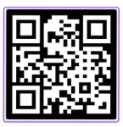

Conference options
One clear message
-------------------
-------------------
-------------------
-------------------
Poster
Notes:
- One clear message or research question
- Minimal text: use headings, diagrams, tables, and visuals
- Readable from 1–2 metres (large font sizes, high contrast)
- Include: context, methods (brief), key findings, implications
During the Session
- Prepare a 1–2 minute verbal summary and a longer explanation
- Be approachable: stand by your poster, invite questions
- Adapt explanations to different audiences/disciplines
- Have a QR code or handout for full paper / contact details

Slide 6

Short talk
Notes:
Purpose
Communicate one strong idea clearly and memorably
Spark interest rather than cover everything
Structure
Clear opening: research question + why it matters
Focus on 1–2 key findings or arguments only
Strong takeaway or provocation at the end
Allocate time strictly (e.g. ~1 minute per slide)
You usually have 10 – 15 minutes (including questions)
Delivery Tips
Fewer slides than minutes; avoid dense text
Use examples or visuals instead of methodological detail
Practice timing—short talks feel faster than expected
Assume limited time for questions: be concise and accessible

Slide 7

Long talk
Notes:
Purpose
Present a coherent narrative of a project or paper
Show depth while remaining audience‑focused
Structure
Clear signposting: introduction, methods, findings, implications
Balance context, data, and interpretation
Build a logical story rather than listing results
Delivery Tips
Slides support your talk—don’t read from them
Explain disciplinary assumptions and key terms
Use transitions and verbal signposts (“Next, I’ll discuss…”)
Finish by returning to the research question and wider relevance

Slide 8

Should you always present?
The short answer is no!
Notes:
Attending without presenting can still be really valuable, especially early on. It lets you see how conferences work, how people present their research, and what the expectations are in your field.
On the other hand, presenting can raise your profile and give you targeted feedback. The key point is that both are legitimate — going to learn and listen is just as valid as going to present.

Slide 9

Do you need to have published?
Again, the short answer is no!
Notes:
Another big misconception is that you need to have published research before you can attend or present at a conference.
The short answer is no. Many conferences welcome work-in-progress, early-stage PhD findings, or even conceptual ideas.
Presenting before publishing can actually improve your work, because you get questions and suggestions that help you refine it before it goes to a journal.

Slide 10

How to decide which conferences to go to
Be strategic
Who attends?
Is this aligned with my research or professional goals?
Notes:
When deciding which conferences to attend, it helps to be strategic.
You don’t need to attend everything—quality and fit matter more than volume
Consider timing: is this the right stage of your project to present (early ideas vs full findings)?
Think about outcomes: feedback, publication pathways, networking, visibility
Prioritise conferences you can return to regularly to build a presence in a community
Ask yourself: Who usually attends this conference, and are they people I want to connect with?
Is the audience disciplinary, interdisciplinary, or practitioner‑focused? Will people who cite, supervise, review, or collaborate attend?
Check keynote speakers, strands, and previous programmes
Consider whether peers (e.g. other PhD students / ECRs) attend—often best for supportive feedback
Is this aligned with my research or professional goals right now?
Does the conference align with your methods, theory, or substantive area?
Will it help you: develop your PhD/paper?
- test ideas before publication?
- explore post‑PhD career paths (academic, policy, practice)?
Is the format right for your goal (poster vs paper vs symposium)?

Slide 11

Practicalities
Costs
Location
Size
Opportunities
Notes:
Practicalities matter too: cost, location, time commitment, and whether there is funding available.
Practical considerations
Costs: registration, travel, accommodation, funding availability
Location and accessibility (including online/hybrid options)
Reputation and scale: large flagship vs smaller specialist events
Opportunities beyond presenting (methods workshops, mentoring, publishing opportunities)

Slide 12

Ask!
Notes:
Finally, talk to others — supervisors, colleagues, or peers — about which conferences they’ve found useful. Choosing fewer, more relevant conferences is usually more valuable than trying to attend everything.

Slide 13
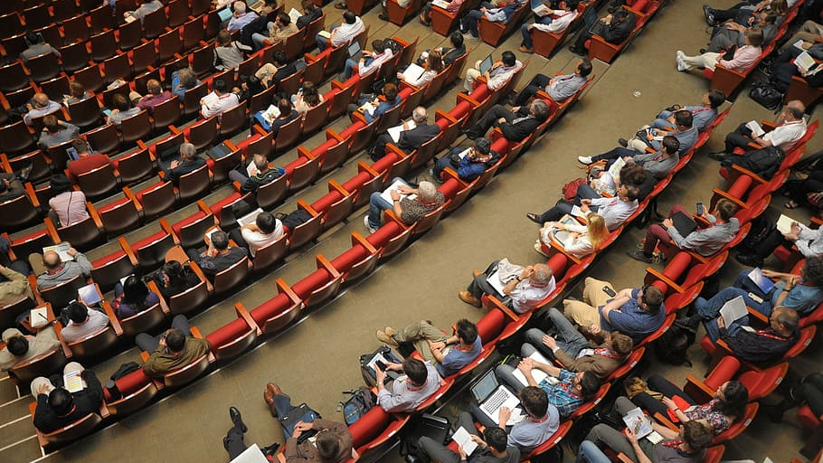

Slide 14
Part 1 – Identify your audience and purpose

Slide 15

Who is going to be at the conference?
Begin by reading the conference programme in advance. Are there any presenters or invited speakers you would like to chat to?
Scroll through social media and see who else is going to be attending.
Put out an announcement on your own social media (“I will be attending x conference in July and would love to further discuss x topic. DM me if you would like to chat on the day!”)
Do this as early as possible. The longer you have to absorb this information, the more time there is to network before the conference.

Slide 16


Slide 17

What do you plan to ask people?
Warm introduction questions:
How is the conference going for you?
How was the journey over?
How is your semester going?
Familiarity questions:
How was the process of conducting your recent x study?
Congratulations on the recent grant! How was the application process?
Technical/insightful questions:
I would love to achieve x. What are your insights and recommendations?
In your recent study on x, how did you find the process of finding participants and analysing the data?
I want to work in academia. Do you have any tips to progress?

Slide 18
Part 2 – Full networking example

Slide 19
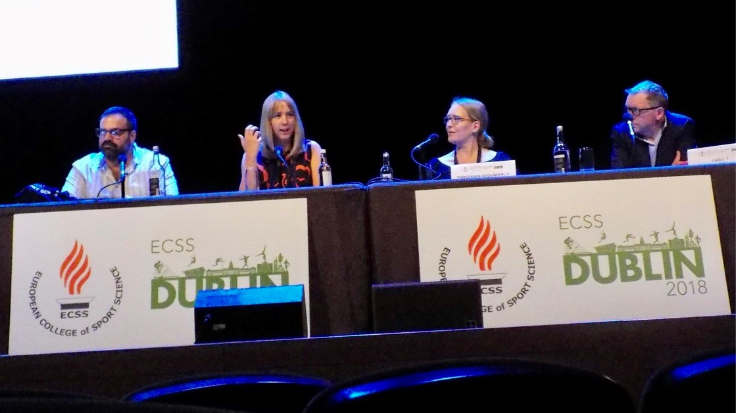

Slide 20
Summary of relevant attendees:
Paul Noon – Applied Sport Scientist at Leicester City.
Naomi Phelan – Applied Sport Scientist/Academic (Northern Ireland National Team).
Chris Harper – Researcher in team sport fatigue at Nottingham Trent University.
Steve Taylor – PhD student (Topic – Mental Fatigue in Elite Cricket).
Michael Phillips – Professor in Exercise Physiology at Brunel University.

Slide 21
I will email Michael before the conference…

Slide 22
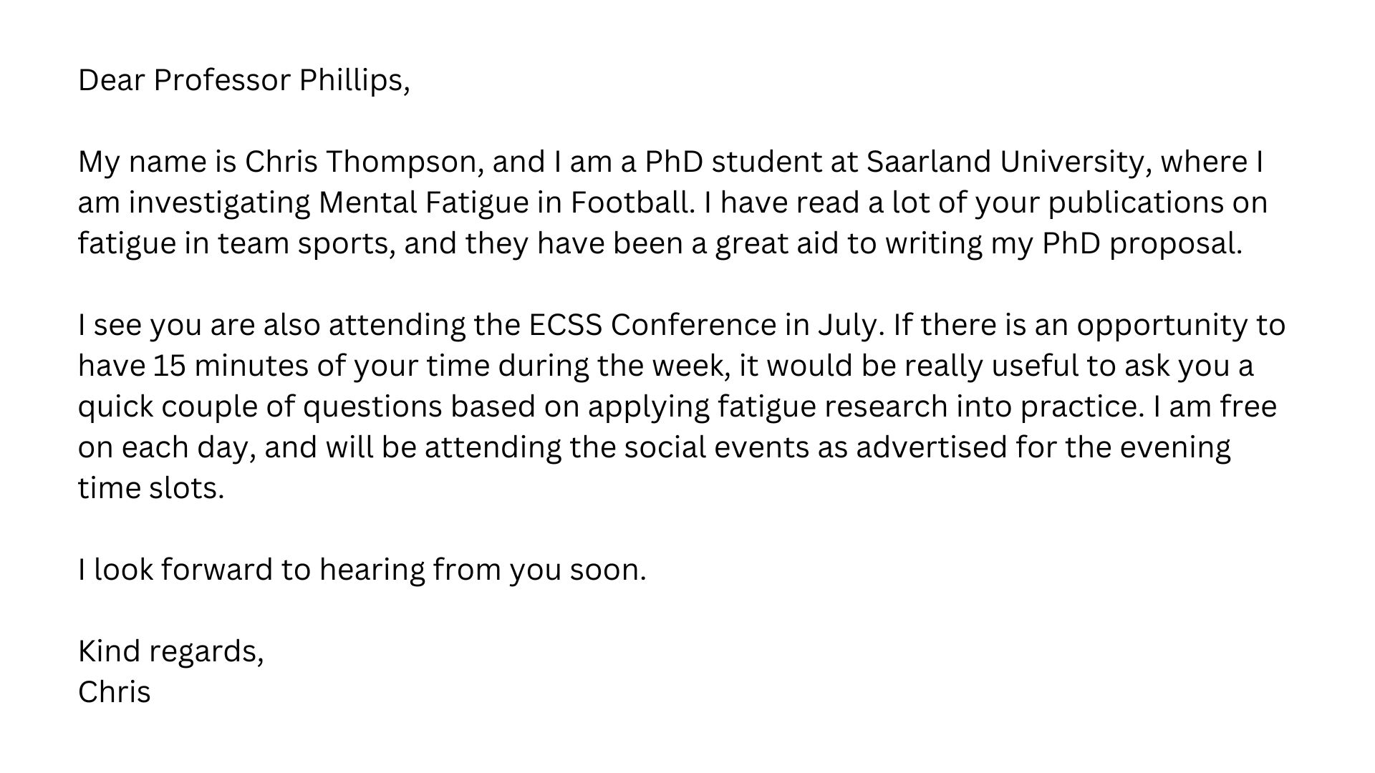

Slide 23
Then I attend Michael’s talk…

Slide 24
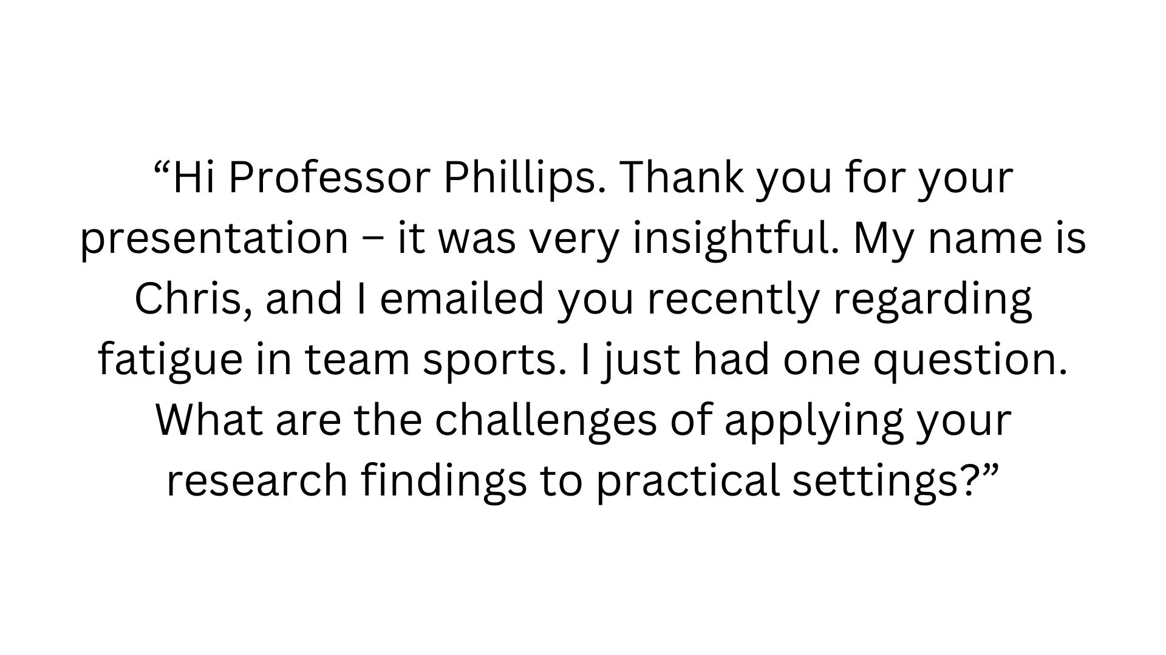

Slide 25
Later on (in a corridor/by a coffee machine)…

Slide 26
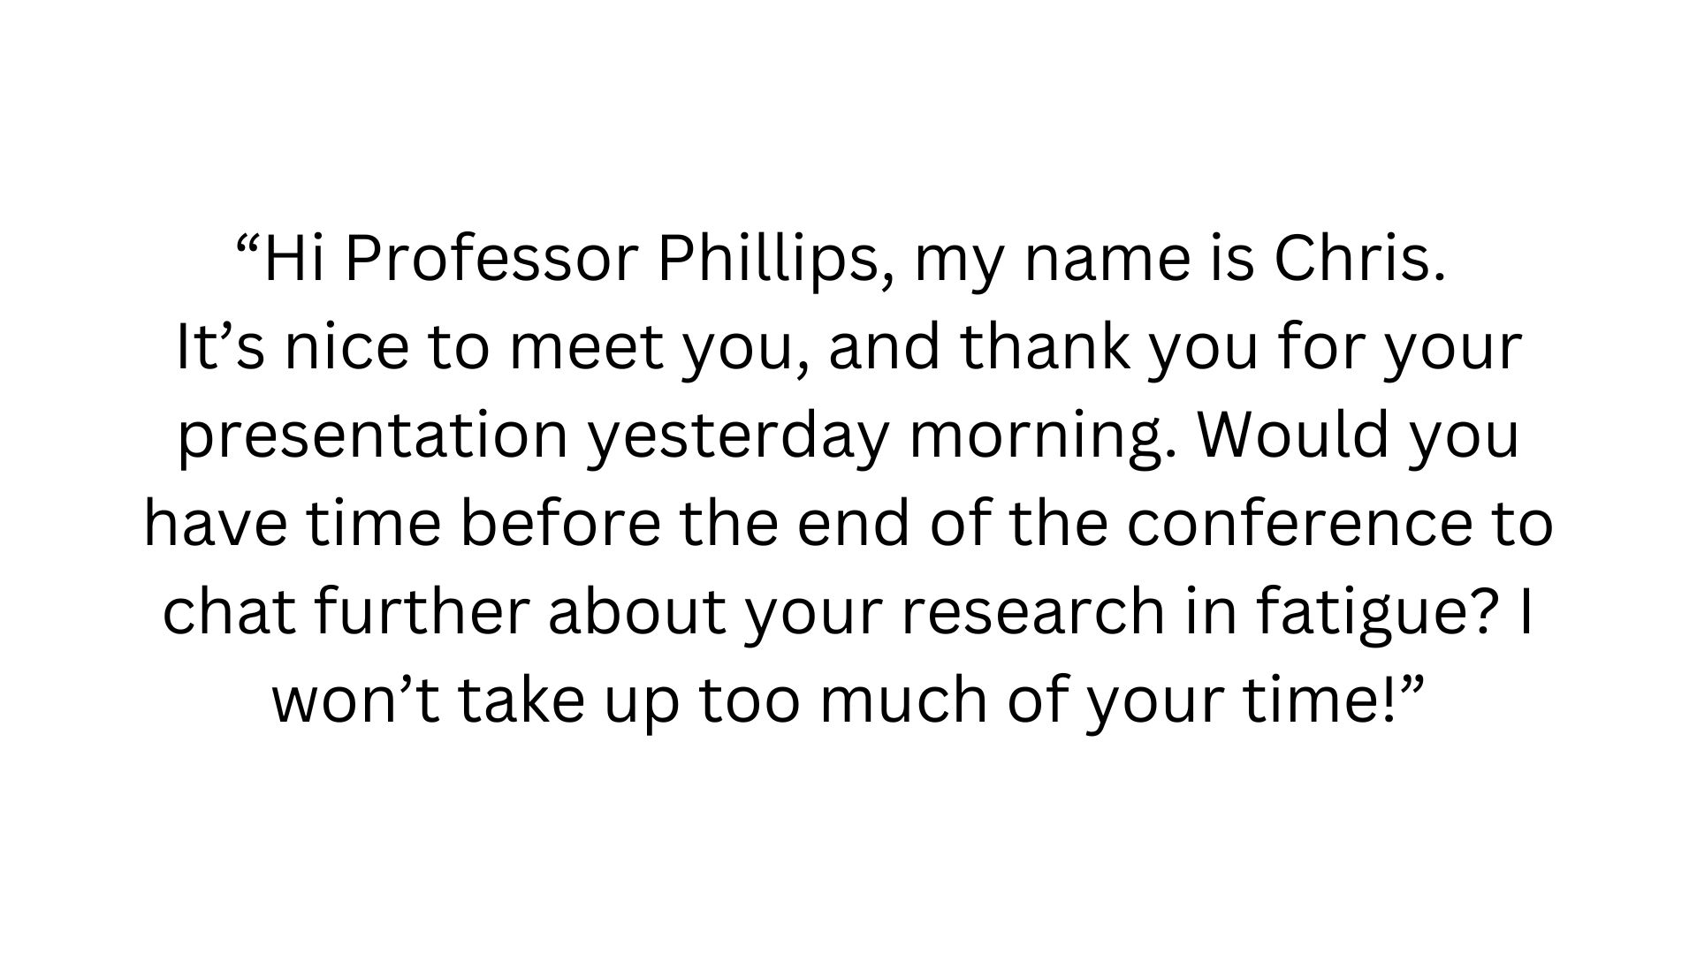

Slide 27
Questions for Professor Phillips:
How are things going with your own mental fatigue research?
How would you describe your PhD experience?
How did you get your position at Brunel University?
What do you think are the major challenges in mental fatigue research?
Are you open to any collaborations in the near future?
Can you recommend anyone else I can talk to about mental fatigue in sport?

Slide 28
I made a point of being visible and socialising

Slide 29
I also only went after connections with
people I liked as well as respected

Slide 30


Slide 31
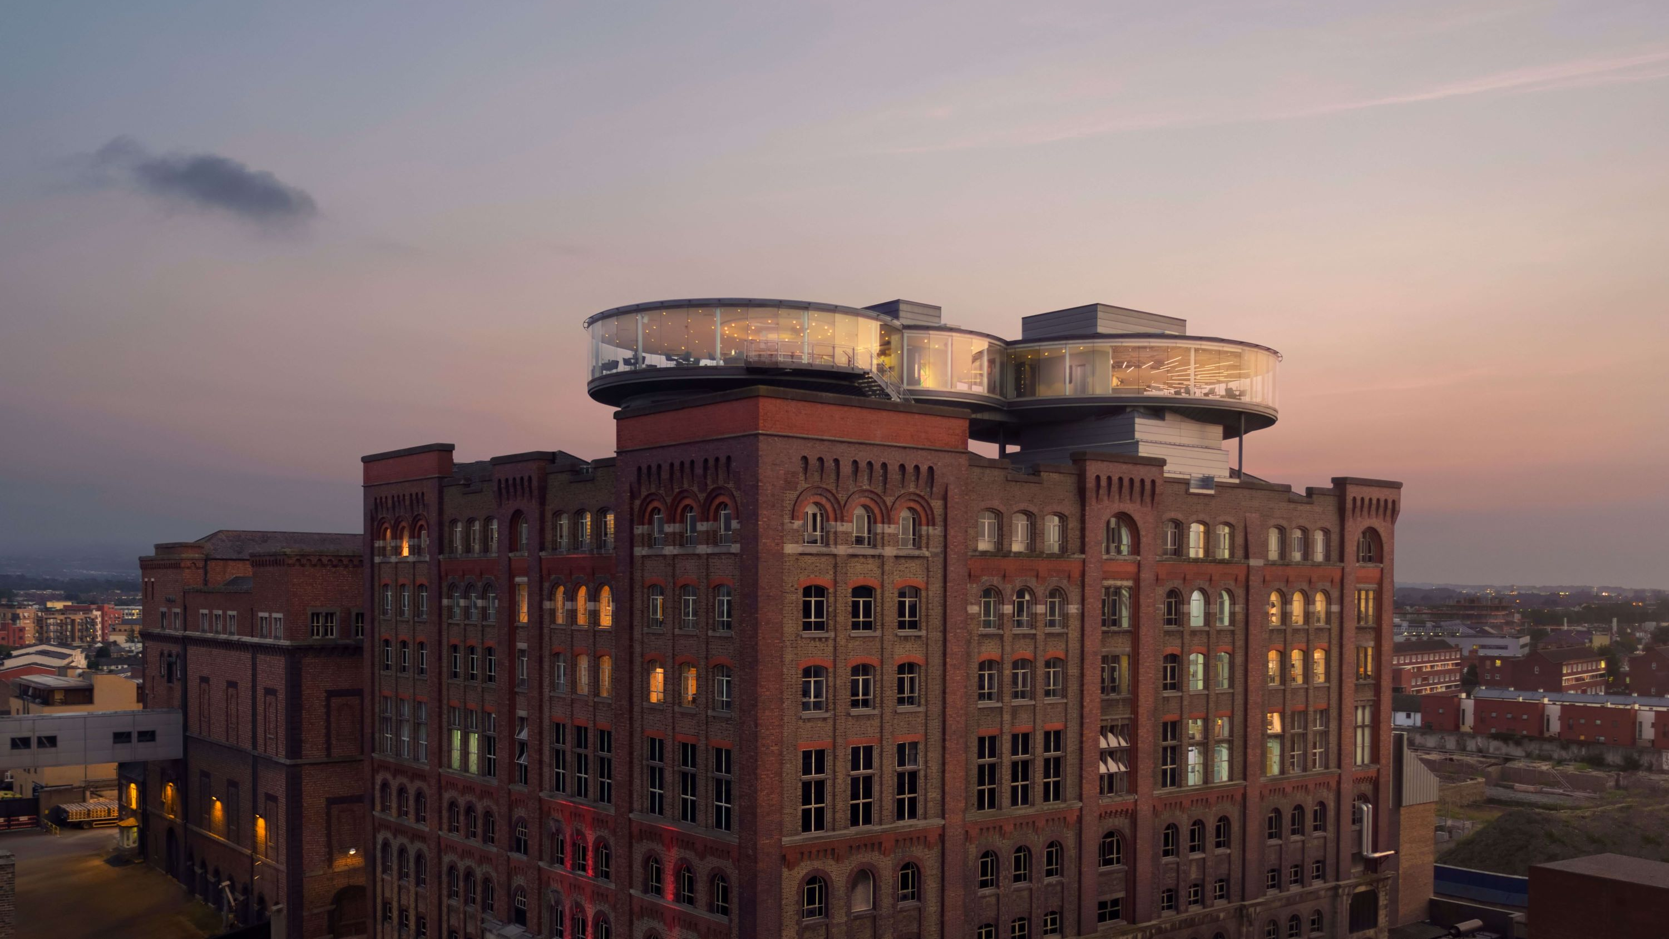

Slide 32
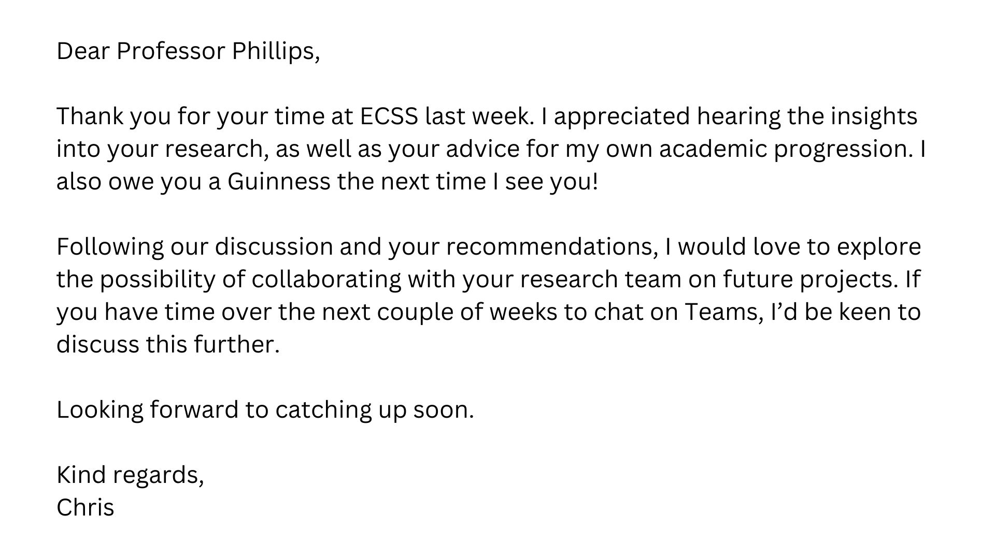

Slide 33
Part 3 – Other conference segments

Slide 34
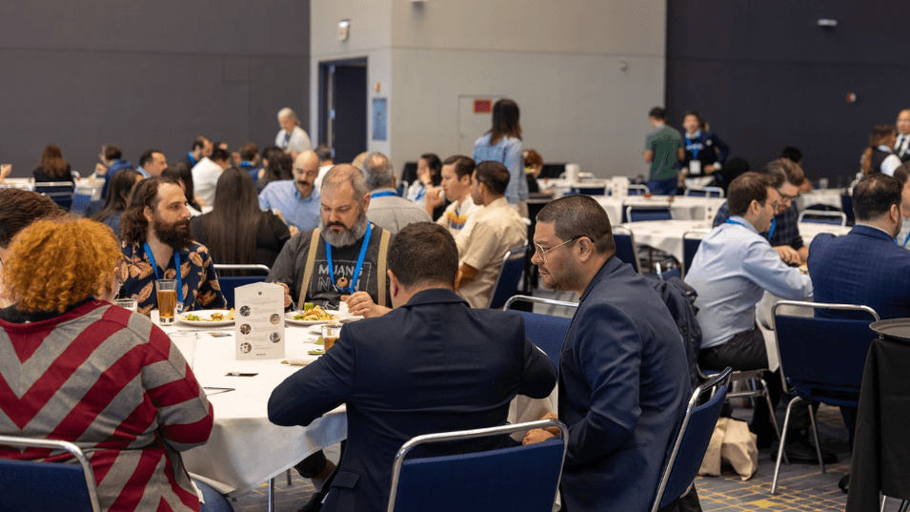

Slide 35

What do you do at lunch?
Sometimes you just eat and do nothing else! You may be tired and just want to refresh and recharge your batteries.
Read the space where possible. If people also look tired/disengaged (or have a mouthful of food), leave them to it and speak later.
Allow interactions to be as natural as possible. If someone is turned away from you, do not go and tap them on the shoulder to start a conversation!
Mix up your conversation topics. Some people may have explained their research multiple times that day, so try a more human approach.

Slide 36


Slide 37

Should you attend the social events?
I love them, but you might not! It is your decision.
You tend to find different groups that drift off naturally. Pub culture, restaurants, cafes, lobby areas etc. Find your preferred group.
A bit like the lunch, do not feel the need to lunge in with a heavy research chat. Most people will just want to unwind at this stage.
You are also more likely to build meaningful connections if you show a genuine interest in the other person beyond their work.
Do not feel you have missed out if you just go back to your room! You have plenty of other opportunities to communicate in the future.

Slide 38
Next steps

Slide 39

Key messages
Make your own luck at conferences. Be proactive in preparing before the conference and target individuals of interest.
Do it your way. You may be comfortable to approach new people face-to-face, or you may prefer most of the networking to be digital.
Remember academics are just people. They have expertise in a subject after years of hard work – they are not superheroes.
Consider an efficient way to sell yourself. A QR code on your presentation/poster (and on your phone) can be useful.
Follow up with people! Most people go home and never follow up with the people they made a connection with. Don’t be the majority here.

