Slide 1
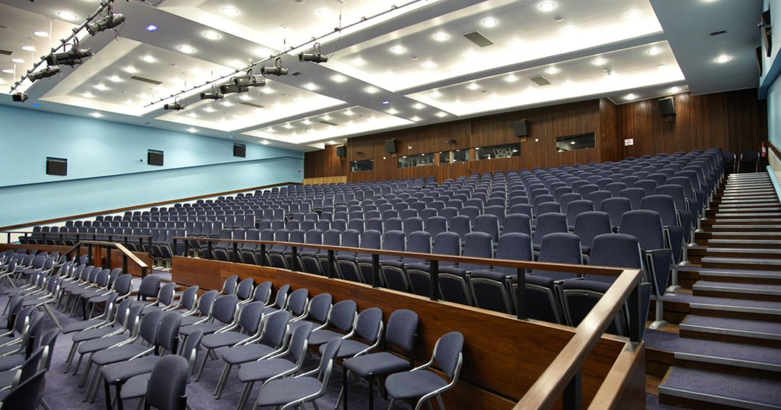

Slide 2
Part 1 – General considerations

Slide 3

No lecturer is a true expert
Regardless of academic level (PhD, Lecturer, Professor), nobody is an expert in all of the modules that they teach.
This should be remembered before teaching (and speaking to a new audience). You provide knowledge, not expertise.
However, do not present this so explicitly to a group of students, as they may misinterpret this and question your knowledge!
Your goal is to present information to a group of students to provide fundamental knowledge and complete assignments/examinations.

Slide 4
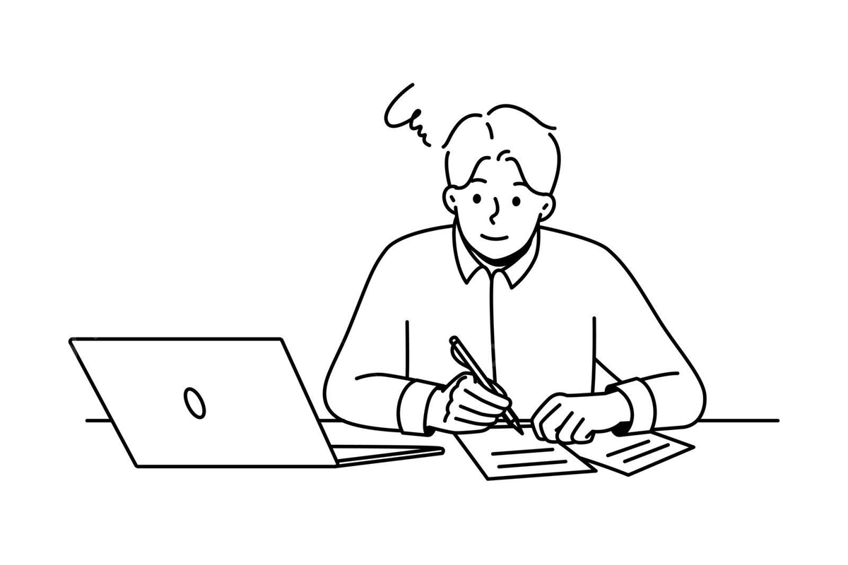
You will know more than the group
When teaching a new module outside of your comfort zone, it is normal to feel like you will be “found out” by the group.
Indeed, you may not have expertise, but you will have knowledge that exceeds that of the group you are teaching.
You have spent the last few days/weeks gaining knowledge on the topic area, The students have not been doing this!
Also bank on the resources you provide alongside your teaching. Recommended reading, digital resources etc.
The first semester is the hardest! It gets better…

Slide 5
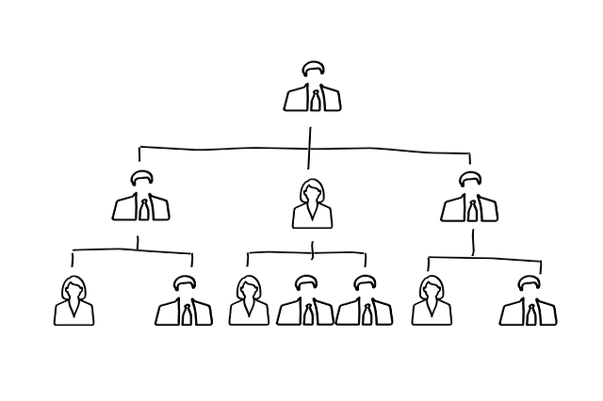
Undergraduates won’t judge ‘credentials’
Professor
As PGRs, we can feel insecure about “our place” in academia – surrounded by seemingly remarkable academics.
This can make us question how our views and knowledge are seen by those in high positions (i.e. at events and conferences).
Undergraduate students do not generally understand the academic hierarchy. They see a lecturer who is teaching their content.
Whether you are a first-day GTA or esteemed Professor, the students want someone who relates to them and keeps them engaged.
You can outperform Professors on this with the right application!
GTA

Slide 6
Part 2 – Realities of lecturing

Slide 7
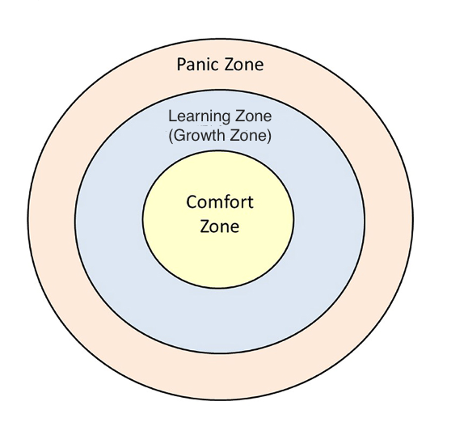
You will teach outside of your scope
In your future lecturing career, you still won’t be an expert on most of the modules you teach.
You will feel different about each module you are given to teach during your PhD. Comfort zone or growth zone.
For the growth zone, see this as an opportunity to teach new modules which enhance your knowledge (and versatility on an academic CV).
Be open about the panic zone. Teaching should not put you in a place where you shouldn’t be in the room (discuss this with a supervisor)

Slide 8

You may be preparing the night before!
In the early phase of your PhD teaching duties, it can be normal to still be preparing for lectures the night before.
You may even find yourself cramming information ahead of the lecture to ensure you are staying ahead of the students.
This should not be normal forever, but do not panic if this is happening in the early phase of your teaching
Analyse how much teaching you need for your development, confidence, and employment prospects (speak to the careers team)

Slide 9

Every other academic has had their doubts
Regardless of their current status, esteemed academics would be lying if they said they breezed through their teaching during their PhD.
They may still struggle – nerves, imposter syndrome, self-doubt, adapting to new technology or teaching methods.
Before teaching, gain as much advice and knowledge from those who have been in your position. This will normalise some feelings.
My teaching challenges – internal pressure to perform, second-guessing the audience reaction, communication style.

Slide 10
Part 3 – Public speaking challenges

Slide 11

“I get really nervous ahead of the lecture”
Firstly, normalise this feeling and remember the insights from other academics who have experienced similar challenges.
Is the anxiety somatic (sweaty palms, shaking), cognitive (self-doubt), or a mixture of both? Knowing this can help with coping mechanisms.
Somatic – physical activity or relaxation, dietary considerations. Cognitive – self-talk, visualisation, music.
Being open about your nerves can let out “your secret” and promote kindness from the audience, which helps put you at ease.
Nerves may always be normal (they show you care!), but if they are consistently detrimental to performance, consider using university services.

Slide 12

“Nobody will care about what I say”
Start with a sense of realism – some people will not care! Can any of us say we had an interest in every module we did as students?
Your job is to deliver the content in a clear, engaging, and professional way. That is your controllable as a lecturer.
“Uncontrollables” are the attitudes of students, their personal interests, and their willingness to engage with the module. Feedback helps though.
It is sometimes difficult to accept this, but remove any personal emotion from this aspect and focus on doing your job well. You can do no more.
Universities will not judge you on your ability to alter personalities!

Slide 13
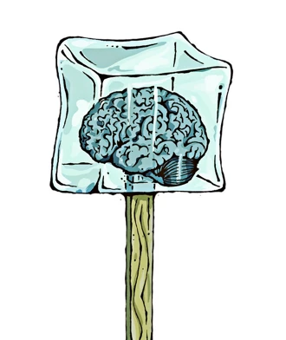
“I freeze in the moment and lose rhythm”
Freezing can happen to anyone of any level, and is not a sign that you lack knowledge (it could be stress, distractions, or overstimulation).
Acknowledge to the group that you have forgotten where you were going with your next point. They may help to remind you.
If you have gone completely blank, just move on to the next point. You can always return later. This makes it feel less awkward.
Animations on a slide can be useful to ensuring you stay on track, particularly if you are nervous. Too much text at once is overwhelming.
The top public speakers I have known rehearsed meticulously. Work on your timing, body language, and pitch as you deliver points.

Slide 14
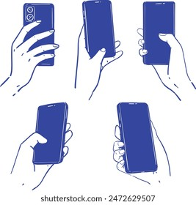
“I struggle to hold the attention of people”
This is another aspect to consider in modern life. We now carry more devices on us that take our attention!
Sadly some lectures will contain some poor etiquette and behaviour from students. This is not personal to you or your career stage.
To capture attention, begin your module with a code of conduct and expectations for both the students and yourself. This shows accountability.
Get to know the names of the students and some of their personal and academic interests. They will feel more included in the talk.
Focus on other developable skills, such as storytelling and PowerPoint skills.

Slide 15

“What if I can’t answer a question?”
You are not expected to have an answer for every question, even if you are a Professor (or “complete expert” in the field).
Students should be made aware of this throughout the module too. Many areas do not have defined answers, and require some critical thinking.
Encourage students to go to a wide range of resources to find answers. Books, journals, digital resources.
If you do not have an answer, be open about this. Don’t pretend!
You will see the student again soon, so say this is something you will go away and give some thought ahead of the next lecture.

Slide 16
Part 3 – Public speaking tips

Slide 17
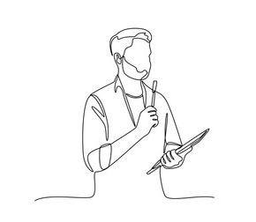
Five ways to improve public speaking
Find a role model and mentor. Who do you admire as a public speaker? Who is available to provide guidance and support?
Learn advanced PowerPoint skills. Being able to use PowerPoint makes your public speaking more fluid. Consider YouTube/LinkedIn Learning.
Rehearse sessions over and over again. Like any skill, you need to work at it. Complete a skills audit and keep a diary of your progress.
Observe or assist lectures first. Ask your supervisor if they need a hand. This gentle introduction should take some of the pressure away.
Consider a buddy system with a fellow GTA. Feedback can be easier to absorb from friends. Follow this system before formal observations!

Slide 18
Hi both,
We have had an extension request from student [number] for [number] days for the [course code] assignment due on [date]. The new deadline for this student would be [new date].
[reason for extension e.g. “The student has reasonable adjustments in place and the reason for the request is an established disability accommodation.”]
Please can you let me know if you are happy to approve this extension?
Best wishes,
Hi both,
We have had an extension request from student [number] for [number] days for the [course code] assignment due on [date]. The new deadline for this student would be [new date].
[reason for extension e.g. “The student has reasonable adjustments in place and the reason for the request is an established disability accommodation.”]
Please can you let me know if you are happy to approve this extension?
Best wishes,

Slide 19
Presenting Tips!
Conferences

Slide 20

Do not take straight faces seriously!
Notes:
It’s easy to think that straight faces, mean boredom or disagreement but this is not true!
Try to put some distance between their expressions and their opinions. It is not a reflection on you, and just not helpful.

Slide 21

Do not crowd the slides
Notes:
Lots of information can be comforting, but is difficult for your audience to take in.
Instead focus on key facts – what are the main points of slide? What summarises your arguments?
Visuals – what images and graphics will capture your audience’s attention? What translates your facts in a memorable way? Another way of doing this can be through using key quotes from your data. Your way of doing this will be dependent on the findings you are talking about. It’s less about what you’re saying, but how you’re saying it. As my supervisor said, you have to tell the story of your data.

Slide 22

Use clear definitions and analogies
Notes:
The scenic route is nice, but sometimes you get lost.
Often your audience will have a limited understanding of your specific research area. You want to make it as easy as possible for them to understand your focus, and using clear definitions and analogies helps with this.
Be specific in your language. Use examples that have clear patterns. This also saves time, and means you can use more of your presentation time on your findings or other aspects important to your research.

Slide 23
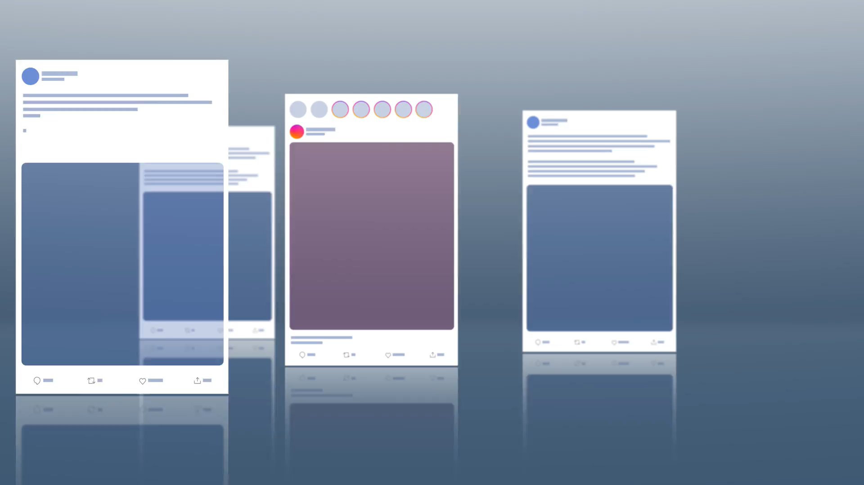
Approach technology with caution
Notes:
In all likelihood you will be nervous on the day. You want to make the logistics of presenting as easy as possible for yourself so you can have as little concerns as possible.
Now technology can be a great way to involve your audience, either through polls or through including videos or… However, these aspects should be tested out many times before your present. You should be confident that they work seamlessly and in your ability to use them. It is also good to look at troubleshooting and any potential issues that could go wrong.
BUT conferences are a great place to present, because everybody is also doing one! They will be prepared with extra cables, etc. so it’s good to remember you are in safe hands!
It is helpful to consider a quick benefits vs risks when using technology and using your own common sense.

Slide 24

Remember to smile
It helps build trust and rapport
It relaxes you as well as the audience
Fake it till you make it!
Notes:
It makes you seem more approachable
A smile signals warmth and openness, helping the audience feel comfortable engaging with you.
It builds trust and rapport
Audiences are more likely to listen to (and believe) speakers who appear positive and confident.
It relaxes you as well as the audience
Smiling can reduce visible nerves and helps you appear calmer, even if you feel anxious inside.
It invites connection
People mirror facial expressions — smiling encourages the audience to respond positively.
It sets the emotional tone
A friendly expression early on helps establish an encouraging, supportive atmosphere.

Slide 25
Answering Tips!
Conferences

Slide 26
Keep calm
Notes:
This may sound obvious but it is important to be aware of.
When delivering a presentation nerves can prevent you from delivering your best presentation. Take some steadying breaths and try to keep calm so your mind can focus on what you do well.

Slide 27

Questions are a chance to learn
Notes:
Questions are an opportunity – not just for the audience member, but for you too!
It is not a quiz, and you are not being tested. Questions are really an opportunity for engagement and discussion with your research, and it is a great opportunity to connect with others in your field.

Slide 28
It’s okay not to be able to answer!
Notes:
It is okay not to be able answer questions!
You are not expected to know everything, and it is not a weakness to acknowledge this. Where you don’t have an answer you can acknowledge this, and there are a few options!
Link it to what you do know (if appropriate and relevant)
Ask the other audience members
Mention what the literature says about this

Slide 29

Preparation is key
Boosts confidence
Provide clarity when speaking
Keeps you on track
Notes:
Boosts confidence
Knowing your content reduces nerves and helps you sound more assured.
Improves clarity
Preparation helps you structure ideas clearly and explain them simply.
Keeps you on track
You’re less likely to ramble, rush, or run out of time.
Helps you handle questions
Anticipating questions makes you calmer and more responsive.
Allows flexibility
When you’re prepared, it’s easier to adapt if something goes wrong.

Slide 30

Difficult audience members?
Don’t take it personally!
Notes:
If someone wants to be difficult, they will – you cannot change their behaviour but are ways of dealing with difficult audience members.
Personally – often the issue is about the TOPIC not YOU! Mentally create some distance to separate yourself from their behaviour.
Boundaries – use the audience members as allies, focus on the majority that is supportive. Ask their opinions on a relevant topic.

Slide 31

Acknowledge, then re-direct
That’s a useful point – what I’ll focus on here is…
That’s worth noting, and it links to my next point about…
I can see why that’s important. In this context, what matters most is…
Notes:
Acknowledge – “that’s an interesting point – here’s what’s relevant…” this avoids a back and forth that’s not helpful.

Slide 32

Set Boundaries gently
Stick to your expertise
That’s outside my area of expertise, but what I can say is…
I’m not the best person to answer that – my focus is on…
Notes:
Boundaries – use the audience members as allies, focus on the majority that is supportive. Ask their opinions on a relevant topic.

Slide 33
Key Takeaways
Presenting is a great experience and a chance to talk about your research with others – try to enjoy it!
Practice what you preach – try out your talking points, slides, technology
Nerves are natural – you’ve got this!

