Slide 1
Post-PhD Jobs, Academia, etc.
Dr Thomas Perry Lecturer, Educational Effectiveness, Improvement and Leadership Programme Director, MEd Educational Leadership and Degree Apprenticeship route
Programme Director, MA School Improvement and Educational Leadership
Twitter: @TWPerry1
Website: www.thomasperry.education

Slide 2
Overview
My Background
My journey in and out of academia (and back in again)
What have I leant? Advice…
Q&A / Discussion

Slide 3
Background
Economics (BSc, MSc, Leicester)
PGCE Warwick – Economics Teaching
Primary School Teacher (KS2 – Year 4, Age 11)
PhD Education – School value-added measures
Original motivations
Research + teaching
Is my PhD worth anything?

Slide 4
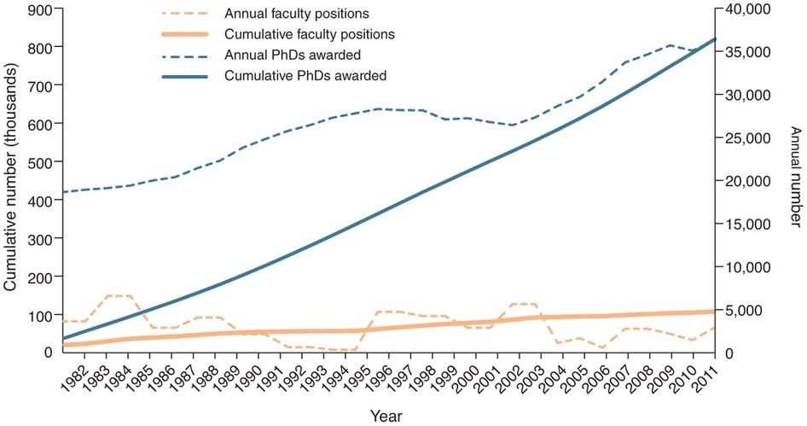
PhDs – the bigger picture
Highly employable – very few PhDs are unemployed (c. 2.5%)
Over-supply (field dependent) (Education – 3 PhDs to perm academic jobs)
‘Portfolio’ work common
Some benefits of this
Point of contention
Tensions (discussed later)
US 1982-2011

Slide 5
Final stages of PhD and beyond
A footholds/stepping stones/setting up camp –free-lancing/gig economy
Research Fellow (EEF Evaluation project)
Bid (TALIS) (eggs, baskets…)
Teaching (MA School Improvement and Educational Leadership) (MA Social Research Methods)
Options
0.4? Teaching only?
Jobs market
Research assistance? Odd jobs?

Slide 6
Out of Academia (but hanging on)
Teaching – VL 0.2fte equivalent
Research Manager – CUREE (Centre for the Use of Research and Evidence in Education) (Y1, 0.8fte, then Y2, 0.65fte)
Management experience
Impact (Connecting research to practice)
Varied research – Jack of all research
Write Research papers – a fun thing to do on Sundays

Slide 7
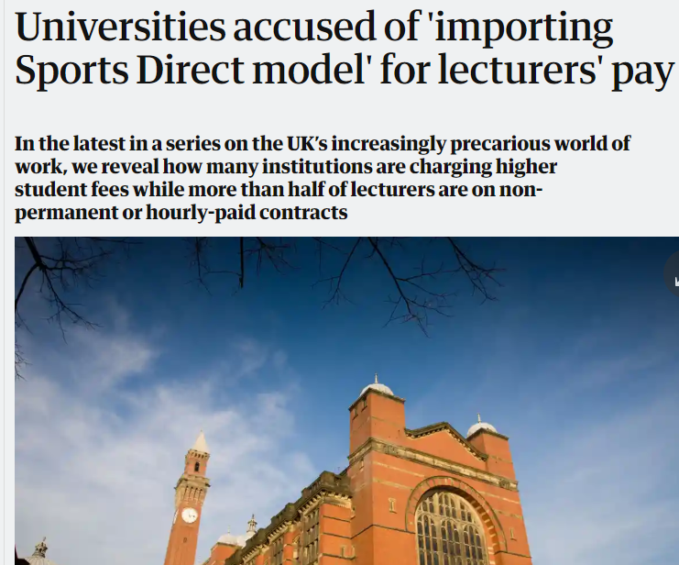
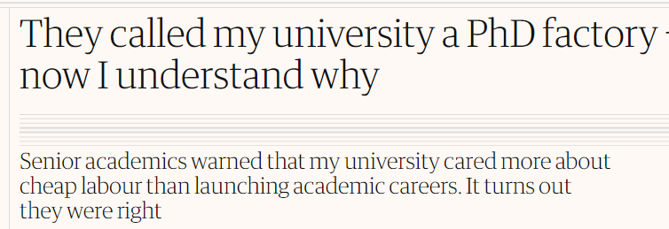
When/if portfolio work is not welcome…
Finding contracts (time)
Gaps in income
Mobility
Family life
It feels precarious
Guardian 2016 - The University of Birmingham has among the Russell Group’s largest proportions of teaching staff on insecure contracts – 70%.

Slide 8
Tensions – Education Research (2 academic yrs)
Private Sector | Academic
Value for ‘Clients’ (i.e. schools, organisations) | REF/TEF/KEF etc. Papers
Efficiency / Value for money Communication/Audience | REF (Originality, Significance, Rigour)
Project management Organisation | Time Deep thinking
Practical / Broad | Expertise / Specialist / Narrow
Collaborative / flexible | Varies – but more individual
Quantity | Quality
Formative but unsustainable

Slide 9
Pause
Anyone else trying to make up their mind whether or not to pursue an academic career?
What are you torn between/why?

Slide 10

Decision time. Hanging on?
“As I reluctantly consider quitting academia after a year-long research fellowship, I find myself recalling a drug dealer’s line in the film Withnail and I: “If you’re hanging on to a rising balloon, you’re presented with a difficult decision – let go before it’s too late or hang on and keep getting higher, posing the question: how long can you keep a grip on the rope?” His words describe my dilemma: do I hold on to my dream of a permanent university lectureship or abandon it as illusory and hazardous to my mental health?”
https://www.theguardian.com/higher-education-network/2018/mar/23/they-called-my-university-a-phd-factory-now-i-understand-why

Slide 11
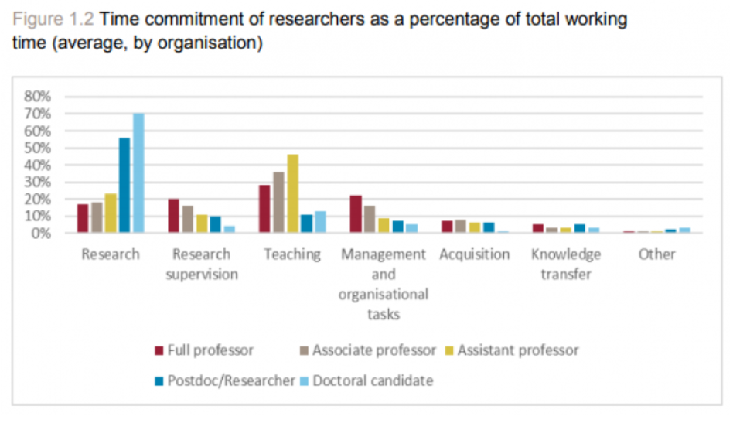
Questioning my motivations…
(Data from Netherlands)
Notes:
Leaving academia to pursue my dream of teaching and research/

Slide 12
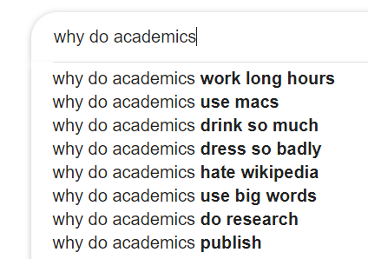
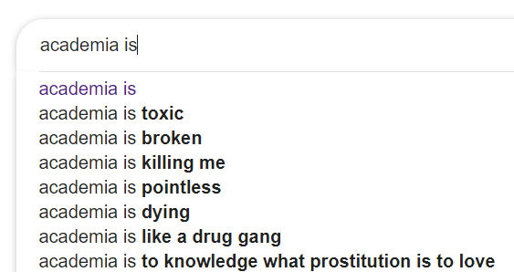

Googling didn’t help
Notes:
A personal decision

Slide 13
Back into Academia
Looking for specialist research – use specialist skills
Hope (that I would get a job, that it could be rewarding)
Looking further afield
UCL – Research Associate
Warwick (Economics)
Warwick (Education)
IFS
UoB – Staffing MA School Improvement Educational Leadership

Slide 14
This year – an investment year
A management job
An ‘unviable’ programme which had not been invested in
Last tutor standing (of 4)
Paperwork to develop 3 new pathways/routes
Recruitment, marketing, administration, timetabling
Teaching and Assessment – lots of this!
Bidding – 5 research bids in, 2 misses, 1 (small) hit
Research – a backlog of loose ends, some ‘quick wins’, lots of plans
Right decision?

Slide 15
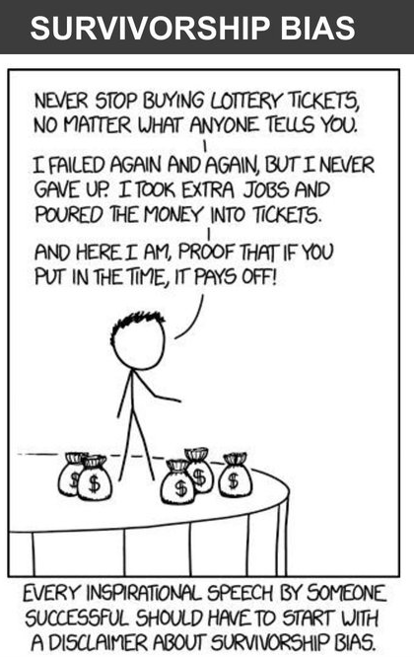
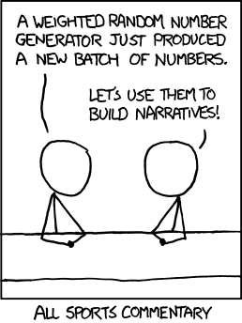
Offering Advice: A Critical Perspective

Slide 16
Some advice (/observations)
Be in the right place at the right time
Locus of control / resiliency
As good as your last work
Publish or perish
Have on example of everything (ECR)… but….
…have specialist knowledge/skills (use /advertise them)
Read person/job specs – look further afield too
Monetise/market yourself (what sells?) (but see 16)
Methods (quants + helpful ones)
Collaborators (not like your ‘lone wolf’ PhD)
Network - get out there
Grow in public (introverts/perfectionists)
Be ready to be rejected, a lot
Distinguish urgent vs. important
Play the game, be strategic (until you have a permanent job)…
… but don’t lose sight of what you care about.

Slide 17
Questions? Comments?

