Slide 1

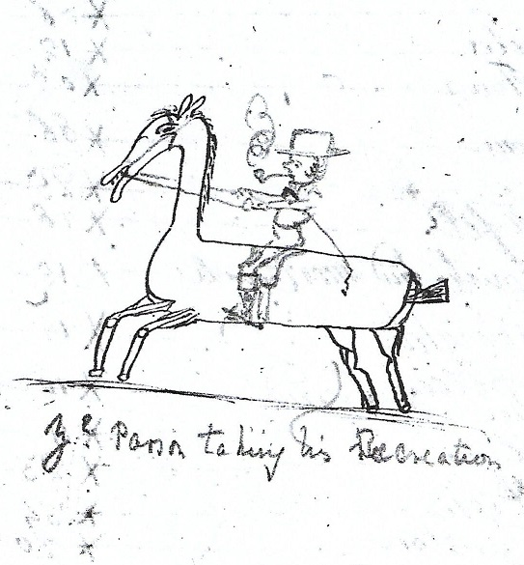
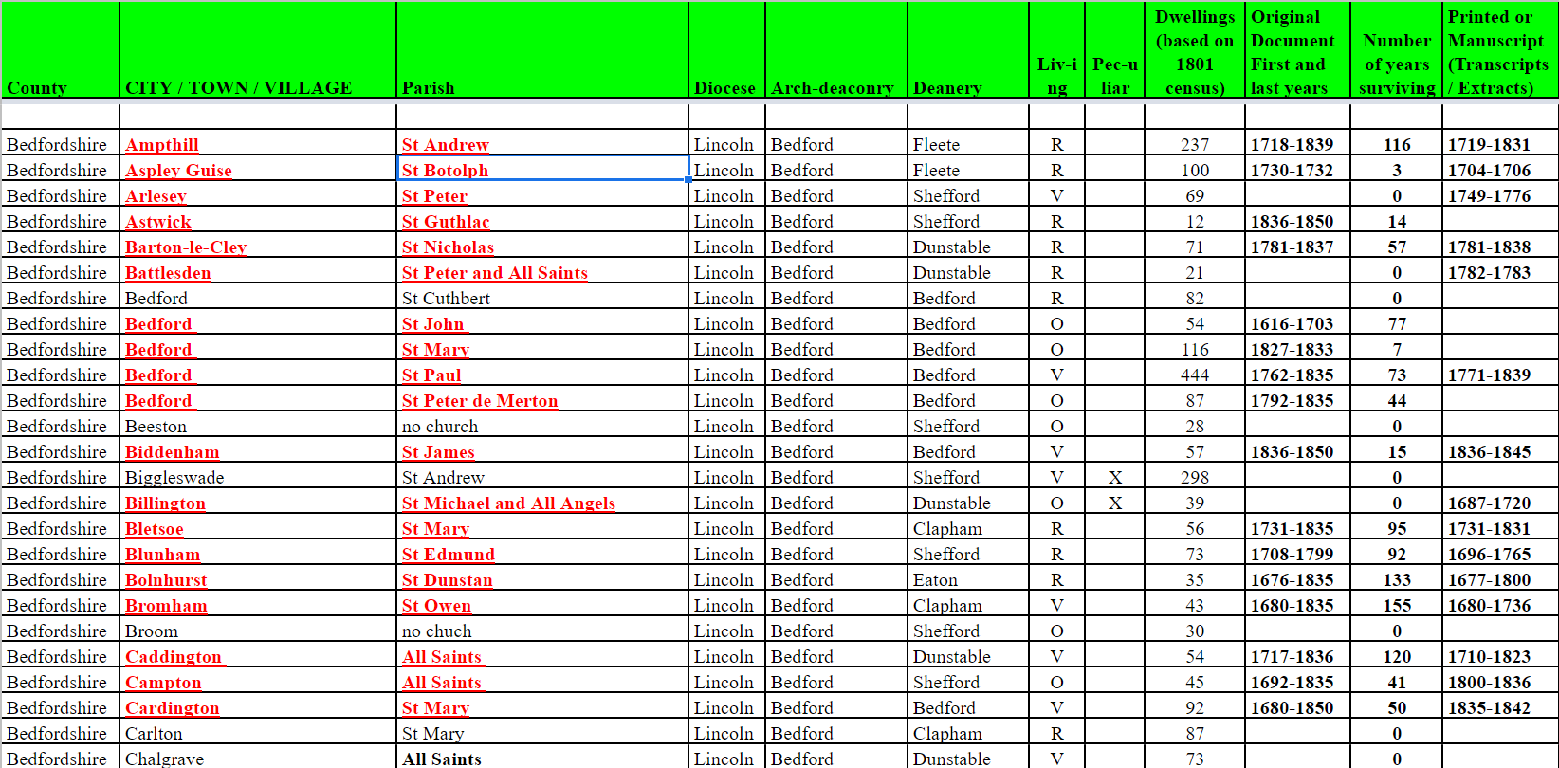
INTRODUCTION TO THE CWA DATABASE
N
Nick Edwards
& Beat Kümin
(Warwick)

Slide 2

The CWA online database in its current state was formed as a result of several common challenges when designing a database:
How long will it feasibly take to create?
How easy is it to use and maintain the database?
Where is the data hosted and how much does it cost to host?
Can it be updated remotely?
Will it take up too much space on the server and / or the users’ computer?
There were several false starts and unsustainable experiments (e.g. trying to put everything on the Warwick server or to type all data afresh on dedicated webpages ….)

Slide 3
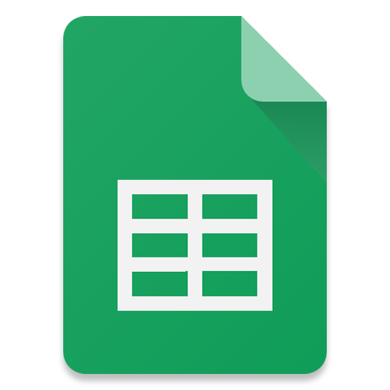

As huge volumes of CWA data already existed in spreadsheets, Nick suggested to try and emulate the present data’s structure, thereby minimising the time it would take to set up.
This was made possible by using the service Google Sheets, which provides free online hosting for spreadsheets.
Thanks, Nick !

Slide 4
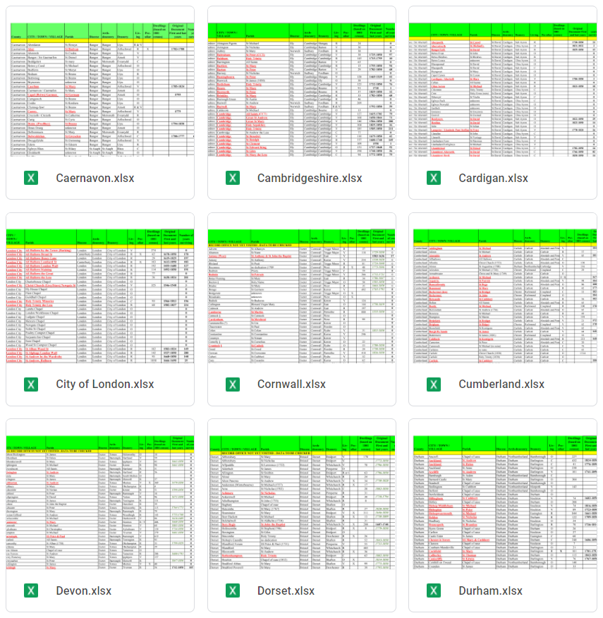
The primary benefit of Google Sheets is that it provides an easy and familiar layout for both the researcher and end-user.
The original files can be updated on the fly, meaning that the maintenance required is kept to a minimum.
All the updating is done here, with the website linking to these Google Sheets.

Slide 5
So how does it work ?
Your access point is on the My-Parish website (over 1.5 K views / month) at: http://warwick.ac.uk/cwad
The landing page provides an introduction to the project and guidelines about how to use the database
Several sub-pages facilitate different approaches / queries:
The alphabetical ‘Parish Master List’ features all churches and chapels with surviving accounts
Users can check diocesan / archdeaconry affiliations
… but for most purposes, the ‘County List’ serves as the most convenient starting-point

Slide 6
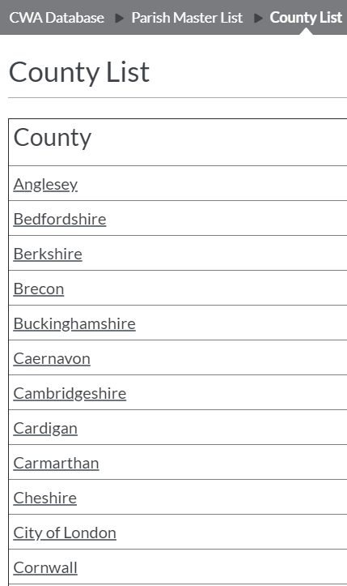
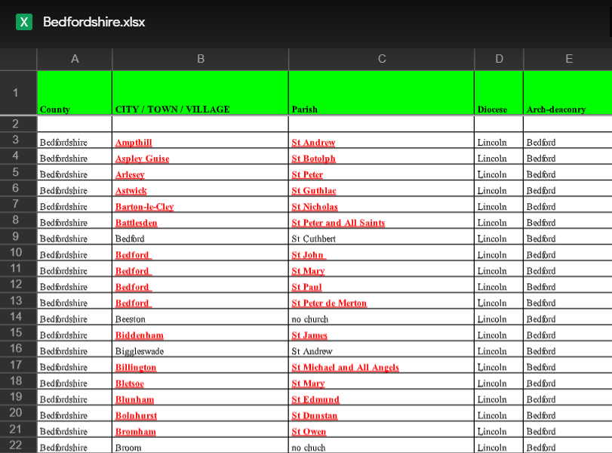
The CWA Database website hosted by My-Parish, therefore, acts as a sign-post for the various levels of spreadsheet files hosted on Google Sheets.
For example - the County List page provides direct links to each individual county’s spreadsheet.
From the
respective
County
sheet you can
then access
individual parishes

Slide 7
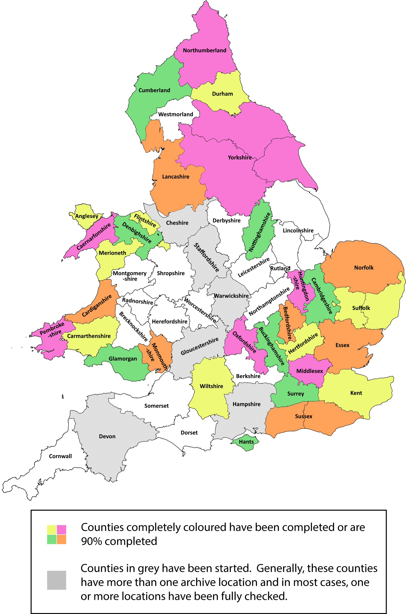
… and where are we now?

