Slide 1
Churchwardens’ Accounts Database (CWAd)
Valerie Hitchman
University of Kent

Slide 2
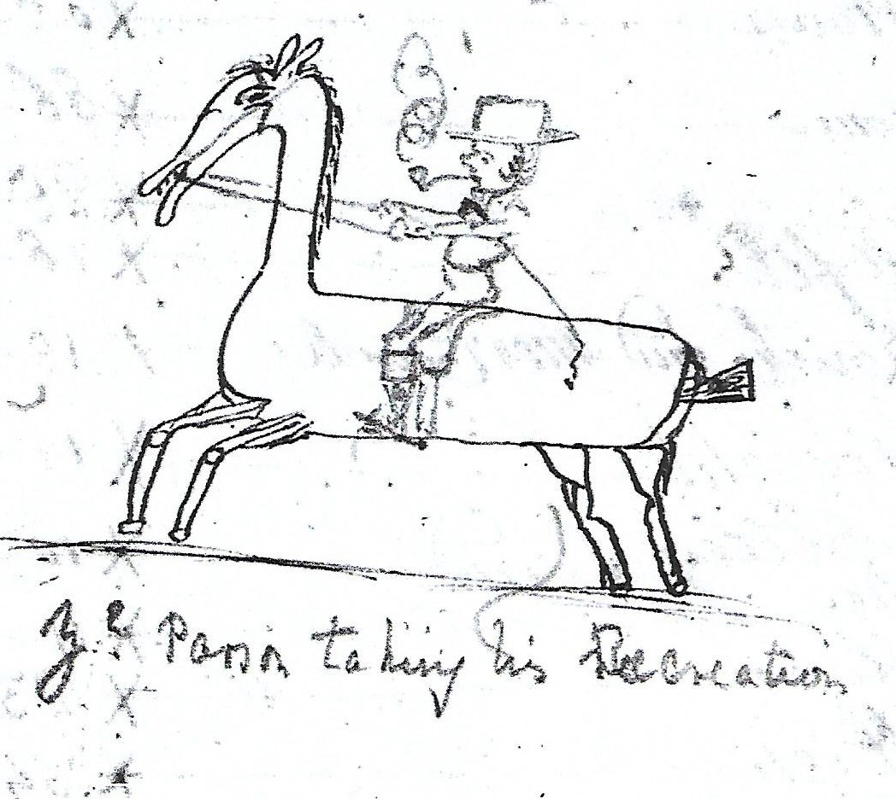
Our Logo
Our
Canterbury Cathedral Archives: Ref.U3/123/5/1 Ospringe churchwardens’ accounts 1729-1767
The word ‘accounts’ does tend to cause a glazed expression but prior to somewhere in the region of 1850 the accounts were not just a set of figures. They can be fascinating, full of local colour, and fun.as you can see.

Slide 3
Why churchwardens’ accounts?
They are valuable source for local and national historians and genealogists - full of names and occupations.
They provide insight into the history of ordinary people.
Record religious changes.
Reveal social structure and diversity.
Detail the economic structure of the parish and community.
Show how news was transmitted across the county vis orders to ring the bells and special prayers to be said.

Slide 4
Why a database?
Most archive catalogues list only the first and last date of survival.
Giving no indication of how complete the run of accounts might be.
Some documents listed as churchwardens’ accounts are overseers, surveyors or even constables accounts.
As all documents listed in the database have been checked, the database will enable researchers to easily locate parishes with surviving accounts.
The database will save researchers time, frustration and money.

Slide 5
What will the database contain?
Every known church and chapel in England and Wales.
Church or chapel dedication where known.
Diocese, archdeanery & deanery wherever possible.
Each year that an account survives.
Total expenditure for each year wherever possible.
County maps showing parishes with surviving accounts.

Slide 6
Extra Information for each parish
will include
The condition of any original document at risk or conserved, in the latter case the condition before conservation will be noted.
Bibliographic information about individual churches.
The number of parishes with surviving accounts for each year within each county.

Slide 7
Database to date (September 2019)
25 of the 44 English counties have been completed:
Bedfordshire |  | Kent |  | Suffolk
Buckinghamshire |  | Lancashire |  | Surrey
Cambridgeshire |  | London, City |  | Sussex, East
Cumberland |  | Middlesex |  | Sussex, West
Durham |  | Norfolk |  | Wiltshire
Essex |  | Northumberland |  | Yorkshire, East Riding
Hertfordshire |  | Nottinghamshire |  | Yorkshire, North Riding
Huntingdonshire |  | Oxfordshire |  | Yorkshire, West Riding
Isle of Wight
10 of the 13 Welsh counties have also been completed.
Anglesey (Sir Fôn) |  | Flintshire (Sir y Fflint)
Cardiganshire (Sir Aberteifi or Ceredigion) |  | Glamorganshire (Sir Forgannwg or Morgannwg)
Caernarfonshire (Sir Gaernarfon) |  | Merionethshire (Sir Feirionnydd or Meirionnydd)
Carmarthenshire (Sir Gaerfyrddin or Sir Gâr) |  | Monmouthshire (Sir Fynwy) (part of England until 1974)
Denbighshire (Sir Ddinbych) |  | Pembrokeshire (Sir Benfro)

Slide 8
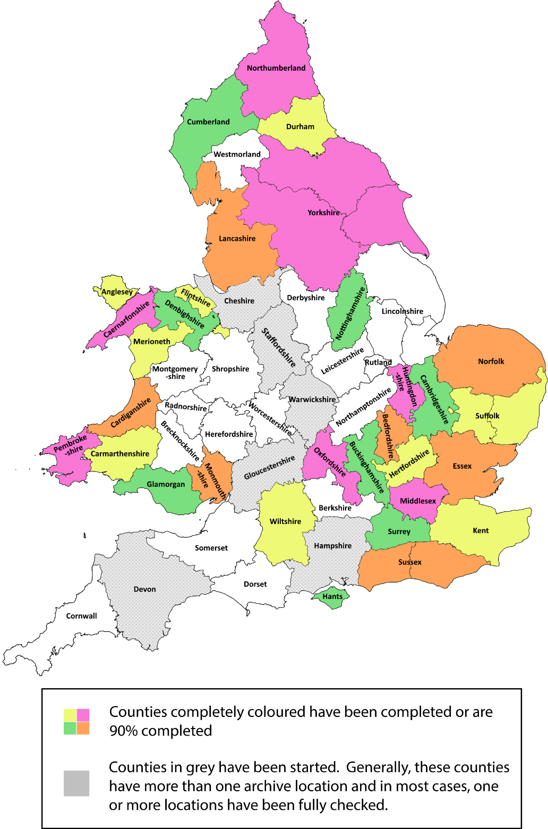

Slide 9
Database to date (September 2019)
113 of 138 Record Offices / Local Studies Libraries have been visited with all identified records checked and data collected.
A further 4 Record Offices / Local Studies Libraries have been partially checked. (work is in progress)
Maps have been created for 30 counties.
The introductory pages have been completed.

Slide 10
Database to date
Original searches suggested that somewhere in the region of 4,300 parishes had pre-1850 accounts surviving.
It now appears that almost 6,000 may have survived.
So far, data from original documents has been collected for just under 3,500 parishes and from printed sources (transcript or extracts) for just over 1200 parishes.
This equates to 215, 272 annual accounts.
So, a mere 2,300 parishes left to check ……..

Slide 11
So go check out the website …………..
www.warwick.ac.uk/cwad

