Slide 1
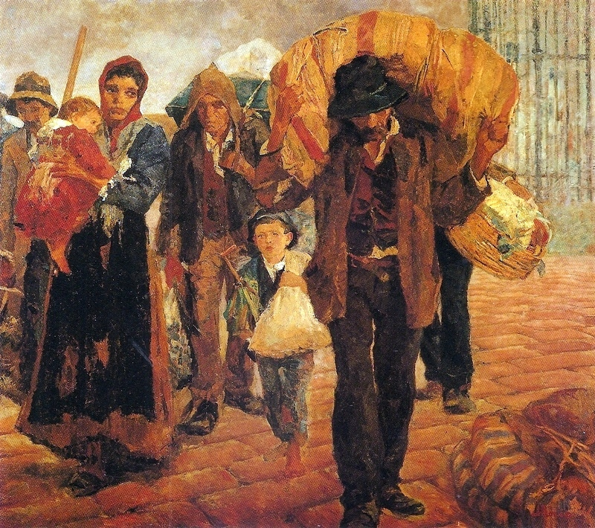



Parishes & migration
Ideas café at st john the Baptist church, berkswell
Friday 6 july 2018

Slide 2


Your discussion partners
Ruth Barbour
Beat Kümin
Angela Nicholls
Felicita Tramontana
Moderator: Anastasia Stylianou

Slide 3
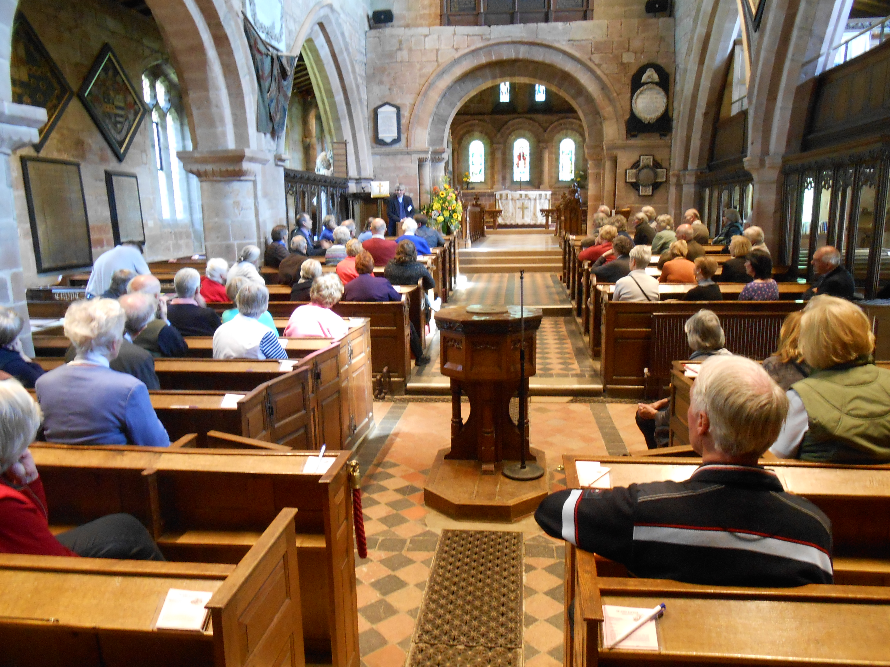
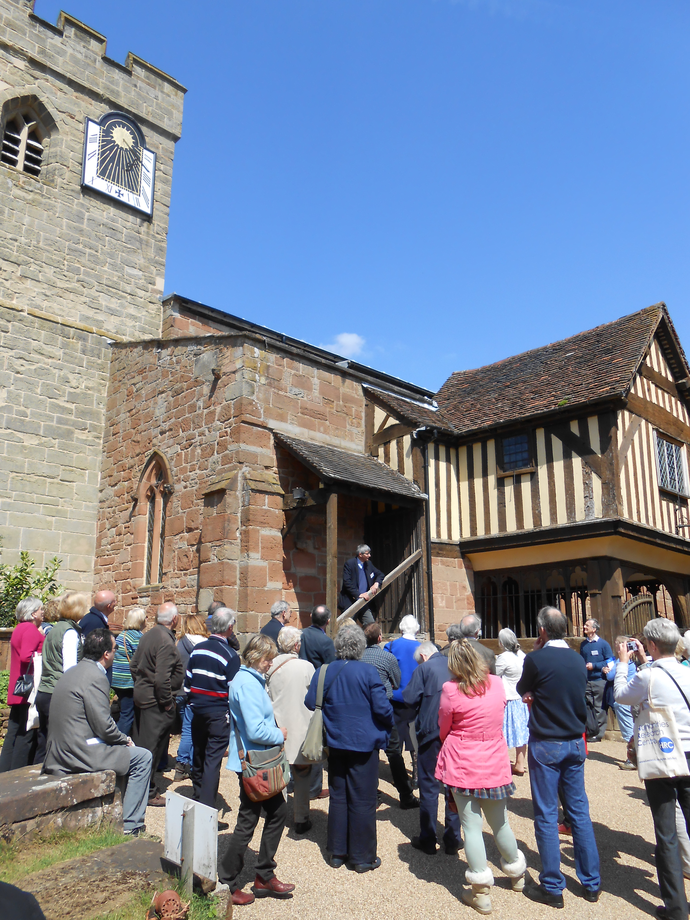
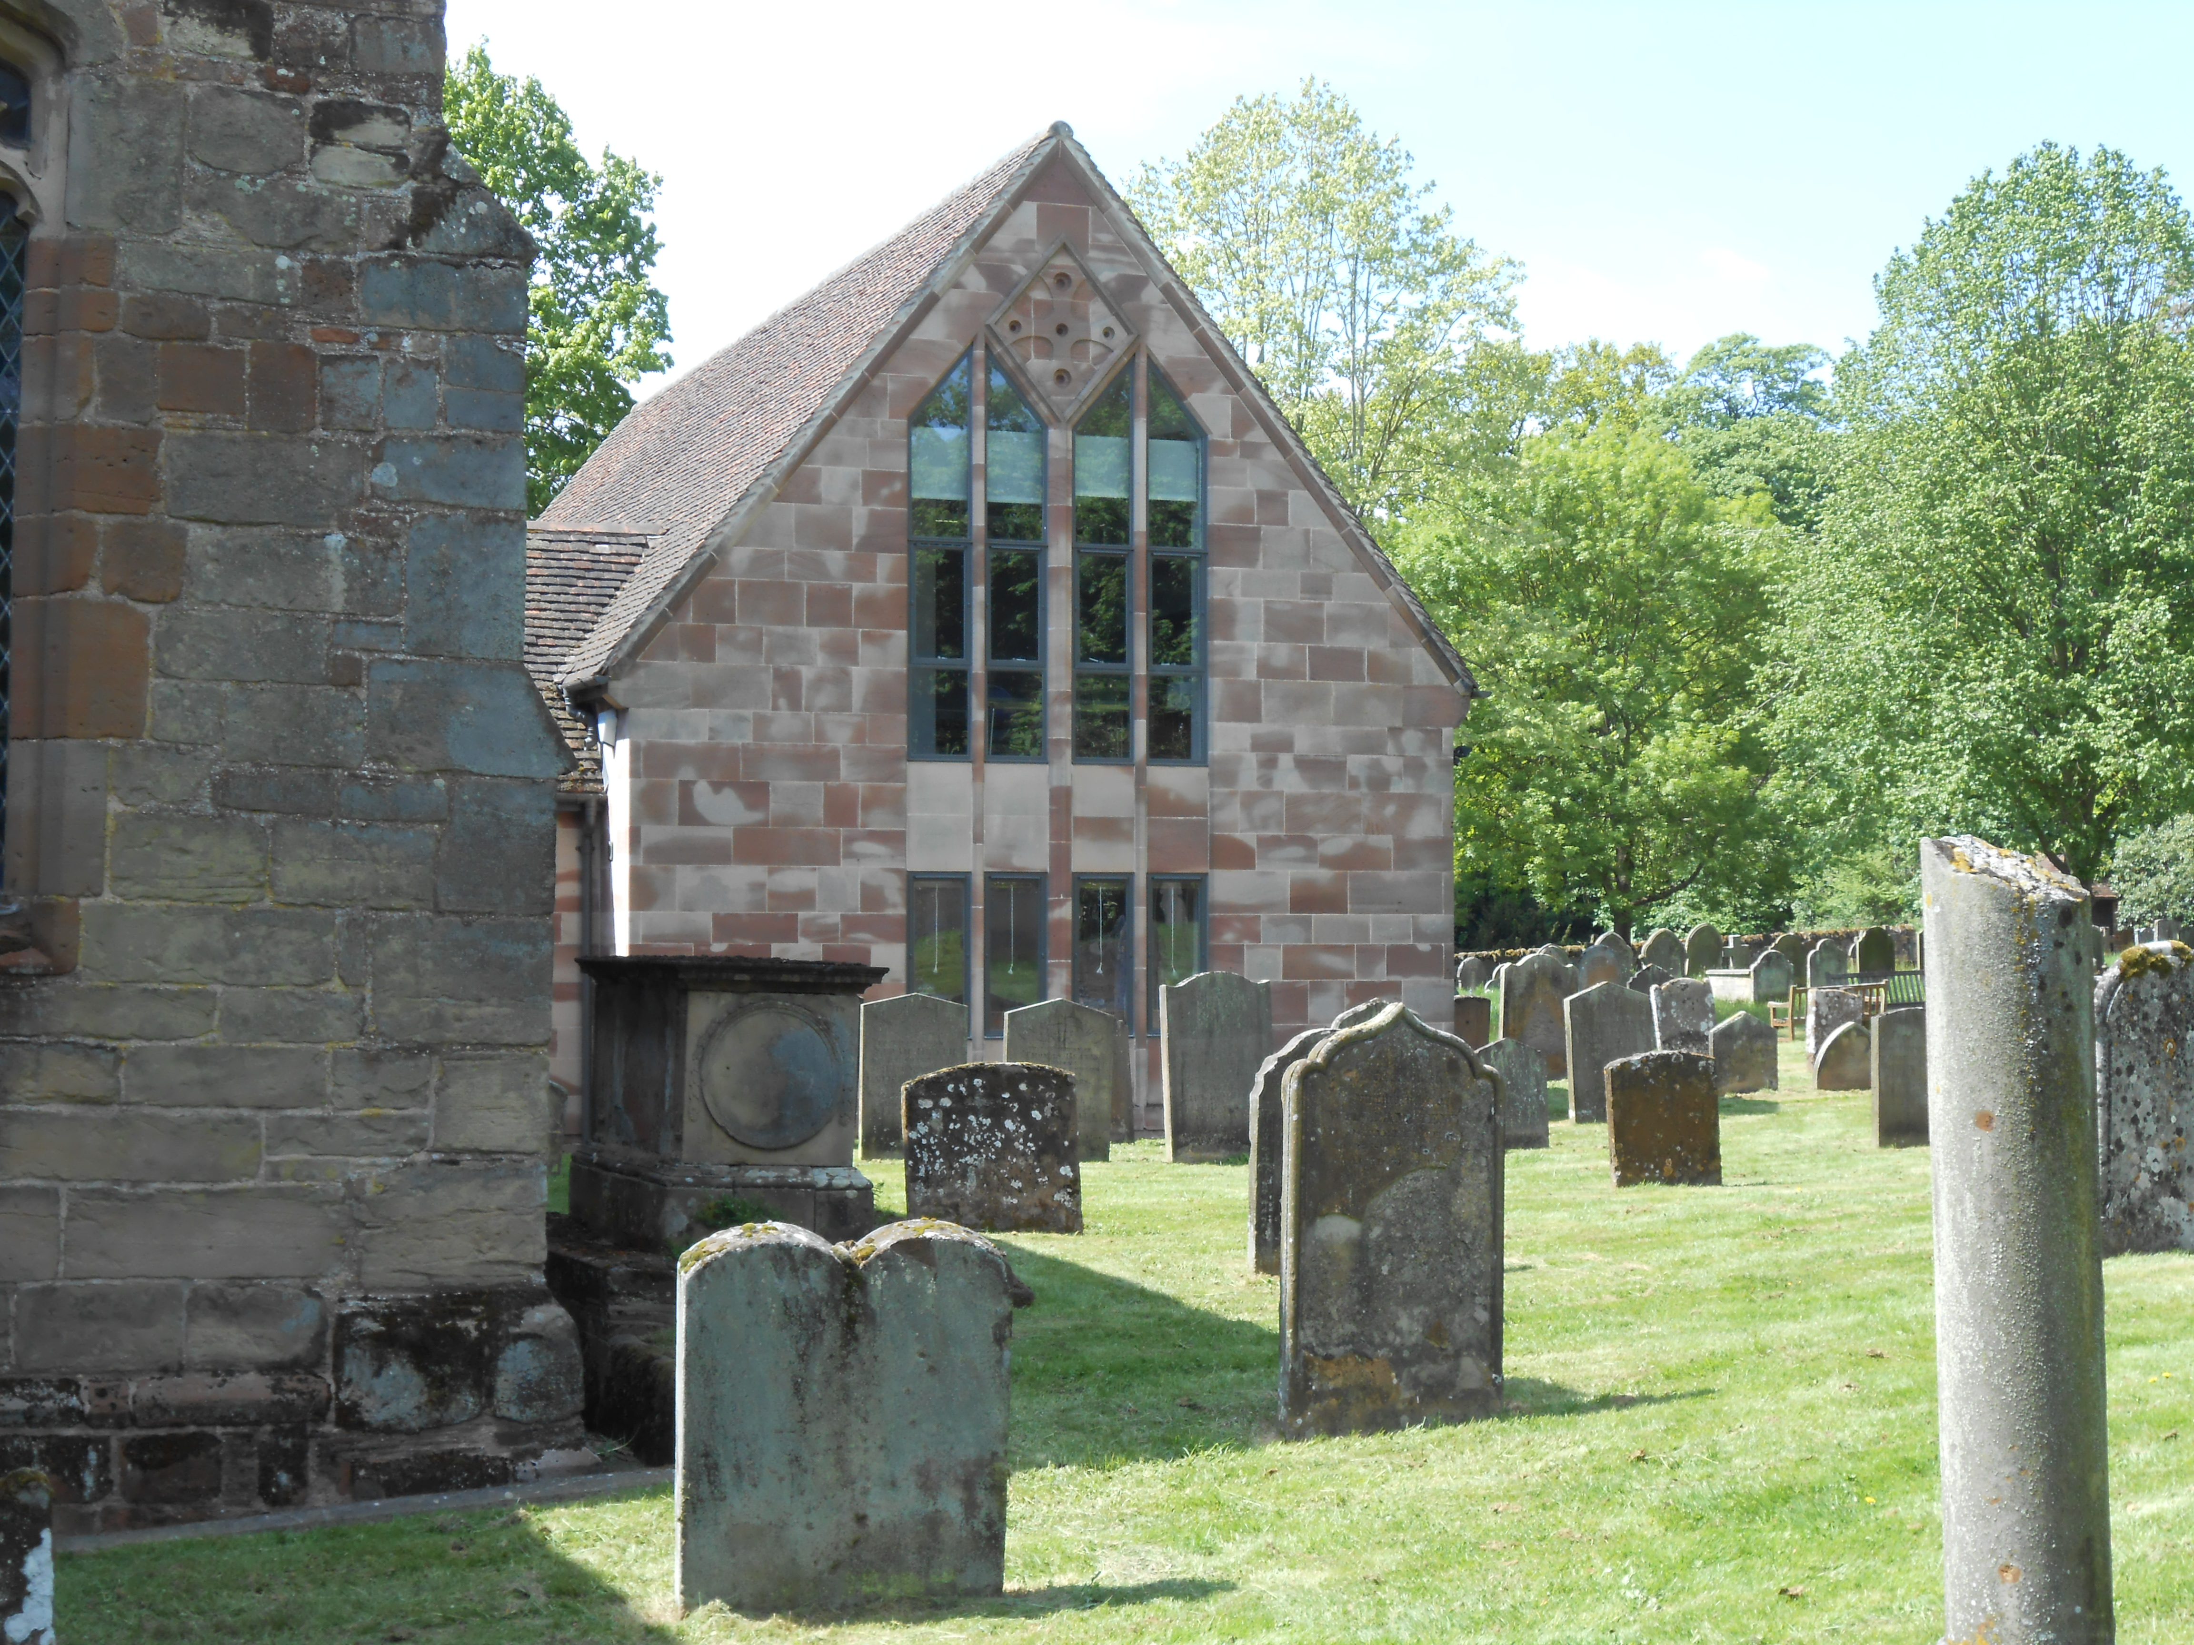
Parish communities –
a brief introduction
In this country, a local ecclesiastical network emerged between c. 1000-1300
Parish priests provide access to sacraments, pastoral care and – ultimately / hopefully (!) – salvation
The Protestant ‘Church of England’ resulted from a series of Tudor ‘Reformations’ (under Henry, Edward, Mary, Elizabeth)
Churchwardens & overseers assumed local government duties (poor relief, highway maintenance) from the 16thC
Parishes encompassed nearly all of local society: gentry to cottagers, men & women, people of different ages …
… yet they also excluded some outsiders: heretics, nonconformists, vagrants …
Today’s theme: how did parishes intersect with various forms of religious, economic and occasional migration?

Slide 4
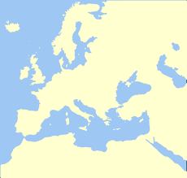
circulation of people in the Mediterranean
The focus of my research Palestine.
I analyse local and regional migration in the past.

Slide 5
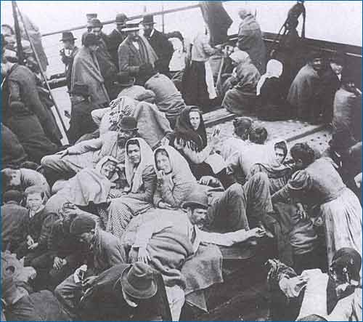
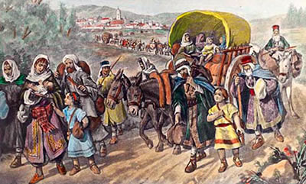
Few interesting things I learned about migration in the past:
- In the Mediterranean migrants moved from North to South
- As today, in the past some people were forced to leave their home by religious and political persecutions other moved in search of a better life
What was migration like in the past?

Slide 6
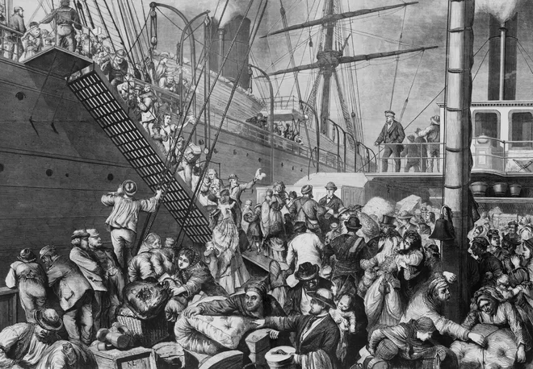

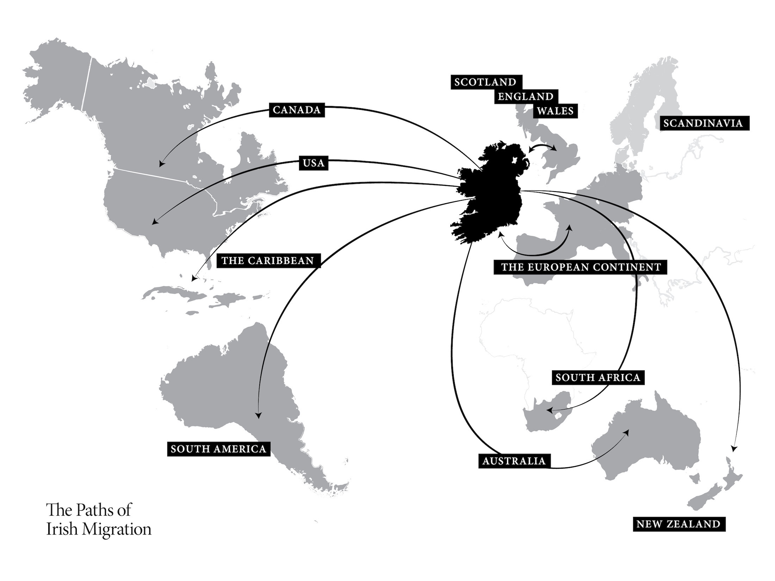
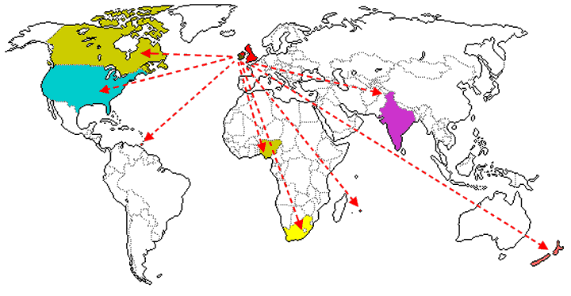
Europeans were “the migrants” as well
Irish migration
British migration

Slide 7
Beat’s
Start-off
Questions
Do you experience parishes as welcoming and inclusive communities?
Can you think of reasons why they exclude(d) some people from their services?
What might (short- / long-distance) migrants have to contribute?

Slide 8
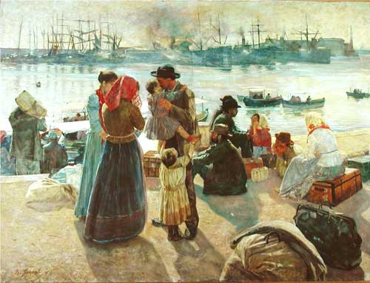
Angela’s start-off questions
Is economic migration inevitable?
How should society respond?
Should the economic status of migrants make a difference in how we respond?
What similarities strike you between our response to migration now and in the distant past?

Slide 9
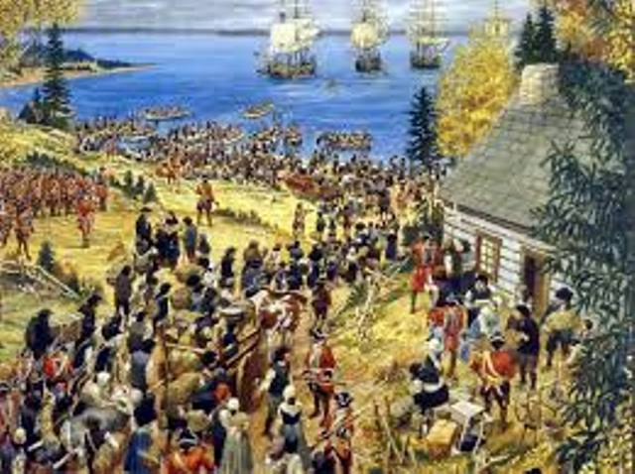
Felicita’s start-off questions
Have any of your ancestors migrated to/from England?
What are the reasons that push people to leave their homes in the past and in the present?
Do you know any migrant?

Slide 10
Ruth’s Start-off questions
Are there factors that make migrants more welcome – or at least reduce antipathy (e.g. personal knowledge or special skills)?
Are proportionately smaller numbers of migrants assimilated better into communities?
Does fear of the unknown ‘other’ stimulate anti-migrant feeling?

