Slide 1

TRACE: TRacking health And Care partnerships in England
ARC West Midlands Public Health Summit
26th November, 12.00-15.00
Adam Briggs, Hon Associate Clinical Professor
adam.briggs@warwick.ac.uk | @ADMBriggs

Slide 2
What is TRACE?
A potential research programme aimed at tracking the implementation and development of geographically-based organisational partnerships within health and care in England

Slide 3
Background
Partnership formation in the NHS and social care is nothing new
Strong partnerships are hard to achieve
There are limited data on what aspects of partnership relate to what processes or outcomes
This is particularly the case for outcomes related to population health, inequalities, and disease prevention
Notes:
There are lots of data on partnerships in healthcare, and between health and non-health organisations.

Slide 4
The 1973 NHS Reorganisation Act
Before 1973, the NHS had three separately administered functions: hospital services, executive councils (including general practice and pharmaceuticals), and local health authorities (including a range of public health and maternity services). The 1973 Act brought these functions under a single NHS administration. It created nine regional health authorities and 90 area health authorities. As far as possible, area health authority boundaries aligned with local government authority boundaries, with the intention that local government and the NHS would work together to improve local health and welfare – advised by local Joint Consultative Committees.
The 2006 NHS Act
The 2006 Act reiterated and consolidated various pieces of legislation from the 1999 and 2001 Acts. NHS organisations and local authorities could pool budgets and share service provision; local care trusts could be formed either voluntarily or under mandate from the Secretary of State; and there was a formal requirement for health and social care services to work together to improve local health and wellbeing.
Pioneers, the Better Care Fund, Devolution, and Integrated Personal Commissioning
Between 2013 and 2015, the coalition government introduced a range of policies aimed at health and social care integration. These included testing new approaches through 25 integrated care pioneers, creating the £3.8bn Better Care Fund to support local health and social care providers to work together, and signing a £6bn Greater Manchester health and social care devolution agreement. Finally, integrated personal commissioning was introduced to give individuals with complex needs the opportunity to control their own health and social care spend.
1982 NHS Reorganisation
Informed by a 1979 NHS Royal Commission and following the 1980 Health Services Act, area health authorities were abolished and 192 district health authorities were created. The changes were intended to decentralise and simplify NHS management, ensuring that local services matched local need. However this also meant that in many places, health and local authorities no longer shared boundaries.
The 1999 Health Act
Parts of this Act aimed to improve care coordination between the NHS and local government authorities. GP fundholding was abolished and primary care trusts were introduced to commission local health services. Primary care trusts and local authorities could establish pooled budgets with a single lead commissioner allowing for service provision to cover integrated health and social care services where appropriate.
Integrated care pilots and the CQC
16 sites were announced as pilot sites for testing new approaches to integrating health and social care, and the Care Quality Commission was created to regulate both health and social care.
1970
1973
1977
1982
1990
1999
2001
2003
2006
2009
2012
2013-2015
2015-2019
2020
Vanguards, STPs, and ICSs
In 2015, the first vanguards were announced –locally developed ‘new care models’ testing new ways that NHS organisations might work more closely together. Soon after came sustainability and transformation partnerships (STPs) and integrated care systems (ICSs), more detail on these is provided in the main text.
The 1990 NHS and Community Care Act
The creation of NHS Trusts, the NHS internal market, the purchaser-provider split, and GP fundholding. Local authorities became responsible for assessing the community care needs of older people and those with disabilities, with funding for the necessary services moved from the Department of Social Security to local government authorities. The Act promoted support at home and increased the role of the independent sector in providing community services.
The 2003 Community Care Act
This required local authorities to pay healthcare providers when a delayed NHS discharge was due to appropriate local community care services being unavailable.
1998 Devolution Acts
Joint Care Planning Teams
A 1977 Department of Health and Social Services circular introduced joint finance. This was a dedicated pot of health service money that joint care planning teams (formed as part of the 1973 Act) could spend on projects aimed at improving local care that involved both health service providers and local government authorities.
The 2012 Health and Social Care Act
To encourage health and social care integration, the 2012 Act established local health and wellbeing boards made up of NHS and local authority members. Local authorities and NHS commissioning groups were required to produce Joint Strategic Needs Assessments and joint health and wellbeing strategies, and to consider how to implement findings through pooled budgets and shared service provision. The 2014 Care Act came soon after and also required local authorities to promote health service integration.
The 2001 Health and Social Care Act
The 2001 Act allowed local NHS trusts and local government authorities to create care trusts either voluntarily, or as directed by the Secretary of State. These formal partnerships could be used to provide a range of services such as social care, mental health services, and community care.
Notes:
Integration is not new – was mainly about services and now as much organizational as service
Meaning of integrated care evolved over time, now as much about organisational
STPs exemplify post-politics-closing down the political dimensions of policy-making by associating 'place' with 'local' empowerment to undertake highly resource-constrained management of health systems, distancing responsibility from national political processes.

Slide 5
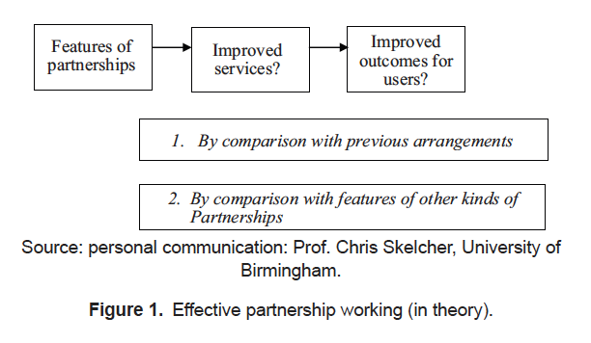
Glasby et al. Int J Integr Care. 2011;11:e002

Slide 6
Original proposal
1. Survey
Understand organizational and contextual determinants of success/failure
2. Quantitative
Linked routine quant outcome data
3. Qualitative
Inform survey design, and to identify the how and the why

Slide 7
Uses
Data repository for academics, policy makers, and organisations
Taxonomy of health and care partnerships
Development of partnerships
Prioritisation of processes and services
Explanation of performance
Impacts on inequalities
Approaches to addressing social needs
…

Slide 8
Questions and challenges
Development of survey instrument
Relevant survey domains
Relevant unit of analysis
Dissemination of survey and response rates
Linking of survey data to routine data
Identifying relevant outcomes
Relating survey data to outcomes
Use of data and insights to improve health and care

Slide 9
Questions continued
to discuss the key rationale for developing a bespoke survey instrument to track health and care partnerships in England;
to discuss potential methodological approach, theoretical frameworks, units of analysis, and project scope;
to identify key collaborators;
to identify potential funding opportunities.

Slide 10
Options
Option 1. Plan a large-scale research programme aimed at tracking and understanding health and care partnerships in England.
Option 2. Plan a pilot research project initially focusing on methods development.
Option 3. Plan a small-scale/pilot programme of research that aims to understand the relationship between a health and care partnership and pre-defined outcomes.
Option 4. Plan a research project that aims to develop a list of potential metrics against which health and care partnerships can/should be evaluated.

Slide 12
Time | Title | Format | Speaker/chair
10.30-11.00 | Logging on and checking in
11.00-11.20 | Introduction, background and rationale | Presentation and discussion | Adam Briggs (WMS)
11.20-11.50 | Lessons from evaluation of the Pioneers programme | Presentation and Q&A | Bob Erens/Nick Mays (PIRU, LSHTM)
11.50-12.30 | Organisational theory in healthcare | Presentation and Q&A | Graeme Currie (Warwick Business School)
12.30-12.40 | Tea, coffee, food, stretch legs
12.40-13.30 | Methods and outcomes from NSACO and NSHOS (with lunch) | Presentation and Q&A (via videolink) | Elliott Fisher (The Dartmouth Institute)
13.30-13.50 | Challenges of relating organisational data to outcomes | Presentation and Q&A | Jonathan Stokes (University of Manchester)
13.50-14.10 | Service and public perspective | Reflections and discussion
14.10-14.20 | Tea, coffee, food, stretch legs
14.20-15.10 | Discussion of methods Theoretical frameworks for project development Survey instrument development Unit of analysis Data linkage Scope | Discussion | Adam Briggs (WMS)
15.10-15.30 | Collaborators, funding opportunities, and next steps | Discussion | Adam Briggs (WMS)

Slide 13
By the end of the day
an initial decision about the general feasibility of the project.
And if potentially feasible,
suggested scope;
suggested methodological approach;
proposed next steps (who, what, where);
identification of possible funding opportunities.

Slide 14
Discussion of methods
Theoretical frameworks for project development
Survey instrument development
Unit of analysis
Data linkage
Scope

Slide 15
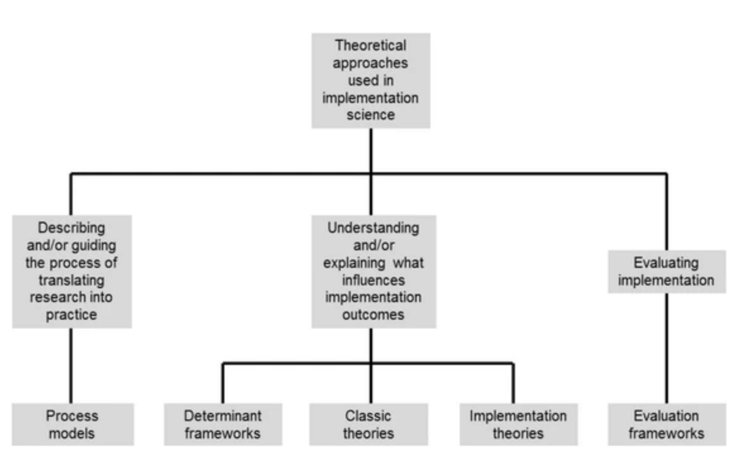
Theoretical frameworks
Nilsen. Implement Sci. 2015;10:53

Slide 16
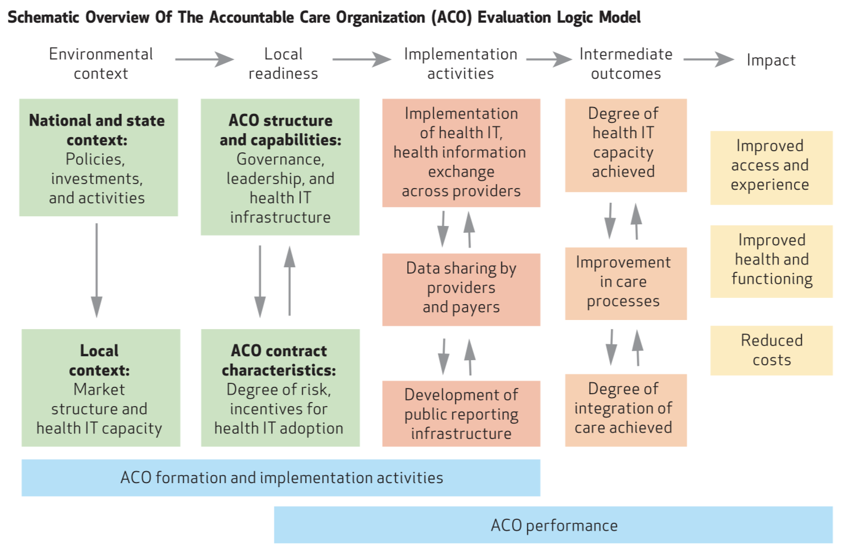
Fisher et al. Health Affairs. 2012;31(11):2368-78

Slide 17
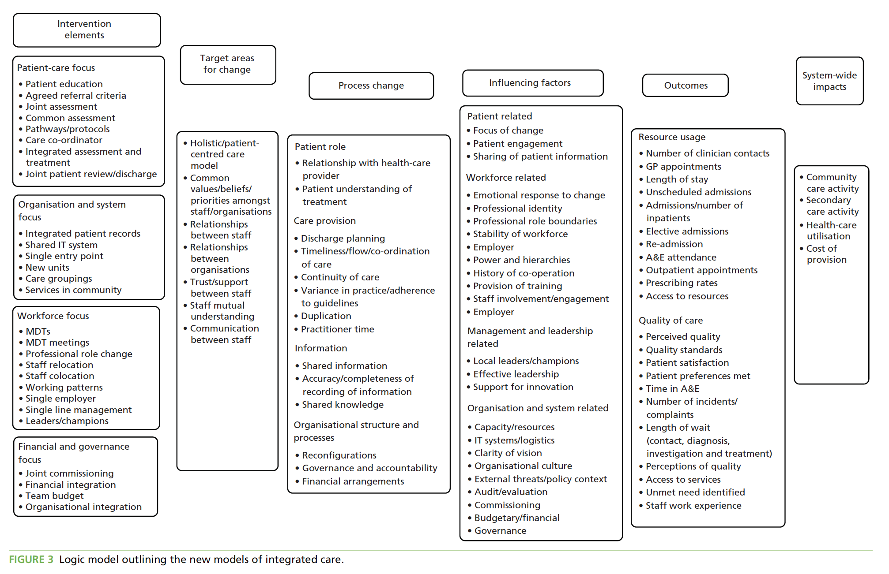
Baxter et al. HSDR. 2018;6(29)

Slide 18
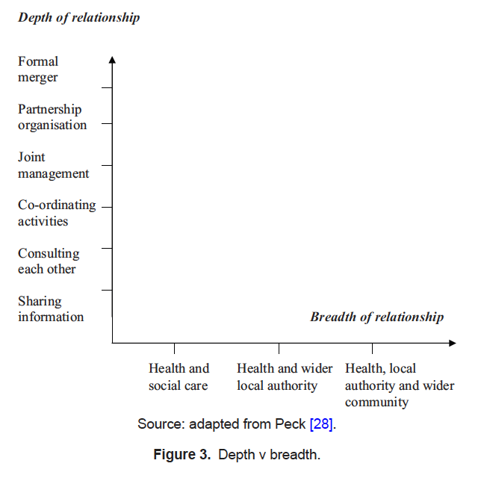
Glasby et al. Int J Integr Care. 2011;11:e002
Peck et al. Manag Comm Care. 2002;10(3):16

Slide 19
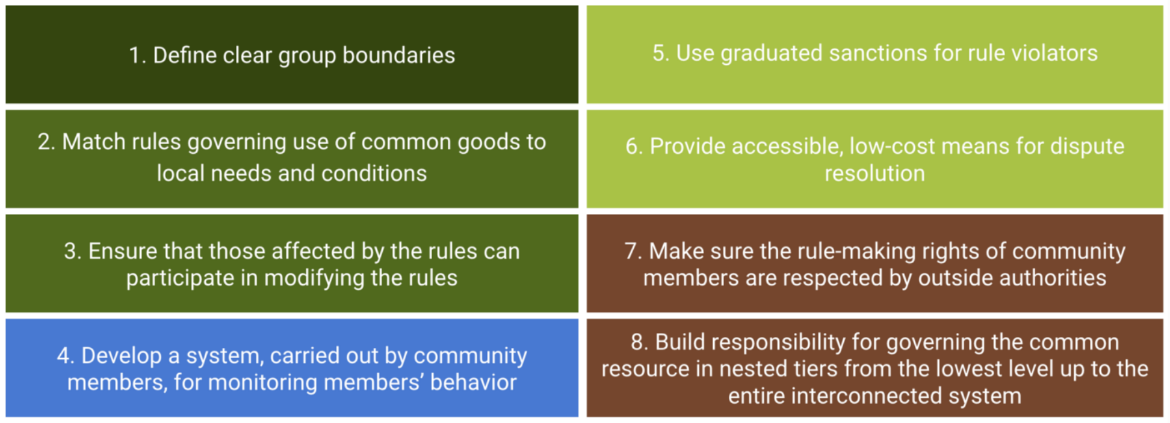
Elinor Ostrom
Ostrom, E (1990). Governing the Commons: The Evolution of Institutions for Collective Action. New York, USA: Cambridge University Press.
Figure: thealternative.org.uk

Slide 20
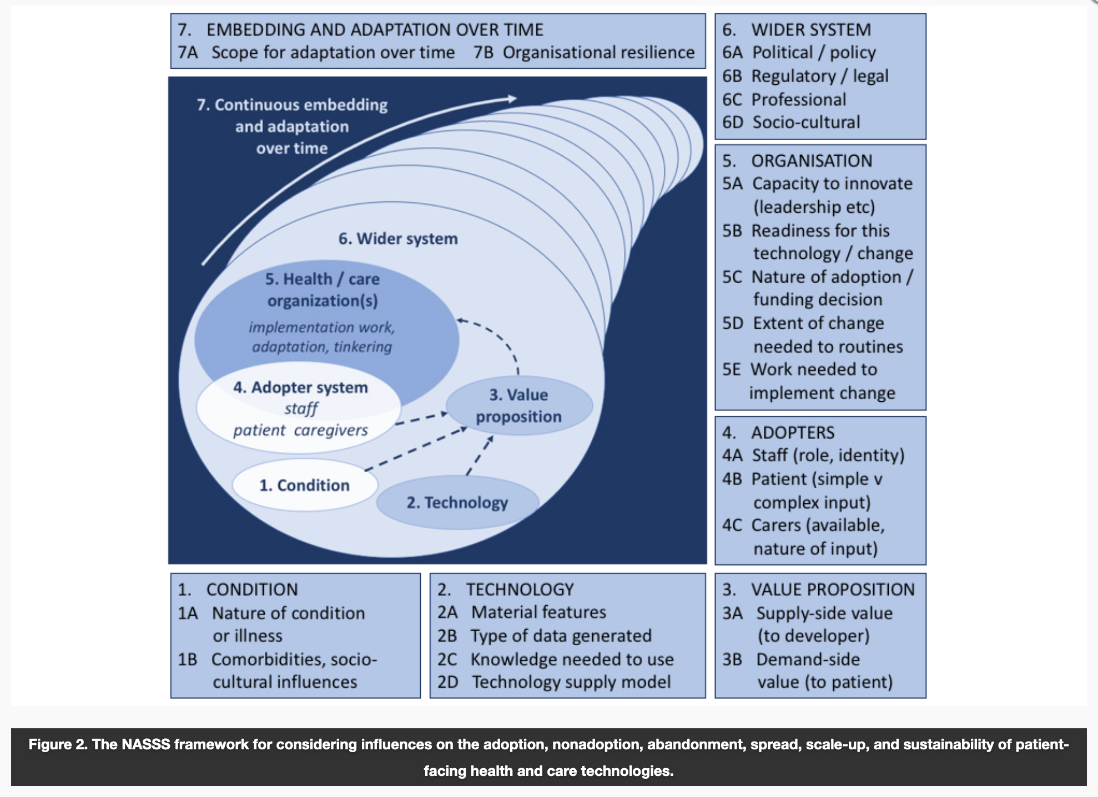
Greenhalgh et al. JMIR. 2017;19(11):e367

Slide 21
Survey instrument
Domains to include, e.g.
Glasby et al. Int J Integr Care. 2011;11:e002
NSHOS, NSACO domains
Pioneer programme
…
Notes:
Culture

Slide 22
Unit of analysis
NHS trusts, local government, CCGs, PCNs, ICSs,

Slide 23
Data linkage and methodological challenges

Slide 24
Scope
Survey instrument and domains
Scale/types of partnerships
Linking to routine data

Slide 25
Collaborators, funding, next steps
Notes:
3rd sept

