Slide 1

Coventry
City of Culture 2021
Ila Bharatan WBS
Rebecca Johnson, Coventry University
(with thanks to Jonothan Neelands)

Slide 2
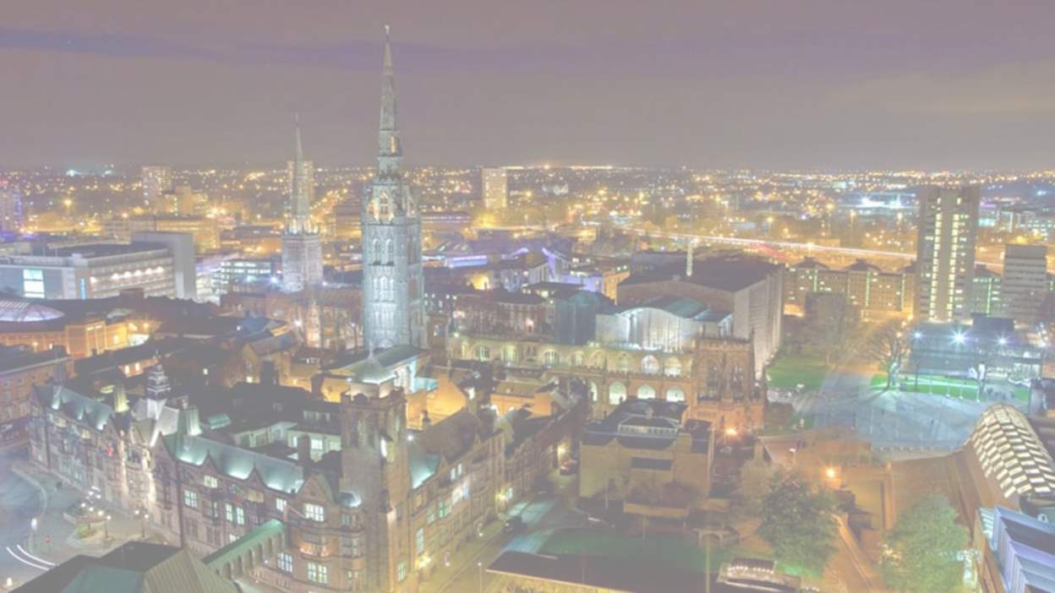
Coventry
City of Culture
Bid submitted 2017- success
Evidence to support positive links between health and well-being and cultural participation
Ethos of focus on health inequalities within an Arts and Culture programme of activities
Notes:
Put in context of WBS measurement and evaluation team, sitting across Coventry University and Warwick Business School, working closely with City of Culture Trust and Coventry City Council - truly a partnership
Nested within this overall evaluation is a focus on the relationship between cultural participation, health and health inequalities. Therefore we have an ethos on the significant role of culture on health, and health on culture in how the evaluation is shaped by this.
References
1 Camic, P.M. and Chatterjee, H.J. (2013), “Museums and art galleries as partners for public health interventions” Perspectives in public health, 133(1), pp.66-71.
2 Fancourt D., S. Finn (2019) “What is the evidence on the role of the arts in improving health and well-being? A scoping review, Health Evidence Network Synthesis Report 67, http://www.euro.who.int/en/publications/abstracts/what-is-the-evidence-on-the-role-of-the-arts-in-improving-health-and-well-being-a-scoping-review-2019 accessed 28 Nov 2019

Slide 3
AMION - EIA
MB ASSOC. - SVA
MEL – SENTIMENT SURVEY
FOUR – SOCIAL LISTENING PROJECT
MEL – HOUSEHOLD SURVEY 2020, 2022 and 2024
TECHNICAL REFERENCE GROUP
Membership:
DCMS
Arts Council England
What Works Centre Wellbeing
University of Derby
NESTA
Spirit of 2012
Royal Shakespeare Company
Freelance Cultural Data Scientist
CORE M&E
PhD/PGR
AHRC CITIES OF CULTURE NETWORK
FOCUS STUDIES
EVENT STUDIES
ACE LEADERSHIP PROGRAMME
NIHR FAMILY HUBS

Slide 4
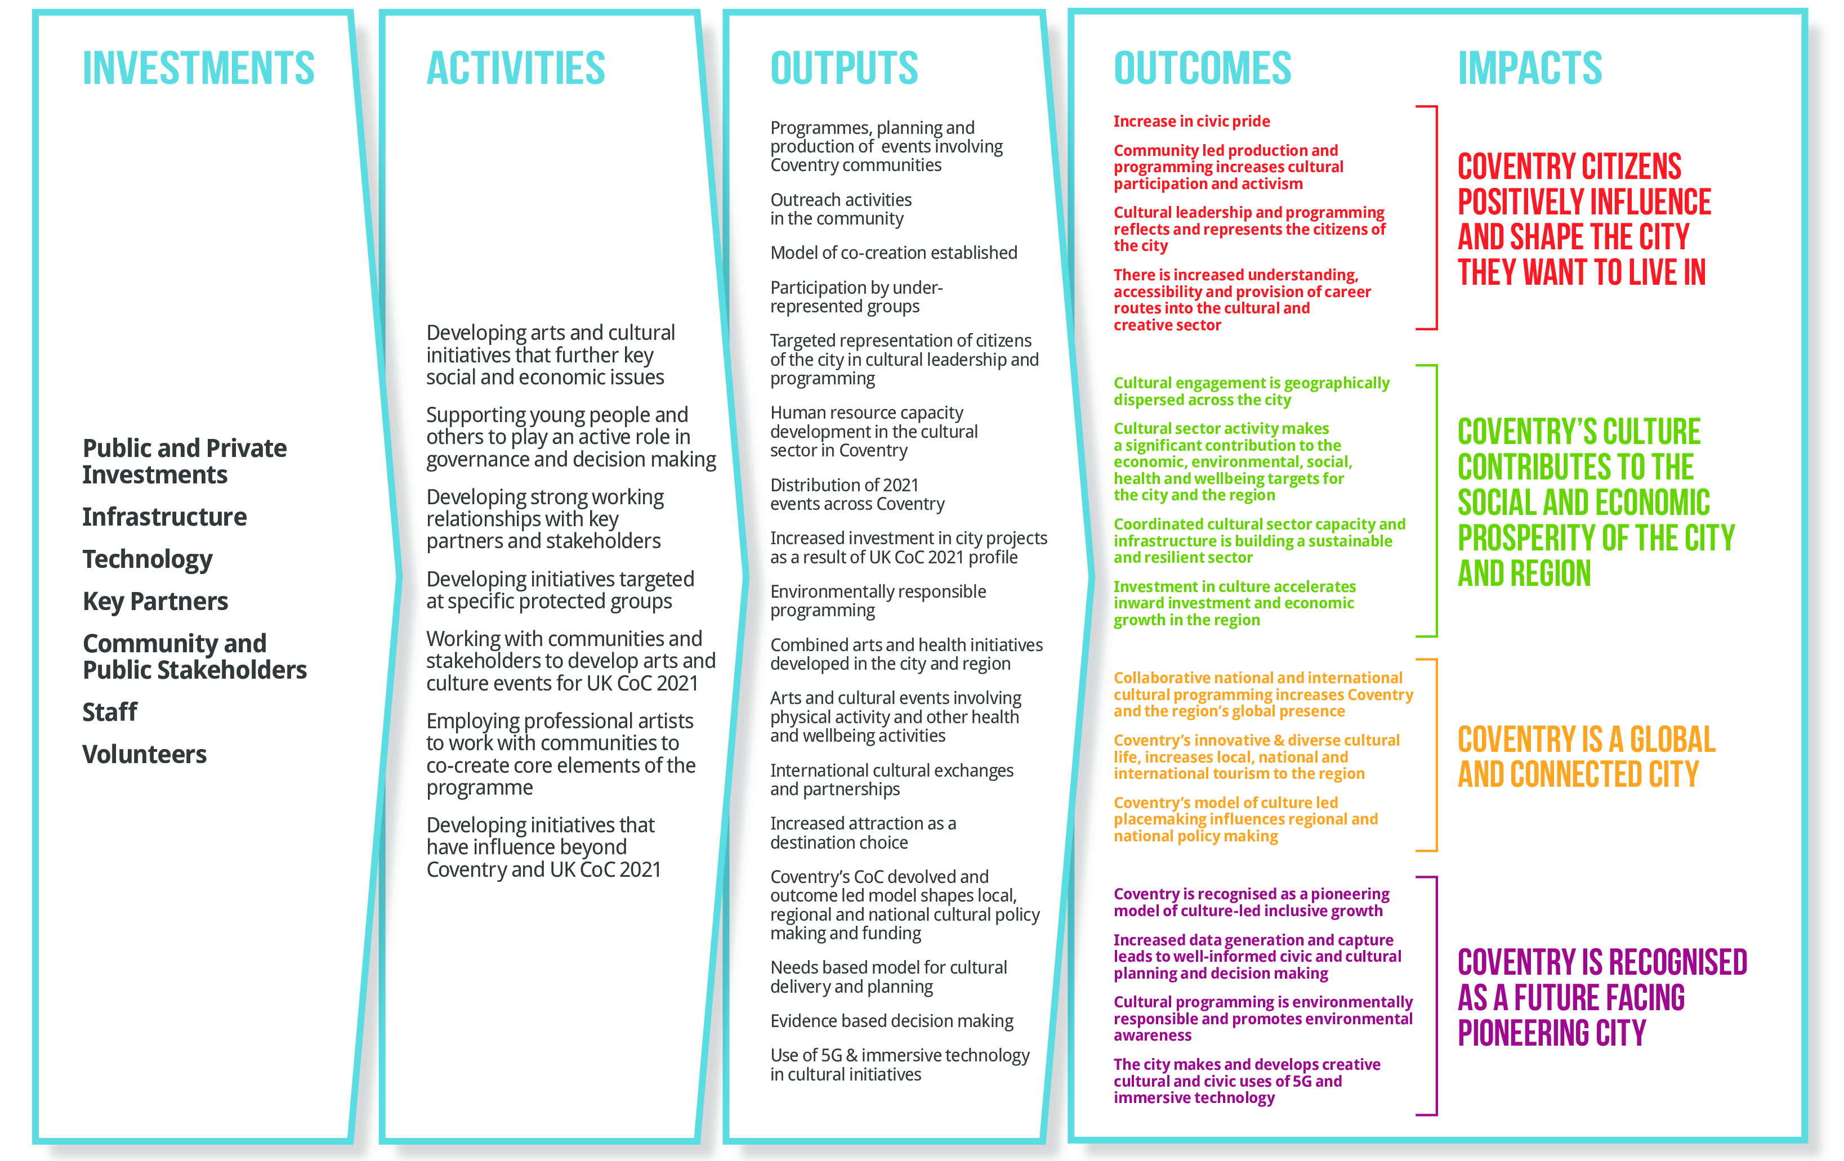


Slide 5
From theory of change to story of change
Investment
Activity
Outputs
Outcomes
Impacts
How were the investments used to develop activity that led to outputs that contributed to outcomes that delivered transformational impacts for the people of Coventry?

Slide 6
City of Culture Health Impact Study
Marmot City
Exploring the impact of the city of culture on the health and wellbeing of the local communities.
Three phases, mixed method
Examine CC2021 impact and reach --> health inequalities
How are inequality-related issues addressed by local organisations using high-profile cultural activities?
Notes:
Coventry is a Marmot City, with a focus on partnership working to address health inequalities across the city. It is a unique position, it is the sole surviving Marmot City, having chose to maintain this status and work independently to continue addressing health inequalities. This focus on health inequalities acts as a frame for strategic decision making including the City of culture programme
The organisations we have engaged with provide services to the populations most in need of local health and wellbeing services. Focusing on these organisations will allow us to examine the above impact and reach in relation to health inequalities and how inequality related issues are addressed by local organisations using high-profile cultural activities
Three phases of data collection – before, during and after the CoC, ethnographic study.
House hold survey collection annually 2020, 2021, 2022 – Tim when is it again
Integrating findings from both for a Mixed methods index development (on the horizon) - bridging qualitative findings with HHS findings to develop a culture and health impact index – very much in progress.
Collaborating closely with colleagues in WBS, COV uni, and Coventry city council

Slide 7
Early and Emergent Findings
Community space ownership
Partnership pinch points
Inequalities and access to cultural activities
Notes:
In the current phase, we are interested in how local community asset organisations are engaging in design of the city of culture activities, to what extent are health and wellbeing issues being considered in the design of the activities and how partnerships are being formed or not during this stage.
WE note the attention paid in our analysis to direct links to health (activities with a health purpose), as well as indirect links to health ( activities which may not be directly intending to affect health outcomes, but indirectly do so).
IB has undertaked 14 interviews so far.
Emergent Theme 1 - example how issues that create health inequalities, for example resources such as information, community amenities, transport, also play a role in whether or not people can access cultural activities.
Emergent theme 2- community spaces. Interviewees have mentioned that perceptions of who the space is perceived to belong to plays a role in who accesses the space. From both a health and wellbeing and cultural participation perspective, the issues of being part of the community, feeling able to enter and access spaces (and the resources within them) are important for individuals to access or not available resources.
Emergent theme 3- partnership building and the role that uncertainty and ambiguity plays constraining partnership development
SUMMARY
Clear links are emerging between findings regarding cultural activities, community, and health- for example, community spaces reflect identity and isolation issues (we can develop these strands in phase 2 as well) partnership issues mean that the health and wellbeing needs of the local communities may not be well articulated at this stage.
Next steps – HHS commences in early 2021
Qualitative data collection ongoing
Continuing to collect data and

Slide 8
Discussion
Can we leverage cultural participation for the good of communities?
Culture in the time of a pandemic – where to now?
Health inequalities challenges greater than ever – what are we going to do about it? What does CoC have to do with it?
Notes:
The whole cultural sector is changing, deprived areas of Coventry are at risk more than ever and there evidence that inequalities are extending because of the pandemic – how to contextualise this?
Marmot Partnership Group well placed to support partnered changes which organically integrate – the framework for ideal partnership? What can it contribute nationally?
The pandemic exacerbates health inequalities and the knock-on effects of the lockdown can increase things like poverty, isolation etc which can also reduce cultural participation.

