Slide 1
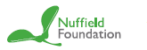

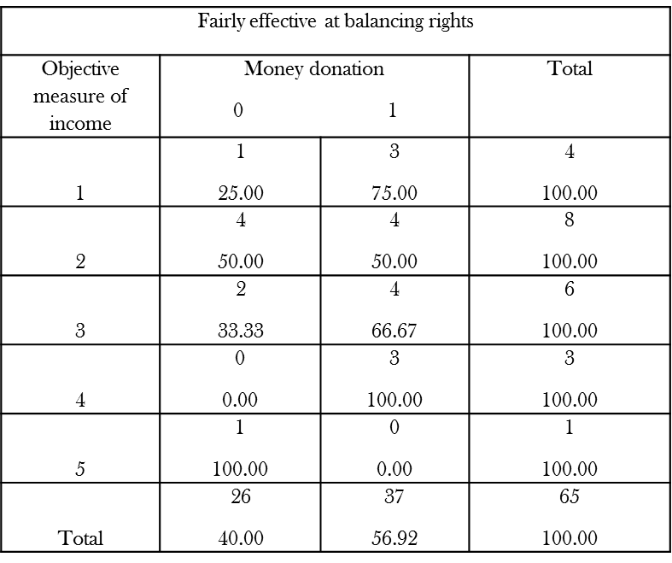
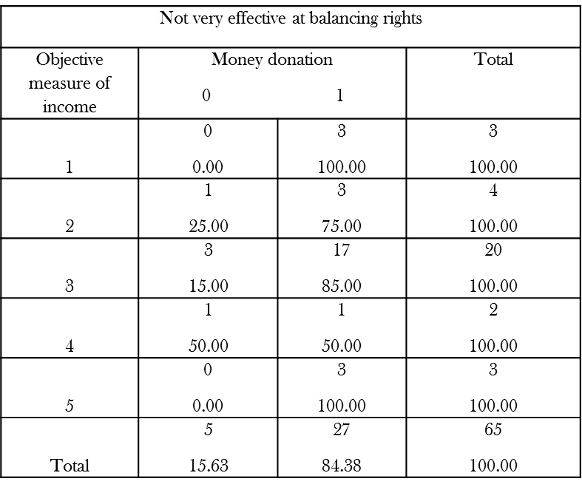
Social class, prosocial behaviour and the criminal justice system
Delal Etel
University of Warwick
Methods
Questionnaire
Stata- Chi square test and Pearson correlation coefficient
100 participants
Convenience sampling
Aims
Identify the relationship between social class, prosocial behaviour and the criminal justice system.
Introduction
Current researchers are cognizant in the relationship between social class and prosocial behaviour.
The combination with the criminal justice system has very little research attention.
Abstract
How does perceived fairness in the criminal justice system influence the relationship between social class and prosocial behaviour?
Through various questionnaire analysis, the results have shown that there is a significant positive correlation between prosocial behaviour and social class within the category of participants that consider the criminal justice system to treat people ‘very fairly’ or ‘quite fairly’.
Discussion 1.
Within the category of those who believe that the rights are fairly balanced, 75% donated money to a charitable organisation within the last 12 months have a household income of less than £20,000.
Whereas, 66.67% of individuals have donated to a charitable organisation within the last 12 months and have a household income of £30,001 to £45,000.
Acknowledgements
Professor Ulf Liebe , Nicole Schwitter, Nuffield Foundation and the Department of Sociology
Conclusions
My study perceives that those who believe the criminal justice system is not very effective at balancing rights of the offender and the victim have an income of less than £20,000 and have donated within the last 12 months this therefore shows that they are more likely to perform prosocial behaviour.
Discussion 2.
Within the category of those who believe that the rights are not very effective at balancing the rights, 100% of those participants have donated money within the last 12 months have a household income of less than £20,000.
Compared to 85% of participants who have donated have a house hold income of £30,001 to £45,000.
Further work
The differences between the upper class and lower class in regards to antisocial behaviour and which tier of the class hierarchy is most likely to perform antisocial behaviour.

