Slide 1



Science City Advanced Materials 2: Innovative Uses for Advanced Materials in the Modern World
Dr Emma Melia
Project Manager
University of Warwick

Slide 2
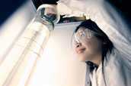
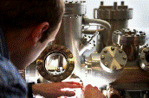
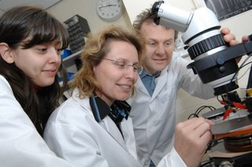

Birmingham Science City – Advanced Materials
Set of three Projects totalling almost £30M investment
AM1: Creating and Characterising Next Generation Advanced Materials
Physics & Physical Chemistry
AM2: Innovative Uses for Advanced Materials in the Modern World
Warwick Chemistry & Physics,
Birmingham Chemical Engineering & Chemistry
and Dentistry
AM3: Processing of Advanced Materials
Engineering & Physics

Slide 3
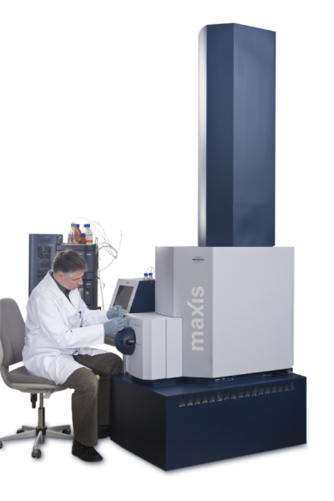
Advanced Materials 2 – Background
AM2 is focused on applications of Advanced Materials and led by University of Warwick
Academics and research groups with global profile and strong industrial collaboration track record:
Warwick Leads: Prof Dave Haddleton & Prof Julie MacPherson
Birmingham Leads: Prof Jon Preece & Prof Mike Adams
£7.9M Capital Investment:
State of the Art Equipment: many unique/bespoke items
Redevelopment of dedicated laboratory space
Almost £1M Revenue Funding
AM2 enabled by Project Manager,
2 FTE Facilities Managers,
Business Engagement Manager
Mass Spectroscopy System supplied by Bruker, Coventry

Slide 4
Advanced Materials 2 - Purpose
Funding was awarded to support Advanced Materials activity in the West Midlands region:
Research and development around new applications for Advanced Materials
Creating a combined Virtual Centre of Excellence in Advanced Materials through the Warwick-Birmingham collaboration
All equipment funded by the Project is available to academics at both Universities
Delivering assistance to regional companies to overcome industrial challenges in Advanced Materials
Securing a reputation with national and international companies and developing long term collaborations

Slide 5
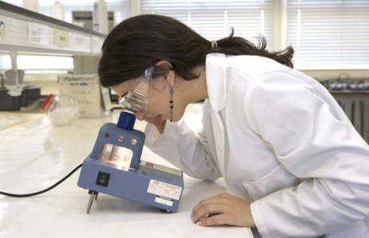
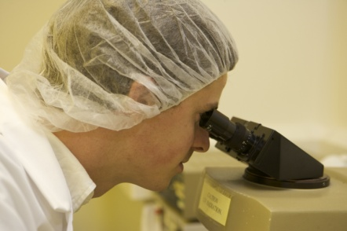
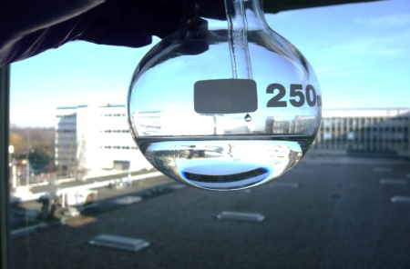
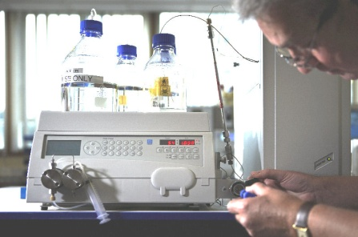
Advanced Materials 2 – Research Themes
Six Core Research Themes
Biosensors
Diagnostics, biosecurity, nanoparticles, biomedical applications
Smart Biomaterials
Medical and dental materials, scaffolds for cell growth, bioconjugates, drug delivery
Sensors for Harsh and Complex Environments
Online monitoring, materials processing, composite material fabrication
Molecular Electronics
Batteries, electronic data storage, nanolithography, display technology
Solar Cells and Photovoltaics
Renewable energy, semiconductor thin films, increasing efficiency, reducing cost
Control and Storage of Hazardous Compounds
Immobilisation, encapsulation, environmental impact

Slide 6
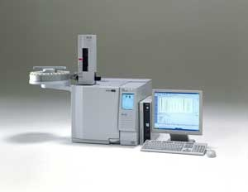
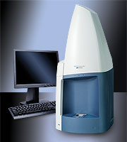
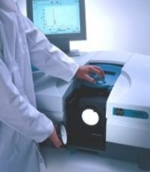
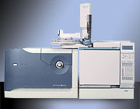
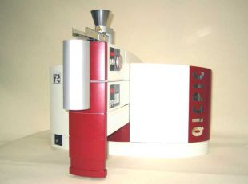
Advanced Materials 2 – Contracted Outputs
To be delivered 2008 – 2018:
53 Jobs Created
6 Businesses Created
79 Businesses Supported to Improve Performance
79 Businesses engaged in New Collaborations with the Knowledge Base
29 Graduates into Employment
132 People Assisted to Improve their Skills
£20 Million Levered Revenue
3 New Demonstrator Projects
3 Patents/Licences
22 Workshops
205 Peer Reviewed Publications
205 Conference Presentations

Slide 7
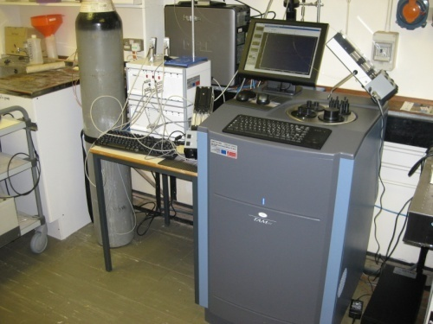
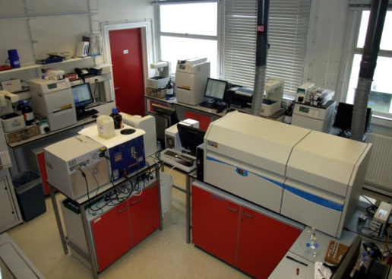
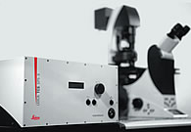
Advanced Materials 2 – Progress and Activities
Procurement and Refurbishment activity underway
Over £6.1M Capital spend to date (Total Capital just under £7.9M)
Equipment Installation underway: Staff and Students receiving skills training
State of the Art laboratory space at University of Warwick is complete
Refurbishment of labs at University of Birmingham finished by Dec 09
Several “Portfolio Project” research grant applications submitted to both public and private sector funders – over £1.7M levered revenue
Preliminary research results submitted to peer reviewed journals and presented at international conferences (acknowledging Science City)
Microcalorimeter
State of the Art GPC Facility
Confocal Microscope
Gas Chromatography MS

Slide 8
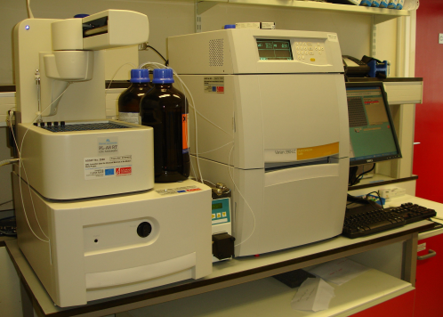
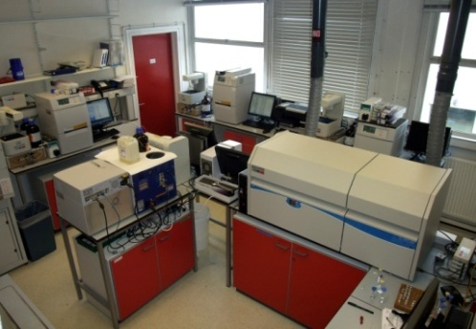
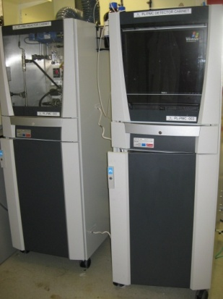
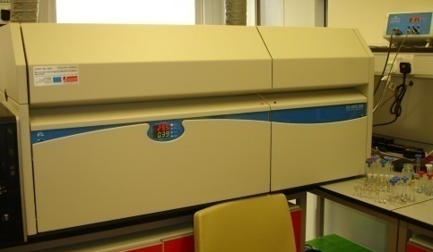
Equipment Highlights
Polymer Research
Gel Permeation Chromatography (GPC) Suite – Unique Facility
Five New Polymer Labs/Varian Systems
High Temperature GPC (PL 220)
multiple detectors on every GPC
Viscometry, diode array, fluorescence, refractive index, light scattering
All commercial solvent/column combinations
DMF, THF, Chloroform, Aqueous
ACOMP: online monitoring GPC (one of only two facilities globally)
Four multi-detector GPC Systems
State of the Art GPC Facility
High Temperature GPC
ACOMP: Online GPC

Slide 9
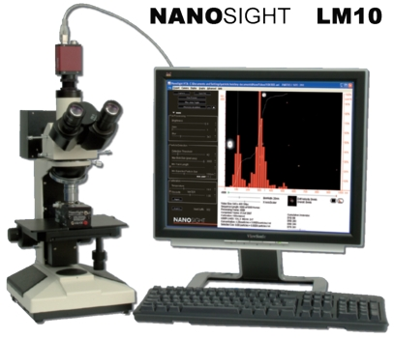
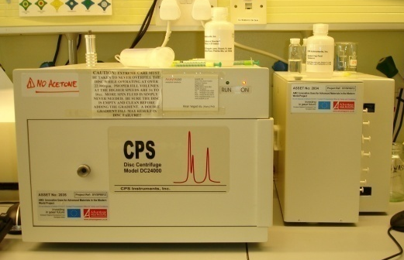
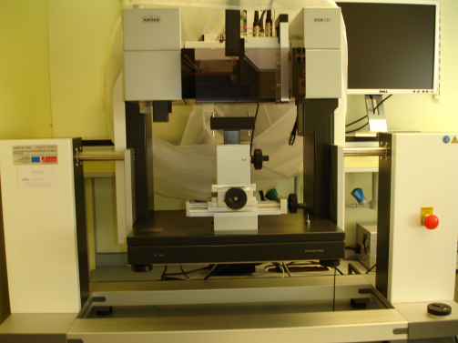
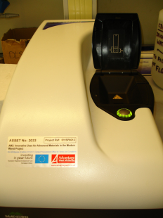
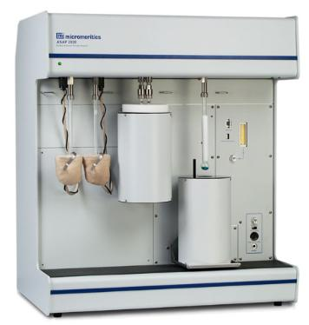
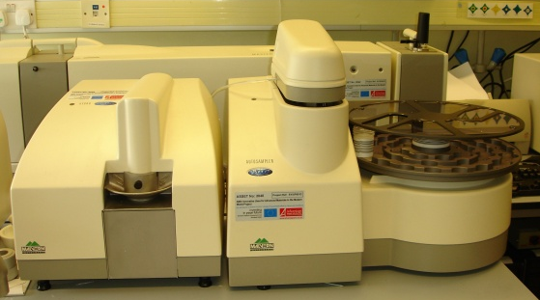
Equipment Highlights
Particle Size and Shape Analysis
Particle size and micro-pore analysis
Emulsions, solutions, dry powders
Dark field particle tracking microscope
Droplet Shape Analysis
Contact angle, Interfacial and surface tension of liquids
Surface free energy of solids, Rheological experiments
High RPM disc centrifuge
Particle size analysis 5 nm – 75 μm
Separation of particles with 5% difference in size
Dynamic light scattering
Nanosight Particle Analyser
High Speed Disc Centrifuge
Malvern Zetasizer
Micropore Analyser
Malvern Mastersizer
Droplet Shape Analyser

Slide 10
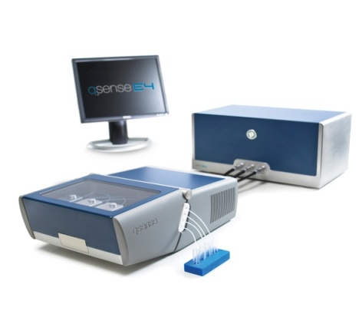
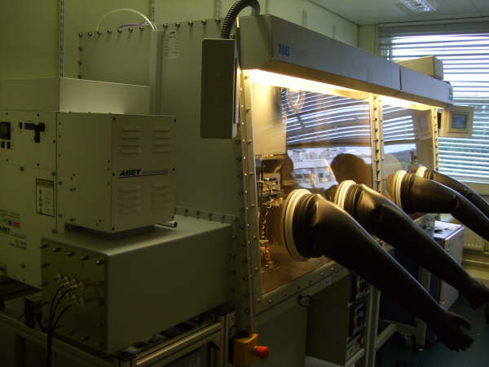
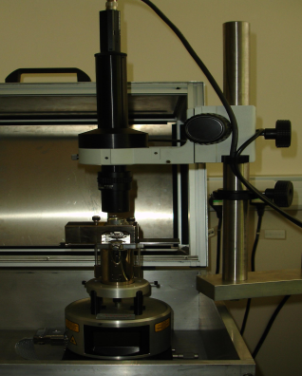
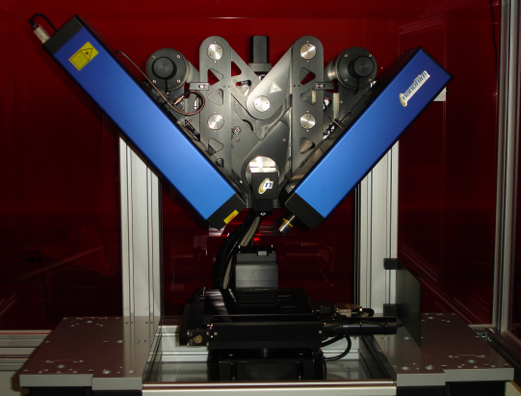
Equipment Highlights
Physical and Measurement Chemistry
Scanning and imaging ellipsometer
Thin film analysis, monolayers
Highest specification commercial Quartz Crystal Microbalance
Atomic Force Microscope
Configured for electrochemistry
Organic thin film deposition and analysis
Photovoltaic research, solar simulator
Quartz Crystal Microbalance
Thin Film Deposition and Analysis
STM/AFM
Broadband Ellipsometer

Slide 11
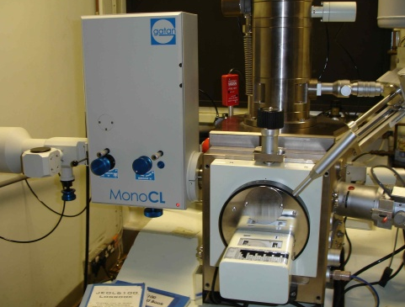
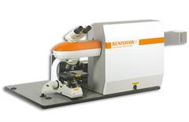
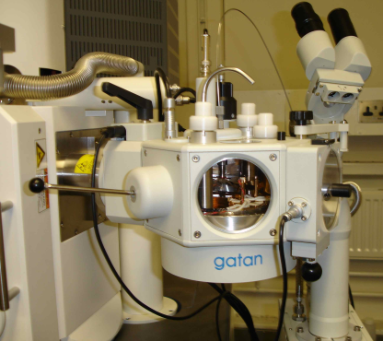
Equipment Highlights
Warwick Microscopy
High specification laser scanning confocal microscope suite: agreement to operate as a demonstration site for supplier Leica
White light and UV sources
Raman Structural and Chemical Analyser – including Photoluminescence and Cathodoluminescence
Cryostage for SEM
UHV-Scanning Tunnelling Microscope
Cathodoluminenscence
Structural and chemical analyser
Laser scanning confocal
Cryo-stage for SEM

Slide 12
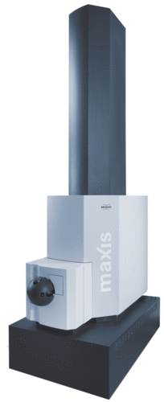
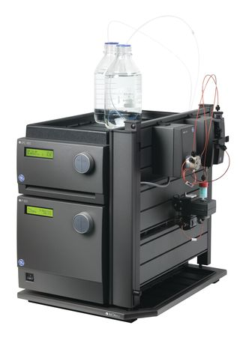
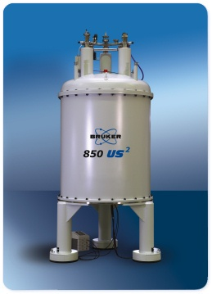
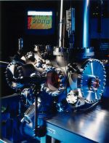
Equipment Highlights
Warwick
Advanced 850 MHz 20 Tesla widebore solid state NMR (1st in UK)
Range of biomaterials analysis equipment including FPLCs, bioanalyser and HPLC-Mass Spec
Bruker MaXis Mass Spectrometer
Unique 850 MHz Solid State NMR
Mass Spectrometer
FPLCs
MaXis Mass Spectrometer
UHV-STM

Slide 13
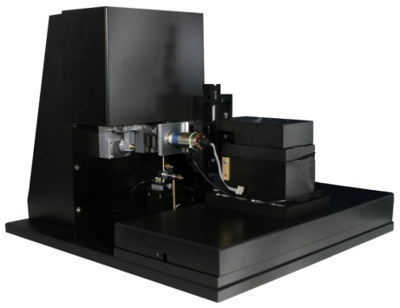
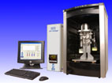
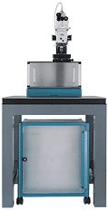
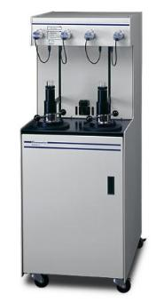
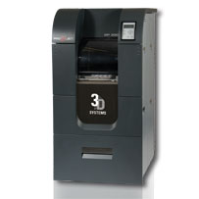
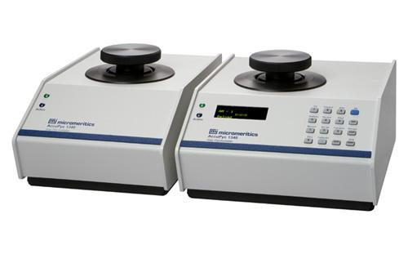
Equipment Highlights
Birmingham
Science City allows academics at both institutions to access equipment housed in departments at both sites
DVS-A Moisture Adsorption Apparatus
NanoTest NanoIndentor
QICPIC Particle Shape Analyser
AcuPyc II 1340 Pycnometer
Rapid Prototyper
AutoPore IV Porosimeter
Confocal Raman

Slide 14
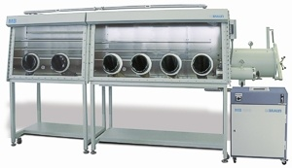
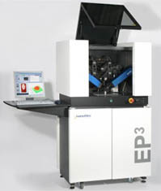

Advanced Materials 2 – Science City
Contact:
Dr Emma Melia
AM2 Project Manager
Department of Chemistry, University of Warwick
e.melia@warwick.ac.uk
07824 541072
Thin Film Deposition System for Organic Photovoltaic Research
Particle Shape Analyser
Broadband Elipsometer
Confocal Raman
Projet Rapid Prototyper
ACOMP Online GPC
NanoTest NanoIndentor

