Slide 1

Thiol-ene Click Chemistry, Catalytic Chain Transfer Polymerization in Conjunction with SET-living Radical Polymerization
David Haddleton
University of Warwick,UK
CRP Meeting
Ol Fosse d'Outh, Houffalize, September 17-18, 2009

Slide 2
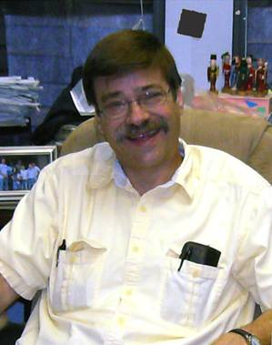
In memory of Charlie Hoyle – University of Southern Mississippi
An extraordinary scientist

Slide 3
Outline
Polymerisation Cu(I) and Cu(0)
SET-LRP
Glycopolymers from CCTP and double click chemistry
One pot LRP and click
Thiol-activated alkene click to peptide conjugates (sCT)
Hyperbranched polymers with functional coronas from thiol-alkene click and CCTP

Slide 4
Outline
Polymerisation Cu(I) and Cu(0)
SET-LRP
Glycopolymers from CCTP and double click chemistry
One pot LRP and click
Thiol-activated alkene click to peptide conjugates (sCT)
Hyperbranched polymers with functional coronas from thiol-alkene click and CCTP

Slide 5
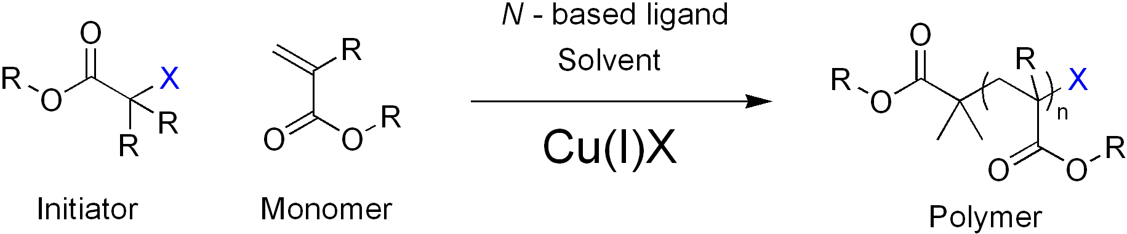
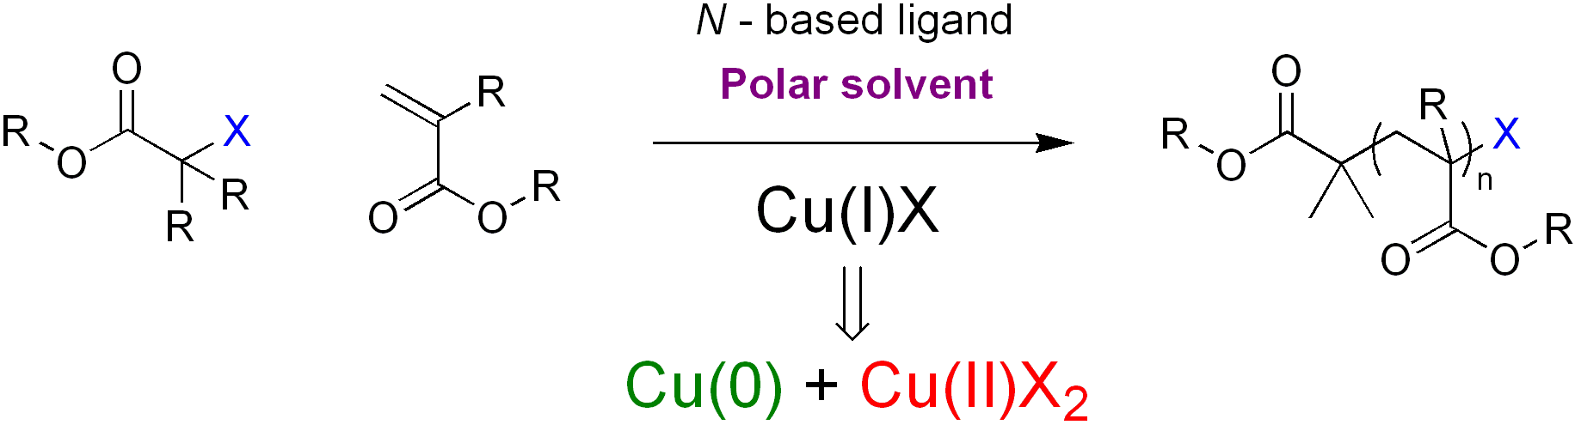
Introduction to SET-LRP
SET-LRP: A brief overview
ATRP with Cu^{I}X
Cu(0) as the active catalyst
Percec, V. et al, J. Am. Chem. Soc. 2006, 128, (43), 14156-14165.

Slide 6
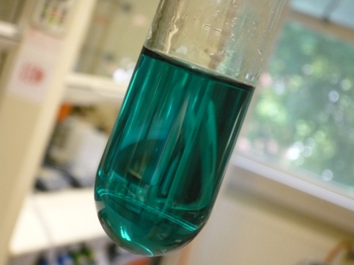
Introduction to SET-LRP
Benefits of SET-LRP
- Ambient Conditions
- ‘Ultrafast’ controlled radical polymerisation
- Wide range of monomers, solvents and functional initiators
eg amide monomers, protic solvents, non activated alkenes
- Synthesis of very high molecular weight polymers > 1 million
- Cu(0) easy to remove, facile polymer clean-up
Investigation of SET-LRP
1
4

Slide 7
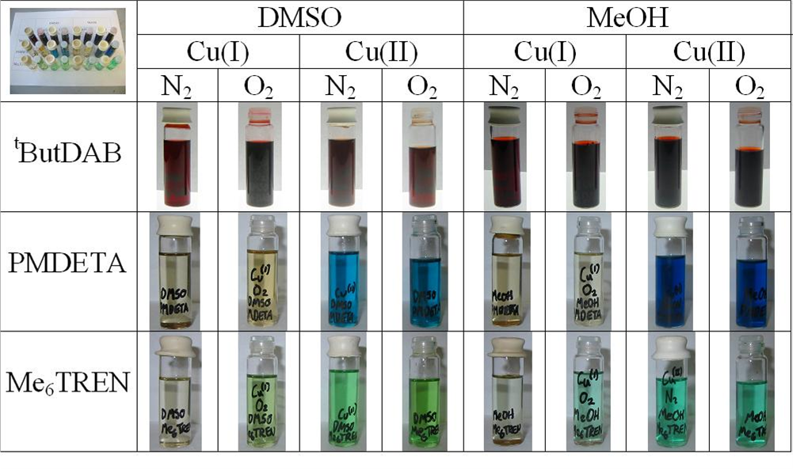


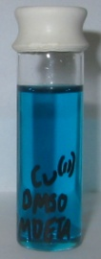
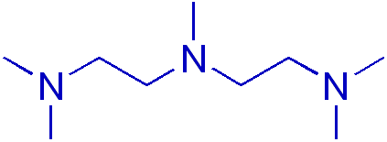
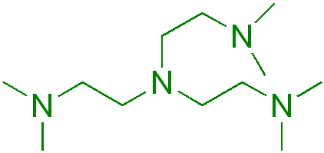
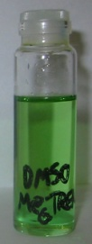
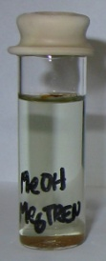
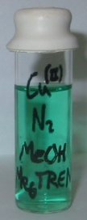
Initial Ligand Studies
Ligand studies in organic solvents
^{t}ButylDAB
PMDETA
Me₆TREN
Investigation of SET-LRP
1
8

Slide 8
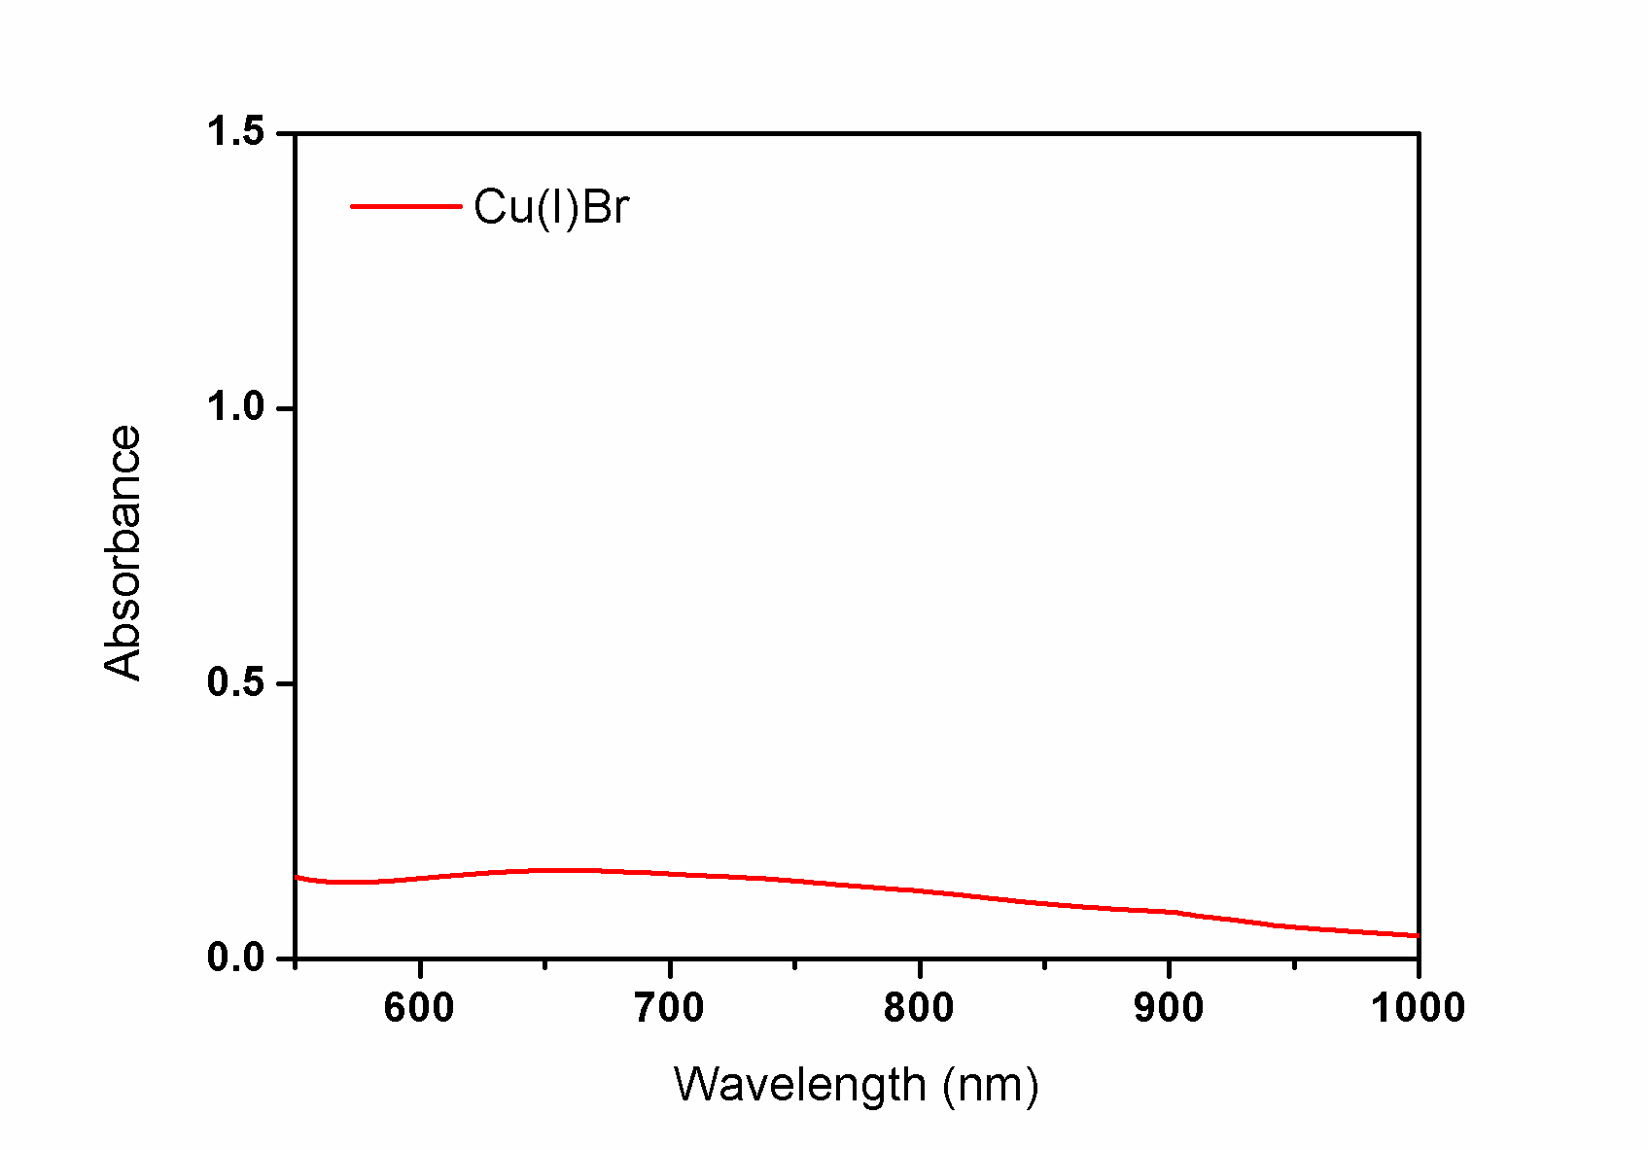
UV-Vis Analysis of SET-LRP System
Monitoring disproportionation using UV-Vis analysis
DMSO
Investigation of SET-LRP
1
11

Slide 9
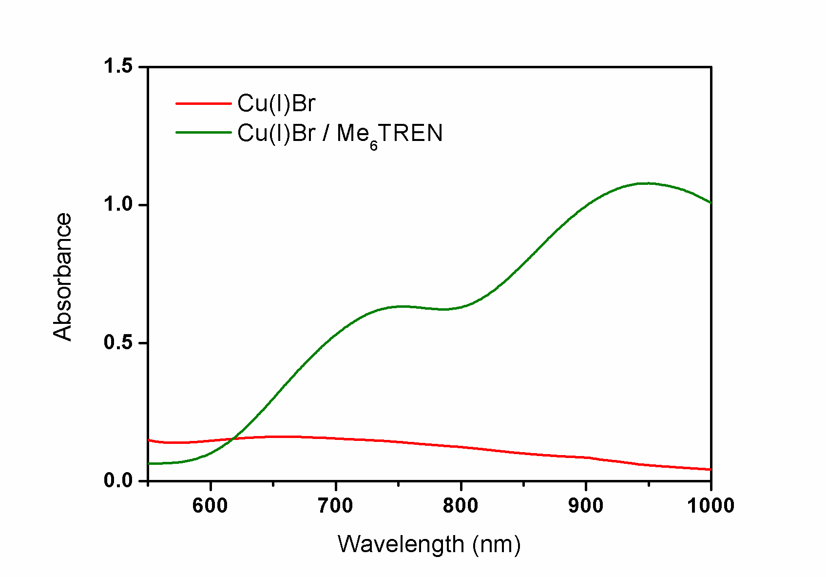
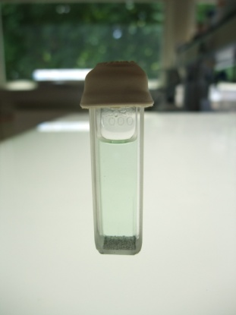
UV-Vis Analysis of SET-LRP System
Monitoring disproportionation using UV-Vis analysis
✓
DMSO
DMSO
Investigation of SET-LRP
1
11

Slide 10
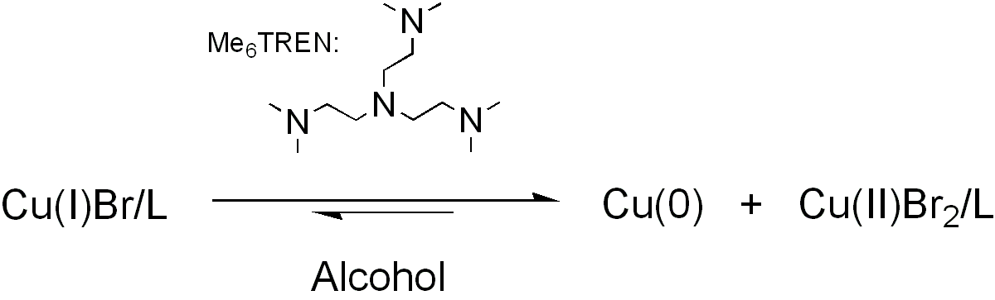
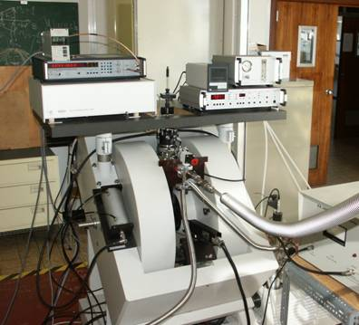
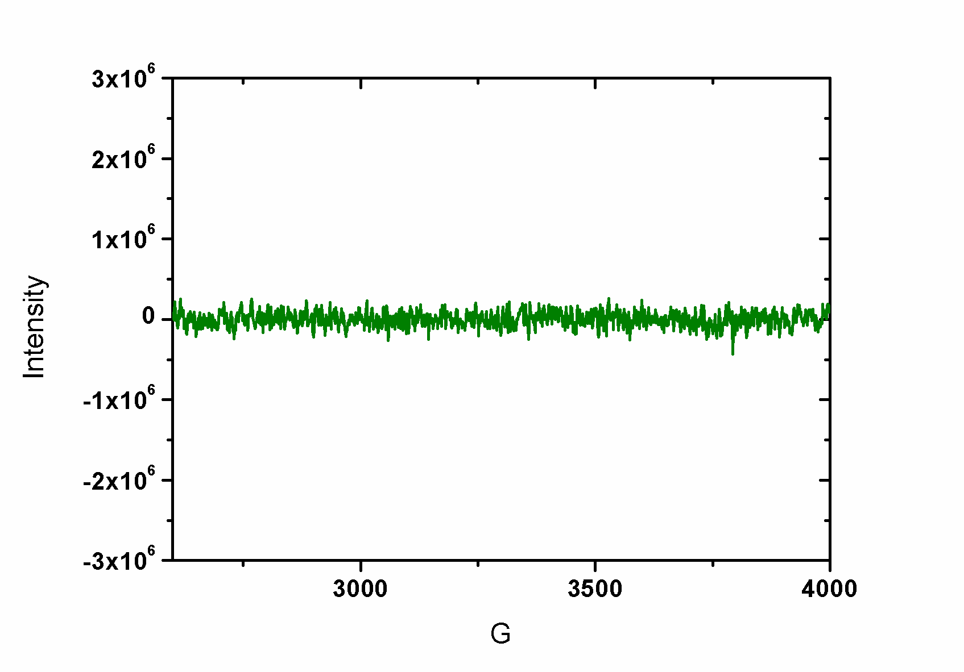
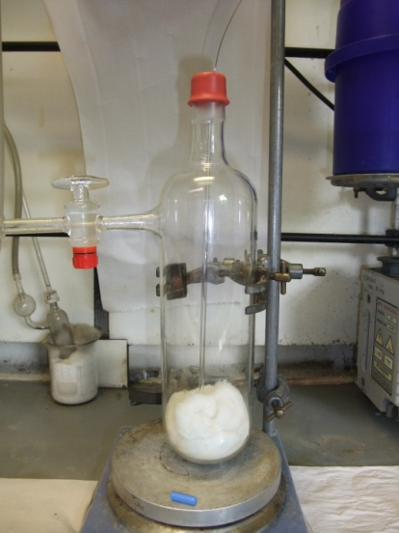
EPR Studies of SET-LRP System
Detecting Cu(II) using EPR analysis
Cu(I)
Professor Mark Newton – UoW Physics

Slide 11
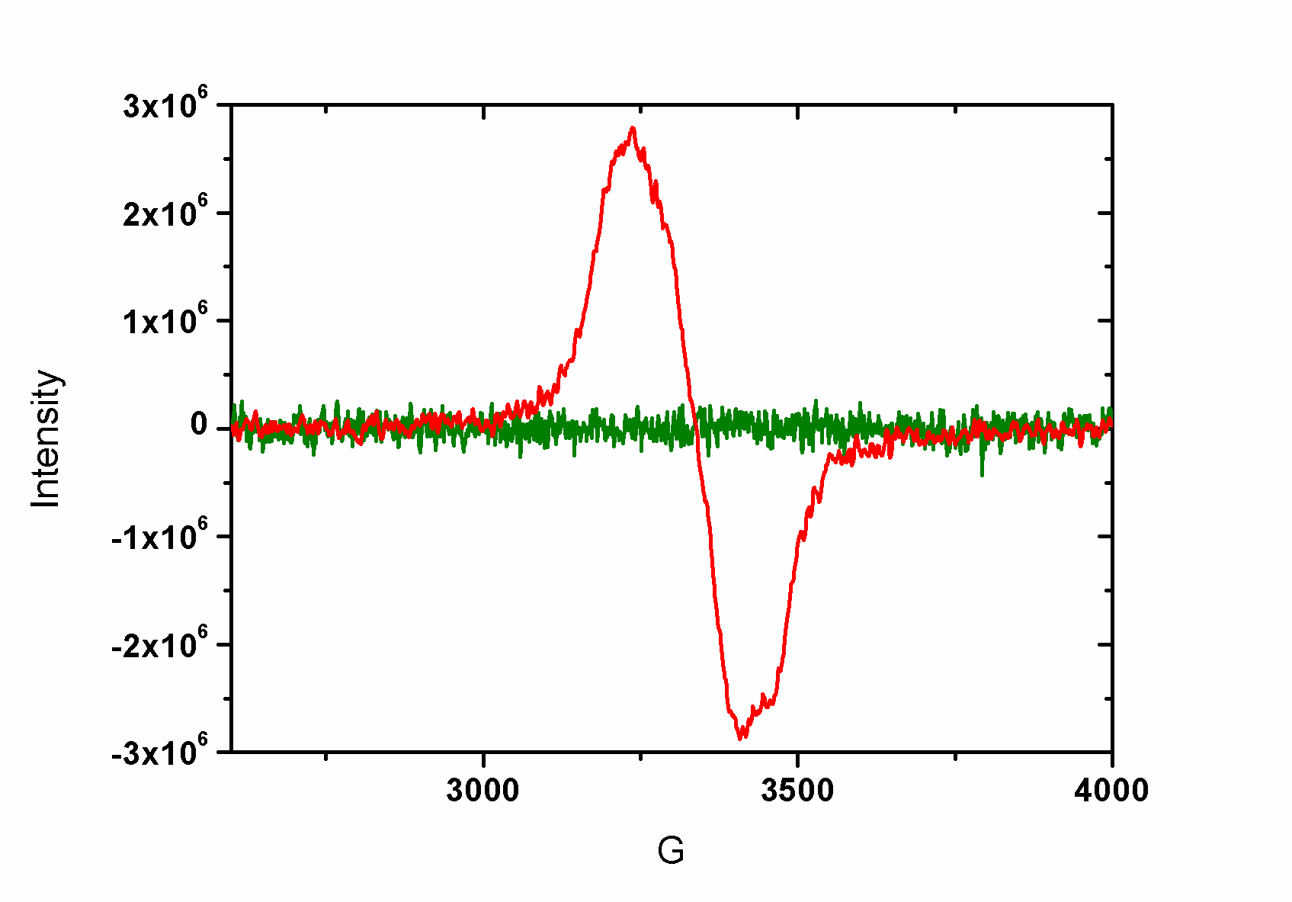
EPR Studies of SET-LRP System
Detecting Cu(II) using EPR analysis
Cu(I)
Cu(II)
Investigation of SET-LRP
1
16

Slide 12
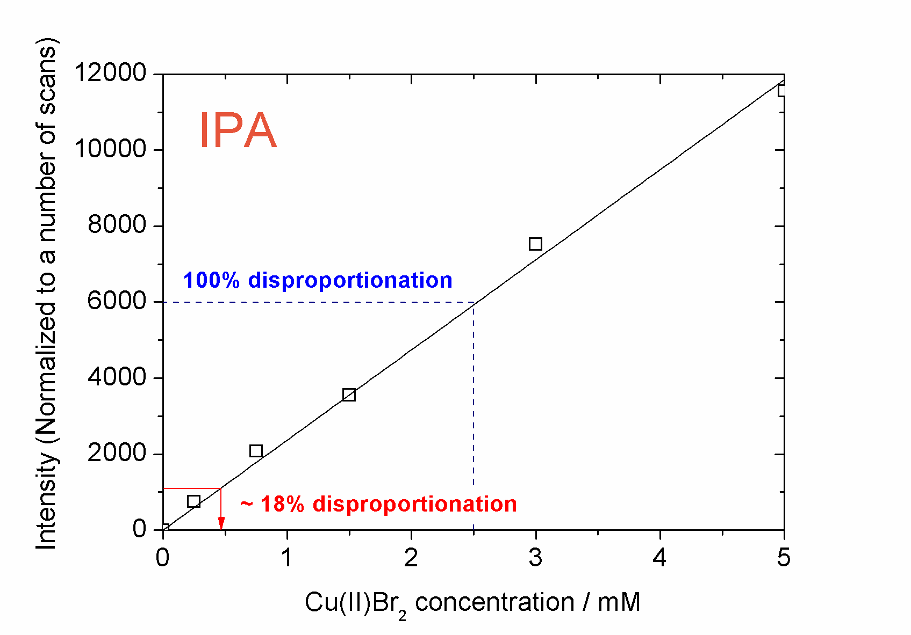
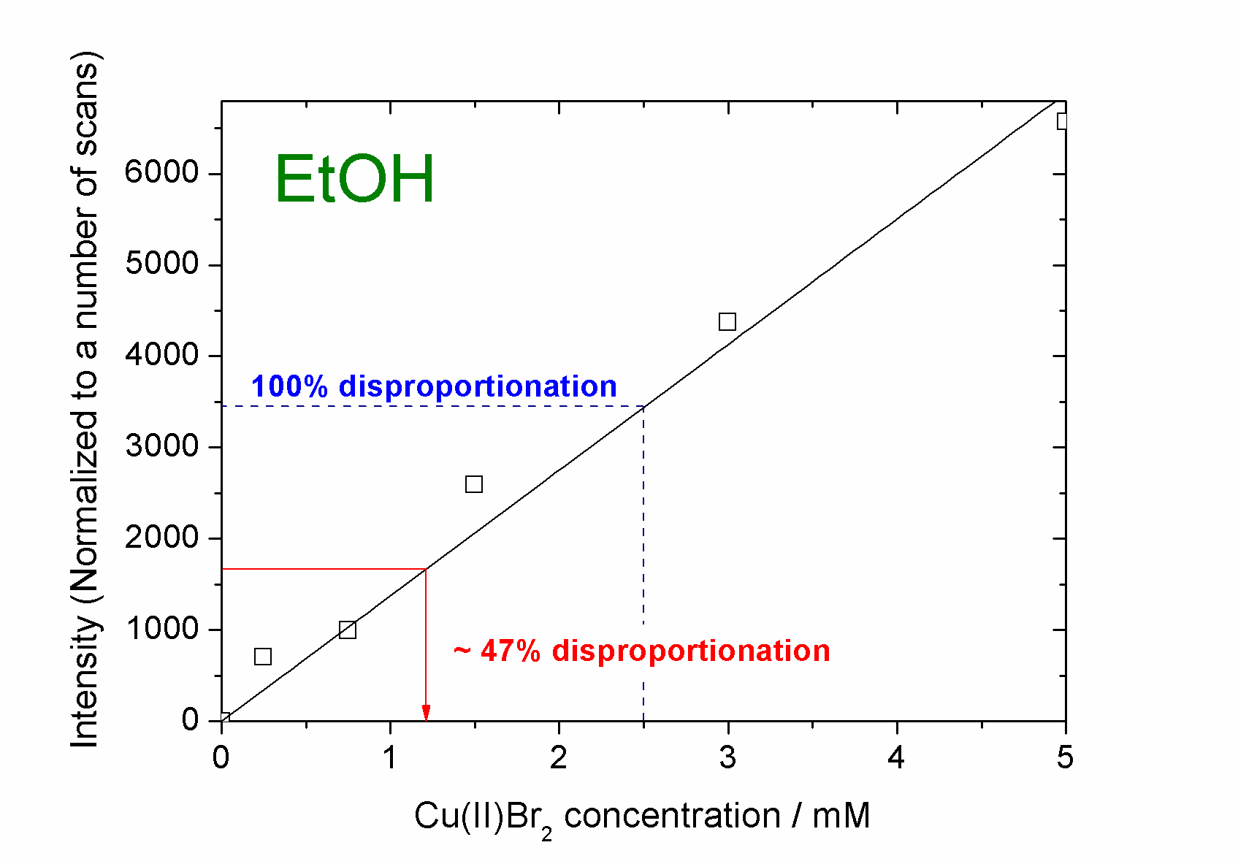
EPR Studies of SET-LRP System
Monitoring disproportionation using EPR analysis
- Using signal intensity rather than absorbance
Investigation of SET-LRP
1
17

Slide 13
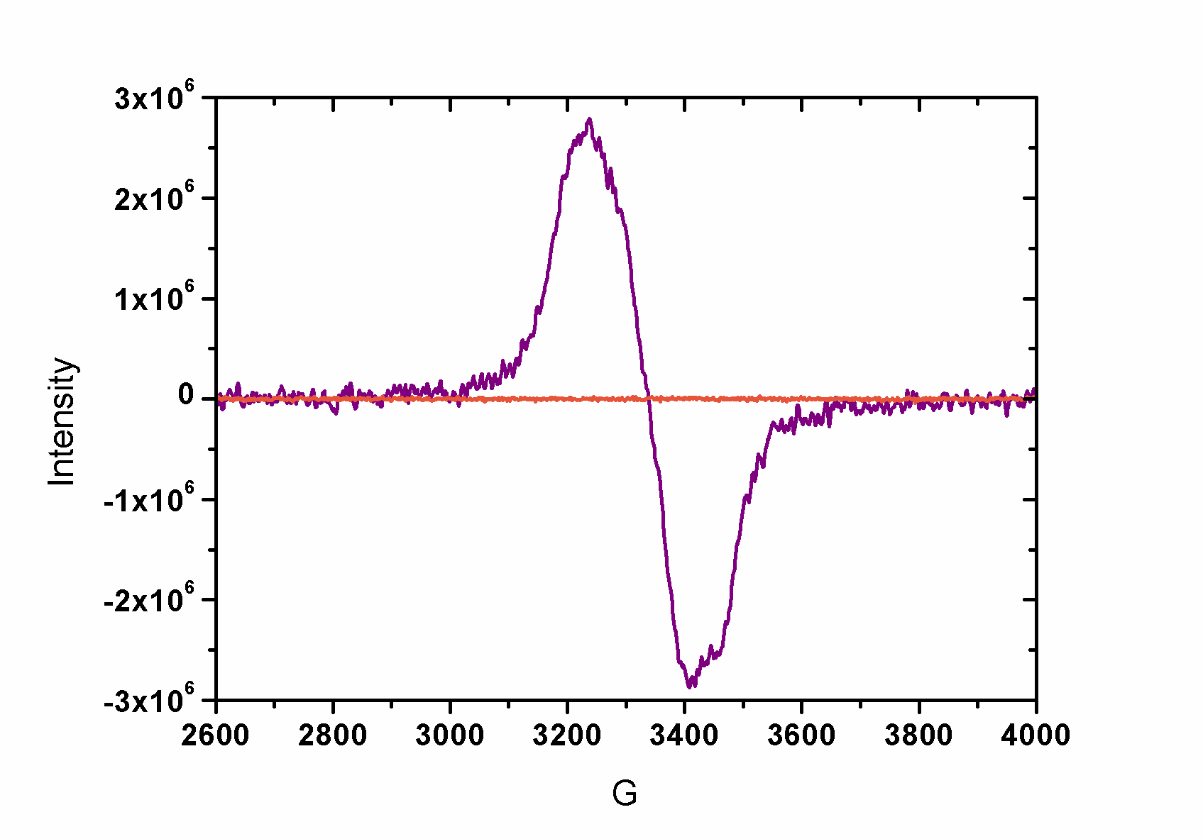
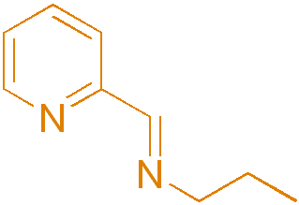
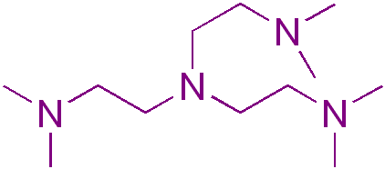
EPR Studies of SET-LRP System
EPR with N-(n-ethyl)-2-pyridylmethanimine ligand in IPA
- As a control the same experiment was repeated
with a pyridine imine type ligand
- Results showed no Cu(II) present
Investigation of SET-LRP
1
18

Slide 14
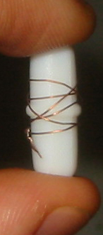
Cu(0) mediated Polymerisations
Traditional polymerisation system used at Warwick:
Reaction performed above ambient (~30-90ºC)
Poor control in aqueous/polar media
Alternative
Cu(0) catalytic system
Polymerisations performed at ambient
>90% and PDi < 1.2 often attainable within an hour
Simplified Polymer workup
Percec et. al. J. Amer. Chem. Soc. (2006), 128(43), 14156-14165
Notes:
16700 Students
Includes visiting and exchange students (heads) and HEFP students in local colleges. Excludes students taught overseas and on external programmes.
3800 Staff
3000 full and part time, 800 casua, 96% non-academic staff live in Coventry. 3rd largest employer in Coventry area
£174.5 m turnover
For year ended July 2001, projected to rise to £222 m by 2004/05
Arts Centre
250,000 visits each year, 70% of audience from Coventry/Warwickshire, 67% self-generated income. £580,000 University subsidy to Arts Centre each year (not all grant)

Slide 15
Cu(0) Polymerisation of MA in non polar solvent

Slide 16
Use of METHANOL to mediate SET-LRP of MA
Notes:
16700 Students
Includes visiting and exchange students (heads) and HEFP students in local colleges. Excludes students taught overseas and on external programmes.
3800 Staff
3000 full and part time, 800 casua, 96% non-academic staff live in Coventry. 3rd largest employer in Coventry area
£174.5 m turnover
For year ended July 2001, projected to rise to £222 m by 2004/05
Arts Centre
250,000 visits each year, 70% of audience from Coventry/Warwickshire, 67% self-generated income. £580,000 University subsidy to Arts Centre each year (not all grant)

Slide 17
Use of alcohol additives to mediate SET-LRP
Notes:
16700 Students
Includes visiting and exchange students (heads) and HEFP students in local colleges. Excludes students taught overseas and on external programmes.
3800 Staff
3000 full and part time, 800 casua, 96% non-academic staff live in Coventry. 3rd largest employer in Coventry area
£174.5 m turnover
For year ended July 2001, projected to rise to £222 m by 2004/05
Arts Centre
250,000 visits each year, 70% of audience from Coventry/Warwickshire, 67% self-generated income. £580,000 University subsidy to Arts Centre each year (not all grant)

Slide 18
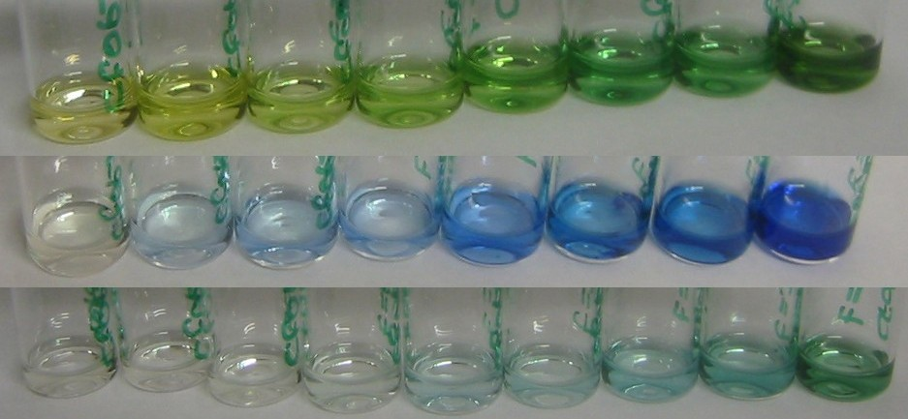
PEGMA with SETLRP
DMSO
Mn ~8000
PDI ~1.14
MeOH
^{i}PrOH
Notes:
16700 Students
Includes visiting and exchange students (heads) and HEFP students in local colleges. Excludes students taught overseas and on external programmes.
3800 Staff
3000 full and part time, 800 casua, 96% non-academic staff live in Coventry. 3rd largest employer in Coventry area
£174.5 m turnover
For year ended July 2001, projected to rise to £222 m by 2004/05
Arts Centre
250,000 visits each year, 70% of audience from Coventry/Warwickshire, 67% self-generated income. £580,000 University subsidy to Arts Centre each year (not all grant)

Slide 19
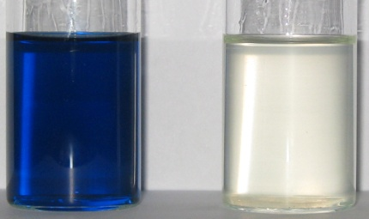
PEGMA with SETLRP
Following Cu(II) production by UV-VIS
Cu(0), PMDETA, PEGMA₄₇₅ and MeOH
Tungsten lamp and fibre optic
Copper reflections and stirrer vibrations
Notes:
16700 Students
Includes visiting and exchange students (heads) and HEFP students in local colleges. Excludes students taught overseas and on external programmes.
3800 Staff
3000 full and part time, 800 casua, 96% non-academic staff live in Coventry. 3rd largest employer in Coventry area
£174.5 m turnover
For year ended July 2001, projected to rise to £222 m by 2004/05
Arts Centre
250,000 visits each year, 70% of audience from Coventry/Warwickshire, 67% self-generated income. £580,000 University subsidy to Arts Centre each year (not all grant)

Slide 20
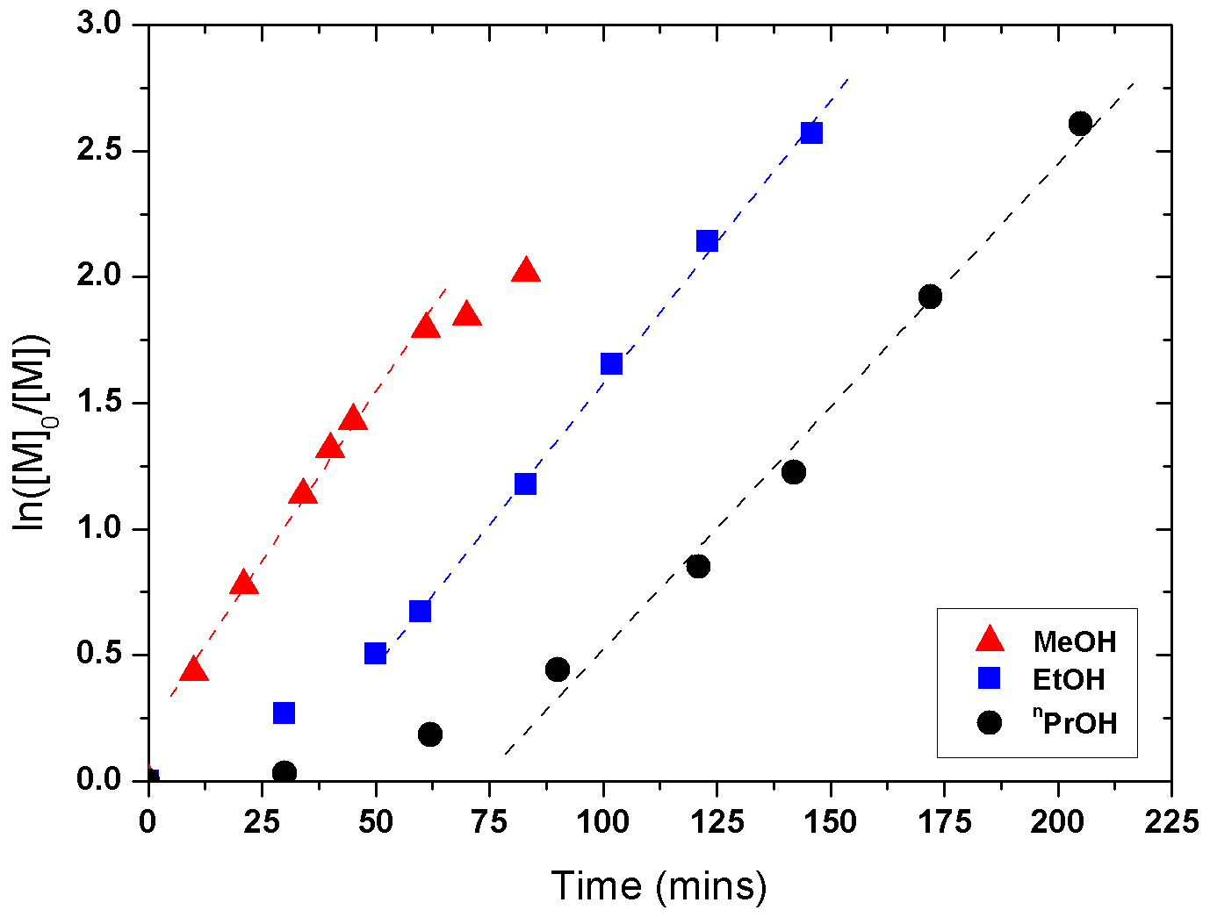
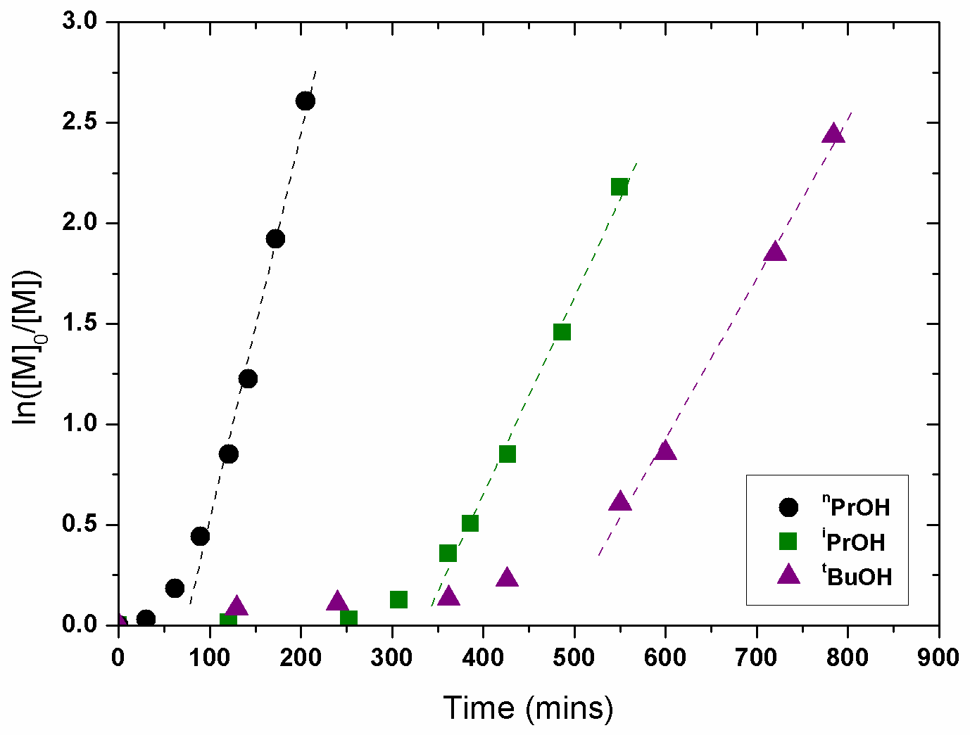
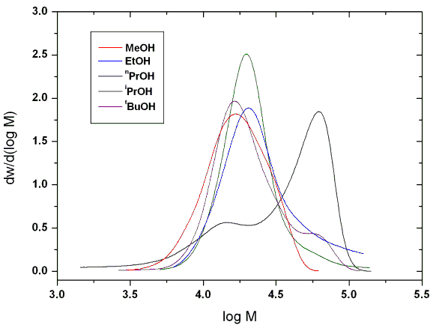
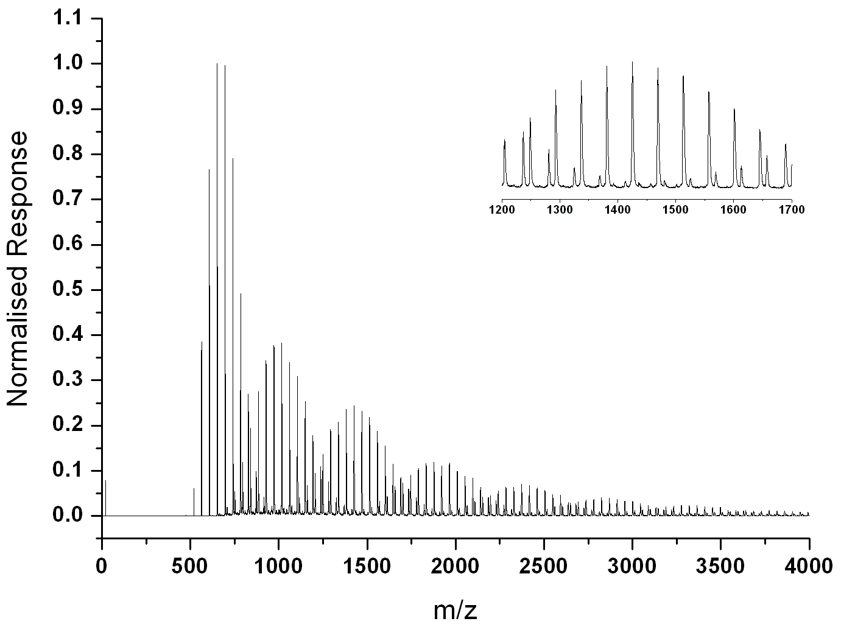
Cu(0)-catalysed polymerisation of PEGMA₄₇₅
[Cu(0)]:[I]:[L]:[Mes]:[PEGMA₄₇₅] = 1/1/1/15/30.L = PMDETA

Slide 21
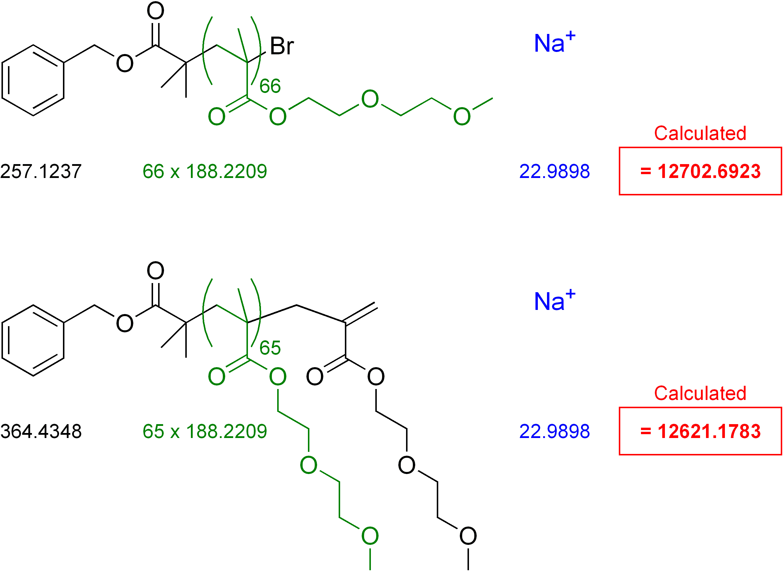
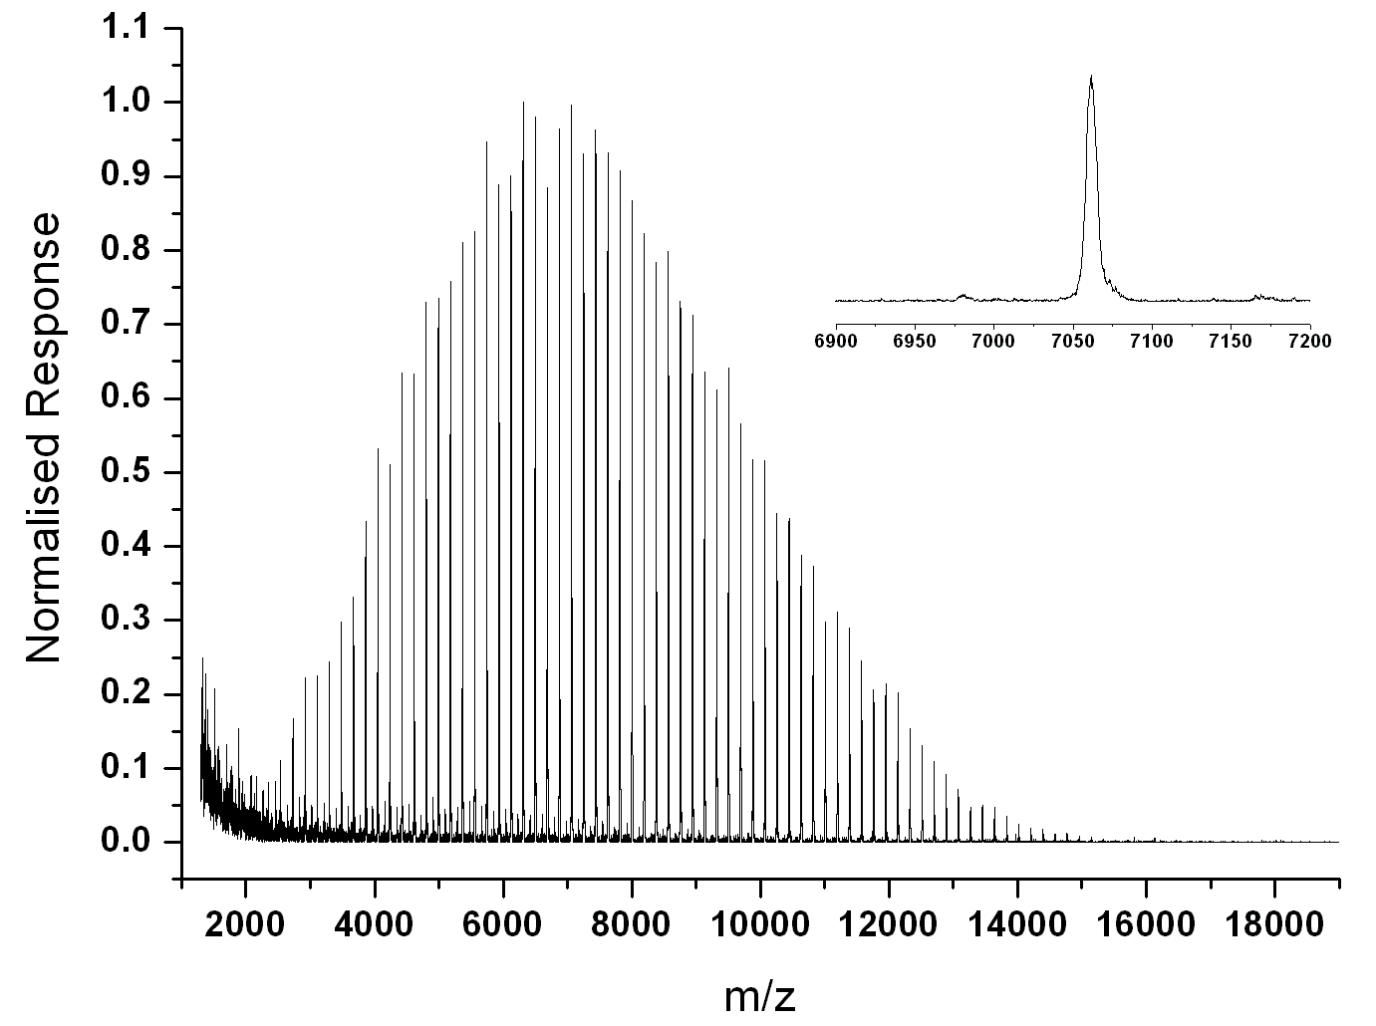
DEGMEMA with Cu(0)
Repeat Units | Theoretical Mass (Da) | Actual Mass (Da) | Difference (ppm)
64 | 12326.250 | 12326.892 | 52
65 | 12514.471 | 12514.825 | 28
66 | 12702.692 | 12702.601 | 7

Slide 22
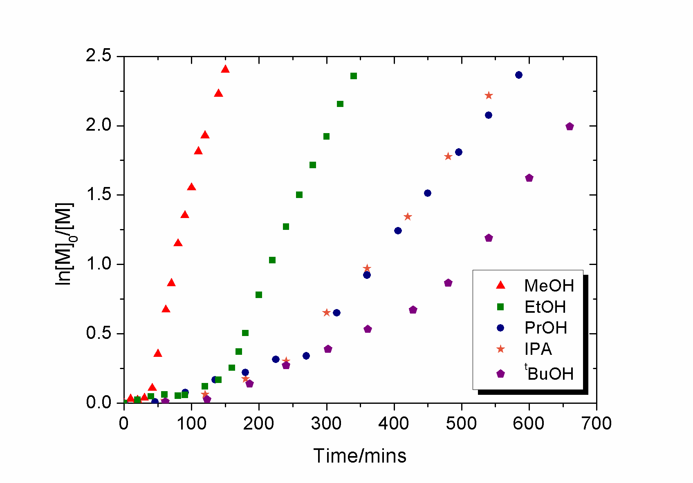
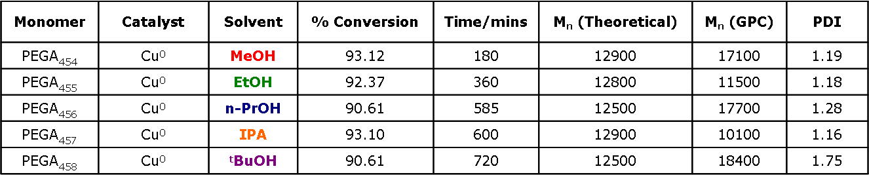
PEG Monomers and SET-LRP
Polymerisation of PEGA₄₅₄ in selected alcohols
Investigation of SET-LRP
1
23

Slide 23
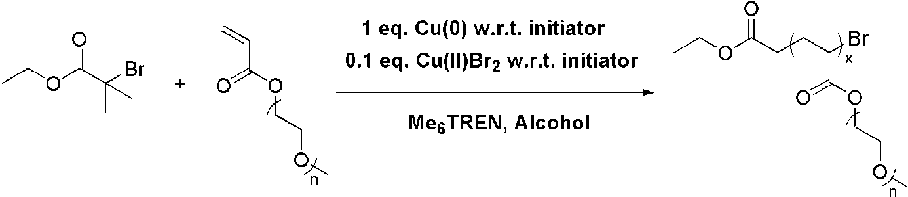
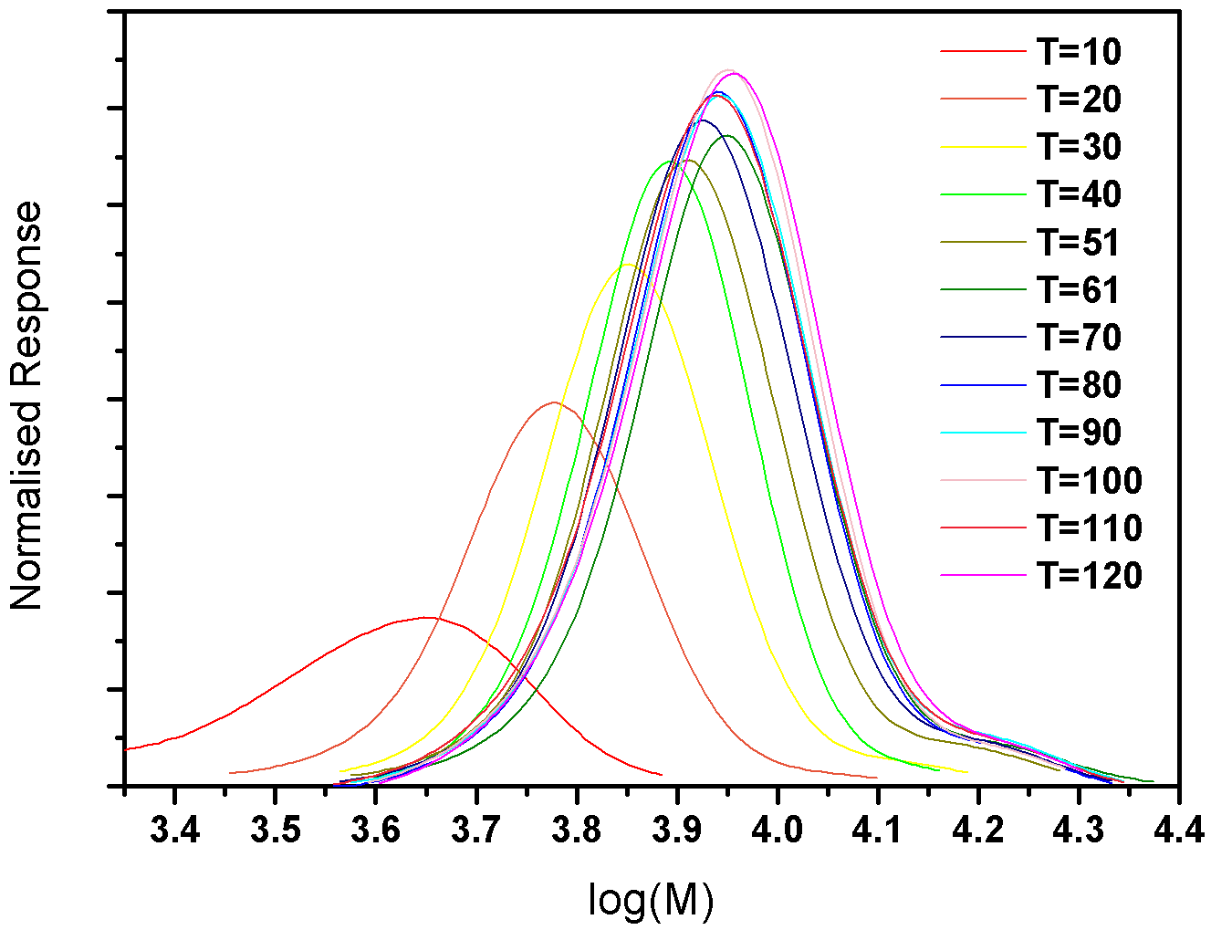
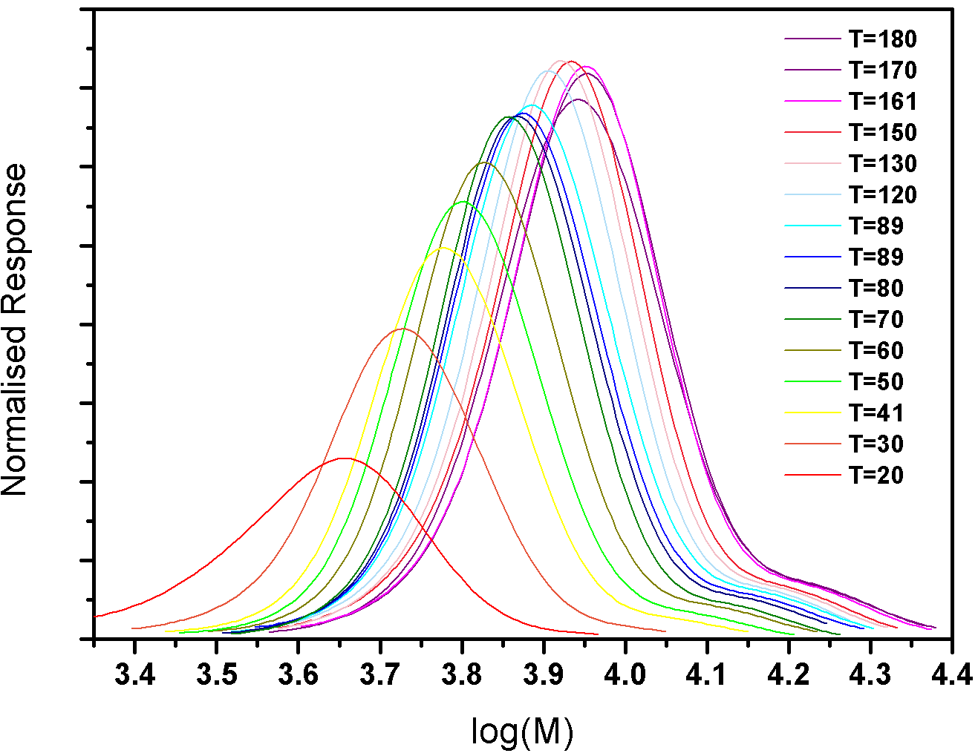
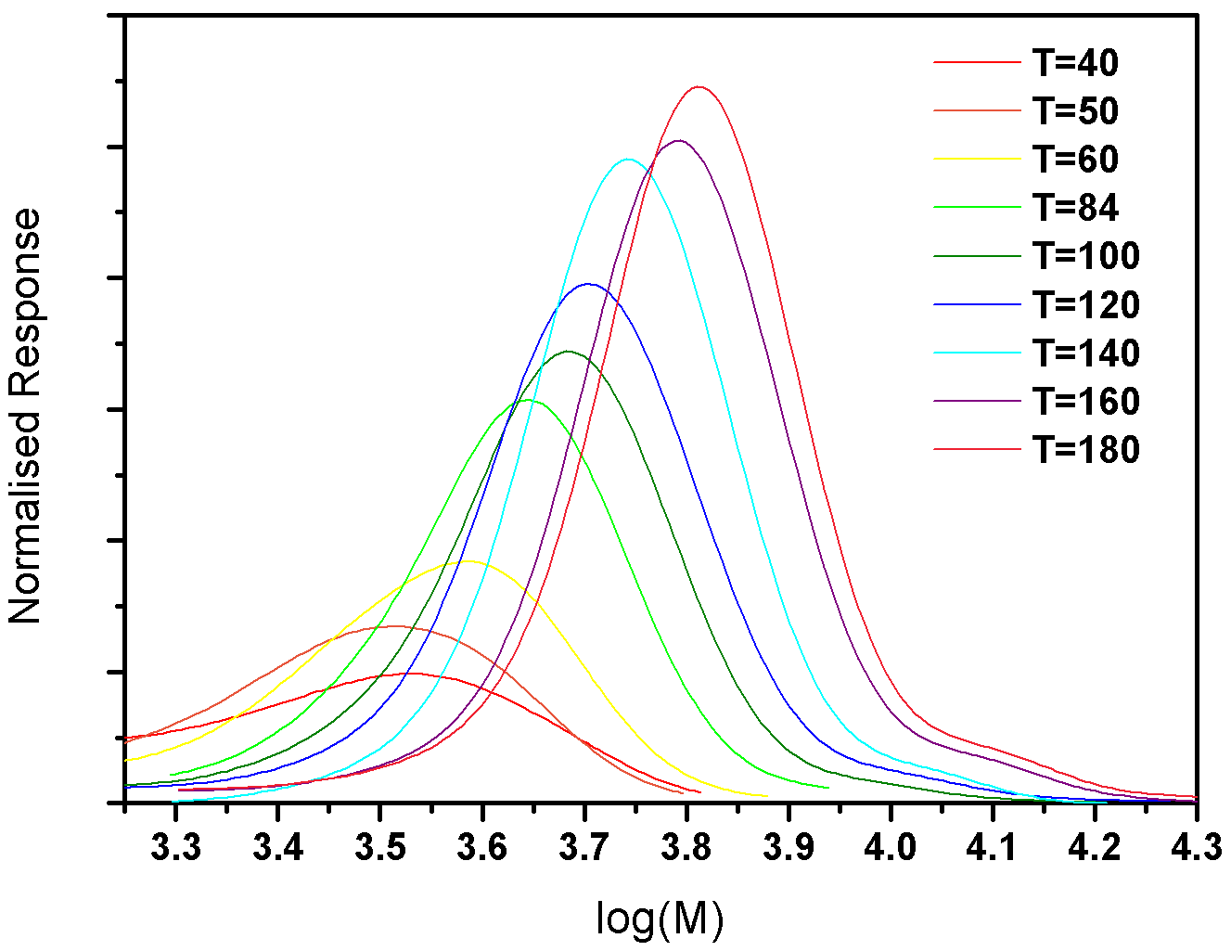
Analysis by GPC
Polymerisation of PEGA₄₅₄ in selected alcohols with Cu(II) additive
GPC traces are characteristic of well controlled LRPs
T = time(mins)
Methanol Ethanol IPA
Investigation of SET-LRP
1
28

Slide 24
Outline
Polymerisation Cu(I) and Cu(0)
SET-LRP
Glycopolymers from CCTP and double click chemistry
One pot LRP and click
Thiol-activated alkene click to peptide conjugates (sCT)
Hyperbranched polymers with functional coronas from thiol-alkene click and CCTP

Slide 25
Two independent synthetic routes to glycoconjugates
Haddleton, Geng, Mantovani et. al. JACS 2007; 129(49); 15156-15163

Slide 26
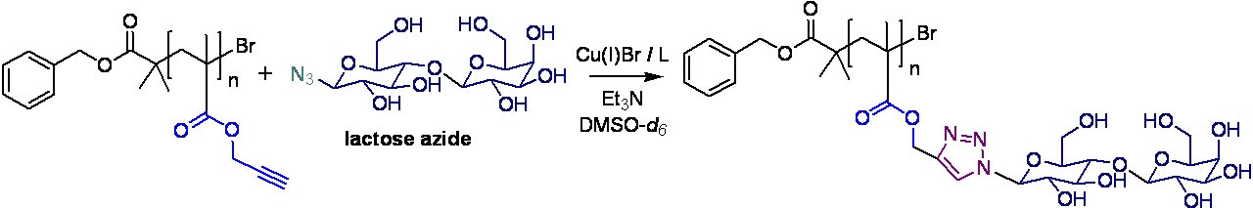
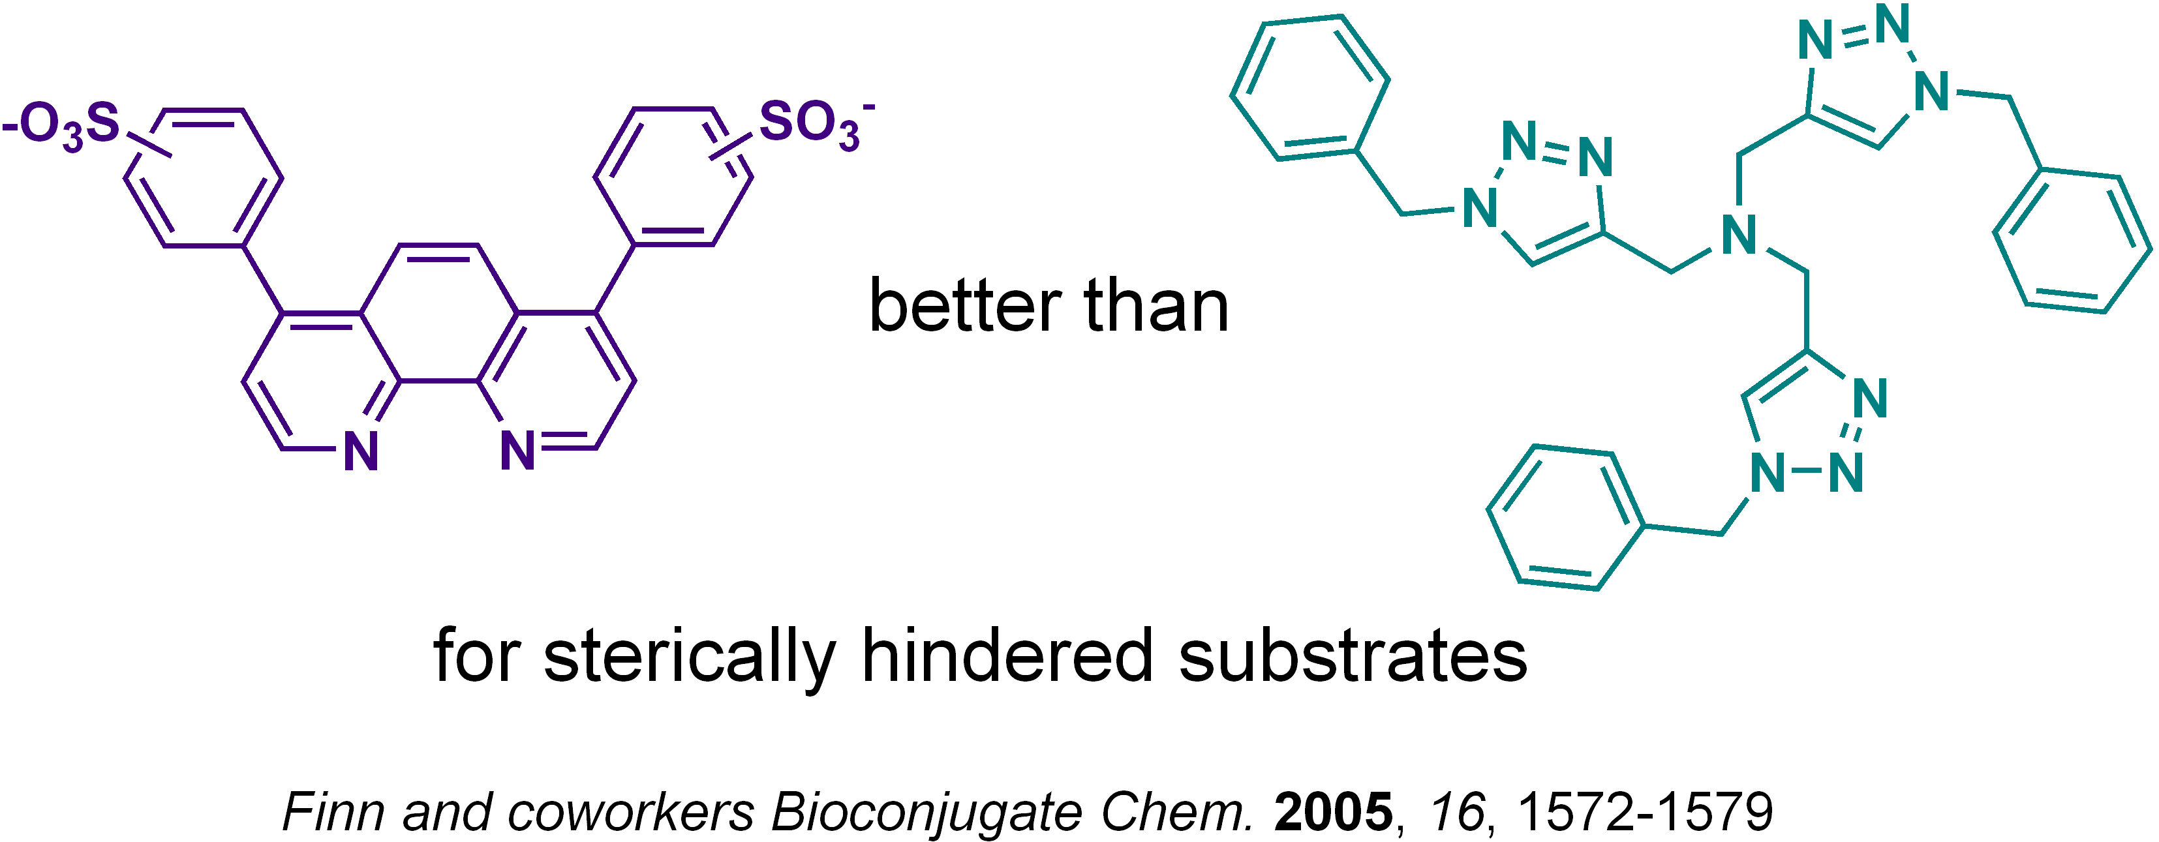
Clicking of sterically hindered lactose azide
Difficult to get full functionalisation: both ligand and sugar azide are quite bulky
Haddleton, Lindqvist, Mantovani, Geng, QSAR 2007, 11-12, 2007, 1220-1228

Slide 27
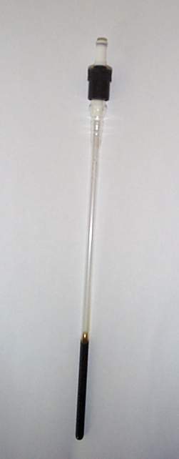
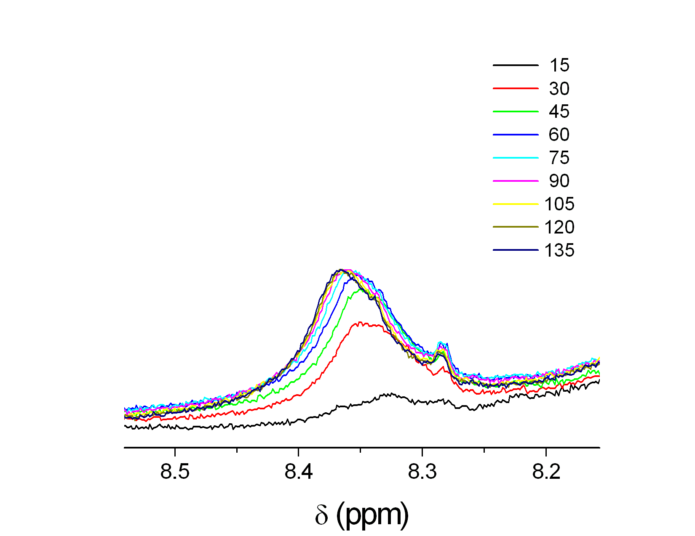
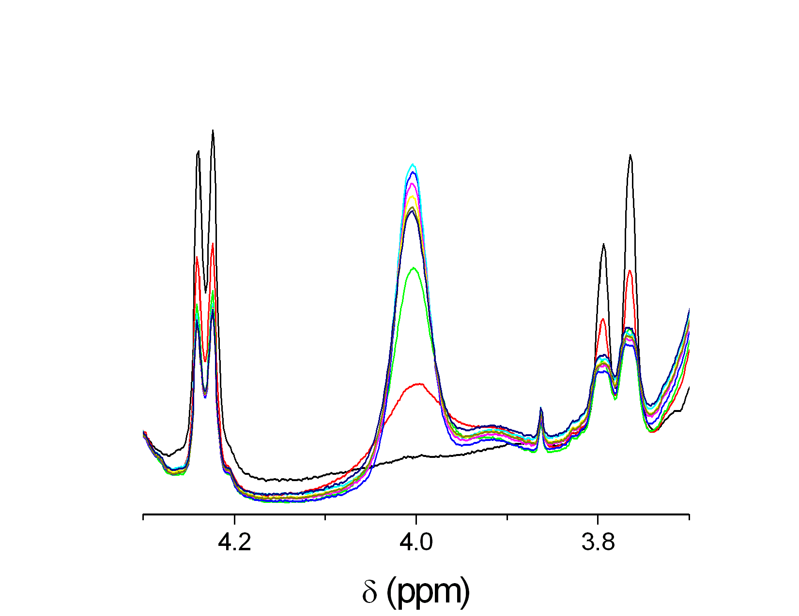
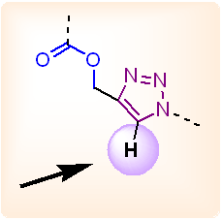
Online NMR clicking for optimisation
time (min)
sugar region
T = 50 °C
Haddleton, Lindqvist, Mantovani, Geng, QSAR 2007, 11-12, 2007, 1220-1228

Slide 28
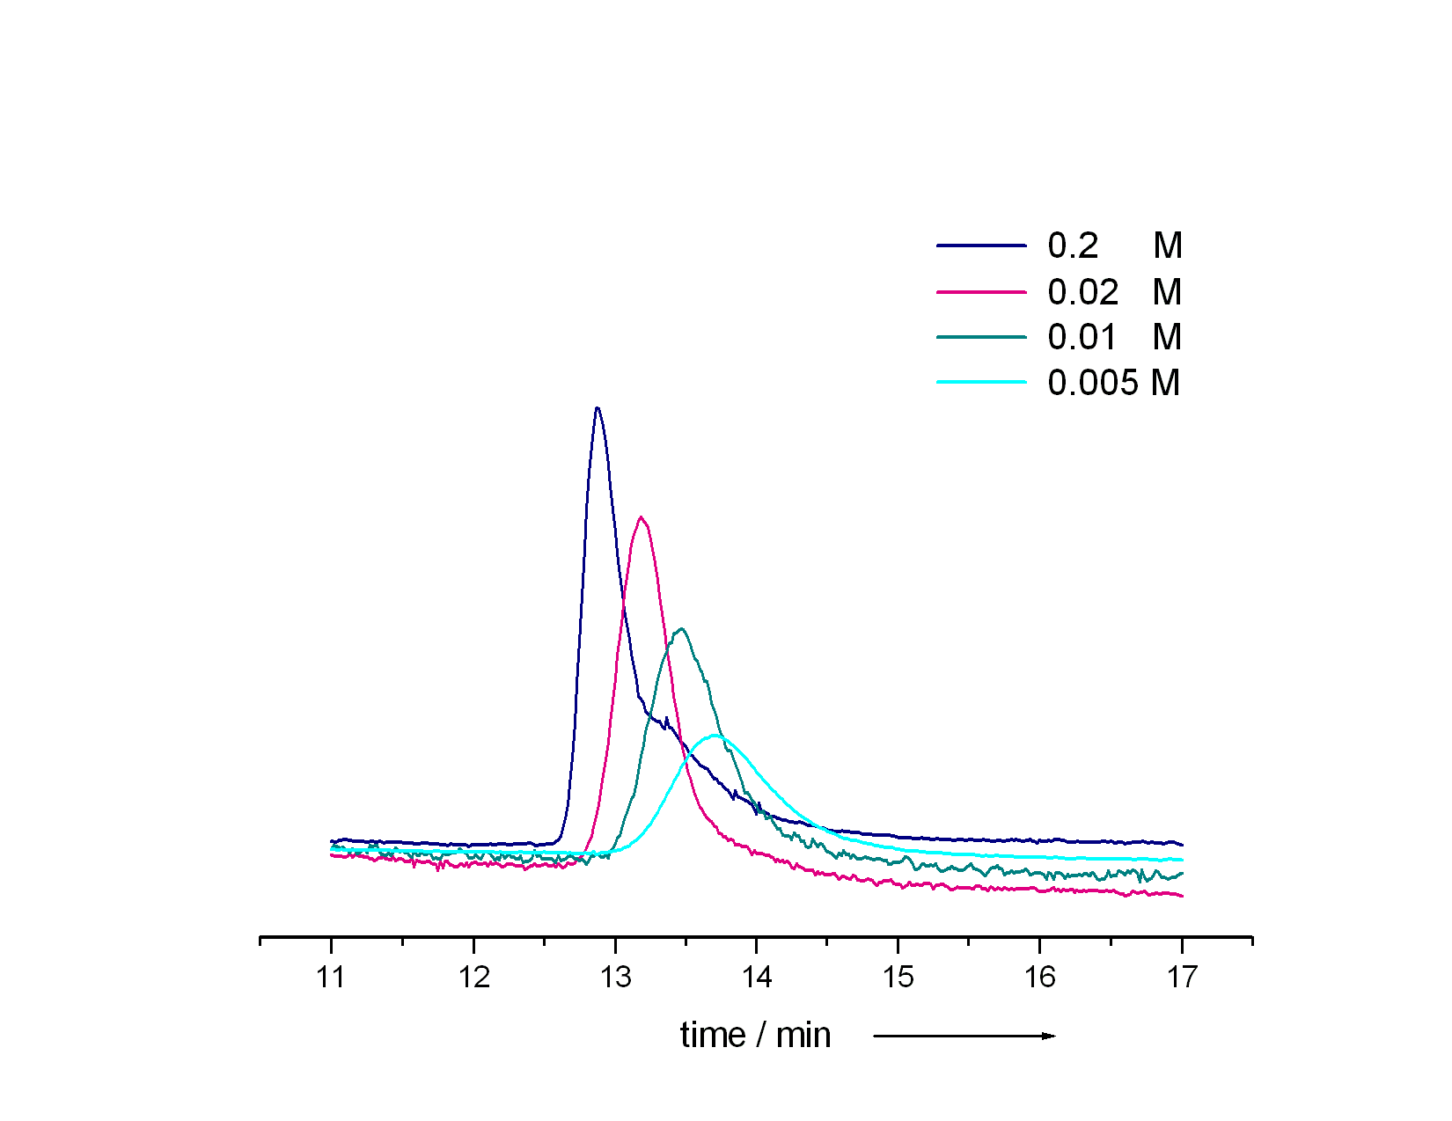
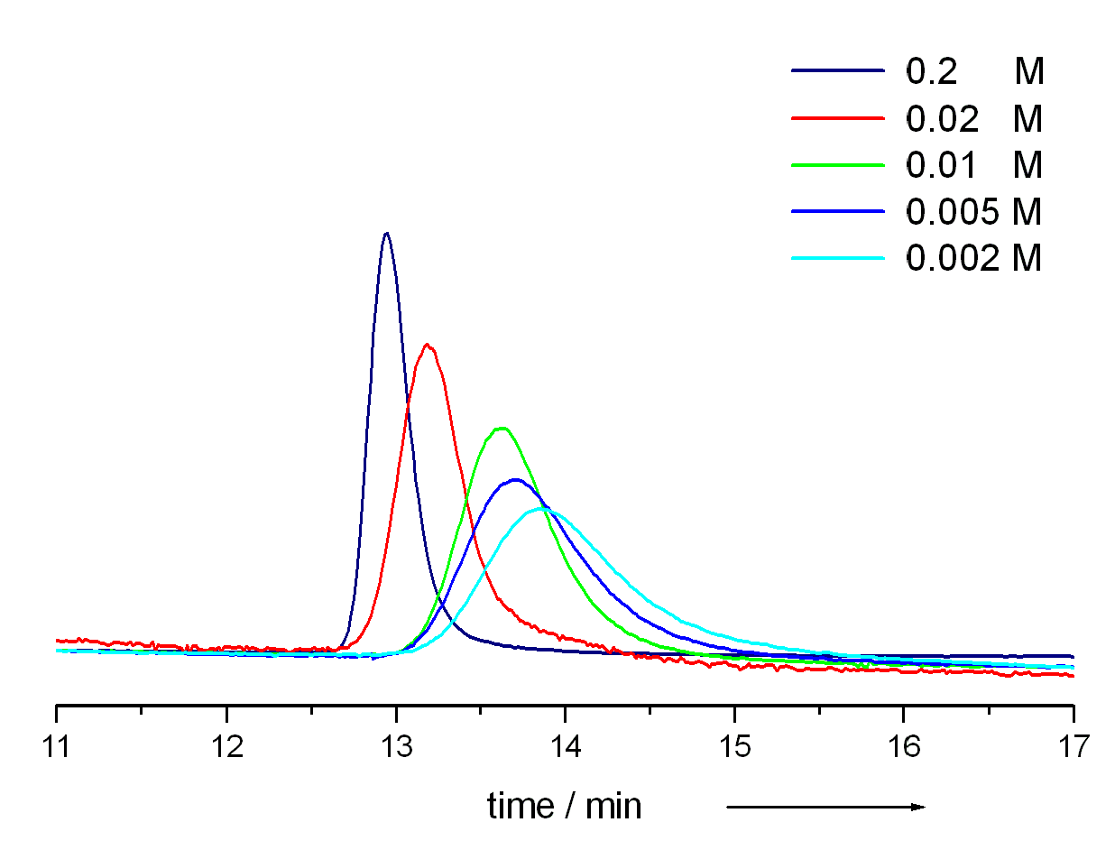
Ricinus Communis Agglutinin I (RCA I) as a recognition test
120 kDa dimeric lectin isolated from Ricinus communis (castor bean), interact selectively with galactose epitopes
Immobilised RCA I employed as stationary phase for affinity chromatography
Galactose polymer
Lactose polymer
Conditions: 66.7 mM PBS (pH 7.4), 150 mM NaCl, ambient temperature.
Different concentrations of D-galactose in the mobile phase were employed in each run.
Haddleton, Lindqvist, Mantovani, Geng, QSAR 2007, 11-12, 2007, 1220-1228

Slide 29
Outline
Polymerisation Cu(I) and Cu(0)
SET-LRP
Glycopolymers from CCTP and double click chemistry
One pot LRP and click
Thiol-activated alkene click to peptide conjugates (sCT)
Hyperbranched polymers with functional coronas from thiol-alkene click and CCTP

Slide 30
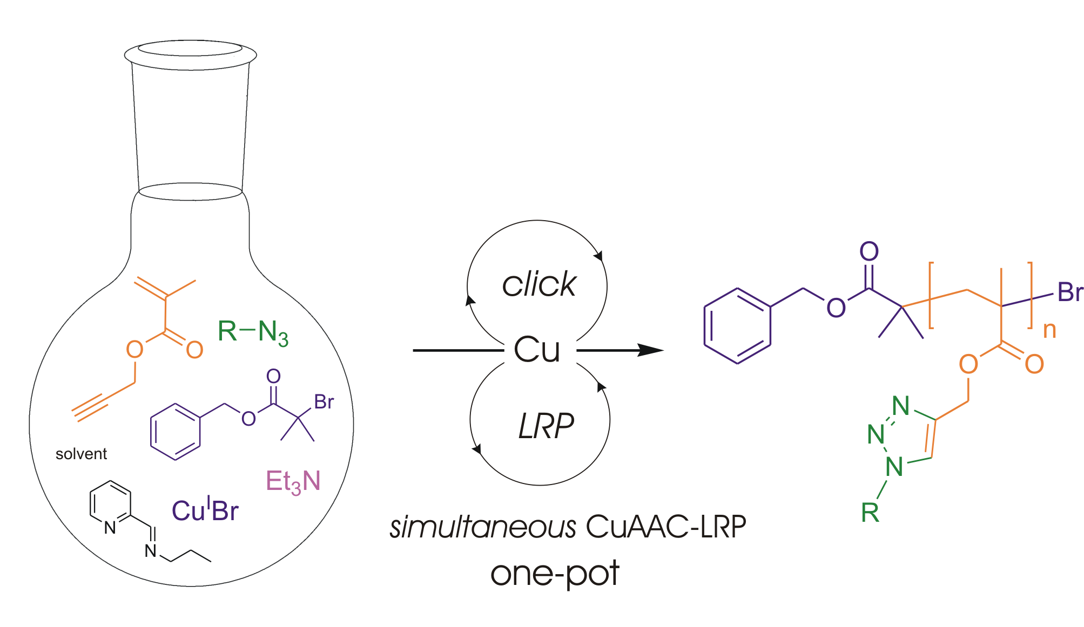
Simultaneous Cu(I)-catalysed CuAAC and ATRP
Geng, J.; Lindqvist, J.; Mantovani, G.*; Haddleton, D. M.* Angew. Chem. Int. Ed. 2008

Slide 31
Click Vs Polymerization in Different Solvents
Lindqvist, J.; Mantovani, G.; Haddleton, D. M.

Slide 32
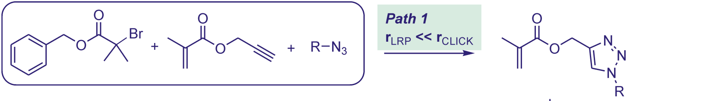
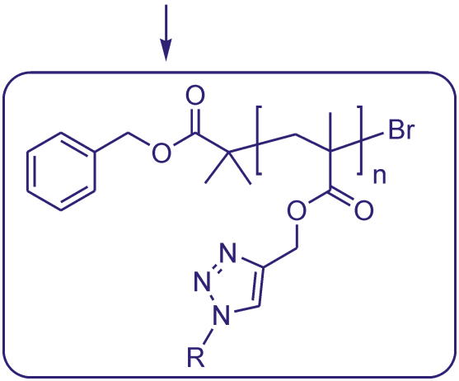


Simultaneous Cu(I)-catalysed CuAAC and ATRP
Lindqvist, J.; Mantovani, G.; Haddleton, D. M.

Slide 33
Outline
Polymerisation Cu(I) and Cu(0)
SET-LRP
Glycopolymers from CCTP and double click chemistry
One pot LRP and click
Thiol-activated alkene click to peptide conjugates (sCT)
Hyperbranched polymers with functional coronas from thiol-alkene click and CCTP

Slide 34
Thio-Michael Addition without radical initiator
Bowman, C. N. Polymer 2007, 48, 2014 and Hoyle, Lowe
Notes:
16700 Students
Includes visiting and exchange students (heads) and HEFP students in local colleges. Excludes students taught overseas and on external programmes.
3800 Staff
3000 full and part time, 800 casua, 96% non-academic staff live in Coventry. 3rd largest employer in Coventry area
£174.5 m turnover
For year ended July 2001, projected to rise to £222 m by 2004/05
Arts Centre
250,000 visits each year, 70% of audience from Coventry/Warwickshire, 67% self-generated income. £580,000 University subsidy to Arts Centre each year (not all grant)

Slide 35
¹H NMR; PEGMA + 2-Mercaptoethanol / DMPP
G Rees, R Randev, M Jones
Notes:
16700 Students
Includes visiting and exchange students (heads) and HEFP students in local colleges. Excludes students taught overseas and on external programmes.
3800 Staff
3000 full and part time, 800 casua, 96% non-academic staff live in Coventry. 3rd largest employer in Coventry area
£174.5 m turnover
For year ended July 2001, projected to rise to £222 m by 2004/05
Arts Centre
250,000 visits each year, 70% of audience from Coventry/Warwickshire, 67% self-generated income. £580,000 University subsidy to Arts Centre each year (not all grant)

Slide 36
MALDI: PEGA + 2-Mercaptoethanol / ^{n}C₅H₉NH₂
78 Da
G Rees, R Randev, M Jones
Notes:
16700 Students
Includes visiting and exchange students (heads) and HEFP students in local colleges. Excludes students taught overseas and on external programmes.
3800 Staff
3000 full and part time, 800 casua, 96% non-academic staff live in Coventry. 3rd largest employer in Coventry area
£174.5 m turnover
For year ended July 2001, projected to rise to £222 m by 2004/05
Arts Centre
250,000 visits each year, 70% of audience from Coventry/Warwickshire, 67% self-generated income. £580,000 University subsidy to Arts Centre each year (not all grant)

Slide 37
Rates of Conversion; PEGMA + 2-ME with 5 wt% DMPP / TBP / ^{n}C₅H₉NH₂ / ^{n}C₇H₇NH₂
G Rees, R Randev
Notes:
16700 Students
Includes visiting and exchange students (heads) and HEFP students in local colleges. Excludes students taught overseas and on external programmes.
3800 Staff
3000 full and part time, 800 casua, 96% non-academic staff live in Coventry. 3rd largest employer in Coventry area
£174.5 m turnover
For year ended July 2001, projected to rise to £222 m by 2004/05
Arts Centre
250,000 visits each year, 70% of audience from Coventry/Warwickshire, 67% self-generated income. £580,000 University subsidy to Arts Centre each year (not all grant)

Slide 38
Reaction with 2–(acryloyloxy)ethyl methacrylate
2 – (acryloyloxy)ethyl methacrylate + 2-ME / ^{n}C₅H₉NH₂
G Rees, R Randev
Notes:
16700 Students
Includes visiting and exchange students (heads) and HEFP students in local colleges. Excludes students taught overseas and on external programmes.
3800 Staff
3000 full and part time, 800 casua, 96% non-academic staff live in Coventry. 3rd largest employer in Coventry area
£174.5 m turnover
For year ended July 2001, projected to rise to £222 m by 2004/05
Arts Centre
250,000 visits each year, 70% of audience from Coventry/Warwickshire, 67% self-generated income. £580,000 University subsidy to Arts Centre each year (not all grant)

Slide 39

Salmon Calcitonin and Determination of the polymer attachment site
Tryptic digestion of sCT derivatives
¹Cys-¹¹Lys 1120.53 Da
¹²Leu-¹⁸Lys 853.96 Da
¹⁹Leu-²⁴Arg 776.42 Da
²⁵Thr-³²Pro 732.34 Da

Slide 40




Thiol Conjugation

Slide 41
Phosphine-Mediated One-Pot Thiol-Ene “Click”
Approach to Polymer-Protein Conjugates
M Jones

Slide 42
Polymer-Protein Conjugates via a “Grafting To” Approach
RP-HPLC Analysis
S-S Reduction
Quantitative reduction observed after 10 mins
Thiol-ene Click
Quantitative conversion to di-PEGylated sCT in 1.5 hours
M Jones

Slide 43
Polymer-Protein Conjugates via a “Grafting To” Approach
MALDI-TOF Analysis
M Jones

Slide 44
Polymer-Protein Conjugates via a “Grafting To” Approach
Tryptic Digest with MALDI-TOF Analysis
Trypsin digest of conjugate reveals complete selectivity towards cysteine residues and conjugation at both cysteine residues.
M Jones

Slide 45
Bioactivity of Conjugates from the “Grafting To” Approach
In Vitro Testing of Conjugates
In Vivo Testing of Conjugates
M Jones

Slide 46
Polymer-Protein Conjugates via a “Grafting From” Approach
Protein Macroinitiator Synthesis
ATRP / SET-LRP
M Jones

Slide 47
Polymer-Protein Conjugates via a “Grafting From” Approach
Protein Macroinitiator Synthesis
(-HBr)
M Jones

Slide 48
Polymer-Protein Conjugates via a “Clicking To” Approach
Facile introduction of clickable units into a protein’s structure
CuAAC
M Jones

Slide 49
Polymer-Protein Conjugates via a “Clicking To” Approach
Facile introduction of clickable units into a protein’s structure
M Jones

Slide 50
Catalytic Chain Transfer Polymerisation (CCTP)
Certain Low-Spin Cobalt Complexes
Typical [Mon]/[Co] ratio of ca. 10⁶
C_{s} =40,000 cf RSH = 1
CoBF
CCTP of MMA using CoBF at 60ºC

Slide 51
L Nurmi, J Lindqvist: Chem Comm, 2009

Slide 52
Polymer-Protein Conjugates via a “Grafting To” Approach
“Thiol-ene click” of Cysteine Residues to CCT Macromonomers
M Jones

Slide 53
Polymer-Protein Conjugates via a “Grafting To” Approach
“Thiol-ene click” of Cysteine Residues to CCT Macromonomers
K Amos, M Jones

Slide 54
Outline
Polymerisation Cu(I) and Cu(0)
SET-LRP
Glycopolymers from CCTP and double click chemistry
One pot LRP and click
Thiol-activated alkene click to peptide conjugates (sCT)
Hyperbranched polymers with functional coronas from thiol-alkene click and CCTP

Slide 55
Polymerization preparation (oil bath 70˚C)
5 ml EGDMA
5 ml 1,2-dichloroethane
0.005 g CoBF
0.05 g dimethyl 2,2- azobis(2-methylpropionate)
(V-601)
J Menzel and K McKeown

Slide 56
Overlay of GPC data
J Menzel and K McKeown

Slide 57
GPC traces of P(EGDMA)
J Menzel and K McEwan

Slide 58
Michael-Addition of thiols
J Menzel and K McKeown

Slide 59

Acknowledgements
Dr G Mantovani (Nottingham) All
Dr J Lindqvist (KTH) Glyco
Dr A De-Cuendias SET
Dr T Kreft ACOMP
M Jones Conj
R Randev Conj
K Amos (Manchester) Conj
J Menzel Thiol
K McEwan ACOMP/Thiol
J Geng (Cambridge) Glyco
Y Gou Glyco
G Li Thiol
G Rayner EPR
G Rees Thiol
Dr V Ladmiral (UNSW) Glyco
Dr M Levere (Le Mans) SET
Dr C Fidge, (Texas A&M) SET
Dr Peter Wright (Infineum) SET
A Grice SET
L Nurmi (HTU) Glyco
Dr C Sayers (WEP) Conj
Prof D Brayden (UCD) Animal
Dr S Walsh (UCD) Animal
EU
EPSRC
Lubrizol
Warwick Effect Polymers
Unilever
Polymer Laboratories (Varian)
Syngenta

Slide 60
In memory of Charlie Hoyle – University of Southern Mississippi
An extraordinary scientist

Slide 61
Thiol-ene Click Chemistry, Catalytic Chain Transfer Polymerization in Conjunction with SET-living Radical Polymerization
David Haddleton
University of Warwick,UK
CRP Meeting
Ol Fosse d'Outh, Houffalize, September 17-18, 2009

