Slide 1

Glycopolymers via Catalytic Chain Transfer Polymerisation (CCTP) and double click reactions
David Haddleton
University of Warwick,UK
APME
Dresden, October 5th 2009

Slide 2
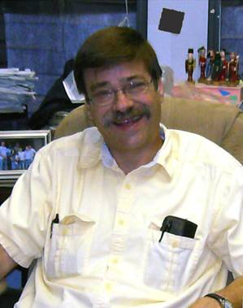
In memory of Charlie Hoyle – University of Southern Mississippi
An extraordinary scientist

Slide 3
Outline
Polymerisation Cu(I) and Cu(0)
SET-LRP
Glycopolymers from CCTP and double click chemistry
One pot LRP and click
Thiol-activated alkene click to peptide conjugates (sCT)
Hyperbranched polymers with functional coronas from thiol-alkene click and CCTP

Slide 4
Outline
Polymerisation Cu(I) and Cu(0)
SET-LRP
Glycopolymers from CCTP and double click chemistry
One pot LRP and click
Thiol-activated alkene click to peptide conjugates (sCT)
Hyperbranched polymers with functional coronas from thiol-alkene click and CCTP

Slide 5
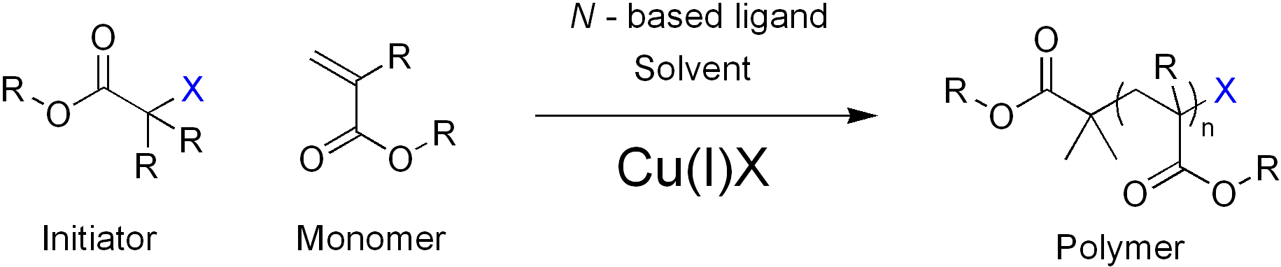
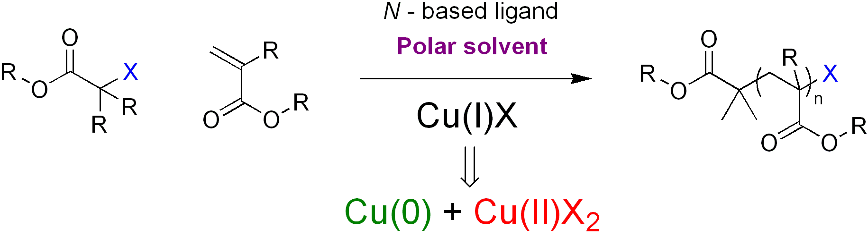
Introduction to SET-LRP
SET-LRP: A brief overview
ATRP with Cu^{I}X
Cu(0) as the active catalyst
Percec, V. et al, J. Am. Chem. Soc. 2006, 128, (43), 14156-14165.

Slide 6
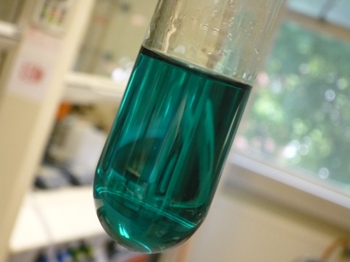
Introduction to SET-LRP
Benefits of SET-LRP
- Ambient Conditions
- ‘Ultrafast’ controlled radical polymerisation
- Wide range of monomers, solvents and functional initiators
eg amide monomers, protic solvents, non activated alkenes
- Synthesis of very high molecular weight polymers > 1 million
- Cu(0) easy to remove, facile polymer clean-up
Investigation of SET-LRP
1
4

Slide 7
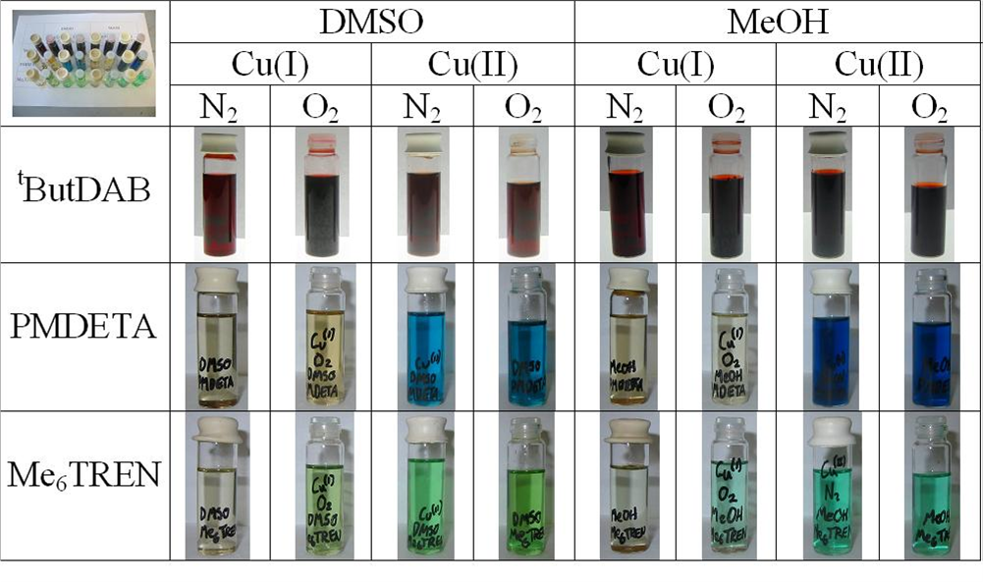


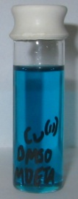
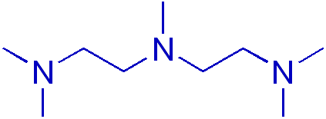
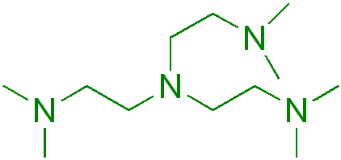
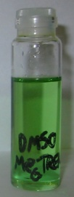
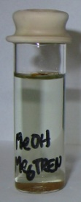
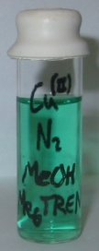
Initial Ligand Studies
Ligand studies in organic solvents
^{t}ButylDAB
PMDETA
Me₆TREN
Investigation of SET-LRP
1
8

Slide 8
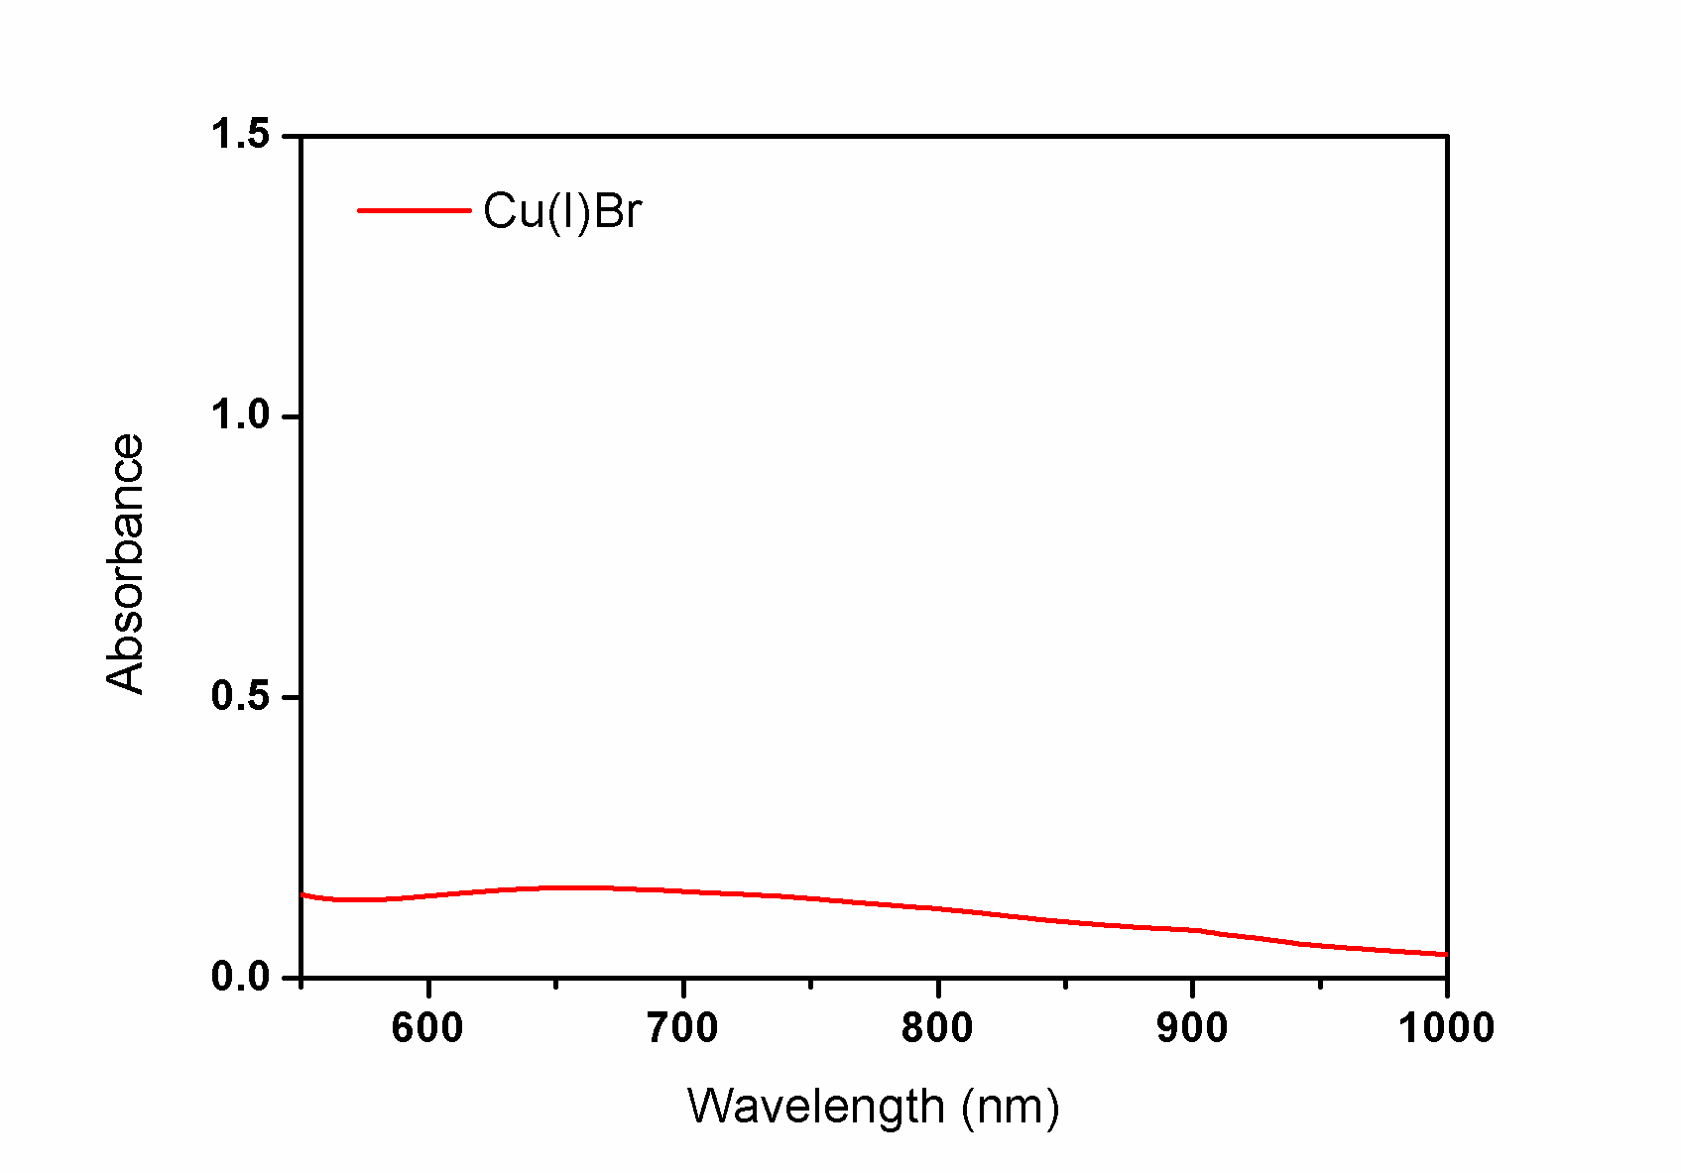
UV-Vis Analysis of SET-LRP System
Monitoring disproportionation using UV-Vis analysis
DMSO
Investigation of SET-LRP
1
11

Slide 9
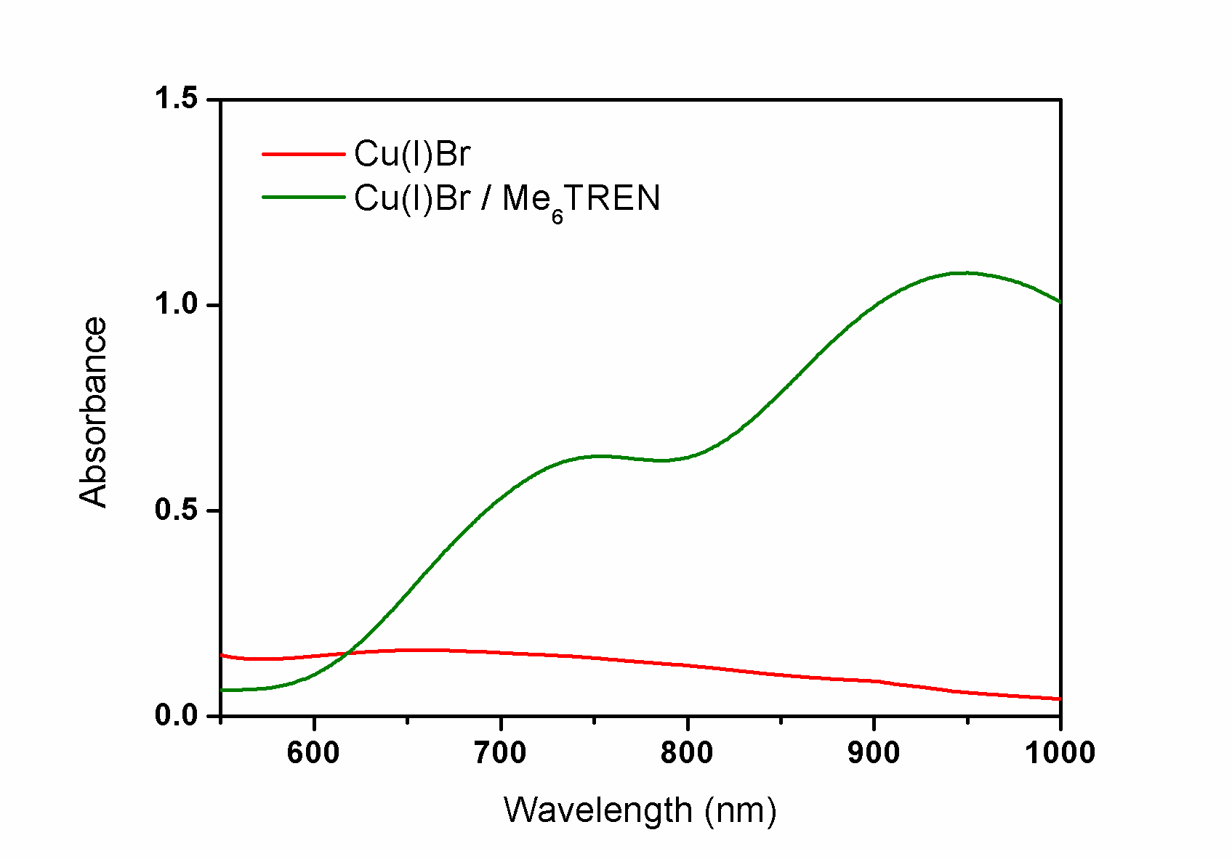
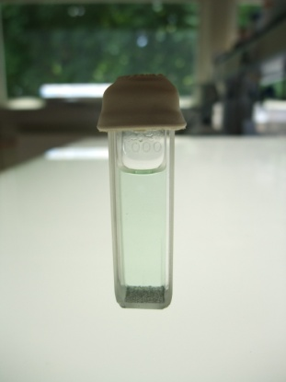
UV-Vis Analysis of SET-LRP System
Monitoring disproportionation using UV-Vis analysis
✓
DMSO
DMSO
Investigation of SET-LRP
1
11

Slide 10
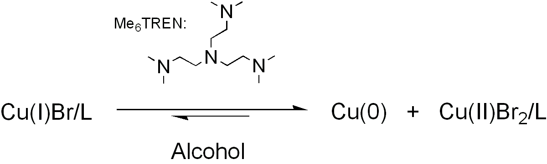
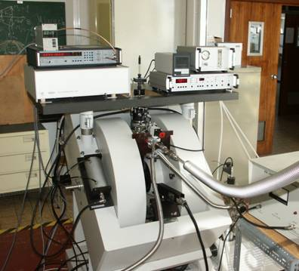
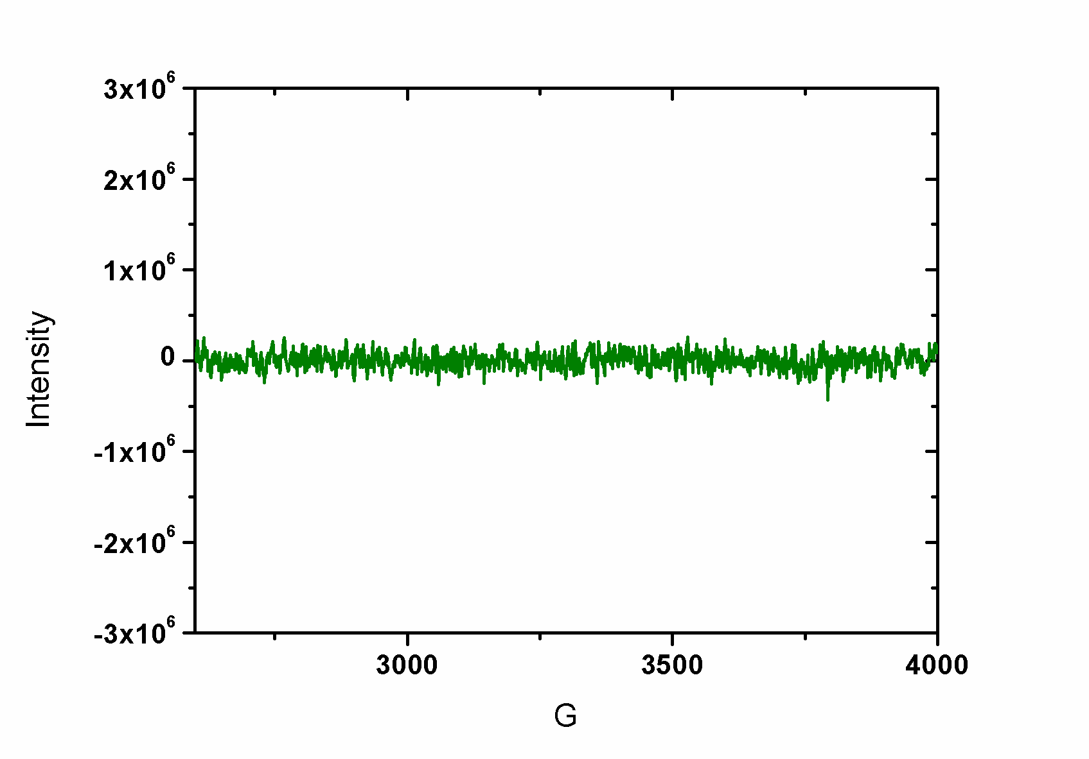
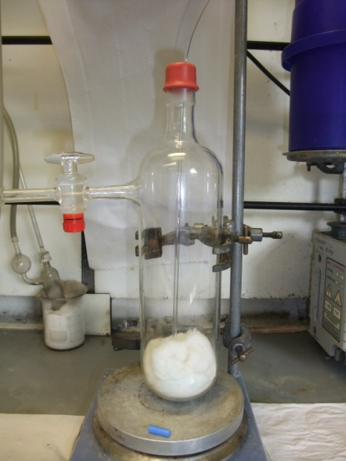
EPR Studies of SET-LRP System
Detecting Cu(II) using EPR analysis
Cu(I)
Professor Mark Newton – UoW Physics

Slide 11
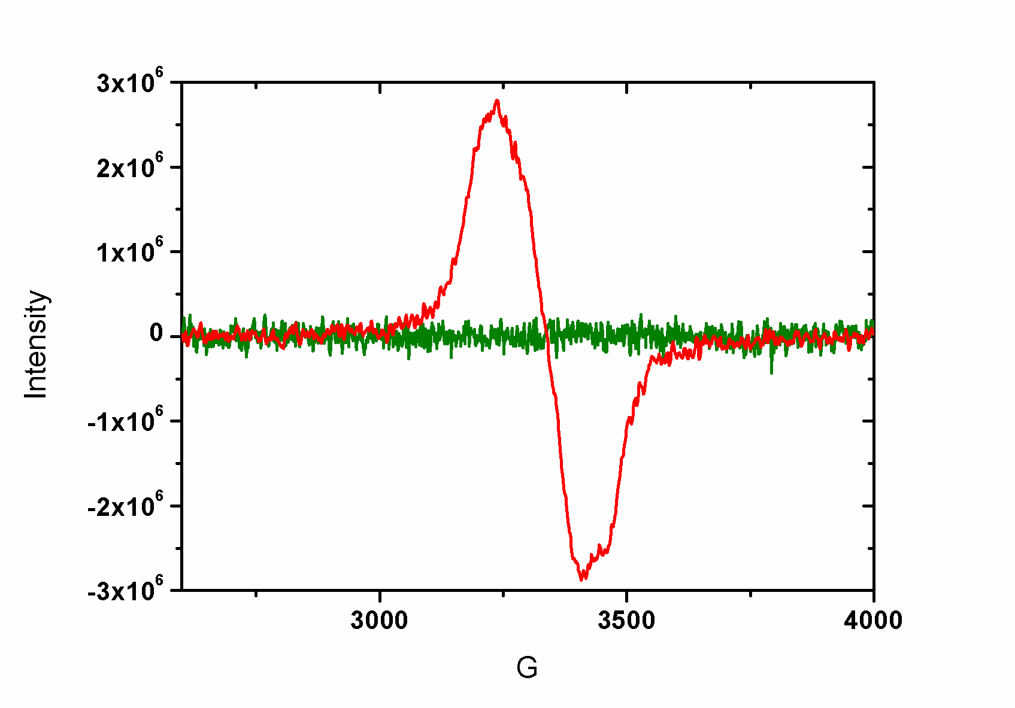
EPR Studies of SET-LRP System
Detecting Cu(II) using EPR analysis
Cu(I)
Cu(II)
Investigation of SET-LRP
1
16

Slide 12
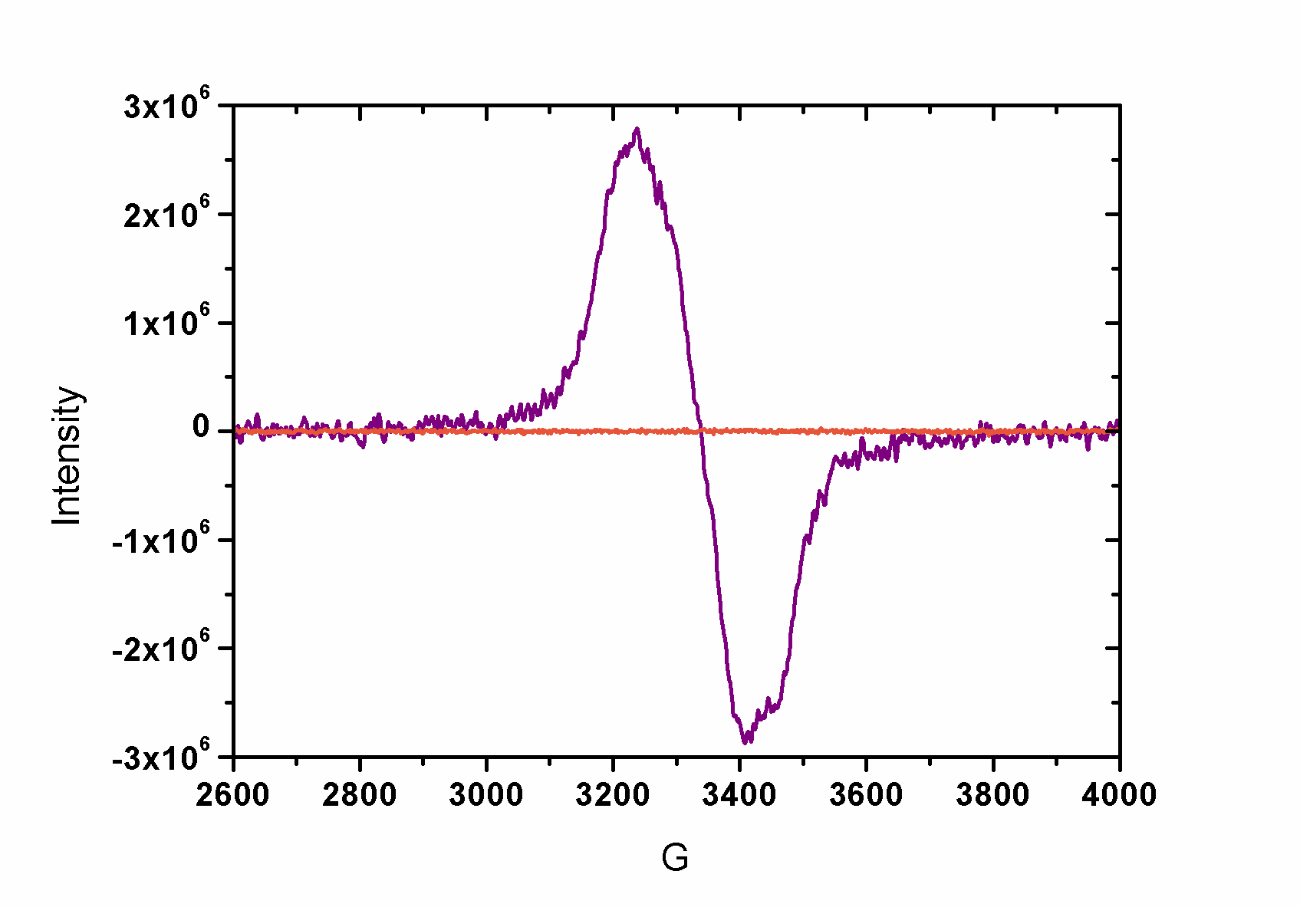
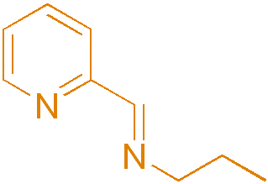
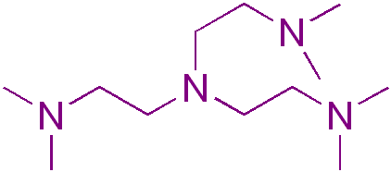
EPR Studies of SET-LRP System
EPR with N-(n-ethyl)-2-pyridylmethanimine ligand in IPA
- As a control the same experiment was repeated
with a pyridine imine type ligand
- Results showed no Cu(II) present
Investigation of SET-LRP
1
18

Slide 13
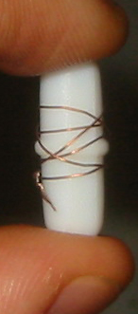
Cu(0) mediated Polymerisations
Traditional polymerisation system used at Warwick:
Reaction performed above ambient (~30-90ºC)
Poor control in aqueous/polar media
Alternative
Cu(0) catalytic system
Polymerisations performed at ambient
>90% and PDi < 1.2 often attainable within an hour
Simplified Polymer workup
Percec et. al. J. Amer. Chem. Soc. (2006), 128(43), 14156-14165
Notes:
16700 Students
Includes visiting and exchange students (heads) and HEFP students in local colleges. Excludes students taught overseas and on external programmes.
3800 Staff
3000 full and part time, 800 casua, 96% non-academic staff live in Coventry. 3rd largest employer in Coventry area
£174.5 m turnover
For year ended July 2001, projected to rise to £222 m by 2004/05
Arts Centre
250,000 visits each year, 70% of audience from Coventry/Warwickshire, 67% self-generated income. £580,000 University subsidy to Arts Centre each year (not all grant)

Slide 14
Cu(0) Polymerisation of MA in non polar solvent

Slide 15
Use of METHANOL to mediate SET-LRP of MA
Notes:
16700 Students
Includes visiting and exchange students (heads) and HEFP students in local colleges. Excludes students taught overseas and on external programmes.
3800 Staff
3000 full and part time, 800 casua, 96% non-academic staff live in Coventry. 3rd largest employer in Coventry area
£174.5 m turnover
For year ended July 2001, projected to rise to £222 m by 2004/05
Arts Centre
250,000 visits each year, 70% of audience from Coventry/Warwickshire, 67% self-generated income. £580,000 University subsidy to Arts Centre each year (not all grant)

Slide 16
Use of alcohol additives to mediate SET-LRP
Notes:
16700 Students
Includes visiting and exchange students (heads) and HEFP students in local colleges. Excludes students taught overseas and on external programmes.
3800 Staff
3000 full and part time, 800 casua, 96% non-academic staff live in Coventry. 3rd largest employer in Coventry area
£174.5 m turnover
For year ended July 2001, projected to rise to £222 m by 2004/05
Arts Centre
250,000 visits each year, 70% of audience from Coventry/Warwickshire, 67% self-generated income. £580,000 University subsidy to Arts Centre each year (not all grant)

Slide 17
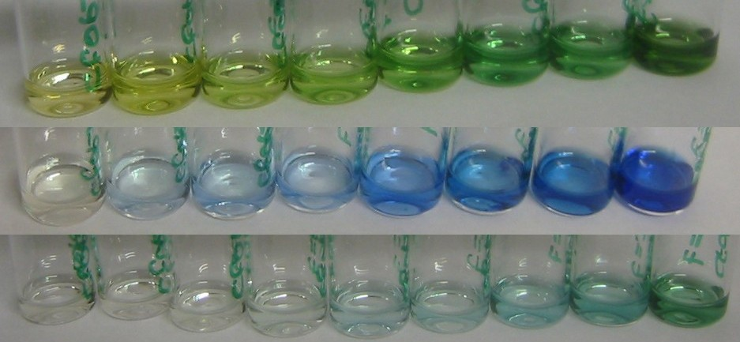
PEGMA with SETLRP
DMSO
Mn ~8000
PDI ~1.14
MeOH
^{i}PrOH
Notes:
16700 Students
Includes visiting and exchange students (heads) and HEFP students in local colleges. Excludes students taught overseas and on external programmes.
3800 Staff
3000 full and part time, 800 casua, 96% non-academic staff live in Coventry. 3rd largest employer in Coventry area
£174.5 m turnover
For year ended July 2001, projected to rise to £222 m by 2004/05
Arts Centre
250,000 visits each year, 70% of audience from Coventry/Warwickshire, 67% self-generated income. £580,000 University subsidy to Arts Centre each year (not all grant)

Slide 18
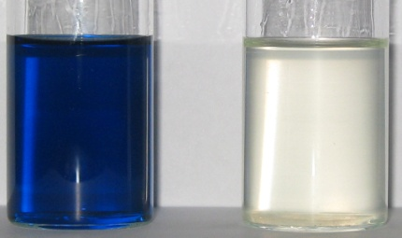
PEGMA with SETLRP
Following Cu(II) production by UV-VIS
Cu(0), PMDETA, PEGMA₄₇₅ and MeOH
Tungsten lamp and fibre optic
Copper reflections and stirrer vibrations
Notes:
16700 Students
Includes visiting and exchange students (heads) and HEFP students in local colleges. Excludes students taught overseas and on external programmes.
3800 Staff
3000 full and part time, 800 casua, 96% non-academic staff live in Coventry. 3rd largest employer in Coventry area
£174.5 m turnover
For year ended July 2001, projected to rise to £222 m by 2004/05
Arts Centre
250,000 visits each year, 70% of audience from Coventry/Warwickshire, 67% self-generated income. £580,000 University subsidy to Arts Centre each year (not all grant)

Slide 19
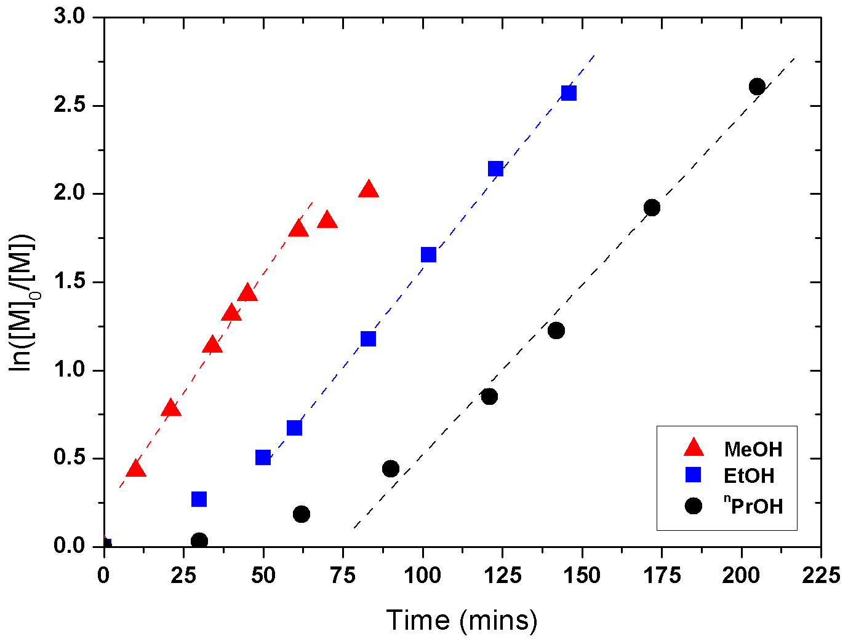
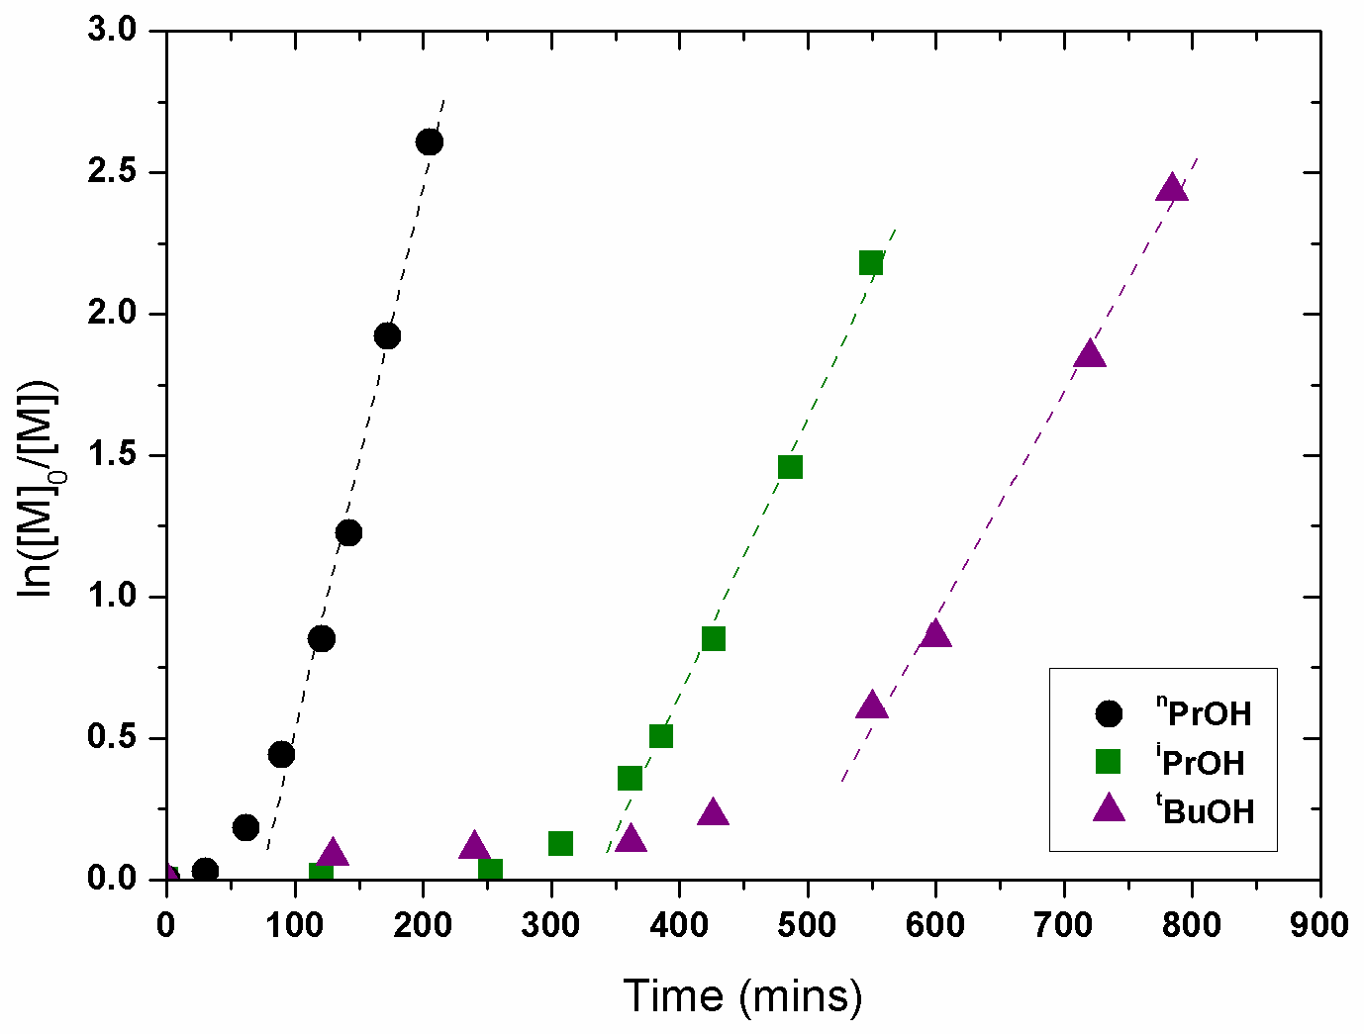
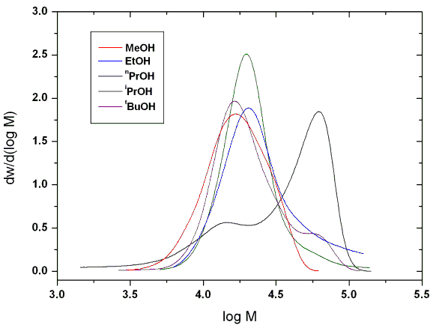
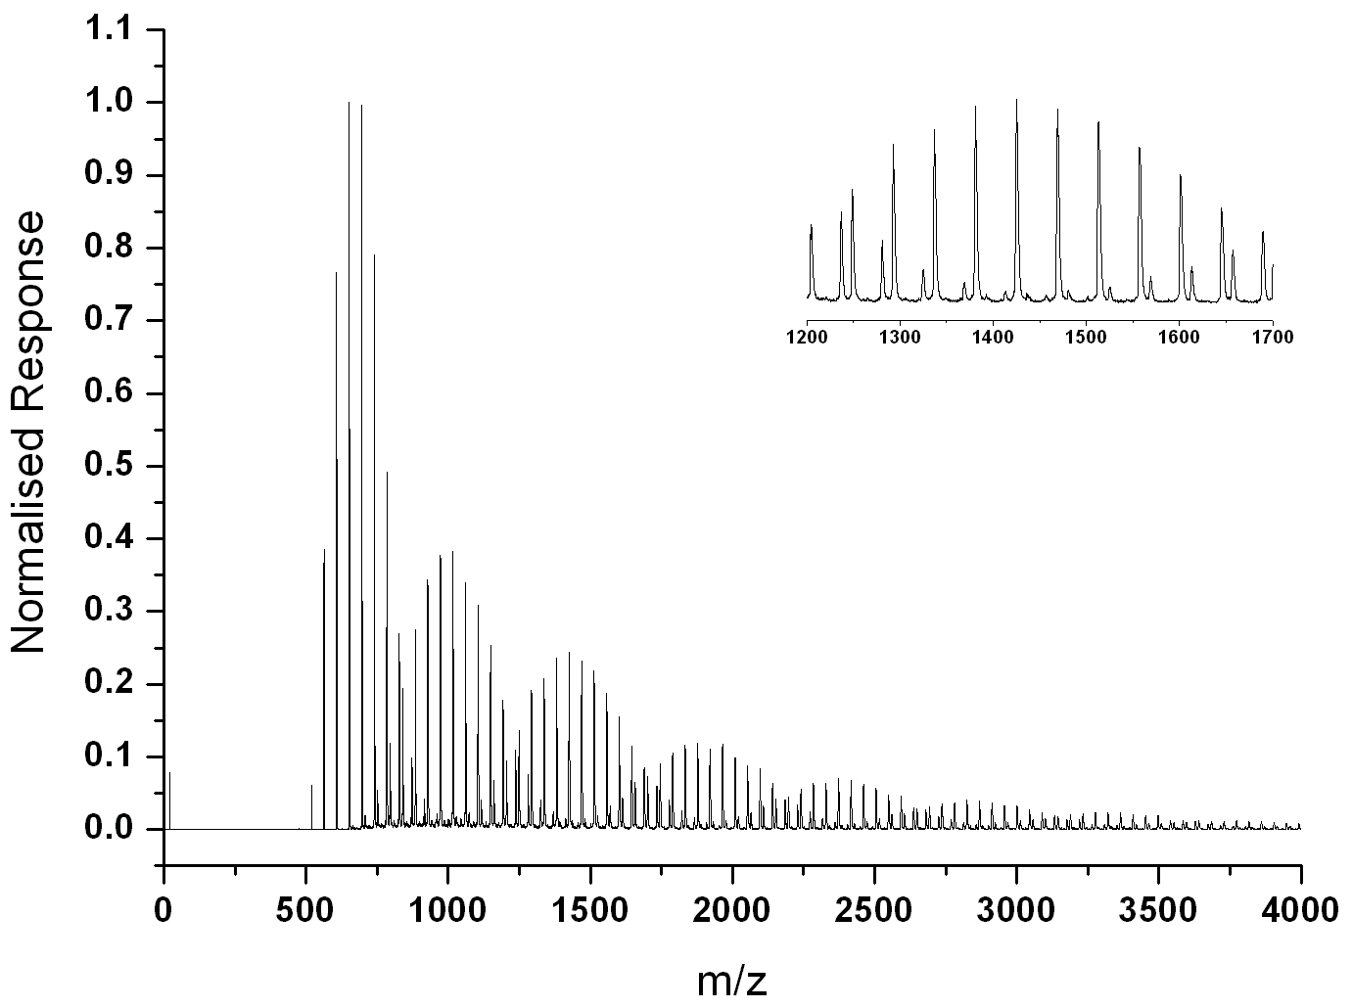
Cu(0)-catalysed polymerisation of PEGMA₄₇₅
[Cu(0)]:[I]:[L]:[Mes]:[PEGMA₄₇₅] = 1/1/1/15/30.L = PMDETA

Slide 20
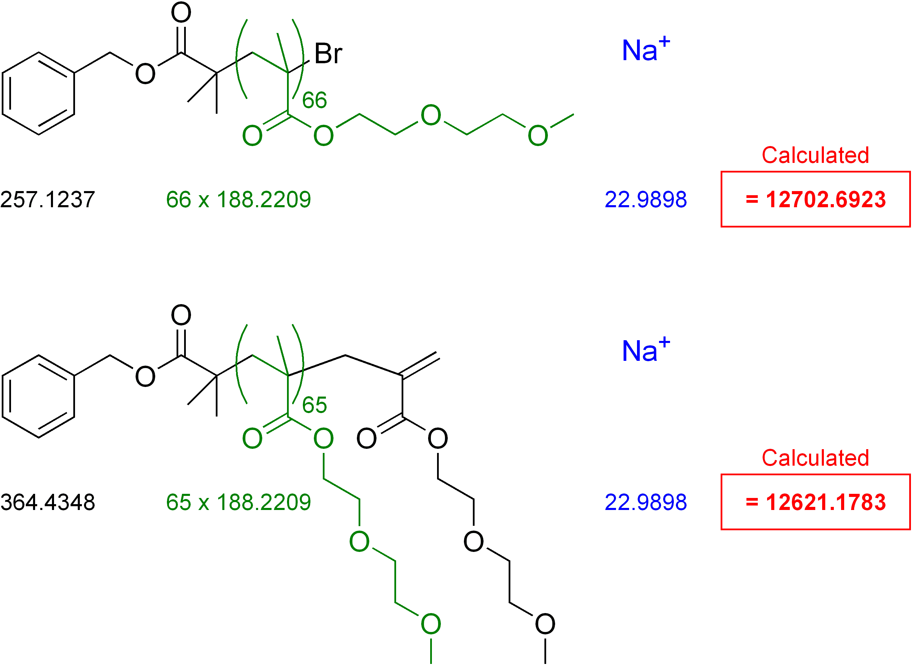
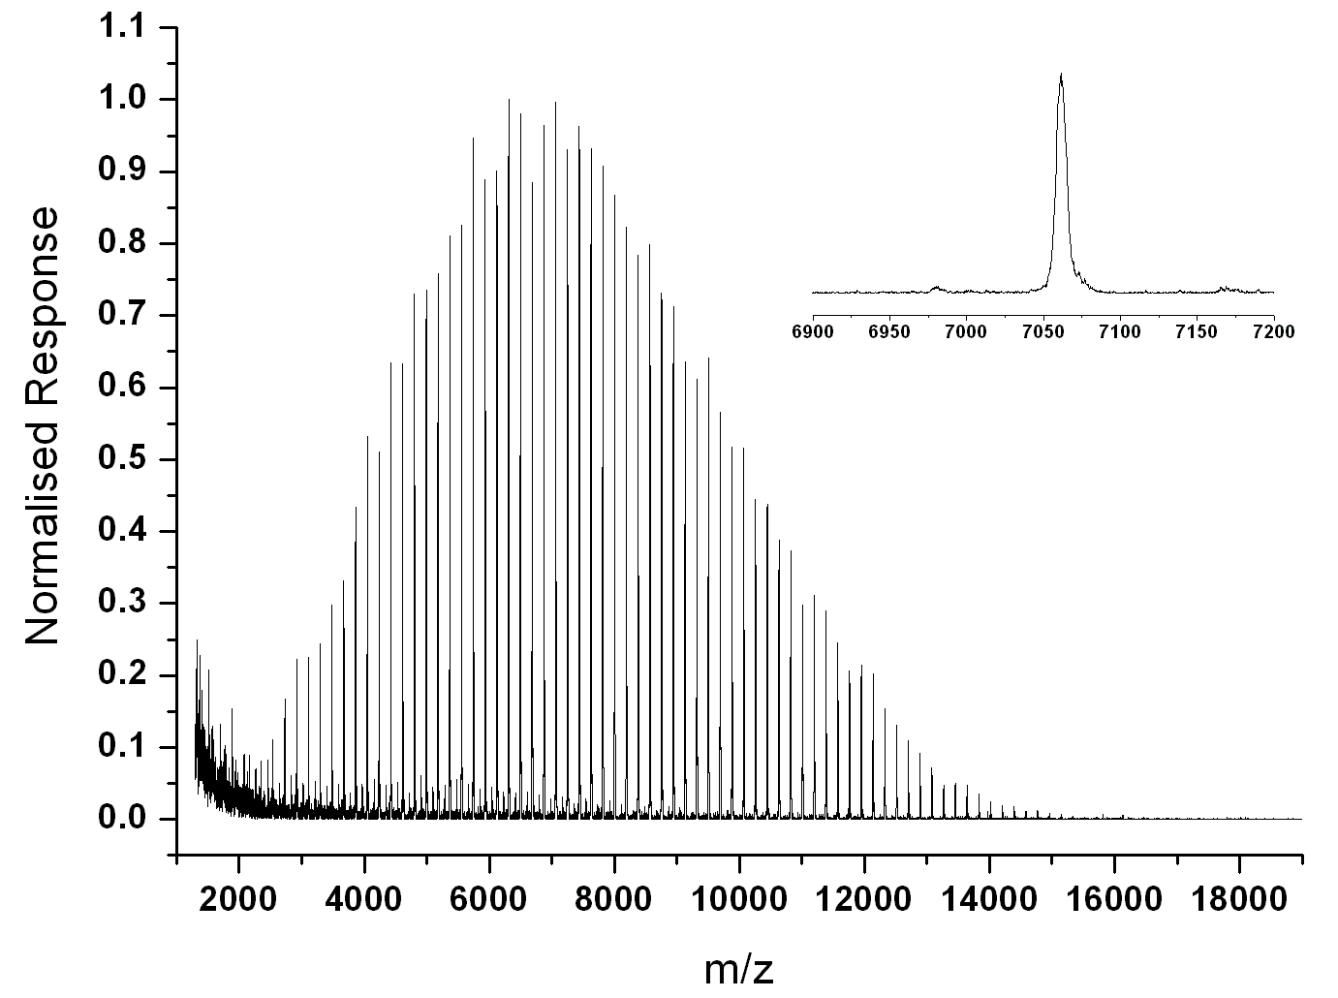
DEGMEMA with Cu(0)
Repeat Units | Theoretical Mass (Da) | Actual Mass (Da) | Difference (ppm)
64 | 12326.250 | 12326.892 | 52
65 | 12514.471 | 12514.825 | 28
66 | 12702.692 | 12702.601 | 7

Slide 21
Outline
Polymerisation Cu(I) and Cu(0)
SET-LRP
Glycopolymers from CCTP and double click chemistry
One pot LRP and click
Thiol-activated alkene click to peptide conjugates (sCT)
Hyperbranched polymers with functional coronas from thiol-alkene click and CCTP

Slide 22
Two independent synthetic routes to glycoconjugates
Haddleton, Geng, Mantovani et. al. JACS 2007; 129(49); 15156-15163

Slide 23
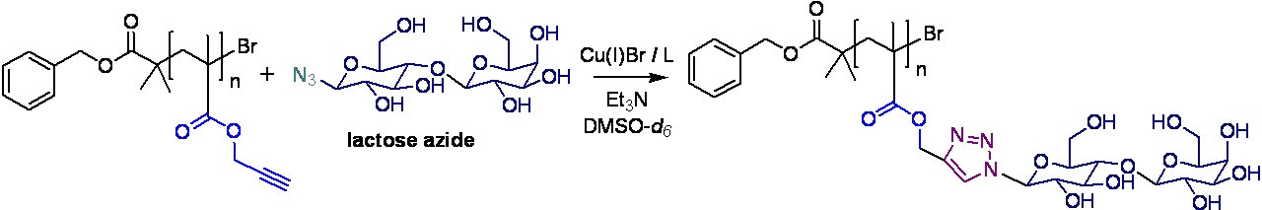
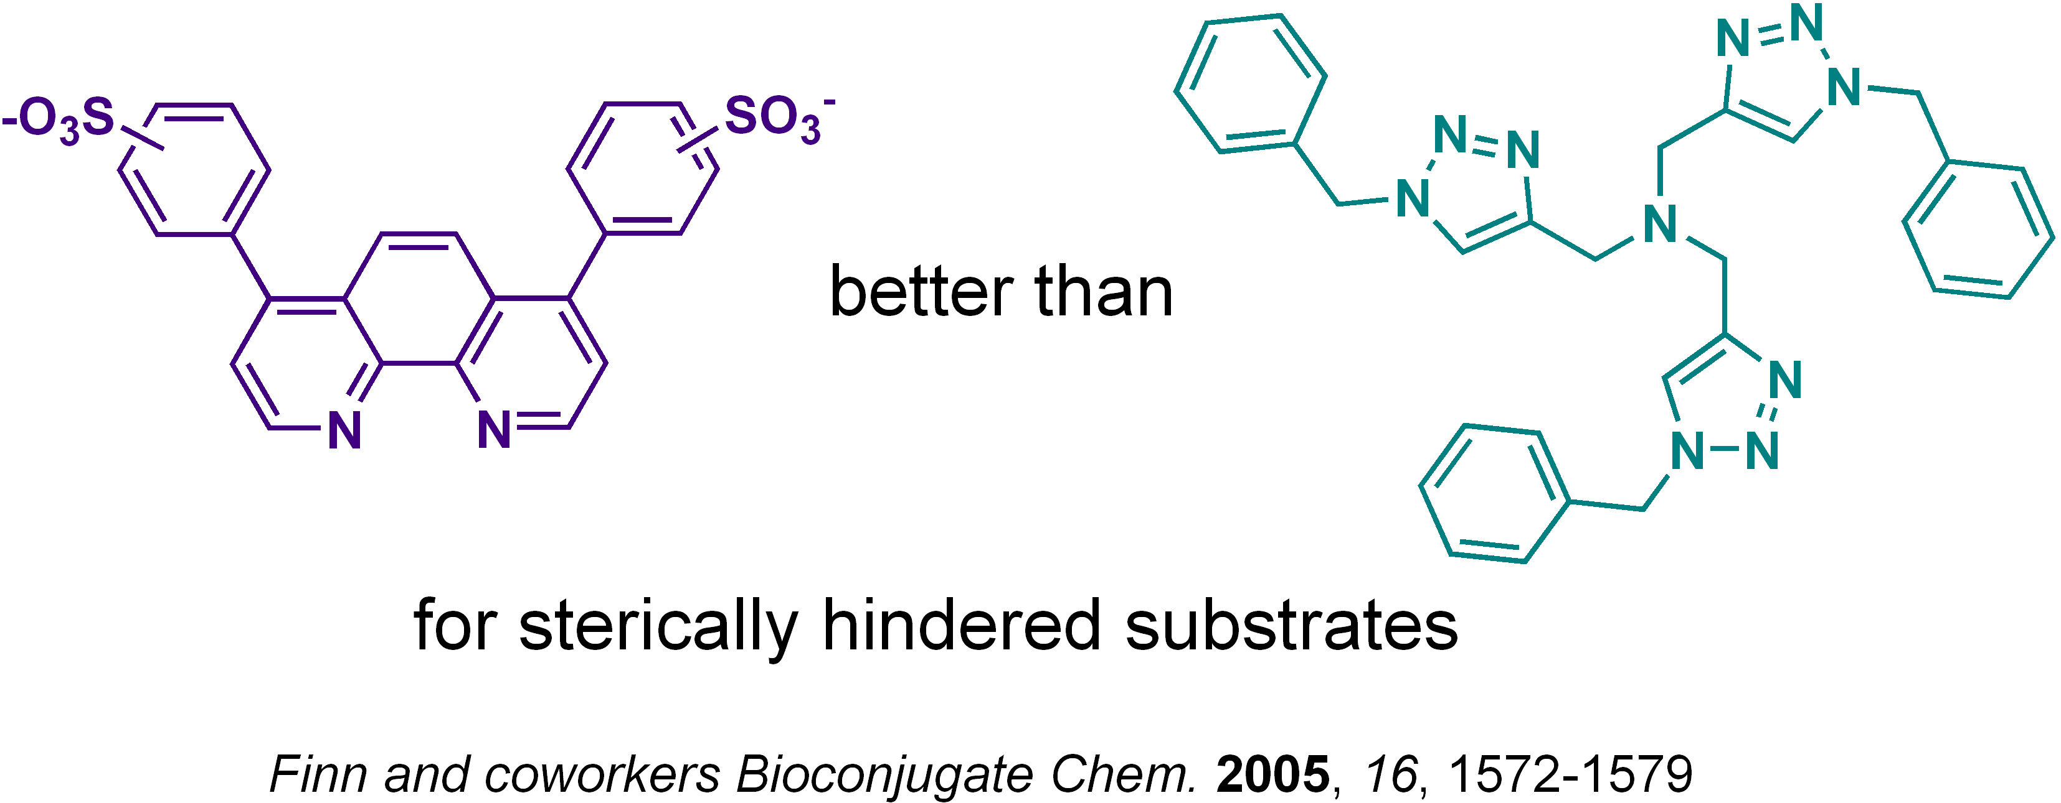
Clicking of sterically hindered lactose azide
Difficult to get full functionalisation: both ligand and sugar azide are quite bulky
Haddleton, Lindqvist, Mantovani, Geng, QSAR 2007, 11-12, 2007, 1220-1228

Slide 24
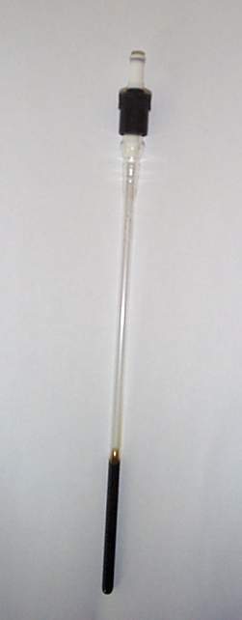
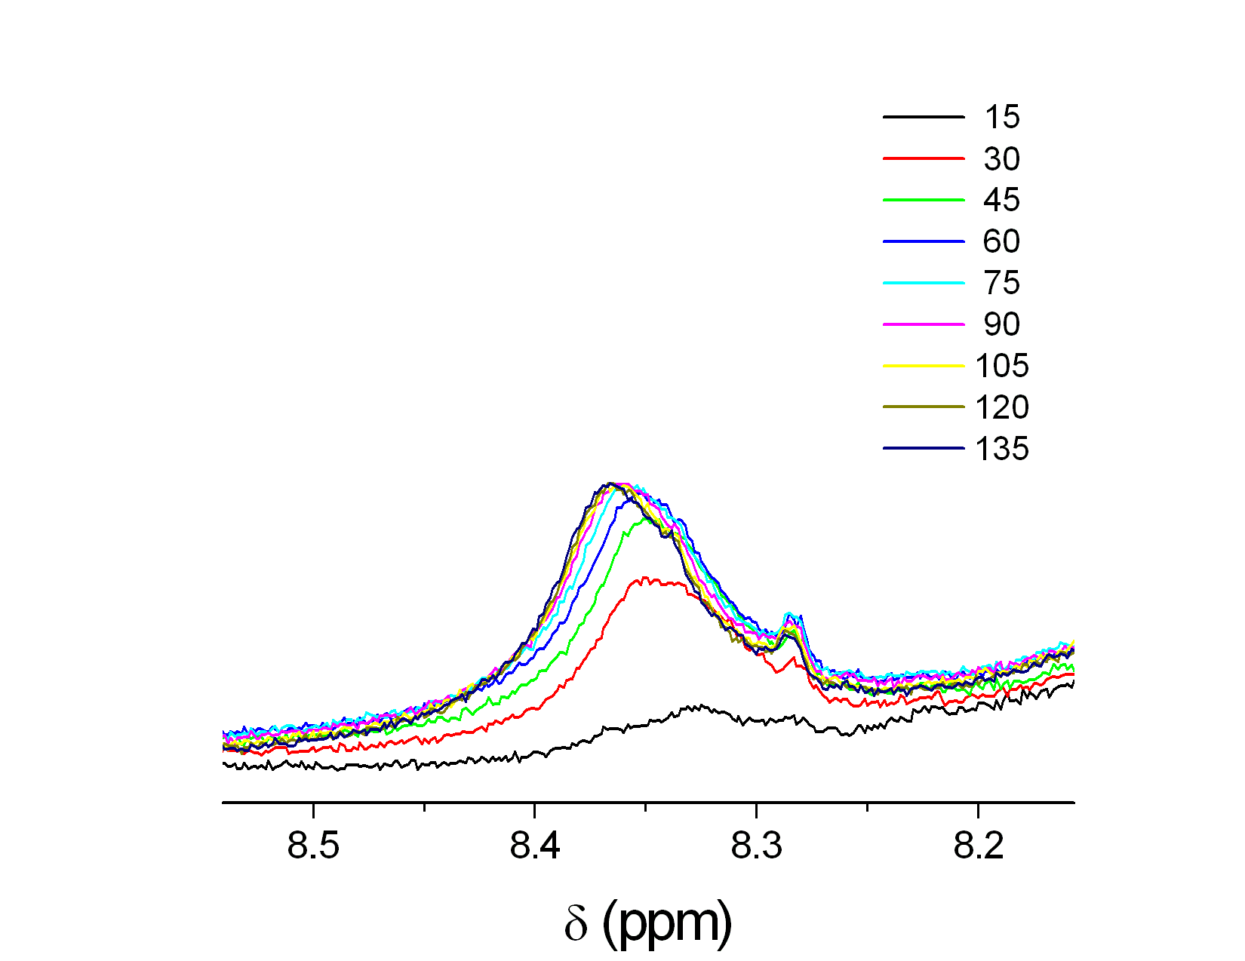
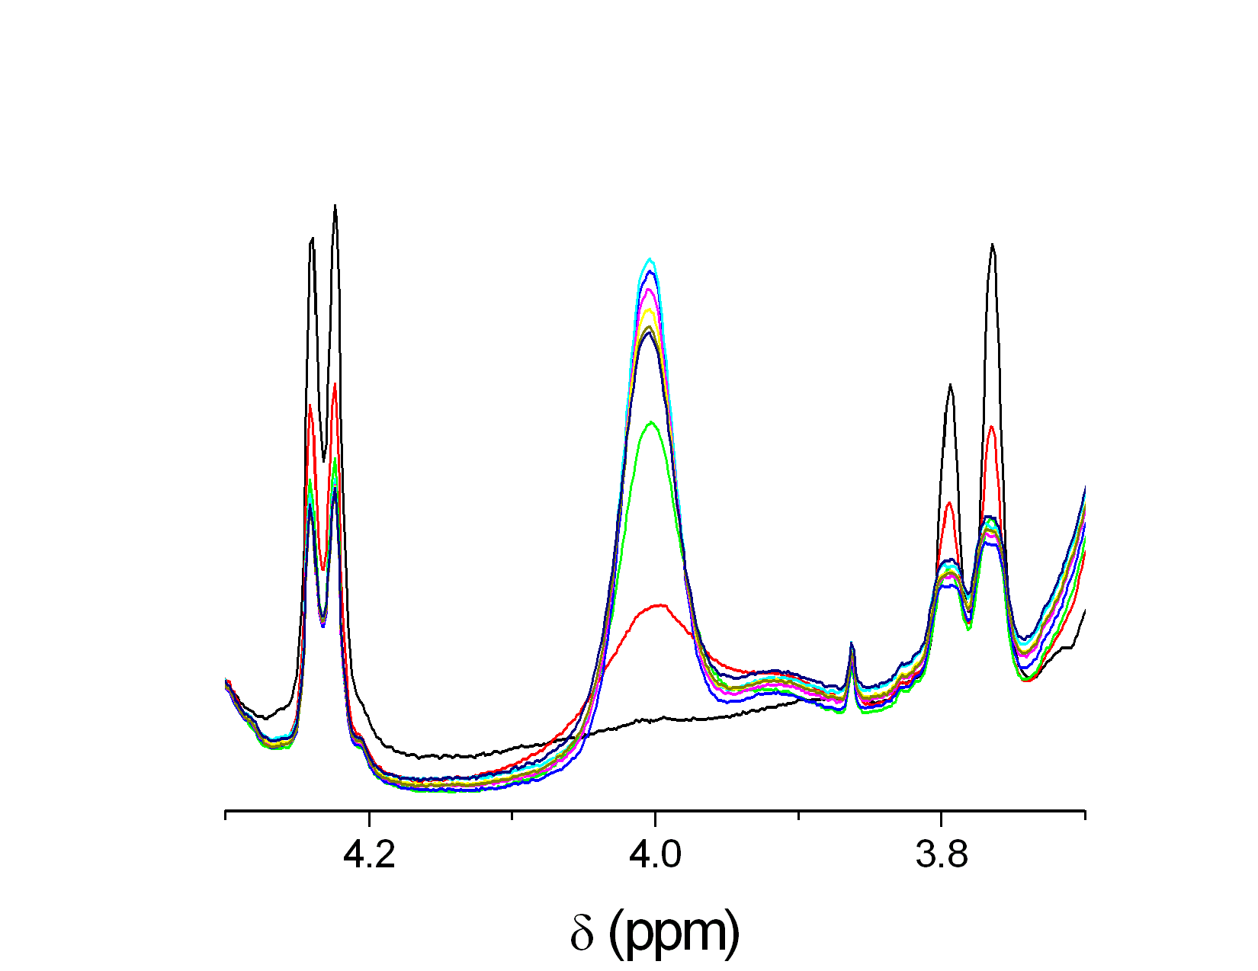
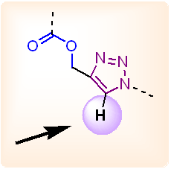
Online NMR clicking for optimisation
time (min)
sugar region
T = 50 °C
Haddleton, Lindqvist, Mantovani, Geng, QSAR 2007, 11-12, 2007, 1220-1228

Slide 25
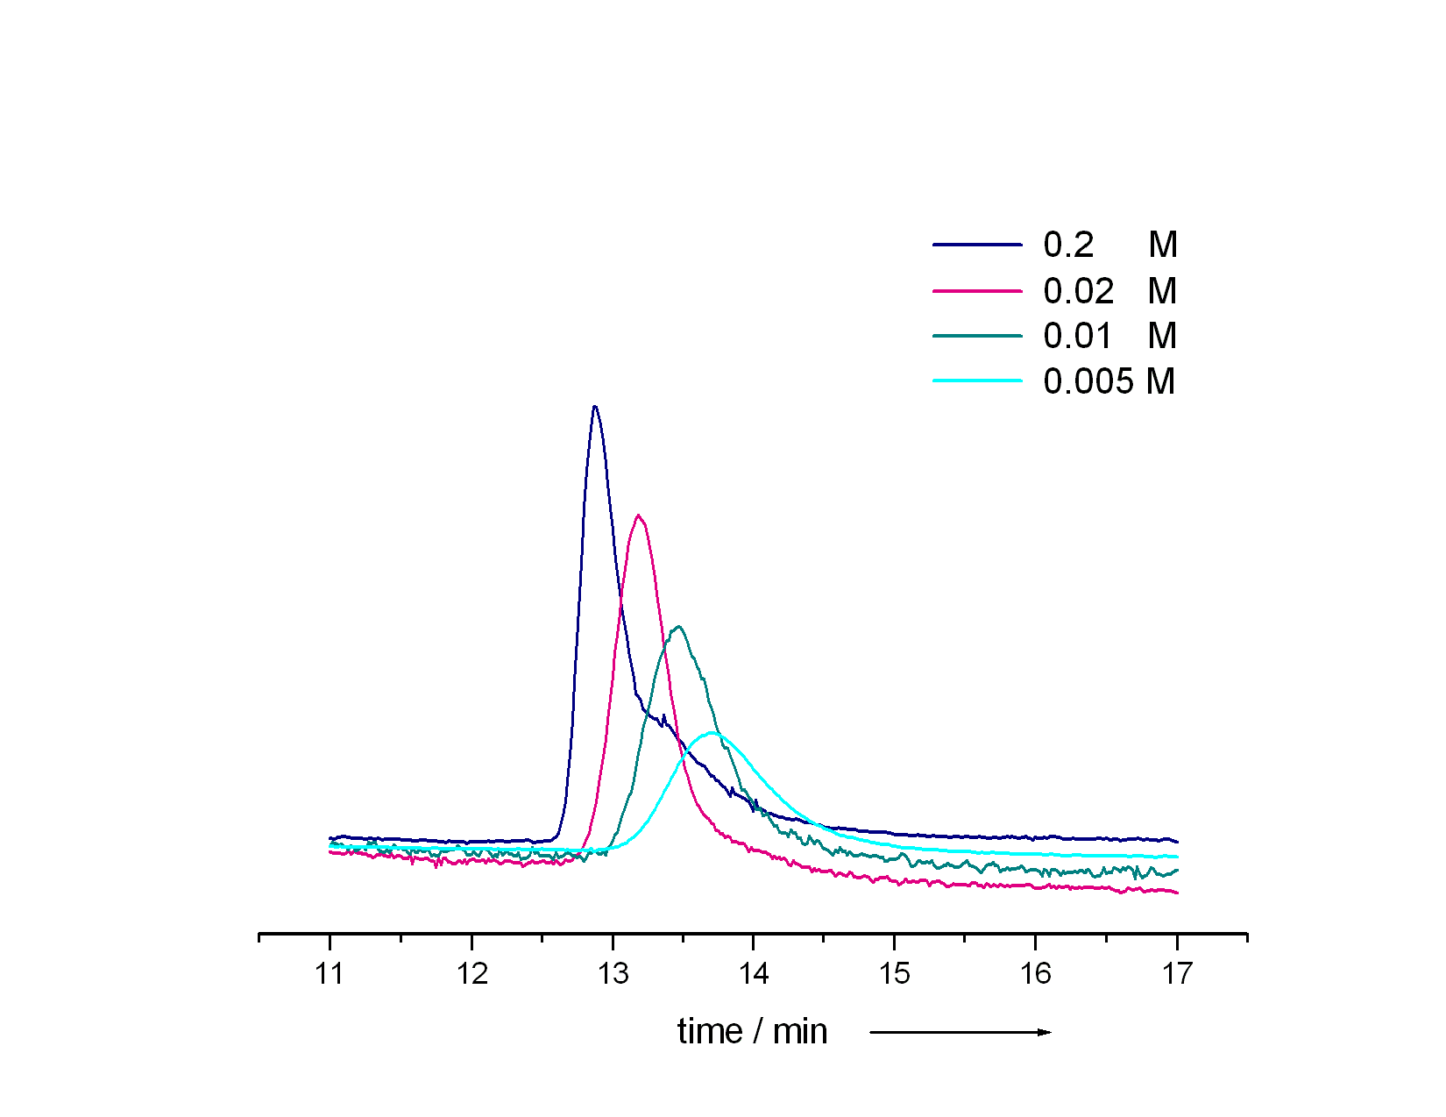
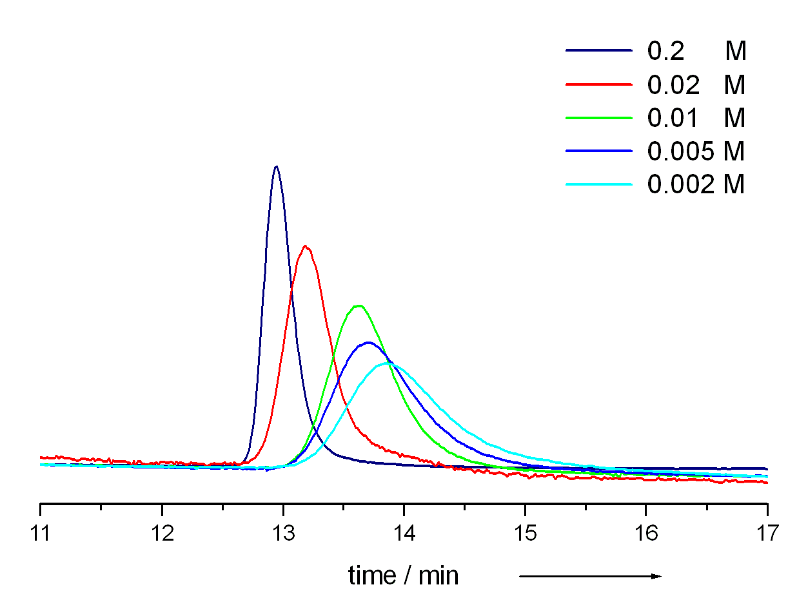
Ricinus Communis Agglutinin I (RCA I) as a recognition test
120 kDa dimeric lectin isolated from Ricinus communis (castor bean), interact selectively with galactose epitopes
Immobilised RCA I employed as stationary phase for affinity chromatography
Galactose polymer
Lactose polymer
Conditions: 66.7 mM PBS (pH 7.4), 150 mM NaCl, ambient temperature.
Different concentrations of D-galactose in the mobile phase were employed in each run.
Haddleton, Lindqvist, Mantovani, Geng, QSAR 2007, 11-12, 2007, 1220-1228

Slide 26
Outline
Polymerisation Cu(I) and Cu(0)
SET-LRP
Glycopolymers from CCTP and double click chemistry
One pot LRP and click
Thiol-activated alkene click to peptide conjugates (sCT)
Hyperbranched polymers with functional coronas from thiol-alkene click and CCTP

Slide 27
Thio-Michael Addition without radical initiator
Bowman, C. N. Polymer 2007, 48, 2014 and Hoyle, Lowe
Notes:
16700 Students
Includes visiting and exchange students (heads) and HEFP students in local colleges. Excludes students taught overseas and on external programmes.
3800 Staff
3000 full and part time, 800 casua, 96% non-academic staff live in Coventry. 3rd largest employer in Coventry area
£174.5 m turnover
For year ended July 2001, projected to rise to £222 m by 2004/05
Arts Centre
250,000 visits each year, 70% of audience from Coventry/Warwickshire, 67% self-generated income. £580,000 University subsidy to Arts Centre each year (not all grant)

Slide 28
¹H NMR; PEGMA + 2-Mercaptoethanol / DMPP
G Rees, R Randev, M Jones
Notes:
16700 Students
Includes visiting and exchange students (heads) and HEFP students in local colleges. Excludes students taught overseas and on external programmes.
3800 Staff
3000 full and part time, 800 casua, 96% non-academic staff live in Coventry. 3rd largest employer in Coventry area
£174.5 m turnover
For year ended July 2001, projected to rise to £222 m by 2004/05
Arts Centre
250,000 visits each year, 70% of audience from Coventry/Warwickshire, 67% self-generated income. £580,000 University subsidy to Arts Centre each year (not all grant)

Slide 29
MALDI: PEGA + 2-Mercaptoethanol / ^{n}C₅H₉NH₂
78 Da
G Rees, R Randev, M Jones
Notes:
16700 Students
Includes visiting and exchange students (heads) and HEFP students in local colleges. Excludes students taught overseas and on external programmes.
3800 Staff
3000 full and part time, 800 casua, 96% non-academic staff live in Coventry. 3rd largest employer in Coventry area
£174.5 m turnover
For year ended July 2001, projected to rise to £222 m by 2004/05
Arts Centre
250,000 visits each year, 70% of audience from Coventry/Warwickshire, 67% self-generated income. £580,000 University subsidy to Arts Centre each year (not all grant)

Slide 30
Rates of Conversion; PEGMA + 2-ME with 5 wt% DMPP / TBP / ^{n}C₅H₉NH₂ / ^{n}C₇H₇NH₂
G Rees, R Randev
Notes:
16700 Students
Includes visiting and exchange students (heads) and HEFP students in local colleges. Excludes students taught overseas and on external programmes.
3800 Staff
3000 full and part time, 800 casua, 96% non-academic staff live in Coventry. 3rd largest employer in Coventry area
£174.5 m turnover
For year ended July 2001, projected to rise to £222 m by 2004/05
Arts Centre
250,000 visits each year, 70% of audience from Coventry/Warwickshire, 67% self-generated income. £580,000 University subsidy to Arts Centre each year (not all grant)

Slide 31
Reaction with 2–(acryloyloxy)ethyl methacrylate
2 – (acryloyloxy)ethyl methacrylate + 2-ME / ^{n}C₅H₉NH₂
G Rees, R Randev
Notes:
16700 Students
Includes visiting and exchange students (heads) and HEFP students in local colleges. Excludes students taught overseas and on external programmes.
3800 Staff
3000 full and part time, 800 casua, 96% non-academic staff live in Coventry. 3rd largest employer in Coventry area
£174.5 m turnover
For year ended July 2001, projected to rise to £222 m by 2004/05
Arts Centre
250,000 visits each year, 70% of audience from Coventry/Warwickshire, 67% self-generated income. £580,000 University subsidy to Arts Centre each year (not all grant)

Slide 32
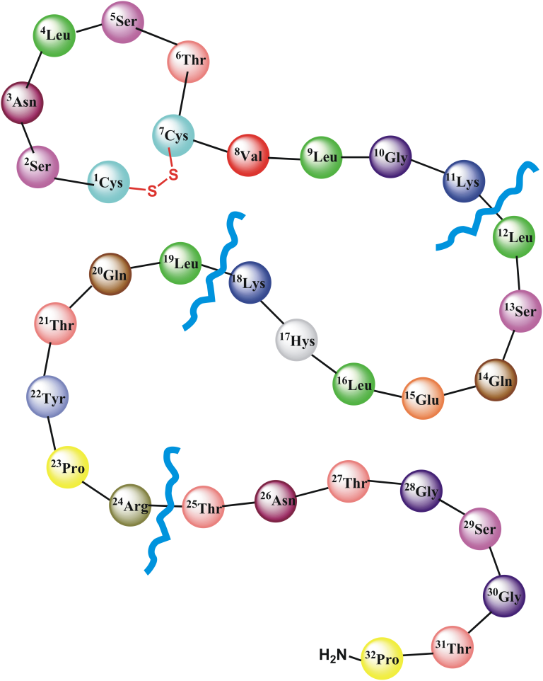
Salmon Calcitonin and Determination of the polymer attachment site
Tryptic digestion of sCT derivatives
¹Cys-¹¹Lys 1120.53 Da
¹²Leu-¹⁸Lys 853.96 Da
¹⁹Leu-²⁴Arg 776.42 Da
²⁵Thr-³²Pro 732.34 Da

Slide 33
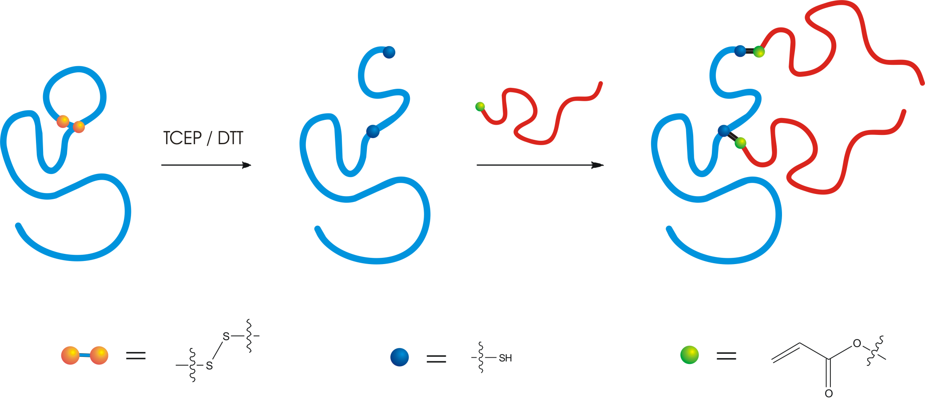
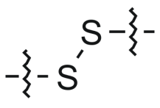
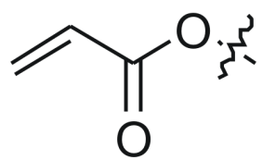

Thiol Conjugation

Slide 34
Phosphine-Mediated One-Pot Thiol-Ene “Click”
Approach to Polymer-Protein Conjugates
M Jones

Slide 35
Polymer-Protein Conjugates via a “Grafting To” Approach
RP-HPLC Analysis
S-S Reduction
Quantitative reduction observed after 10 mins
Thiol-ene Click
Quantitative conversion to di-PEGylated sCT in 1.5 hours
M Jones

Slide 36
Polymer-Protein Conjugates via a “Grafting To” Approach
MALDI-TOF Analysis
M Jones

Slide 37
Polymer-Protein Conjugates via a “Grafting To” Approach
Tryptic Digest with MALDI-TOF Analysis
Trypsin digest of conjugate reveals complete selectivity towards cysteine residues and conjugation at both cysteine residues.
M Jones

Slide 38
Bioactivity of Conjugates from the “Grafting To” Approach
In Vitro Testing of Conjugates
In Vivo Testing of Conjugates
M Jones

Slide 39
Polymer-Protein Conjugates via a “Grafting From” Approach
Protein Macroinitiator Synthesis
ATRP / SET-LRP
M Jones

Slide 40
Polymer-Protein Conjugates via a “Grafting From” Approach
Protein Macroinitiator Synthesis
(-HBr)
M Jones

Slide 41
Polymer-Protein Conjugates via a “Clicking To” Approach
Facile introduction of clickable units into a protein’s structure
CuAAC
M Jones

Slide 42
Polymer-Protein Conjugates via a “Clicking To” Approach
Facile introduction of clickable units into a protein’s structure
M Jones

Slide 43
Catalytic Chain Transfer Polymerisation (CCTP)
Certain Low-Spin Cobalt Complexes
Typical [Mon]/[Co] ratio of ca. 10⁶
C_{s} =40,000 cf RSH = 1
CoBF
CCTP of MMA using CoBF at 60ºC

Slide 44
L Nurmi, J Lindqvist: Chem Comm, 2009

Slide 45
Polymer-Protein Conjugates via a “Grafting To” Approach
“Thiol-ene click” of Cysteine Residues to CCT Macromonomers
M Jones

Slide 46
Polymer-Protein Conjugates via a “Grafting To” Approach
“Thiol-ene click” of Cysteine Residues to CCT Macromonomers
K Amos, M Jones

Slide 47
Outline
Polymerisation Cu(I) and Cu(0)
SET-LRP
Glycopolymers from CCTP and double click chemistry
One pot LRP and click
Thiol-activated alkene click to peptide conjugates (sCT)
Hyperbranched polymers with functional coronas from thiol-alkene click and CCTP

Slide 48
Polymerization preparation (oil bath 70˚C)
5 ml EGDMA
5 ml 1,2-dichloroethane
0.005 g CoBF
0.05 g dimethyl 2,2- azobis(2-methylpropionate)
(V-601)
J Menzel and K McKeown

Slide 49
Overlay of GPC data
J Menzel and K McKeown

Slide 50
GPC traces of P(EGDMA)
J Menzel and K McEwan

Slide 51
Michael-Addition of thiols
J Menzel and K McKeown

Slide 52

Acknowledgements
Dr G Mantovani (Nottingham) All
Dr J Lindqvist (KTH) Glyco
Dr A De-Cuendias SET
Dr T Kreft ACOMP
M Jones Conj
R Randev Conj
K Amos (Manchester) Conj
J Menzel Thiol
K McEwan ACOMP/Thiol
J Geng (Cambridge) Glyco
Y Gou Glyco
G Li Thiol
G Rayner EPR
G Rees Thiol
Dr V Ladmiral (UNSW) Glyco
Dr M Levere (Le Mans) SET
Dr C Fidge, (Texas A&M) SET
Dr Peter Wright (Infineum) SET
A Grice SET
L Nurmi (HTU) Glyco
Dr C Sayers (WEP) Conj
Prof D Brayden (UCD) Animal
Dr S Walsh (UCD) Animal
EU
EPSRC
Lubrizol
Warwick Effect Polymers
Unilever
Polymer Laboratories (Varian)
Syngenta

Slide 53
In memory of Charlie Hoyle – University of Southern Mississippi
An extraordinary scientist

Slide 54
Glycopolymers via Catalytic Chain Transfer Polymerisation (CCTP) and double click reactions
David Haddleton
University of Warwick,UK
APME
Dresden, October 5th 2009

Slide 55
Outline
Polymerisation Cu(I) and Cu(0)
SET-LRP
Glycopolymers from CCTP and double click chemistry
One pot LRP and click
Thiol-activated alkene click to peptide conjugates (sCT)
Hyperbranched polymers with functional coronas from thiol-alkene click and CCTP

Slide 56
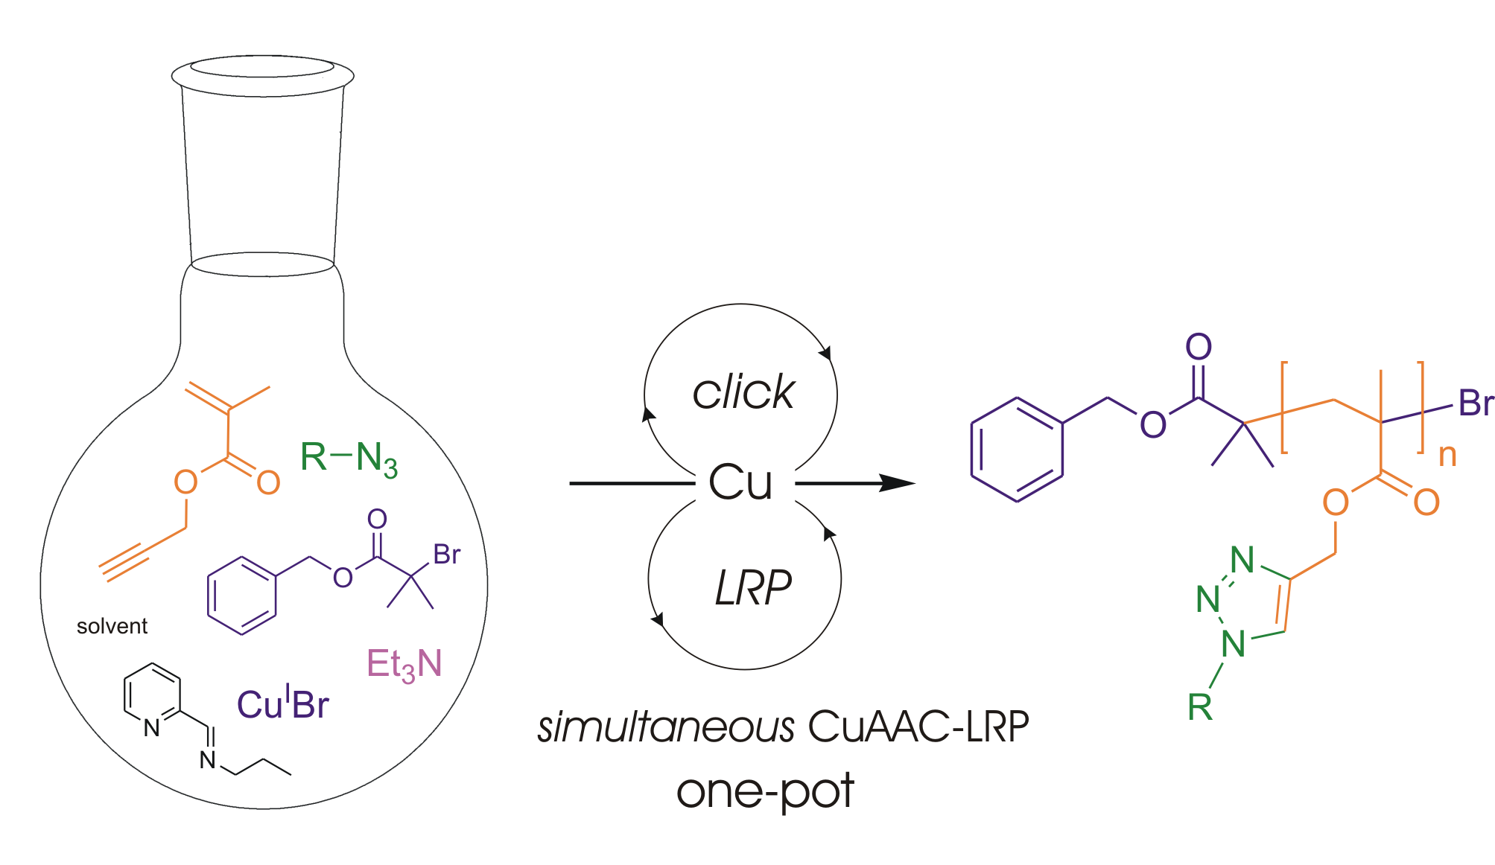
Simultaneous Cu(I)-catalysed CuAAC and ATRP
Geng, J.; Lindqvist, J.; Mantovani, G.*; Haddleton, D. M.* Angew. Chem. Int. Ed. 2008

Slide 57
Click Vs Polymerization in Different Solvents
Lindqvist, J.; Mantovani, G.; Haddleton, D. M.

Slide 58
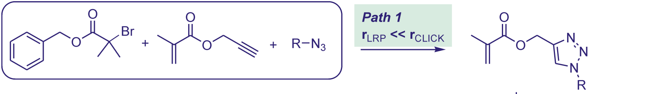
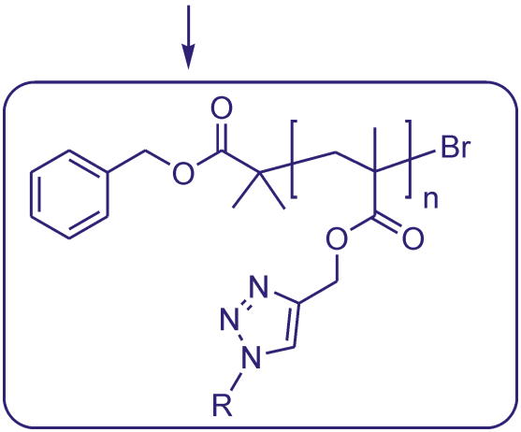
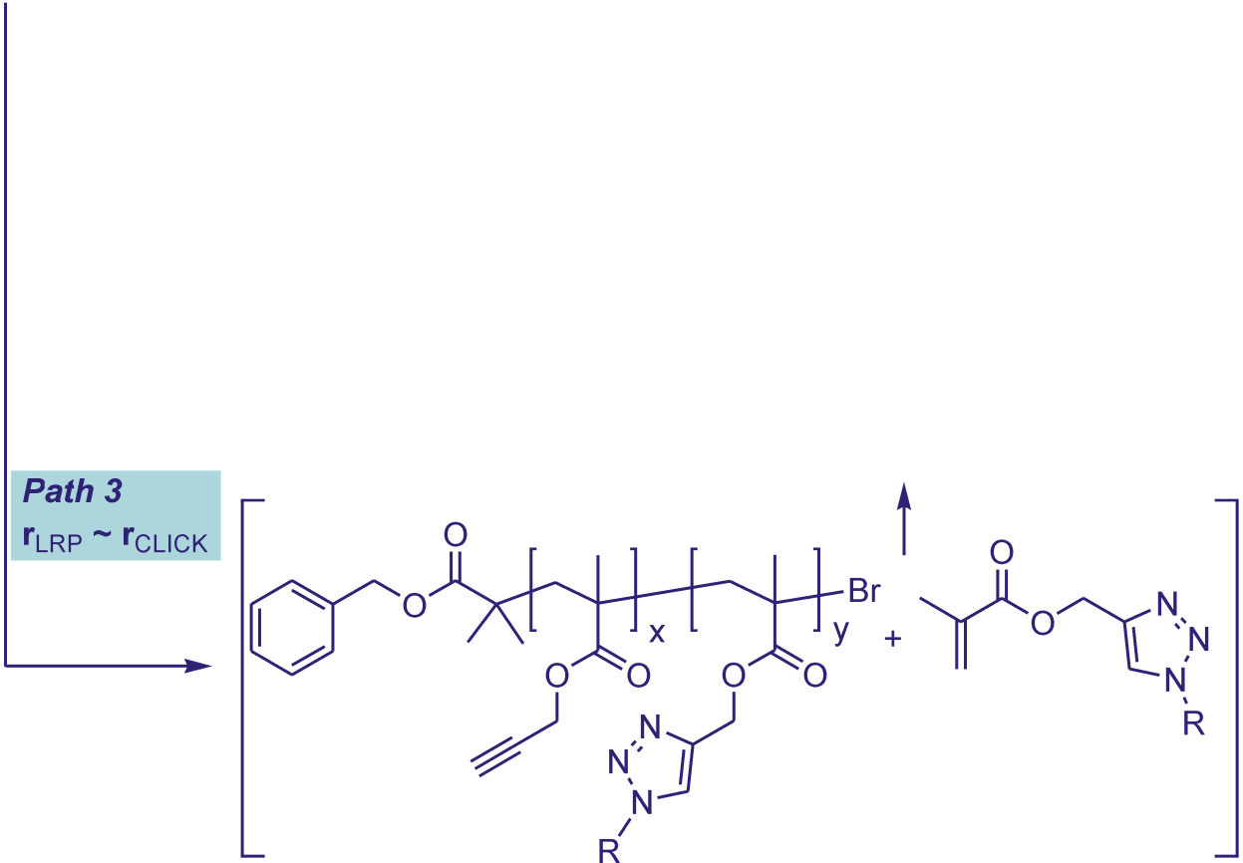
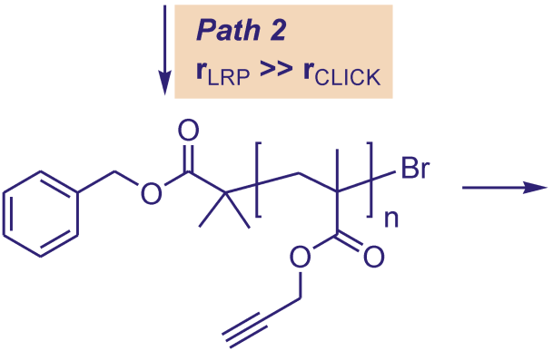
Simultaneous Cu(I)-catalysed CuAAC and ATRP
Lindqvist, J.; Mantovani, G.; Haddleton, D. M.

Slide 59
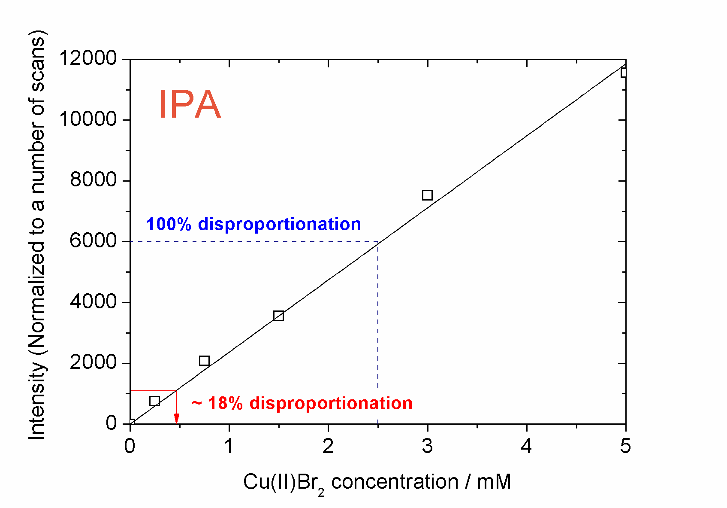
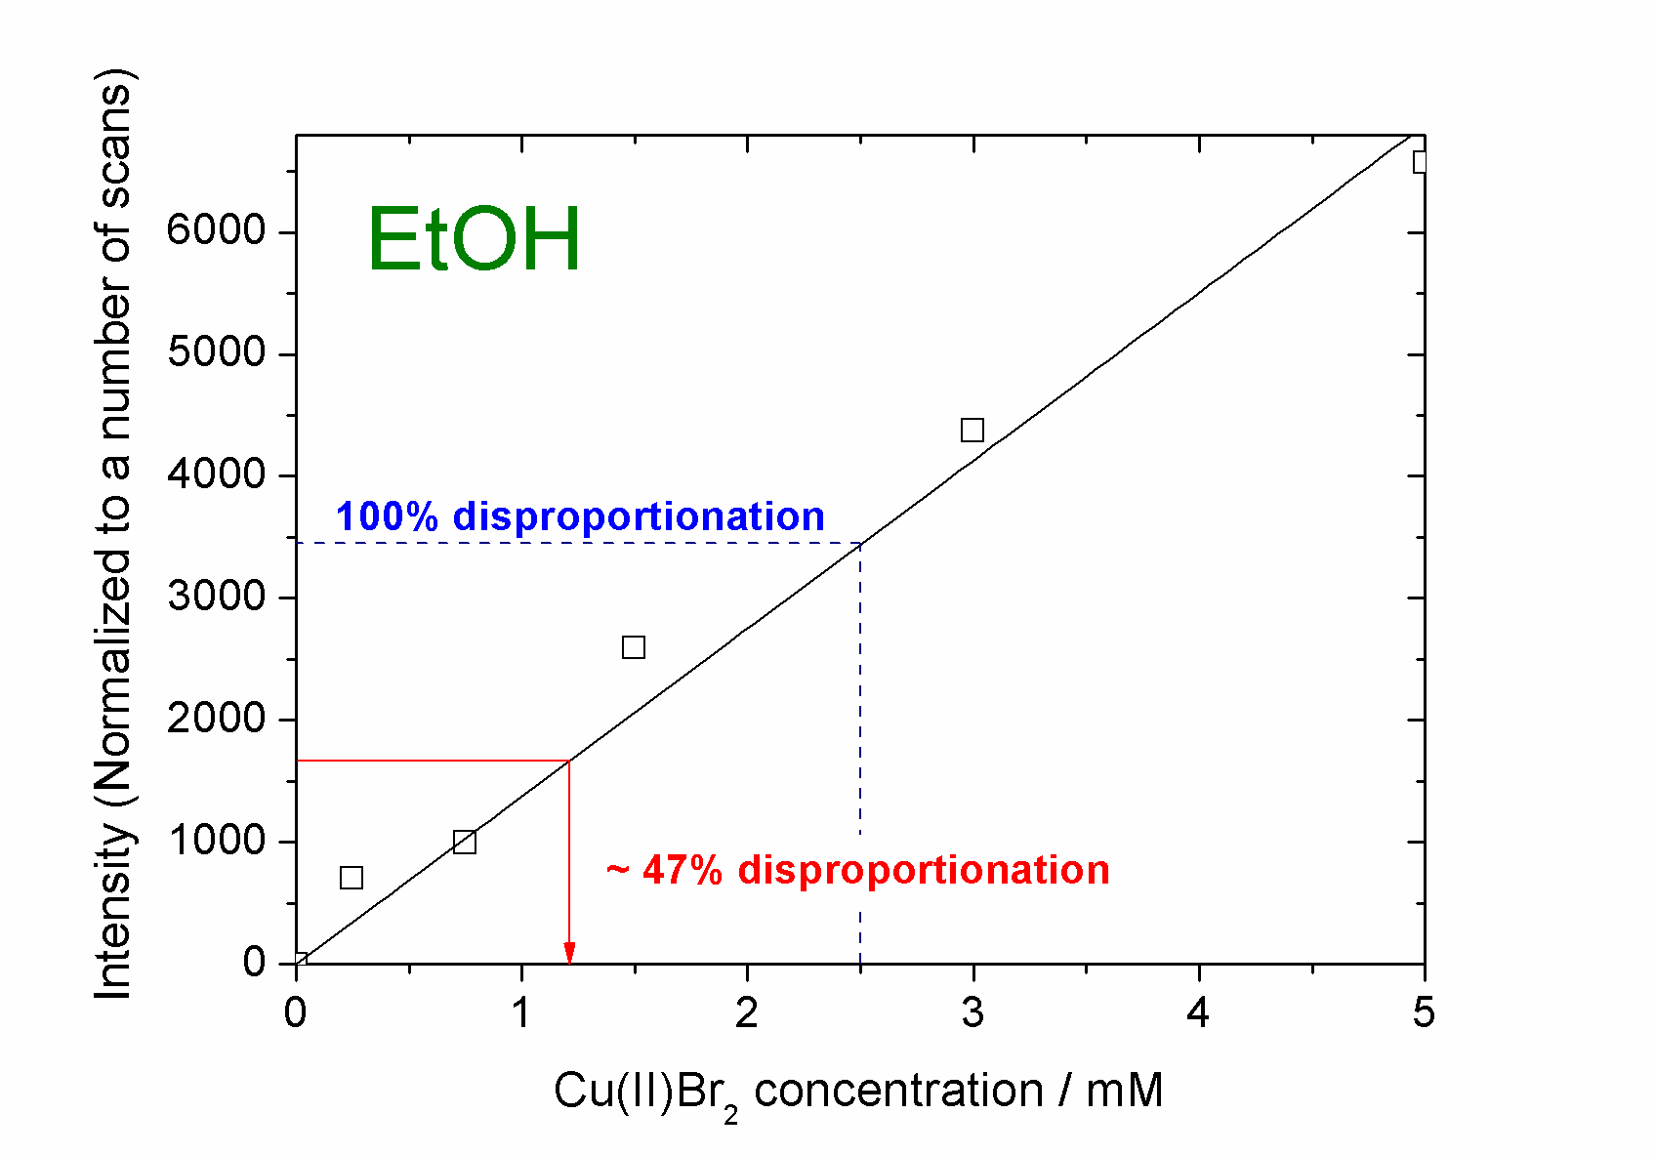
EPR Studies of SET-LRP System
Monitoring disproportionation using EPR analysis
- Using signal intensity rather than absorbance
Investigation of SET-LRP
1
17

Slide 60


PEG Monomers and SET-LRP
Polymerisation of PEGA₄₅₄ in selected alcohols
Investigation of SET-LRP
1
23

Slide 61




Analysis by GPC
Polymerisation of PEGA₄₅₄ in selected alcohols with Cu(II) additive
GPC traces are characteristic of well controlled LRPs
T = time(mins)
Methanol Ethanol IPA
Investigation of SET-LRP
1
28

Slide 62


DMAEMA as an Intrinsic Reducing Agent
Evidence for the reduction of Cu(II)Cl₂/TPMA with DMAEMA
Characteristic CuCl₂/TPMA in acetone peak at 938 nm decreases as Cu(II) is reduced

Slide 63

Proposed Mechanism of Reduction of Cu(II)₂Cl/TPMA with DMAEMA

Slide 64

DMAEMA as an Intrinsic Reducing Agent
EPR monitoring of Cu(II)Cl₂ signal in reaction:

Slide 65
DMAEMA as an Intrinsic Reducing Agent
EPR monitoring of Cu(II)Cl₂ signal in reaction:
Cu(II) EPR signal decreases over time

Slide 66

DMAEMA as an Intrinsic Reducing Agent
EPR monitoring of Cu(II)Cl₂ signal in reaction:

Slide 67

DMAEMA as an Intrinsic Reducing Agent
EPR monitoring of Cu(II)Cl₂ signal in reaction:

Slide 68

DMAEMA as an Intrinsic Reducing Agent
EPR monitoring of Cu(II)Cl₂ signal in reaction:

Slide 69

DMAEMA as an Intrinsic Reducing Agent
Reproducing UV-Vis experiment from the paper:

Slide 70

DMAEMA as an Intrinsic Reducing Agent
Reproducing UV-Vis experiment from the paper:

Slide 71

DMAEMA as an Intrinsic Reducing Agent
Change solvent to IPA to solubilise complex:

Slide 72
DMAEMA as an Intrinsic Reducing Agent
Change solvent to IPA to solubilise complex:
No decrease of Cu(II) signal

Slide 73
DMAEMA as an Intrinsic Reducing Agent
Change solvent to IPA to solubilise complex:
O₂

Slide 74

DMAEMA as an Intrinsic Reducing Agent
Repeat under nitrogen to avoid possible oxidation:
Cu(II) signal decreases

Slide 75
DMAEMA as an Intrinsic Reducing Agent
Repeat under nitrogen to avoid possible oxidation:
Repeat experiment in an EPR tube

