Slide 1

Glycopolymers via catalytic chain transfer polymerisation and double click reactions
Single electron transfer living radical polymerisation
SET-LRP
David Haddleton
University of Warwick,UK
IUPAC Chemical Congress August 2009, Glasgow

Slide 2
Outline
Polymerisation Cu(I) and Cu(0)
SET-LRP
Polymerisation in different solvents
Polymerisation of PEG containing monomers
Glycopolymers from CCTP and double click chemistry
One pot LRP and click
Thiol-activated alkene click to peptide conjugates (sCT)
Hyperbranched polymers with functional coronas from thiol-alkene click and CCTP

Slide 3
Outline
Polymerisation Cu(I) and Cu(0)
SET-LRP
Polymerisation in different solvents
Polymerisation of PEG containing monomers
Glycopolymers from CCTP and double click chemistry
One pot LRP and click
Thiol-activated alkene click to peptide conjugates (sCT)
Hyperbranched polymers with functional coronas from thiol-alkene click and CCTP

Slide 4
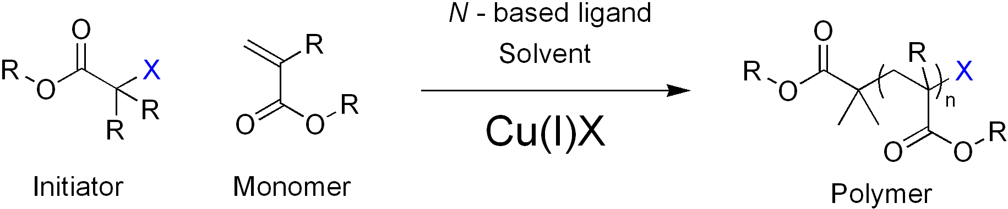
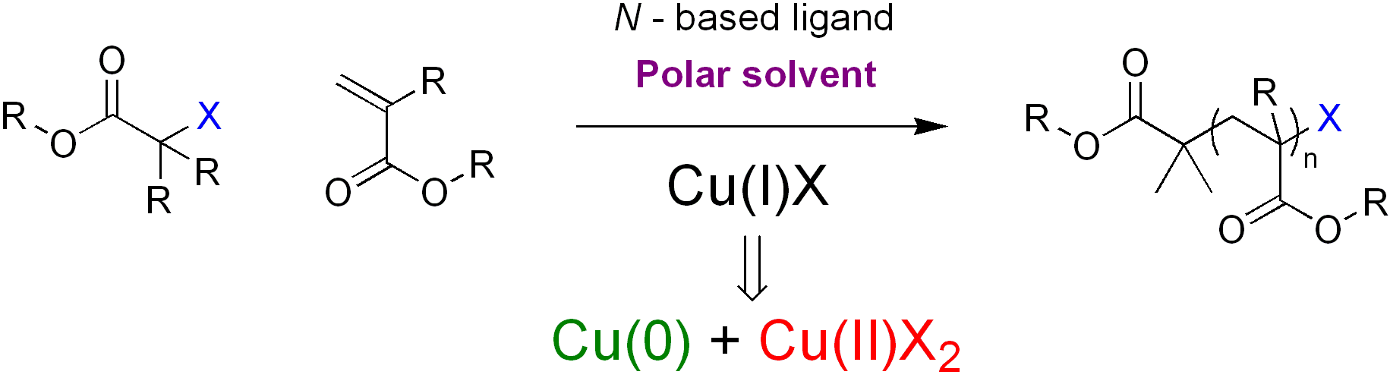
Introduction to SET-LRP
SET-LRP: A brief overview
ATRP with Cu^{I}X
Cu(0) as the active catalyst
Percec, V. et al, J. Am. Chem. Soc. 2006, 128, (43), 14156-14165.

Slide 5
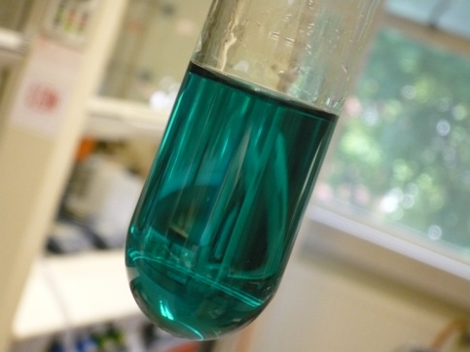
Introduction to SET-LRP
Benefits of SET-LRP
- Ambient Conditions
- ‘Ultrafast’ controlled radical polymerisation
- Wide range of monomers, solvents and functional initiators
eg amide monomers, protic solvents, non activated alkenes
- Synthesis of very high molecular weight polymers > 1 million
- Cu(0) easy to remove, facile polymer clean-up
Investigation of SET-LRP
1
4

Slide 6
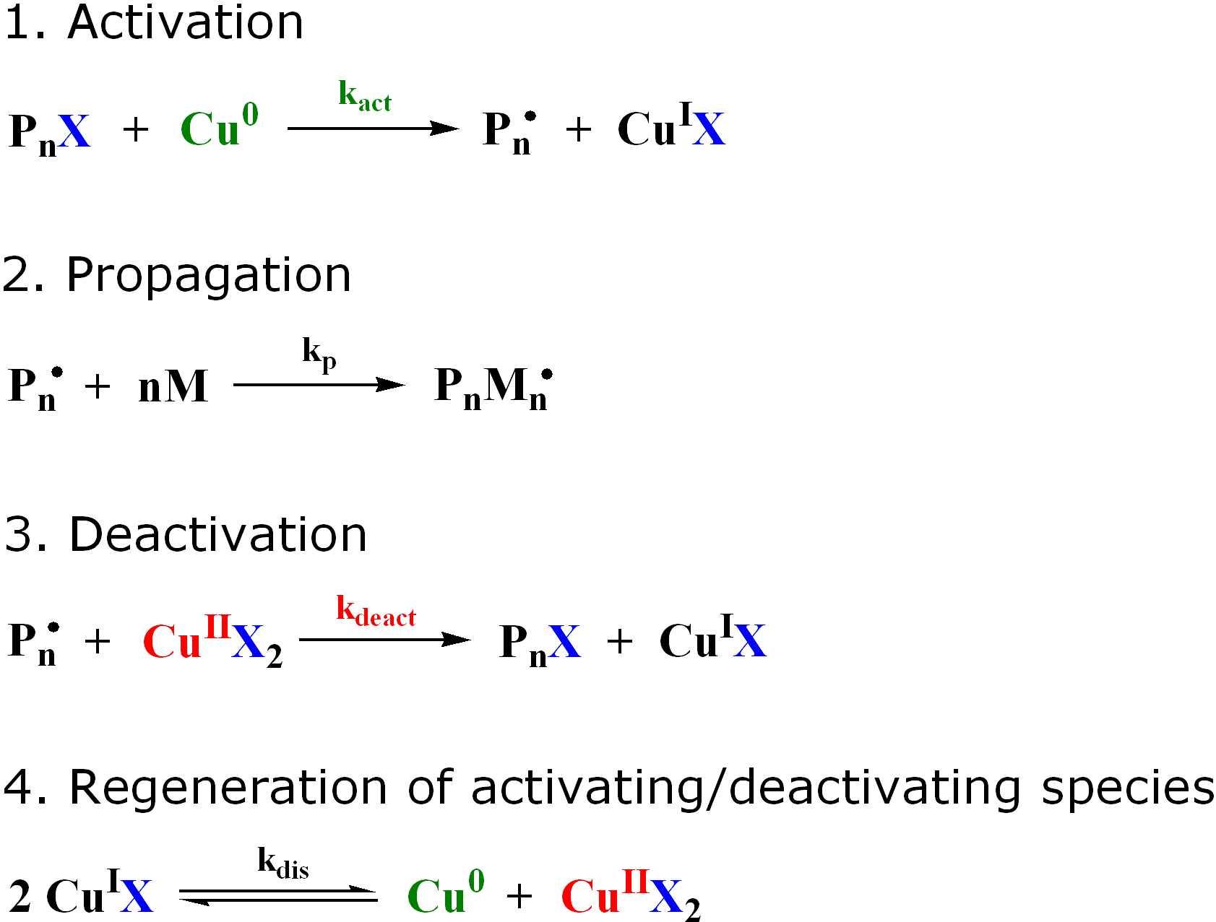
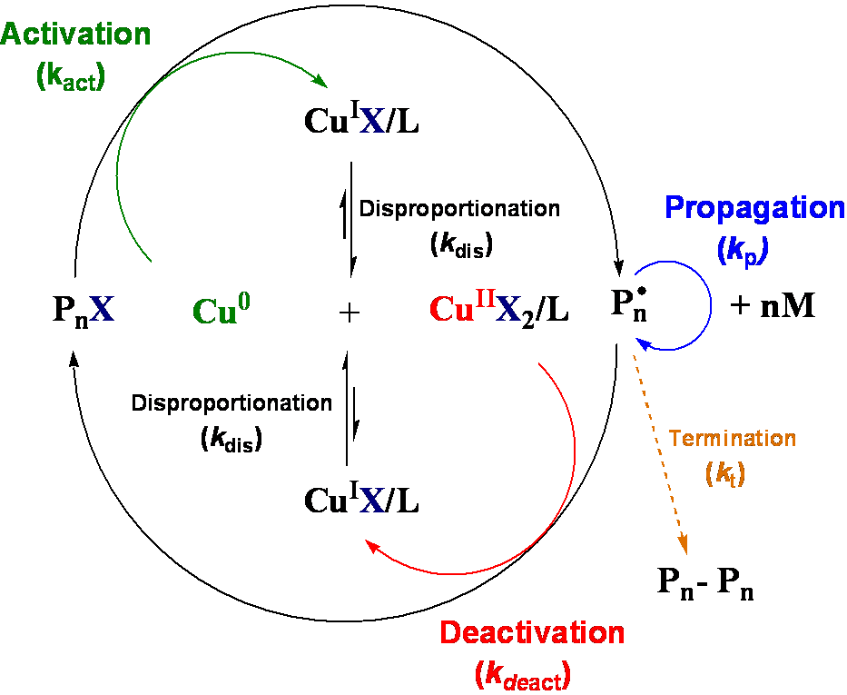
Introduction to SET-LRP
Investigation of SET-LRP
1
6

Slide 7
Introduction to SET-LRP
Investigation of SET-LRP
1
6

Slide 8
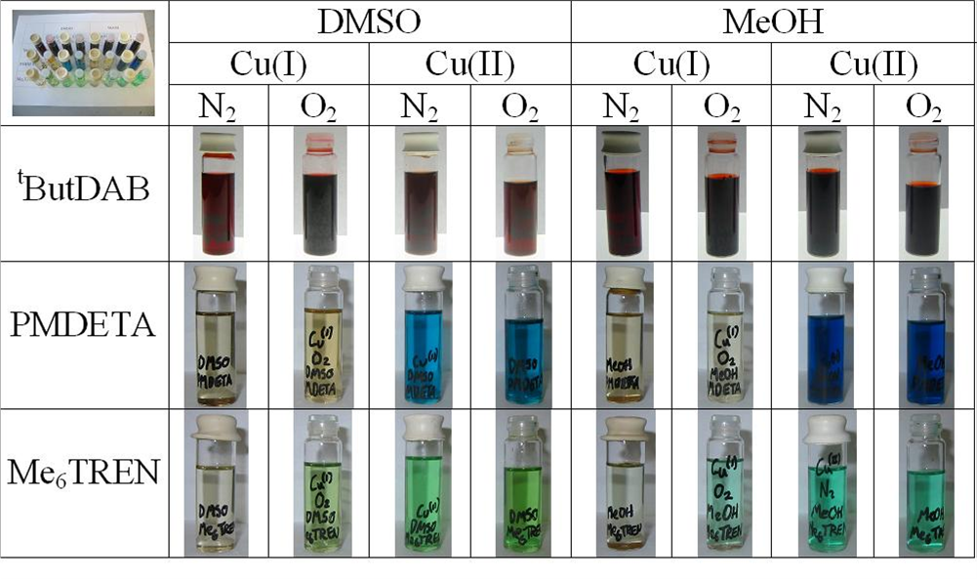


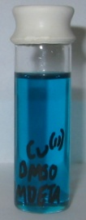
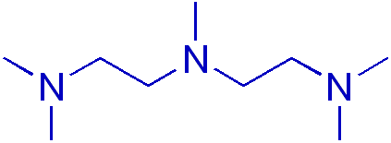
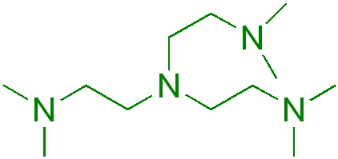
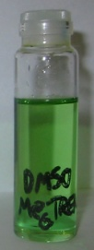
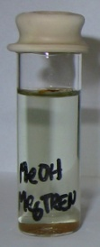
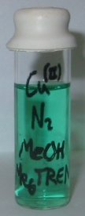
Initial Ligand Studies
Ligand studies in organic solvents
^{t}ButylDAB
PMDETA
Me₆TREN
Investigation of SET-LRP
1
8

Slide 9
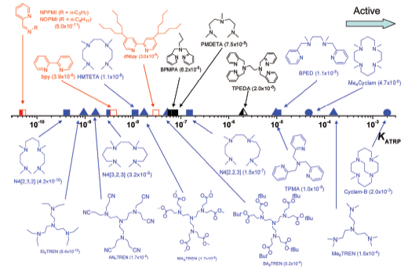
Living Radical Polymerisation (LRP)
Solubility of catalyst can be tuned by the ligand to aid catalyst removal in all media.
Pyridine imine ligands have the right redox potential for Methacrylates.
Methacrylates
Acrylates
Taken from Matyjaszewski et. al. JACS, 2008, 10702
Notes:
9

Slide 10
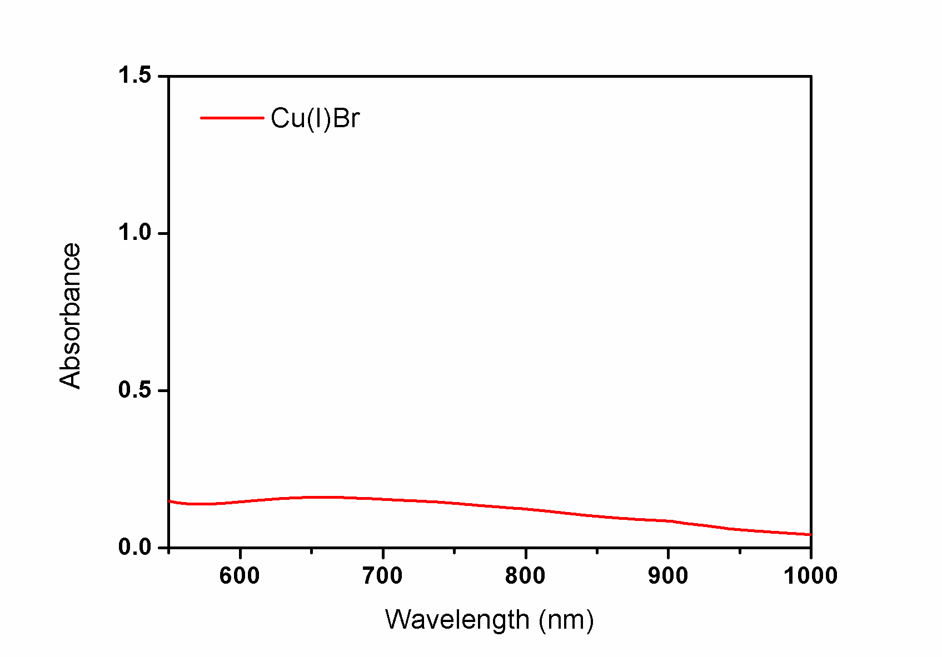
UV-Vis Analysis of SET-LRP System
Monitoring disproportionation using UV-Vis analysis
DMSO
Investigation of SET-LRP
1
11

Slide 11
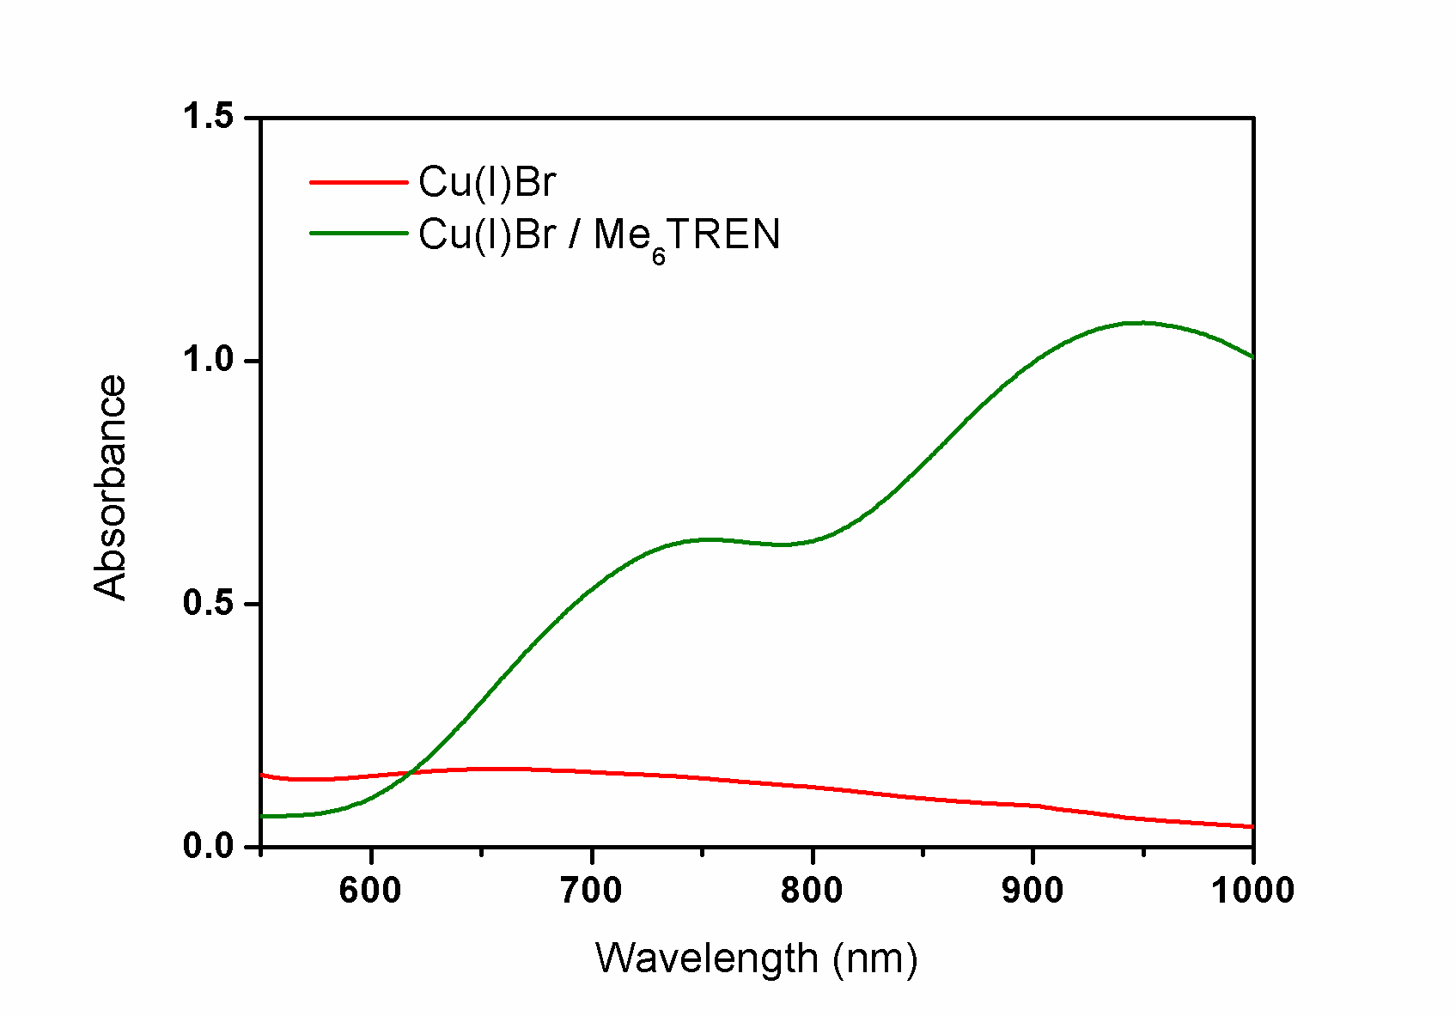
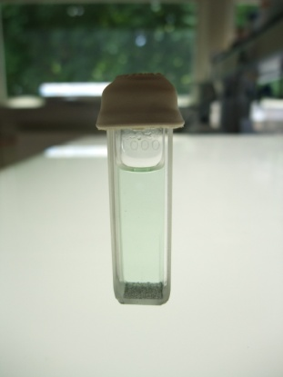
UV-Vis Analysis of SET-LRP System
Monitoring disproportionation using UV-Vis analysis
✓
DMSO
DMSO
Investigation of SET-LRP
1
11

Slide 12
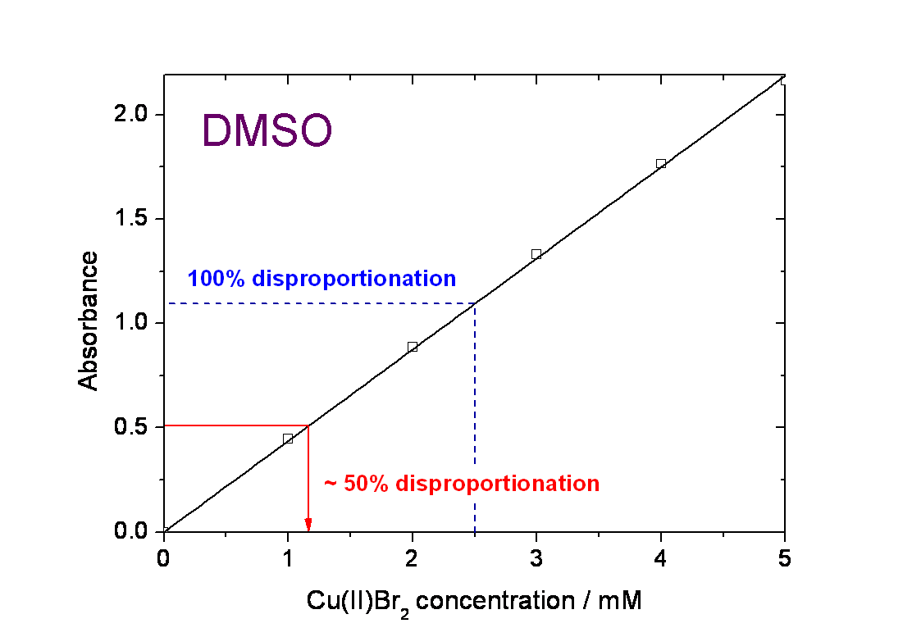
UV-Vis Analysis of SET-LRP System
Monitoring disproportionation quantitatively using UV-Vis analysis
- Cu^{II}Br₂ calibration with Me₆TREN @ 960.06 nm
DMSO, Me₆TREN
50% Cu^{I}Br disproportionation
Toluene/Phenol, Me₆TREN
Less polar system
30%
Ethanol, Me₆TREN
49%
IPA, Me₆TREN
Less polar system
17%
Experiment:5 mM Cu^{I}Br solution
- 100% disproportionation , Abs ~ 1.15
- Absorbance of approx. 0.5: 50
disproportionation
Investigation of SET-LRP
1
12

Slide 13
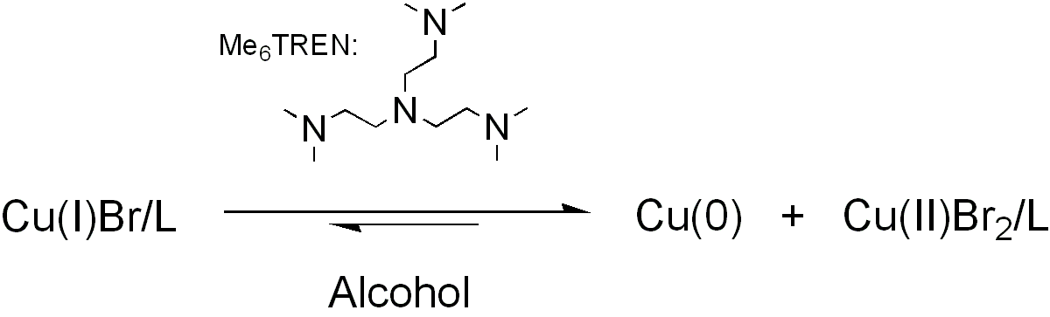
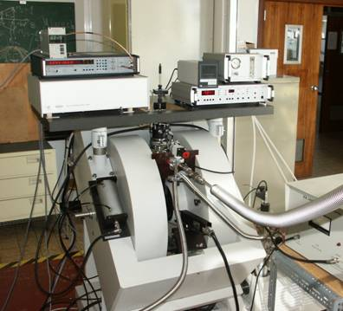
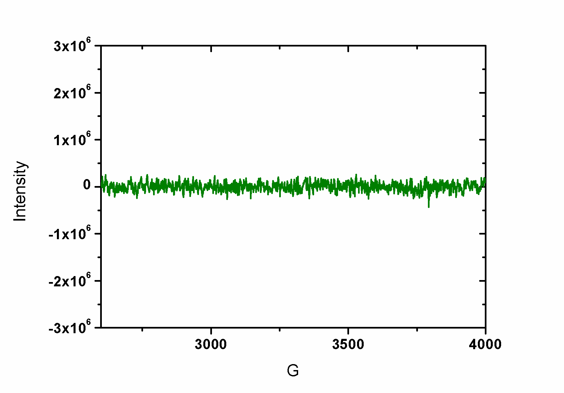
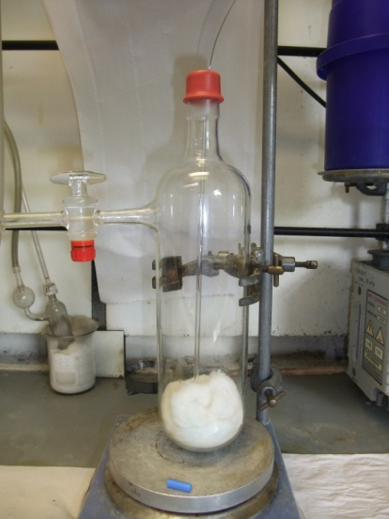
EPR Studies of SET-LRP System
Detecting Cu(II) using EPR analysis
Cu(I)
Professor Mark Newton – UoW Physics

Slide 14
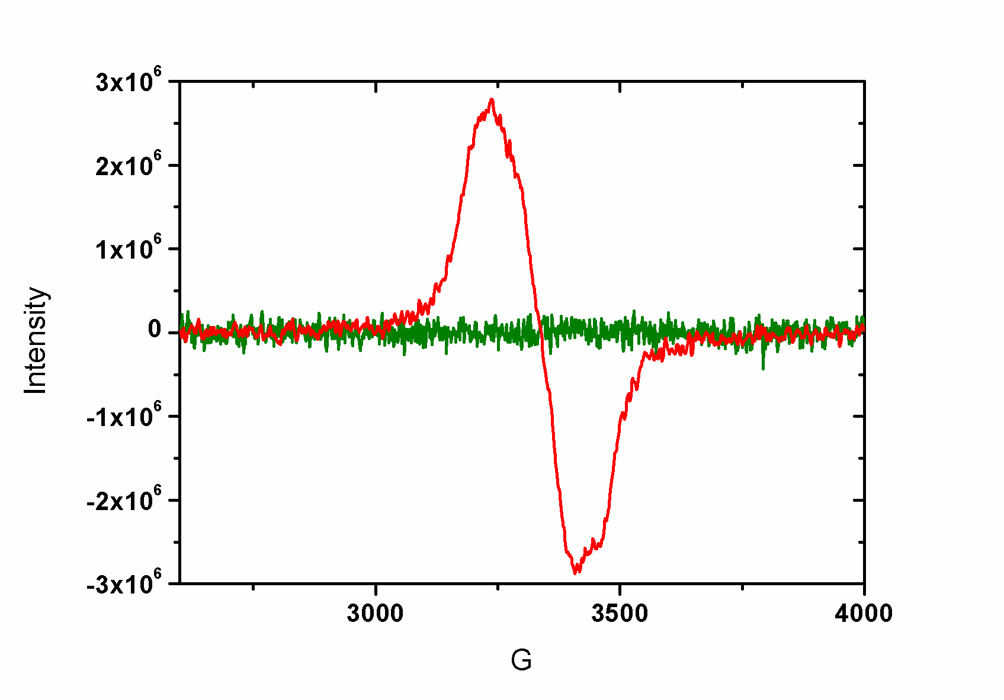
EPR Studies of SET-LRP System
Detecting Cu(II) using EPR analysis
Cu(I)
Cu(II)
Investigation of SET-LRP
1
16

Slide 15
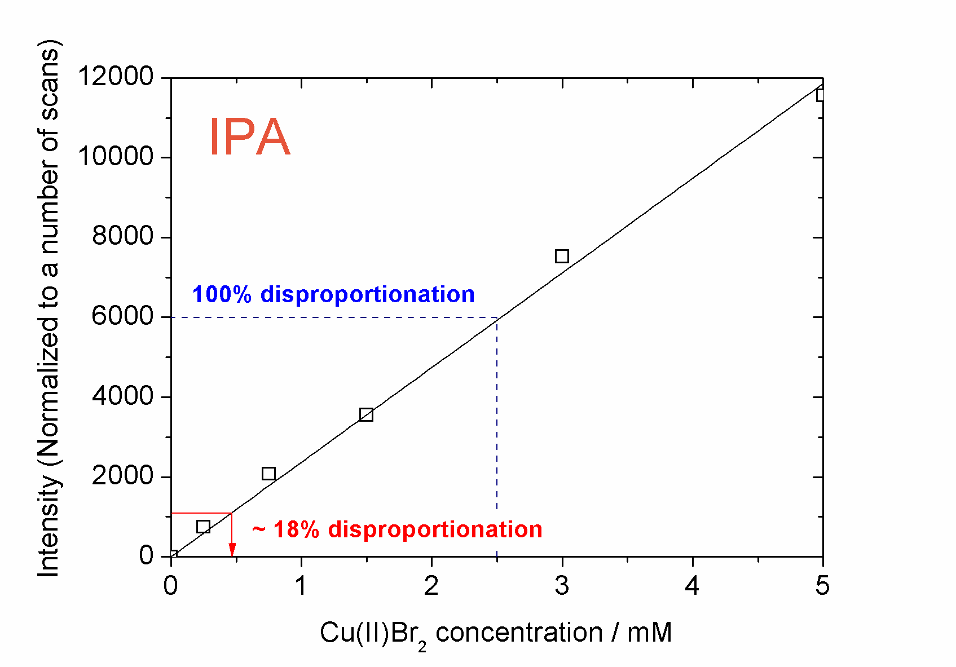
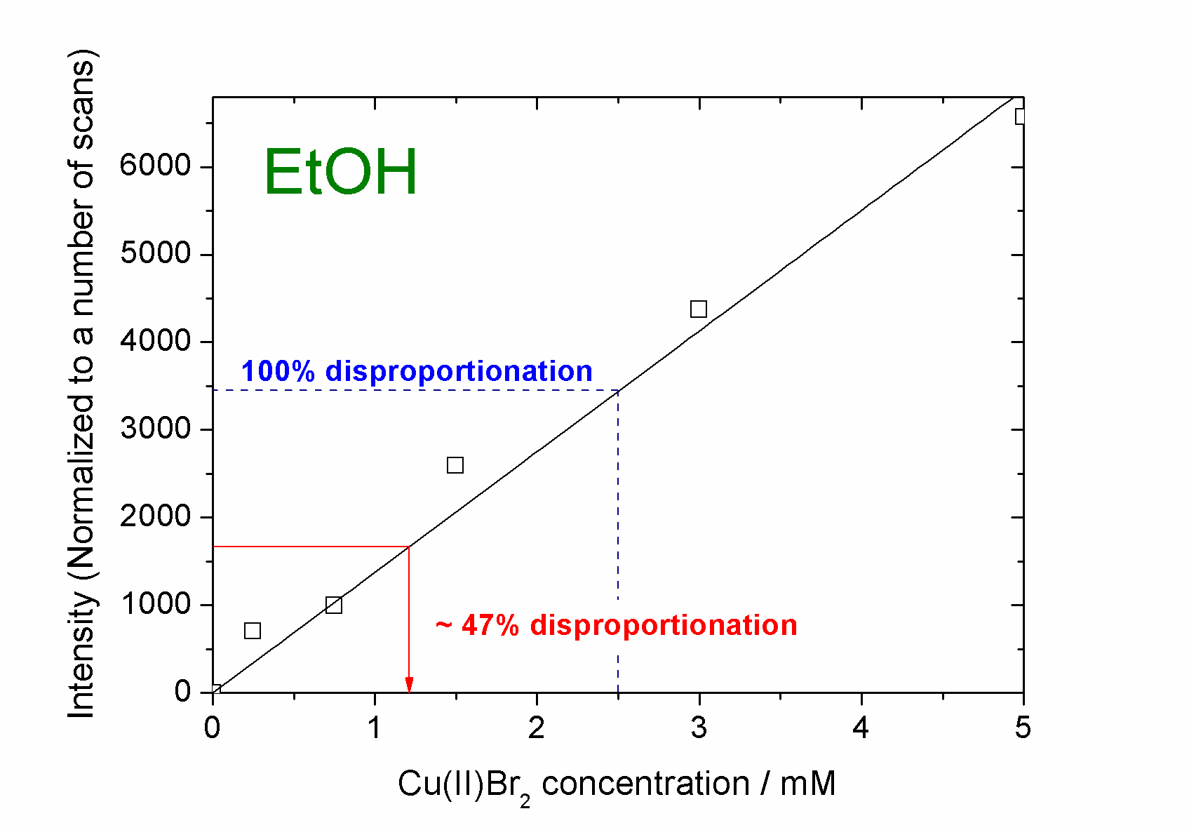
EPR Studies of SET-LRP System
Monitoring disproportionation using EPR analysis
- Using signal intensity rather than absorbance
Investigation of SET-LRP
1
17

Slide 16
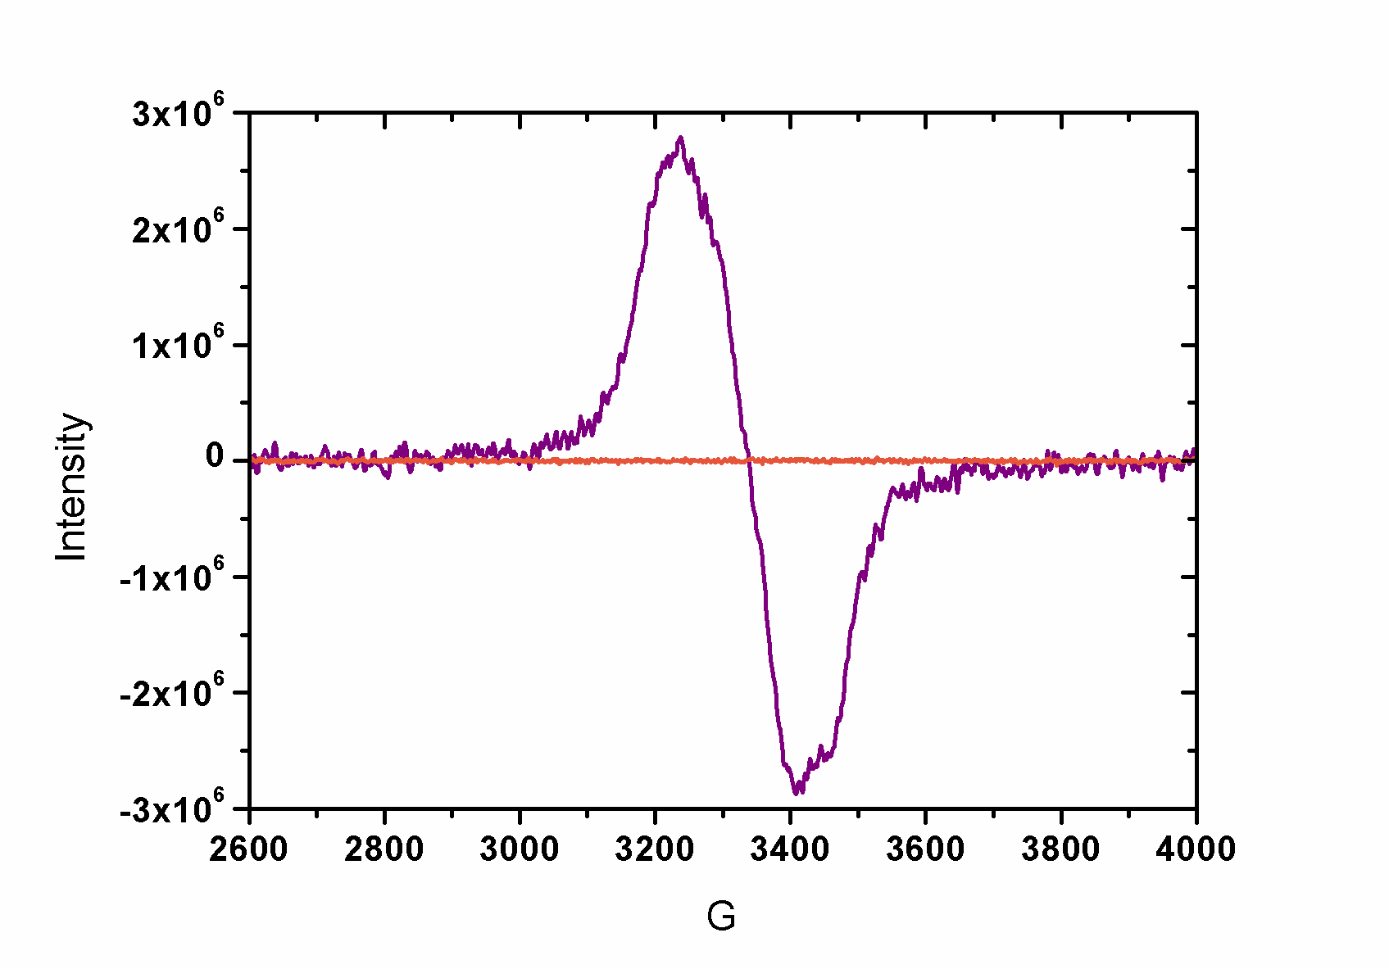
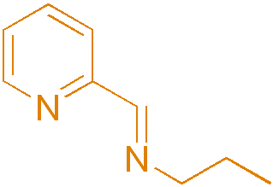
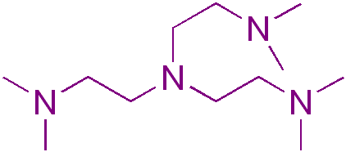
EPR Studies of SET-LRP System
EPR with N-(n-ethyl)-2-pyridylmethanimine ligand in IPA
- As a control the same experiment was repeated
with a pyridine imine type ligand
- Results showed no Cu(II) present
Investigation of SET-LRP
1
18

Slide 17
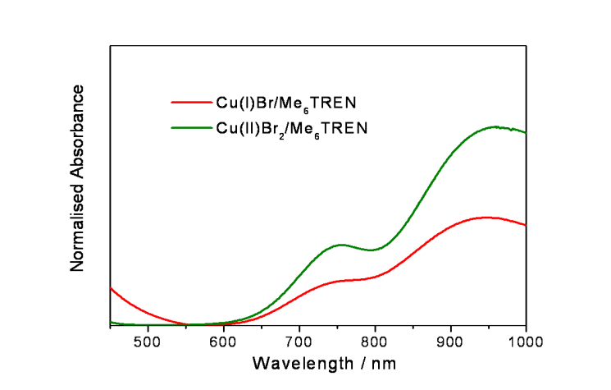
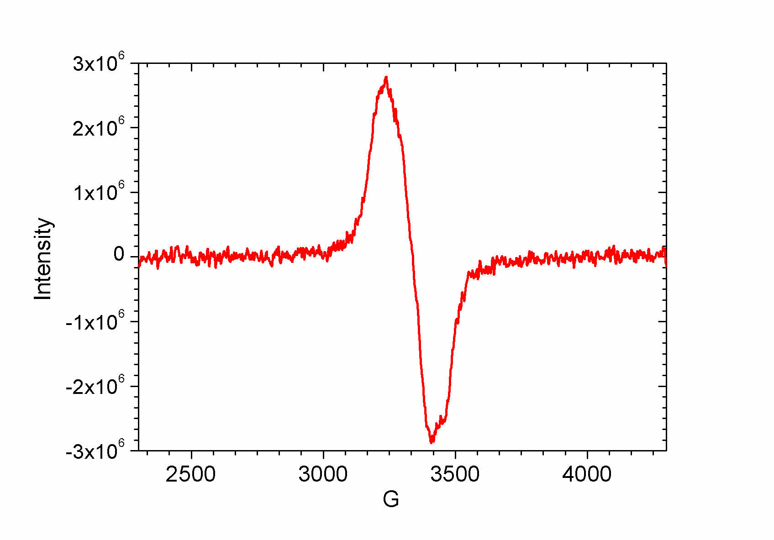
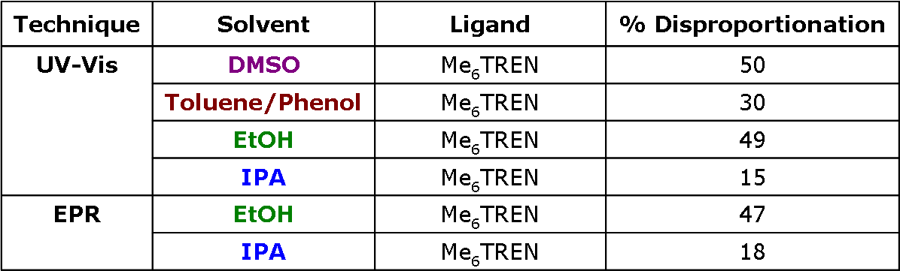
EPR Studies of SET-LRP System
UV-Vis
EPR
Comparison of Techniques
Investigation of SET-LRP
1
19

Slide 18
Outline
Polymerisation Cu(I) and Cu(0)
SET-LRP
Polymerisation in different solvents
Polymerisation of PEG containing monomers
Glycopolymers from CCTP and double click chemistry
One pot LRP and click
Thiol-activated alkene click to peptide conjugates (sCT)
Hyperbranched polymers with functional coronas from thiol-alkene click and CCTP

Slide 19
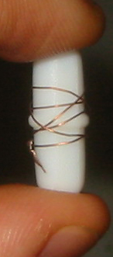
Cu(0) mediated Polymerisations
Traditional polymerisation system used at Warwick:
Reaction performed above ambient (~30-90ºC)
Poor control in aqueous/polar media
Alternative
Cu(0) catalytic system
Polymerisations performed at ambient
>90% and PDi < 1.2 often attainable within an hour
Simplified Polymer workup
Percec et. al. J. Amer. Chem. Soc. (2006), 128(43), 14156-14165
Notes:
16700 Students
Includes visiting and exchange students (heads) and HEFP students in local colleges. Excludes students taught overseas and on external programmes.
3800 Staff
3000 full and part time, 800 casua, 96% non-academic staff live in Coventry. 3rd largest employer in Coventry area
£174.5 m turnover
For year ended July 2001, projected to rise to £222 m by 2004/05
Arts Centre
250,000 visits each year, 70% of audience from Coventry/Warwickshire, 67% self-generated income. £580,000 University subsidy to Arts Centre each year (not all grant)

Slide 20
Molecular Weight Control in Cu(0) -LRP of Methyl Acrylate in DMSO
Target M_{n} = 8600 at 100% conversion
M_{n} = 7710ª at 83% conversion ( 2 hours), PDi = 1.08
(a – against linear PMMA standards in CHCl₃)

Slide 21
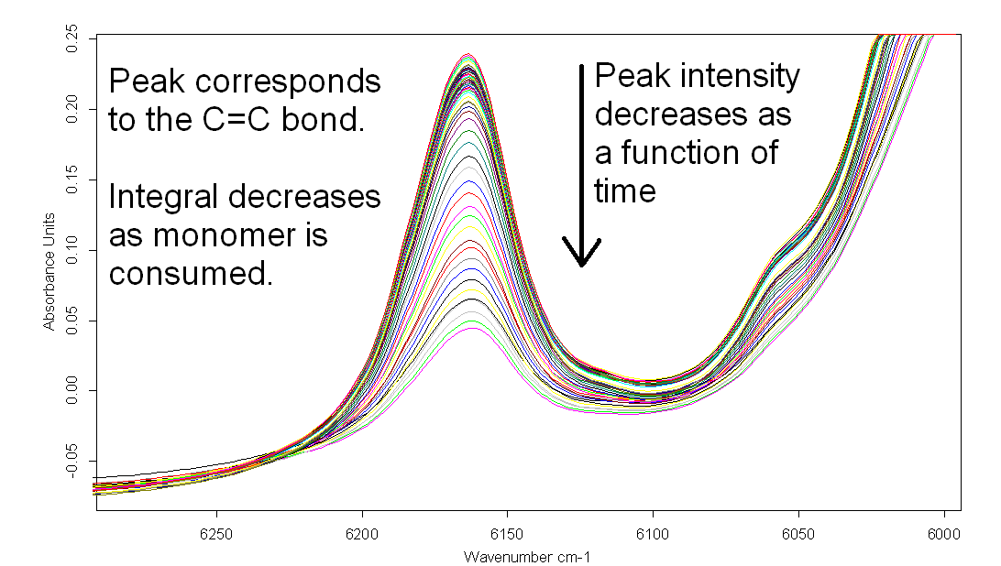
Monitoring Conversion via FT-NIR

Slide 22
SET-LRP of Methyl Acrylate in DMSO
Time / mins | % Conversion | Mn (theo.) / g mol⁻¹ | Mn (exp.) / g mol⁻¹ | PDi
116 | 83 | 7140 | 7760 | 1.09

Slide 23
Cu(0) Polymerisation of MA in non polar solvent

Slide 24
Use of METHANOL to mediate SET-LRP of MA
Notes:
16700 Students
Includes visiting and exchange students (heads) and HEFP students in local colleges. Excludes students taught overseas and on external programmes.
3800 Staff
3000 full and part time, 800 casua, 96% non-academic staff live in Coventry. 3rd largest employer in Coventry area
£174.5 m turnover
For year ended July 2001, projected to rise to £222 m by 2004/05
Arts Centre
250,000 visits each year, 70% of audience from Coventry/Warwickshire, 67% self-generated income. £580,000 University subsidy to Arts Centre each year (not all grant)

Slide 25
Use of alcohol additives to mediate SET-LRP
Notes:
16700 Students
Includes visiting and exchange students (heads) and HEFP students in local colleges. Excludes students taught overseas and on external programmes.
3800 Staff
3000 full and part time, 800 casua, 96% non-academic staff live in Coventry. 3rd largest employer in Coventry area
£174.5 m turnover
For year ended July 2001, projected to rise to £222 m by 2004/05
Arts Centre
250,000 visits each year, 70% of audience from Coventry/Warwickshire, 67% self-generated income. £580,000 University subsidy to Arts Centre each year (not all grant)

Slide 26
Effect of varying the wire surface area
30 cm wire
Powder in presence of CuBr2

Slide 27
Monitoring SET-LRP online

Slide 28
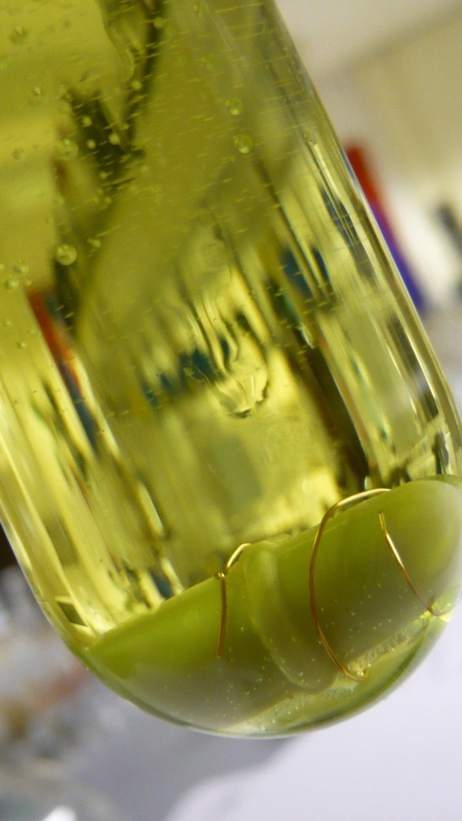
Effect of CuBr₂ on rate of conversion of MA

Slide 29
Rapid GPC analysis

Slide 30
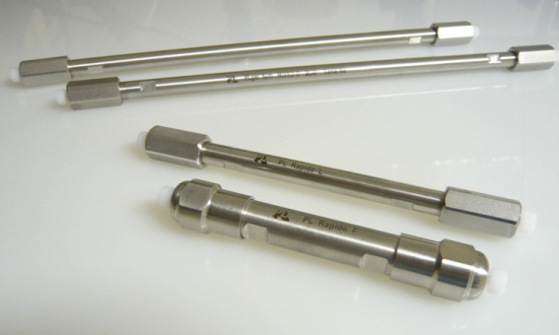
Online Monitoring via Rapid GPC
Notes:
16700 Students
Includes visiting and exchange students (heads) and HEFP students in local colleges. Excludes students taught overseas and on external programmes.
3800 Staff
3000 full and part time, 800 casua, 96% non-academic staff live in Coventry. 3rd largest employer in Coventry area
£174.5 m turnover
For year ended July 2001, projected to rise to £222 m by 2004/05
Arts Centre
250,000 visits each year, 70% of audience from Coventry/Warwickshire, 67% self-generated income. £580,000 University subsidy to Arts Centre each year (not all grant)

Slide 32
Outline
Polymerisation Cu(I) and Cu(0)
SET-LRP
Polymerisation in different solvents
Polymerisation of PEG containing monomers
Glycopolymers from CCTP and double click chemistry
One pot LRP and click
Thiol-activated alkene click to peptide conjugates (sCT)
Hyperbranched polymers with functional coronas from thiol-alkene click and CCTP

Slide 33
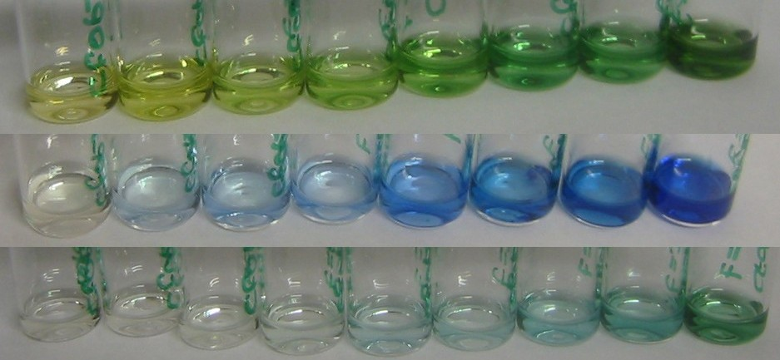
PEGMA with SETLRP
DMSO
Mn ~8000
PDI ~1.14
MeOH
^{i}PrOH
Notes:
16700 Students
Includes visiting and exchange students (heads) and HEFP students in local colleges. Excludes students taught overseas and on external programmes.
3800 Staff
3000 full and part time, 800 casua, 96% non-academic staff live in Coventry. 3rd largest employer in Coventry area
£174.5 m turnover
For year ended July 2001, projected to rise to £222 m by 2004/05
Arts Centre
250,000 visits each year, 70% of audience from Coventry/Warwickshire, 67% self-generated income. £580,000 University subsidy to Arts Centre each year (not all grant)

Slide 34
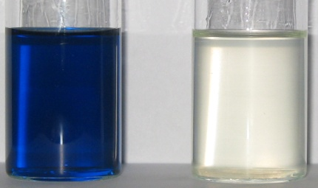
PEGMA with SETLRP
Following Cu(II) production by UV-VIS
Cu(0), PMDETA, PEGMA₄₇₅ and MeOH
Tungsten lamp and fibre optic
Copper reflections and stirrer vibrations
Notes:
16700 Students
Includes visiting and exchange students (heads) and HEFP students in local colleges. Excludes students taught overseas and on external programmes.
3800 Staff
3000 full and part time, 800 casua, 96% non-academic staff live in Coventry. 3rd largest employer in Coventry area
£174.5 m turnover
For year ended July 2001, projected to rise to £222 m by 2004/05
Arts Centre
250,000 visits each year, 70% of audience from Coventry/Warwickshire, 67% self-generated income. £580,000 University subsidy to Arts Centre each year (not all grant)

Slide 35
PEGMA with SETLRP
Detector saturation at t~3 h
Data only attainable up to 40 % monomer conversion
Cu(II) increase
Notes:
16700 Students
Includes visiting and exchange students (heads) and HEFP students in local colleges. Excludes students taught overseas and on external programmes.
3800 Staff
3000 full and part time, 800 casua, 96% non-academic staff live in Coventry. 3rd largest employer in Coventry area
£174.5 m turnover
For year ended July 2001, projected to rise to £222 m by 2004/05
Arts Centre
250,000 visits each year, 70% of audience from Coventry/Warwickshire, 67% self-generated income. £580,000 University subsidy to Arts Centre each year (not all grant)

Slide 36
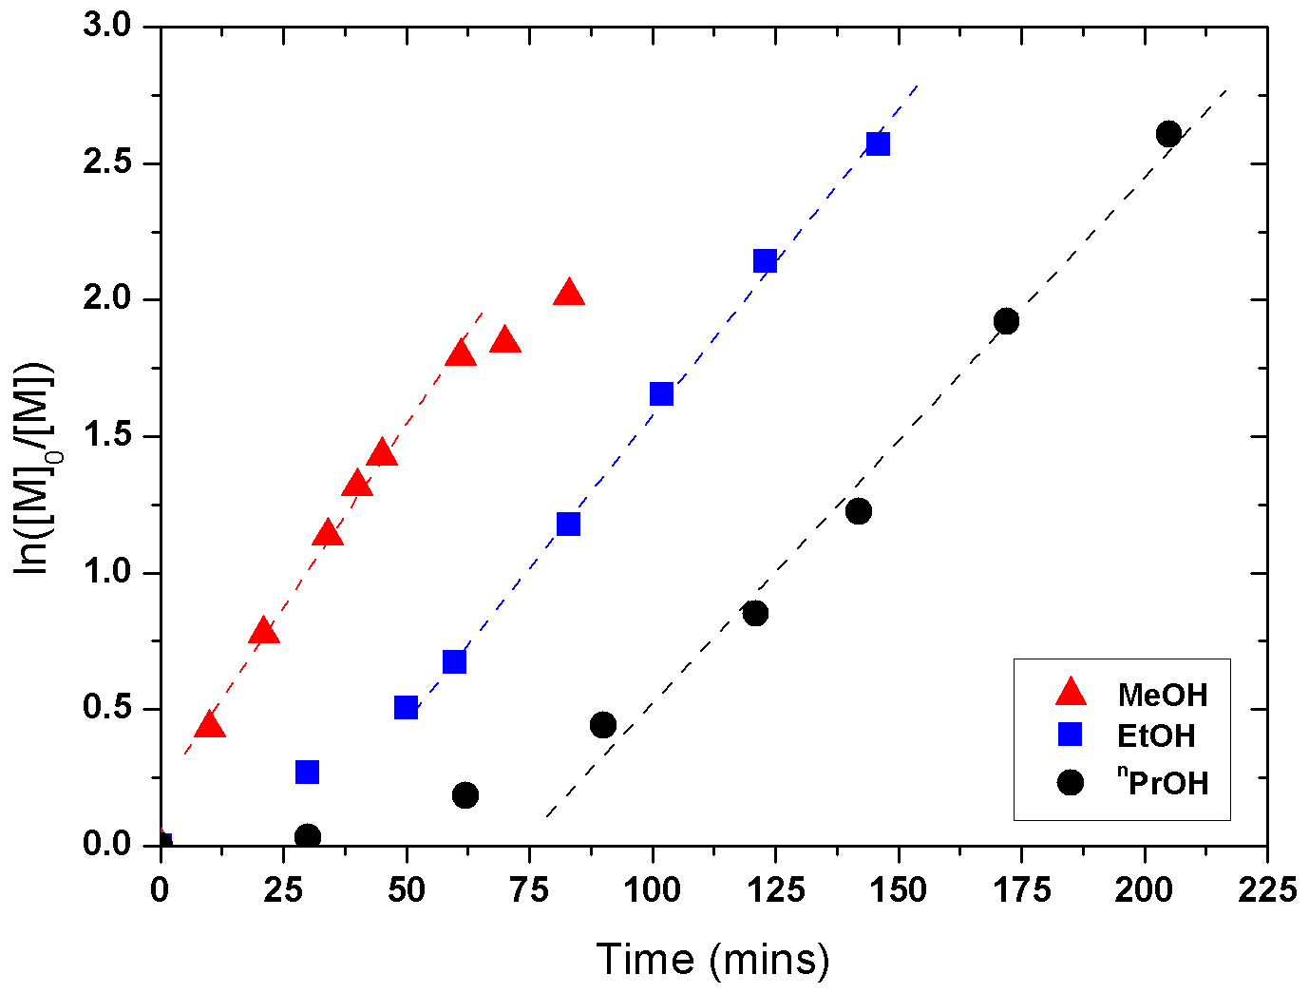
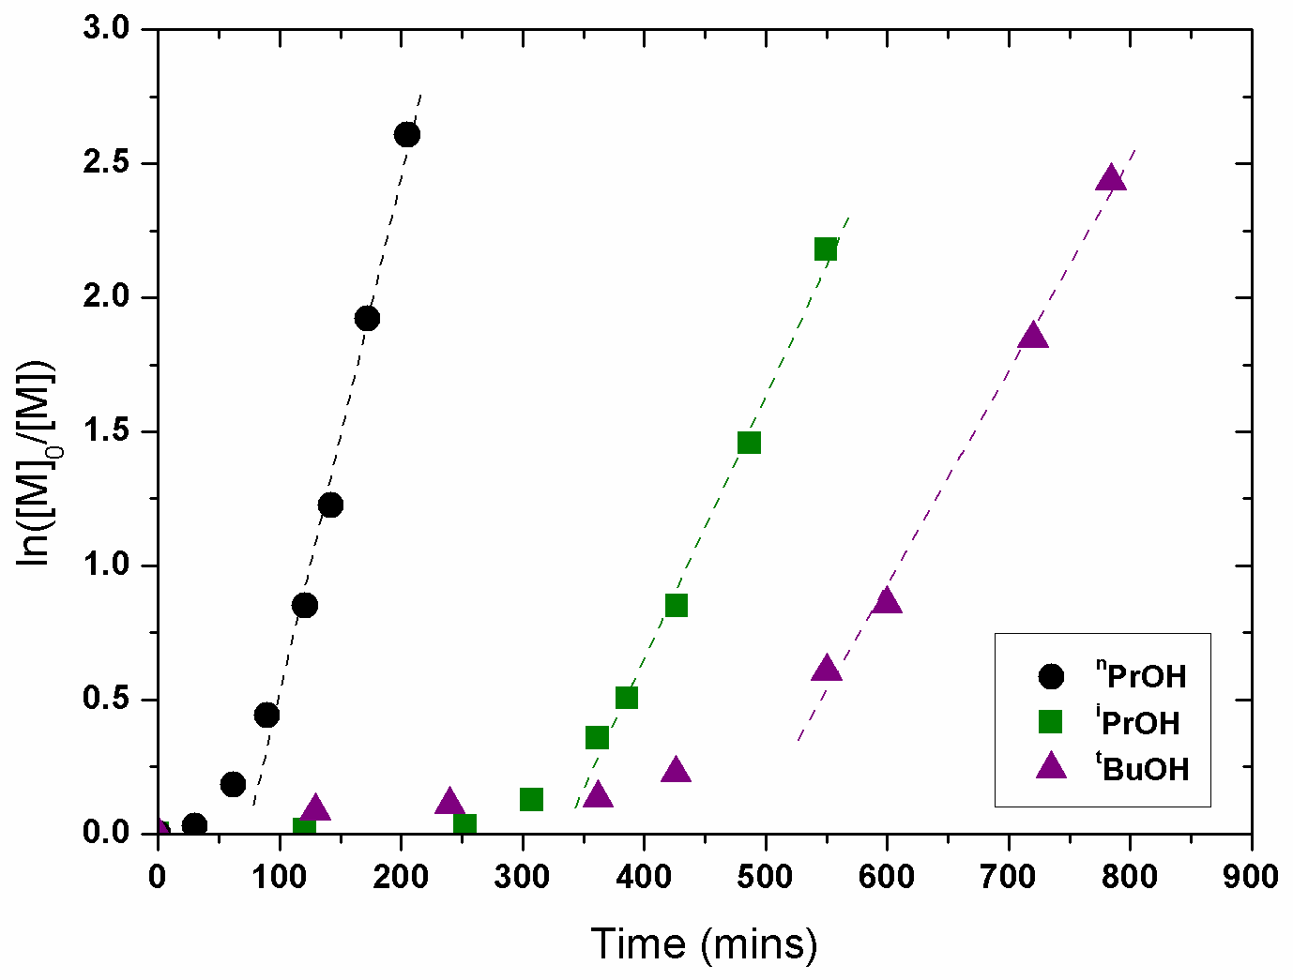
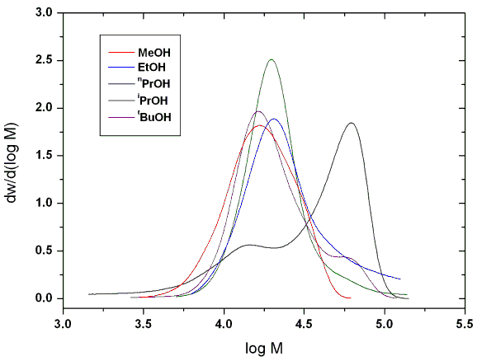
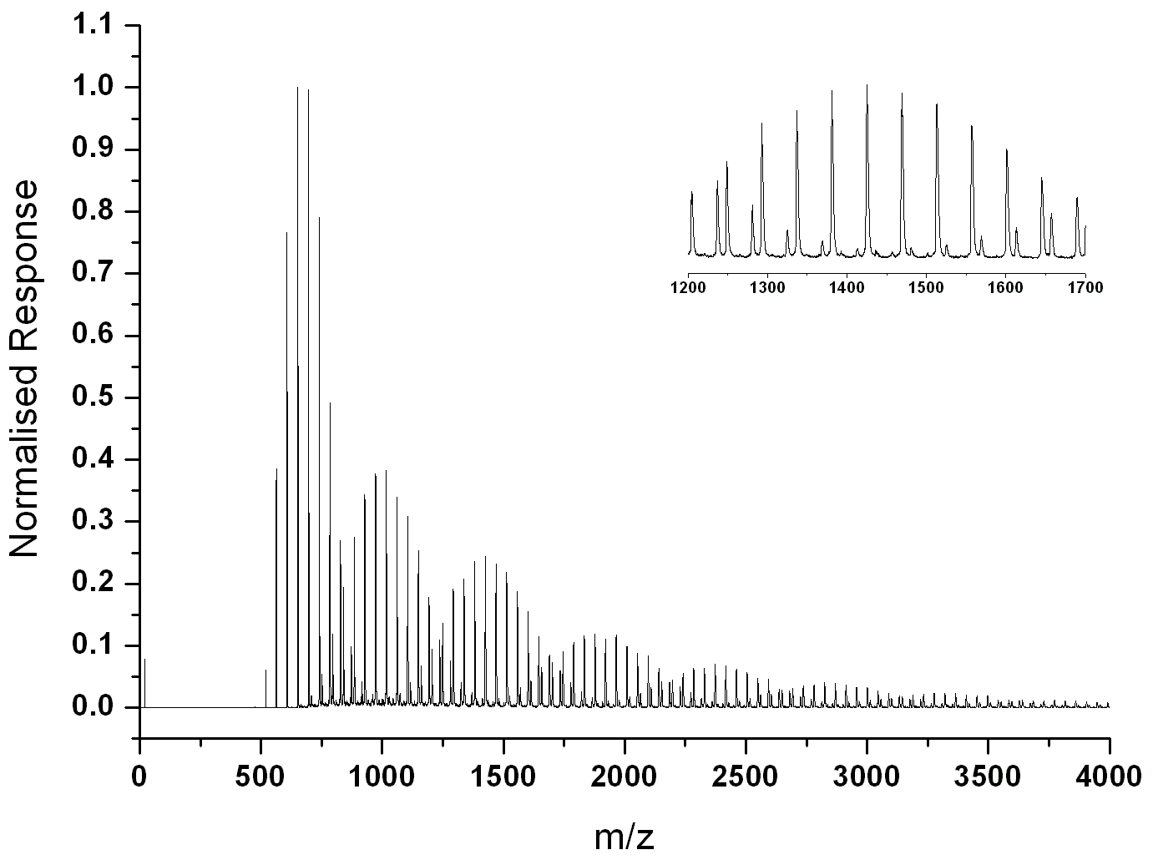
Cu(0)-catalysed polymerisation of PEGMA₄₇₅
[Cu(0)]:[I]:[L]:[Mes]:[PEGMA₄₇₅] = 1/1/1/15/30.L = PMDETA

Slide 37
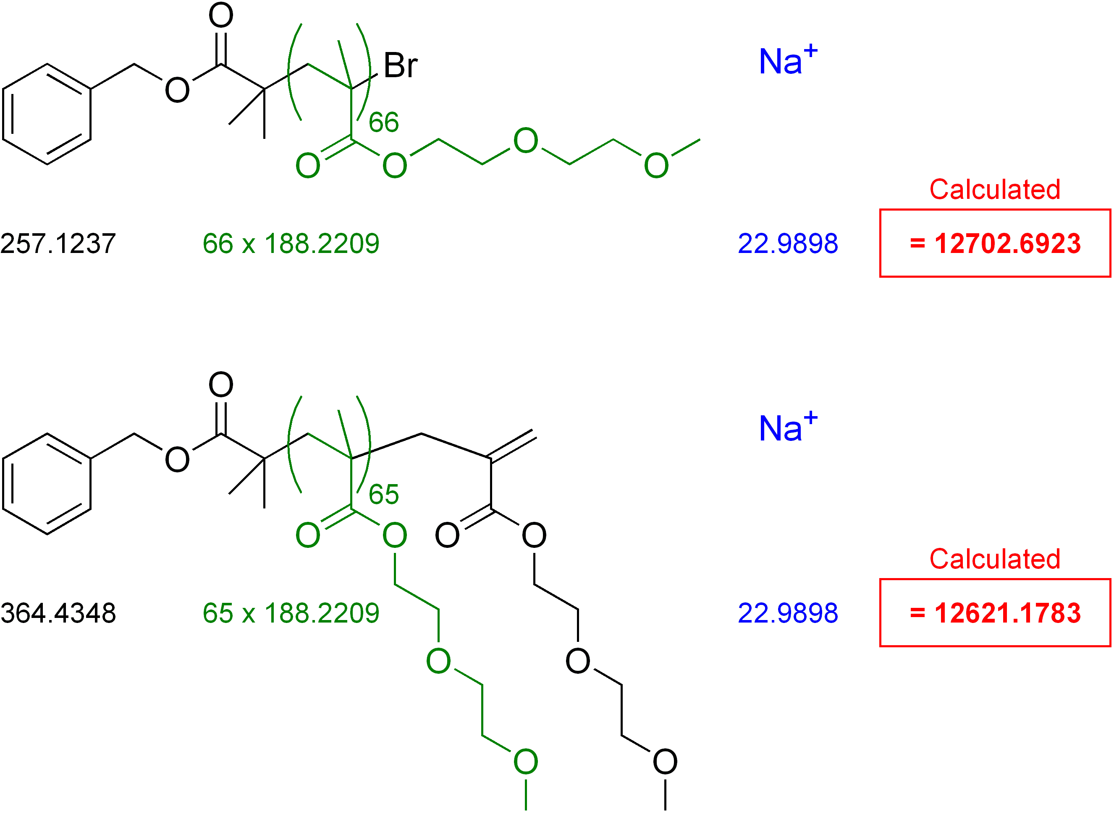
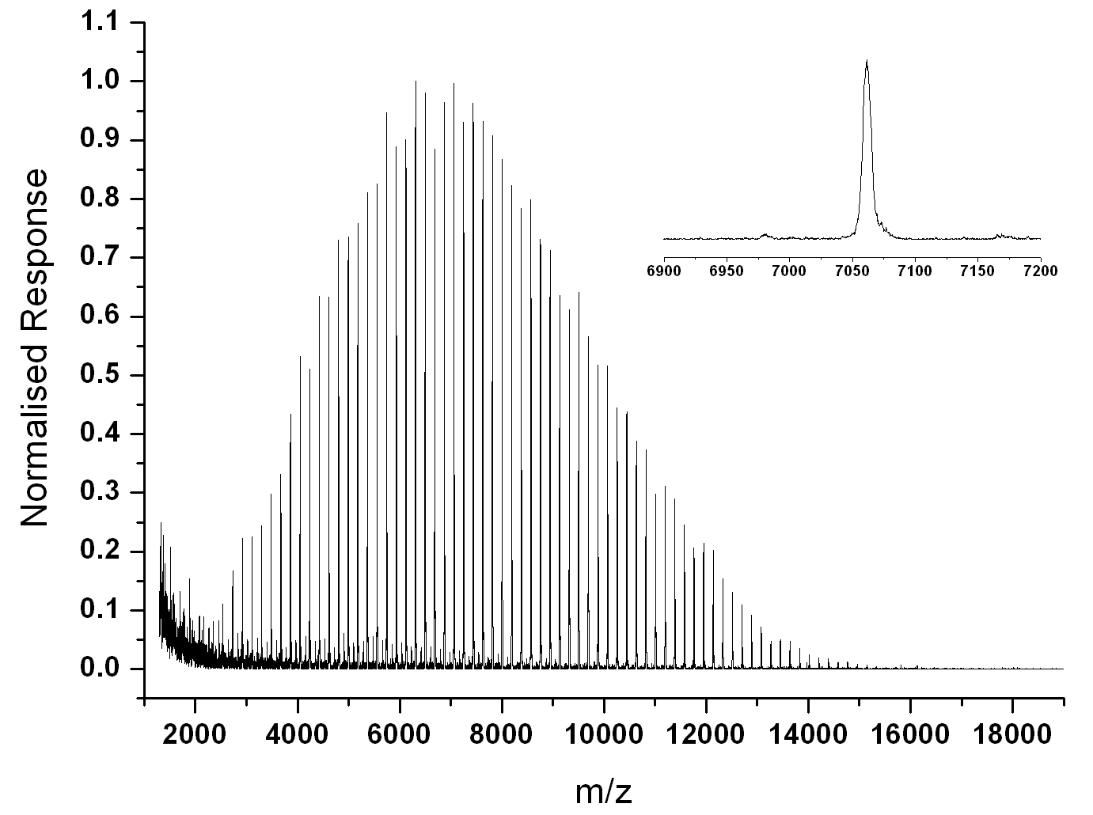
DEGMEMA with Cu(0)
Repeat Units | Theoretical Mass (Da) | Actual Mass (Da) | Difference (ppm)
64 | 12326.250 | 12326.892 | 52
65 | 12514.471 | 12514.825 | 28
66 | 12702.692 | 12702.601 | 7

Slide 38
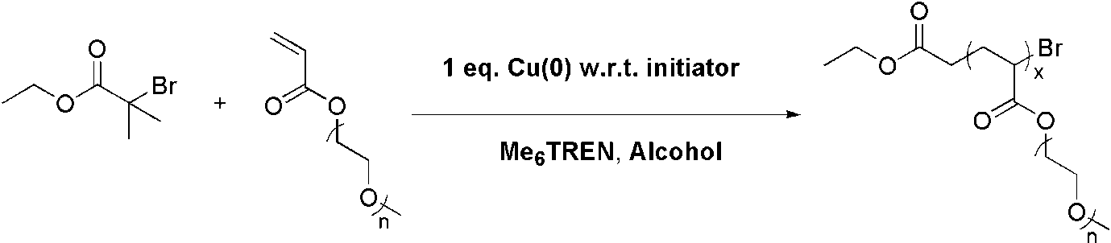
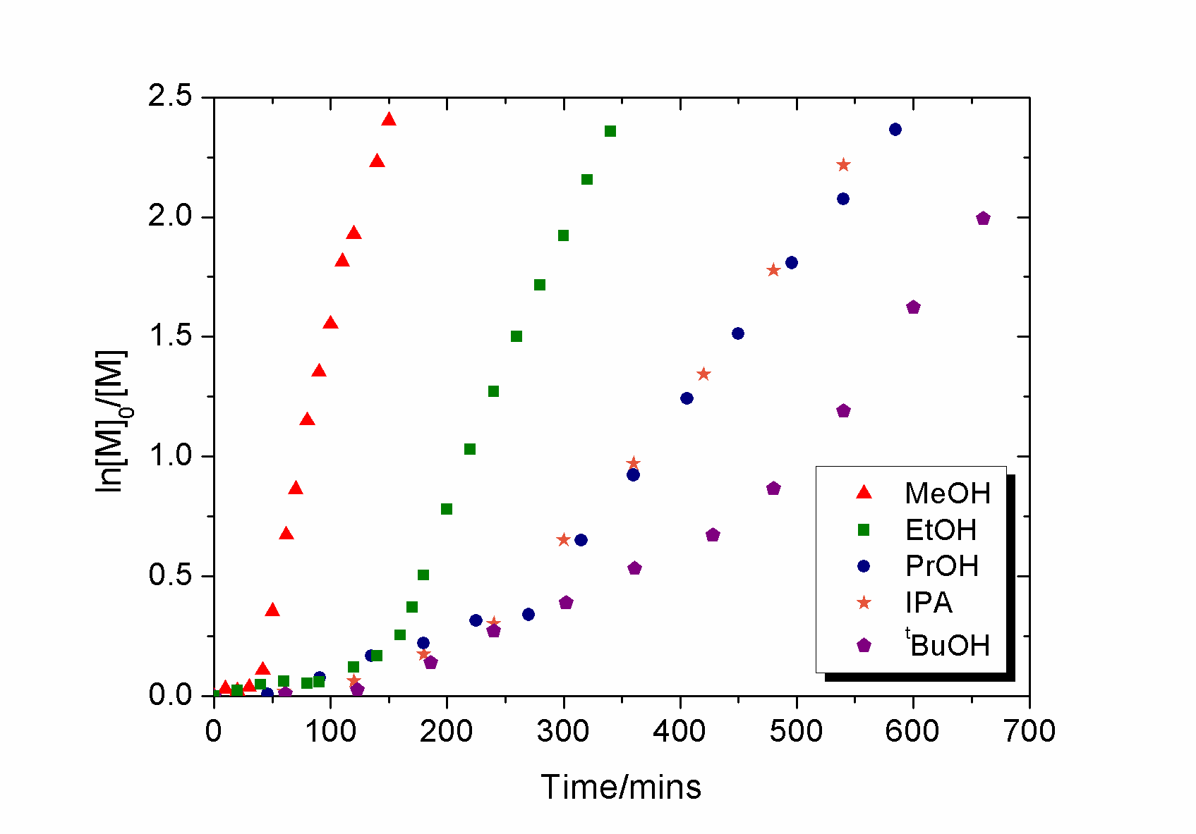
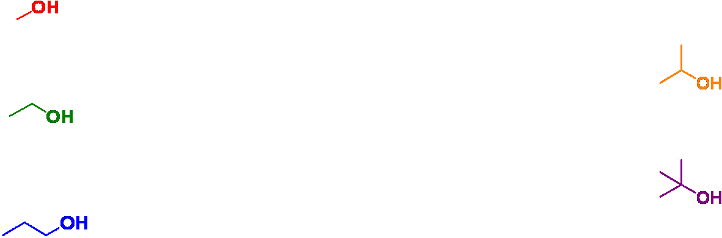
PEG Monomers and SET-LRP
Polymerisation of PEGA₄₅₄ in selected alcohols
Investigation of SET-LRP
1
22

Slide 39
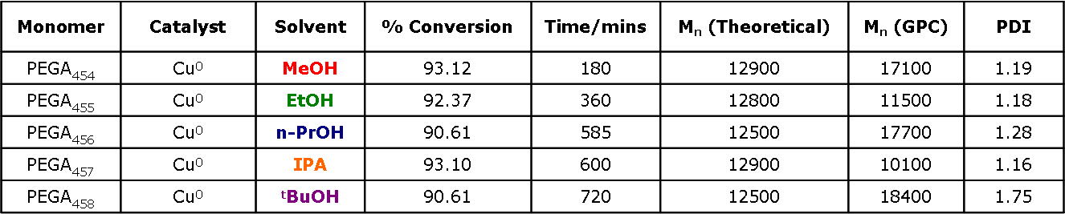
PEG Monomers and SET-LRP
Polymerisation of PEGA₄₅₄ in selected alcohols
Investigation of SET-LRP
1
23

Slide 40
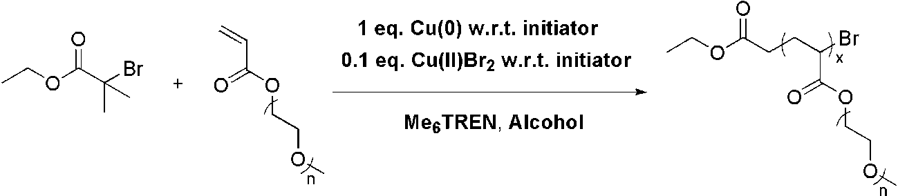
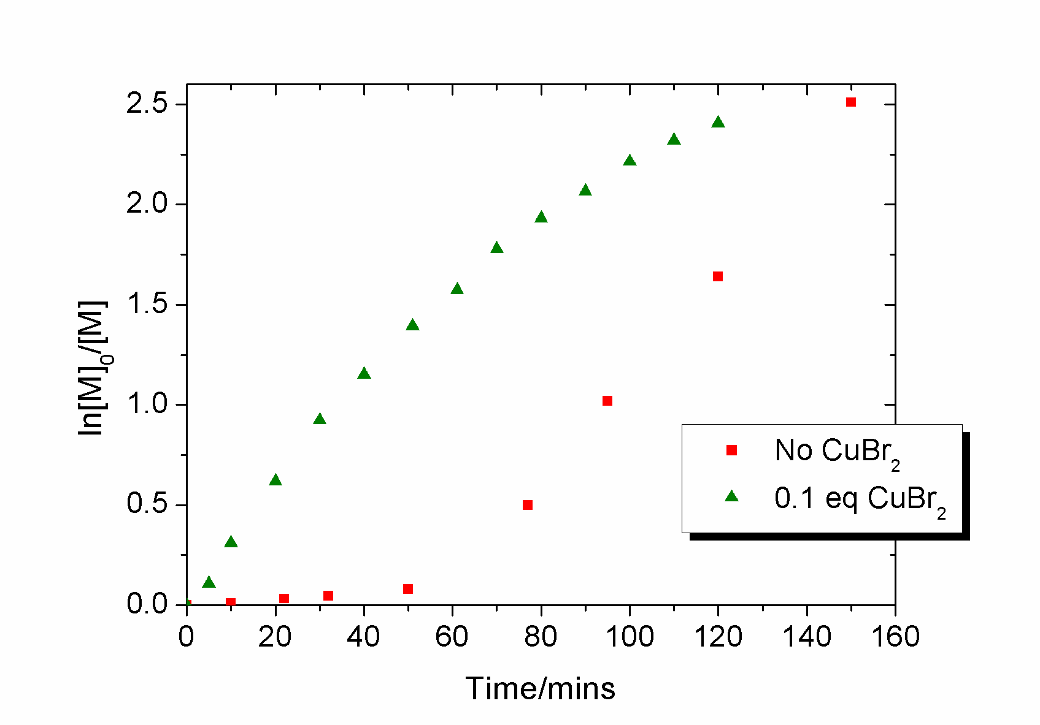
PEG Monomers and SET-LRP
Polymerisation of PEGA₄₅₄ in MeOH with Cu(0) and Cu(II)Br₂ additive
Investigation of SET-LRP
1
24

Slide 41

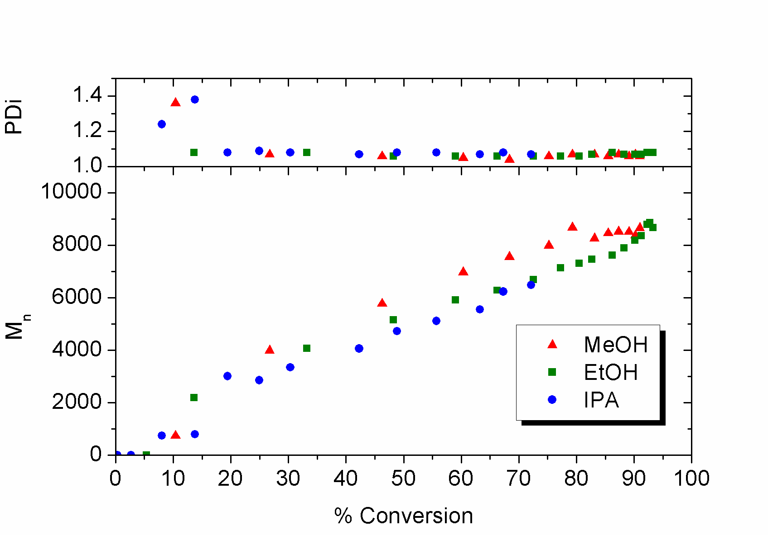
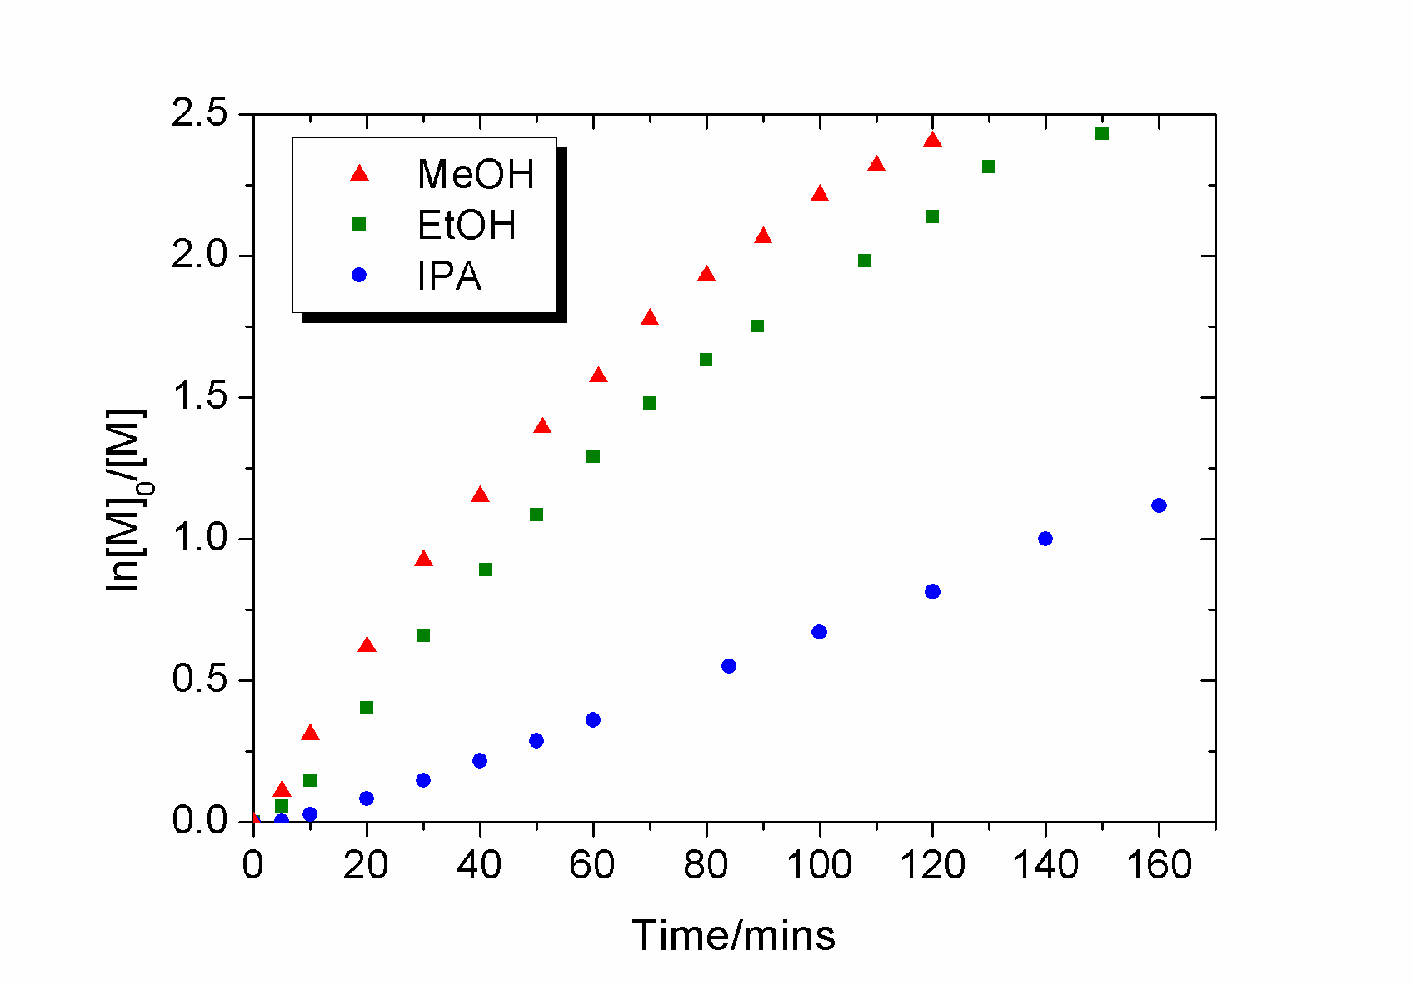
PEG Monomers and SET-LRP
Polymerisation of PEGA₄₅₄ in selected alcohols with Cu(II) additive
Investigation of SET-LRP
1
25

Slide 42

PEG Monomers and SET-LRP
Polymerisation of PEGA₄₅₄ in selected alcohols with Cu(II) additive
Investigation of SET-LRP
1
26

Slide 43



Analysis by GPC
Polymerisation of PEGA₄₅₄ in selected alcohols with Cu(II) additive
GPC traces are characteristic of well controlled LRPs
T = time(mins)
Methanol Ethanol IPA
Investigation of SET-LRP
1
28

Slide 44
Outline
Polymerisation Cu(I) and Cu(0)
SET-LRP
Polymerisation in different solvents
Polymerisation of PEG containing monomers
Glycopolymers from CCTP and double click chemistry
One pot LRP and click
Thiol-activated alkene click to peptide conjugates (sCT)
Hyperbranched polymers with functional coronas from thiol-alkene click and CCTP

Slide 45
Two independent synthetic routes to glycoconjugates
Haddleton, Geng, Mantovani et. al. JACS 2007; 129(49); 15156-15163

Slide 46


Clicking of sterically hindered lactose azide
Difficult to get full functionalisation: both ligand and sugar azide are quite bulky
Haddleton, Lindqvist, Mantovani, Geng, QSAR 2007, 11-12, 2007, 1220-1228

Slide 47




Online NMR clicking for optimisation
time (min)
sugar region
T = 50 °C
Haddleton, Lindqvist, Mantovani, Geng, QSAR 2007, 11-12, 2007, 1220-1228

Slide 48


Ricinus Communis Agglutinin I (RCA I) as a recognition test
120 kDa dimeric lectin isolated from Ricinus communis (castor bean), interact selectively with galactose epitopes
Immobilised RCA I employed as stationary phase for affinity chromatography
Galactose polymer
Lactose polymer
Conditions: 66.7 mM PBS (pH 7.4), 150 mM NaCl, ambient temperature.
Different concentrations of D-galactose in the mobile phase were employed in each run.
Haddleton, Lindqvist, Mantovani, Geng, QSAR 2007, 11-12, 2007, 1220-1228

Slide 49

Simultaneous Cu(I)-catalysed CuAAC and ATRP
Geng, J.; Lindqvist, J.; Mantovani, G.*; Haddleton, D. M.* Angew. Chem. Int. Ed. 2008

Slide 50
Click Vs Polymerization in Different Solvents
Lindqvist, J.; Mantovani, G.; Haddleton, D. M.

Slide 51




Simultaneous Cu(I)-catalysed CuAAC and ATRP
Lindqvist, J.; Mantovani, G.; Haddleton, D. M.

Slide 52
Outline
Polymerisation Cu(I) and Cu(0)
SET-LRP
Polymerisation in different solvents
Polymerisation of PEG containing monomers
Glycopolymers from CCTP and double click chemistry
One pot LRP and click
Thiol-activated alkene click to peptide conjugates (sCT)
Hyperbranched polymers with functional coronas from thiol-alkene click and CCTP

Slide 53
Thio-Michael Addition without radical initiator
Bowman, C. N. Polymer 2007, 48, 2014 and Hoyle, Lowe
Notes:
16700 Students
Includes visiting and exchange students (heads) and HEFP students in local colleges. Excludes students taught overseas and on external programmes.
3800 Staff
3000 full and part time, 800 casua, 96% non-academic staff live in Coventry. 3rd largest employer in Coventry area
£174.5 m turnover
For year ended July 2001, projected to rise to £222 m by 2004/05
Arts Centre
250,000 visits each year, 70% of audience from Coventry/Warwickshire, 67% self-generated income. £580,000 University subsidy to Arts Centre each year (not all grant)

Slide 54
¹H NMR; PEGMA + 2-Mercaptoethanol / DMPP
G Rees, R Randev, M Jones
Notes:
16700 Students
Includes visiting and exchange students (heads) and HEFP students in local colleges. Excludes students taught overseas and on external programmes.
3800 Staff
3000 full and part time, 800 casua, 96% non-academic staff live in Coventry. 3rd largest employer in Coventry area
£174.5 m turnover
For year ended July 2001, projected to rise to £222 m by 2004/05
Arts Centre
250,000 visits each year, 70% of audience from Coventry/Warwickshire, 67% self-generated income. £580,000 University subsidy to Arts Centre each year (not all grant)

Slide 55
MALDI: PEGA + 2-Mercaptoethanol / ^{n}C₅H₉NH₂
78 Da
G Rees, R Randev, M Jones
Notes:
16700 Students
Includes visiting and exchange students (heads) and HEFP students in local colleges. Excludes students taught overseas and on external programmes.
3800 Staff
3000 full and part time, 800 casua, 96% non-academic staff live in Coventry. 3rd largest employer in Coventry area
£174.5 m turnover
For year ended July 2001, projected to rise to £222 m by 2004/05
Arts Centre
250,000 visits each year, 70% of audience from Coventry/Warwickshire, 67% self-generated income. £580,000 University subsidy to Arts Centre each year (not all grant)

Slide 56
Rates of Conversion; PEGMA + 2-ME with 5 wt% DMPP / TBP / ^{n}C₅H₉NH₂ / ^{n}C₇H₇NH₂
G Rees, R Randev
Notes:
16700 Students
Includes visiting and exchange students (heads) and HEFP students in local colleges. Excludes students taught overseas and on external programmes.
3800 Staff
3000 full and part time, 800 casua, 96% non-academic staff live in Coventry. 3rd largest employer in Coventry area
£174.5 m turnover
For year ended July 2001, projected to rise to £222 m by 2004/05
Arts Centre
250,000 visits each year, 70% of audience from Coventry/Warwickshire, 67% self-generated income. £580,000 University subsidy to Arts Centre each year (not all grant)

Slide 57
Reaction with 2–(acryloyloxy)ethyl methacrylate
2 – (acryloyloxy)ethyl methacrylate + 2-ME / ^{n}C₅H₉NH₂
G Rees, R Randev
Notes:
16700 Students
Includes visiting and exchange students (heads) and HEFP students in local colleges. Excludes students taught overseas and on external programmes.
3800 Staff
3000 full and part time, 800 casua, 96% non-academic staff live in Coventry. 3rd largest employer in Coventry area
£174.5 m turnover
For year ended July 2001, projected to rise to £222 m by 2004/05
Arts Centre
250,000 visits each year, 70% of audience from Coventry/Warwickshire, 67% self-generated income. £580,000 University subsidy to Arts Centre each year (not all grant)

Slide 58
HBA
DEAEA
DEAEMA
HBA +RSH, 1 day
DEAEA +RSH,1.5h
DEAEMA+RSH, 2days
HBA +RSH+TEA, 1h
DEAEA +RSH, 3.5h
DEAEMA+RSH, 6days

Slide 59

Salmon Calcitonin and Determination of the polymer attachment site
Tryptic digestion of sCT derivatives
¹Cys-¹¹Lys 1120.53 Da
¹²Leu-¹⁸Lys 853.96 Da
¹⁹Leu-²⁴Arg 776.42 Da
²⁵Thr-³²Pro 732.34 Da

Slide 60




Thiol Conjugation

Slide 61
Phosphine-Mediated One-Pot Thiol-Ene “Click”
Approach to Polymer-Protein Conjugates
M Jones

Slide 62
Polymer-Protein Conjugates via a “Grafting To” Approach
RP-HPLC Analysis
S-S Reduction
Quantitative reduction observed after 10 mins
Thiol-ene Click
Quantitative conversion to di-PEGylated sCT in 1.5 hours
M Jones

Slide 63
Polymer-Protein Conjugates via a “Grafting To” Approach
MALDI-TOF Analysis
M Jones

Slide 64
Polymer-Protein Conjugates via a “Grafting To” Approach
Tryptic Digest with MALDI-TOF Analysis
Trypsin digest of conjugate reveals complete selectivity towards cysteine residues and conjugation at both cysteine residues.
M Jones

Slide 65
Bioactivity of Conjugates from the “Grafting To” Approach
In Vitro Testing of Conjugates
In Vivo Testing of Conjugates
M Jones

Slide 66
Polymer-Protein Conjugates via a “Grafting From” Approach
Protein Macroinitiator Synthesis
ATRP / SET-LRP
M Jones

Slide 67
Polymer-Protein Conjugates via a “Grafting From” Approach
Protein Macroinitiator Synthesis
(-HBr)
M Jones

Slide 68
Polymer-Protein Conjugates via a “Clicking To” Approach
Facile introduction of clickable units into a protein’s structure
CuAAC
M Jones

Slide 69
Polymer-Protein Conjugates via a “Clicking To” Approach
Facile introduction of clickable units into a protein’s structure
M Jones

Slide 70
Catalytic Chain Transfer Polymerisation (CCTP)
Certain Low-Spin Cobalt Complexes
Typical [Mon]/[Co] ratio of ca. 10⁶
C_{s} =40,000 cf RSH = 1
CoBF
CCTP of MMA using CoBF at 60ºC

Slide 71
L Nurmi, J Lindqvist: Chem Comm, 2009

Slide 72
Polymer-Protein Conjugates via a “Grafting To” Approach
“Thiol-ene click” of Cysteine Residues to CCT Macromonomers
M Jones

Slide 73
Polymer-Protein Conjugates via a “Grafting To” Approach
“Thiol-ene click” of Cysteine Residues to CCT Macromonomers
K Amos, M Jones

Slide 74
Outline
Polymerisation Cu(I) and Cu(0)
SET-LRP
Polymerisation in different solvents
Polymerisation of PEG containing monomers
Glycopolymers from CCTP and double click chemistry
One pot LRP and click
Thiol-activated alkene click to peptide conjugates (sCT)
Hyperbranched polymers with functional coronas from thiol-alkene click and CCTP

Slide 75
CCTP of Ethylene Glycol DimethAcrylate (EGDMA)
Polymerization preparation (oil bath 70˚C)
5 ml EGDMA
5 ml 1,2-dichloroethane
0.005 g CoBF
0.05 g dimethyl 2,2- azobis(2-methylpropionate)
(V-601)
J Menzel and K McKeown

Slide 76
J Menzel and K McKeown

Slide 77
Overlay of GPC data
J Menzel and K McKeown

Slide 78
GPC traces of P(EGDMA)
J Menzel and K McEwan

Slide 79
Michael-Addition of thiols
J Menzel and K McKeown

Slide 80

Acknowledgements
Dr Giuseppe Mantovani All
Dr Josefina Lindqvist Glyco
Dr Anne De-Cuendias SET
Dr Tomasz Kreft ACOMP
M Jones Conj
R Randev Conj
K Amos Conj
J Menzel Thiol
K McEwan ACOMP/Thiol
Jin Geng Glyco
Y Gou Glyco
G Li Thiol
G Rayner EPR
G Rees Thiol
Dr Vincent Ladmiral (UNSW) Glyco
Dr Martin Levere SET
Dr Chris Fidge SET
Dr Peter Wright SET
Anthony Grice SET
Leena Nurmi (HTU) Glyco
Dr Claire Sayers Conj
Prof David Brayden (UCD) Animal
Sinead Walsh (UCD) Animal
EU
EPSRC
Lubrizol
Warwick Effect Polymers
Unilever
Polymer Laboratories (Varian)
Syngenta

Slide 81
Glycopolymers via catalytic chain transfer polymerisation and double click reactions
Single electron transfer living radical polymerisation
SET-LRP
David Haddleton
University of Warwick,UK
IUPAC Chemical Congress August 2009, Glasgow

