Slide 1
Application of in silico methods to antimicrobial drug discovery
Dr Ricky Cain
Mathematics for Real-World Systems Summer School
5th July 2016

Slide 2
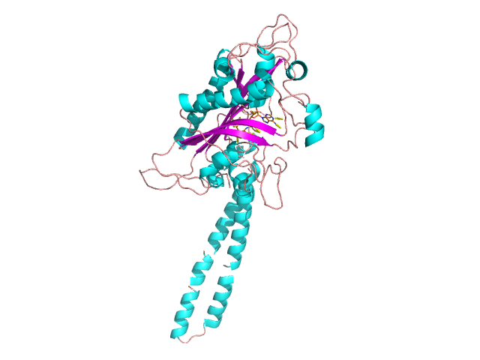
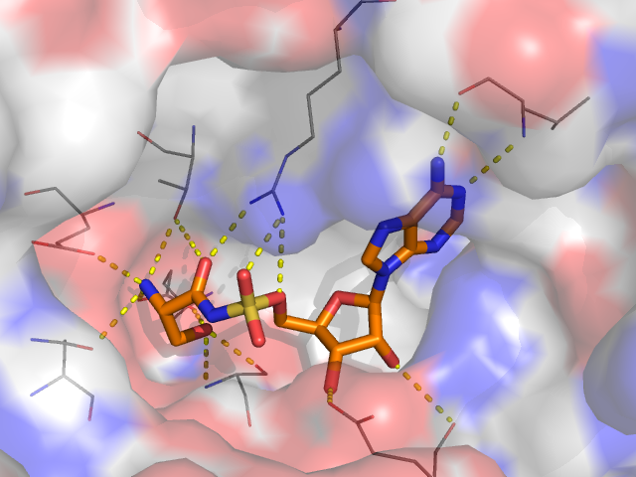
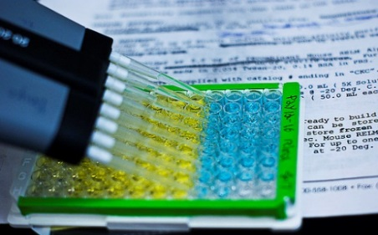
What is Structure based drug discovery (SBDD)
Virtual High-throughput Screening (vHTS)
Compound
libraries
Synthesis
Putative
Inhibitors
Structural
refinement
De novo molecular design

Slide 3
Why structure-based drug discovery (SBDD)?
Cost:
  Structure based drug design is much cheaper than other current methods including HTS and genomics based approaches. Only need to make the few identified hits
Space:
  Much smaller amount of space required than for large physical libraries of compounds
Time:
  Often much quicker than standard screens and able to screen millions of compounds
SBDD is being used more frequently for antimicrobial drug discovery which has been seen as not the most attractive/profitable field by “big pharma”
Ricky Cain¹, Sarah Narramore¹, Martin McPhillie, Katie Simmons, Colin W.G. Fishwick. Bioorganic Chemistry, 2014, 55, 69-76
Katie Simmons, Ian Chopra, Colin W. G. Fishwick, Nature Reviews Microbiology, 2010, 8, 501-510

Slide 4
Structure-based drug discovery (SBDD)
Identifying a suitable target
An antimicrobial-drug target should be essential, have a unique function in the pathogen and exhibit an activity that can be altered by small molecules.
Programs including SiteMap are available which help to identify potential binding sites within a given protein.
The Protein Data Bank is often the source of many known structures.
However, for a large number of new targets, a homology model is often necessary providing that a crystal structure is available for a protein with substantial sequence similarity.
SWISS-MODEL and PHYRE2 have been designed to automate the process of making a homology model.
Ricky Cain¹, Sarah Narramore¹, Martin McPhillie, Katie Simmons, Colin W.G. Fishwick. Bioorganic Chemistry, 2014, 55, 69-76
Katie Simmons, Ian Chopra, Colin W. G. Fishwick, Nature Reviews Microbiology, 2010, 8, 501-510

Slide 5
Structure-based drug discovery (SBDD)
There are three main methods of SBDD
Structure and known inhibitor design
  Known inhibitor or co-factor is modified to improve binding affinity or selectivity
Virtual High Throughput Screening (vHTS)
  Docking of small molecules into the crystal structure which are scored and ranked
De novo design
  A molecule is designed from scratch to bind in the active site. Fragments are docked then joined to create full molecules. These molecules are then scored and ranked.
Ricky Cain¹, Sarah Narramore¹, Martin McPhillie, Katie Simmons, Colin W.G. Fishwick. Bioorganic Chemistry, 2014, 55, 69-76
Katie Simmons, Ian Chopra, Colin W. G. Fishwick, Nature Reviews Microbiology, 2010, 8, 501-510

Slide 6
Structure and known ligand modification
This approach takes a known inhibitor and structurally modifies it to give more potent inhibitors.
Programs which have been employed include SPROUT HitOpt and Maestro
Maestro is part of the Schrodinger software package and allows users to visualize the desired receptor in three-dimensional form. A surface of the molecule can be generated and any areas for possible expansion or modification of the inhibitor can be identified and modified within the package.
Much more visual modifications / more classical Med Chem approach.

Slide 7
Real life example – Design aminoacyl-tRNA synthetase inhibitors
Transcription

Slide 8
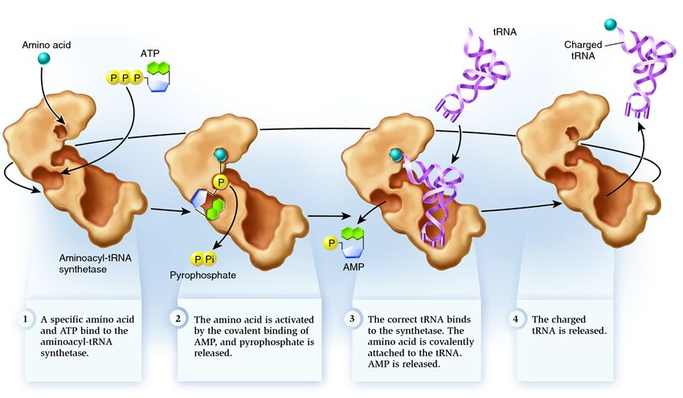
Real life example – Design aminoacyl-tRNA synthetase inhibitors
Aminoacyl t-RNA synthetases
Stiling, P., et al., Biology, McGraw-Hill Education, 2nd edition, 2010.

Slide 9
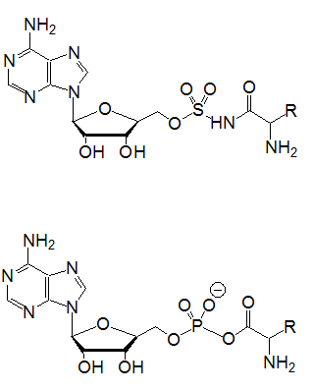
Aminoacyl sulfamoyl-adenosines (aaSA)
Potent aaRS inhibitors
Non-hydrolysable adenylate analogues
Non-selective inhibitors
Poor bioavailability
Structure of aminoacyl sulfamoyl adenosine
Structure of aminoacyl adenylate

Slide 10
Structural Overlays
Used Maestro to perform structure overlays to work out the degree of difference between the mammalian and bacterial enzymes
 | E. coli SerRS | S. aureus SerRS | Bovine SerRS | Human SerRS
E. coli SerRS |  | RMSD: 1.48 Alignment: 0.094 | RMSD: 2.63 Alignment: 0.2994 | RMSD: 1.84 Alignment: 0.1356
S. aureus SerRS |  |  | RMSD: 2.38 Alignment: 0.2445 | RMSD: 2.04 Alignment: 0.1665
Bovine SerRS |  |  |  | RMSD: 2.16 Alignment: 0.2041
Lower score is better

Slide 11
Virtual High-Throughput Screening (vHTS)
Rapid docking algorithms search databases of commercially available compounds in order to identify novel molecules predicted to bind to the chosen protein target.
Recent advancements in technology make this a fast and efficient process.
Libraries which are available for screening include:
  ZINC library (35 million compounds)
  Chemnavigator library (102 million compounds)
The identified putative inhibitors can be used to obtain a highly focused library of compounds.
Libraries generated using vHTS have been shown to give hit rates of 20–30%. Standard HTS give a hit rate of less than 1%

Slide 12



Virtual High-Throughput Screening (vHTS)
Docking programs include: AutoDock, Glide (Schrodinger), Gold, Dock, FRED and eHiTS.
Typically a library of ~100,000 compounds is docked using one of the docking programs.
Results ranked using a scoring function (more later)
The ‘top-slice’ of compounds are visually inspected to monitor synthetic accessibility, etc.

Slide 13
vHTS
100,000 Compounds
AutoDock Docking
100
Hit Identification
Compound Selection
10
Enzyme Assay
1 Active Compound
SAR/Analogue Synthesis
Lead Optimisation
Lead
Series

Slide 14
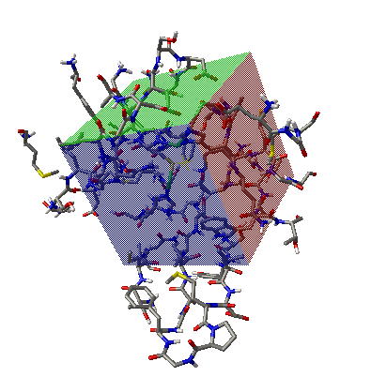
AutoDock
A grid box is defined by the user - docking takes place here
Results are shown in a bar chart form base upon the number of docking runs resulting in the same lowest energy pose (Clustering)

Slide 15
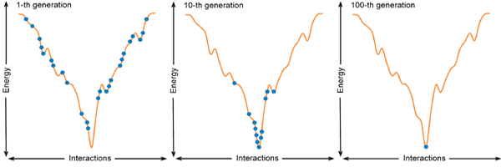
How does the docking work? – Genetic algorithms.
1st generation
10th generation
100th generation
Comes from the idea of parent and child genetics
Each generation is a learning process where the next round of docking poses is based upon the lowest energy poses from the previous round
Continues until the lowest energy minima is reached

Slide 16

How does the docking work? – Genetic algorithms – Fitness (Docked energy).
Pro-portional selection to decide which individuals will reproduce. Thus, individuals that have better-than-average fitness receive proportionally more offspring, in accordance with:
where n_{o} is the integer number of offspring to be allocated to the individual; f_{i} is the fitness of the individual i.e., the energy of the ligand; f_{w} is the fitness of the worst individual, or highest energy in the last N generations i.e., N is a user-definable parameter, typically 10 ; and <f> is the mean fitness of the population.

Slide 17
How does the docking work? – Genetic algorithms cont.
Because the worst fitness, f_{w} , will always be larger than either f_{i} or <f>,except when f_{i} = f_{w} , then for individuals that have a fitness lower than the mean, f_{i} < <f> , the numerator in this equation, f_{w} - f_{i} , will always be greater than the denominator f_{w} - <f> , and thus such individuals will be allocated at least one offspring, and thus will be able to reproduce. AutoDock checks for f_{w} = <f> beforehand, and if true, the population is assumed to have converged, and the docking is terminated.
Process is repeated a number of times defined by the user
Notes:
Because the worst fitness, fw , will always be larger than either fi or <f>,except when fi = fw , then for individuals that have a fitness lower than the mean, fi < <f> , the numerator in this equation, fw - fi , will always be greater than the denominator fw - <f> , and thus such individuals will be allocated at least one offspring, and thus will be able to reproduce. AUTODOCK checks for fw = <f> beforehand, and if true, the population is assumed to have converged, and the docking is terminated

Slide 18
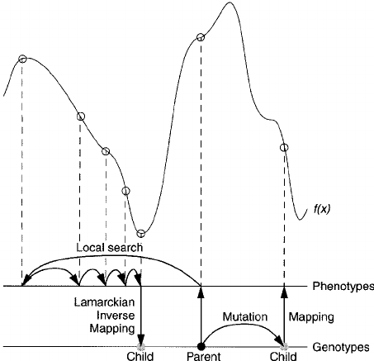
How does the docking work? – Lamarckian Genetic algorithms.
The hybrid of the Genetic algorithm (GA) method with the adaptive Local Search (LS) method together form the so-called Lamarckian genetic algorithm (LGA)
LGA , which has enhanced performance relative to simulated annealing and GA alone

Slide 19
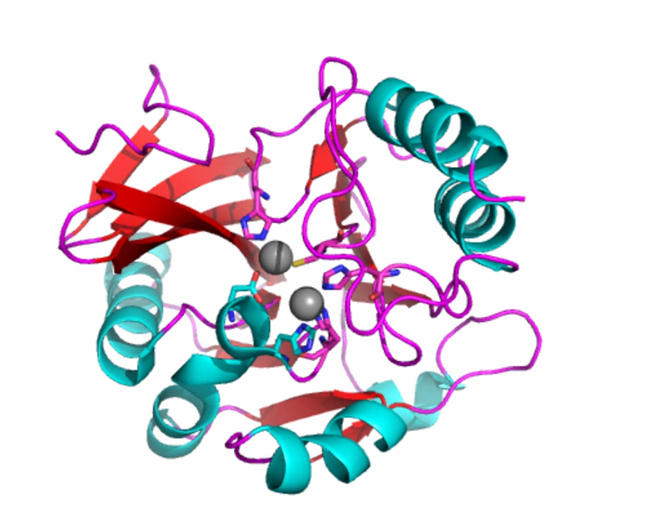
Real life example 2– Design of Metallo-β-lactamase inhibitors
Penam
Penicillin G
Carbapenem
Imipenem
Family of enzymes produced by bacteria to develop resistance against β-lactam antibiotics
Catalytically hydrolyse β-lactam antibiotics rendering them unable to inhibit peptidoglycan biosynthesis

Slide 20
Β-lactamases
Clavulanic acid
Serine-β-lactamase inhibitor
Inhibitors for the serine-β-lactamases are already in clinical trials
Metallo-β-lactamases use zinc atoms to ionise and co-ordinate a nucleophilic water to mediate hydrolysis
Currently no known clinically relevant inhibitors of the metallo-β-lactamases

Slide 21
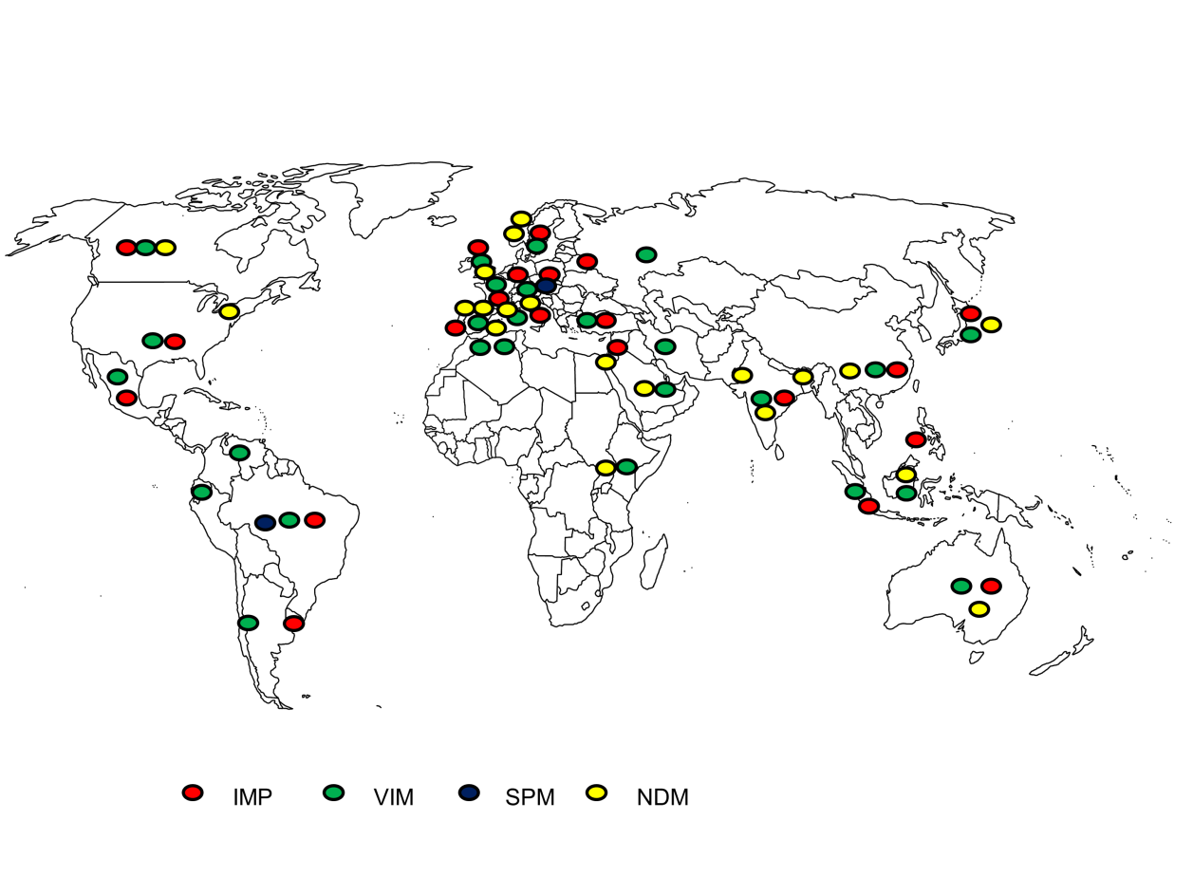
The spread of MBLs
New Delhi Metallo-β-lactamase (NDM)
Verona Integron-encoded Metallo-β-lactamase (VIM)
Imipenemase (IMP)
Sao Paulo Metallo-β-lactamase (SPM)

Slide 22
New Delhi Metallo-β-lactamase (NDM-1)
Broad spectrum β-lactamase that inactivates all β-lactams except aztreonam
First case reported in a Swedish patient who had previously been hospitalised in New Delhi in 2007
Only colistin and tigecycline have been shown to inhibit NDM-1 producers
Aztreonam
Colistin
Tigecycline
Notes:
colistin and tigecycline both polymyixins
Why so interested in NDM-1
Not restricted to a single strain of bacteria
E. coli
K. pneumonia
E. colcae
Hydrolyses including the carbapenems

Slide 23
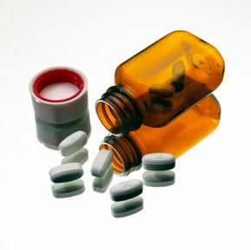
Real life example 2– Design of Metallo-β-lactamase inhibitors
Aim: Design a novel inhibitor which could be co-administered with current β-lactam antibiotics thus retaining the β-lactam antibiotic’s susceptibility to the bacterial target.

Slide 24
Real life example 2– Design of Metallo-β-lactamase inhibitors
Screened the Peakdale molecular library (~25,000) and the Chembridge library (~100,000)
Screened in 24 hours on a parallel processor of 60 nodes.
10 compounds from each library were purchased based upon having the best calculated binding affinity.
Possible to conduct this kind of screening at the institute of computing here at Warwick
27,000 Compounds
AutoDock
100
Hit Identification
Compound Selection
10
Enzyme Assay
1 Active Compound
SAR/Analogue Synthesis
Lead Optimisation
Lead
Series

Slide 25
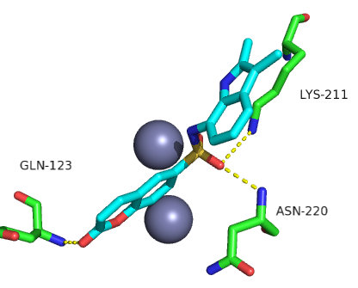
Results
Results can be analysed visually as shown below
Best Peakdale compound gave 75% residual activity (RA) at 100 µM against NDM-1. Best Chembridge compound gave 81% RA against NDM-1
Compounds not investigated further as >20% RA
MC = Main chain
SC = Side chain
Binding interactions of identified inhibitor in a) 2D skeletal representation and b) 3D representation

Slide 26
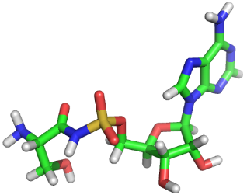
Shape and electrostatic similarity screening
Shape similarity studies can be conducted where there is a known query molecule
Used as a good way to jump away from undesired chemical properties
Much faster than vHTS however is limited to the pose the ligand is already in.
Zinc diversity subset (100000 compounds)
ROCS using subrocs feature
ROCs Best scoring
(1000 compounds)
EON
EON Best scoring
(100 compounds)
VIDA results visualisation
Query molecule

Slide 27
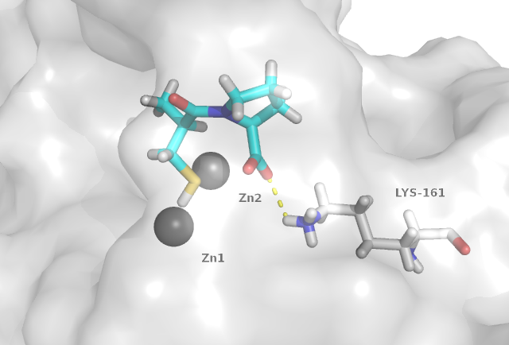
MBL shape similarity
Sulfur binds strongly to zinc – Captopril an ACE inhibitor
Captopril IC₅₀ against NDM-1 = 32µM
CYS-PRO Mimic

Slide 28
De novo design
(Starting from the beginning, anew)
Chemical space, the total number of possible small organic molecules, is estimated to exceed 10⁶⁰.
When trying to design new molecules from scratch it is possible to come up with almost infinite possibilities.
Therefore, the design of molecules must be constrained to those which fit certain spatial and electronic characteristics which will allow them to bind favorably to a target protein.
De novo programs include SPROUT and LUDI
SPROUT has been the program most frequently used in the design of inhibitors of antibacterial targets

Slide 29
De novo design
SPROUT – De novo design package developed at the University of Leeds and marketed by SymBioSys.
A
B
C
D
-8.00
X
Linker
Y
SCORE
Binding pocket characterisation and active site identification
Fragment and template docking
Fragment connection and skeleton generation
Scoring and structural analysis
-7.50
X
Linker
Y
X
Y
X
Linker
Y
-7.00
X
Linker
Y
-6.50
X
Linker
Y
-6.00
X
Linker
Y

Slide 30
Scoring functions and force fields
SPROUT calculates the free energy of the designed structures within the protein binding site allowing prediction of:
  Binding affinity
  Best candidates
  ΔG_{score} = ΔG_{h bonds} + ΔG_{hydrophobic} + ΔG_{VdW} + ΔG_{rotatable}
Comes from ΔG = ΔH – TΔS where ΔH is enthalpy of bond formations and ΔS is the order in the system (H₂O displacement)

Slide 31
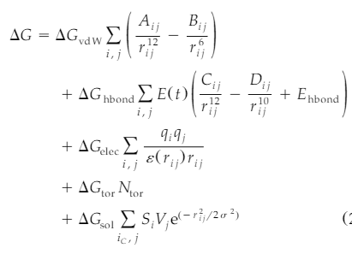
Scoring functions and force fields
More detailed calculation (Specifically AutoDock 4)
where E is the estimated average energy of hbond hydrogen bonding of water with a polar atom, and the summation in the solvation term is performed-over all pairs consisting of only carbon atoms in the ligand, i, and atoms of all types, j, in the protein.

Slide 32
Scoring functions and force fields
Structures generated using de novo design can be complex and difficult to synthesize, so SPROUT includes a method for analyzing the complexity or synthetic tractability of the designed structures.
  Gives a score based upon the number of unfavorable features in the molecules
Ligand efficiency:
LE = ΔG / N where N = Number of Heavy Atoms
(A heavy atom is any atom that is not H)
Partition coefficient:
cLogP = log(c_{octanol}/c_{water})
Notes:
Antimicrobials tend to have a cLogP of 1 to -1

Slide 33
Outstanding challenges / Questions
Most SBDD programs rely upon a single high-resolution crystal structure.
However: Protein in solution is flexible and will often undergo conformational changes upon substrate binding. Examining protein flexibility also exponentially increases the computational time to model ligand binding.
Molecular dynamics studies can be conducted on proteins to identify flexible binding regions
However: Complexity and time of calculation makes this inefficient and unrealistic for large compound libraries.

Slide 34
Outstanding challenges / Questions
Most docking programs do not account for water movement.
  Typically either removed entirely or only key molecules are present
Many programs do not account for metal ions
Docking is only as good as the crystal structure / homology model available
  Many are poor
  Many are unavailable
Chemical space?
  Very large
  Need a way of selecting the best drug like molecules
Can not predict all pharmacokinetic properties such as cell penetration which is particularly important for antimicrobial drug discovery.

Slide 35
Available programs
Structure viewing and manipulation
  Maestro, Schrodinger http://www.schrodinger.com/productpage/14/12/ academic
Homology modelling
  SWISS-MODEL: http://swissmodel.expasy.org/ academic
  Phyre2, Imperial College London: http://www.sbg.bio.ic.ac.uk/phyre2/html/page.cgi?id=index academic
Databases
  ZINC database, University of California San Francisco: http://zinc.docking.org/ commercially available compounds
  ChemNavigator: www.chemnavigator.com Commercially available compounds
  Chembridge: http://www.hit2lead.com/ Commercially available compounds
  Peakdale: http://www.peakdale.co.uk/ Commercially available compounds
  Protein Data Bank, RCSB: http://www.pdb.org/pdb/home/home.do academic

Slide 36
Available programs
Docking
  AutoDock, Scripps institute: http://autodock.scripps.edu free
  DOCK, University of California San Francisco: http://dock.compbio.ucsf.edu academic
  eHiTS, Simbiosys: http://www.simbiosys.ca/ehits/index.html commercial
  GLIDE, Schrodinger: http://www.schrodinger.com/productpage/14/5/ commercial
  GOLD, CCDC: http://www.ccdc.cam.ac.uk/products/life_sciences/gold commercial
  FRED, OpenEye: http://www.eyesopen.com/products commercial
De novo design
  SPROUT and SPROUT-Hit-Opt, Simbiosys: http://simbiosys.ca/sprout/index.html commercial
  CAVEAT, University of California Berkeley: http://www.cchem.berkeley.edu/pabgrp/Data/caveat.html academic
  LigBuilder, Peking University: http://ligbuilder.org/ academic
  SYBYL, Tripos: http://tripos.com/index.php?family=modules,SimplePage&page=SYBYL-X commercial
  LUDI, part of Accelrys Discovery Studio: http://accelrys.com/products/discovery-studio/index.html commercial

Slide 37




Acknowledgements
Warwick
Dr David Roper
Prof Chris Dowson
Dr Adrian Lloyd
C10 Lab Group
Leeds
Prof. Colin Fishwick
Fishwick Group
Oxford
Dr Jürgen Brem
Dr Michael McDonough
Prof. Chris Schofield
Bristol
Dr Jim Spencer
Funding
EPSRC ‘Bridging the gaps’, MRC, BBSRC

