Slide 1

Reducing inappropriate antimicrobial prescribing by 50% by 2020 – can we do it?
INTEGRATE network Warwick 15th June 2017
Elizabeth Beech National Project Lead - Healthcare Acquired Infection and Antimicrobial Resistance NHS Improvement & Pharmacist - NHS Bath and North East Somerset CCG Elizabeth.beech@nhs.net tweets @elizbeech
Notes:
Title slide with embedded images

Slide 2
UK 5-year AMR Strategy 2013-18: Seven key areas for action
DH – High Level Steering Group
PHE
Human health
Defra
Animal health
DH
5) Improving the evidence base through research
6) Developing new drugs, vaccines and other diagnostics and treatments
7) Strengthening UK and international collaboration
1) Better access to and use of surveillance
2) Optimising prescribing practice
3) Improving infection prevention and control
4) Improving professional education, training and public engagement data
Notes:
UK 5 Year Antimicrobial Resistance (AMR) Strategy 2013-2018 - Measuring success
https://www.gov.uk/government/uploads/system/uploads/attachment_data/file/322358/Outcome_measures.pdf
https://www.gov.uk/government/publications/carbapenem-resistance-implementation-of-an-enhanced-surveillance-system
https://www.gov.uk/government/publications/amr-summary-of-the-current-evidence
https://www.gov.uk/government/publications/antimicrobial-resistance-amr-systems-map

Slide 3
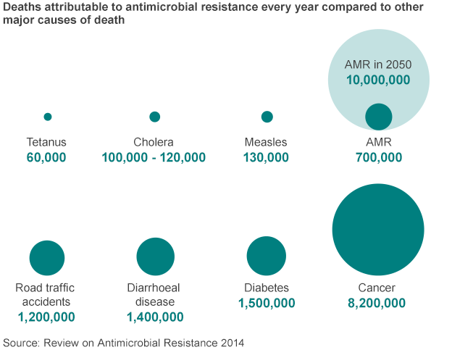
Superbugs to kill 'more than cancer' by 2050 – The Review on AMR
Notes:
Antimicrobial Resistance: Tackling a Crisis for the Health and Wealth of Nations on December 11 at a launch event hosted by its Chair, Jim O’Neill, in London. In this report we explain why failing to tackle drug-resistant infections will cause 10 million deaths a year and cost up to US$ 100 trillion a year by 2050
http://amr-review.org/
In Europe and the United States, antimicrobial resistance causes at least 50,000 deaths each year, they said. And left unchecked, deaths would rise more than 10-fold by 2050 http://www.bbc.co.uk/news/health-30416844

Slide 4
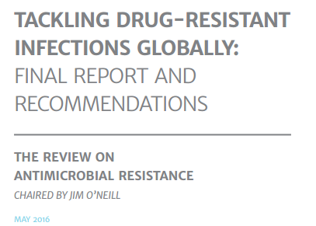
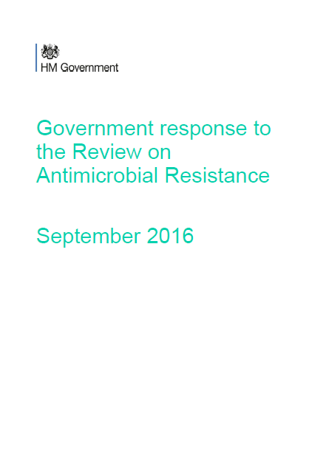
AMR Review 2016
We will reduce inappropriate antibiotic prescribing by 50%, with the aim of being a world leader in reducing prescribing by 2020
We will reduce healthcare associated Gram-negative bloodstream infections in England by 50% by 2020
We will run a regional, highly targeted pilot campaign to determine the most effective way to raise awareness of antimicrobial resistance, and drive behaviour change amongst key audiences
Notes:
https://amr-review.org/
https://amr-review.org/sites/default/files/160525_Final%20paper_with%20cover.pdf

Slide 5
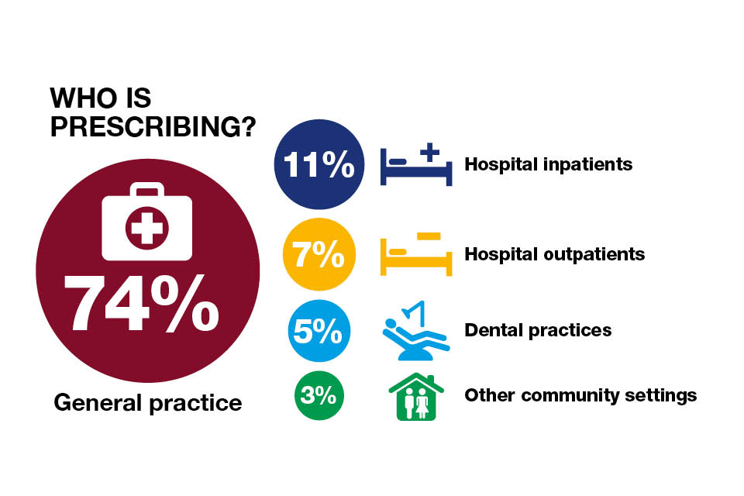
English surveillance programme for antimicrobial utilisation and resistance (ESPAUR) report 2014
Notes:
https://www.gov.uk/government/publications/english-surveillance-programme-antimicrobial-utilisation-and-resistance-espaur-report
PHE Matters AMR Blog https://www.gov.uk/government/publications/health-matters-antimicrobial-resistance/health-matters-antimicrobial-resistance

Slide 6
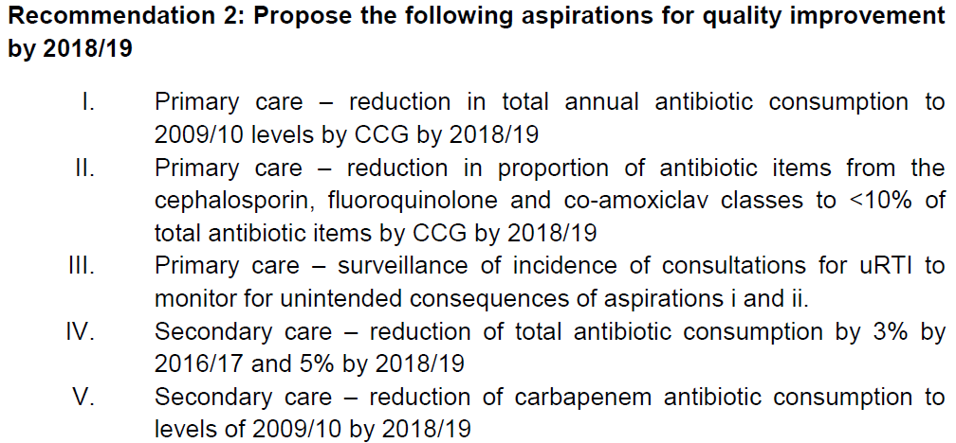
APRHAI – Quality measures published 2014 Advisory Committee on Antimicrobial Prescribing, Resistance and Healthcare Associated Infection
Advisory Committee on Antimicrobial Resistance and Hospital Acquired Infections (ARHAI) Recommended Antimicrobial Prescribing Quality Measures. 2014. https://app.box.com/ARHAI-Minutes-Papers/1/2152374732/18606265032/1
Notes:
https://www.gov.uk/government/groups/advisory-committee-on-antimicrobial-resistance-and-healthcare-associated-infection

Slide 7


National incentive schemes for AMR & sepsis
2015-2017
Quality Premium for improved antibiotic prescribing in primary care 2015/16 and 2016/17
Sepsis CQUIN 2015/16 & 2016/17 - systematic screening for sepsis and timely treatment
AMR CQUIN 2016/17 - Reduced antibiotic consumption in acute trusts & improved stewardship review 2016/17
2017-2109
CQUIN 2017/19 - Reducing the impact of serious infection
Quality Premium 2017/19 - Reducing Gram Negative Bloodstream Infections (GNBSIs) and inappropriate antibiotic prescribing in at risk groups

Slide 8
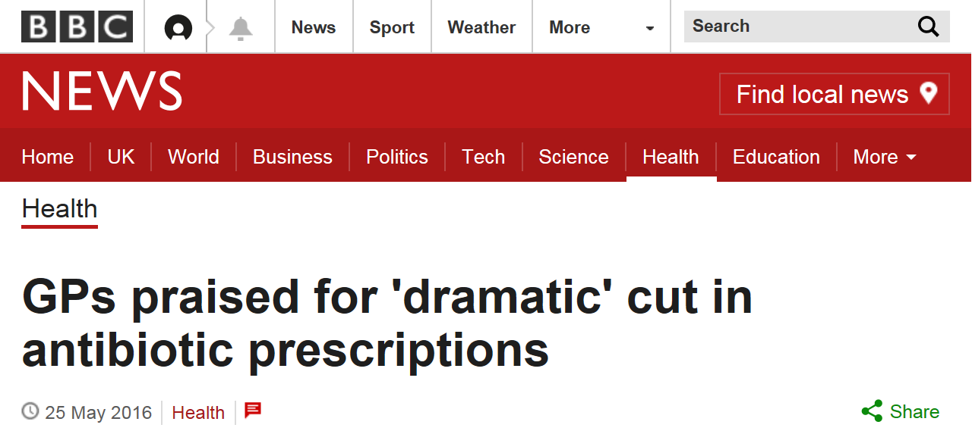
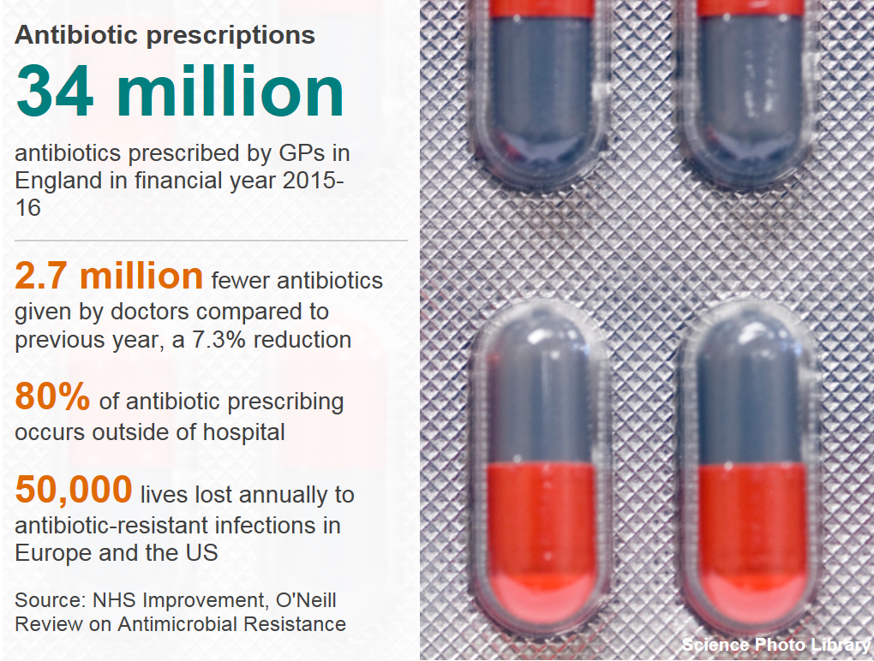

Slide 9
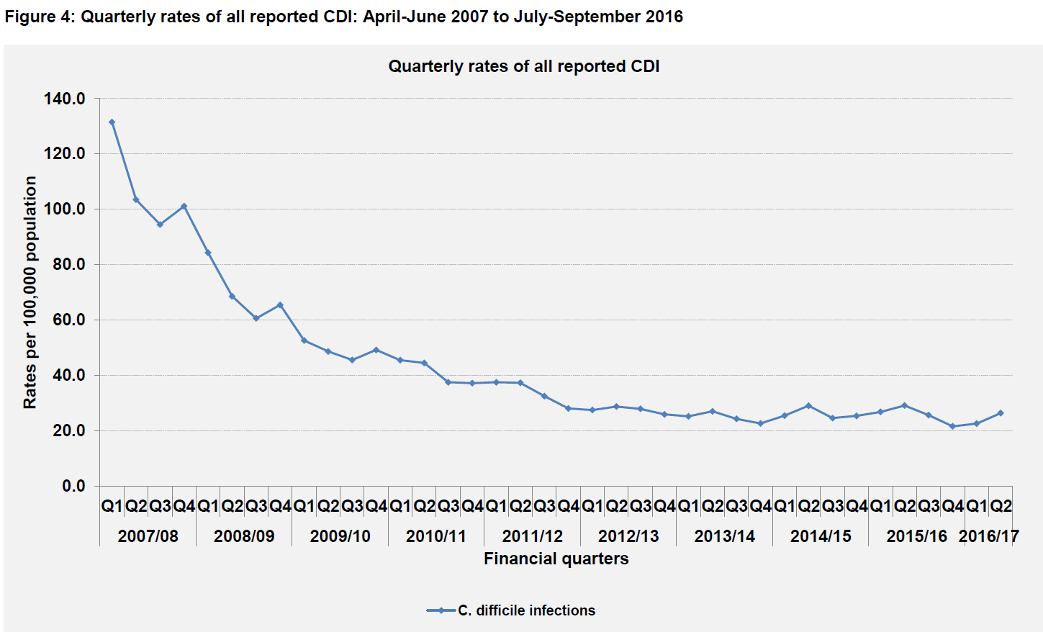
Unintended consequences? The England AMR incentive schemes have reduced Clostridium difficile infection rates in England by 10% Q on Q
Notes:
https://www.gov.uk/government/collections/clostridium-difficile-guidance-data-and-analysis
Q1 FY1516 vs FY1617: 16.1% ↓ cases (-588) 15.9% ↓ rate of CDI
Q2 FY1516 vs FY1617: 9%↓ cases (-383) & 10%↓ rate of CDI
Q3 FY1516 vs FY1617: 10.8% ↓ cases (-381)

Slide 10
So what worked and will it sustain? How Low can we go?
Collaborate and champion
NHS England appointed national leads for HAI & AMR includes diagnostics
Collaborative working – Public Health England, NHS England, NHS Improvement, DoH, Health Education England, CQC, Royal Colleges, research organisations, Innovate UK and others
Guidance and resources
Update 2008 Health & Social Care Act Code of Practice
NICE guidelines NG15: Antimicrobial Stewardship
NHS Patient Safety Alert August 2015 promoting Start Smart then Focus and TARGET stewardship resources
PHE Behavioural Insights Team testing interventions
PHE AMR Portal publishes AMR, HAI, AMS, IPC metrics as open data
Incentivise, support and empower
Incentivise via National NHS schemes – Quality Premium & CQUIN
National workshops to engage, catalyse rapid action & share learning
Innovative use of primary care prescribing data – do it once
PrescQIPP Antimicrobial Stewardship Hub collaboration – go with the footfall
HEE developed educational resources AMR and sepsis
Notes:
https://www.nice.org.uk/guidance/ng15
https://www.gov.uk/government/publications/the-health-and-social-care-act-2008-code-of-practice-on-the-prevention-and-control-of-infections-and-related-guidance
https://www.england.nhs.uk/patientsafety/2015/08/18/psa-amr/
http://www.rcgp.org.uk/TARGETantibiotics
https://www.gov.uk/government/publications/antimicrobial-stewardship-start-smart-then-focus
https://fingertips.phe.org.uk/profile/amr-local-indicators
https://www.england.nhs.uk/resources/resources-for-ccgs/ccg-out-tool/ccg-ois/qual-prem/
https://www.england.nhs.uk/nhs-standard-contract/cquin/cquin-16-17/
https://www.prescqipp.info/antimicrobial-stewardship/projects/antimicrobial-stewardship

Slide 11
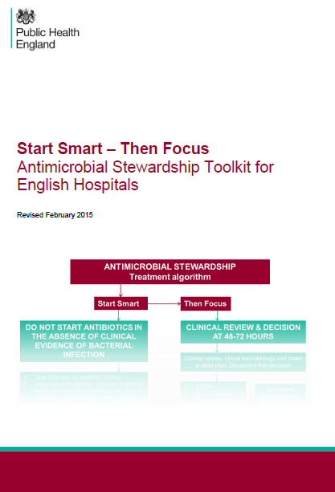
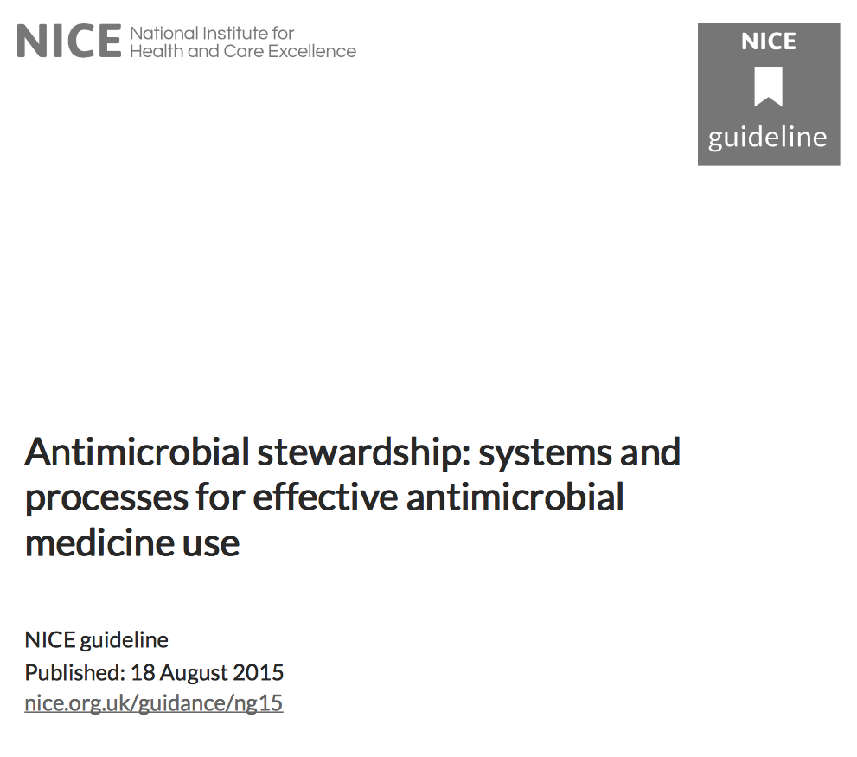
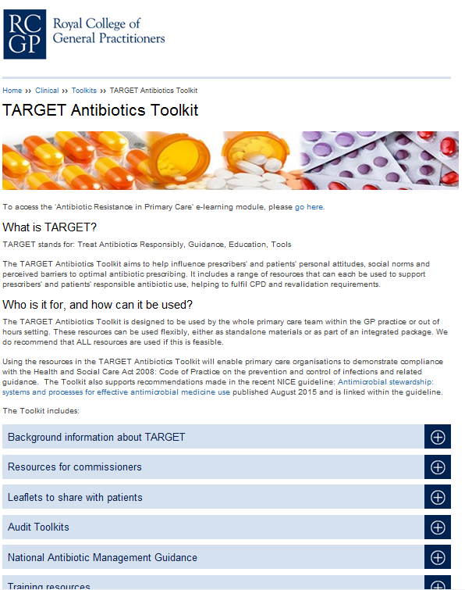

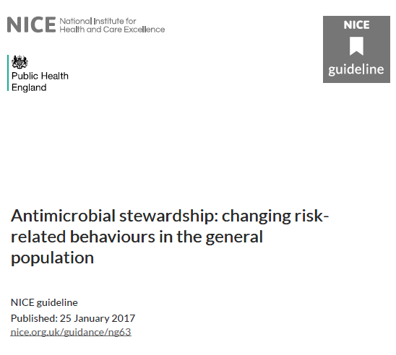
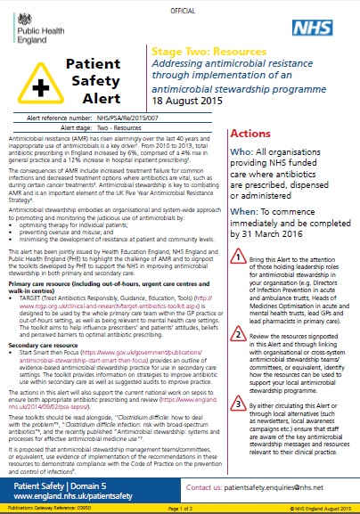
Antimicrobial Stewardship Documents

Slide 12

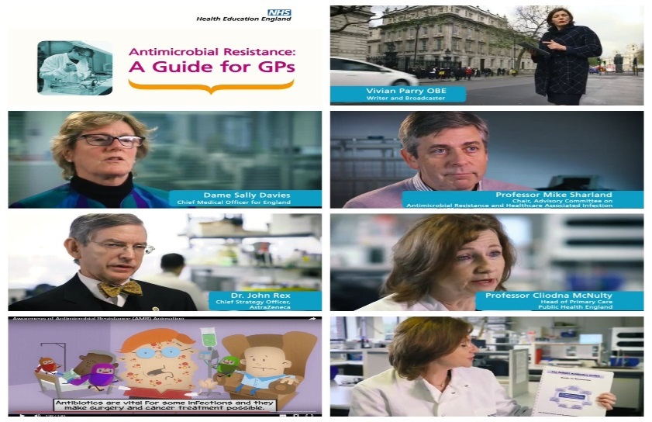
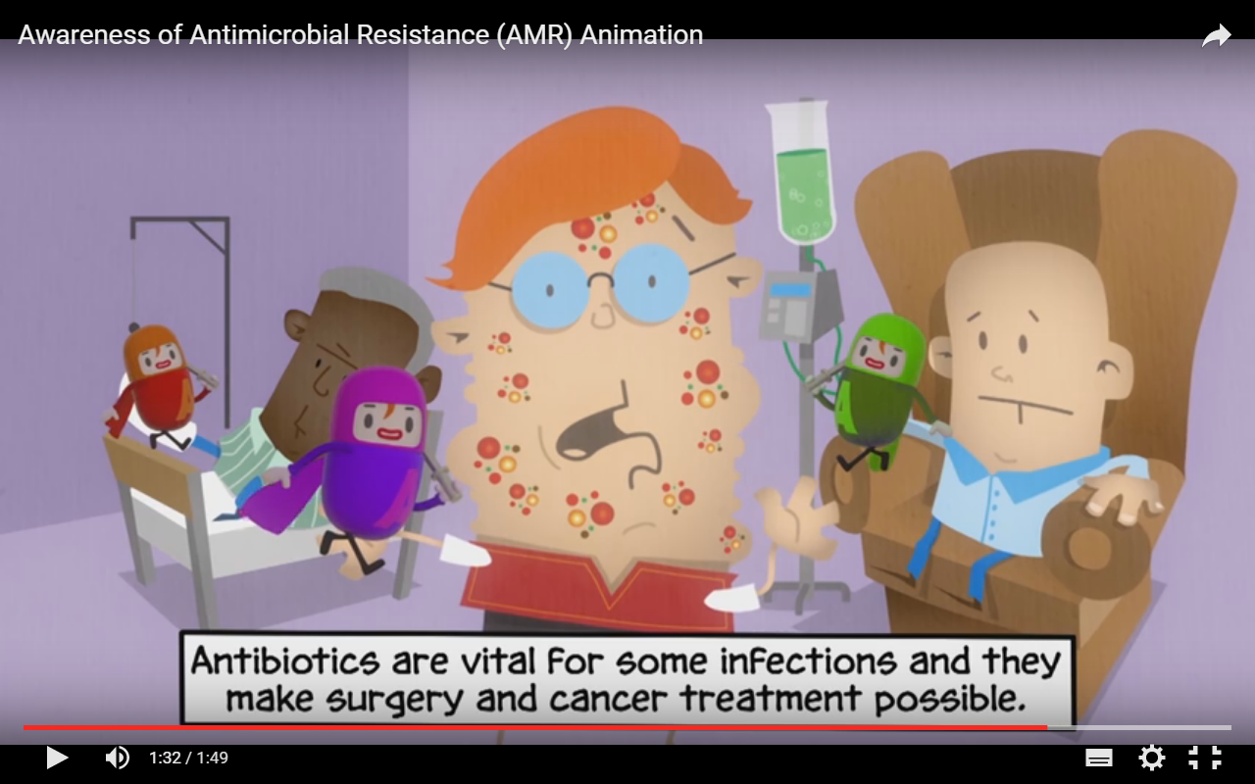
HEE AMR learning materials
http://www.e-lfh.org.uk/programmes/antimicrobial-resistance/
@NHS_HealthEdEng #antimicrobialresistance #AMR
mohamed.sadak@hee.nhs.uk
Notes:
Quick to find – can Google AMR HEE or AMR elfh – should appear as the first search term and resources available on both websites.
All open access so freely available – encourage staff to undertake the free introductory learning module.
Two films - the first film, a guide for GPs on antimicrobial resistance, supports a range of educational materials for GPs and other primary-care prescribers called the TARGET toolkit. This film also introduces a short informative but simple animation that can be used by GPs and other health professionals when speaking with patients about the risks of antibiotic resistance and misuse. The creation of the animation was influenced by the work of the Wellcome Trust in understanding how the public responds to information about antimicrobial resistance. Both available on YouTube.

Slide 13
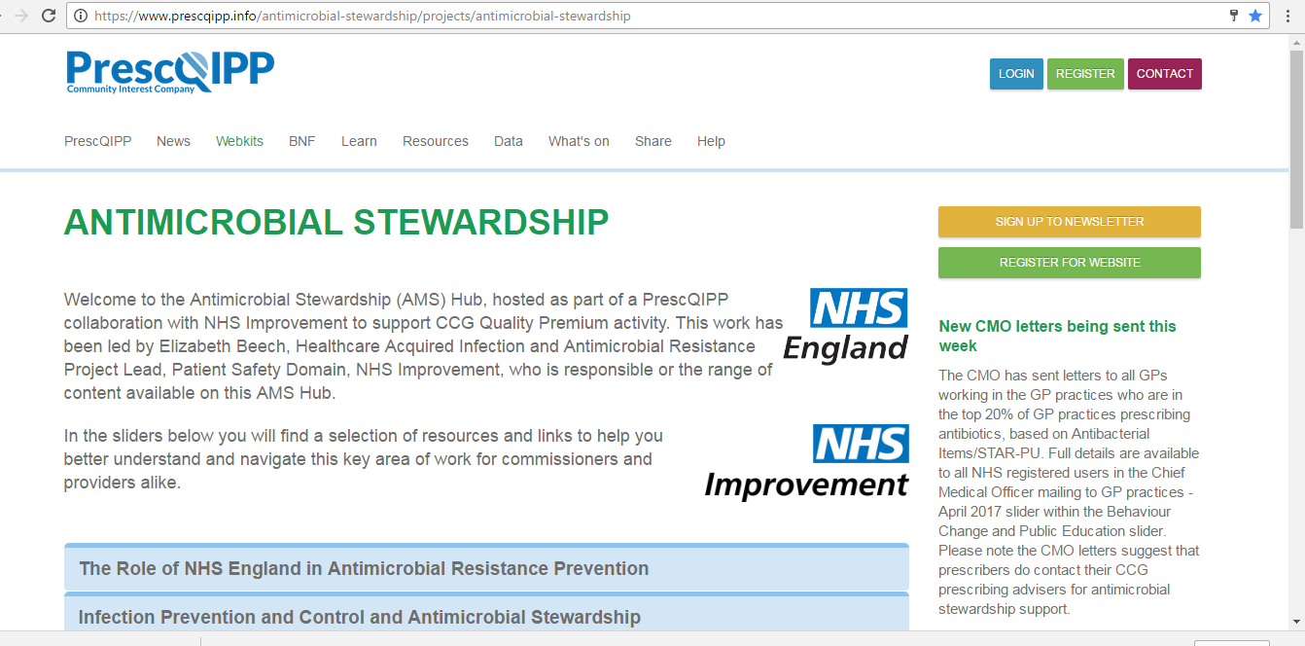
PrescQIPP AMS Hub established June 2015 to support CCGs deliver antimicrobial stewardship at pace & free to access Links to key resources & provides data formatted to support local implementation
Notes:
https://www.prescqipp.info/antimicrobial-stewardship/projects/antimicrobial-stewardship

Slide 14
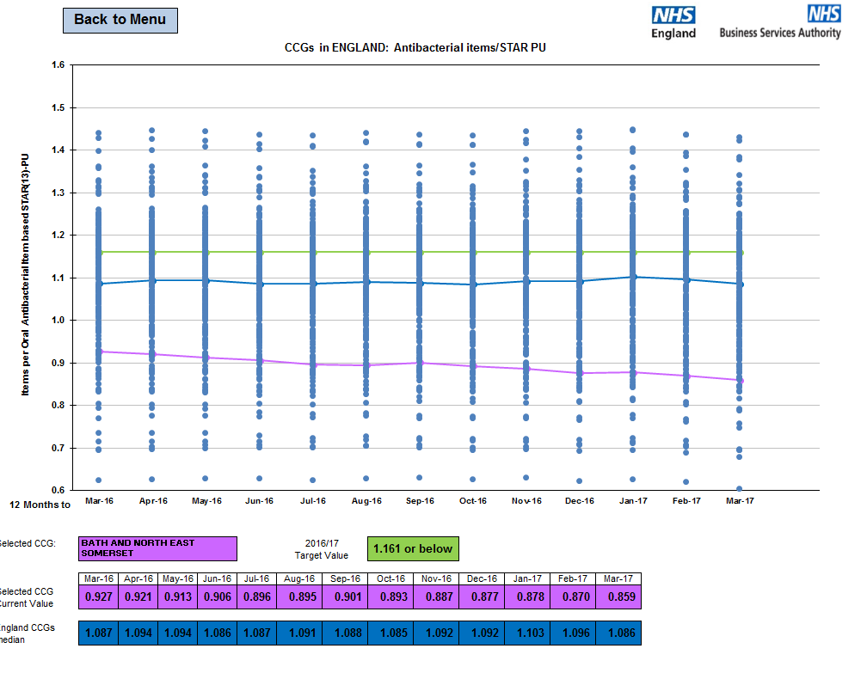
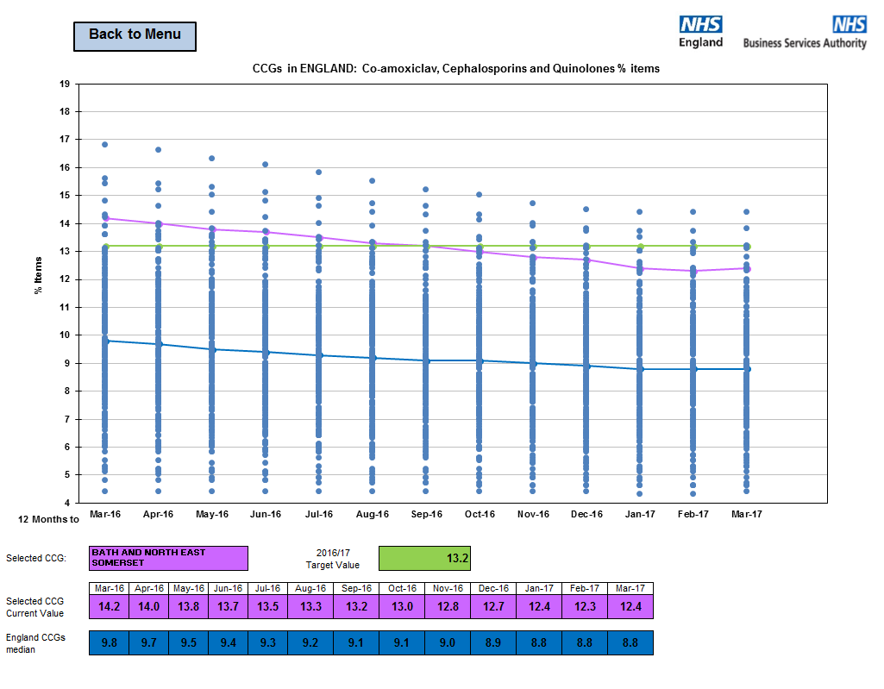
NHS England Antibiotic Quality Premium dashboard established March 2015 supports assurance reporting
Notes:
To support NHS England assurance teams, CSUs and CCGs to monitor progress with the Antibiotic element of the 2015/16 Quality Premium, the NHS BSA and NHS England have published a dashboard on the NHS England web site which will be updated at the start of each month
http://www.england.nhs.uk/resources/resources-for-ccgs/ccg-out-tool/ccg-ois/anti-dash/

Slide 15
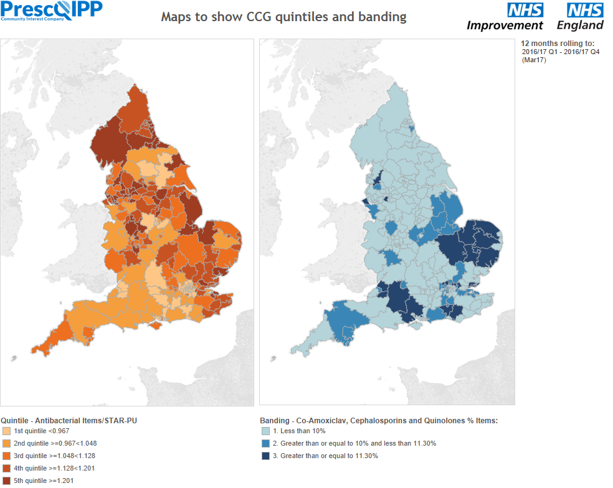
Notes:
https://www.prescqipp.info/antimicrobial-stewardship/projects/antimicrobial-stewardship#ams-visualisations-by-prescqipp-to-support-the-ams-quality-premium-activities

Slide 16
Bath and North East Somerset GP practices continue to prescribe a greater proportion of broad spectrum antibiotics when compared to all GP practices in England and the CCG is working to improve appropriate use of antibiotics

Slide 17
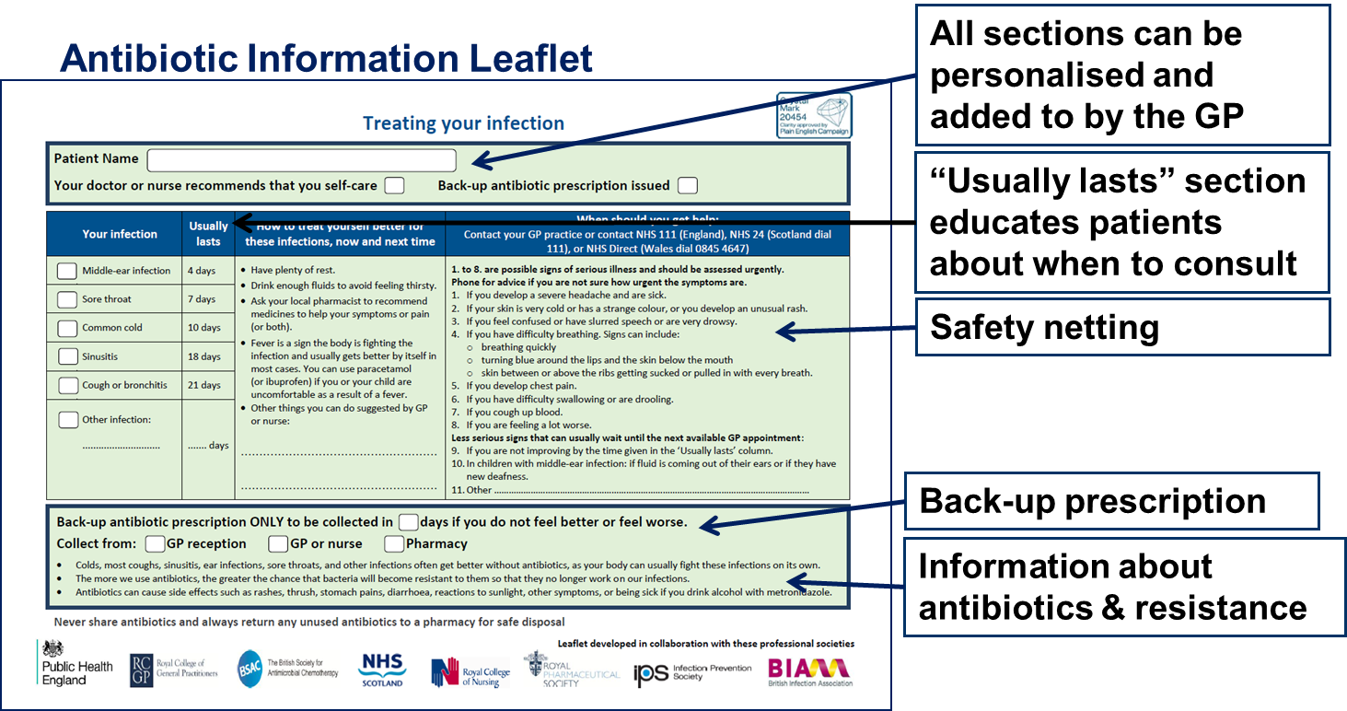
TARGET: patient information leaflet
Adapted version now available for community pharmacists and OOH
Notes:
http://www.rcgp.org.uk/TARGETantibiotics

Slide 18
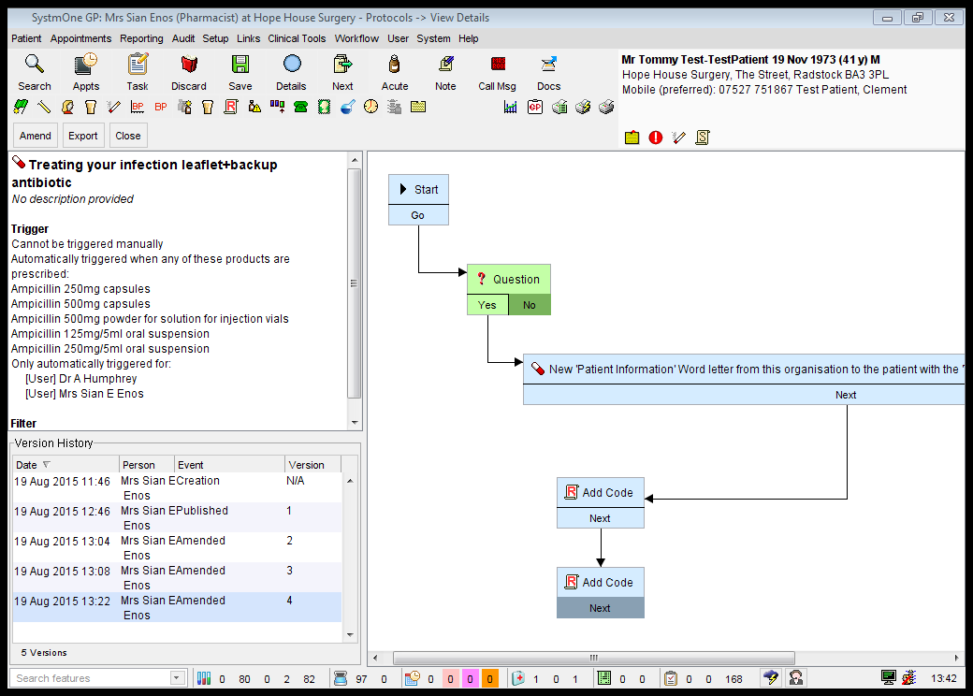
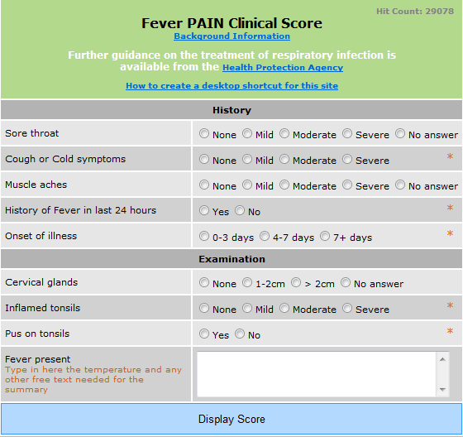
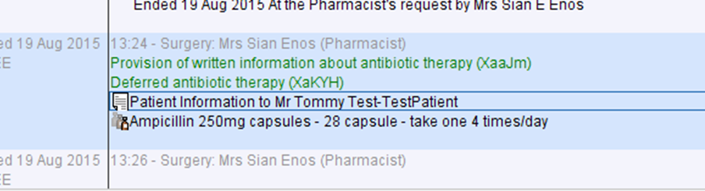
Need to maximise GP e-health record functionality to improve intervention use and coding

Slide 19


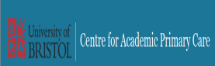
Primary care clinician antibiotic prescribing decisions in consultations for children with RTIs: a qualitative interview study Prognostic uncertainty remains an important driver of HCPs’ antibiotic prescribing
Notes:
http://www.bristol.ac.uk/primaryhealthcare/researchthemes/target/resources/
Primary care clinician antibiotic prescribing decisions in consultations for children with RTIs: a qualitative interview study Jeremy Horwood, Christie Cabral, Alastair D Hay, Jenny Ingram DOI: 10.3399/bjgp16X683821 Published 2 August 2016 Conclusion Prognostic uncertainty remains an important driver of HCPs’ antibiotic prescribing. Experience and training in recognising severe RTIs, together with more evidence to help HCPs identify the children at risk of future illness deterioration, may support HCPs’ identification of the children most and least likely to benefit from antibiotics

Slide 20
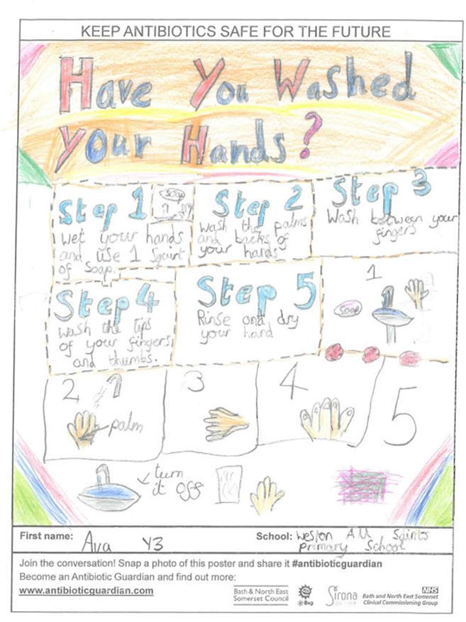
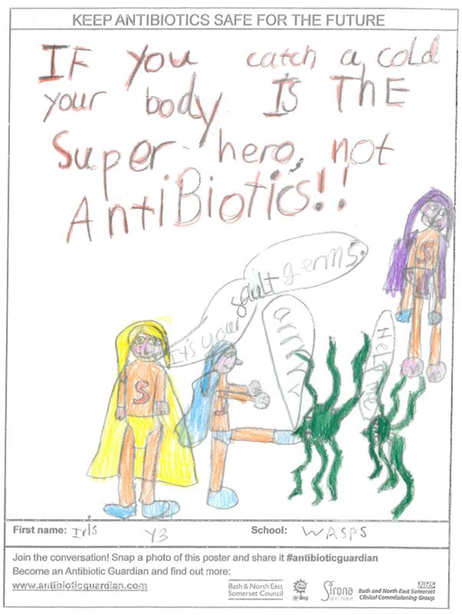
A Whole Health Economy Approach to Antimicrobial Stewardship
Notes:
Bath and North East Somerset Winter 2016-17 AMR poster campaign

Slide 21
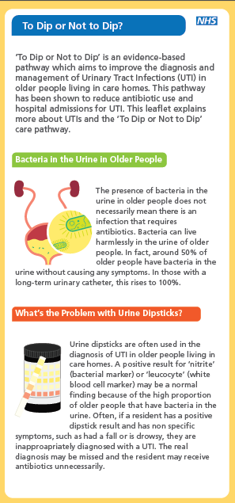
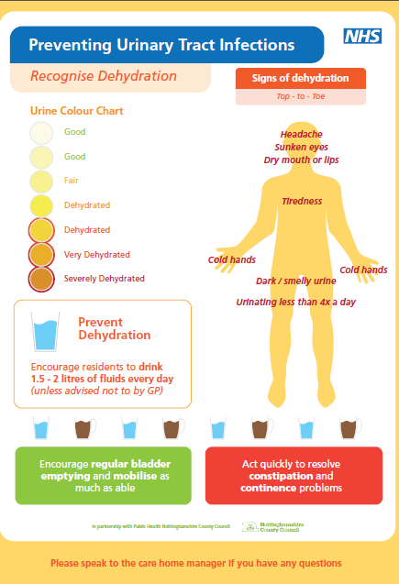
Diagnostic stewardship – room to improve

Slide 22
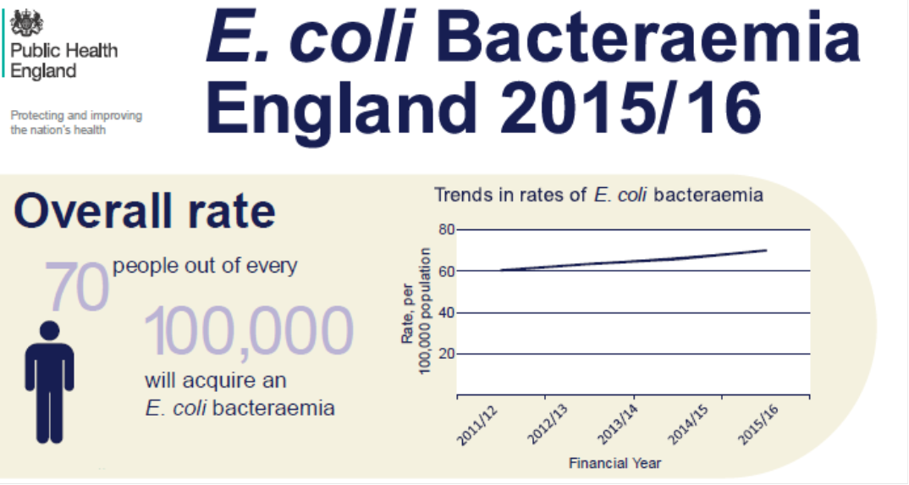

Slide 23




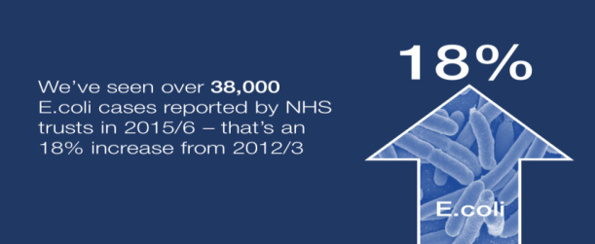
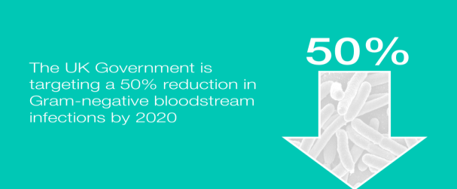







Interventions to Reduce Gram-Negative Bloodstream Infections
Gram-negative bacteria are a common cause of urinary tract and intra-abdominal infections. They can also cause surgical site infections, pneumonia and infections of intravascular devices. Gram negative bacteria include E. coli, Klebsiella, Pseudomonas and Enterobacter.
Good Infection Prevention and Control practice should be adhered to by all staff
Staff should adhere to the World Health Organisation’s 5 Moments for Hand Hygiene
Staff should follow guidance and ensure safe aseptic insertion and care of intravascular devices
All clinical staff required to insert, use, or look after vascular catheters must have adequate training
Poor hydration is known to increase the risk of urinary tract infections. All hospital patients should have their state of hydration checked and recorded during each nursing shift. This should also be observed in residential care
Medium and long term vascular access devices must only be accessed by people with documented competency in their use and always following aseptic technique
Antibiotic treatment of urinary infection should follow treatment guidelines and not be stopped prematurely
Does the patient need a catheter? Only insert a catheter if it is essential
Patients with medium/long term vascular access and carers should be educated in the care of their lines by a healthcare worker trained in the insertion and care of such lines.
Bladder scanners should be available in all inpatients areas to aid decisions on catheterisation
All clinical staff required to insert, use, or look after urinary catheters must have adequate training
Ulcers and wounds should be minimised using preventative policies based on current guidance, participation in surveillance and audit
The date of insertion, expected date of removal, and justification for insertion of any urinary catheter must be recorded in the clinical notes
Ventilator-associated pneumonia should be minimised by monitored systems as part of a validated care bundle
Patients leaving hospital with an urinary catheter in situ, and those catheterised in the community, should be provided with a catheter passport giving details of the catheterisation
References: Tacconelli E et al. ESCMID guidelines for the management of the infection control measures to reduce transmission of multidrug-resistant Gram-negative bacteria in hospitalized patients. Clinical microbiology and infection. 2014; 20 Suppl 1:1-55. Wilson APR et al. Prevention and control of multi-drug-resistant Gram-negative bacteria. Journal of Hospital Infection. 92:S1-S44.

Slide 24
Reducing Gram Negative Bloodstream Infections and Inappropriate Antibiotic Prescribing in at Risk Groups Quality Premium for CCGs
Part a) reducing gram negative blood stream infections (BSI) across the
whole health economy
a 10% reduction (or greater) in all E coli BSI
Part b) reduction of inappropriate antibiotic prescribing for urinary tract
infections (UTI) in primary care
a 10% reduction (or greater) in the Trimethoprim: Nitrofurantoin prescribing ratio
a 10% reduction (or greater) in the number of trimethoprim items prescribed to patients aged 70 years or greater
Part c) sustained reduction of inappropriate prescribing in primary care
Stay at or below 1.161 antibacterial items/STAR-PU
Notes:
https://www.england.nhs.uk/resources/resources-for-ccgs/ccg-out-tool/ccg-ois/qual-prem/

Slide 25
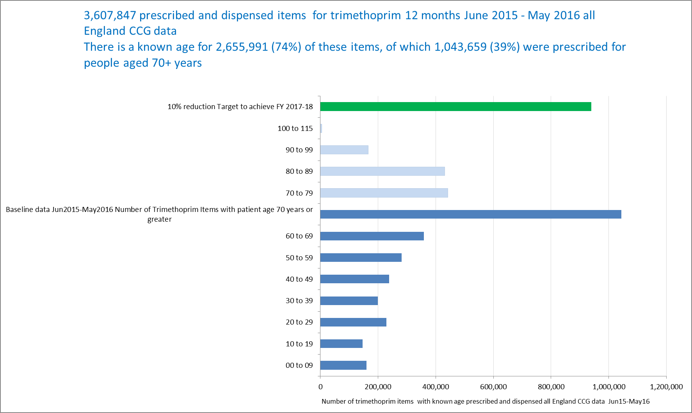
How much trimethoprim is prescribed for people aged 70+ years?

Slide 26
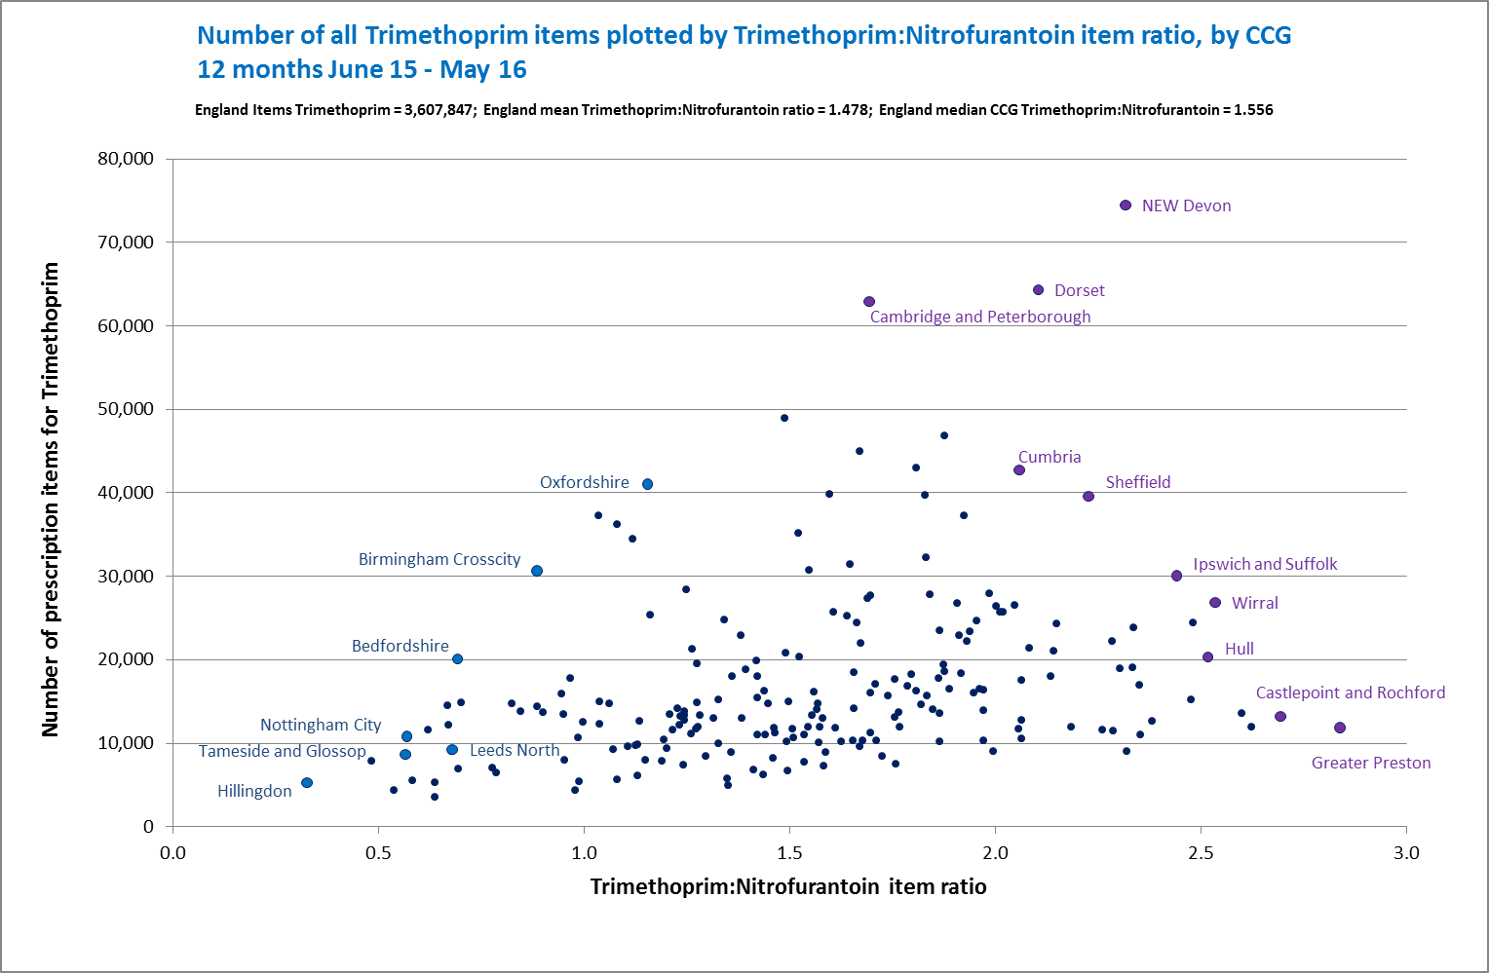
Five fold variation in current prescribing of trimethoprim and nitrofurantoin between CCGs

Slide 27

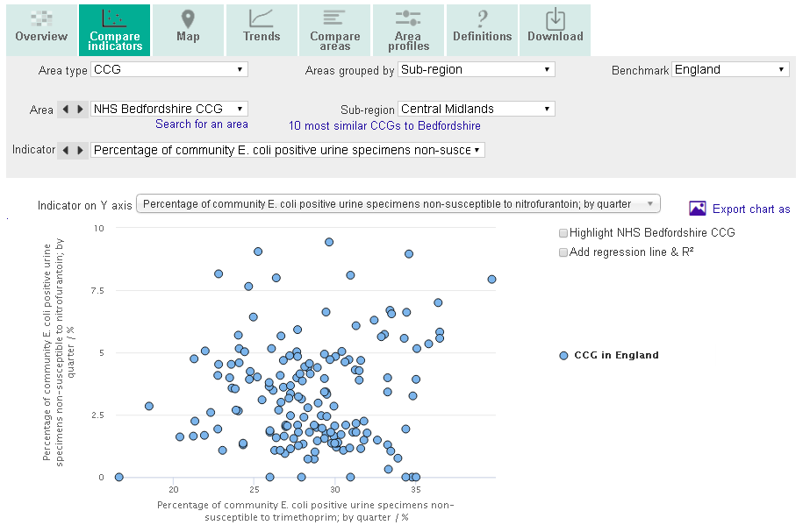
27

Slide 28
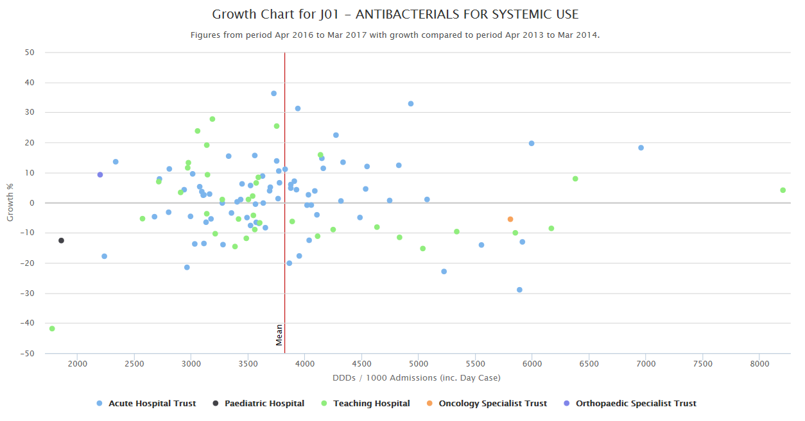
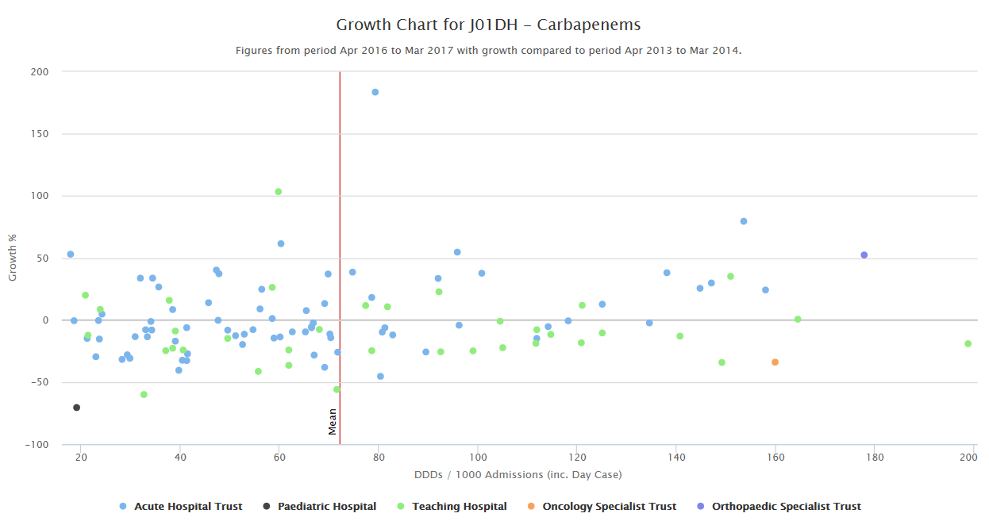
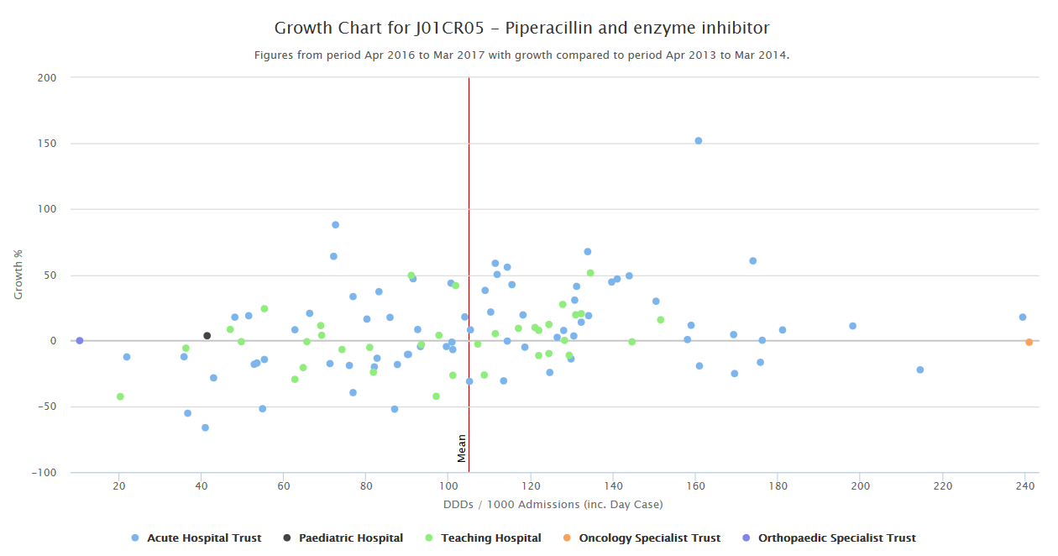
Wide variation on AMR CQUIN performance
Trusts (dots) below the 0% growth line are currently meeting the AMR-CQUIN target
Dots to right of red line = 2% ↓target & those to left = 1%↓
Notes:
And Trust variability

Slide 29
Reducing inappropriate antimicrobial prescribing by 50% by 2020 – can we do it?
Define inappropriate as?
Can it be measured?
Elizabeth Beech National Project Lead - Healthcare Acquired Infection and Antimicrobial Resistance NHS Improvement & Pharmacist - NHS Bath and North East Somerset CCG Elizabeth.beech@nhs.net tweets @elizbeech
Notes:
Title slide with embedded images

