Slide 1
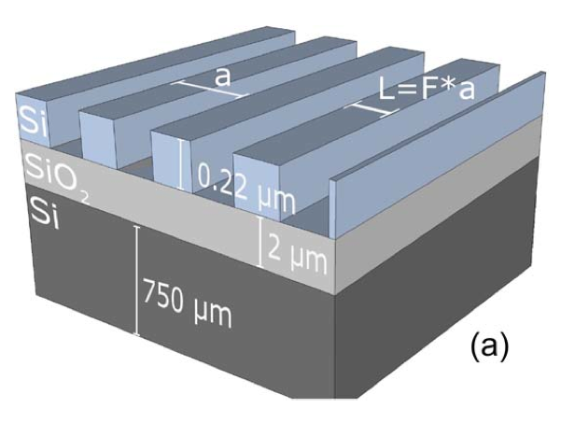
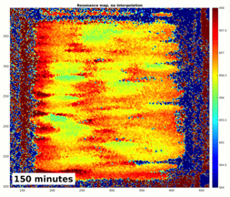
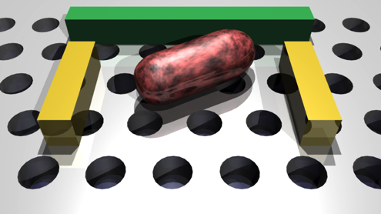



Nanophotonic Antimicrobial Susceptibility Test
Thomas F Krauss, Steve Johnson
Departments of Physics and Electronic Engineering, University of York
Towards a low cost test. Towards a fast test.

Slide 2
Guided mode resonance
1. Light couples into the grating
2. Light is Bragg-reflected.
3. Light couples out again. The phase of the Bragg reflected light and the thickness of the high index layer determine whether the outgoing light is reflected or transmitted.

Slide 3
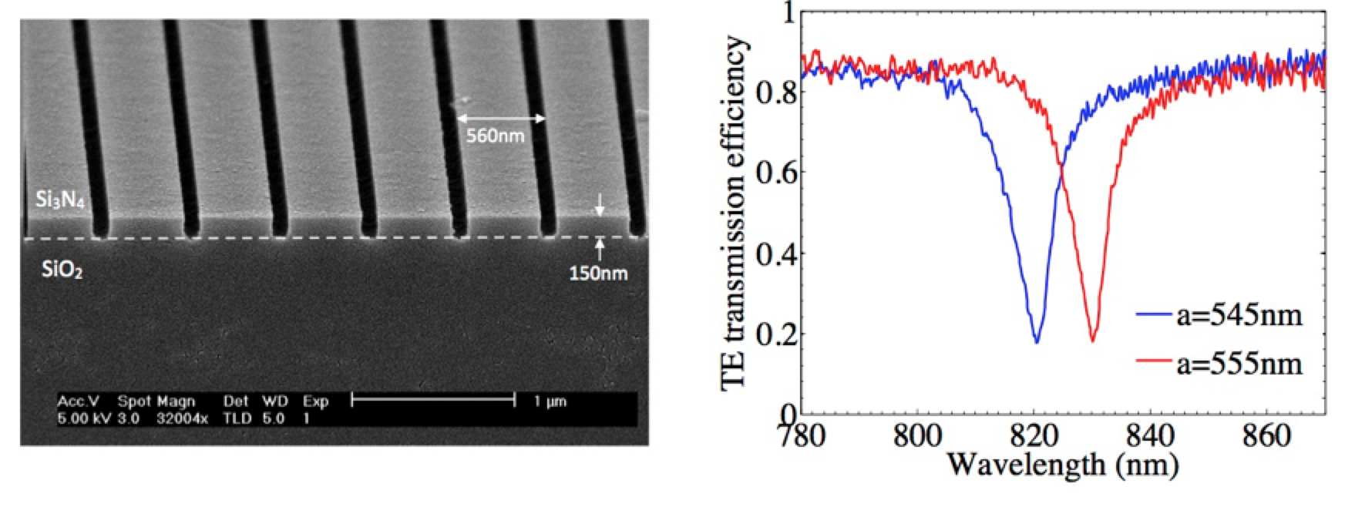
Guided mode resonance
Q≈200
We use silicon or silicon nitride. Typical operating wavelength is 800-900nm (therapeutic window).

Slide 4
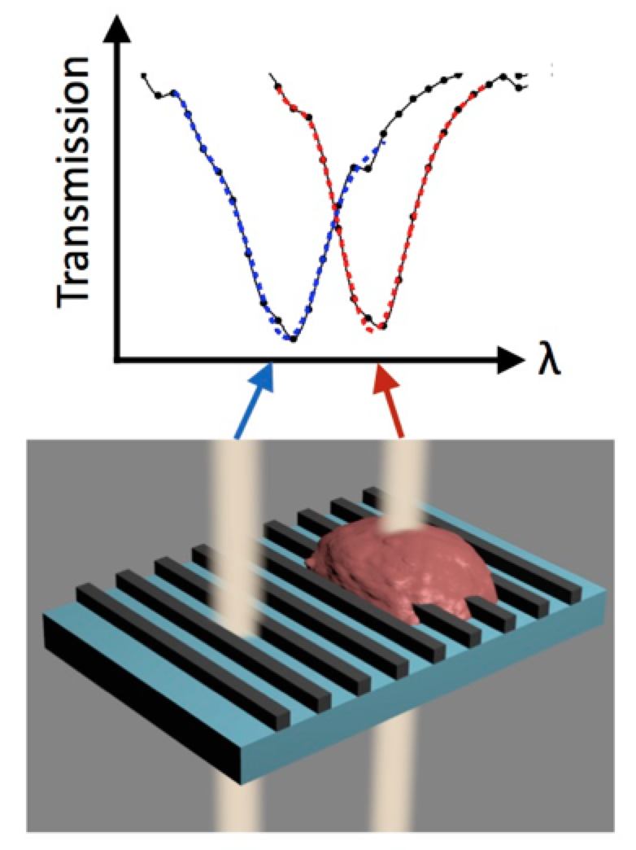
Imaging
Detect refractive index change locally, e.g. attachment of cells and bacteria.
Spatial resolution 2-5µm
GJ Triggs, TF Krauss et al., “Spatial resolution and refractive index contrast of resonant photonic crystal
surfaces for biosensing” IEEE Photonics Journal, 7(3), 1–10 (2015)

Slide 5
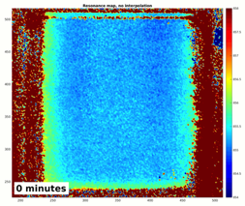
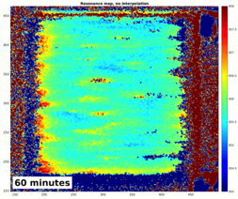
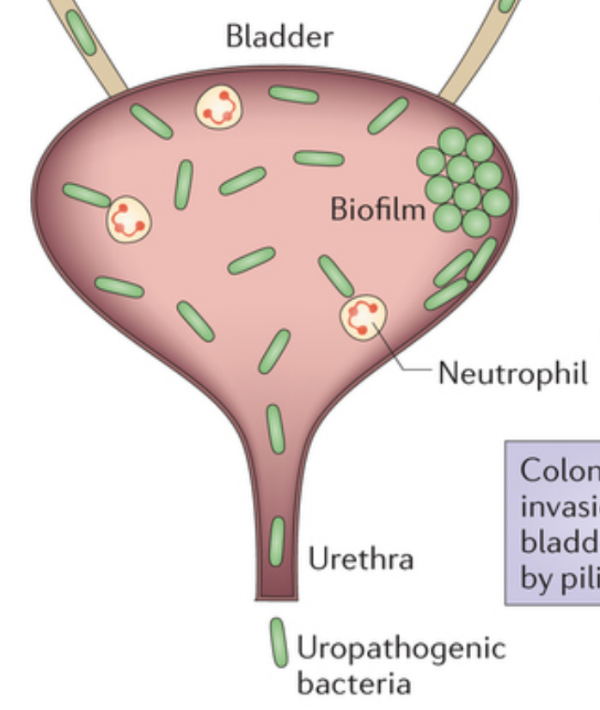
Biofilm Imaging
858 nm
856 nm
0 minutes
60 minutes
150 minutes
854 nm
Guided mode: Penetration depth 100-200 nm

Slide 6
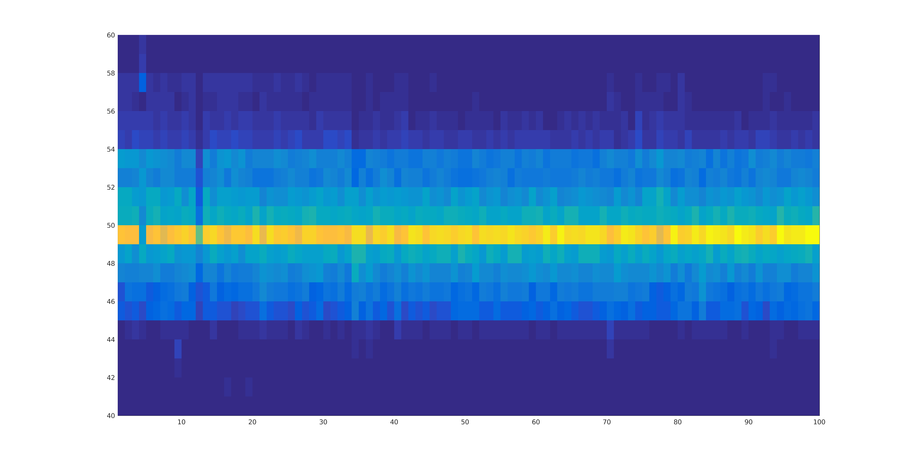
Reference media
0 2 4 6 8 10 12 13 14 16 18 h

Slide 7
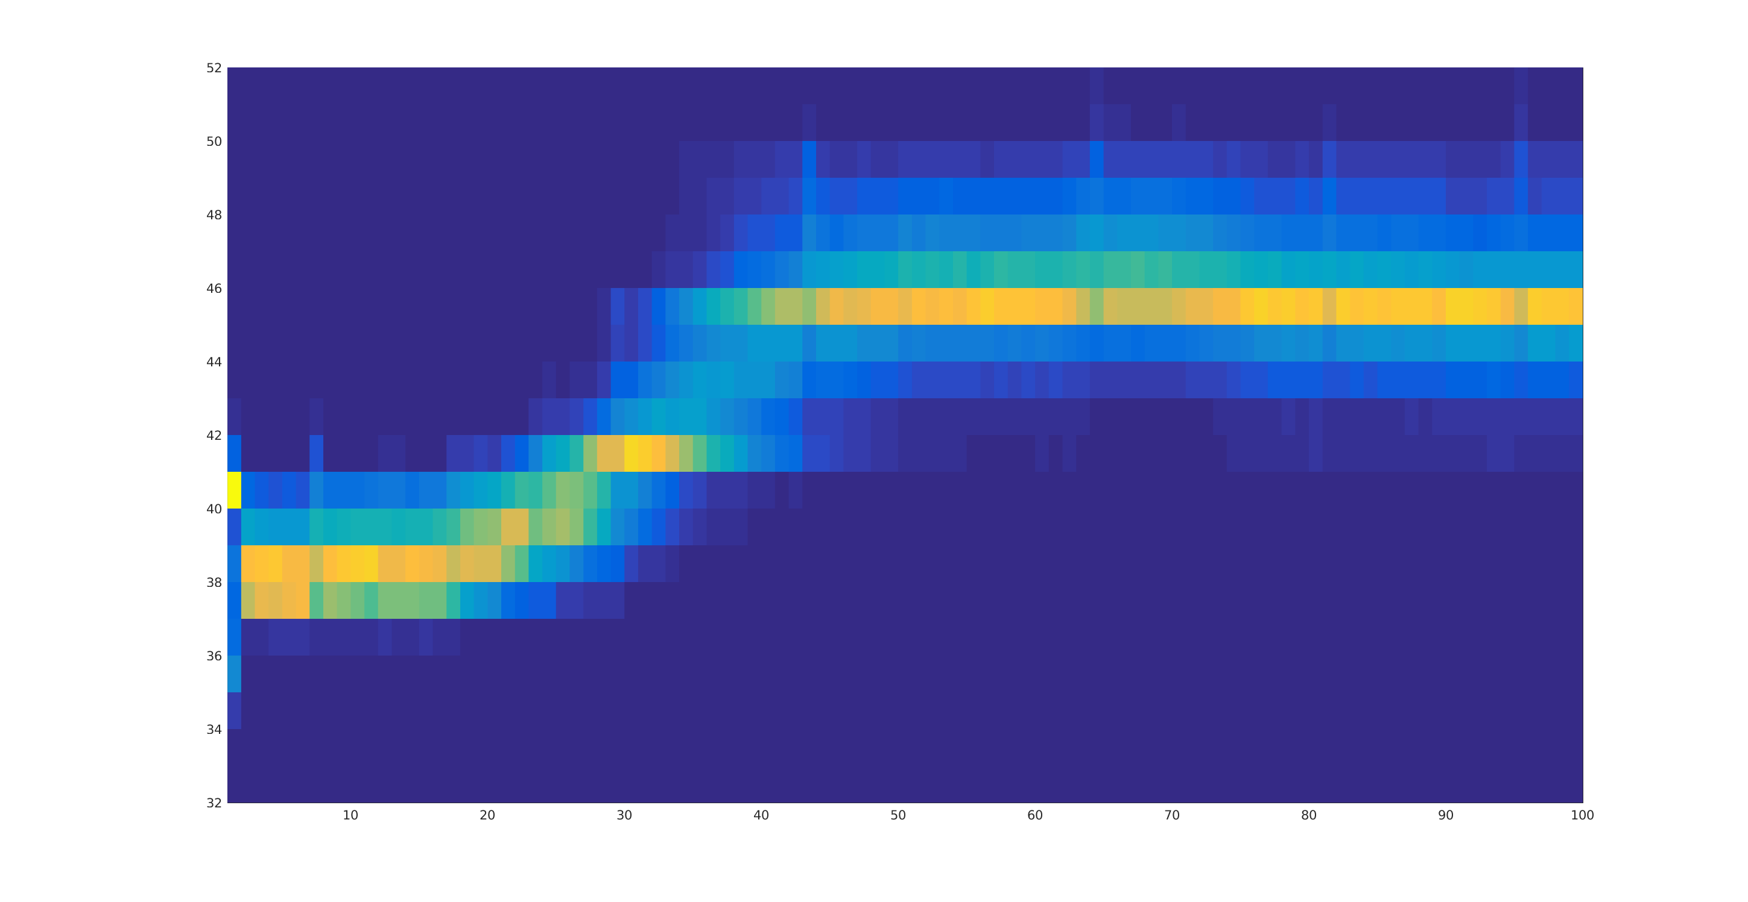
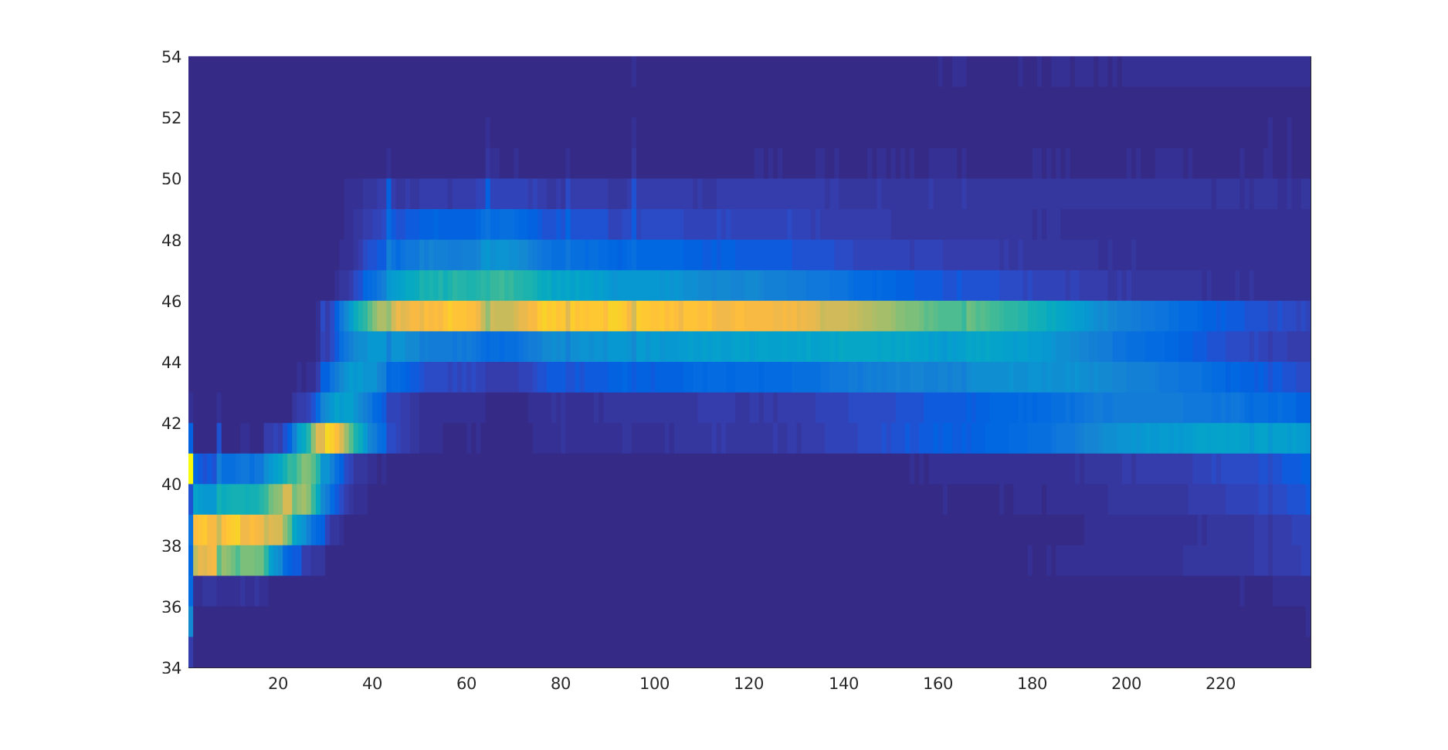
E.coli @ 10⁷ cfu/ml
150 minutes
0 2 4 6 8 10 12 13 14 16 18 h

Slide 8
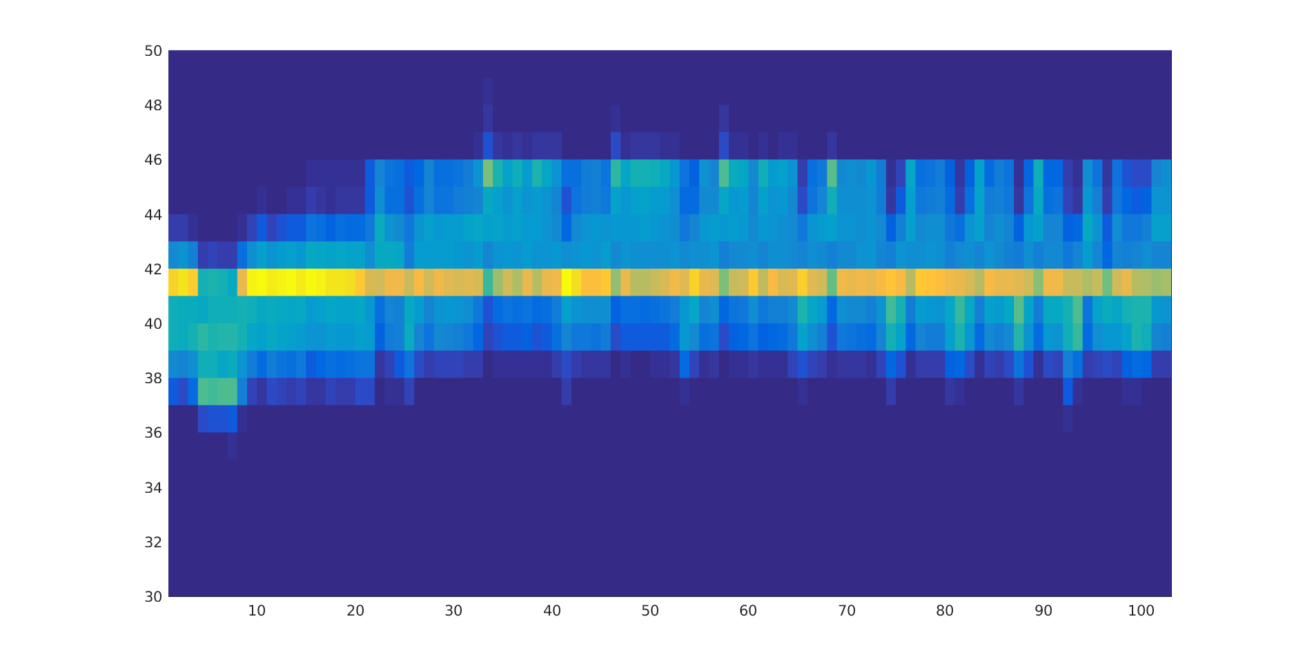
Antibiotic after 0 h
Trimethoprim antibiotic after 0 h
0 2 4 6 8 10 12 13 14 16 18 h

Slide 9
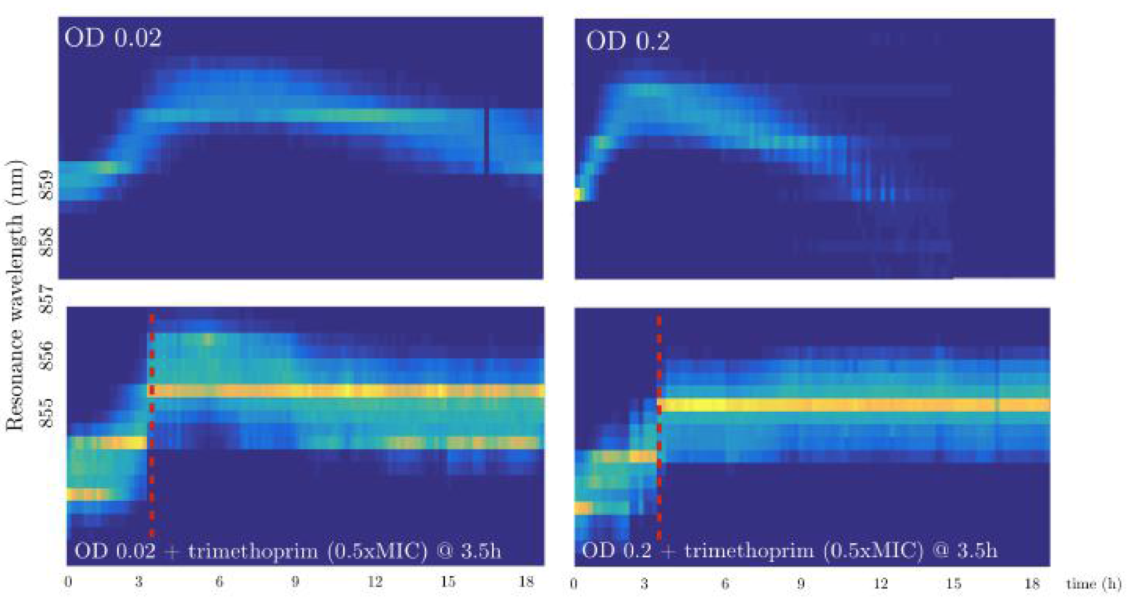
Antibiotic after 3.5 h
10⁷ cfu/ml
10⁸ cfu/ml
Trimethoprim antibiotic after 3.5 h
Trimethoprim antibiotic after 3.5 h
Behaviour with/without antibiotic is clearly different – can tell whether bottom layer of bacteria is affected.

Slide 10
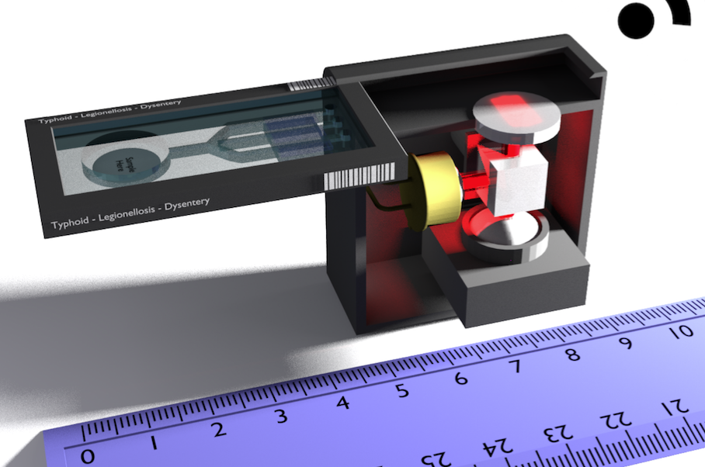

Towards a low cost test

Slide 11
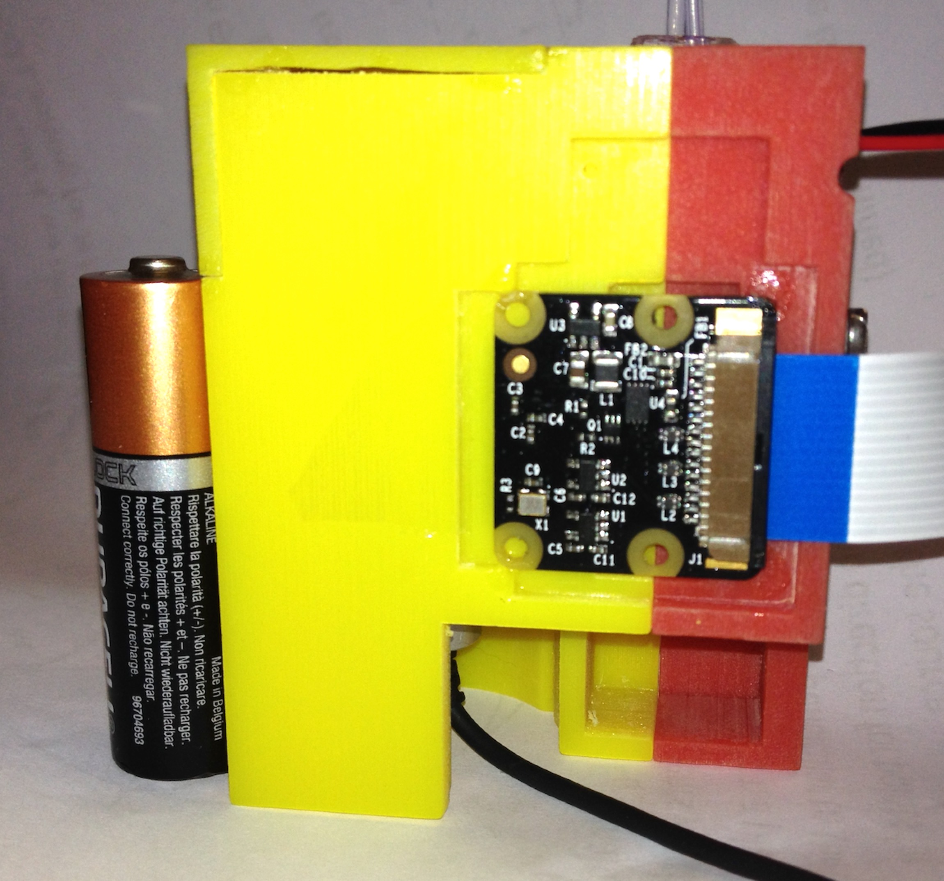
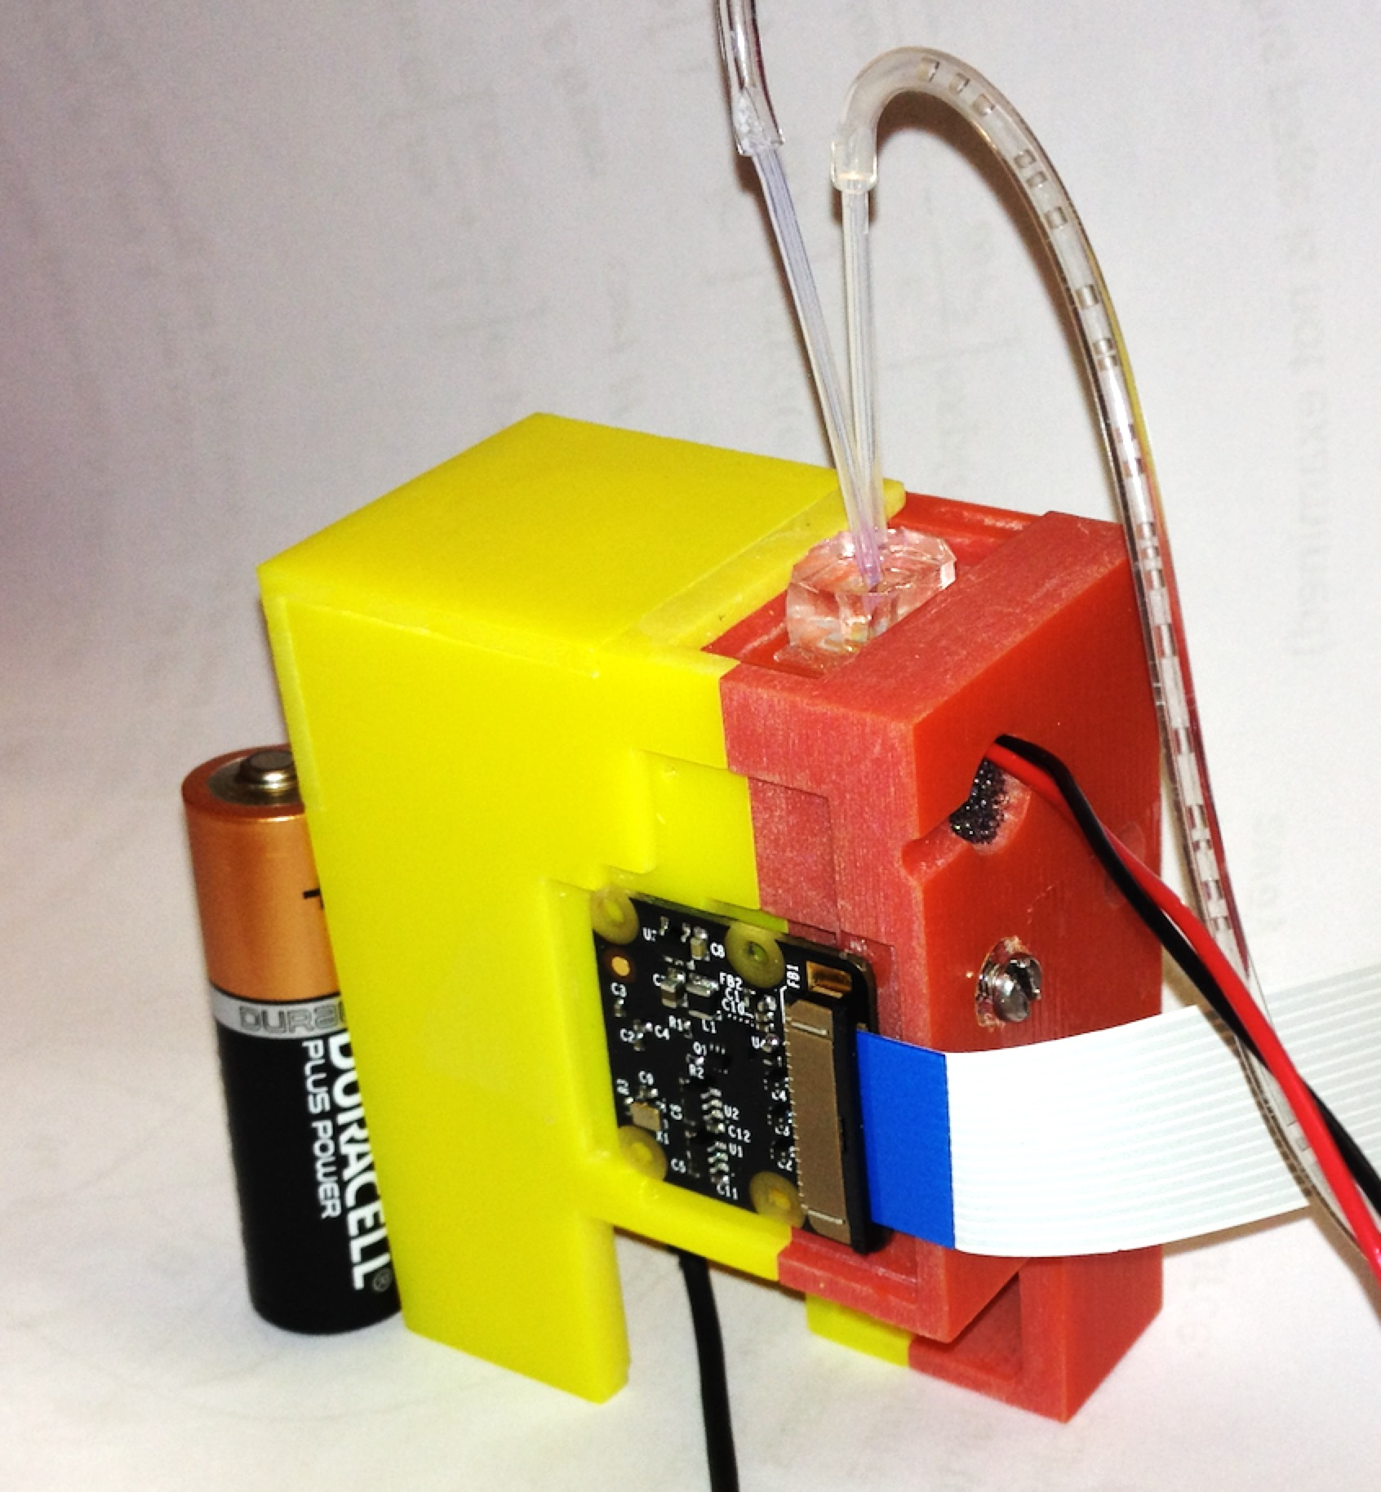
Autonomous sensor
Cost of components £10-£40
“IMPROVED SENSOR AND ASSOCIATED METHODS” UK Patent Application No. 1610647.8

Slide 12
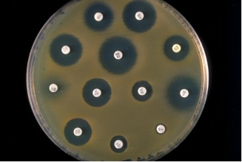
Towards a fast test
Our test works in the vertical direction cf the agar test that works in the horizontal.

Slide 13
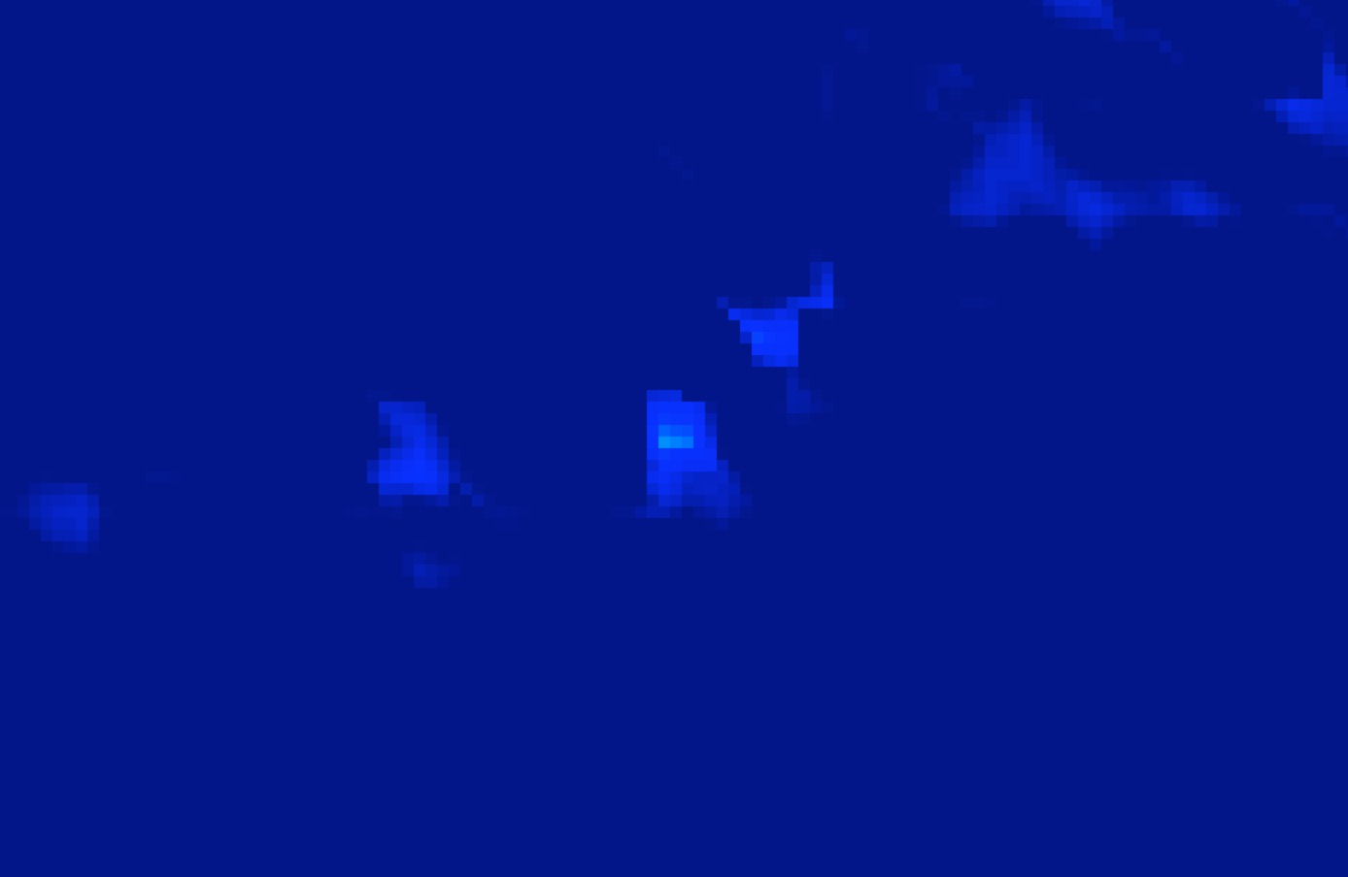
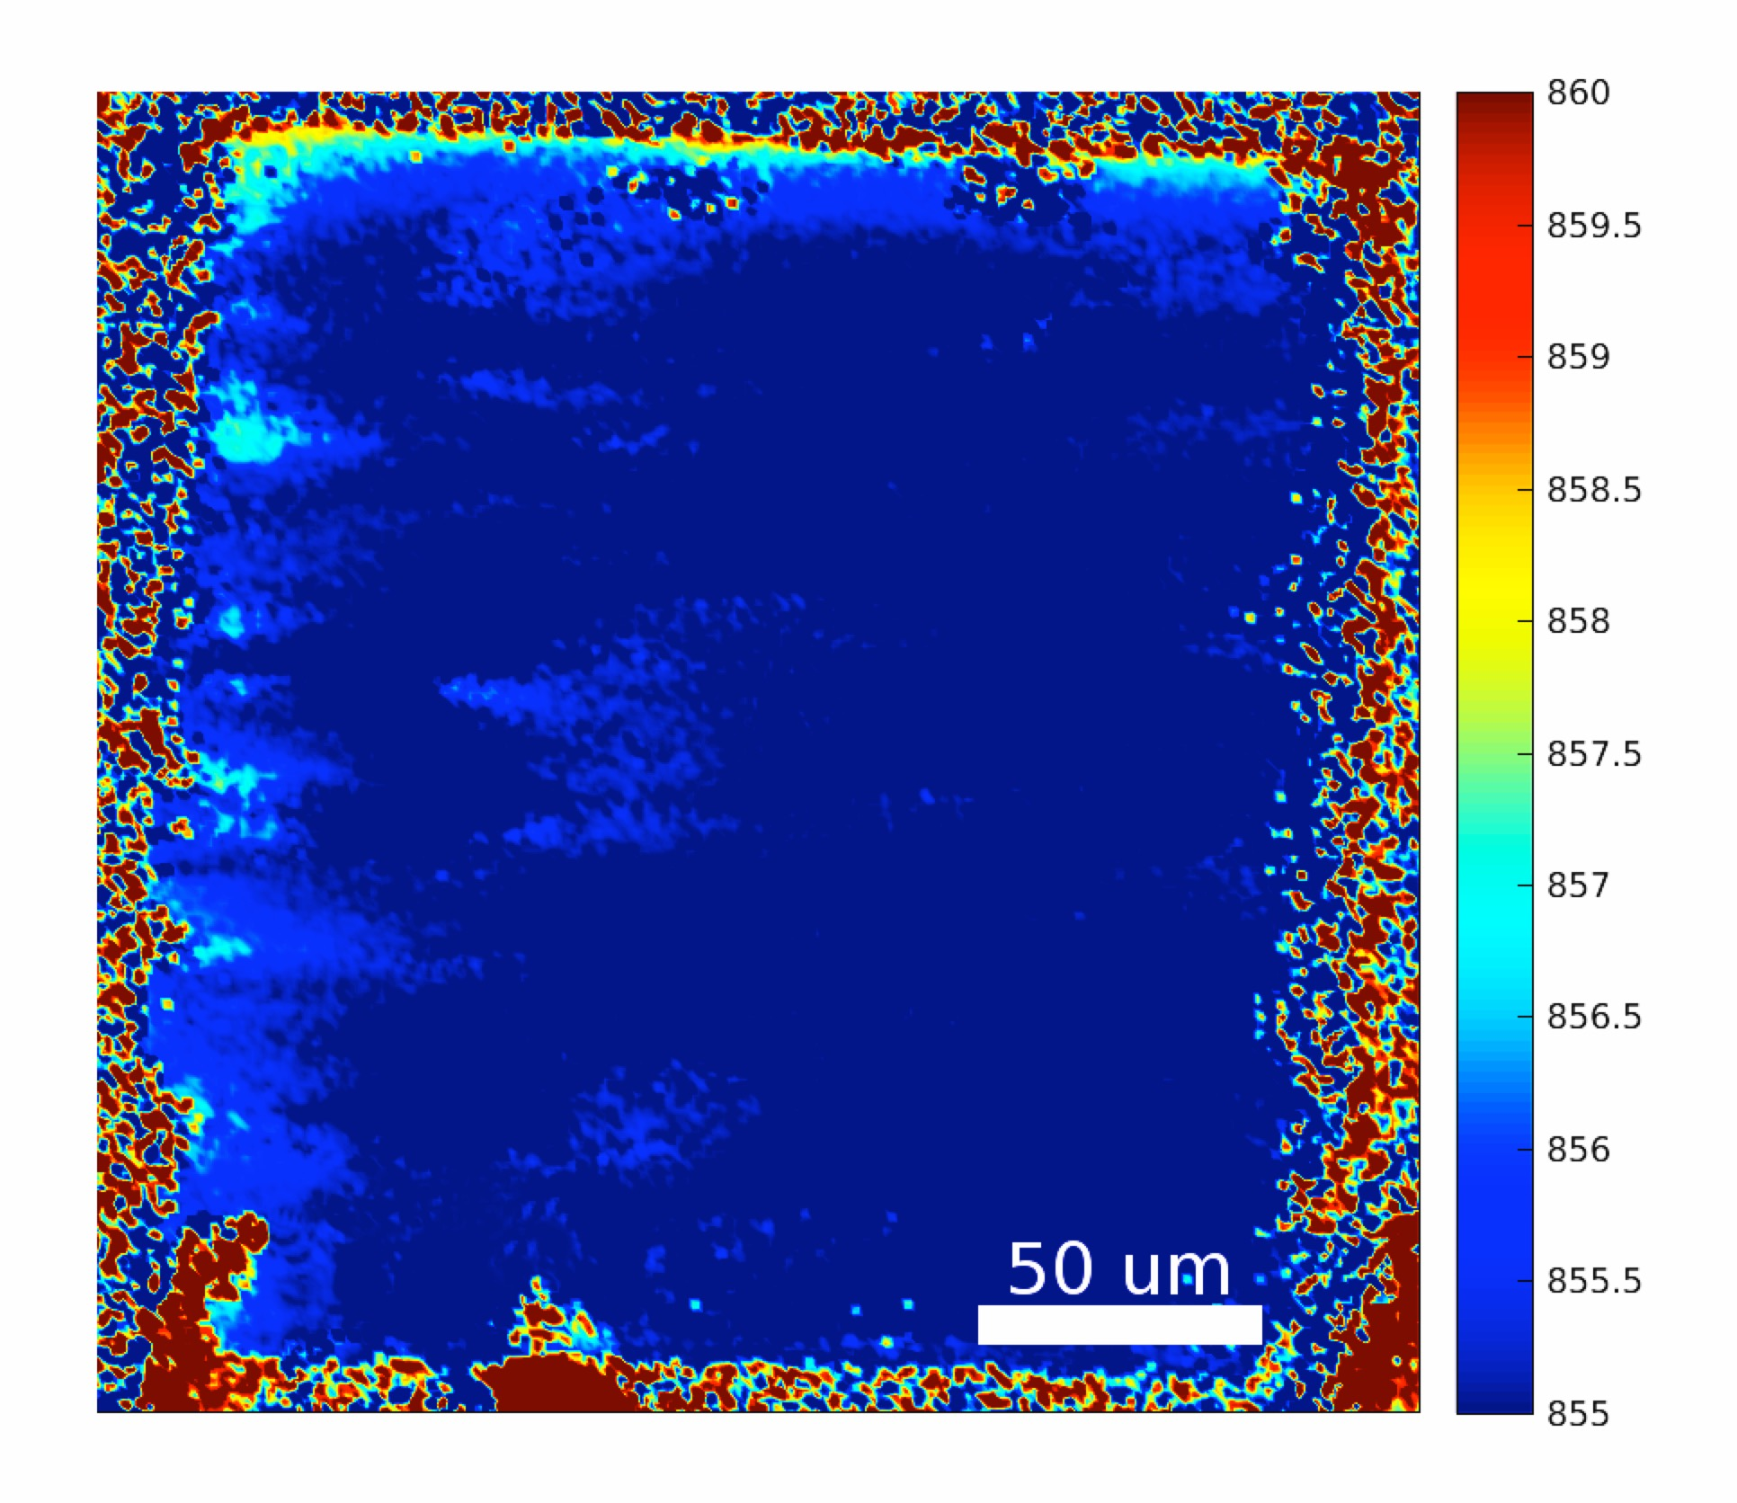
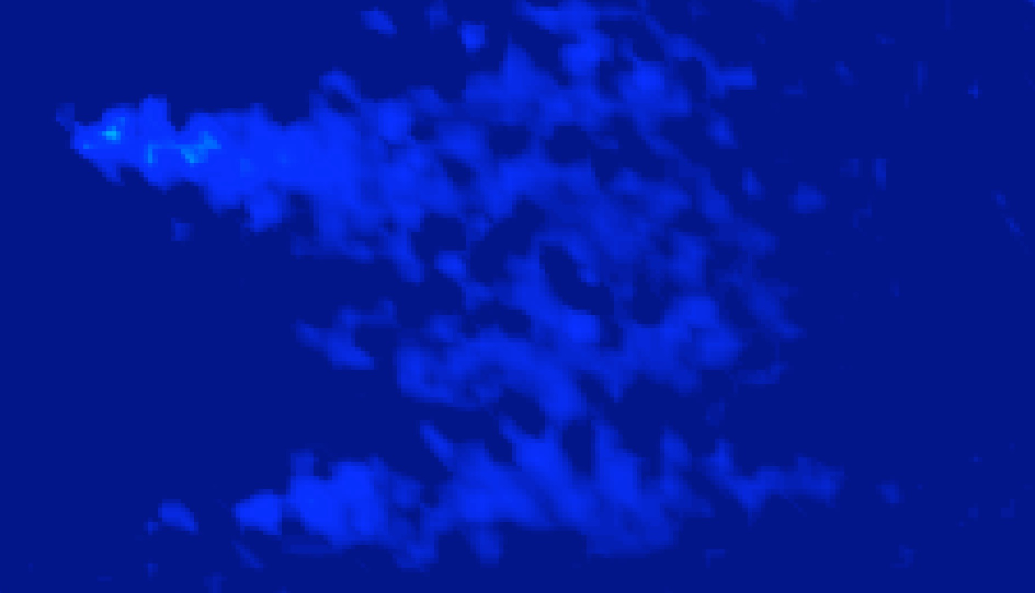
Individual bacteria
3µm
The test can look at individuals or small clusters of bacteria.
5µm

Slide 14
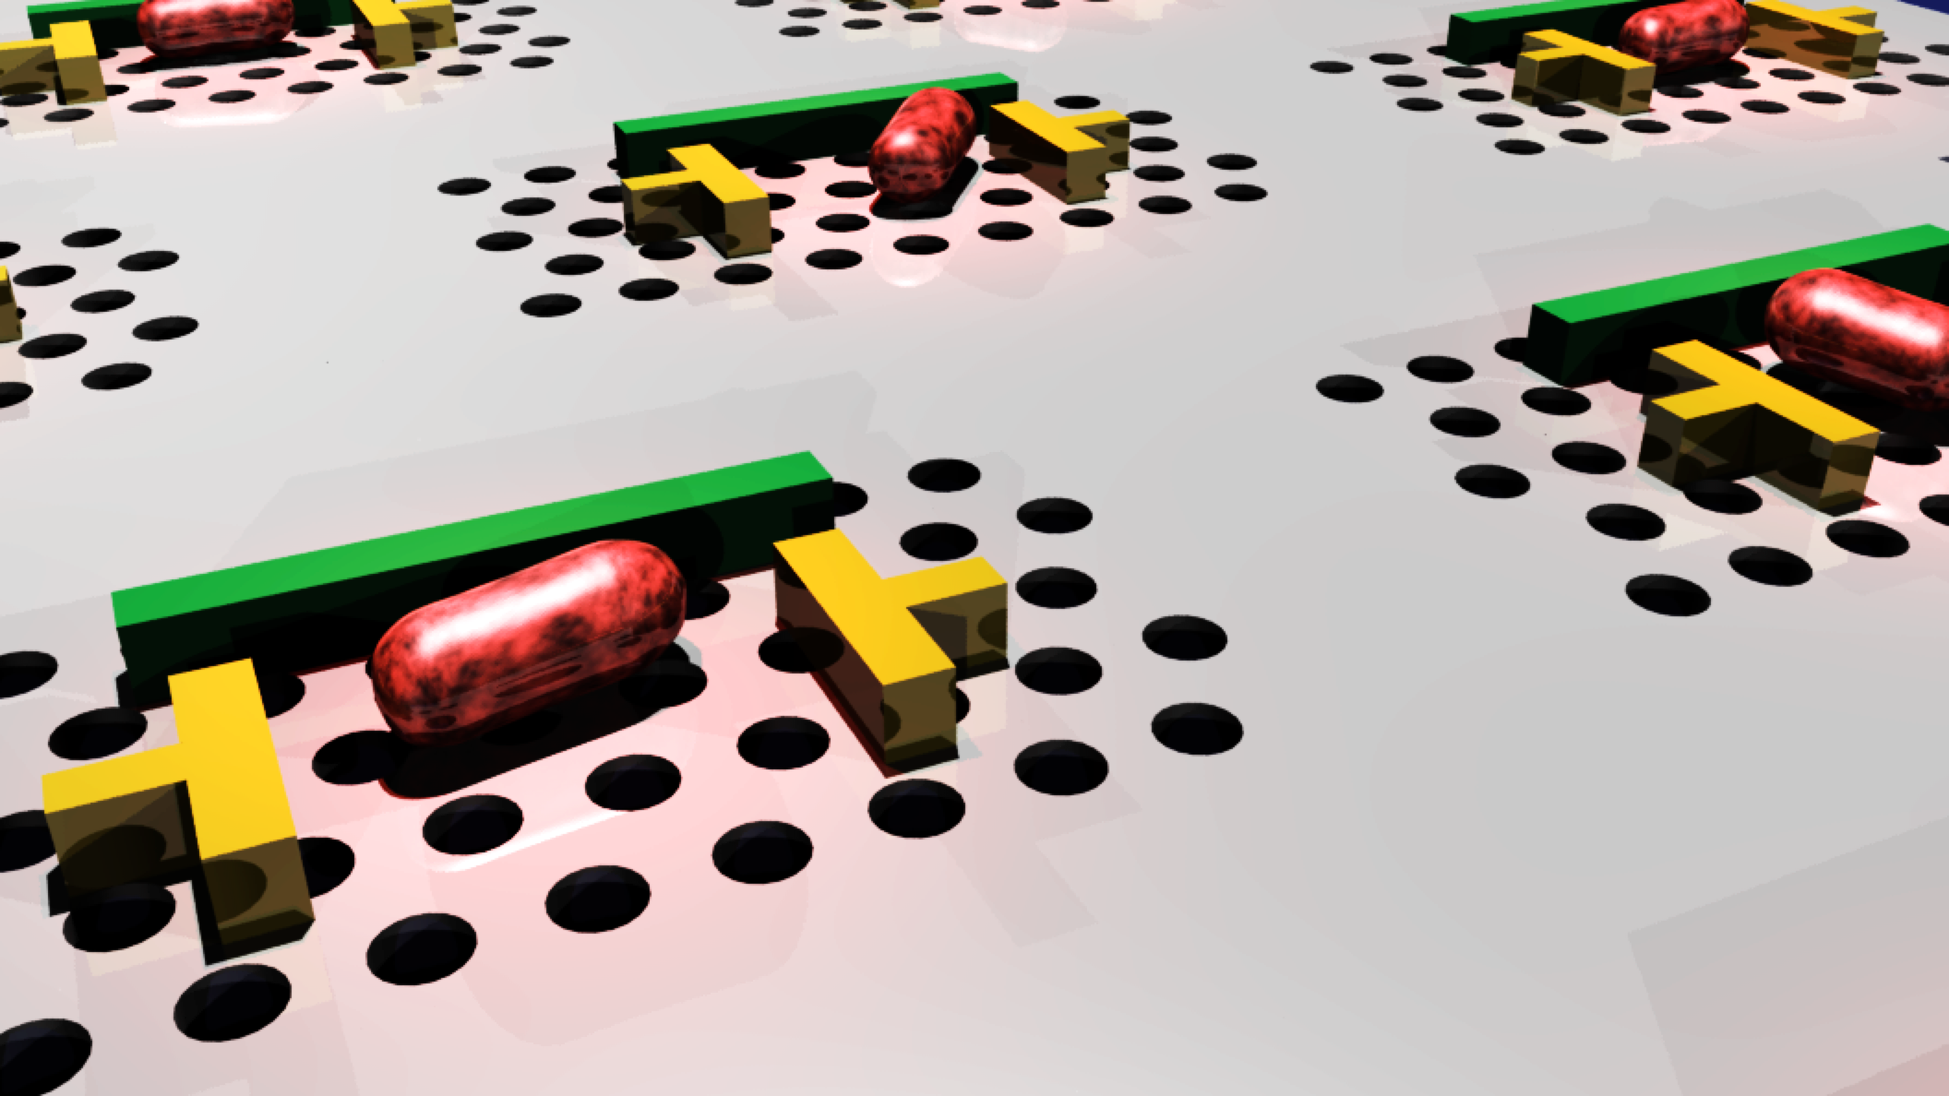
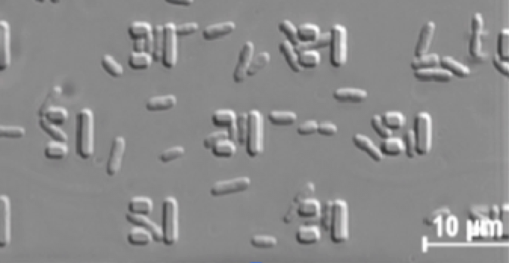
Trap ndividual bacteria
C. Probst, A. Grünberger et al., “Polydimethylsiloxane (PDMS) Sub-Micron Traps for Single-Cell Analysis of Bacteria“, Micromachines 4, pp.357-369 (2013)

Slide 15
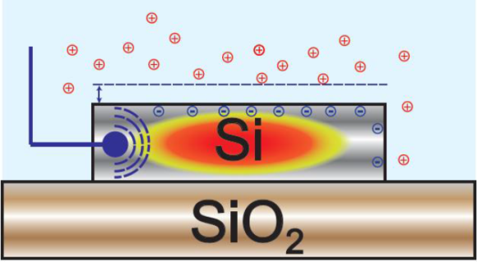
Electrophotonics
J.J. Colas, TF Krauss, SD Johnson et al., “The electrophotonic silicon biosensor”, Nature Comms 12769, 2016
G.N. Stewart, "The changes produced by the growth of bacteria in the molecular concentration and electrical conductivity of culture media”
Journal of Experimental Medicine. 4, pp. 235–243 (1899)

Slide 16
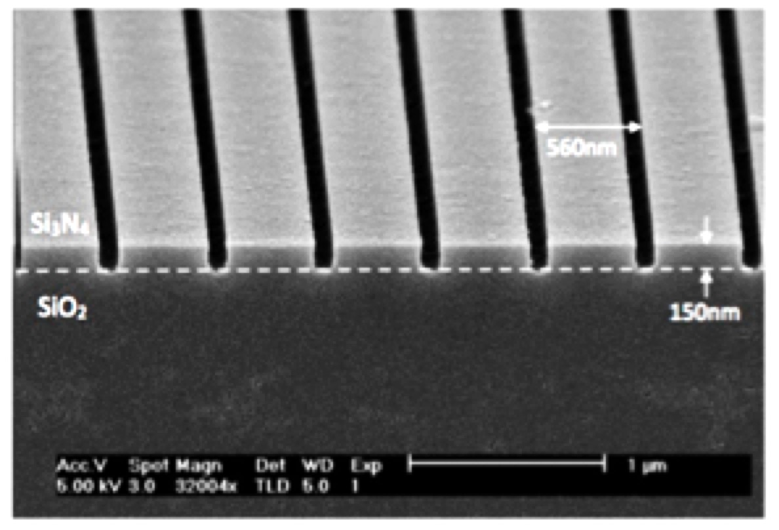
Conclusion
1. The surface sensitivity of our nanophotonic approach allows us to monitor biofilms and their response to antibiotics accurately.
2. The technique can be realised in a simple package (-> low cost)
3. Now working towards individual bacteria (-> high speed)

