Slide 1
Antimicrobial resistance in clinical practice: challenges and aspirations
Dr Abid Hussain
Consultant Microbiologist & Director of Infection Prevention & Control
Public Health Laboratory Birmingham
June 2017

Slide 2
Applying policy to clinical practice
Changing patient population
Healthcare Associated Infection (HCAI) trends
Paucity of new antibiotics
Changes in antimicrobial resistance
How do we deliver safe and effective patient care?

Slide 3
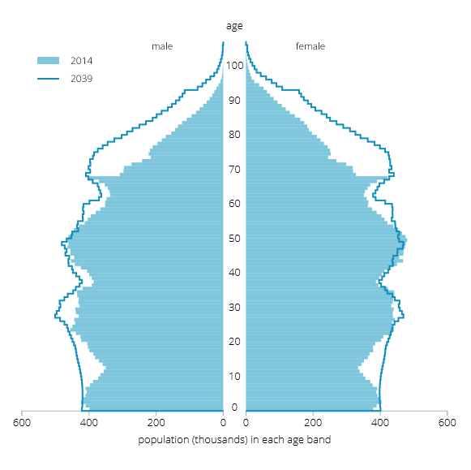
How is the population changing?
The UK population is projected to increase by 9.7m over the next 25 years (64.6m in 2014 to 74.3m in 2039)
The UK population is projected to reach 70m by mid-2027
Average age rising from 40.0 years in 2014 to 40.9 years in mid-2024 and 42.9 by mid-2039
By mid-2039, more than 1 in 12 of the population is projected to be aged 80 or over

Slide 4
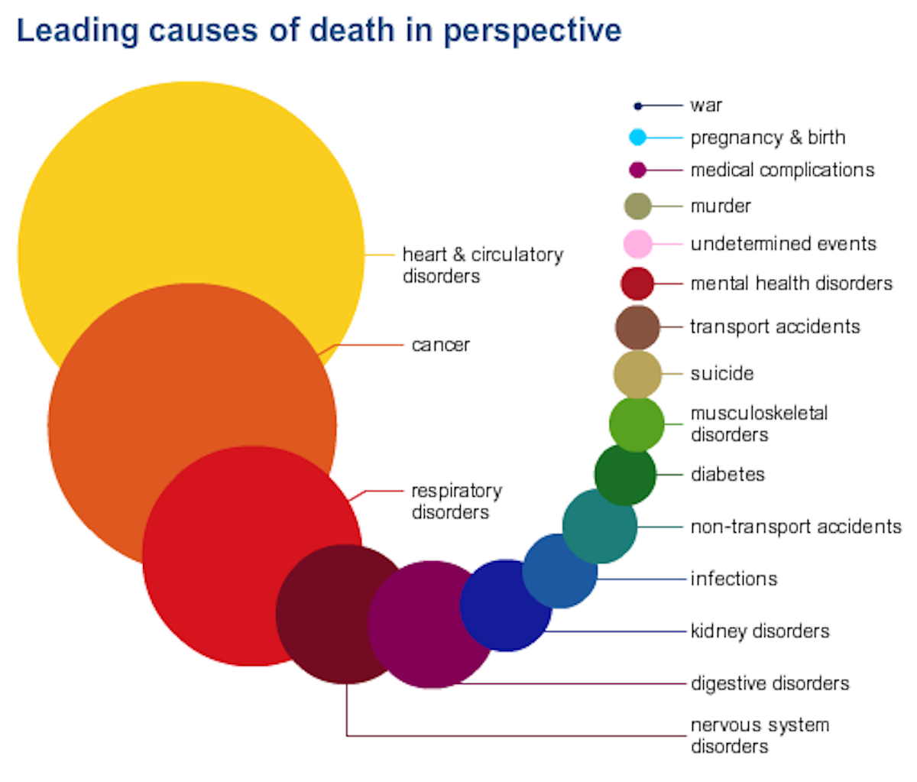

Slide 5
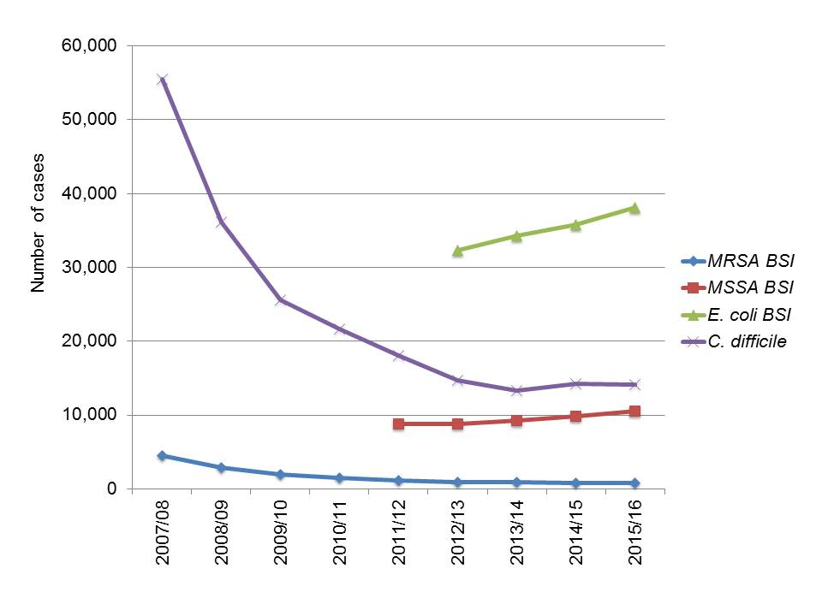
Health care associated infections
How are providers measured?
  Blood stream infections (MRSA, MSSA, E coli)
  Other infections (CDI)
  Prescribing of antimicrobials
Data submitted to Public Health England
Key trends:
  Blood stream infections
  CDI

Slide 6
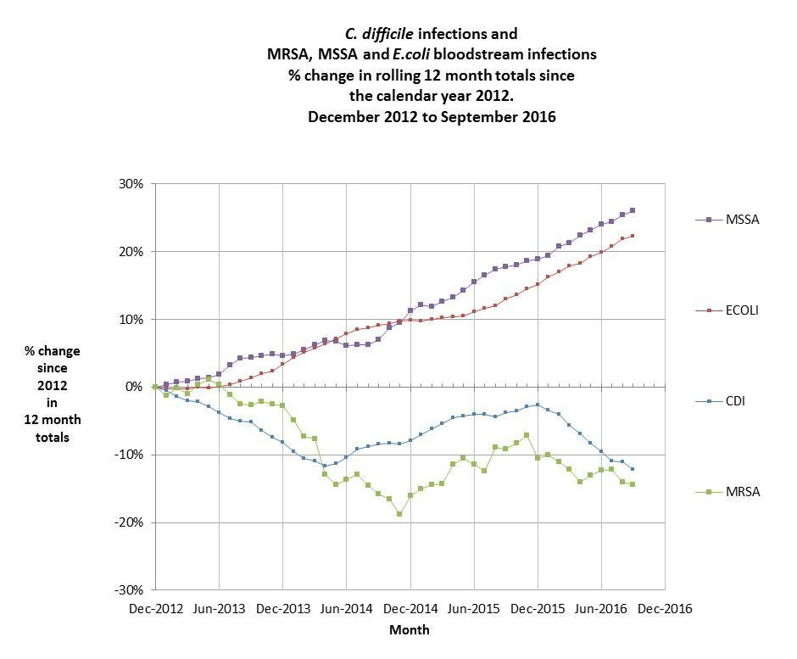

Slide 7
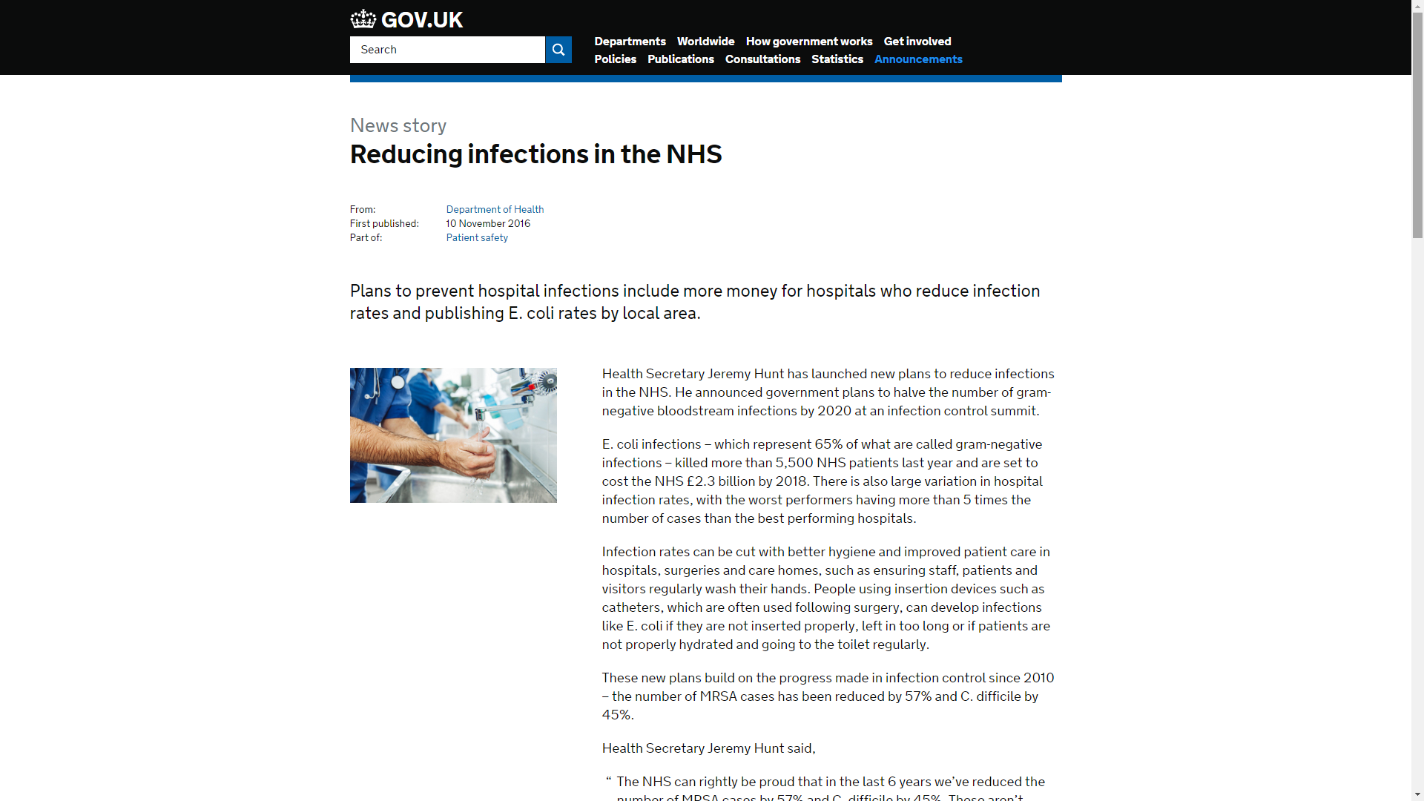
…the NHS publishing staff hand hygiene indicators for the first time…
…independent Care Quality Commission (CQC) inspections focusing on infection prevention based on E. coli rates in hospitals and in the community, and taking action against poor performers….
….A third of E. coli infections are now resistant to antibiotics and those who are infected with a resistant strain are twice as likely to die ….. E. coli infections have increased by a fifth in the last 5 years. Targeting preventable infections like E. coli helps to make care safer for patients….
…displaying E. coli rates on wards, making them visible to patients and visitors in the same way that MRSA and C. difficile are currently…

Slide 8
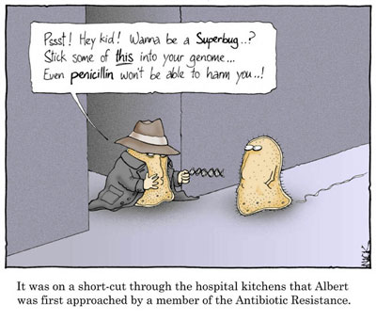
What we healthcare staff do?
Screening
Cleaning
Hand hygiene
Antimicrobial prescribing

Slide 9
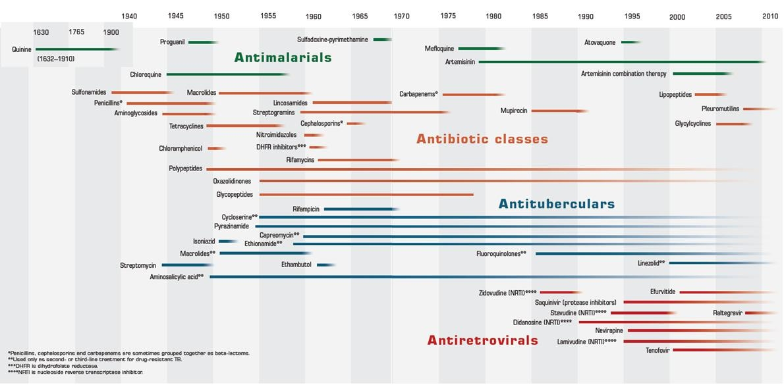
Antibiotic pipeline

Slide 10
Sepsis
Broad spectrum antibiotics
Ineffective stewardship
Resistance
Older antibiotics
Poorer outcomes

Slide 11
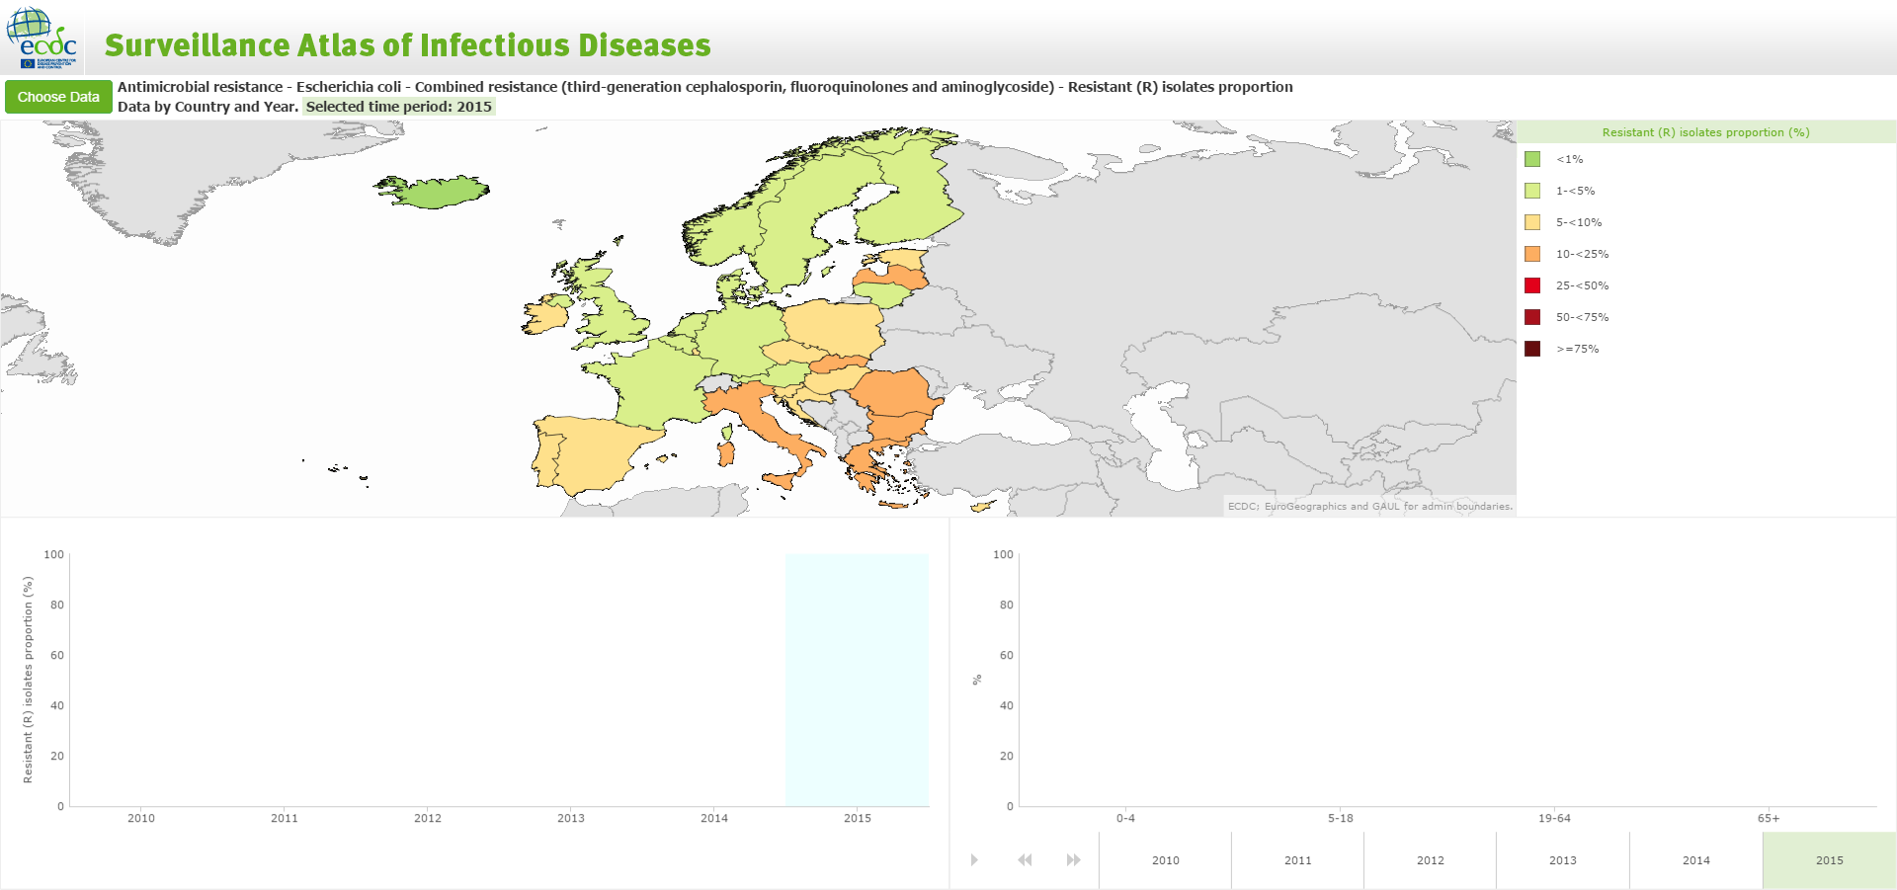
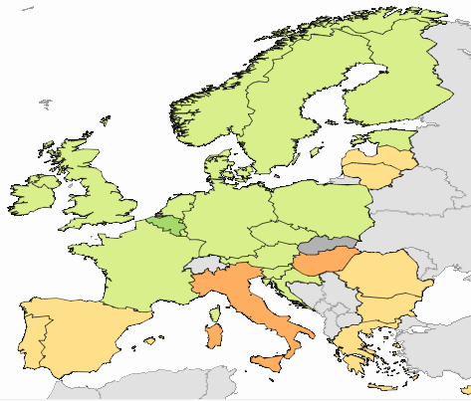

Changes in Antimicrobial Resistance
MDR-E coli reports 2005-2010
MDR-E coli reports 2010-2015
Local data surveillance is key

Slide 13
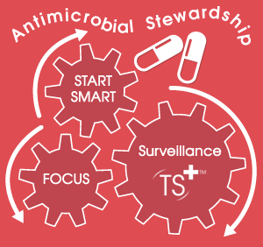
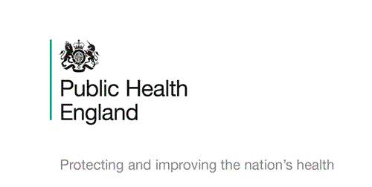




How do we deliver safe and effective patient care?

Slide 14
Pathogen
AMR
Place
Practice
Patient

Slide 15
Antimicrobial Use
Prompt Treatment
Expectation
Antimicrobial resistance
HCAI
Agriculture
Organisms

