Slide 1
NI AMR Network
Collective Insight, Scientific Excellence
Notes:
Scientific excellence all across the UK. We need to act with collective insight to bring this expertise together to solve AMR issues – or we will not succeed. NI AMR Network is the first regional ‘One-Health’ focused AMR group. Approx 200 members, we represent AMR capability and capacity within Northern Ireland. Focus is on creating cross-sector networking & multidisciplinary links.

Slide 2

Leading a
One Health approach to solve AMR issues through collaboration
Academia
Business
Clinicians &
Veterinary
Pharmacists & Scientists
Government

Slide 3
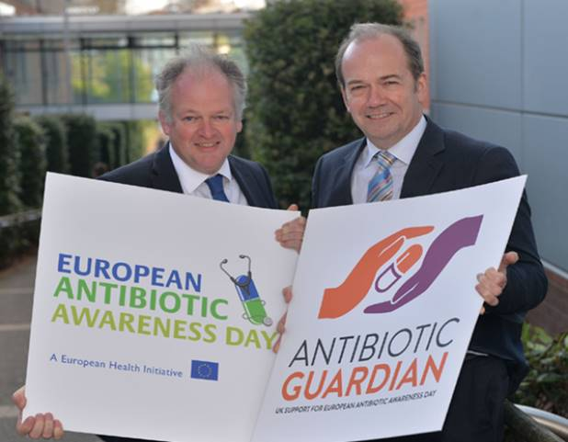
One Health AMR is more than just ‘labs’
  Diagnostics
  New Therapies
  Farm, Food + Environment
  Antibiotic Stewardship
  Changing Behaviour
  Process
  Data Analytics / Learning Models

Slide 4
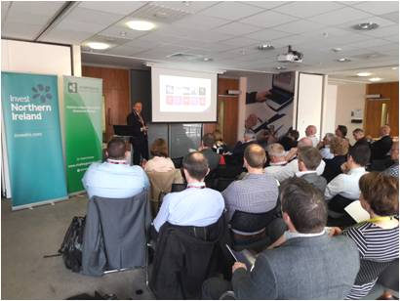


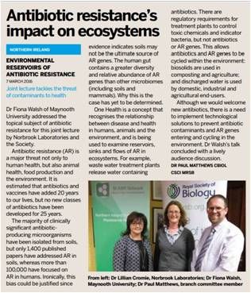
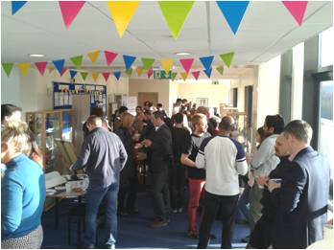





Network Activities
Cross Sector Meetings
Government Engagement
Public Engagement
Industry Engagement
Specialist Events
Leveraged Funding
Leveraged funding: €51M EU H2020; £15M RCUK; £2M Health Technology Hub at Ulster

Slide 5

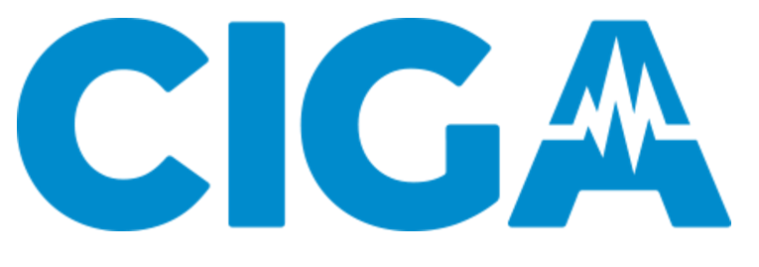




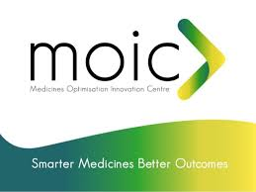
Capability Examples
Diagnostics
Drug Discovery
Data Analytics
Digital Devices
Food Production
Meds Optimisation

Slide 6
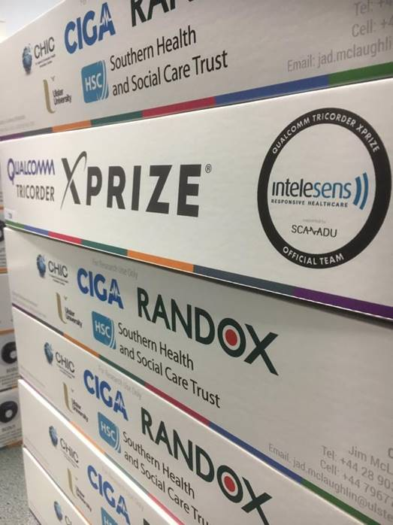
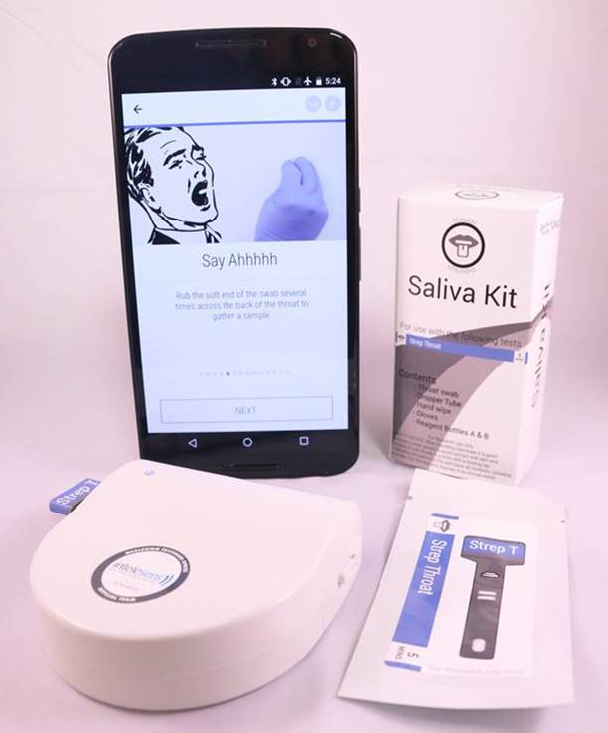

Cross Sector Research

Slide 7
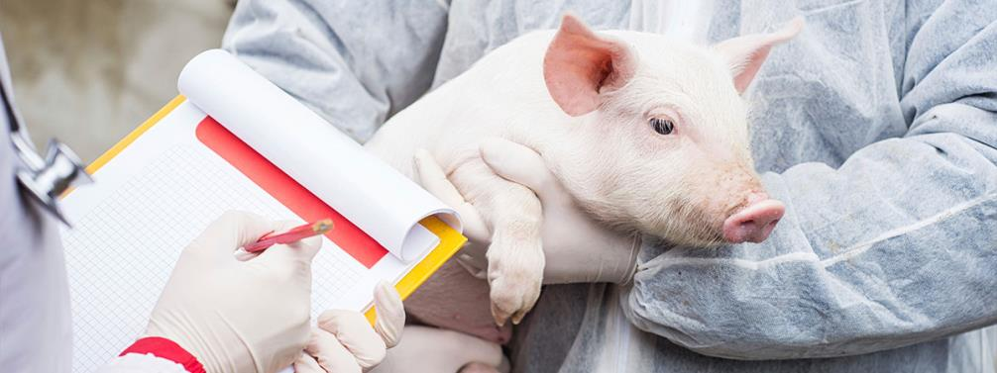


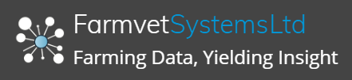
Cross Industry Engagement
Diagnostic capability into veterinary medicine

Slide 8
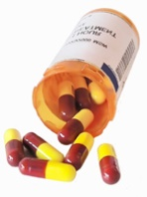








What Did We Learn? It won’t be solved in the lab
Presenting
Infection
Initial Treatment
Administer
Test
Transport to Labs
Process Test
Reporting
Treatment
Decision
Key Wastes Known in Current Process
Unquantified Resistance Impact Areas
Wide spectrum/over prescribing in absence of diagnostics
Delays to decision
Reduced health outcomes of resistance or late treatment
Inconsistent regional prescribing patterns
Patient adherence to medicines guidance
Food chain and environmental treatments

Slide 9
What Did We Learn?
1
Changing behaviour re antibiotic usage is challenging –
provision of information is not enough
Pockets of medicines management excellence exist –
opportunity to learn and share current best practice
Historical antibiotic use and infection rate data is in use today –
opportunity to progress to machine learning and modelling
Data mining is focused on trend analysis of historical information – unrealised real time interventions possible with joined data
Veterinary and farming embracing new technology –
potential for data to cross health, veterinary and food production
Strong appetite for cross disciplinary One Health collaborations –
we must expand ambition of cross-sector work to address AMR
2
3
4
5
6

Slide 10
Ambition: UK Regional Data - One Health AMR
Bio Markers and Scientific Discoveries
New Data: Diagnostic sensors
Discoveries
Data
Existing Health Data : Infection
Existing Health Data : Prescribing
Data Techniques
Diagnostics
Devices
Algorithms
Materials
Bio Markers
Behavioural Influences
Policy Implications
Machine Learning Processes
Veterinary
Prescribing and Infection Control
Food Production: Infection Control

Slide 11


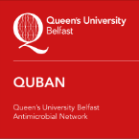


Tackling Antimicrobial Resistance -
A Cross-Sector, Multidisciplinary Approach
Dr Patrick Dunlop (psm.dunlop@ulster.ac.uk)
Nanotechnology and Integrated Bioengineering Centre (NIBEC),
Ulster University, Northern Ireland
www.amrnetwork.org @NIAMRNetwork

