Slide 1
Targets in E. coli bloodstream infection: implications for AMR
Dr Esther Robinson 15/6/17
Lead Public Health Microbiologist for East Midlands

Slide 2
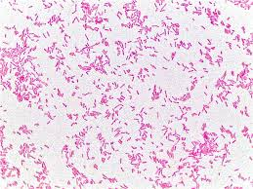
E. coli blood stream infections
Commonest cause of bacteraemia (blood stream infection)
Rising incidence

Slide 3
E. coli bacteraemia: antibiotic resistance

Slide 4
Why set a target for E. coli blood stream infections?

Slide 5
Do targets work? the “MRSA miracle”

Slide 6
So it will work for E. coli?
Rates rising despite improved IPC
So what’s the intervention?
Who, when, why?
West Midlands E coli bacteraemia data
High impact interventions including urinary catheter care bundles
Clean your hands
Mandatory reporting introduced mid 2011

Slide 7
Where?

Slide 8
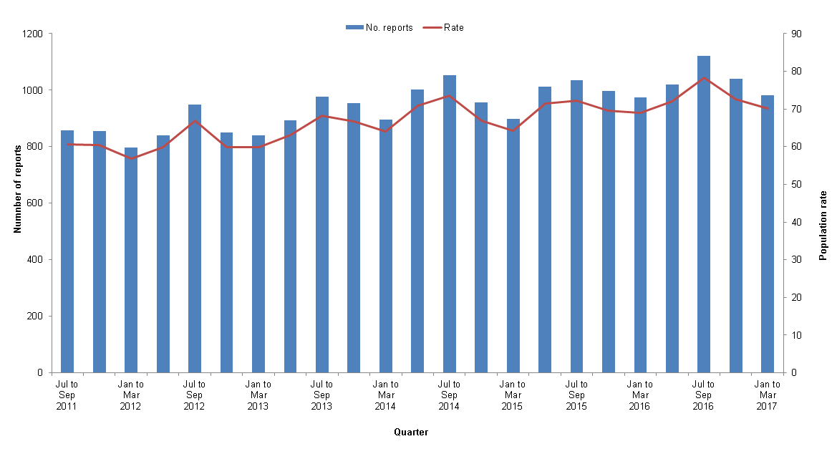
Quarterly E. coli bacteraemia counts and rates per 100,000 population, West Midlands, July - September 2011 to January - March 2017

Slide 9
When and why

Slide 10

Conflicting objectives?
Decrease broad spectrum antibiotics primary and secondary care
Shorter courses
Narrower spectrum
10% reduction E coli bacteraemia this financial year
Rapid treatment sepsis

Slide 11



Targets and gaming
A number of obvious (but wrong!) ways to rapidly affect E. coli bacteraemia rates
Take fewer blood cultures
Give antibiotics before blood culture
Give all over-85s antibiotics during hospital admission

Slide 12
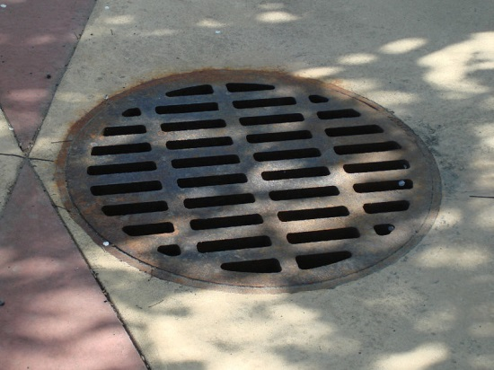

What should we do?
Better data- enhanced mandatory surveillance from Apr 2017
Better data integration- resistance rates, prescribing, sampling
Model interventions for beneficial and adverse effects
Model interventions: biggest “bang for buck"
Likely not one size-fits-all
Are we asking the right question- more AMR focused targets?
Are we asking the right question- environmental and community transmission?

