Slide 1
Medicines Discovery Catapult
Directing Industrial Stimulus via Community Collaboration in Life Sciences
Richard Seabrook, Senior Advisor, Translational R+D

Slide 2
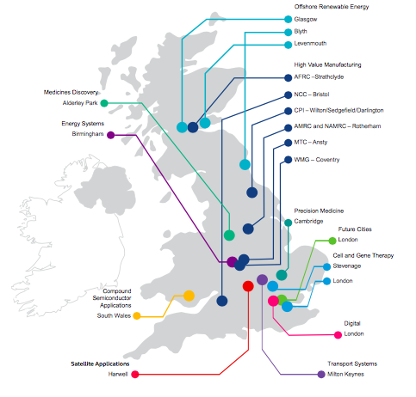

Slide 3

Why Health Catapults Exist

Slide 4
Our Objectives
Raise the tide for UK Medicines discovery by
  Therapy Focus AMR, CNS, Inflammation
  Patient Relevance
  Collaborative Technology Development
  Translating academic assets into the community
  Supporting national initiatives at the academic/industry interface
  Collaborative Informatics Innovation
  Demonstrating and promoting best practice in Virtual Discovery
  Sharing proven process improvements
  Channeling new streams of finance toward the community
  Helping reshape the regulatory pathway on a disease-by-disease basis

Slide 5
AMR is a MDC Priority: First Facility at Warwick

Slide 6
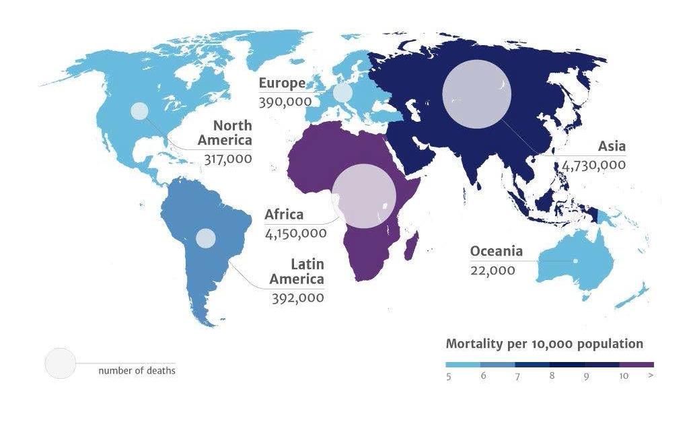
AMR Review 2050 Mortality

Slide 7

AMR Priority
Discovery and development of new ABX has slowed dramatically
Scientific barriers to drug discovery, regulatory challenges, and diminishing ROIs have led drug companies to scale back or abandon antibiotic research
All new ABX brought to market over the past 30 years have been derivatives of an existing class of antibiotic
The more widely ABX are prescribed, the higher the incidence of emergence of drug-resistant bacteria
Reducing use of ABX through appropriate stewardship will help slow this, but existing ABX will continue to lose their effectiveness over time

Slide 8
Technology and AMR
Satellites to DNA Sequencing

Slide 9
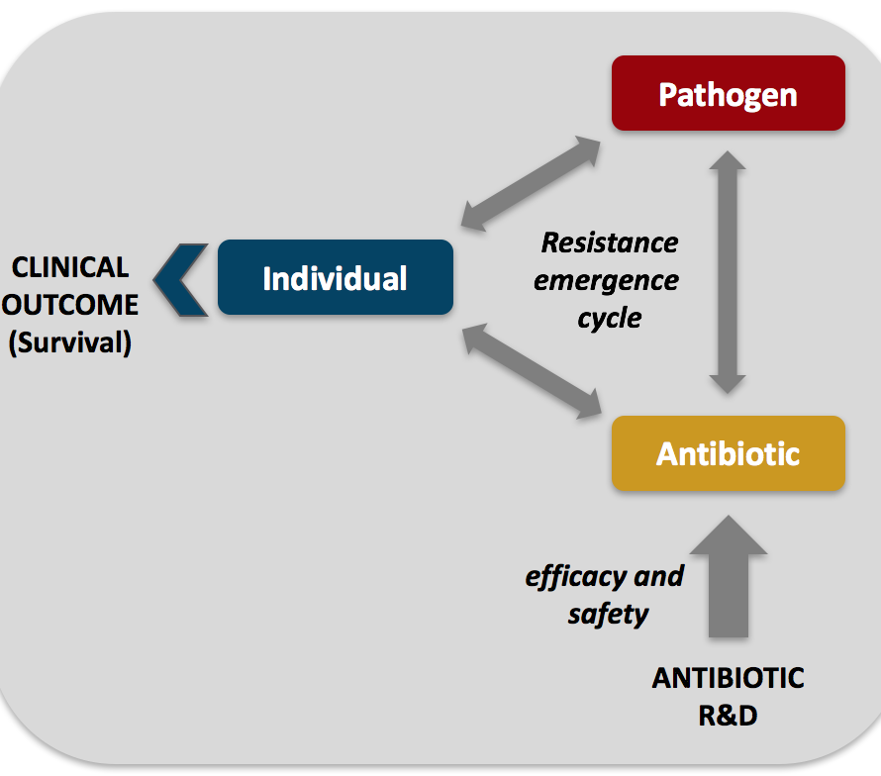
Current Paradigm Focused on the
Individual Scale

Slide 10

Cholera at Global Scale
Physical tracking technology include observing weather patterns, surface water temperatures, chlorophyll concentrations, and rainfall patterns.
Findings of correlations between these phenomena showed that infection rate of cholera is connected to water temperatures. Rising temperature causes algae blooms that host cholera bacteria, and rainfall and extreme weather patterns aid in spreading infectious hosts of cholera among water systems.
Climate change will have a profound impact on the spread of cholera

Slide 11
Evidence for several waves of global transmission in the seventh cholera pandemic
We show here that the seventh pandemic has spread from the Bay of Bengal in at least three independent but overlapping waves with a common ancestor in the 1950s, and identify several transcontinental transmission events.
Additionally, we show how the acquisition of the SXT family of antibiotic resistance elements has shaped pandemic spread, and show that this family was first acquired at least ten years before its discovery in V. cholerae.
Ankur Mutreia, Nature 477, 462–465 (22 September 2011)

Slide 12
AMR Has No Borders
The seventh cholera pandemic was the seventh major outbreak of cholera and occurred 1961 to the 1970s
Based on the strain called El TOR,
Started in Indonesia in 1961, Bangladesh 1963, India 1964, followed by the USSR by 1966.
It reached Italy in 1973 from North Africa and Japan and the South Pacific by the late 1970s. [
570,000 infections by 1991.
The spread of the disease was helped by modern transportation and mass migrations

Slide 13
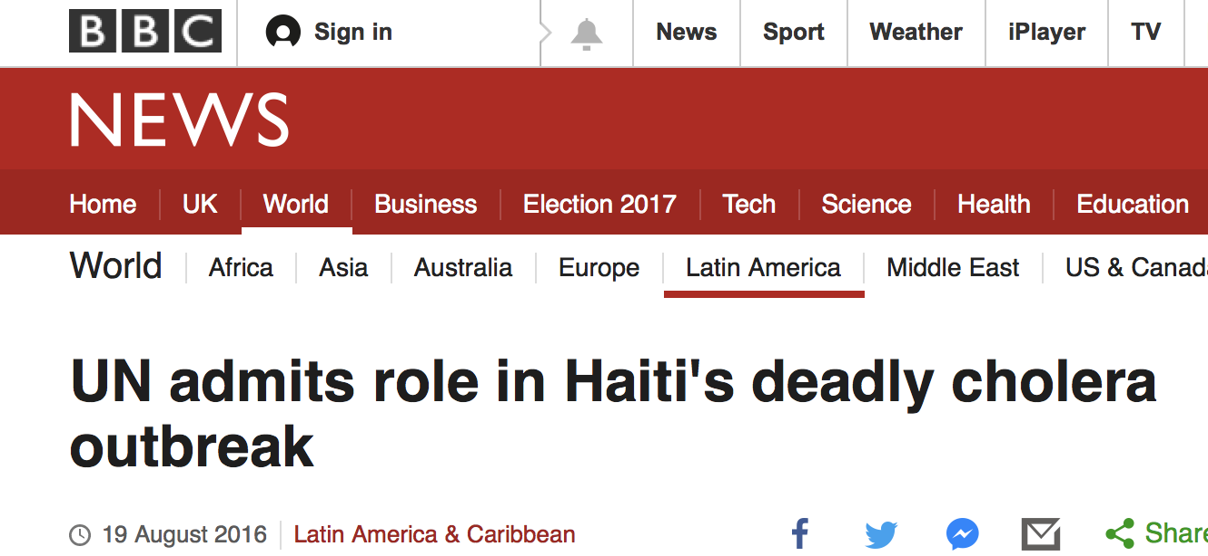
Unintended Consequences
The UN has finally acknowledged it played a role in an outbreak of cholera in Haiti in 2010 that
has since killed about 10,000 people in the country.
Scientific studies have shown that Nepalese UN troops were the source of the disease –
but the UN repeatedly denied responsibility until now.

Slide 14
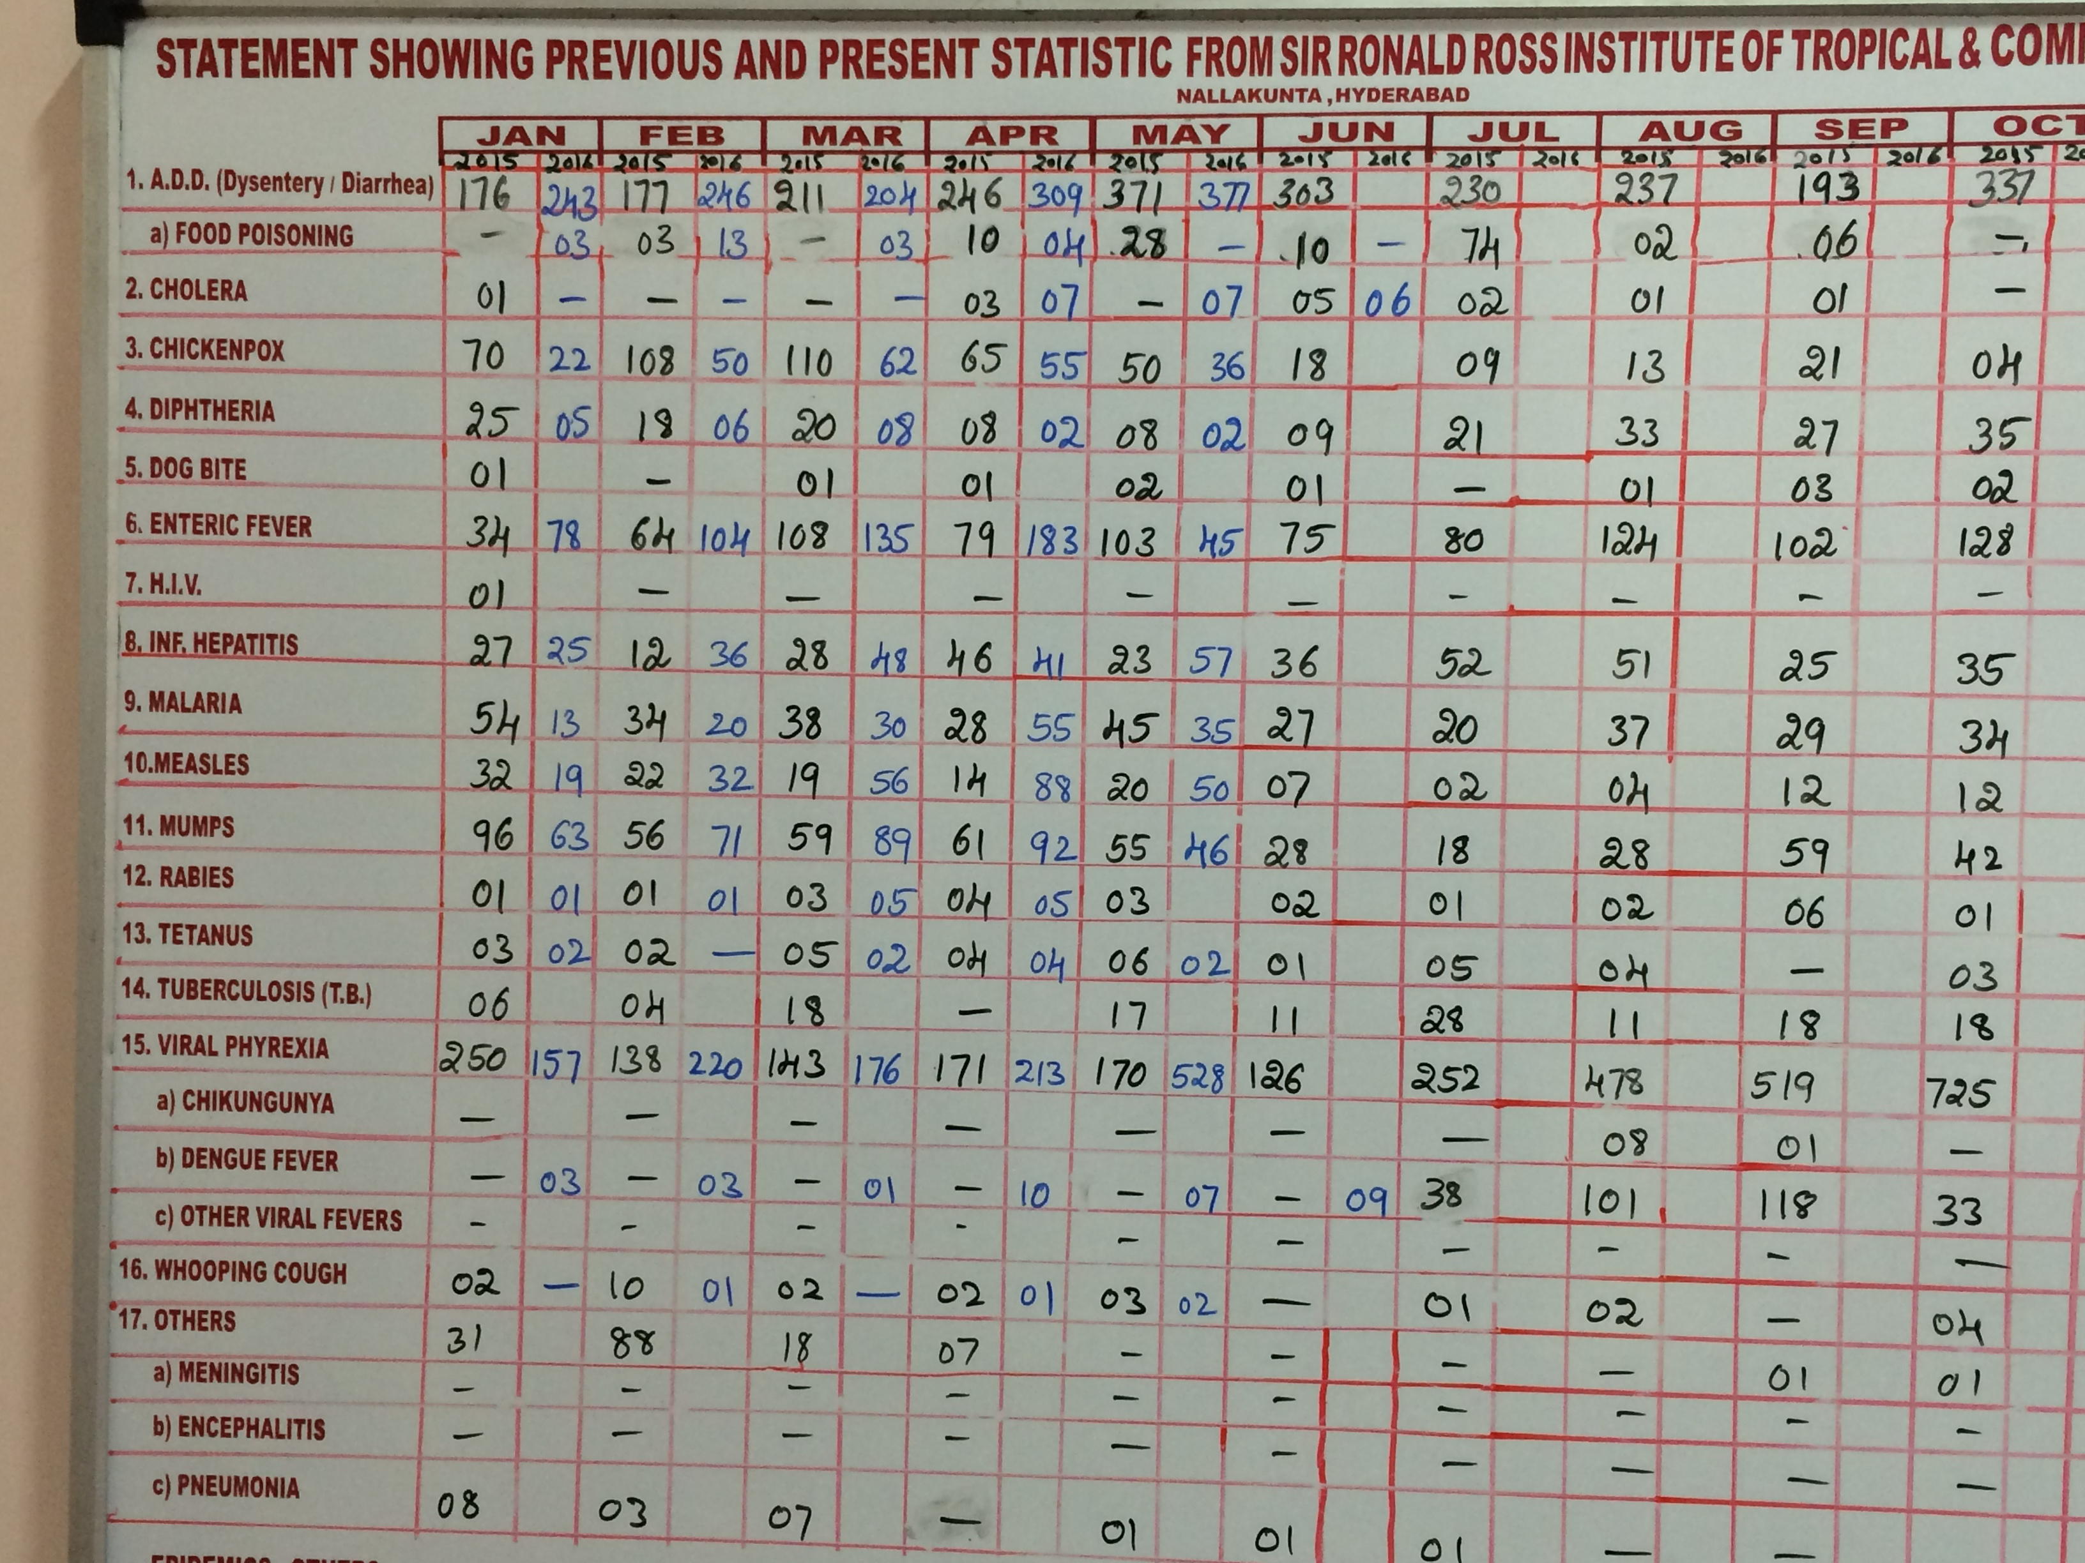

Resource Poor Environments
A Remaining Technology Challenge

Slide 15
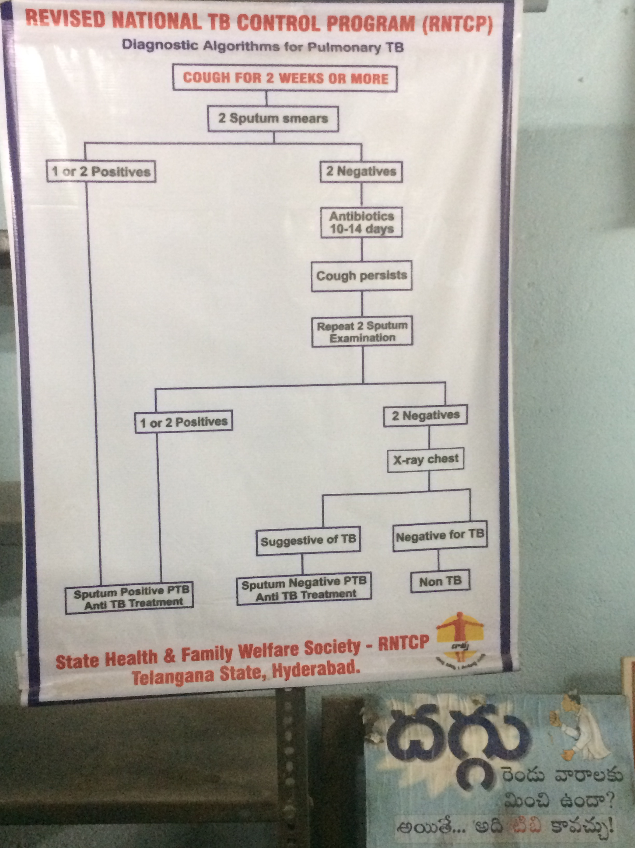
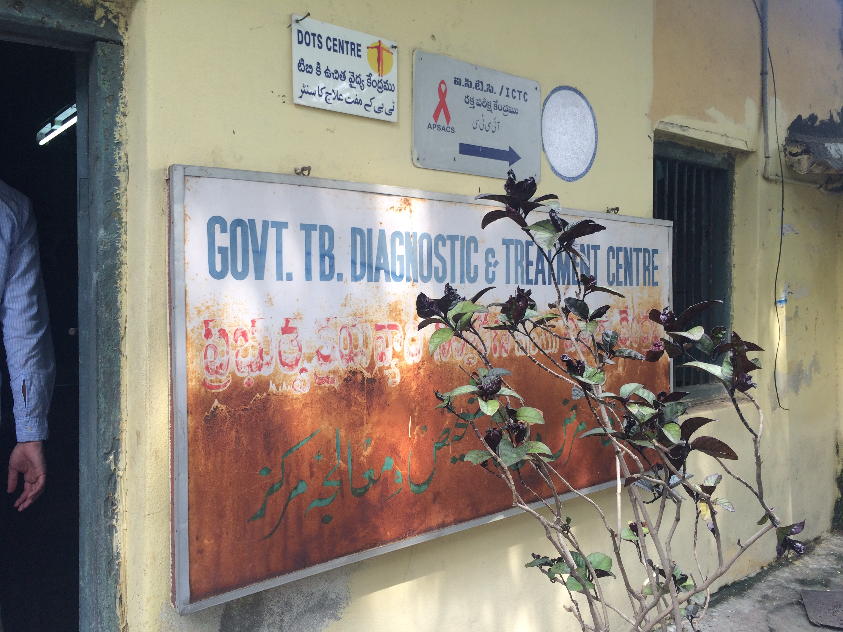
Affordable Diagnostic Algorithm for TB

Slide 16
Resource Poor Environments
Re-Designing Old Technologies
Design criteria: to create a robust, portable, affordable microscope
capable of diagnosing tropical disease at the health periphery
The provision of a portable microscope with fully integrated lighting, XY indexing and high quality optics
capable of diagnosing the blood-borne protists including malaria. The World Health Organisation recently
reaffirmed its conviction that microscopy remains the ‘gold standard’ for the diagnosis of malaria
despite the availability of RDTs (Rapid Diagnosis Tests).

Slide 17
Cholera: simple prevention technology
In one study spanning about 3 years, 65 villages in rural Bangladesh comprising 133,000 individuals, participated in an experiment in which they used folded sari cloth or nylon mesh filters placed over water pots to acquire safe drinking water from their local water ways
These inexpensive and readily available materials yielded a 48% reduction in cholera, when compared with the control: absence of any type of filter

Slide 18
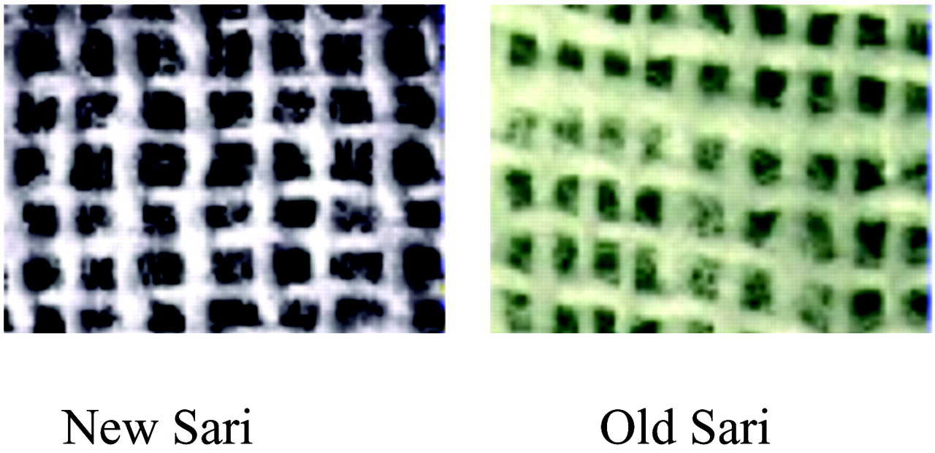
Electron micrographs of a single layer of sari cloth filters.
Pore size is 100–150 μm in old (laundered) sari cloth, but ≈ 20 μm if folded four to eight times.
Rita R. Colwell et al. PNAS 2003;100:1051-1055
©2003 by National Academy of Sciences
Notes:
Electron micrographs of a single layer of sari cloth filters. Pore size is 100–150 μm in old (laundered) sari cloth, but ≈ 20 μm if folded four to eight times.

Slide 19
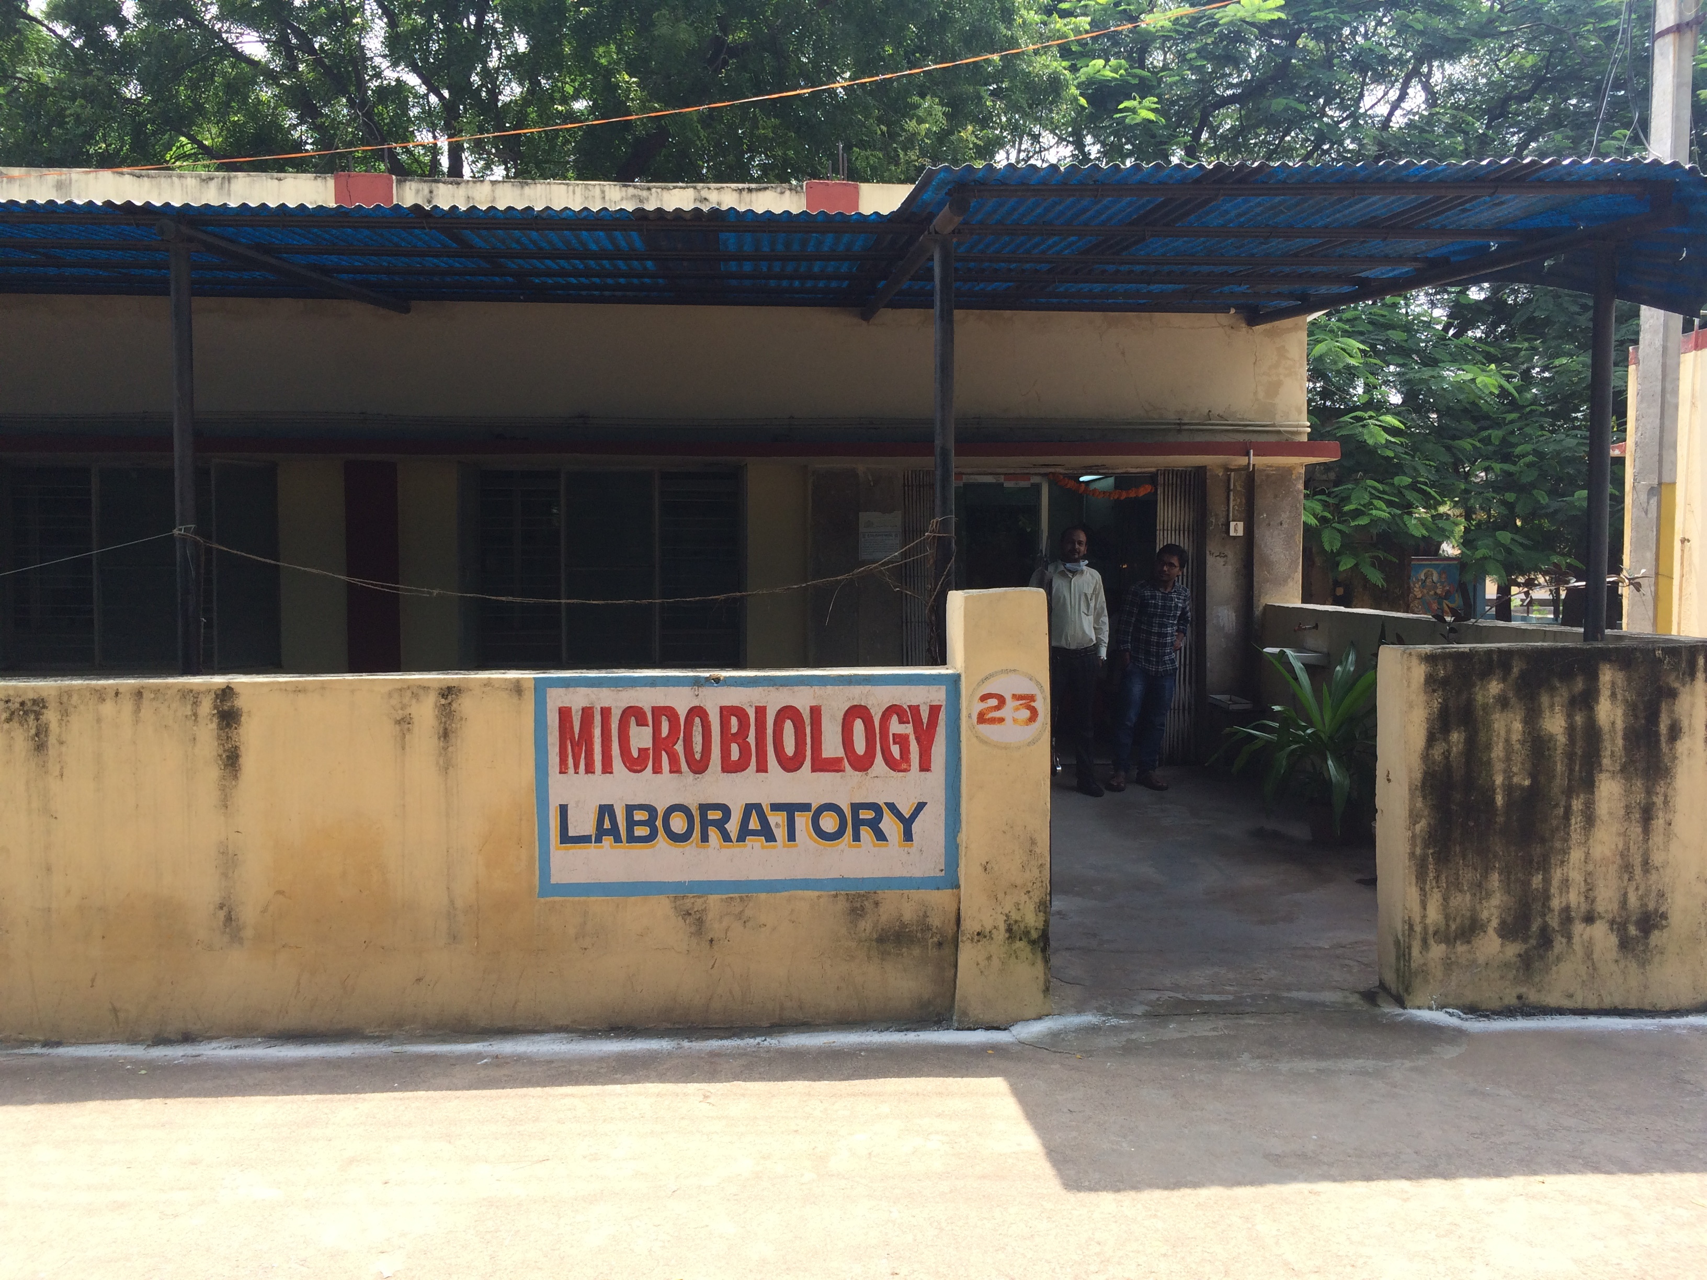
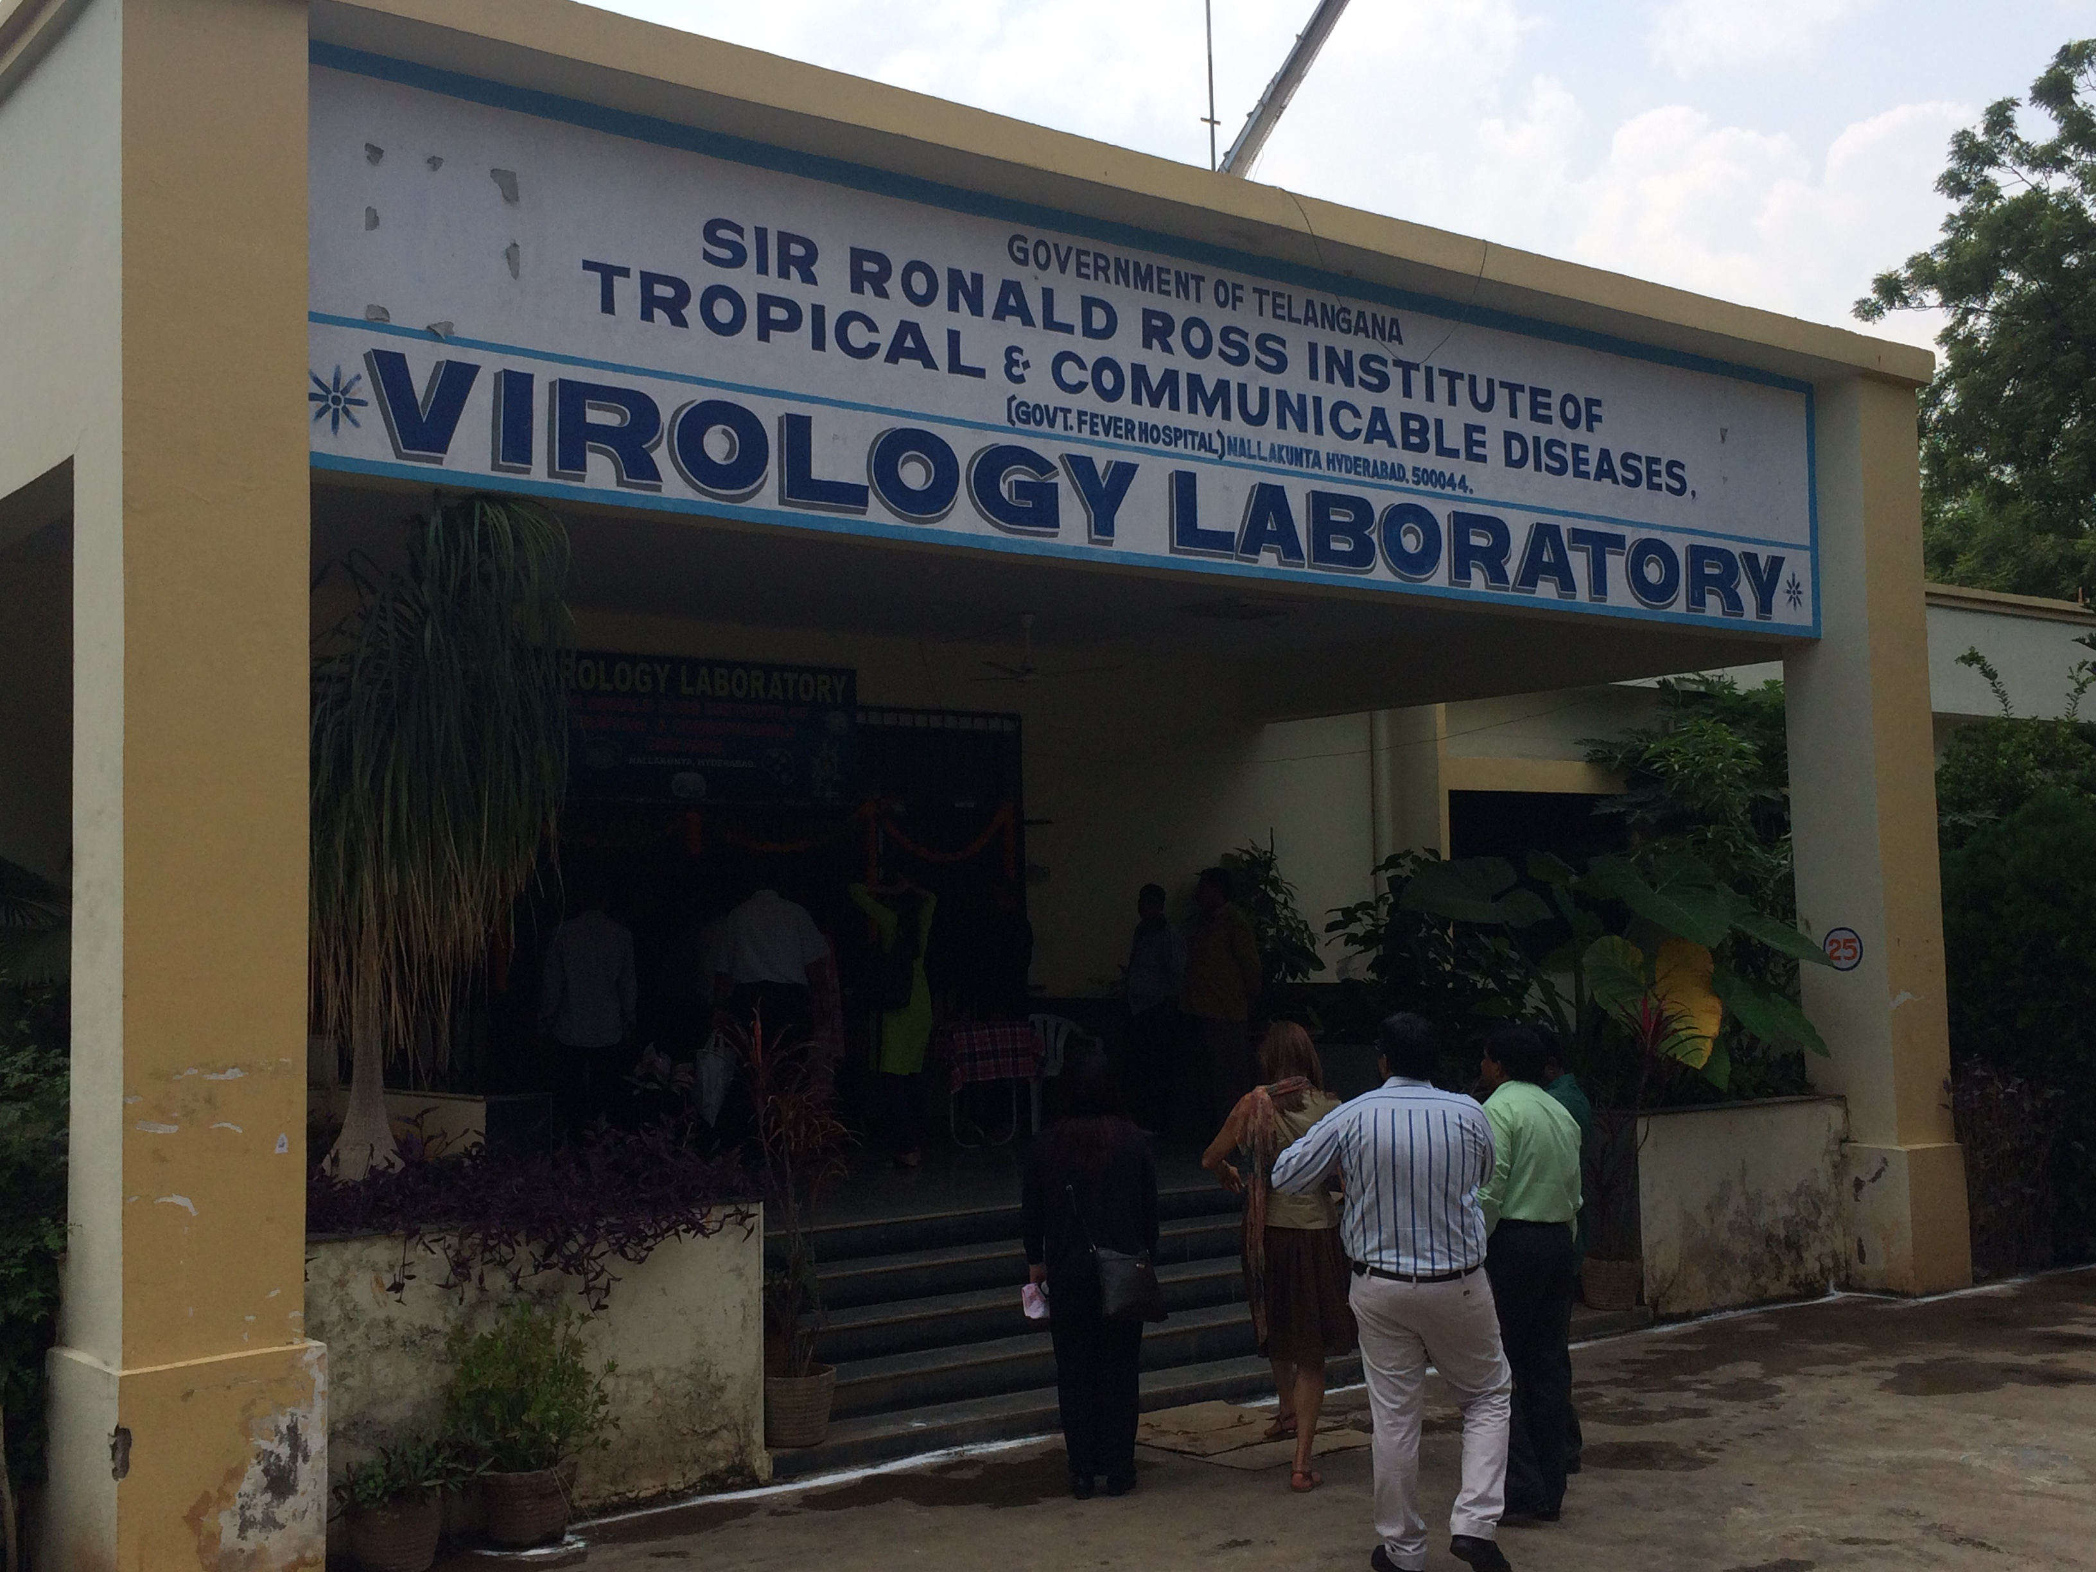
Appearances are Deceptive
Increasing use of Molecular Technologies Behind the Scenes at the AMR Frontier

Slide 20
Molecular Diagnosis, Surveillance and Tracking
Transformation in Economics

Slide 21

Whole-genome sequencing for analysis of an outbreak of meticillin-resistant Staphylococcus aureus: a descriptive study
Simon R Harris, PhD, Edward JP Cartwright, MBBS, M Estée Török, FRCP, Matthew TG Holden, PhD, Nicholas M Brown, MD, Amanda L Ogilvy-Stuart, FRCP, Matthew J Ellington, DPhil, Michael A Quail, PhD, Stephen D Bentley, PhD, Prof Julian Parkhill, PhD, Prof Sharon J Peacock, FRCP
The Lancet Infectious Diseases
Volume 13, Issue 2, Pages 130-136 (February 2013)
DOI: 10.1016/S1473-3099(12)70268-2
Whole-genome sequencing data were used to propose and confirm
that MRSA carriage by a staff member had allowed the outbreak to persist
during periods without known infection on the SCBU and after a deep clean.
Copyright © 2013 Elsevier Ltd Terms and Conditions

Slide 22
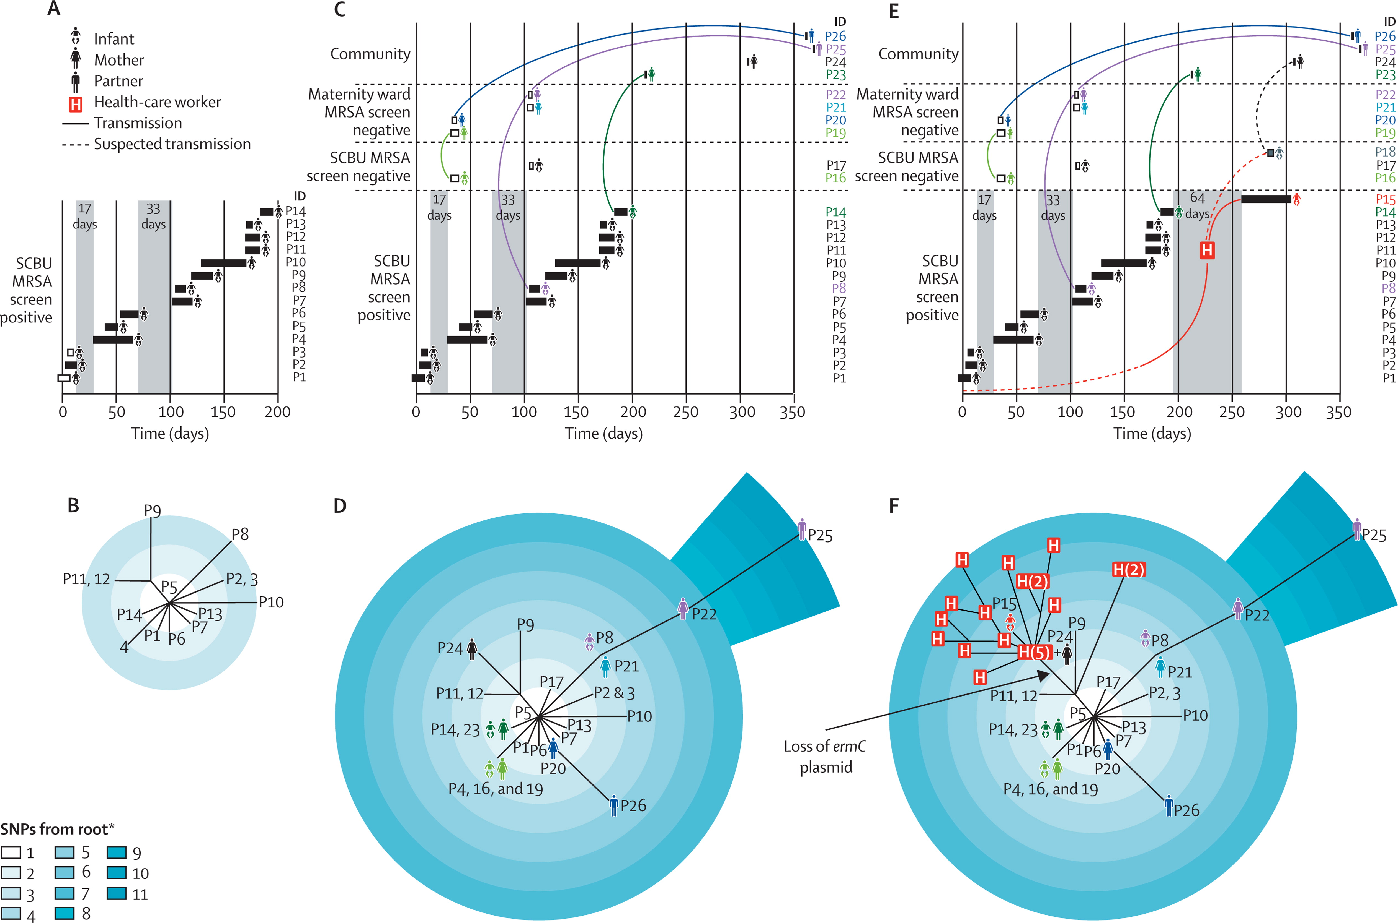
Figure
Transformation in Understanding
Dynamics of Transmission
The Lancet Infectious Diseases 2013 13, 130-136DOI: (10.1016/S1473-3099(12)70268-2)
Copyright © 2013 Elsevier Ltd Terms and Conditions
Notes:
Epidemiology and phylogeny of an outbreak of MRSA sequence type 2371
(A) Epidemiological map of 14 infants on the SCBU (patients 1–14). (B) Phylogenetic tree based on whole-genome sequencing of MRSA isolates from patients 1–14. (C) Epidemiological map of patients 1–14 and ten other patients (patients 16, 17, and 19–26) with linked MRSA infection detected in the community; coloured lines link members of the same family. (D) Phylogenetic tree based on whole-genome sequencing of MRSA isolates from patients 1–14 and patients 16, 17, and 19–26. (E) Epidemiological map of all cases of MRSA identified by whole-genome sequencing, and one patient (patient 18) suspected of being linked to the outbreak but for whom no MRSA colonisation was detected. (F) Phylogenetic tree of all cases of MRSA in the outbreak; 20 individual MRSA colonies from a staff member are shown in red boxes, with multiple colonies from the staff member shown in parentheses. Boxes shown for infants on SCBU in panel A represent duration of hospital stay (black boxes show infants included by the infection-control investigation and white boxes show infants excluded by the infection-control team). Grey vertical blocks in A, C, and E show times on the SCBU when there were no known carriers of MRSA. MRSA=meticillin-resistant Staphylococcus aureus. SCBU=special care baby unit. SNP=single-nucleotide polymorphism. P=patient.*Out-group was the sequence type 22 reference genome.

Slide 23
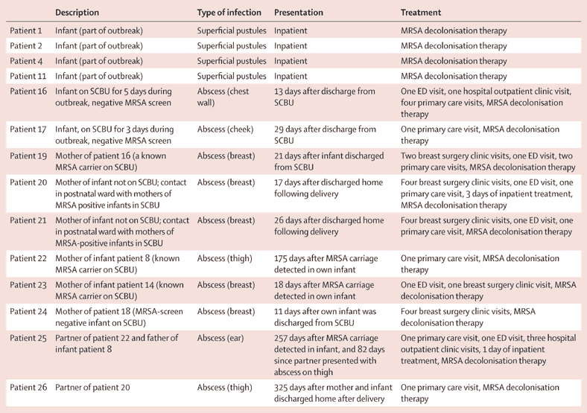
Molecular Surveillance Individual Resolution:
Public Health Impact

Slide 24
How can we leverage the power of ‘Big Data’ for AMR control?
VISION
Reduce AMR burden while personalizing and optimising patient treatment through real time integration and analysis of pathogen, patient, population and ABX data
Design & develop integrated solution combining
multi-source data on patient, pathogen, population surveillance and ABX to best identify optimal
treatment choice, dosage, duration, route
AIMS

Slide 25
Ensuring appropriate use of current treatment options
ABX use and misuse accelerate emergence of drug-resistant strains
ABX amounts prescribed should be minimized, ensuring treatment specific to the bacteria at appropriate dose for appropriate length of time
Critical to understand epidemiology and emergence of resistant bacteria
Coordination of existing surveillance agencies
Use of ‘big data’ could greatly improve targeted drug development
  monitoring global bacterial infection
  monitoring and adapting practice

Slide 26





Open Innovation

Slide 27
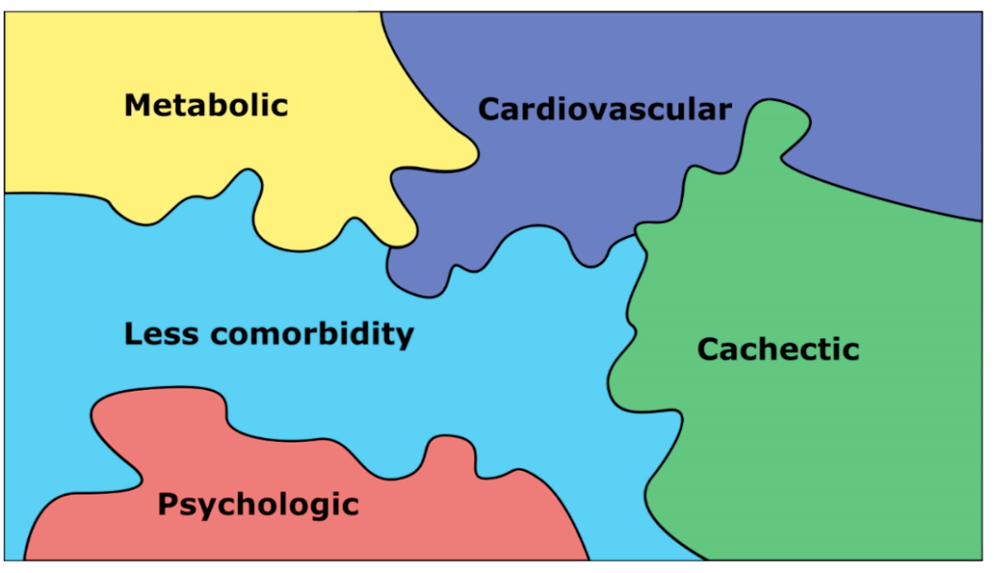
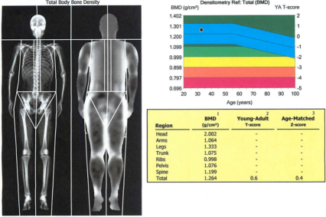
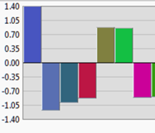
Understanding patient complexity for better treatment
Knowledge management system presents a map based on all patients previously seen
Parameters such as treatment courses, outcomes, immune system status, pathogen and resistance patterns
Patients are organized on the map per their biomedical data points
HYPERTENSION
ATHEROSLEROSIS
ATHEROSCLEROSIS
OBESITY
HYPERTENSION
DYSLIPIDEMIA
HYPERGLYCEMIA
UNDERWEIGHT
MUSCLE WASTING
OSTEOPOROSIS
ANXIETY
DEPRESSION
CHRONIC KIDNEY DISEASE
The knowledge management system gives me all relevant associated information, such as:
My patient is placed on the map by the knowledge management system
The detailed report on the outcome, treatment and any supporting evidence associated on patients similar to my patient
The detailed differentiating comorbidity profile

