Slide 1

The X-Ray Materials Science (XMaS) project
with Professor Tom Hase
and Dr Didier Wermeille

Slide 2
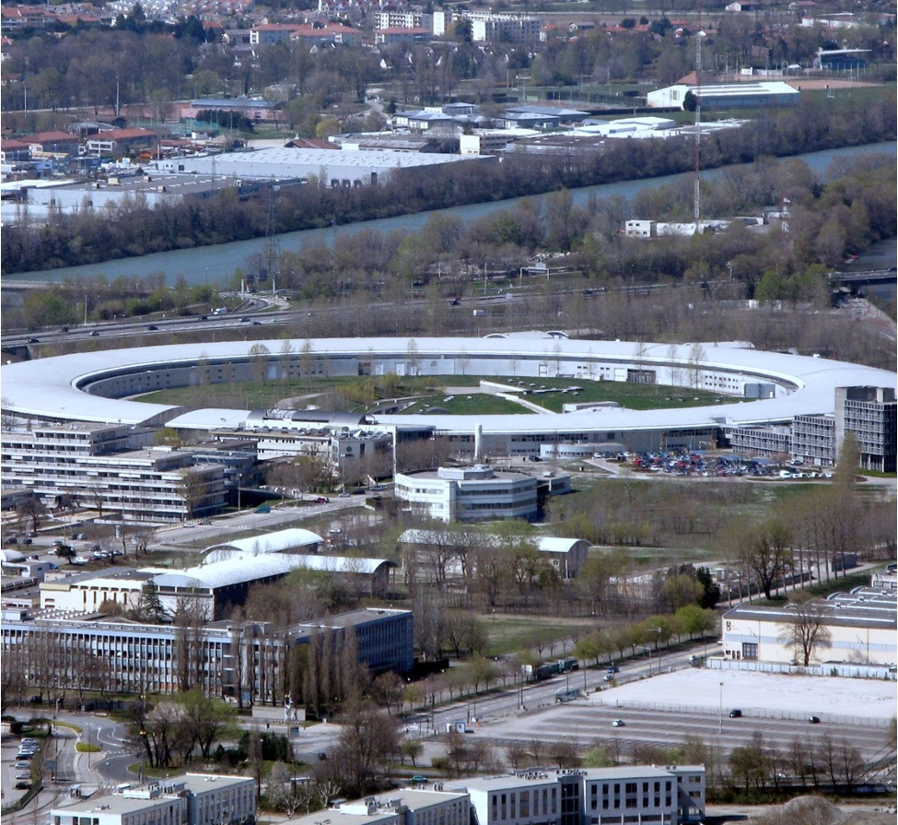
THE ESRF
On the edge of the city of Grenoble in the French Alps lies a huge ring-shaped structure.
This is the European Synchrotron Radiation Facility (ESRF).
Researchers from across Europe use the ESRF to study everything from tooth decay to photovoltaics in solar panels…
… from the Tudor warship Mary Rose to organic electronics…
…and from contraceptive devices to the behaviour of catalysts.

Slide 3
THE ESRF
The synchrotron acts as a ‘super-microscope’, allowing researchers to shed light on the position and motion of atoms in any substance of interest.
This enables them to examine the behaviour of minute and hidden objects, and to explore the structures of both inorganic and organic substances in very fine detail.
So, what exactly is a synchrotron?
A synchrotron is a machine that accelerates electrons inside a circular ring to speeds close to the speed of light and bends their paths using magnets.

Slide 4
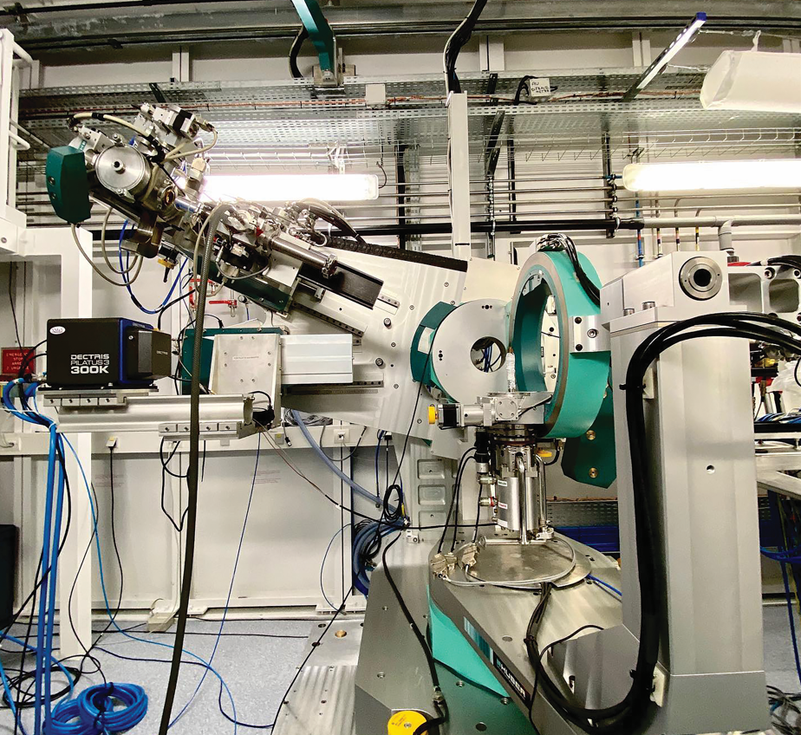
WHAT IS A SYNCHROTRON?
These electrons are not accelerated to make them go faster, but to bend them in a circular trajectory, in the same way you feel acceleration, or force (F = m a), when you take a sharp turn in a car.
When these high-energy electrons change direction, they emit electromagnetic radiation which, due to their speed, results in many high-power X-rays being produced.
These X-rays are directed into structures off the main ring, called beamlines, and are used in experiments. Each beamline is configured slightly differently and targeted at specific scientific research areas.

Slide 5
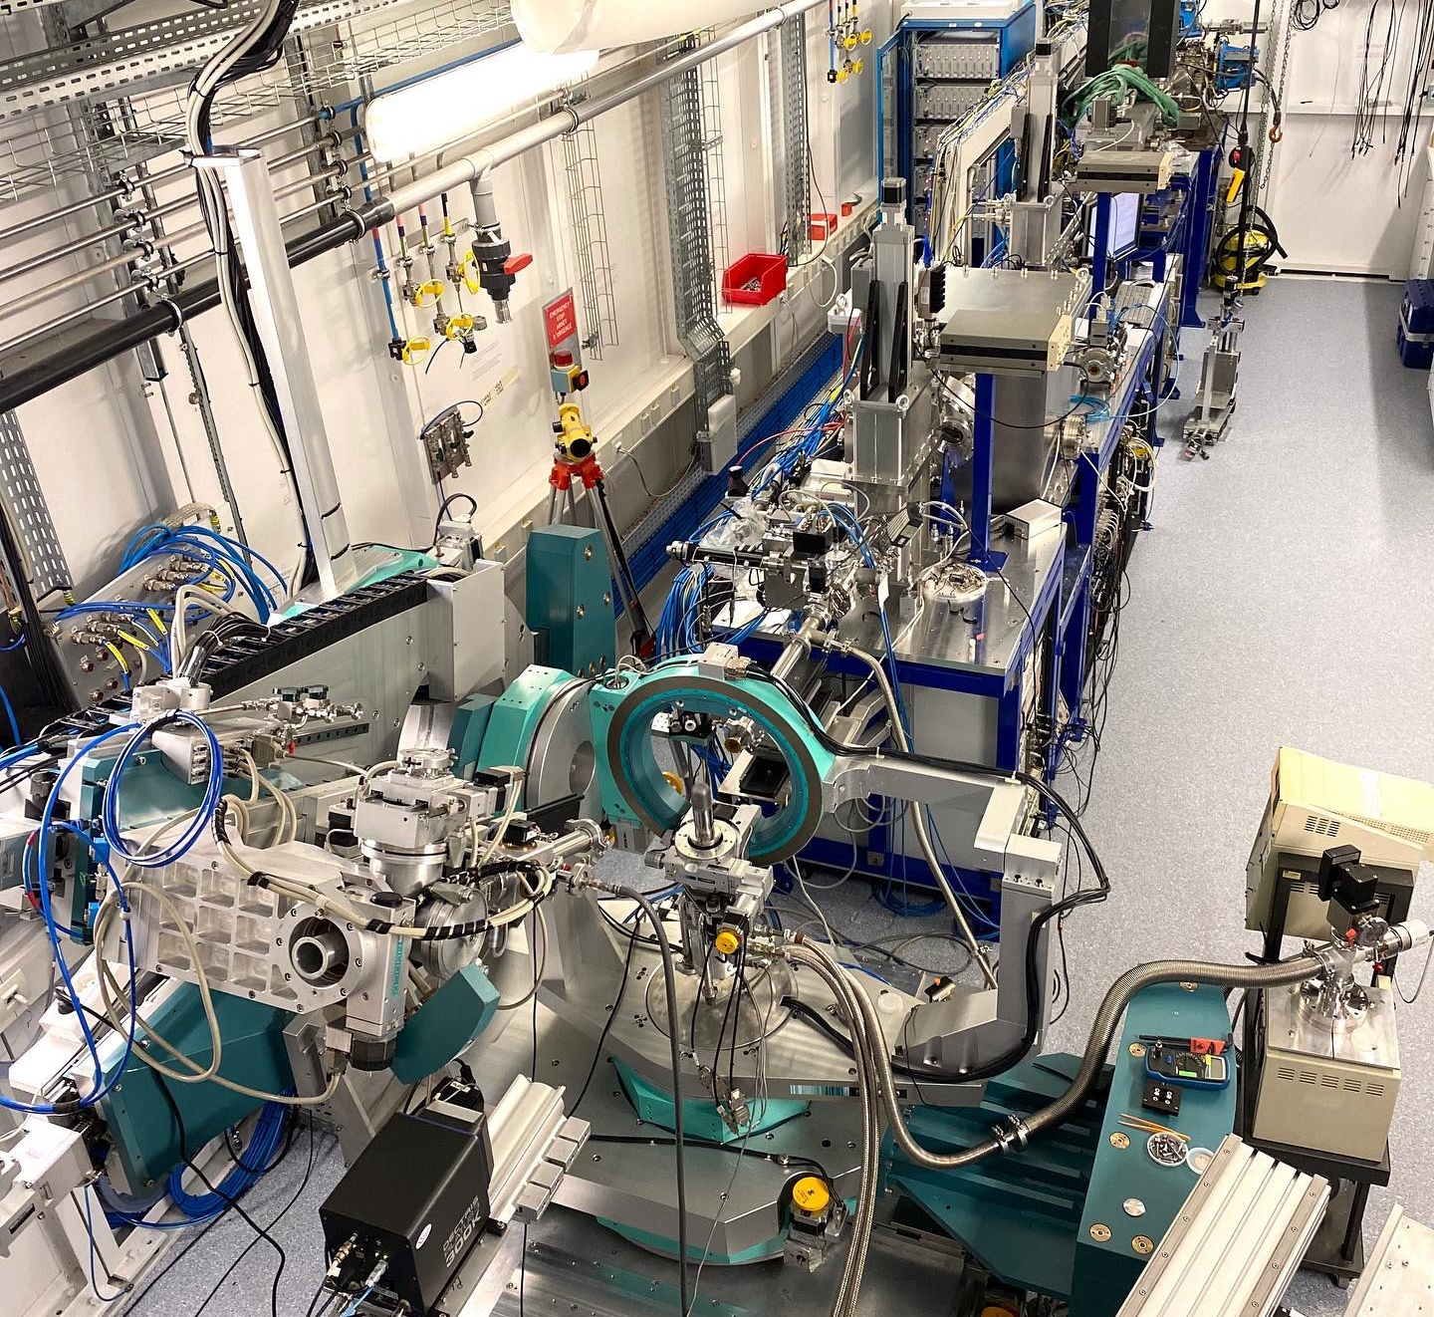
WHAT IS A BEAMLINE?
There are three definitions of a beamline:
A physical space within the ESRF’s experimental hall, consisting of an optics cabin, an experimental cabin and a control cabin.
Equipment that brings the X-ray beam to the material being studied and records the findings.
A research space in which experiments are done in collaboration.
Each beamline at the ESRF is home to a particular research team who uses the X-rays produced by the synchrotron for their own areas of research.

Slide 6
XMaS
One such beamline hosts the X-ray Materials Science, or XMaS, research project.
XMaS is the ESRF beamline that supports the UK materials science communities. Though the XMaS beamline principally investigates materials science, this does not mean the research exclusively involves materials scientists.
“Materials science can be a surprisingly broad term,” says Professor Tom Hase, the co-director of XMaS. “At XMaS… we often work at the interface between disciplines, exploiting advances in one scientific area to impact others.”

Slide 7
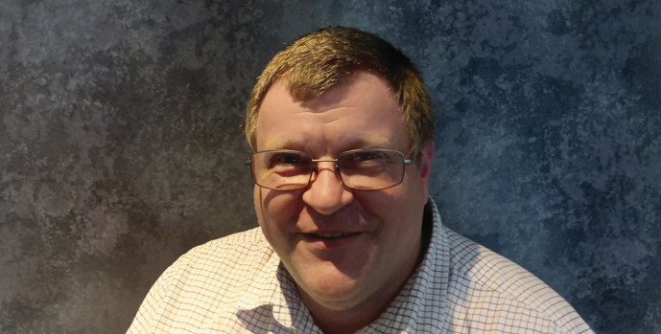
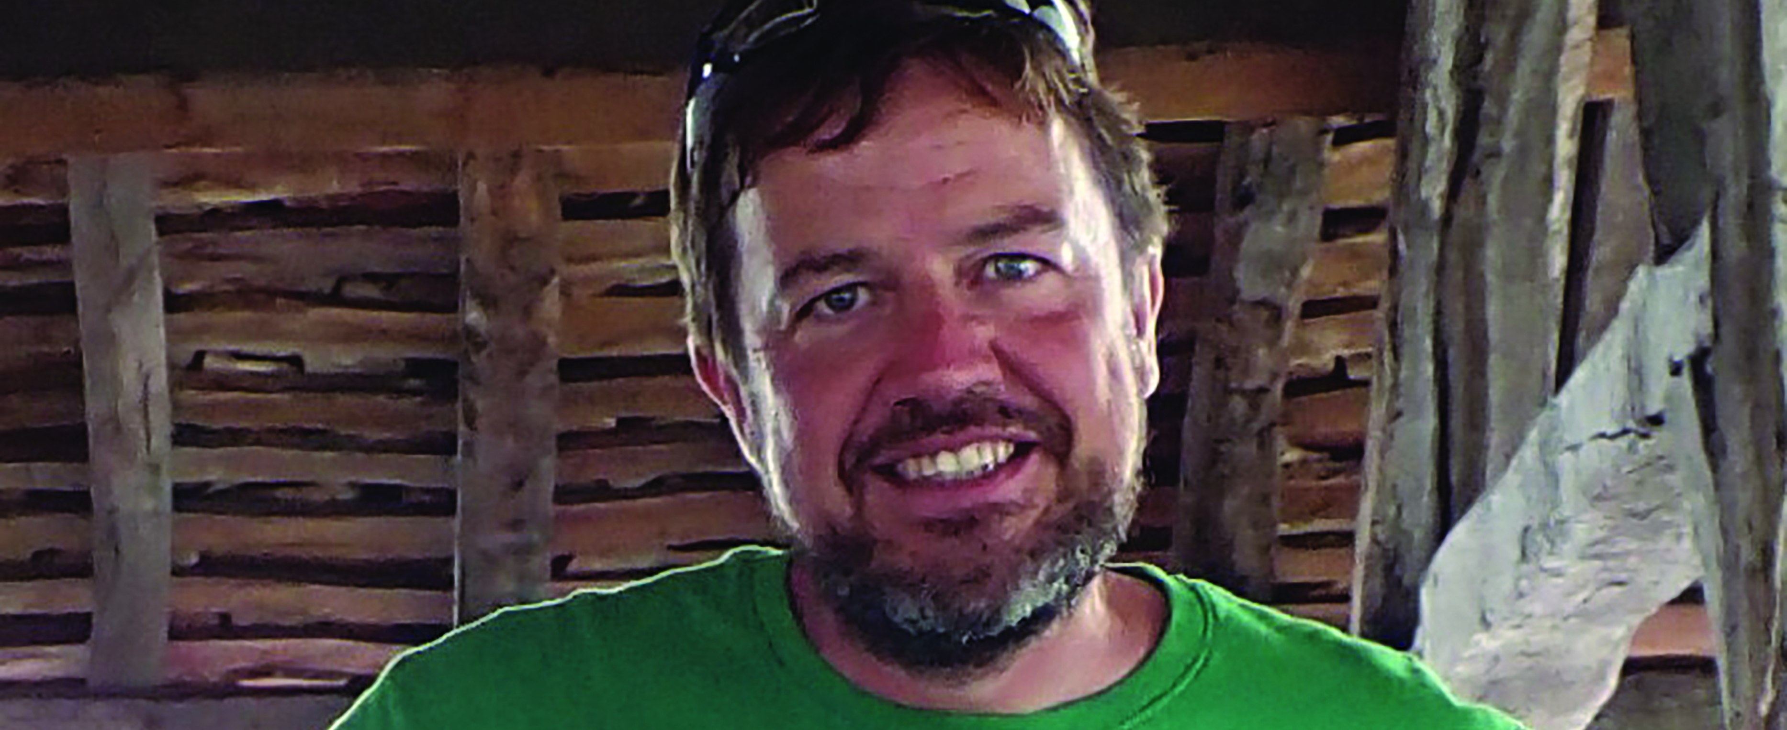
MEET SOME OF THE XMaS TEAM
XMaS is directed by Professor Tom Hase, at the University of Warwick, and Professor Chris Lucas, at the University of Liverpool, in the UK.
On the ground in Grenoble, the XMaS beamline is run by a multinational team of four scientists who support and help users to tackle a wide range of scientific challenges.
Dr Didier Wermeille is known as the ‘Beamline Responsible’. “I facilitate the XMaS experiments, supervise technical upgrades to the beamline, organise the team, liaise with the ESRF’s wider facility, and take care of health and safety.”
Professor Tom Hase
Dr Didier Wermeille

Slide 8
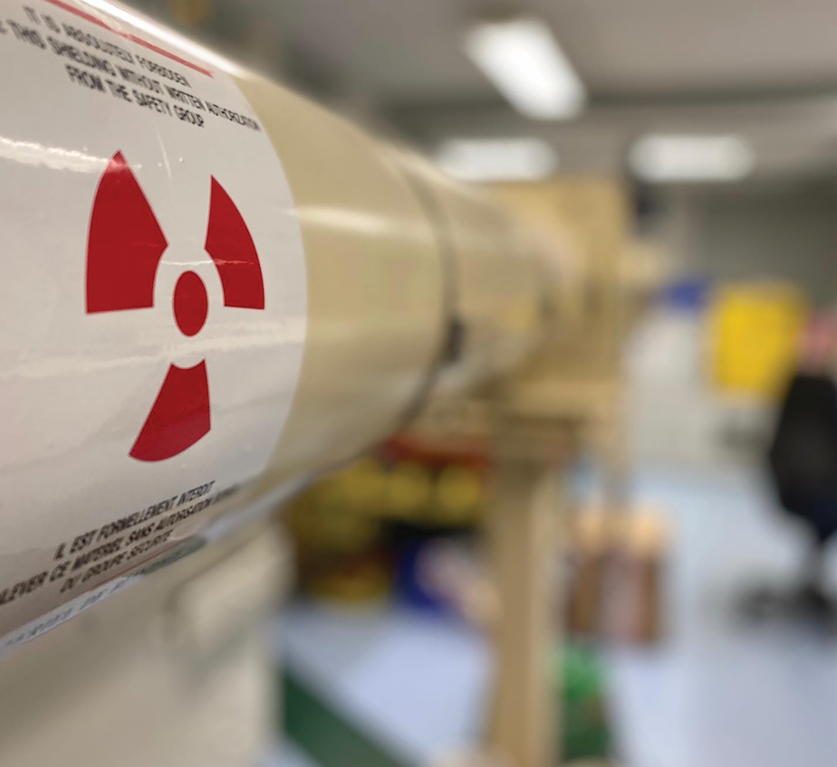
THE POWER OF X-RAYS
Many XMaS researchers are using the X-rays produced by the synchrotron to try to understand the correlation between a material’s useful properties and its structure. “This information can help us make better and more efficient devices and materials,” says Tom.
Research currently undertaken at XMaS includes energy-related issues, the findings of which could assist the transition to clean energy. “There are also studies taking place into unusual magnetic materials, which might one day have some practical use,” says Didier. “And there is research into substances with zero electrical resistance which could have great commercial applications.”

Slide 9
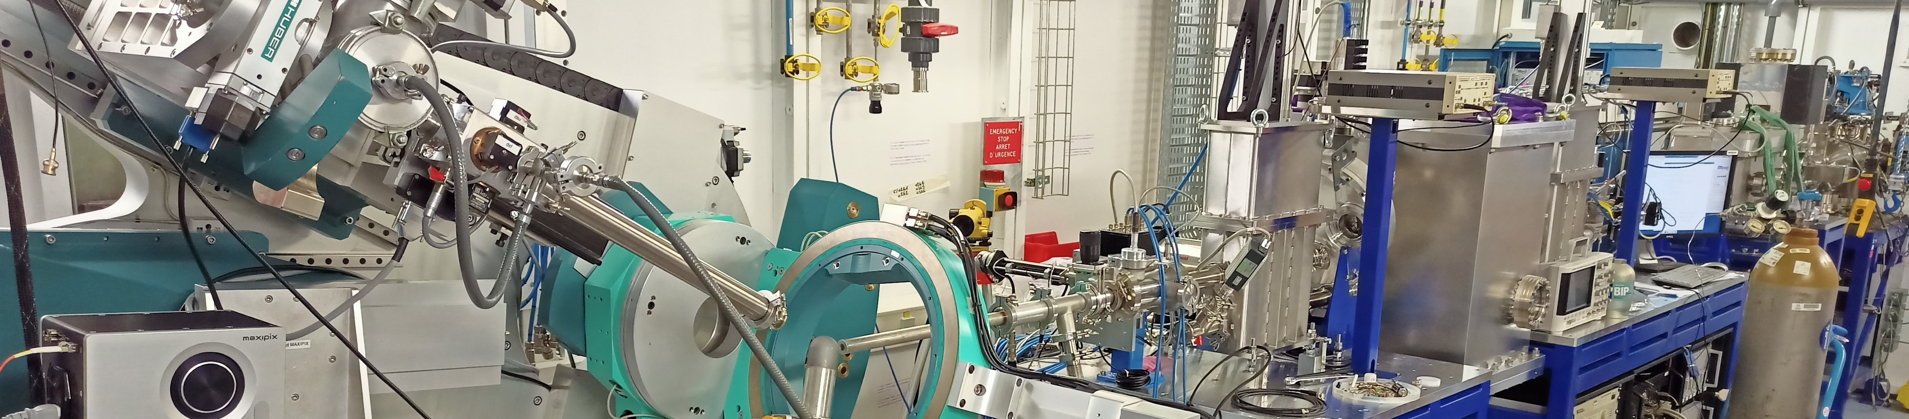
TALKING POINTS
Where is the European Synchrotron Radiation Facility (ESRF) located?
What are the three definitions of a beamline?
How does the ESRF generate high-powered X-rays?
In what ways do you think a material’s microscopic structure can affect its properties and behaviour? Why is this information important?
Much research conducted at XMaS ‘might one day have some practical use’ and ‘could have great commercial applications’. Why is it important to conduct research even when the useful outcomes are uncertain?

Slide 10
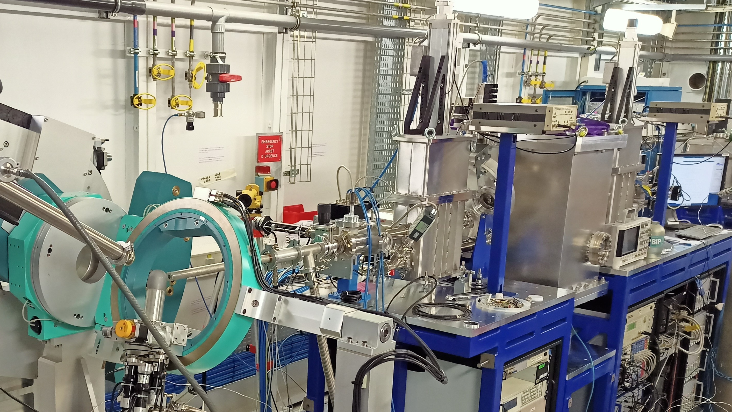
Let’s meet some of the researchers using XMaS…

Slide 11
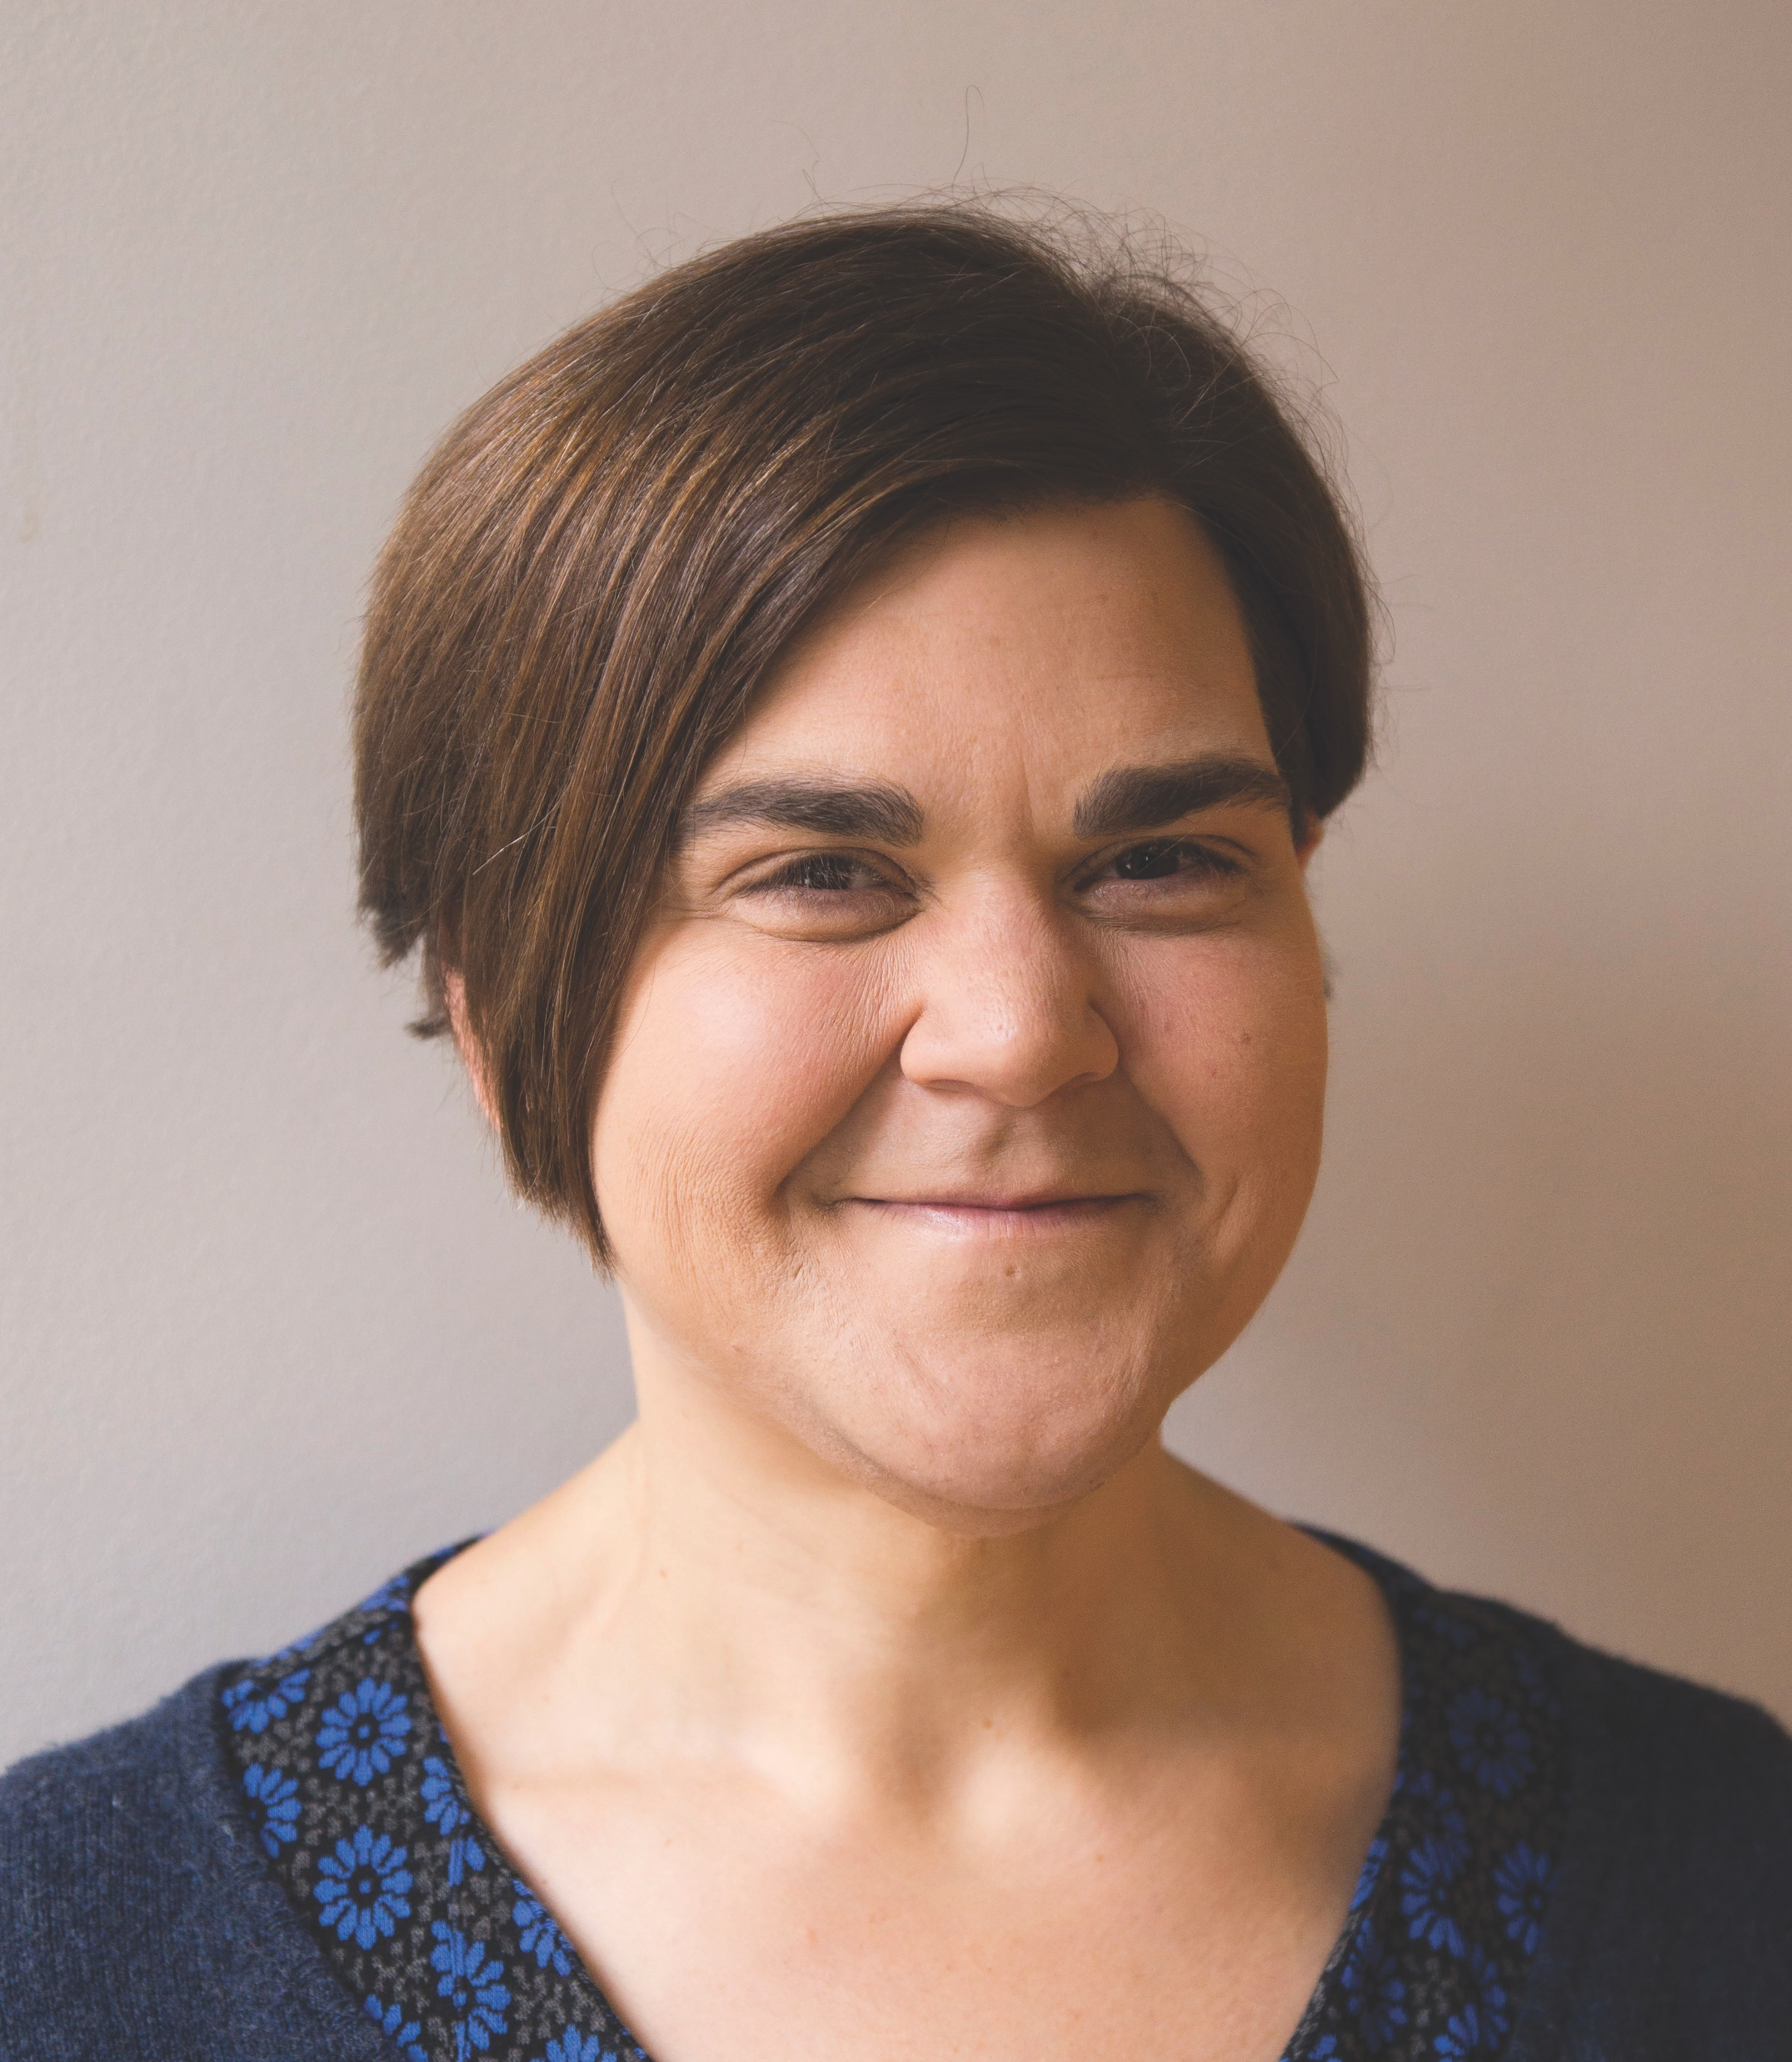
Professor Maisoon Al-Jawad
School of Dentistry, University of Leeds, UK
“I am interested in how teeth and bones grow. Bones comprise around 60% mineral and 40% organic molecules, which means they are strong but have elastic properties, so they don’t break under load. In contrast, dental enamel (the outer coating of a tooth) is made up of 96% mineral and 4% organic components. This makes enamel hard and resistant to wear, such that your teeth should last a lifetime.
XMaS enables us to look in great detail, deep inside tooth and bone samples, to probe structural and chemical features.
We have found that it is possible to restore the complex structure of dental enamel when it has been damaged, and that bone from different sites (e.g. skull bone versus limb bone) looks very different at the nanometre scale.”

Slide 12

Professor Wuge Briscoe
School of Chemistry, University of Bristol, UK
“My team and I have studied how molecules organise at interfaces – surfaces that form the boundary between different matter. This interfacial structural information is important for nanoscience, understanding biological processes, and industrial applications.
XMaS uses the world’s brightest light, and we make use of it to probe buried interfaces that cannot be accessed through other methods. The molecular details of the structures are sometimes surprising, and this helps us advance our understanding of how molecules behave at interfaces.
We have applied our research findings to formulate eco-friendly artificial snow, which has been used in many Hollywood films, and we are helping industries understand how interfacial molecular layers can be optimised for their functionalities in personal care products.”

Slide 13
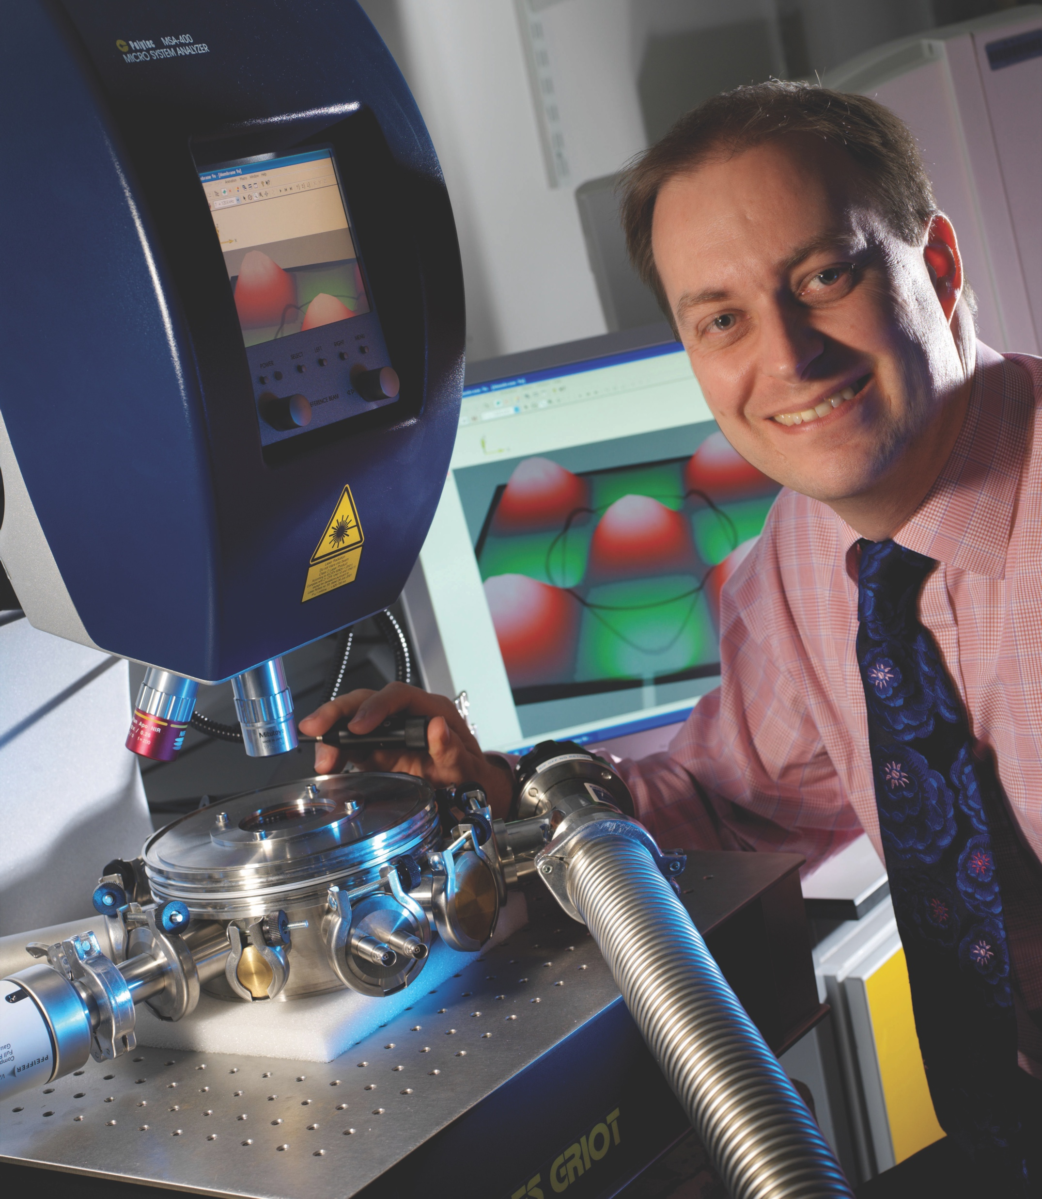
Professor Markys Cain
Electrosciences Ltd, UK
“My research is centred on the development of in situ methods of characterising functional materials. I use X-rays to probe the materials’ electrical, dielectric and functional performance. This is important so we can start to paint a picture of why a material behaves in the way that it does.
My company, Electrosciences Ltd works with many industrial companies that are developing new materials or using novel materials in new ways. One example is the use of piezo-materials in the treatment of arthritis.
All these materials benefit enormously from discovering the links between their function and fundamental crystalline structure, as we test them in conditions that match their real applications (stress, temperature, strain, magnetic and electric fields, and so on).”

Slide 14
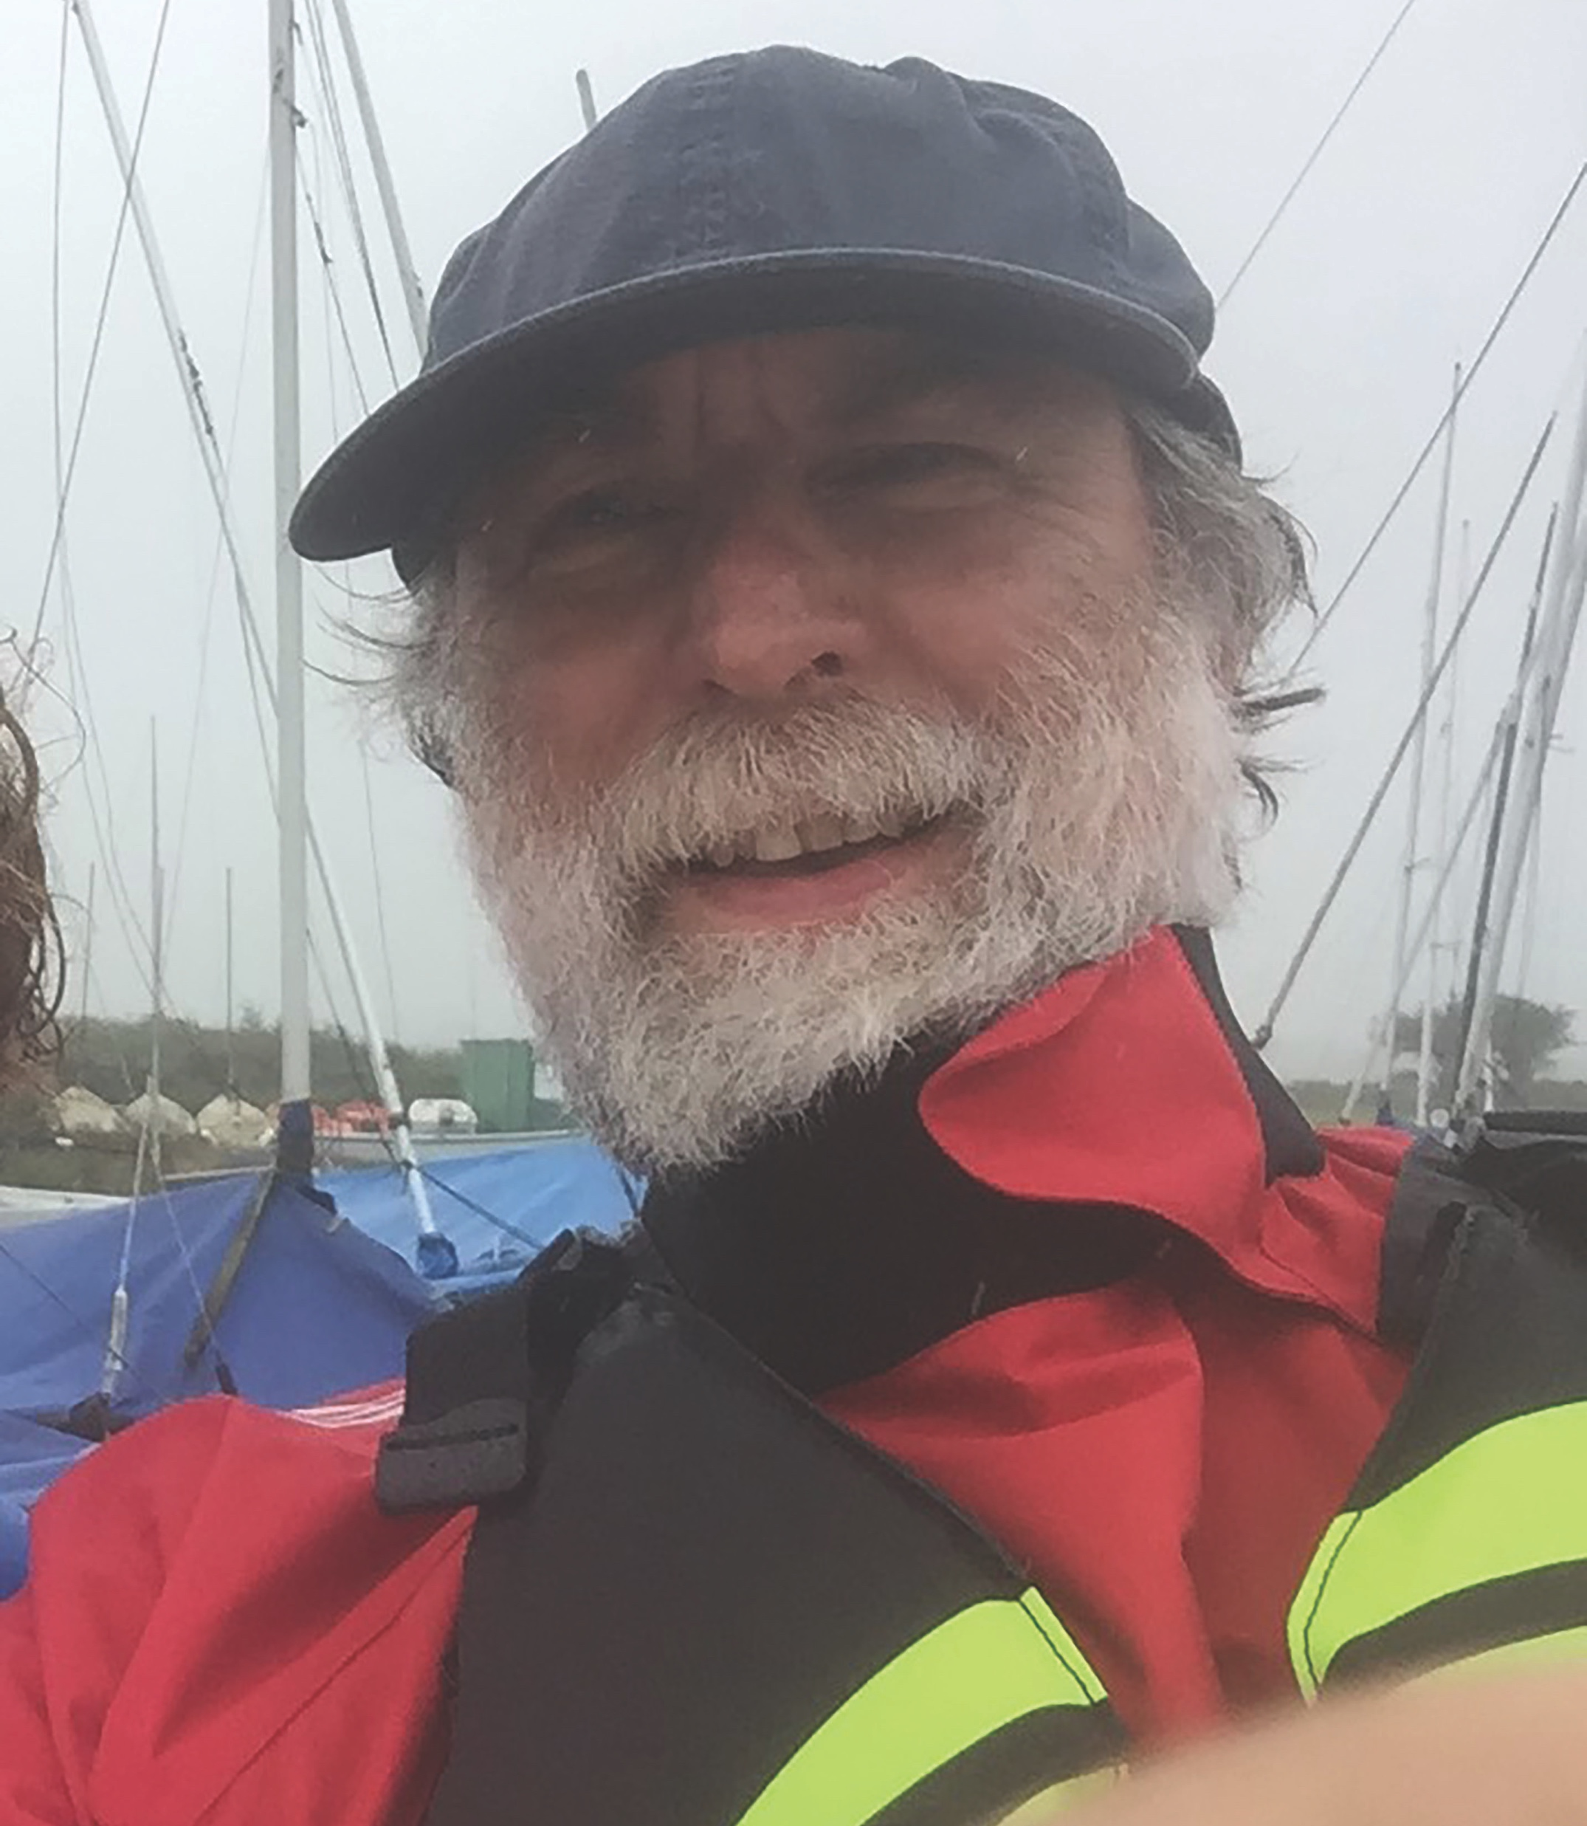
Professor Mark Dowsett
University of Warwick, UK
Ghent University, Belgium
“I work with Professor Mieke Adriaens at Ghent University. She and I use XMaS to watch chemical reactions on surfaces in real time: that is, as they happen.
We can see intermediate reactions, how reactions start and when they come to an end. We use a special electrochemical and environmental cell (eCell) to watch how surfaces change when they are exposed to gases, in corrosive liquids, or coated with protective coatings.
These experiments are important in a huge range of applications, from the study of contraception devices to the corrosion of metals, and the development of protective coatings.”

Slide 15
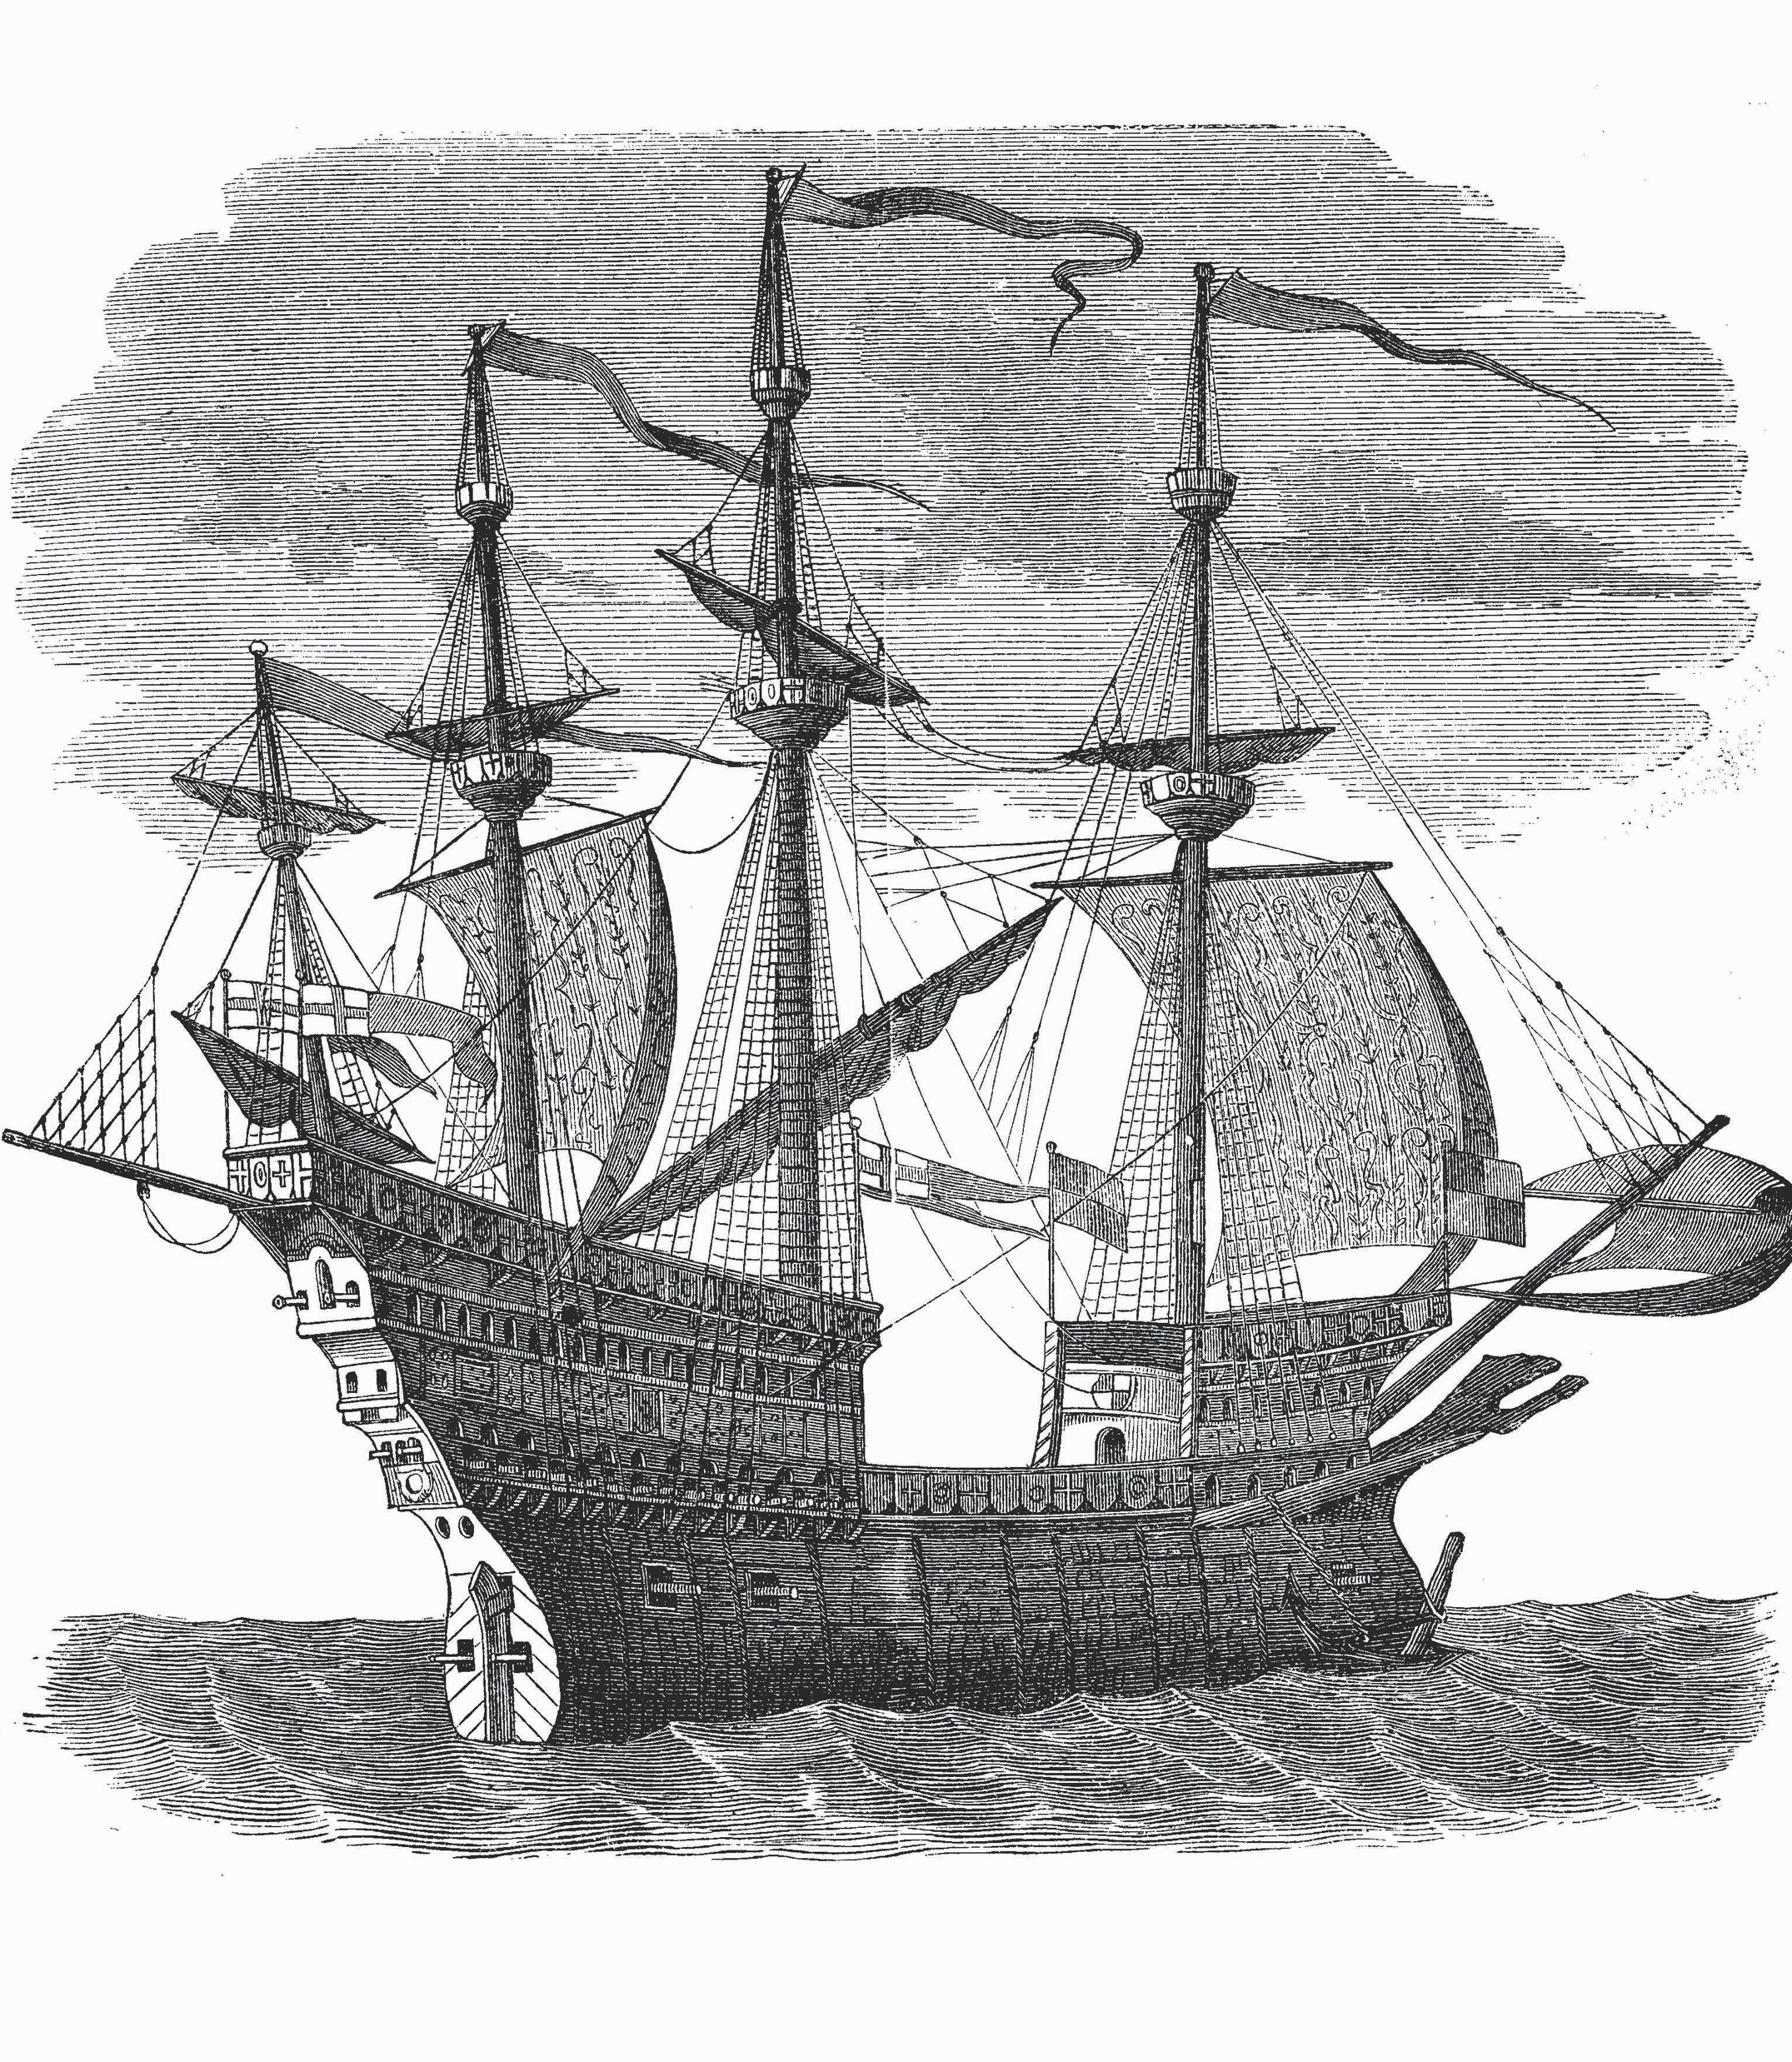
“Recently, we worked with scientists from the Mary Rose Trust to examine metal artefacts recovered from the seabed over 30 years ago. When objects are taken from the sea they rapidly corrode in air and need immediate special treatment if they are to survive. This is even more important if they’re put on long-term display in a museum or used for archaeological study. Using X-ray diffraction, we were able to identify unusual compounds on the surfaces of the metal artefacts. We showed their conservation had been very effective and we discovered traces of other metals – possibly from the tools used by Tudor metalworkers.
Another study looks at the design of less intrusive and more effective intra-uterine devices (IUDs). IUDs, also known as the coil, are used for birth control and release copper in the womb. We made a version of the eCell to simulate the chemical environment of the uterus and measured the chemical changes on the surface of the copper. It’s important to know how IUDs actually work before you can improve them!”
Mary Rose

Slide 16
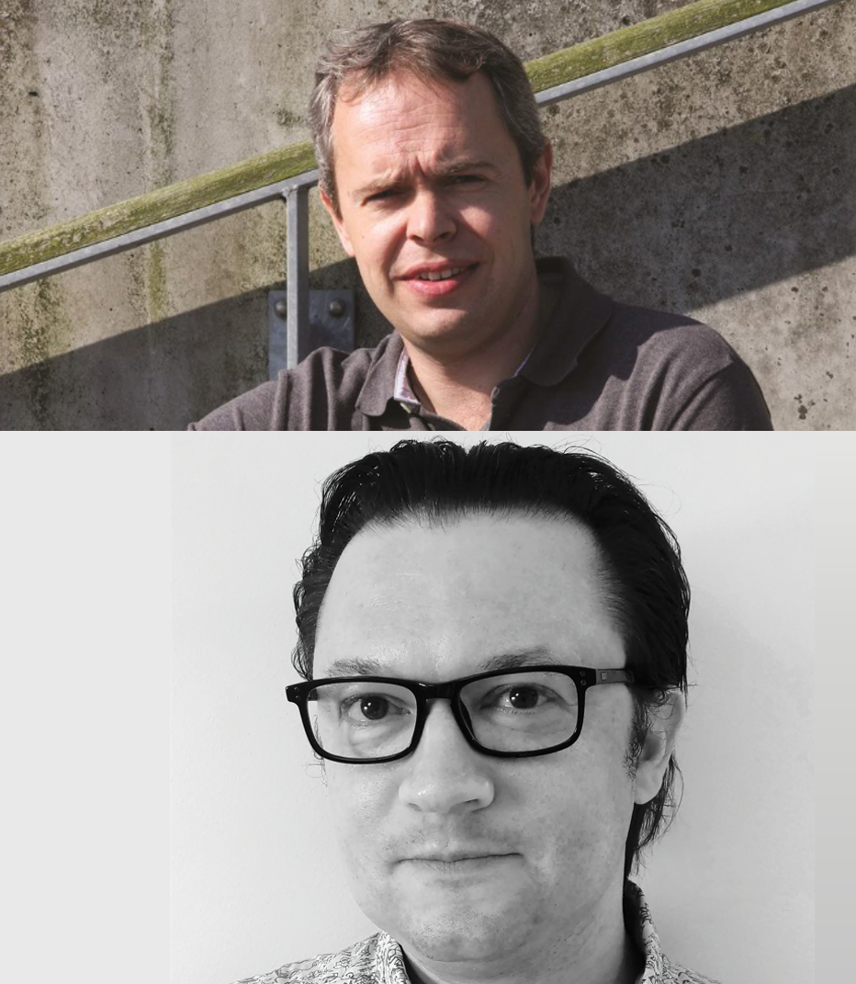
Dr Jakob Kjelstrup-Hansen
University of Southern Denmark, Denmark
Dr Matti Knaapila
Norwegian University of Science and Technology, Norway
“We are interested in organic electronics. In contrast to most electronic devices today, which are hard and rigid, organic electronics enable devices to be mechanically flexible (bendable and stretchable). These materials could be used to create wearable devices that are integrated into clothing, or stretchable organic light-emitting diode displays that wrap around objects.
The plastic materials used for organic electronics consist of microscopic molecules that form a thin layer on a substrate. The performance of the organic electronics component strongly depends on how the molecules are organised on the substrate – the so-called microstructure. Our research at XMaS uses X-rays to characterise the microstructure to better understand how we should fabricate thin layers.”
Dr Jakob Kjelstrup-Hansen
Dr Matti Knaapila

Slide 17
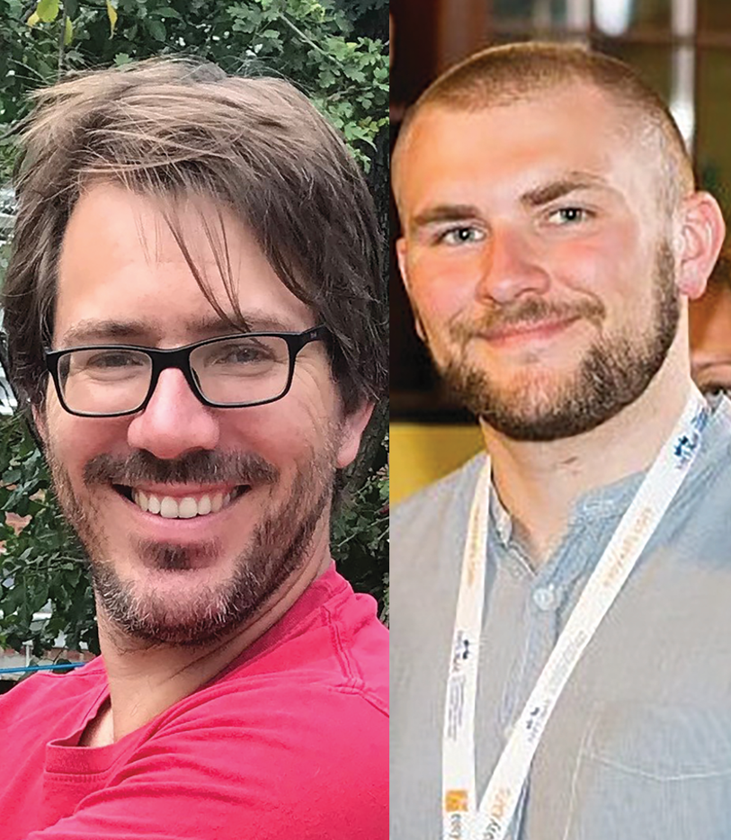
Dr Peter Wells
George Tierney
School of Chemistry,
University of Southampton, UK
“Our research is focused on catalytic processes and our projects at XMaS have two major strands:
Upgrading waste plant matter (biomass) to useful products. Many chemical commodities are based on fossil resources, so instead we need to recycle waste material into useful chemical building blocks. Biomass has the potential to be a plentiful and renewable feedstock.
Automotive exhaust after-treatment. NOx emissions from diesel cars cause many premature deaths. For exhaust after-treatment, we have been investigating the role of palladium (Pd) nanoparticles for the selective oxidation of ammonia. We discovered a new type of Pd structure that has a very important role in stopping the formation of harmful NOx products.”

Slide 18
TALKING POINTS
Which of the XMaS research projects most interests you? Why? What questions would you want to ask the researcher(s) to learn more about their work?
By examining the microscopic structures of different materials, how does each project contribute to society?
What topic would you want to investigate at XMaS? What material(s) would you want to examine at a microscopic level, and what real-world applications could this have?

Slide 19
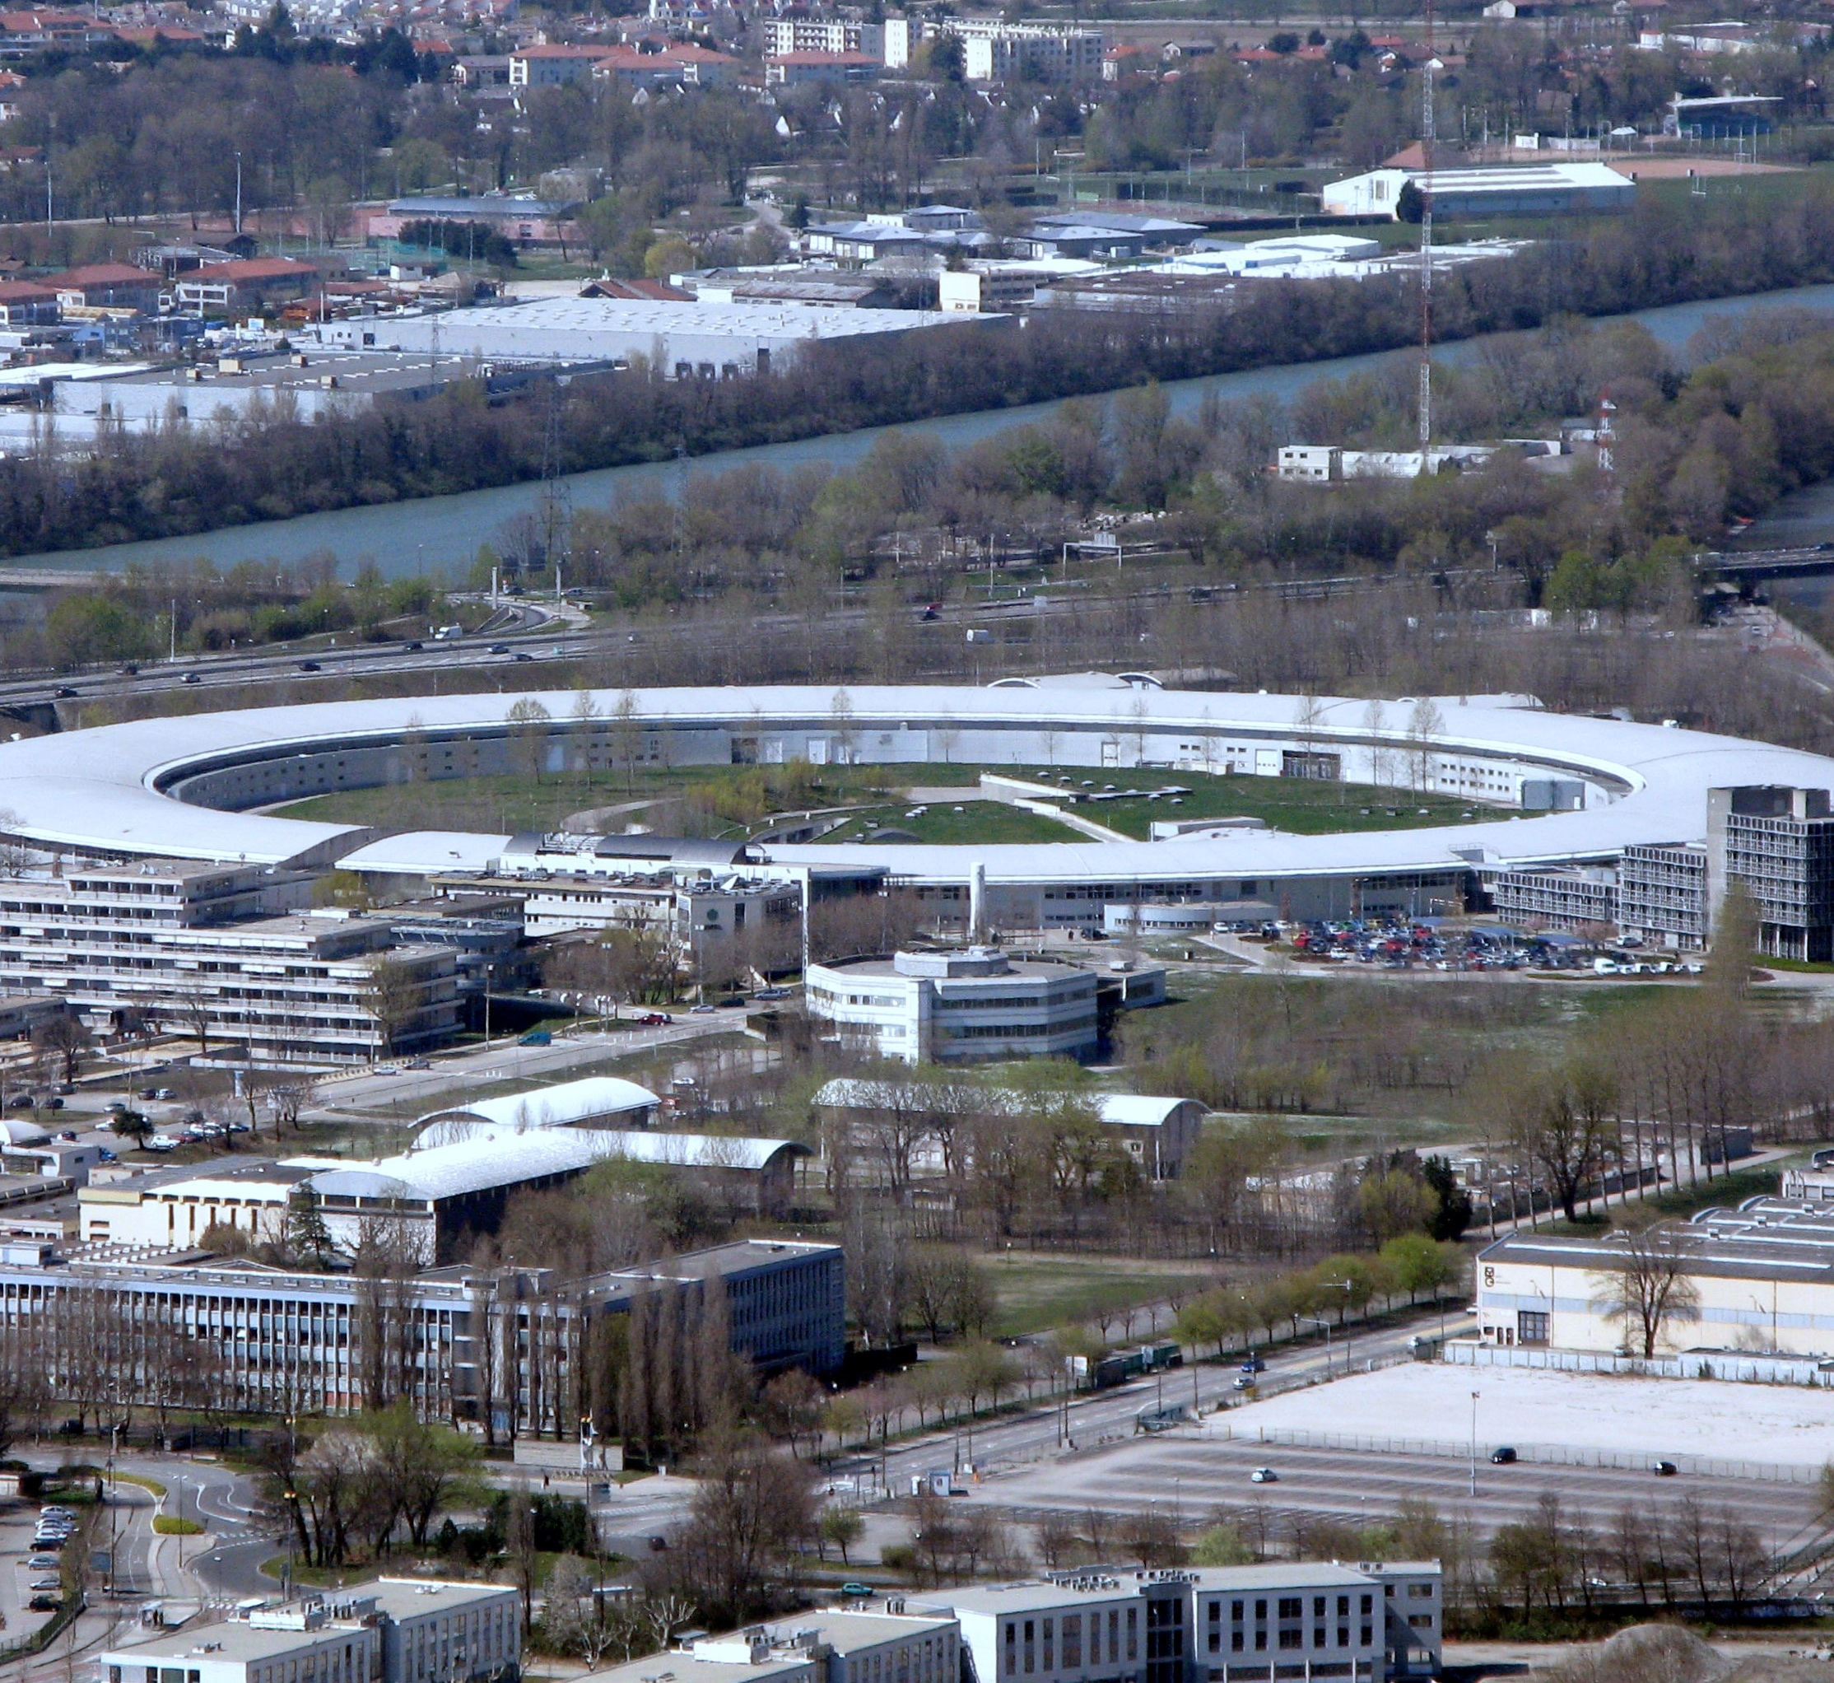
XMaS FOR STUDENTS
XMaS is committed to training students and early career researchers and, as such, has a wide range of outreach activities to fulfil this goal.
Find out more about XMaS and the outreach activities available.
The XMaS team is part of a wider ESRF network, which also offers its own range of outreach activities. This includes site visits for schools, internships and summer schools, and the Synchotron@School programme, a one-day programme of experimental workshops and site visits for high school students.

Slide 20
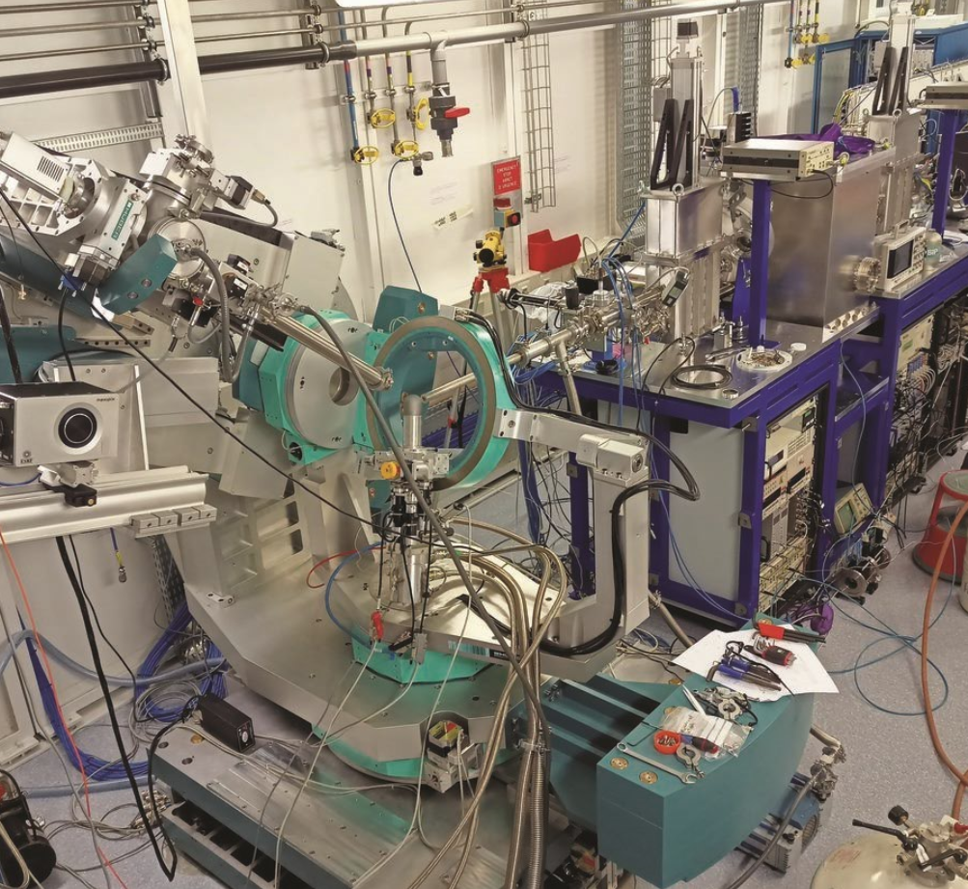
HOW CAN YOU GET INVOLVED?
Win an all-expenses-paid four-day trip to the ESRF! The XMaS Scientist Experience is a UK competition for Year 12 female physics students to encourage female students into scientific careers where they are seriously under-represented. Winners will visit the ESRF, see synchrotron beamlines in action and take part in lab experiments.
The XMaS team at the University of Warwick organises a Science Gala every year, which showcases physics, from astronomy to particle physics, and materials science. Interactive activities send the message that science is fun and exciting and can lead to a wide range of careers.

Slide 21
PATHWAY FROM SCHOOL TO MATERIALS SCIENCE
Materials science is a broad-ranging subject based on investigating and manipulating the properties and behaviour of different artificial and natural materials. This involves understanding the physics and chemistry of matter, and the manufacturing and engineering of materials.
At school, consider studying physics, maths and chemistry. Computer science and biology would also be useful.
“Many people do not start out as material scientists,” says Tom. “A ‘materials scientist’ can cover a multitude of disciplines; it’s really about working at the interface between different subjects and understanding how fundamental processes work in real systems.”

Slide 22
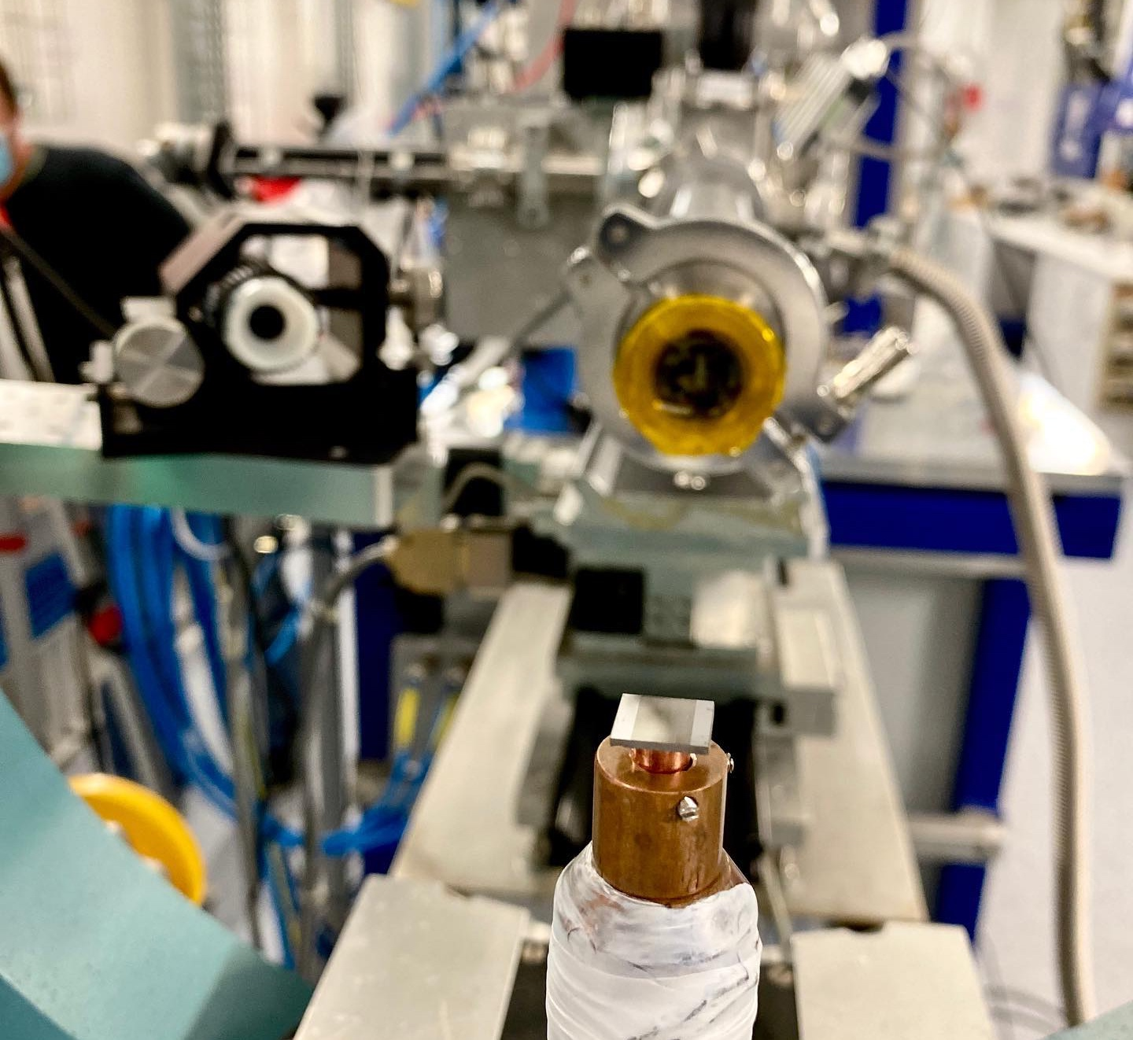
PATHWAY FROM SCHOOL TO MATERIALS SCIENCE
TheUniGuide gives a great introduction to studying materials science at university, including what degree programmes are available and what subjects your courses will cover.
Career Explorer offers a good explanation of what a materials scientist does, including the salary you can expect.
Prospects provides a list of careers open to graduates with a degree in materials science.

Slide 23
TALKING POINTS
How do you think school students benefit from visiting the ESRF? Would you like to visit? What would you gain from the experience?
What skills and knowledge from physics, chemistry, biology, maths and computer science do you think materials scientists need? What other subjects do you think would be useful?
What skills do you have that could contribute to a career in materials science? How could you develop these skills further?
Considering the interdisciplinary nature of the field and the range of projects conducted at XMaS, what career options do you think are available for materials scientists, beyond pure research?

Slide 24
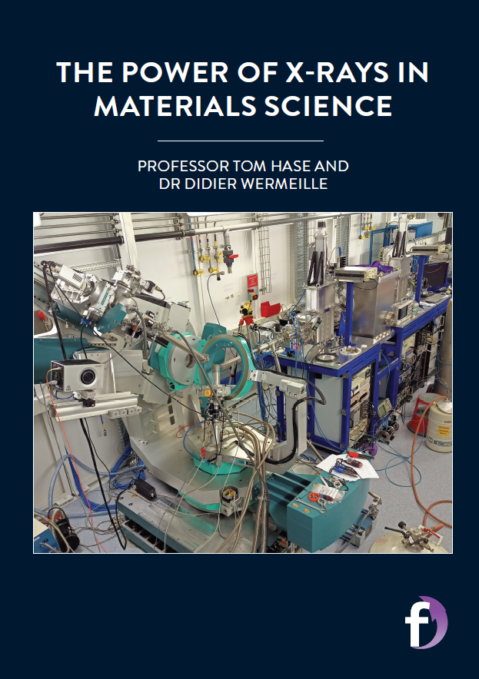

Dig deeper into the XMaS team’s research…
Download their article:
https://futurumcareers.com/the-power-of-x-rays-in-materials-science
Download their activity sheet:
https://futurumcareers.com/Tom_Hase_Activity_Sheet.pdf

Slide 25

