Slide 1
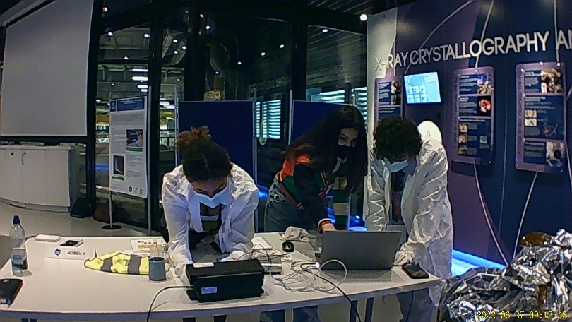

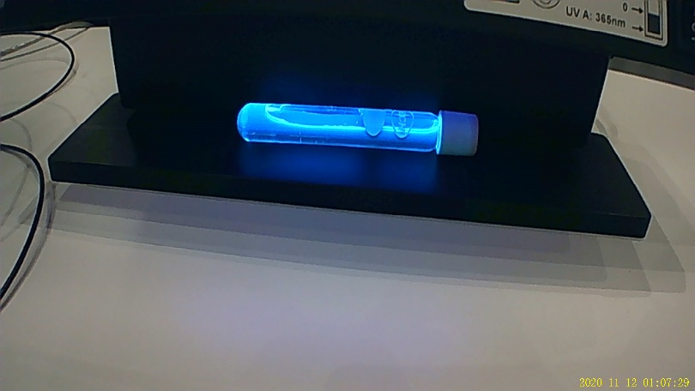




Shining a light
on an unknown
substance
Authors:
Eleanor O’Neill, Lauren Cole, Emily Rowe, India Henry, Anoush Rule, Konstantina Koutri
University of Warwick
COVENTRY CV4 7AL – UNITED KINGDOM – Tel +44 (0)24 7652 3523
University of Liverpool – Department of Physics, Oliver Lodge, Oxford Street
LIVERPOOL L69 7ZE – UNITED KINGDOM – Tel +44 (0)15 1794 3358
EPSRC – Polaris House – North Star Avenue
SWINDON SN2 1ET – UNITED KINGDOM – Tel +44 (0)17 9344 4000

Slide 2
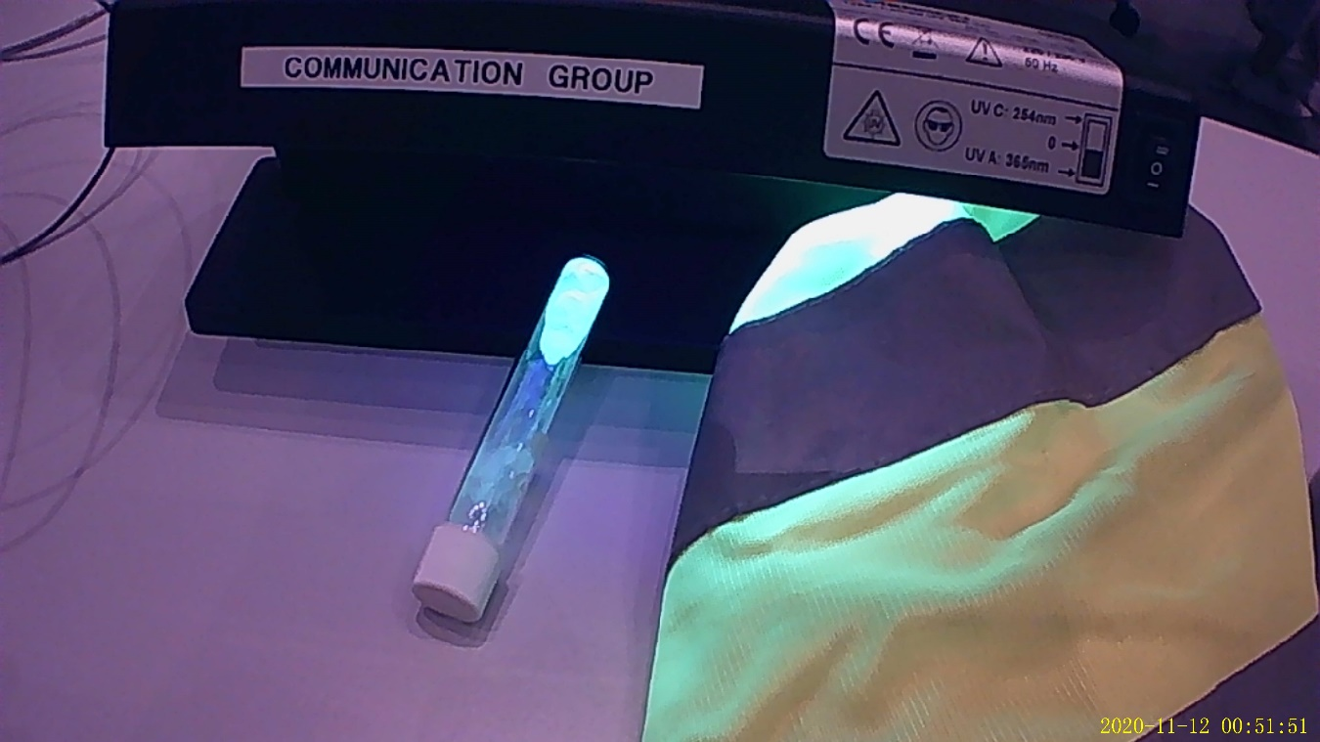
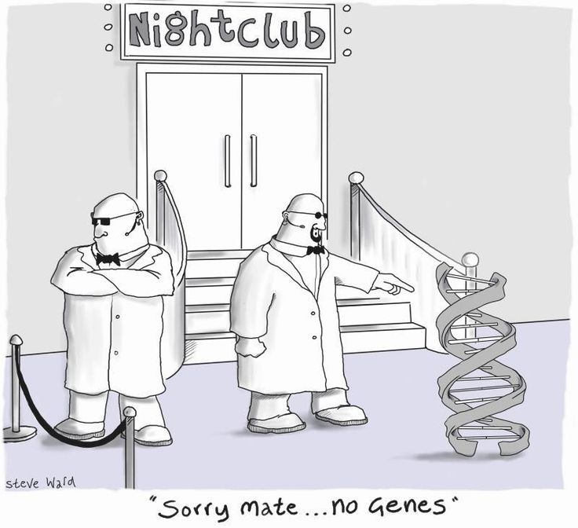
INTRODUCTION
Alfred’s problem = glowing drink
Our problem = identifying the mysterious substances causing this glow
Introductory work = fluorescent or phosphorescent?
Shining a light on an unknown substance | 27/06/2022 | Lauren, Eleanor and Emily

Slide 3
Introduction
Fluorescent or Phosphorescent?
Fluorescent: immediately stops glowing once UV is removed
Phosphorescent: the glow remains after the source is removed and slowly fades
Phosphorescent molecules | Yttria Y₂O₃ + Eu³⁺ | Spinel MgAl₂O₄ + Ce³⁺ | Germania GeO₂
E_{released} (eV) | 2,03 | 2,39 | 2,68
Fluorescent molecules | Deep Purple C₂₃H₂₂O₇ | Fluorescein C₂₀H₁₀Na₂O₅ | Quinin C₂₀H₂₄N₂O
E_{released} (eV) | 2,09 | 2,40 | 2,71
Shining a light on an unknown substance | 27/06/2022 | Lauren, Eleanor and Emily

Slide 4
Method
1.) Identify fluorescence or phosphorescence
2.) Analyse using spectroscopy
3.) Read peak wavelength from the graph
4.) Find the energy using E = hc/λ
5.) Convert to electron volts and compare to known values
Shining a light on an unknown substance | 27/06/2022 | Lauren, Eleanor and Emily

Slide 5
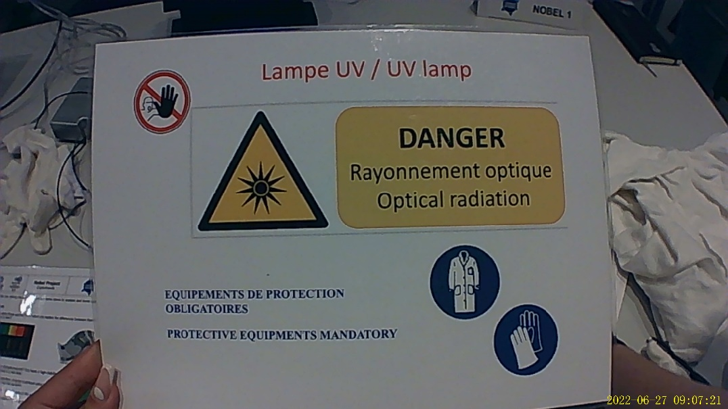
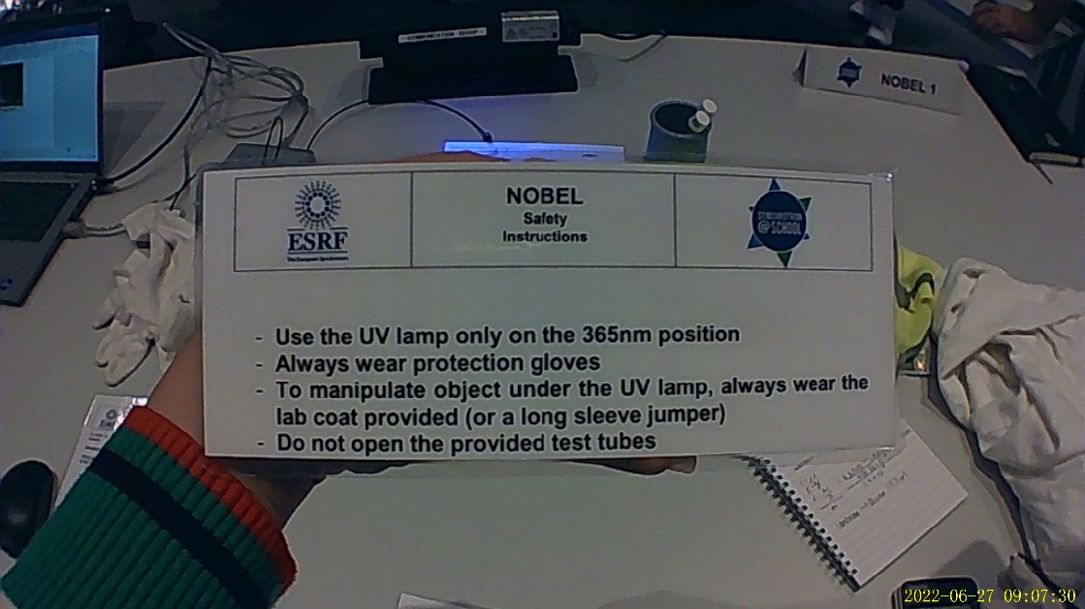
SAFETY PRECAUTIONS
Shining a light on an unknown substance | 27/06/2022 | Lauren, Eleanor and Emily

Slide 6
Results
Quinin
Shining a light on an unknown substance | 27/06/2022 | Lauren, Eleanor and Emily

Slide 7
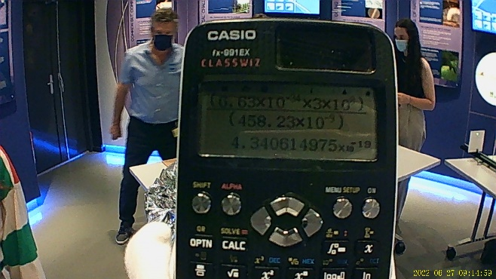
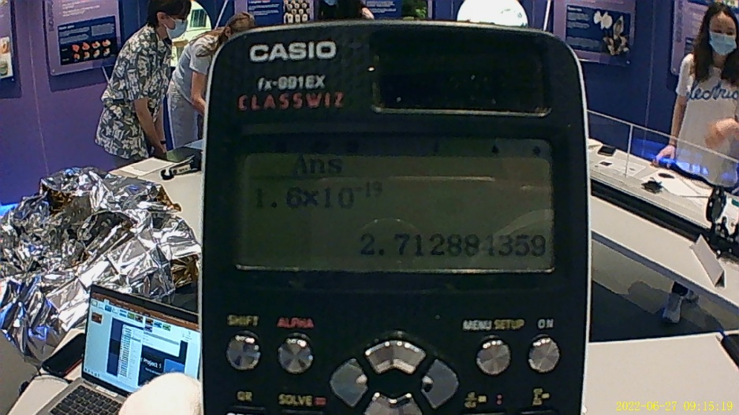
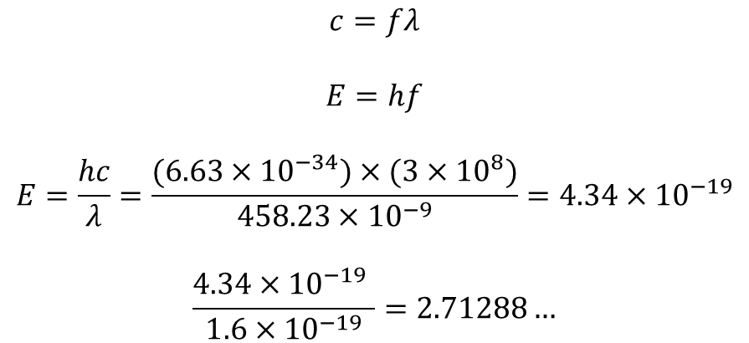
Results
$$c=fλ$$
$$E=hf$$
$$E=\frac{hc}{λ}=\frac{(6.63×{10}^{−34})×(3×{10}^{8})}{458.23×{10}^{−9}}=4.34×{10}^{−19}$$
$$\frac{4.34×{10}^{−19} }{1.6×{10}^{−19}}=2.71288…$$
Deep purple
Fluorescein
Quinin
Shining a light on an unknown substance | 27/06/2022 | Lauren, Eleanor and Emily

Slide 8
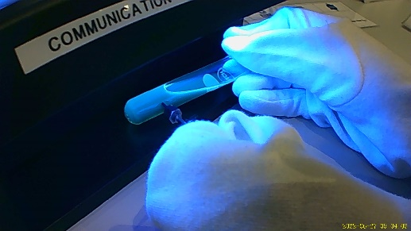
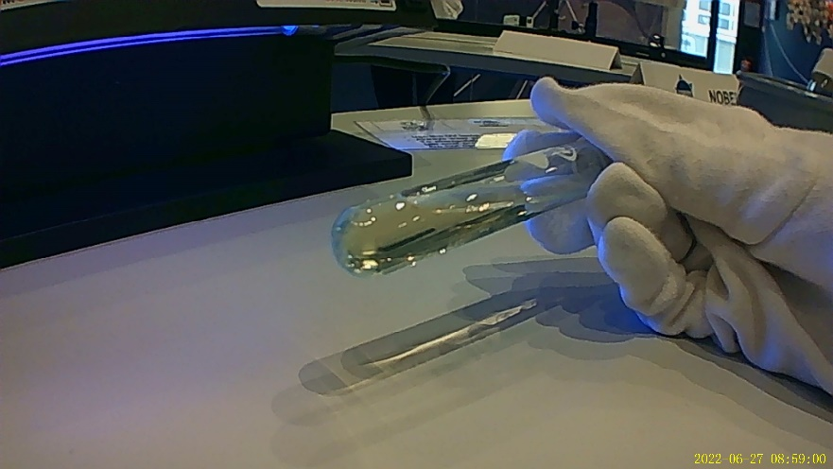
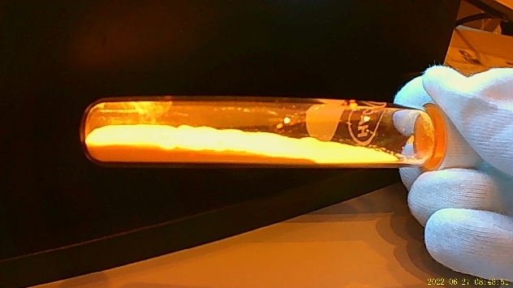

Conclusion
Quinin
UV light to show fluorescence
Spectroscopy to find energy
The quinin was inside the tonic water of Nobel’s drink
It is found in chinchona bark on trees
Also used in drugs to treat malaria and nighttime leg cramps
Shining a light on an unknown substance | 27/06/2022 | Lauren, Eleanor and Emily

Slide 9
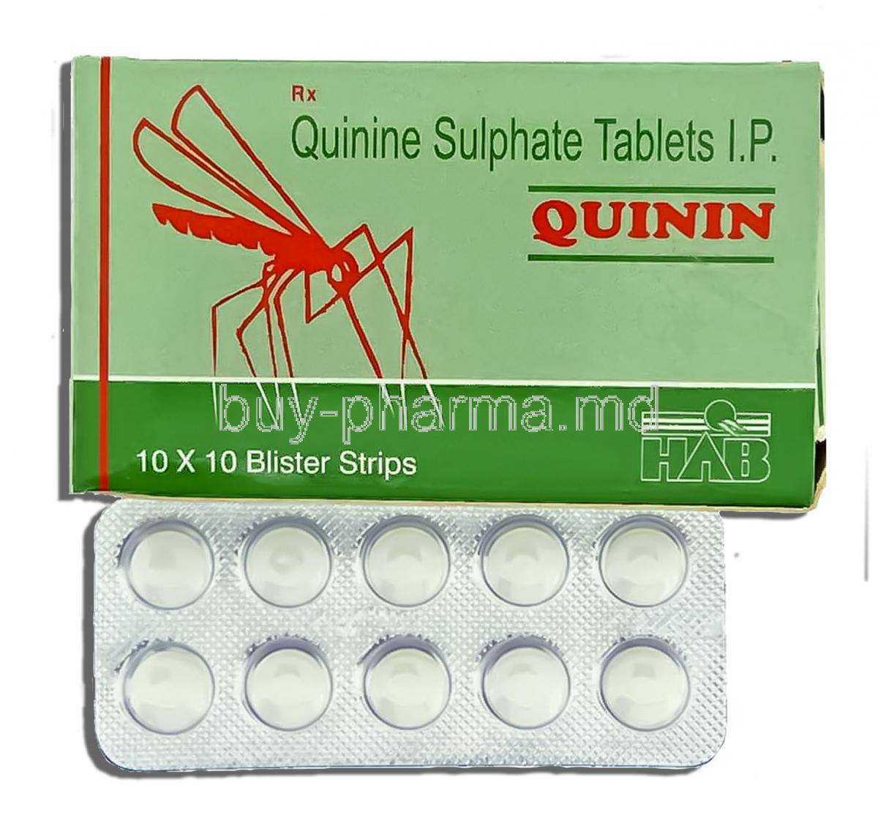
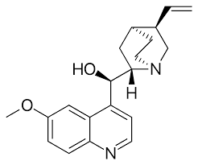
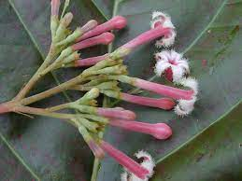
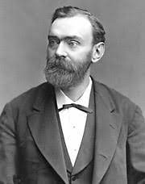
quinin fun facts
The quinin was inside the tonic water of Nobel’s drink
It is found in cinchona bark on trees
Also used in drugs to treat malaria and nighttime leg cramps
Years later, a group of researches won the Nobel Prize for using quinin in the treatment of malaria
Shining a light on an unknown substance | 27/06/2022 | Lauren, Eleanor and Emily

Slide 10
THANK YOU FOR LISTENING
QUININ IS WINNIN’
ANY QUESTIONS?
Shining a light on an unknown substance | 27/06/2022 | Lauren, Eleanor and Emily

Slide 11




