Slide 1





Wilhelm’s Cycle Suit
Authors: Emily Marsh, Sophia Bosch, Emily Kenny
University of Warwick
COVENTRY CV4 7AL – UNITED KINGDOM – Tel +44 (0)24 7652 3523
University of Liverpool – Department of Physics, Oliver Lodge, Oxford Street
LIVERPOOL L69 7ZE – UNITED KINGDOM – Tel +44 (0)15 1794 3358
EPSRC – Polaris House – North Star Avenue
SWINDON SN2 1ET – UNITED KINGDOM – Tel +44 (0)17 9344 4000

Slide 2
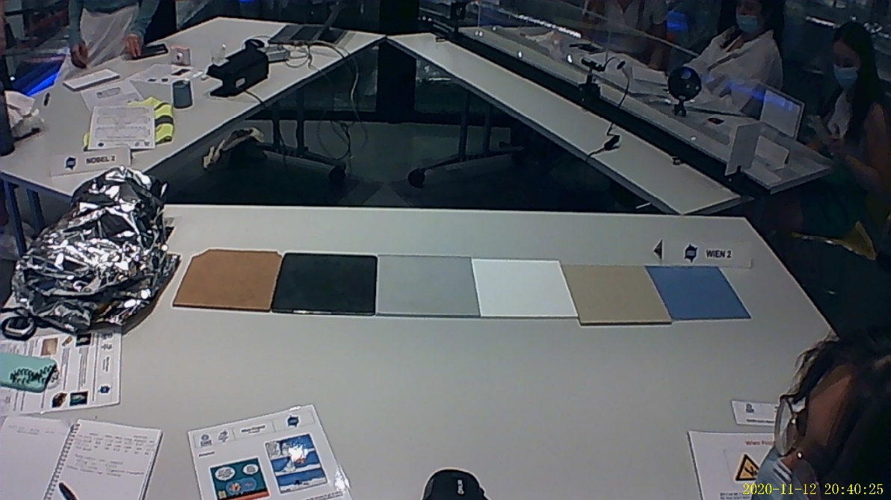
Introduction
Wilhelm is cold
We need to make a cycle suit for Wilhelm
We have a choice of 6 materials
We know the density, price and Young modulus of each material
Have to find best insulator

Slide 3
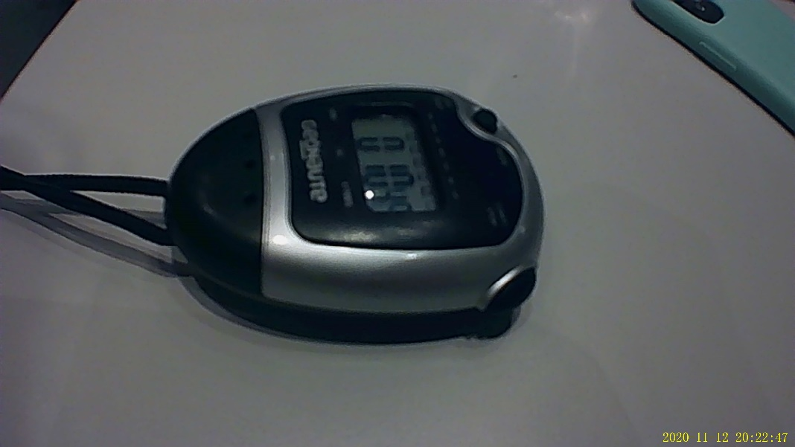
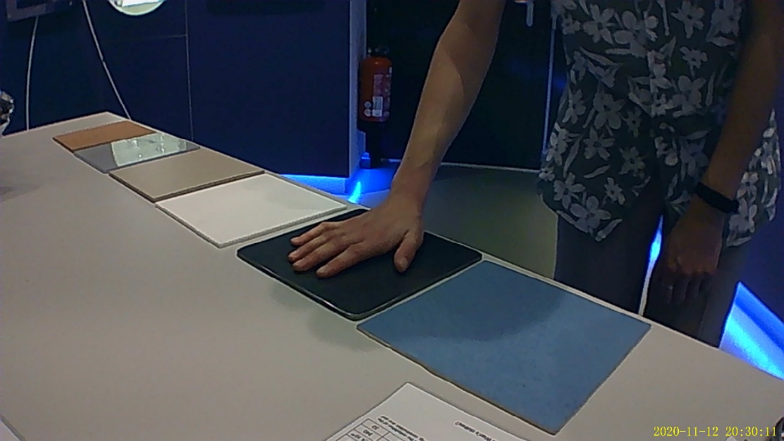
Method
Use thermal camera to find original temperature of material
Place hand on material
Time 120s

Slide 4
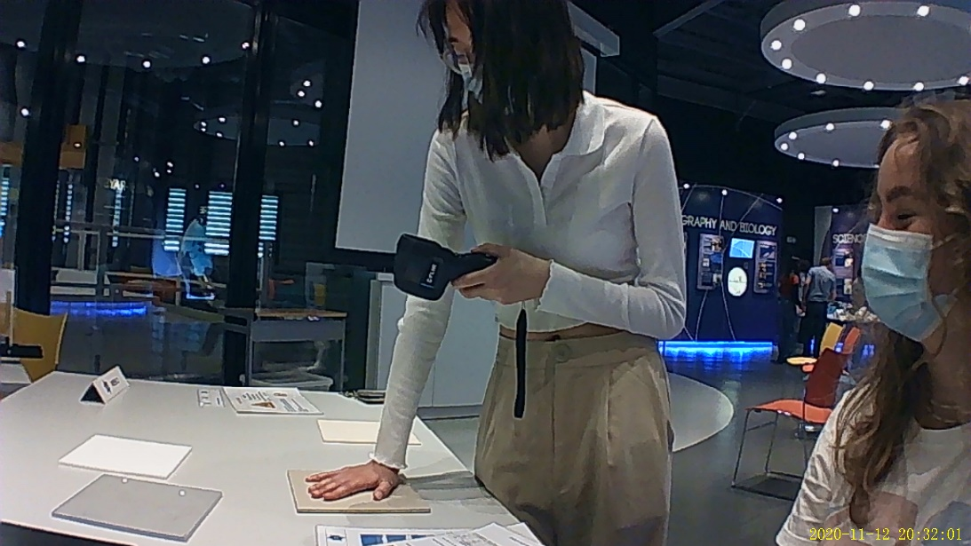
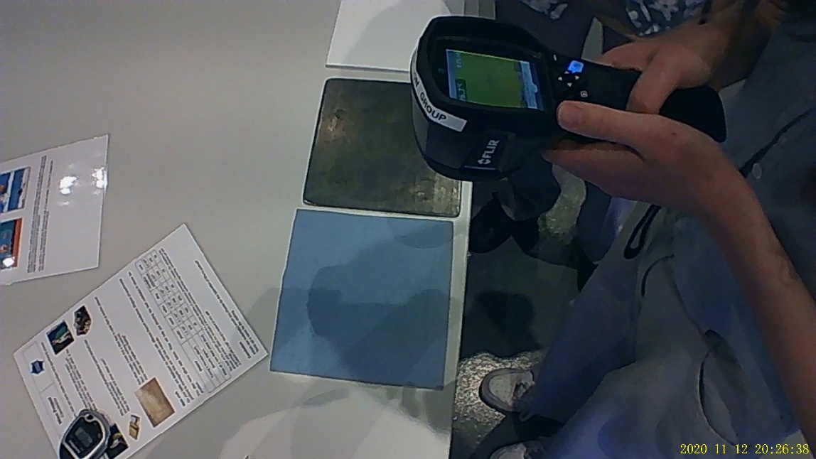
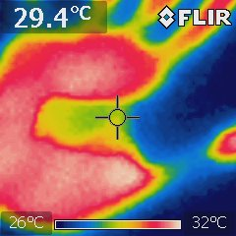
Method
Immediately record temperature of material after hand has been removed
Work out change in temperature
Repeat experiment

Slide 5
Results
Material | Temperature before/ ⁰C | Temperature after/ ⁰C | Temperature change/ ⁰C
Plastic | 26.15 | 32.35 | 6.20
Metal | 25.75 | 27.00 | 1.25
Teflon | 25.65 | 29.80 | 4.15
Tiling | 25.35 | 27.75 | 2.40
Crystalline Polystyrene | 23.35 | 29.40 | 6.05
Cork | 25.40 | 29.95 | 4.55

Slide 6
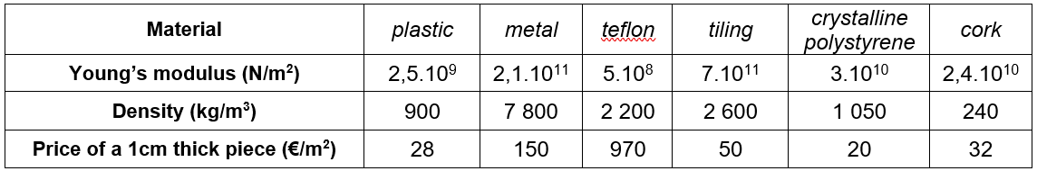
Results
The materials with the largest temperature change are best insulators because they allow less heat through
Those below 4⁰C are conductors because heat passes through
Lowest Young’s modulus: Teflon (5×10⁸) (N/m²)
Density: cork (240) (kg/m³)
Price: crystalline polystyrene (20) (€/m²)

Slide 7
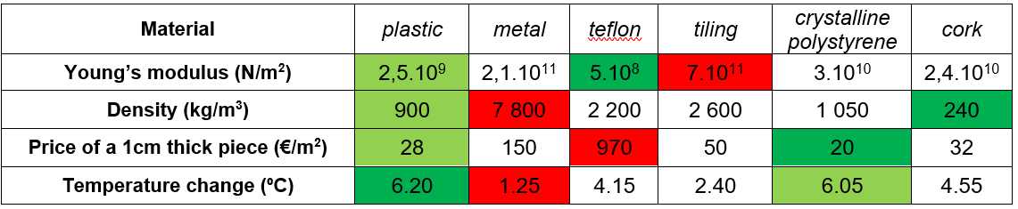
Conclusion
Largest component is plastic
Highest thermal resistivity
2nd lowest price
2nd lowest density
2nd lowest Young Modulus
Teflon incorporated in knees and elbows for wider range of motion
Lowest Young Modulus
Medium density
BUT most expensive

Slide 8




