Slide 1


Bringing us back to earth:
integrated funding of social and health care
Professor Guy Daly

Slide 2
Norman Lamb
6th (5th?) largest economy
We could and should do better
Need for more resources
Need to use the resources better
Post general election opportunity
Strong hypothecation for health and care tax?
NHS and care convention ….?
[need for parity of esteem for social care]

Slide 3
Intro & Content
History
Current context
Funding
International comparisons
Choices

Slide 4
It’s all the fault of our history
Post-war welfare state settlement
Bifurcation of health and care funding
Health – free at point of use, non means tested
Care – means and needs tested
  But didn’t presume people would live so long
  Didn’t think health demand was infinite, thought it would reduce
Perverse incentives of social care funding in 1980s lead to community care changes
Social care postcode lottery
Perverse incentives persist of DTOC due to funding and, increasingly, capacity/availability
  57% of DTOCs due to NHS (1)
  But, also inadequacy of social care funding and consequently social care supply

Slide 5


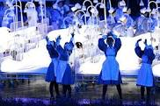

London 2012 Olympic Ceremony

Slide 6
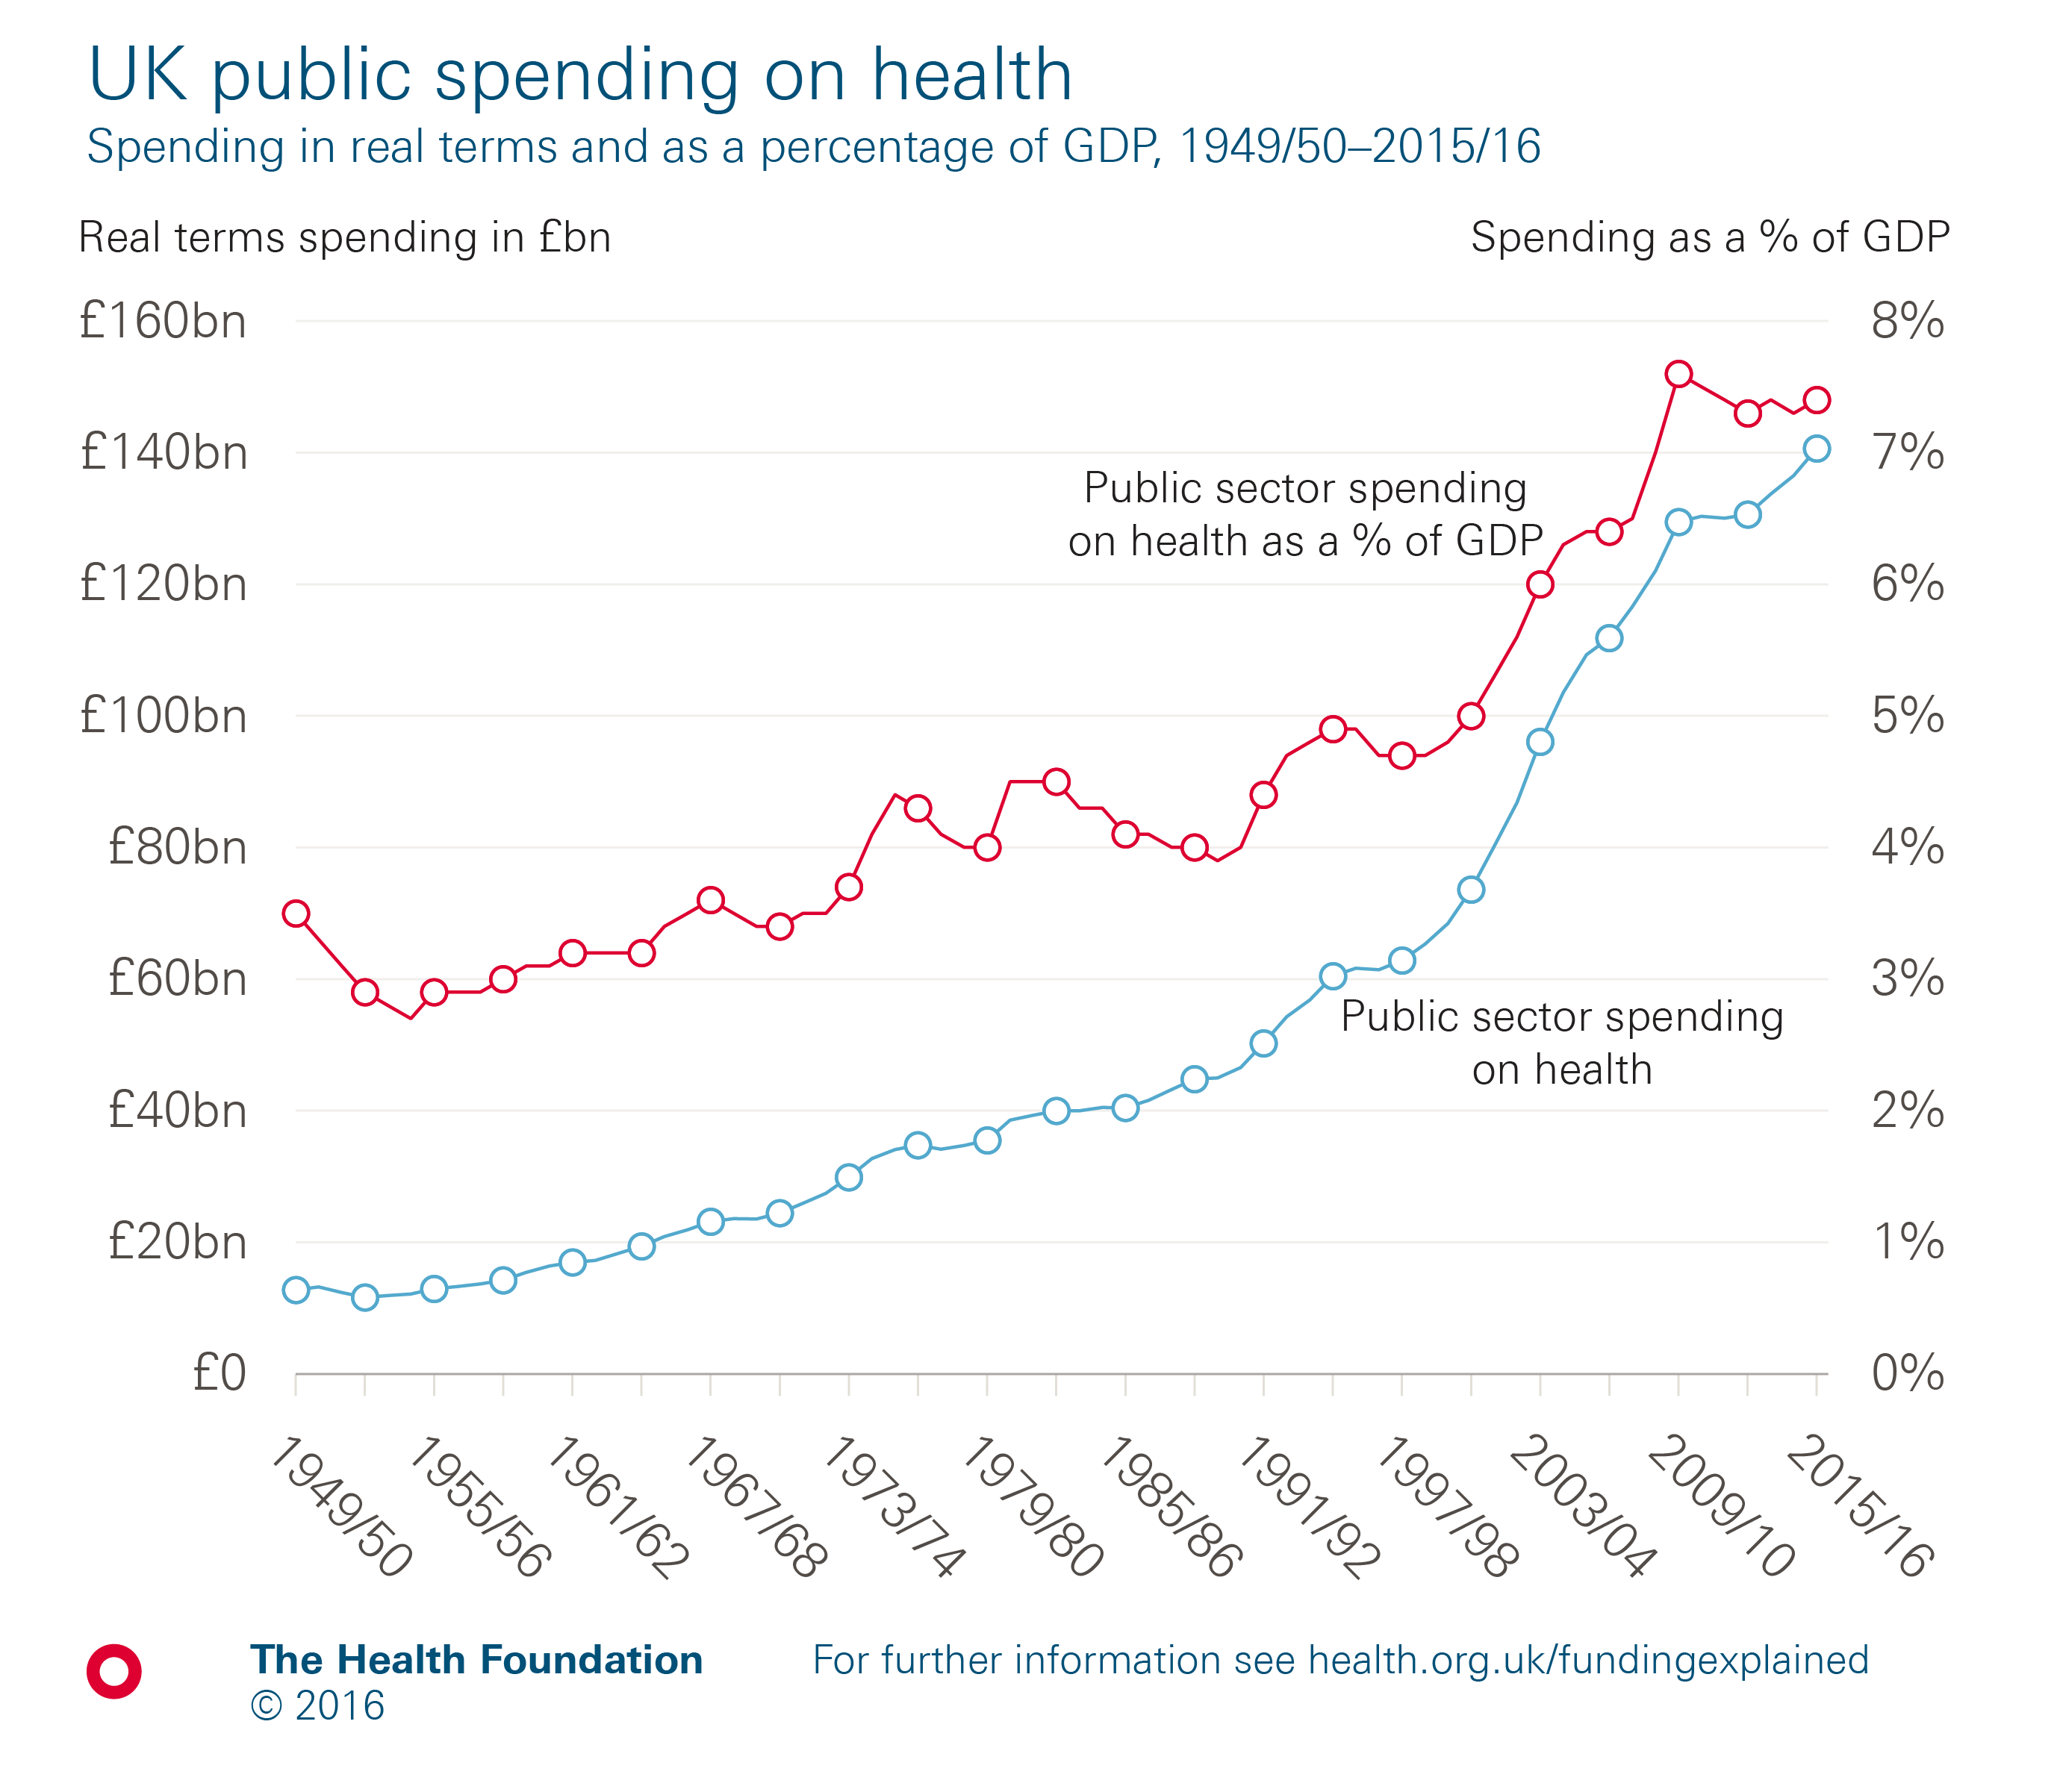
Notes:
Note: Health spending is measured as public spending by health ‘function’, and includes all spending on the NHS in the UK, but excludes administrative costs. It also includes medical research, devolved administrations and local government spending on health.
Source: Health Foundation analyses using data from Public Sector Statistical Analyses 2016 (HM Treasury); Fiscal Facts: Spending by function (Institute of Fiscal Studies); OHE Guide to UK Health and Health Care Statistics 2013 (Office of Health Economics, Hawe E and Cockcroft L); Quarterly National Accounts, Quarter 2 (Apr to June) 2015 dataset (Office for National Statistics); GDP deflators at market prices, and money GDP September 2016 (HM Treasury).

Slide 7
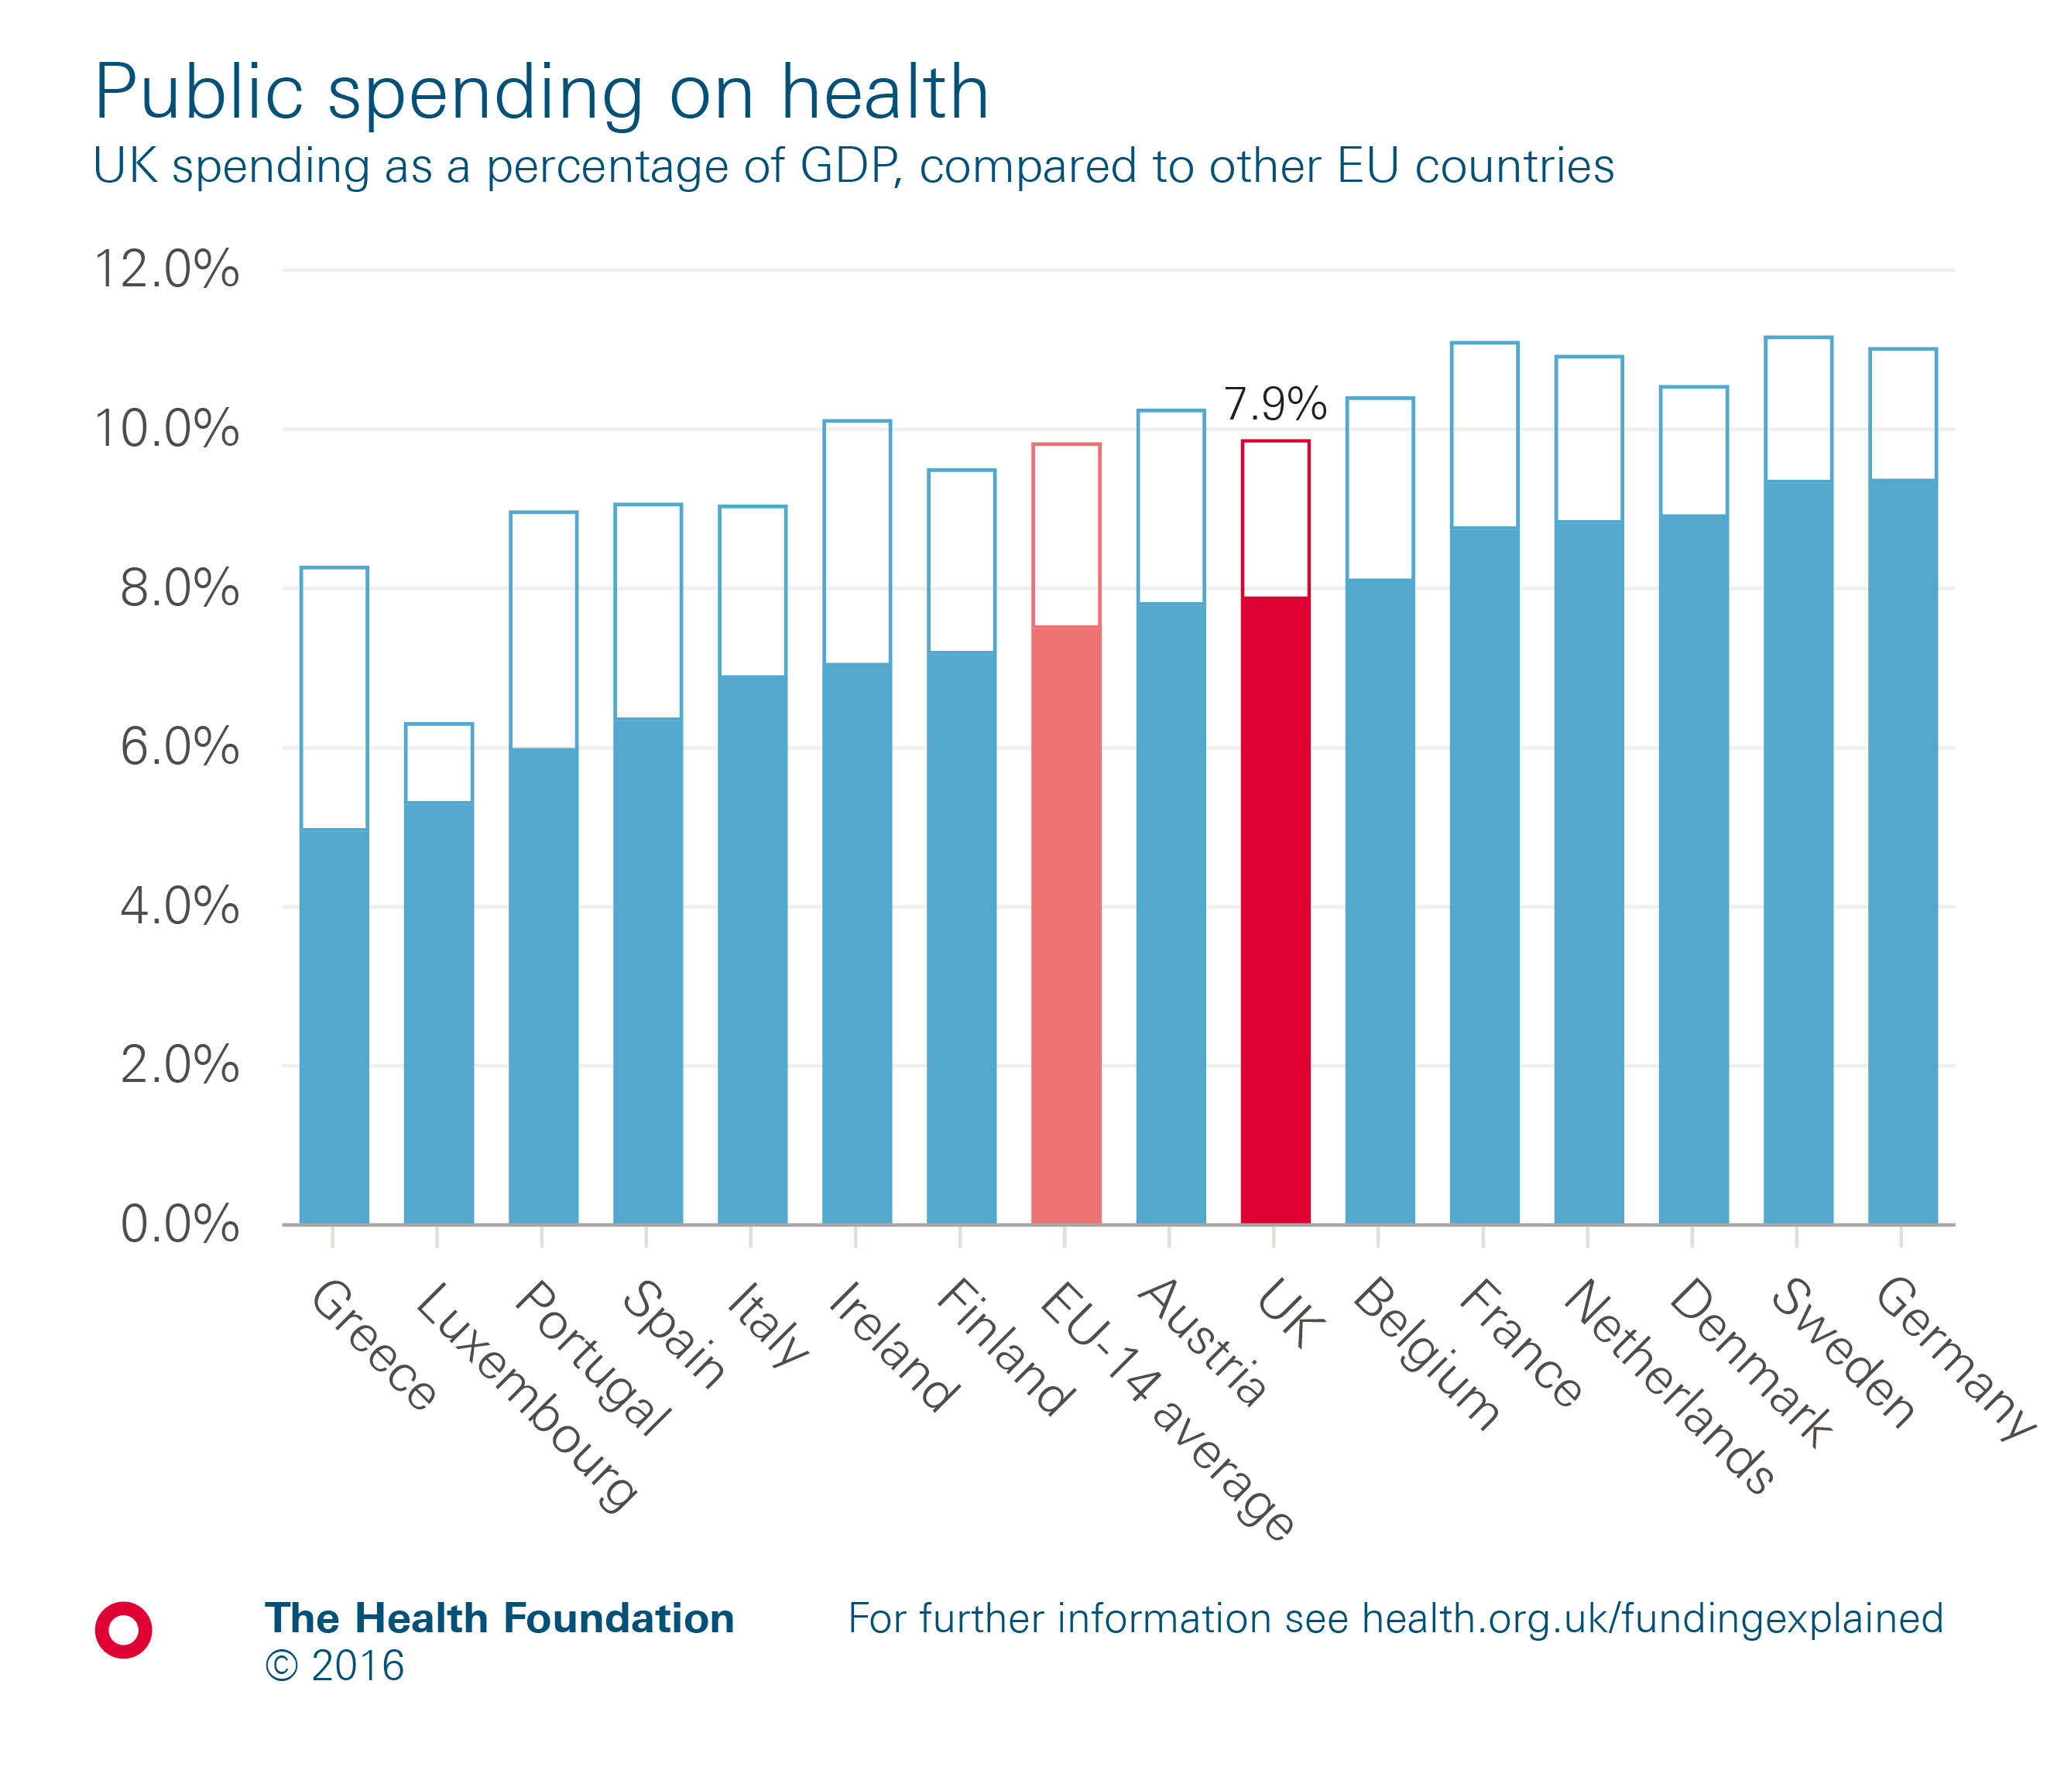
Notes:
Note: EU14 average is the unweighted average of the first 15 countries to join the EU (excluding the UK). Total current spending shown in outline. The OECD definition of health has been used for international comparison which defines health as all activities with the primary purpose of improving, maintaining and preventing the deterioration of the health status of persons and mitigating the consequences of ill health through the application of qualified health knowledge, medical, paramedical and nursing knowledge, including technology, and traditional, complementary and alternative medicine.
Source: Organisation for Economic Co-operation and Development.

Slide 8
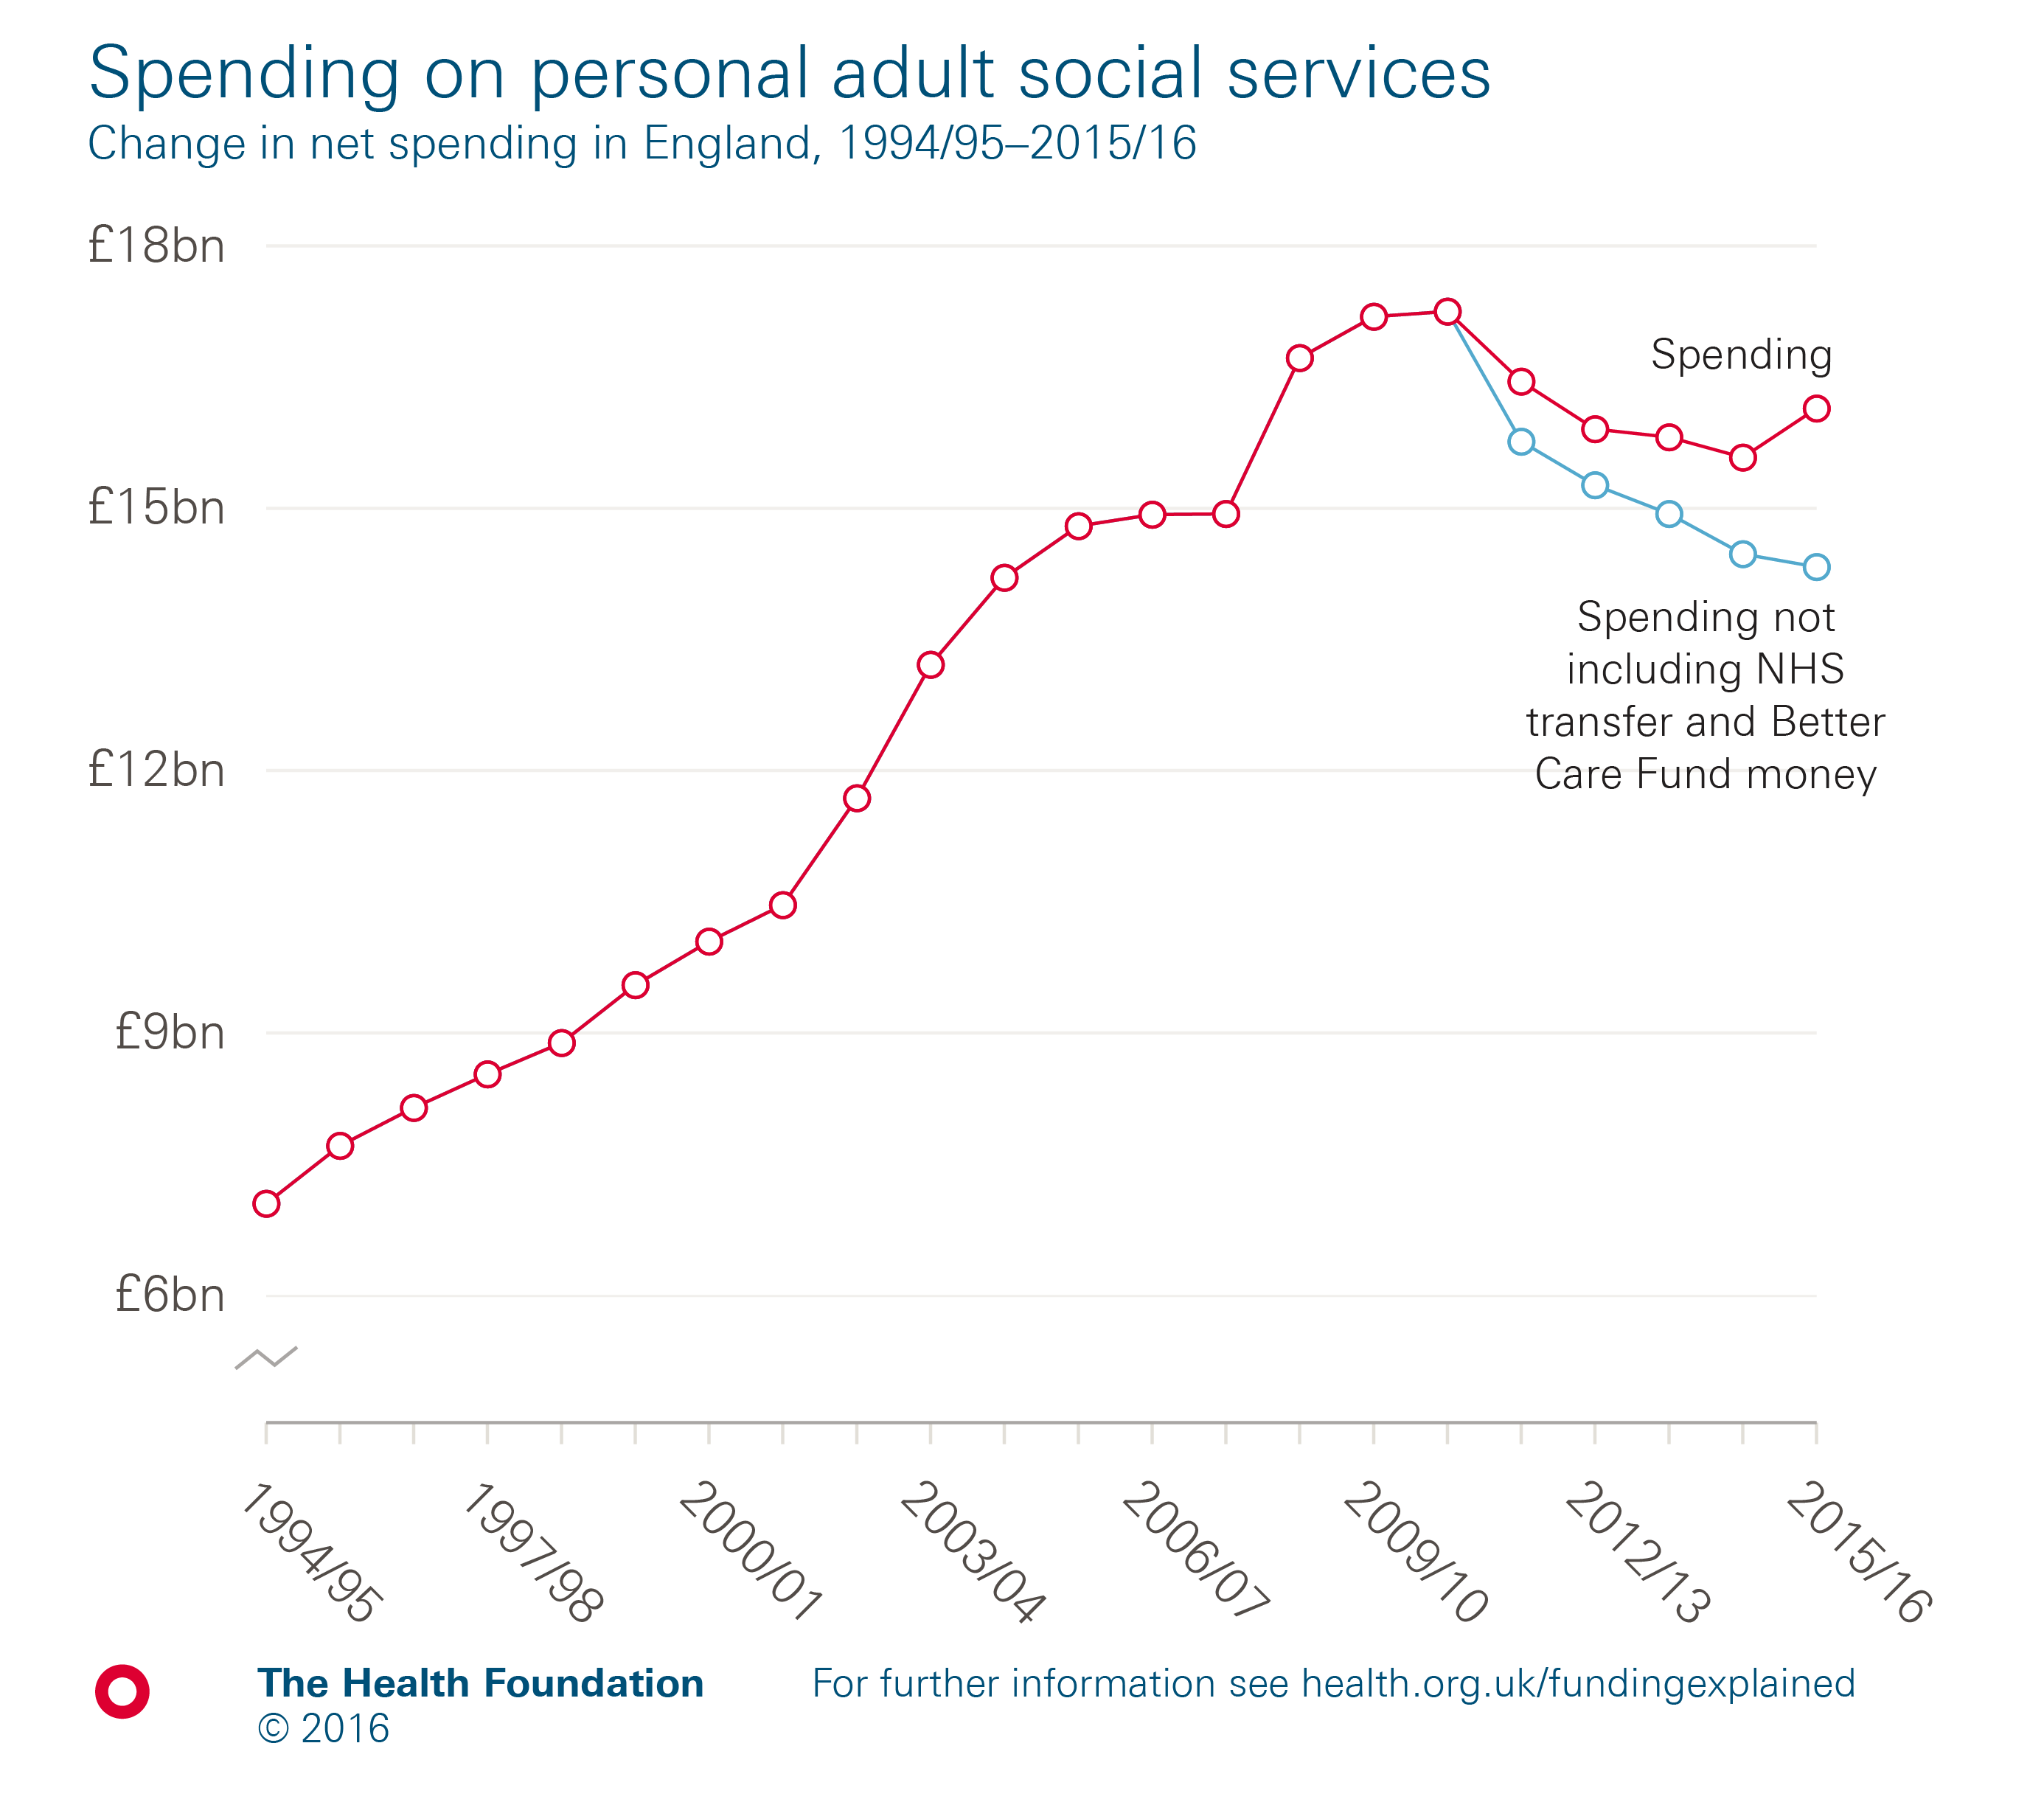
Notes:
Source: Personal Social Services: Expenditure and Unit Costs (NHS Digital).

Slide 9
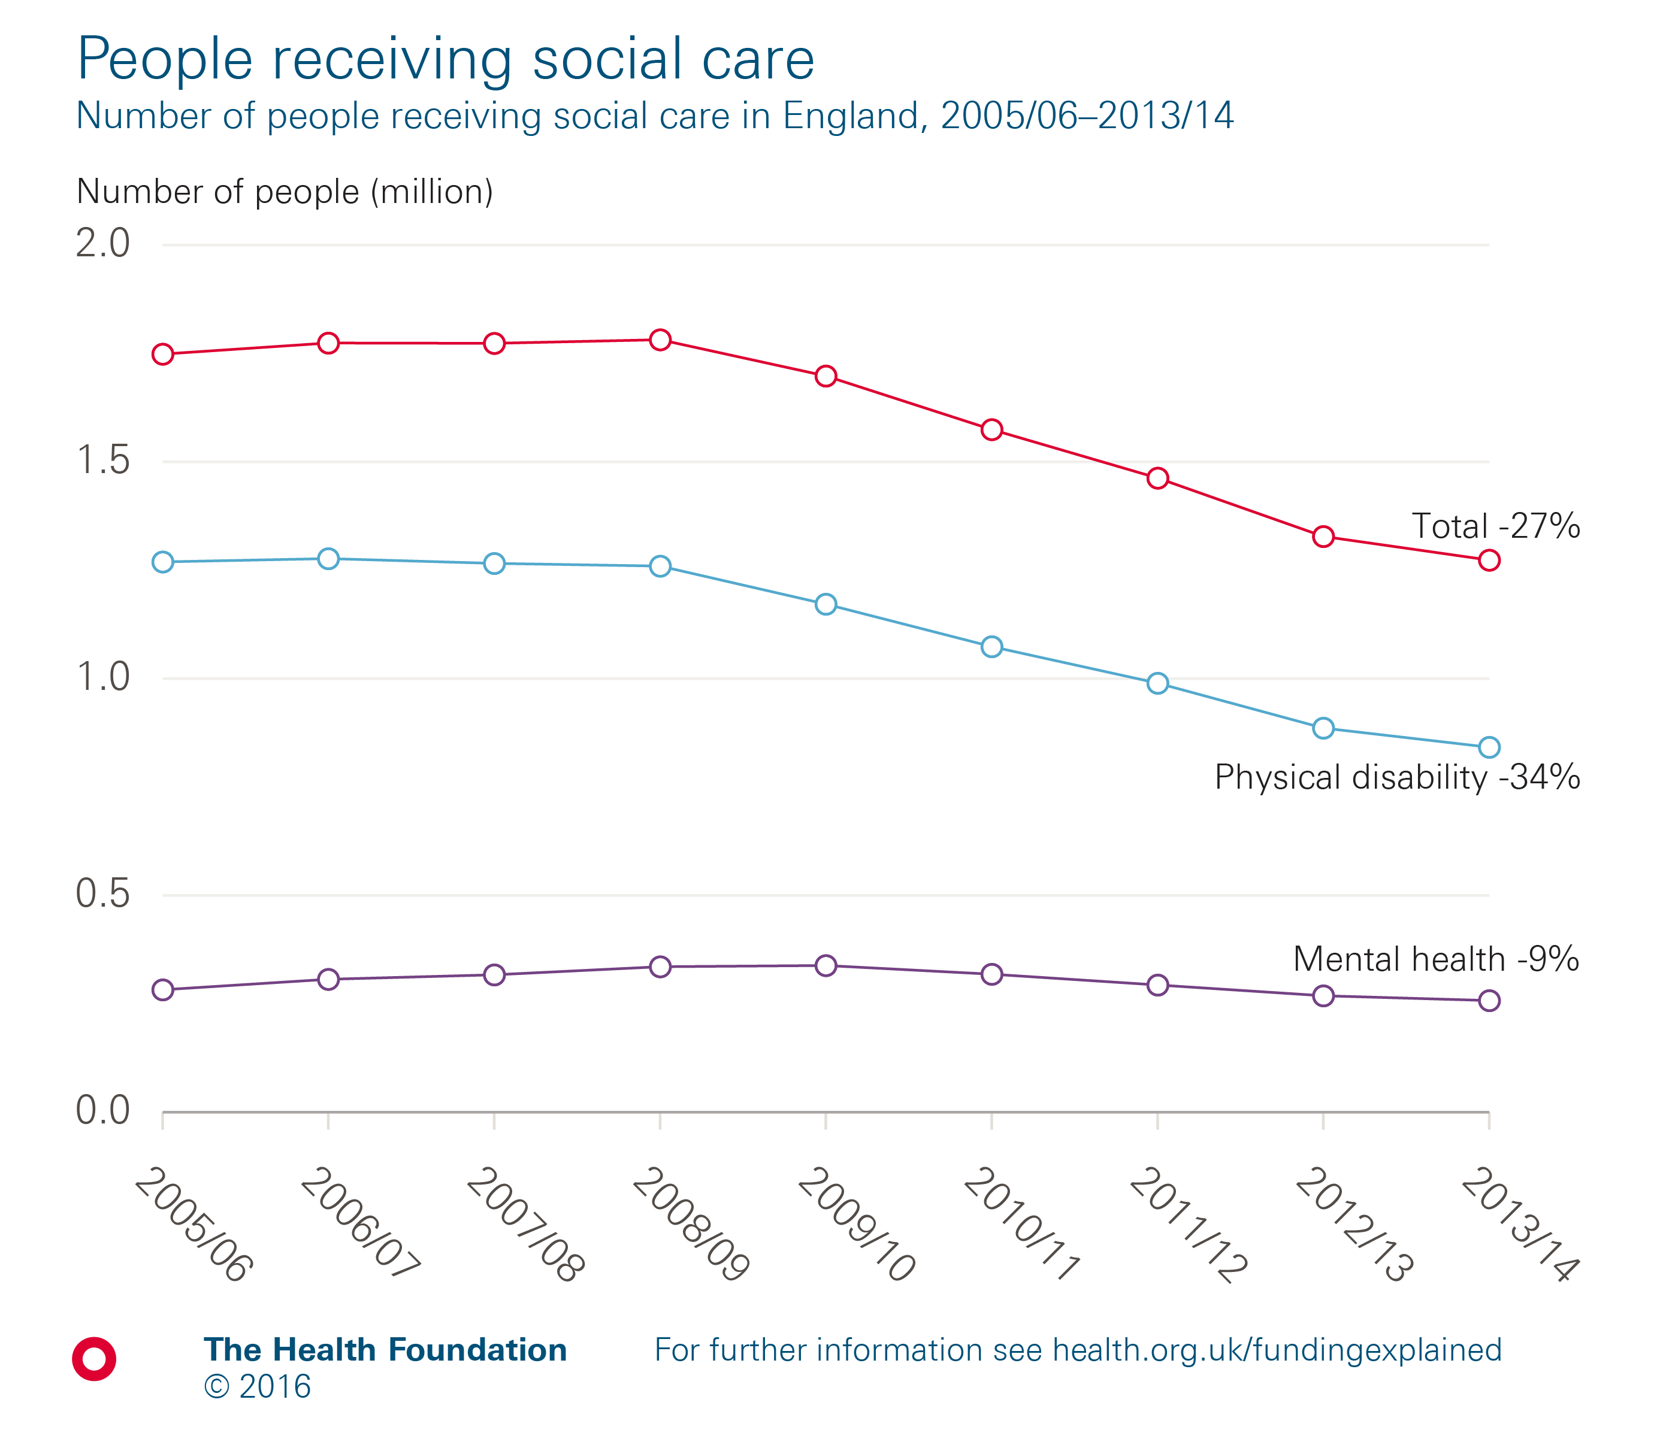
Notes:
Note: Figures relate to the number of people receiving services (community based, residential or nursing care) provided or commissioned by local authorities.
Source: National Adult Social Care Intelligence Service, Referrals and Packages, module P1.

Slide 10
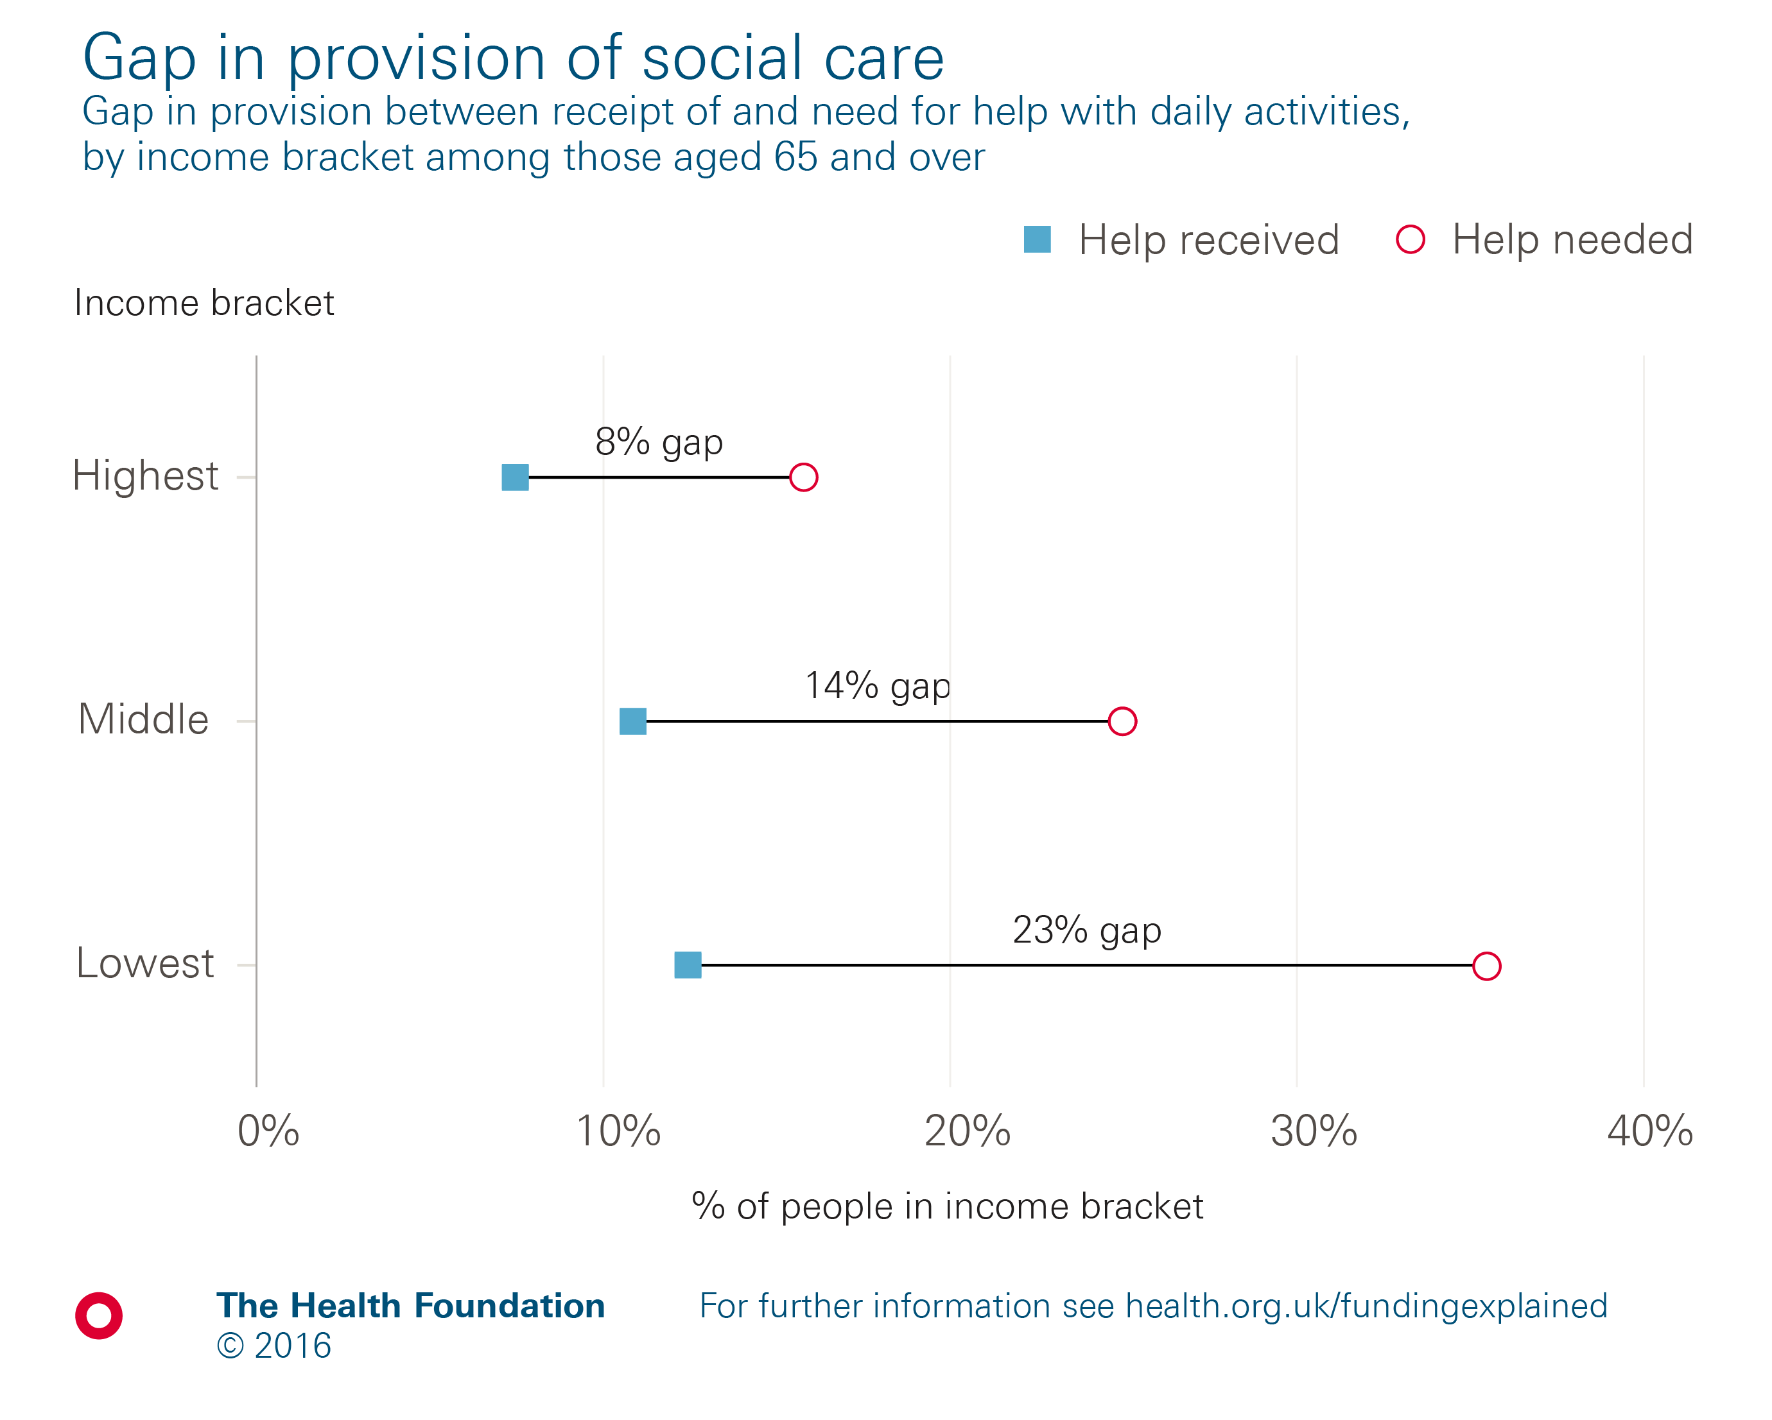
Notes:
Note: Activities of daily living include eating, bathing, dressing.
Source: Health Survey for England.

Slide 11
Social Care Funding
International comparisons
Social care funding is an international conundrum, i.e. no general solution
  some compulsion (Germany, Singapore)
  in US social care is the largest uninsured social welfare risk
Average OECD expenditure on adult social care is 1% of GDP
UK is third highest OECD for informal care providers (18% of population)

Slide 12
Current funding context and issues (1)
Fair Access to Care Services
  Critical and Substantial typically
Care Act Eligibility Regulations - Slazberg/ Slazberg & Beresford:
  eligibility still being ‘shaped’ by funding levels
  still a postcode lottery dependent upon size of social care budget
Better care fund – more than moving health funding across to local authorities?
Continuing health care needs – roulette?
Pooled budgets
Personal budgets and Personal Health Budgets
Social Care Precept
  Easier for some than others

Slide 13

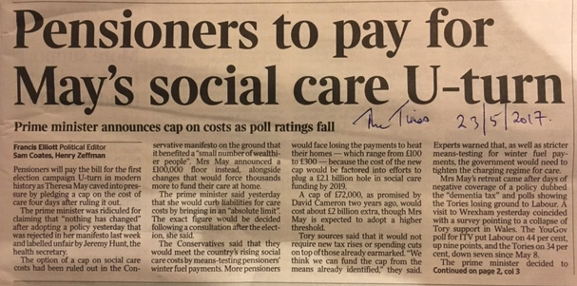
Current funding context and issues (2)
Social Care funding is insufficient and inoperable – hence proposals:
  For a national care service – Gordon Brown
  Dilnott review
  A floor and a ceiling?
Current adult social care spend:
  is <1%% of GDP, i.e. approx. £17bn
  Estimated to be £2bn to £5bn short
  though it’s not just about the £, but it is most definitely partly about the £
And we need a fair/er system

Slide 14
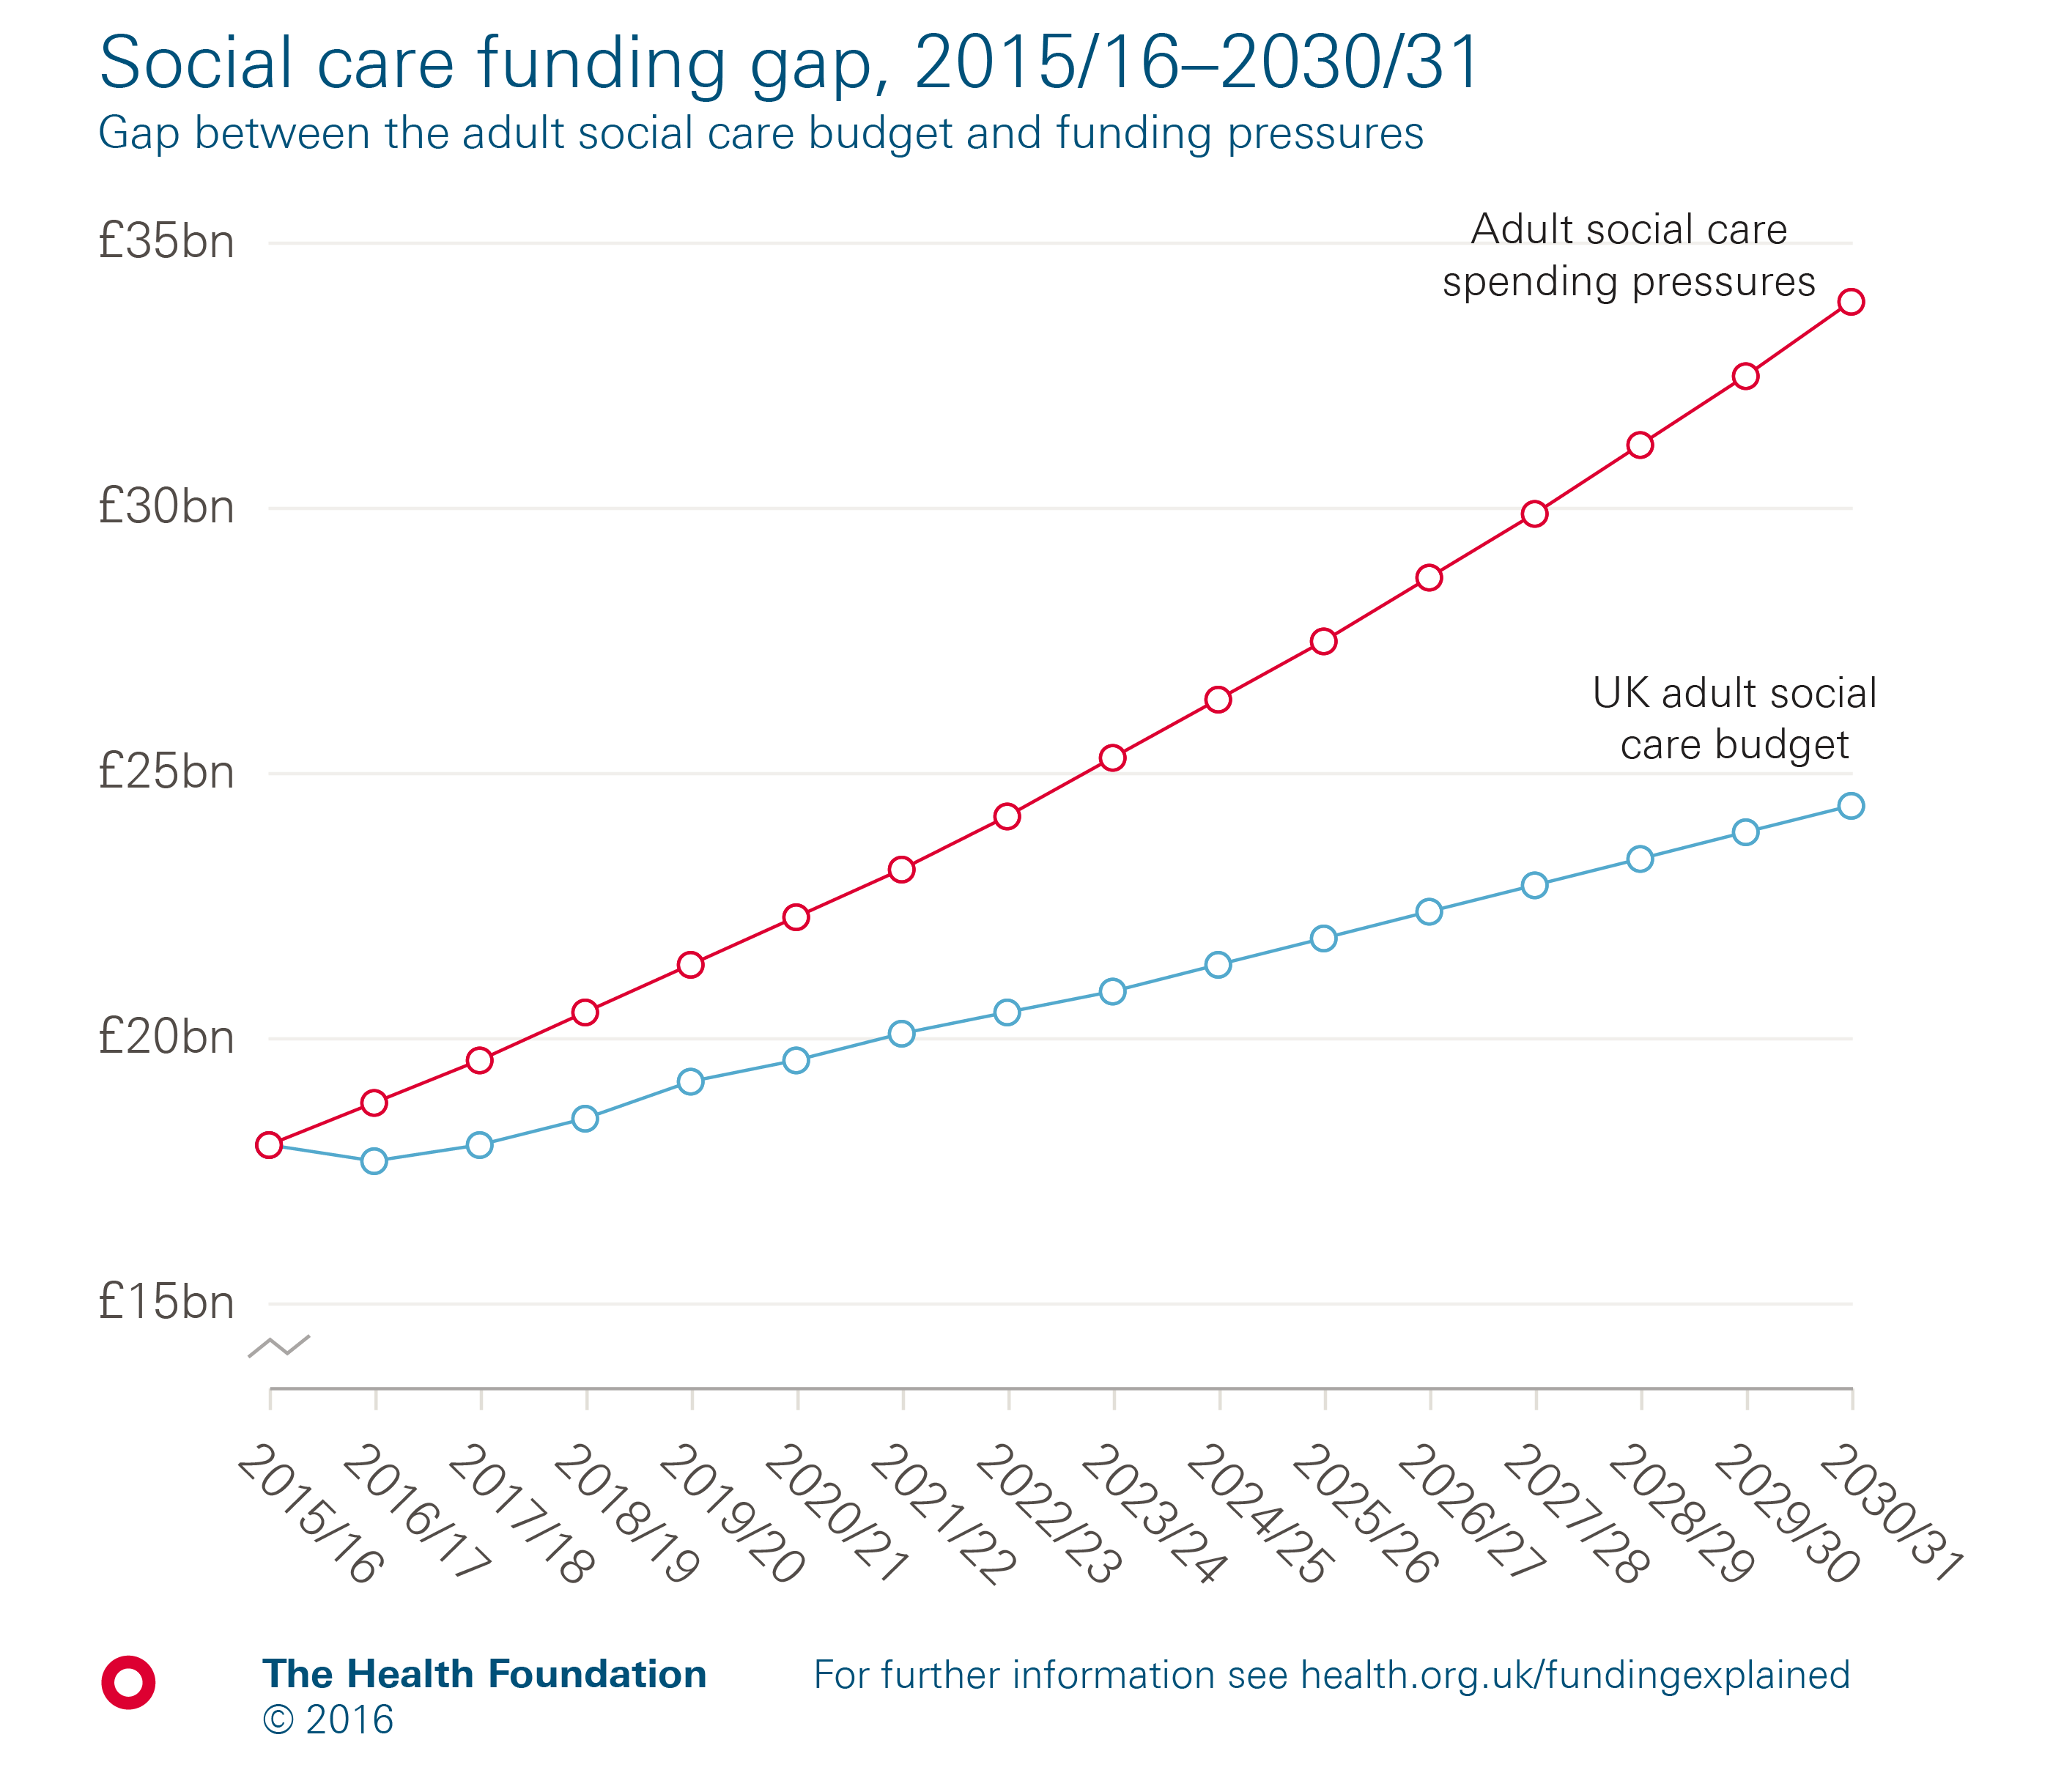
Notes:
Source: Health Foundation analysis using LSE results from Hancock R, Wittenberg R, Hu B, et al. Long-term care funding in England: an analysis of the costs and distributional effects of potential reforms. PSSRU Discussion Paper 2857. London: LSE, 2013.

Slide 15
Other solutions choice, integration, service improvements? (1)
More than just choice - evidence from IBSEN and health budget pilots
Social care IBSEN evaluation – older people diminished psychological wellbeing
PHBs
  No significant impact on health status or mortality relates
  Or health related quality of life
  But improvements in satisfaction levels & wellbeing for some –
More than just integration
  Doesn’t necessarily save £ - PBs have shown some cost reductions
  But can lead to better care and better levels of satisfaction
More than just better/more proactive/improved services
It’s still (in part) about the £

Slide 16
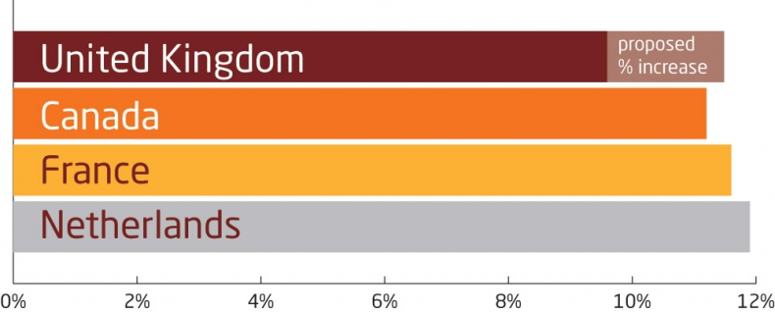
Public spending on health and social care needs to increase from 9.6% to 11–12% by 2025
Funded by increased contributions from those able to
prescription charges
NI
reducing wealthier older people’s allowances (winter fuel, TV, etc.)
wealth and property taxes
Kings Fund 2014 Barker Commission on the Future of Health and Social Care in England

Slide 17
What we need (2)
Increased spend as % of GDP – how much?
(Strong) hypothecation?
Health and care commission – mentioned in Queen’s speech
Implement (a version of) Dilnott
Meantime …
STP partnership is a positive – build this system leadership
Joint. H&WB Board and HOSC?
Greater integration – workforce/MDTs
Workforce planning
Technological solutions
More choice/prevention/integration?

Slide 18
References
1 Commonwealth Fund (2014) US Health System Ranks Last Among Eleven Countries on Measures of Access, Equity, Quality, Efficiency, and Healthy Lives, http://www.commonwealthfund.org/publications/press-releases/2014/jun/us-health-system-ranks-last
2 Crawford, R. and Stoye, G. (2017) The prevalence and dynamics of social care receipt, Institute for Fiscal Studies, London: IFS
3 Daly, G. (2009) ‘LinkAge Plus: The Benefits for Older People’, London: UK HMG – Department of Work and Pensions
4 Daly, G. (2012) ‘Citizenship, choice and care: an examination of the promotion of choice in the provision of adult social care’, Research, Policy and Planning, 29 (2), 179-190
5 Glasby, J. and Daly, G. (2014) ‘Adult Health and Social Care’, in (eds.) Bochel, H. and Daly, G. (2014) Social Policy, London: Routledge
6 Lodge, C., Carnell, E. and Coleman, M. (2016) The New Age of Ageing, Bristol: Policy Press

Slide 19
7 Humphries, R., Thorlby, R., Holder, H., Hall, P. and Charles, A. (2016) Social Care for Older People – Home Truths, Kings Fund, London, Kings Fund
8 Johnston, L., Rozansky, D., Dorrans, S., Dussin, L. and Barker, T. (2017) Integration 2020: Scoping research, Social Care Institute for Excellence, London: SCIE
9 Phillips, D. and Simpson, P. (2017) National standards, local risks: the geography of local authority funded social care, 2009–10 to 2015–16, R128 - Institute for Fiscal Studies, London: IFS
10 West, K. (2014) ‘Older People, Population Ageing, and Policy Responses, in (eds.) Bochel, H. and Daly, G. (2014) Social Policy, London: Routledge
11 WHO (2016) Global strategy and action plan on ageing and health (2016-2020), http://www.who.int/ageing/global-strategy
12 Woolham, J., Daly, G., Sparkes, T., Ritters, K. and Steils, N. (2016) ‘Do direct payments improve outcomes for older people who receive social care?’, Age and Society, Vol. , pp. 1-24

Slide 20
Web references etc.
  13 – see https://www.nuffieldtrust.org.uk/resource/what-s-behind-delayed-transfers-of-care#dtocs-the-tip-of-the-iceberg
  14 – see http://www.communitycare.co.uk/2017/06/16/care-act-funding-decision-exposes-nonsense-eligibility-criteria/
  15 – see http://www.publicfinance.co.uk/opinion/2017/03/how-big-social-care-funding-gap
  16 - https://www.abi.org.uk/news/news-articles/2014/02/seven-things-we-learnt-from-the-abi-social-care-summit-a-world-to-grow-old-in/
  17 http://blogs.lshtm.ac.uk/prucomm/files/2013/04/Personal-Budgets-review-of-evidence_FINAL-REPORT.pdf

