Slide 1
Health and Social Care Summit – Reimagining Integration
26 June 2017
University of Warwick
Integrating social and health care –
overview of current issues
Richard Humphries
Senior Fellow, The King’s Fund
Richard Humphries
Senior Fellow, The King’s Fund, London

Slide 2
Overview
If integrated care is the answer, what is the question ?
The historical context
What does good care for older people look like?
The current policy framework
Evidence and experience
“Top tips”

Slide 3
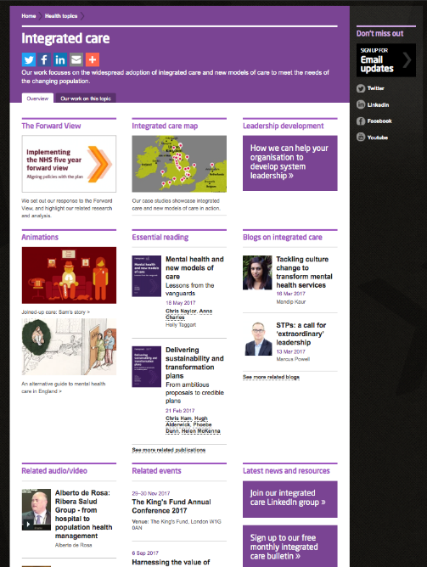
The King’s Fund work on integrated care:
Policy & research
Support to individuals and organisations
  Board development
  Leadership development
  Learning sets
  Bespoke help & advice
Information
  Integrated Care bulletin
  Health & Wellbeing Board bulletin
Conferences & Events
http://www.kingsfund.org.uk/topics/integrated-care

Slide 4
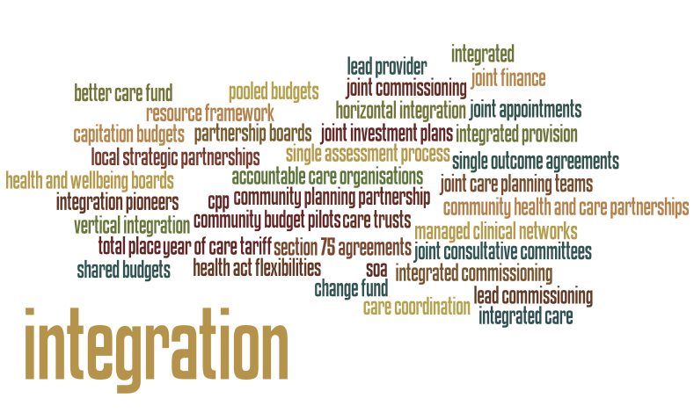
Integration is not a new idea!

Slide 5
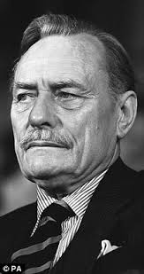
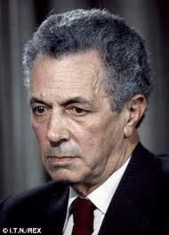
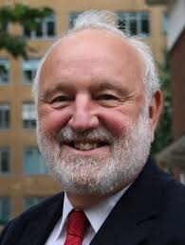

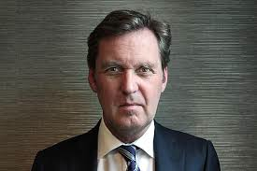
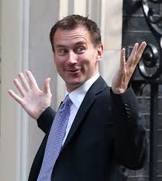
…”at the earliest moment possible, I intend to call on local health and welfare authorities, through the bodies which represent them, to take a hand in mapping the joint future of the hospital and the local authority services”
1961
“Our proposals for the new NHS offer a great, and indeed a new, opportunity for a partnership with local authorities.”
1971
“We are determined to bring down the "Berlin wall" that separates NHS and local authority services so that, in every part of the country, the system is moulded to the needs of the patients—the needs of the people—and not the other way around.”
1998
“If patients are to receive the best care, then the old divisions between health and social care need to be overcome. The NHS and social services do not always work effectively together as partners in care, so denying patients access to seamless services that are tailored to their particular needs. The division between health and social services can often be a source of confusion for people. Fundamental reforms are needed to tackle these problems.”
2000
“In the next two years I expect to see health and social services in every part of the country pooling resources and skills to deliver a seamless service for older people – either through a Care Trust or through use of the existing Health Act flexibilities.”
2002
“For years, successive governments and NHS leaders have talked about joining up our health and care services so people get better care at the right time and in the right place. The time for talk is over – our plans will make this vision a reality for patients and help deliver a sustainable future for the NHS.”
2014

Slide 6
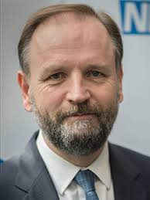
“As the NHS approaches its 70th Birthday, we are now embarked on the biggest national move to integrating care of any major western country. For patients this means better joined up services in place of what has often been a fragmented system that passes people from pillar to post.”
2017

Slide 7
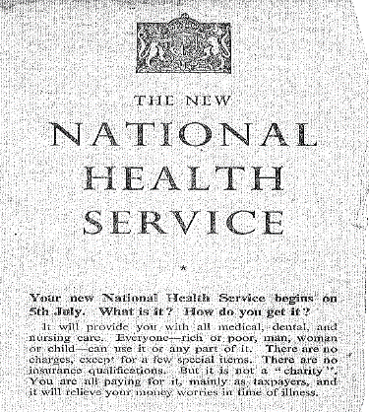
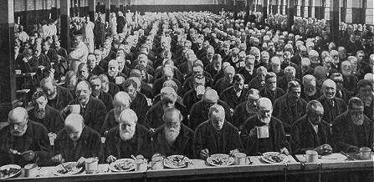
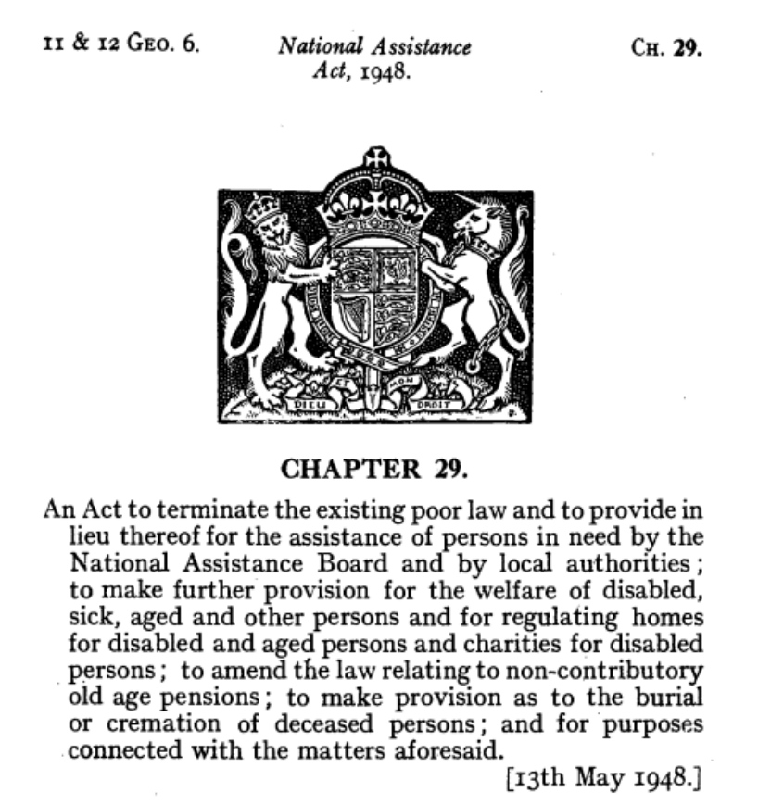
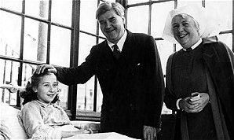
Back to 1948

Slide 8

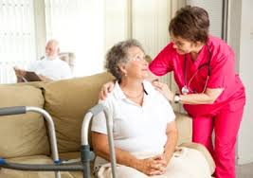
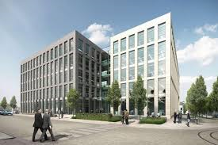
Free at the point of use (mostly)
Means tested
FUNDING
Funded through mix of central & local funding
Funded through general taxation
Limited co-payment
Extensive co-payment
ENTITLEMENT
Universal
Rationed to those with highest needs
GOVERNANCE & ACCOUNTABILITY
‘National’ in NHS
‘Local’ in local authorities (152)
Accountability fragmented but largely national
Accountability via local elected members
DELIVERY
Few services delivered through independent providers
Most services delivered through 19,000 independent providers
Contracting & payment mechanisms incl. tariff set centrally
Commissioning & payment mechanisms set separately by local authorities
REGULATION & PERFORMANCE MANAGEMENT
Complex perforrmance management & inspection/regulation via NHSI, NHSE, CQC ++
Providers regulated by CQC
Sector led improvement by LAs
Notes:
Mundane issues but not big values or differences
These faultlines do generate tensions & disagreements
You have permission to find this difficult

Slide 9
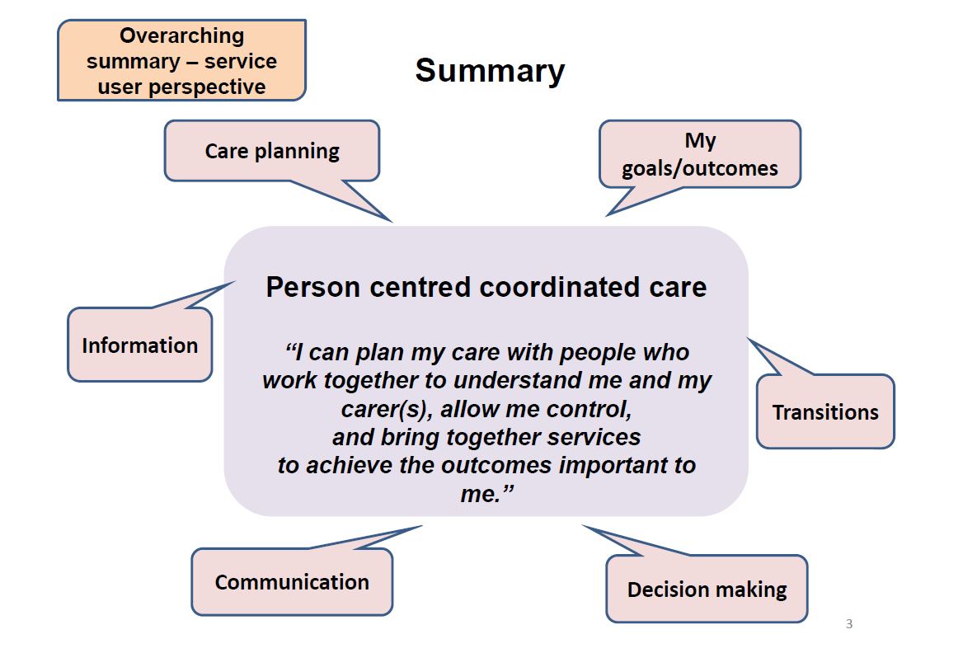

What is integrated care?

Slide 10
What kind of integration ?
Organisational:
  Care Trusts
  Integrated provider organisations based on acute/FT (Northumbria)
  Integrated provider organisations based on community trusts or social enterprises e.g Staffordshire, Bath & North East Somerset
Clinical and/or service integration:
  Multidisciplinary teams
  Single assessment & care coordination processes
  Casefinding/risk stratification
  Shared information including single patient records
  Single care pathways
  Pooled or aligned budgets
  Risk-sharing agreements
Functional
  Integration of specific services eg mental health, learning disability
  Integrated commissioning eg North East Lincolnshire
Place-based or population systems of health
  STPs
  Accountable care systems
  Accountable Care organisations
Notes:
Scope for confusion between organisational form. Methods and process

Slide 11
What do we want to integrate ?
Integration of primary care & secondary care
Integration of physical health & mental health
Integration of health and social care
Integration at population health as well as individual level
Notes:
Scope for confusion between organisational form. Methods and process

Slide 12
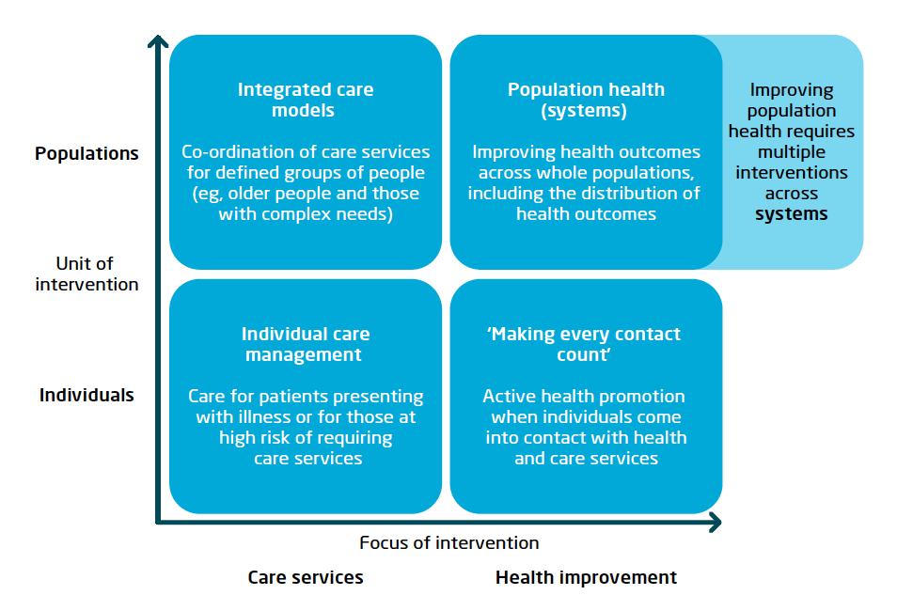
Integration for populations as well as individuals………
When could we add Scotland to this list ?
Examples from abroad:
Kaiser Permanente, United States
Nuka System of Care, Alaska
Gesundes Kinzigtal, Germany
Counties Manukau, New Zealand
Jönköping County Council, Sweden
http://www.kingsfund.org.uk/sites/files/kf/field/field_publication_file/population-health-systems-kingsfund-feb15.pdf

Slide 13
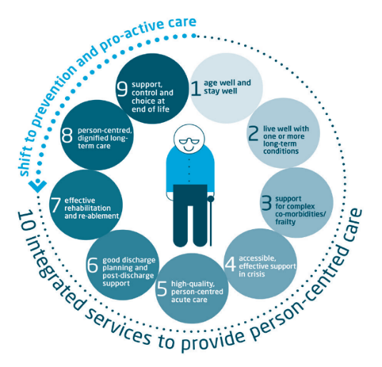
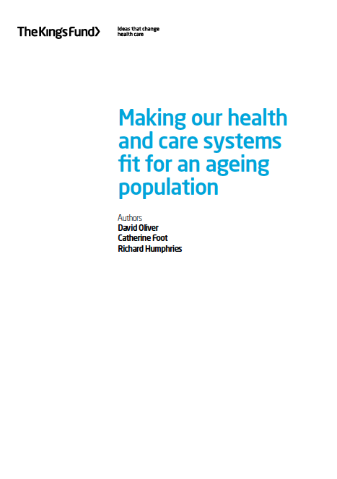
Integrated care and older people
https://www.kingsfund.org.uk/sites/files/kf/field/field_publication_file/making-health-care-systems-fit-ageing-population-oliver-foot-humphries-mar14.pdf

Slide 14
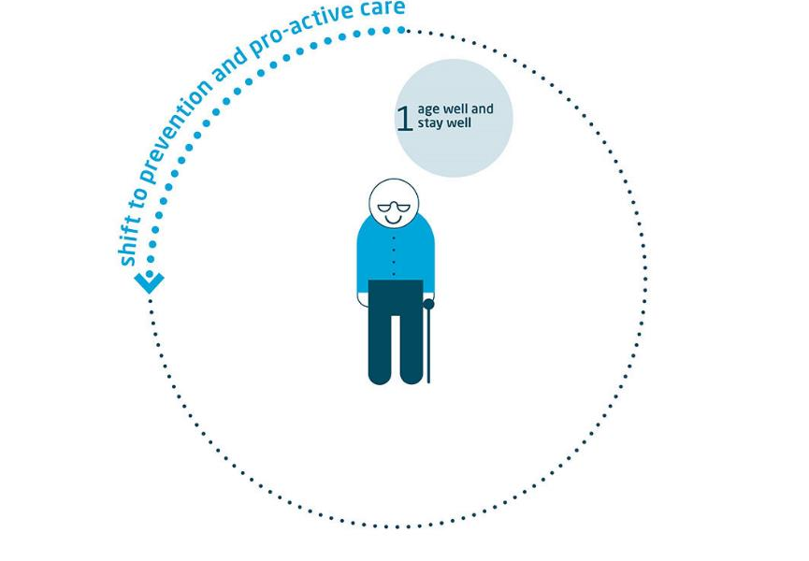

Slide 15
Goal
Older people should be able to enjoy long and healthy lives, feeling safe at home and connected to their community.

Slide 16
Current situation
There remain major inequalities in life expectancy at 65
11 per cent of people over 75 report feeling isolated, and 21 per cent feel lonely
34 per cent of people aged 65–74 are obese, and only 8 per cent of women over 75 take the recommended levels of physical activity
Uptake of influenza and pneumococcal vaccinations is below the levels set by international targets and national guidance

Slide 17
What we know can work
Life-course approaches to health and wellbeing that address the wider determinants of health
Ensuring that we get housing right for older people
Preventing social isolation and promoting age-friendly communities
Cold weather planning
Promoting healthy lifestyles and wellness
Adequate treatment for ‘minor’ needs that limit independence
Vaccination
National screening programmes

Slide 18
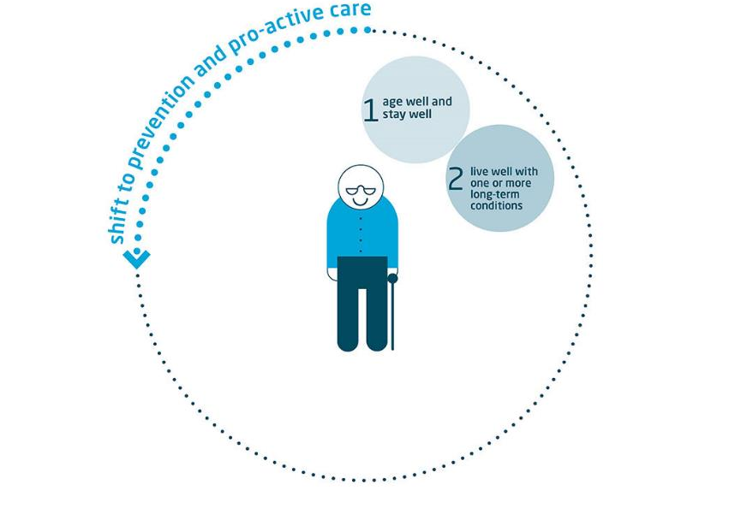

Slide 19
Goal
Older people with simple or stable long-term conditions should be enabled to live well, avoiding unnecessary complications and acute crises.

Slide 20
Current situation
Most people over 65 do live with a long-term condition, and most over 75 live with two or more
Older people receive poorer levels of care than younger people with the same conditions
General medical conditions are treated more effectively than common geriatric conditions

Slide 21
What we know can work (1)
Providing continuity and care co-ordination
Using population risk stratification
Case management delivered through integrated locality-based teams
Involving older people and their families in planning and co-ordinating their own care
Personal care budgets and direct payments
Telehealth

Slide 22
What we know can work (2)
Providing support and education for family and volunteer carers
Ensuring that older people receive the same care and support as younger people with the same condition
Improving care and treatment for the common conditions of ageing

Slide 23
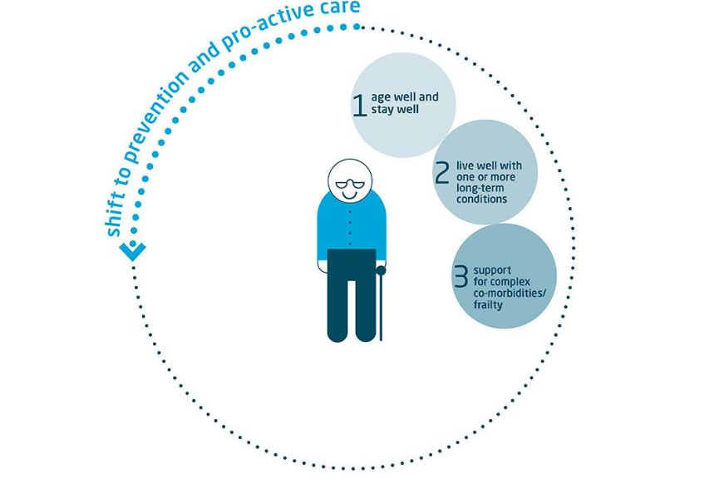

Slide 24
Goal
Health and care services should support older people with complex multiple co-morbidities, including frailty and dementia, to remain as well and independent as possible and to avoid deterioration or complications.

Slide 25
Current situation
Frailty is common but too often neglected
Around 1 in 3 people over 65 and 1 in 2 over 80 fall each year
There is considerable underdiagnosis of dementia compared with expected rates

Slide 26
What we know can work
Recognising the importance of frailty
Using frailty risk assessment and case-finding
Using proactive comprehensive geriatric assessment and follow-up for people identified as frail
Promoting exercise for frail older people
Falls prevention
Providing good care for people with dementia
Reducing inappropriate polypharmacy

Slide 27
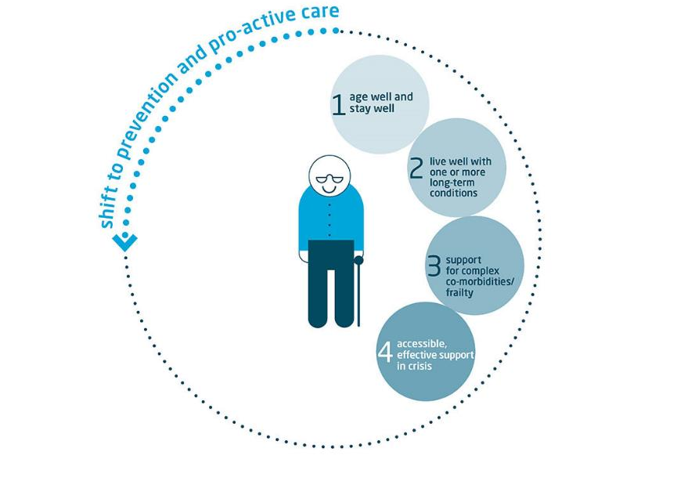

Slide 28
Goal
When the health or independence of older people rapidly deteriorates, they should have rapid access to urgent care, including effective alternatives to hospital.

Slide 29
Current situation
Older people are more likely to call an ambulance from home, more likely to be taken to hospital, and then more likely to be admitted than younger people
People under 65 use an average of 0.2 emergency bed days per year, while people over 85 use an average of 5 bed days

Slide 30
What we know can work
Promoting continuity of primary care
Providing urgent access to primary care
Providing urgent, co-ordinated social care
Ensuring that ambulance services implement shared care strategies with other services
Using admission-prevention Hospital At Home services
Using virtual or community wards
Providing telecare for older people at risk
Discharge-to-assess models
Providing rapid access ambulatory care clinics
Using community and interface geriatrics

Slide 31
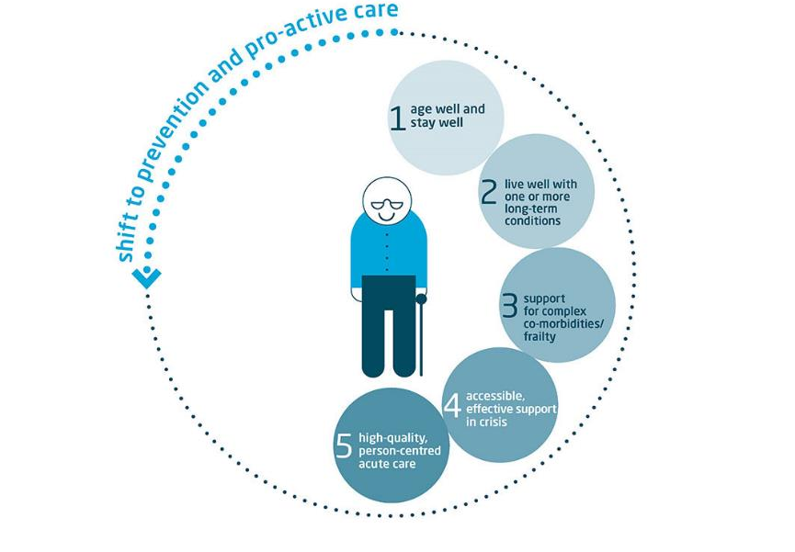

Slide 32
Goal
Acute hospital care must meet the needs of older patients with complex co-morbidities, frailty and dementia.
Services should provide adequate access to specialist input, minimise harms and ward moves, and provide care that is compassionate and person-centred.

Slide 33
Current situation
People over 65 also account for 80 per cent of hospital admissions that involve stays of more than two weeks
Successive audits have shown consistent failures to provide even basic assessments or treatment plans for some of the common harms of hospitalisation
Numerous reports have documented failings in older people’s experience of care in hospital

Slide 34
What we know can work
Using comprehensive geriatric assessment
Focusing on older patients with frailty
Specialist elderly care units and wards
Liaison and in-reach services for frail older people under other medical and surgical specialities
Maximising continuity of care
Improving safety and preventing avoidable deaths
Minimising harms of hospitalisation
Improving care for inpatients with dementia and mental health problems
Focusing on dignified person-centred care

Slide 35
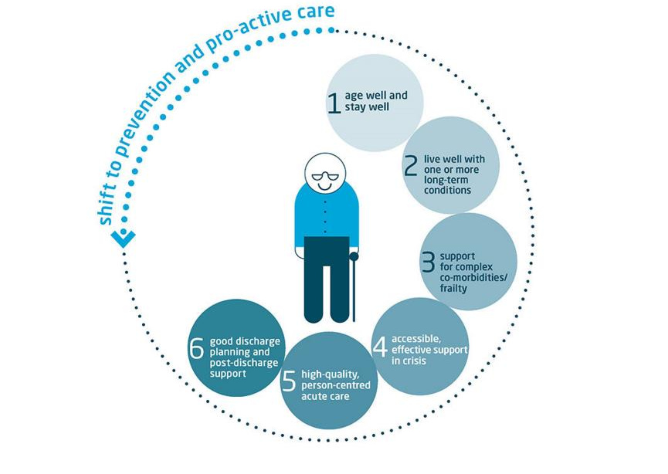

Slide 36
Goal
Discharge planning needs to start at first contact with hospital and be standardised and embedded in practice, with older people and their carers fully and promptly involved.
The NHS and social care should work together to ensure that patients can leave hospital once their clinical treatment is complete, with good post-discharge support in the community.

Slide 37
Current situation
Around 1 in 4 people over 75 in hospital beds have no medical need to be in hospital
Older people frequently report uncertainty, lack of confidence and lack of support on discharge from hospital
Older people with complex needs, including long-term conditions and frailty, are at particularly high risk of readmission

Slide 38
What we know can work
Early senior assessment, assertive discharge planning, and a clear focus on patient flow
A concerted focus on discharge planning throughout hospital stay, and the ability to discharge seven days a week
Involving older people and their carers in discharge plans
Ensuring integrated information systems and structured multi-professional communication
Strengthening post-discharge assessment and support
Reducing delayed transfers of care

Slide 39
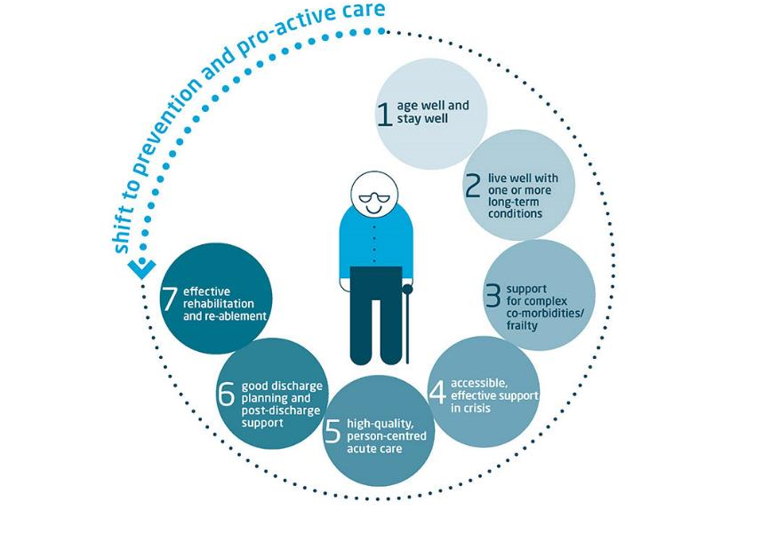

Slide 40
Goal
Older people should receive adequate rehabilitation and re-ablement when needed, to prevent permanent disability, greater reliance on care and support, avoidable admissions to hospital, delayed discharge from hospital, and to provide adequate periods of assessment and recovery before any decision is made to move into long-term care.

Slide 41
Current situation
Most people over 65 presenting acutely to hospital have impairment in one or more activities of daily living and many have not returned to baseline levels of mobility or functional independence on discharge from hospital
The National Intermediate Care Audit for England concluded that there are only around half the beds and places needed to ensure that no older person is in a hospital bed if it can be avoided

Slide 42
What we know can work
Shared and comprehensive assessment of needs and personalised plans
Implementing evidence-based best practice
Commissioning for outcomes
Home-based rehabilitation and re-ablement
Community hospital-based rehabilitation and re-ablement
Using alternative providers
Providing workforce training in re-ablement
Successful ending of and transition from rehabilitation and re-ablement

Slide 43
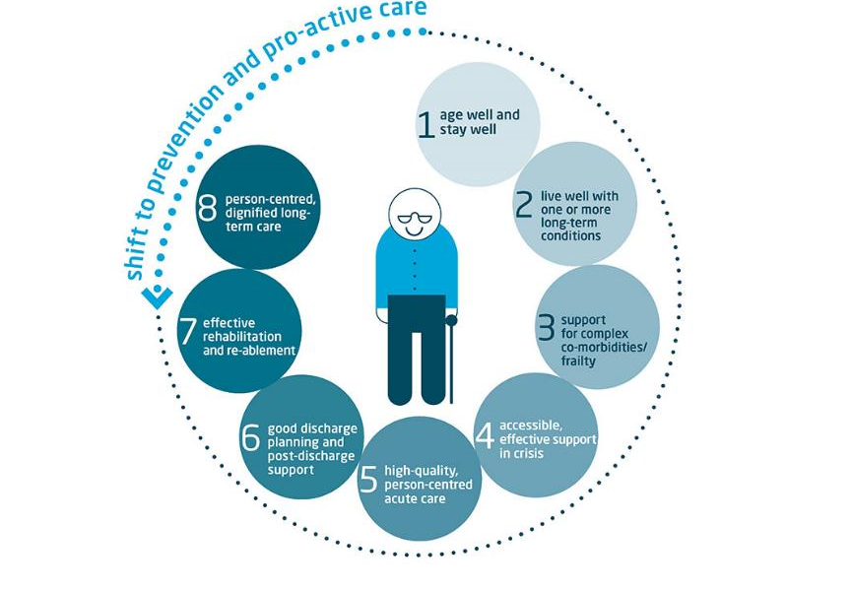

Slide 44
Goal
Though some people make a positive choice to enter long-term care, older people should only generally move into nursing and residential care when treatment, rehabilitation and other alternatives have been exhausted.
Residents should consistently receive high-quality care that is person-centred and dignified, and have the same access to all necessary health care as older people living in other settings.

Slide 45
Current situation
There are an estimated 390,000 people over 65 in care homes in England – four times as many as in hospital beds at any given time
Levels of dependency are rising, so that the population in ‘residential’ homes now resembles that only found in nursing homes a few years ago
People living in nursing and residential homes face wide variation in their access to all necessary health services

Slide 46
What we know can work
Preventing avoidable admissions to long-term care
Active commissioning of health and mental health care for care home residents
Information-sharing
Conducting holistic assessments
Providing support and training for care home staff
Using evidence-based frameworks for assessment of quality of life and improvement of relationship-centred care

Slide 47
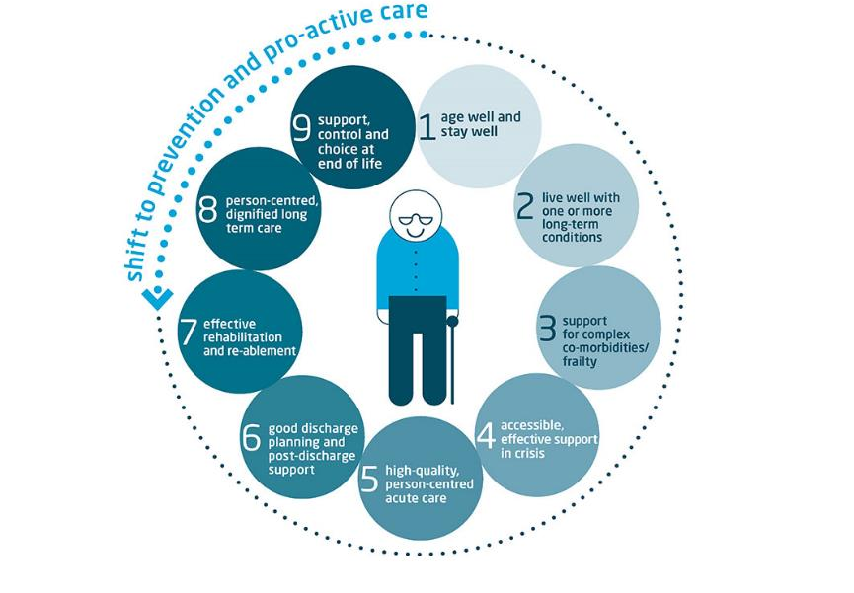

Slide 48
Goal
Older people who are nearing the end of life should receive timely help if they want or need it, to discuss and plan for the end of life.
End-of-life care services should provide high-quality care, support, choice and control, and should avoid over-medicalising what is a natural phase of the ageing life course.

Slide 49
Current situation
Older people receive poorer-quality care towards the end of life than younger people. They are less likely to be involved in discussions about their options, less likely to die where they choose, and less likely to receive specialist care or access hospice beds
In an NAO study, at least 40 per cent of people who died in hospital did not have medical needs that required them to be treated in hospital, and nearly a quarter of them had been in hospital for over a month

Slide 50
What we know can work (1)
Providing workforce training and support
Identifying people in the last year of life
Ensuring effective assessment and advance care planning
Strengthening co-ordination and discharge planning
Ensuring adequate provision of specialist palliative care services
Supporting care home residents to die in the care home rather than in hospital

Slide 51
What we know can work (2)
Providing home-based services
Improving end-of-life care for people with dementia
Improving end-of-life care in hospitals
Management of the dying phase and the crucial importance of involving patients and families

Slide 52
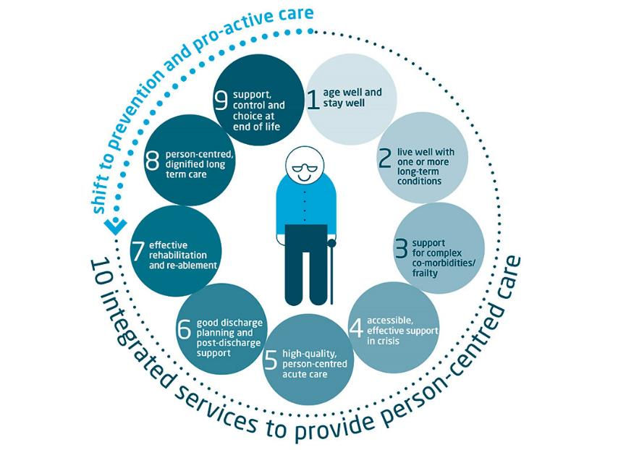

Slide 53
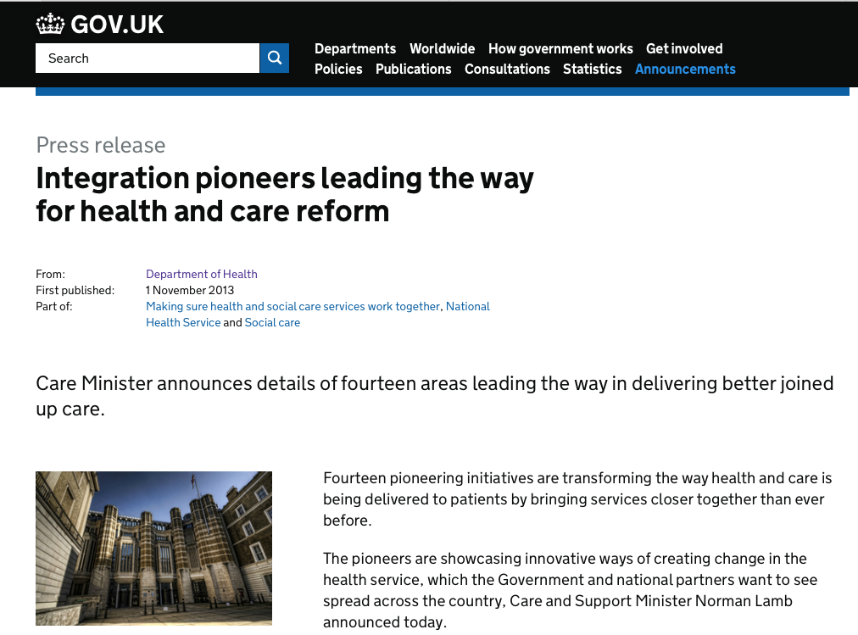
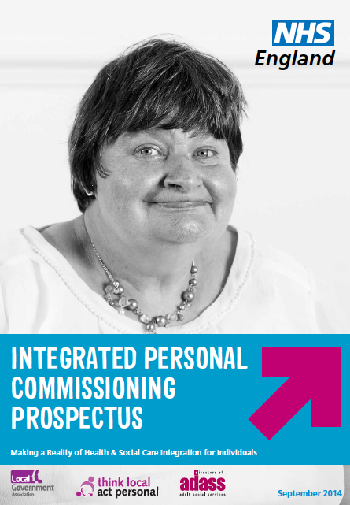

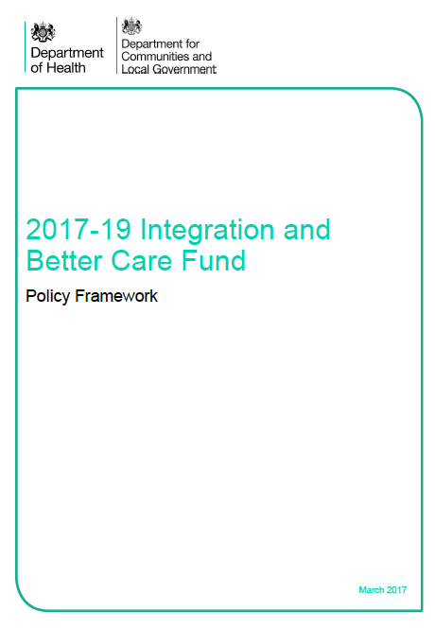

The current policy framework
Definition - coordination of care around individual needs
Separate initiatives:
  Pioneer programme
  Better Care Fund
  Personal health commissioning programme
  NHS Vanguards’ – new models of care
  Devolution
  STPs
  Accountable care systems
All places must have a plan to integrate health and social care by 2020
Notes:
Different initiatives come from different places
Different purposes
BCF re social care finding pressures
NHS about integrating with NHS etc
2015 SR said all places must have a plan
Latest BCF makes a valiant effort

Slide 54
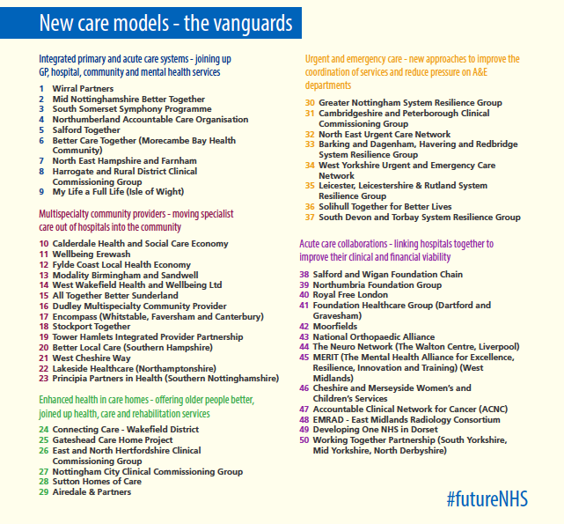
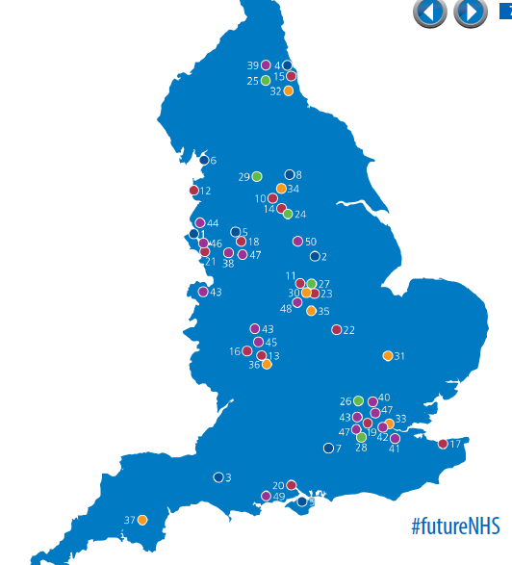

Slide 55
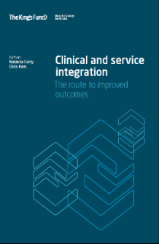
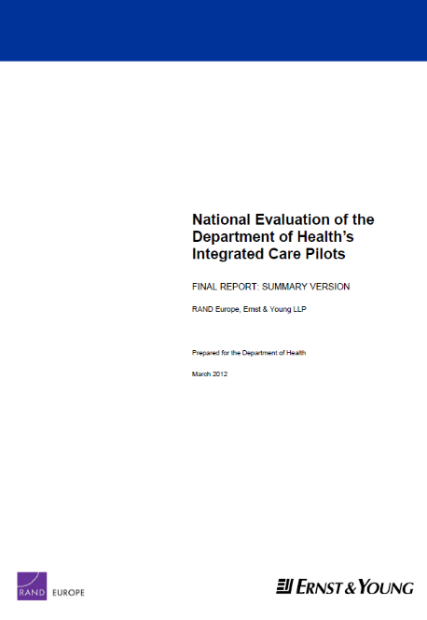
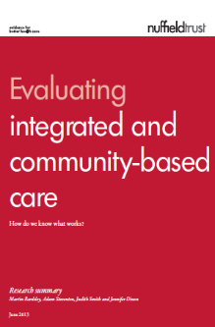




The evidence is mixed……..

Slide 56
But the case for integrated care is overwhelming…..
Potential benefits:
(But……….)
Better outcomes for people
Better use of limited resources
Reduce use of hospitals & long term care
More care closer to home
Avoids the consequences of fragmented & uncoordinated care
It is hard to do
It takes time
In the short term it may cost more ?
It demands different leadership skills and styles
Relationships are the key currency

Slide 57



Slide 58
The national context
STPs are plans for the future of health and care services across 44 parts of the country—the ‘delivery plans’ for the Forward View
STPs are a workaround of a complex and fragmented set of organisational arrangements
Their scope is extremely broad—covering all areas of NHS spending and better integration with local authority services
The plans published in October 2016 are at various stages of development—and some have already changed
From April – STP boards – “a basic implementation and governance support chasis”
Some capital investment announced in the budget for selected STPs (£325m over three years)—but this is in the context of much bigger (£1.2b pa) raids on NHS capital budgets

Slide 59
Testing the assumptions
Are ambitions to prioritise prevention and public health realistic when public health and local authority budgets are being cut?
Can primary and community services really be strengthened when additional resources are being used to fill hospital deficits instead?
Can significant reductions in hospital demand be achieved? Can hospital capacity really be cut when hospitals are running so hot?
Has social care been properly considered in the plans?
Has the case for reconfiguring acute and specialised services been made at a local level (in the context of mixed evidence)?
Can ambitious goals for closing NHS funding gaps be achieved?
What can be realistically delivered by 2020/21? And what skills and resources will be needed for implementation?

Slide 60
ACOs in the NHS
Jargon abounds: ACOs, ACPs, ACSs, STPs…
These are all different ways of describing ambitions to deliver high quality and co-ordinated care within available resources. The jargon matters far less than the ambition
Working together to improve care and manage resources is the right thing to do—but it is far from simple in the today’s NHS
NHS England’s recent delivery plan describes how some parts of the country will develop ‘accountable care systems’ and maybe even ‘accountable care organisations’
Three broad elements to consider:
  providers collaborating to meet the needs of a population;
  providers taking responsibility for a population-based budget from the commissioner(s);
  contracts specifying outcomes and other measures to be delivered

Slide 61
Some lessons (1)
Integration of services is the right thing to be doing. But moving towards an English version of ACOs is hard because the system wasn’t designed with this purpose in mind
there are technical components of developing more integrated systems—eg payment systems, new contracts and use of data
But there are also relational components—centred on culture and relationships. This takes time and effort. It requires:
  frequent personal contact to build understanding and trust
  commitment to working together for the long term
  shared purpose and vision for the population you are serving
  an ability to surface and resolve conflicts (not ignoring them)
  an ability to behave altruistically towards partners
Need to focus on both the technical and relational components—but in the end ‘it’s more sociological then technological’

Slide 62
Some lessons (2)
The success of ACOs ultimately relies on the ability to support and engage staff in the task of redesigning care
Focus on enabling these changes and creating an environment that supports improvement
A broad vision and objectives are good. But define as clearly as possible the small number of priorities for improving care
Be realistic about what can be delivered; developing new care models takes both time and investment
The aim is to improve patient outcomes and experience of care. The research evidence tells us not expect significant reductions in hospital use and costs
Work with local government and other partners to address the non-medical determinants of health

Slide 63
Top tips:
Be clear -& realistic - about what you want to achieve & how long it will take
Look out, not up – all solutions are local
Focus on the benefits for people who use services
One plan for one place
“The soft stuff is the hard stuff” (relationships & culture trumps structure & governance)
Expect disagreement - agree how to manage it
Clinical & service integration matters most
Engagement of staff is critical

Slide 64

r.humphries@kingsfund.org.uk
@Richardatkf

