Slide 1
Introduction to evidence based medicine
Dr. Chisale Mhango FRCOG
COM
May, 2013

Slide 2
Definition of “Evidence Based Medicine”
Evidence based medicine is the conscientious, explicit, and judicious use of current best evidence in making decisions about the care of individual patients.
(Sackett et al. BMJ 1996;312:311-2)
Notes:
Speaker’s notes:
^ ª ^{b} ^{c} Sackett DL, Rosenberg WM, Gray JA, Haynes RB, Richardson WS (January 1996). "Evidence based medicine: what it is and what it isn't". BMJ 312 (7023): 71–2. PMC 2349778. PMID 8555924.
1. Oxford Centre for Evidence-Based Medicine. Levels of evidence and grades of recommendation. Available from http://www.cebm.net/levels_of_evidence.asp

Slide 3
Definition of “Evidence Based Practice”
The practice of evidence based medicine means integrating individual clinical expertise with the best available external clinical evidence from systematic research.
i.e. The use of the most appropriate information available, to make clinical decisions for individual patients....
(Sackett et al. BMJ 1996;312:311-2)
Notes:
Speaker’s notes:
EBP involves complex and conscientious decision-making based not only on the available evidence but also on patient characteristics, situations, and preferences. It recognized that health care is individualized and ever changing and involves uncertainties and probabilities. [3] [3. Gehlbach SH. Interpreting the medical literature, 3rd ed. New York: McGraw-Hill, 1993.]

Slide 4
Barriers to EBP
Some of the barriers encountered by clinicians may include:
Lack skills to evaluate research
Lack of organizational support
Accessibility of research findings

Slide 5
5 Steps in EBP
EBP can be broken down into a 5 step process:
Formulating a searchable question (Asking the clinical question)
Searching the literature efficiently (Collecting the most relevant and best evidence)
Appraising the literature critically (Synthesizing the evidence)
Applying the result to clinical practice or patient (Integrating all evidence with personal expertise, patient preferences, to make practice decision or change)
Evaluating the outcomes of the applied evidence in your practice or patient

Slide 6
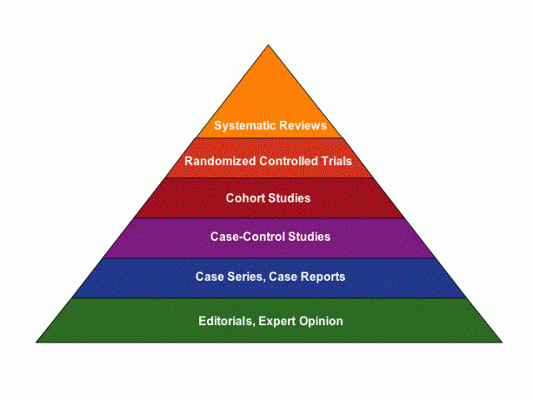
Levels of Evidence
Notes:
Speaker’s notes:
The ability to practice Evidence-Based Medical care requires a basic understanding of the main research designs underlying the published evidence. Some research designs provide a stronger level of evidence than others based on their inherent characteristics. This hierarchy is often shown graphically as a pyramid:

Slide 7
Levels of Evidence
Quantitative Pyramid showing relative usefulness of different types of evidence to answer cause and effect questions.
Qualitative Pyramid showing relative usefulness of different types of evidence to answer meaning or experience questions.

Slide 8
Levels of Evidence Pyramid
Detailed levels of evidence have been developed by the Oxford Centre for Evidence-Based Medicine. They use a numbering scheme ranging from 1a, homogenous systematic reviews of randomized controlled trials, to 5, expert opinion This system can be especially useful when comparing articles with similar study designs. Equivalent research designs do not always produce results of equal quality.
Though finding research studies high on the pyramid is preferred, EBP may need to draw on research designs lower in the evidence hierarchy than case series. Occasionally nothing but case reports or even bench research may exist on a topic.
When making evidence-based decisions for patient care, it is essential to select the highest level research design available for the specific question of interest.

Slide 9
Levels of Evidence
Level I: Evidence obtained from at least one properly designed randomized controlled trial.
Level II-1: Evidence obtained from well-designed controlled trials without randomization.
Level II-2: Evidence obtained from well-designed cohort or case-control analytic studies, preferably from more than one centre or research group.
Level II-3: Evidence obtained from multiple time series with or without the intervention. Dramatic results in uncontrolled trials might also be regarded as this type of evidence.
Level III: Opinions of respected authorities, based on clinical experience, descriptive studies, or reports of expert committees.

Slide 10
Rating System for the Hierarchy of Evidence: Quantitative Questions
Level 1: Systematic review or meta-analysis of all relevant randomized controlled trials (RCTs), or evidence-based clinical practice guidelines based on systematic reviews of RCTs
Level 2: Evidence from at least one well-designed RCT
Level 3: Evidence from a well-designed controlled trial without randomization
Level 4: Evidence from well-designed case-control and cohort studies
Level 5: Evidence from systematic reviews of descriptive and qualitative studies
Level 6: Evidence from a single descriptive or qualitative study
Level 7: Evidence from the opinion of authorities and / or reports of expert committees
From "Evidence-based practice in nursing & healthcare: a guide to best practice" by Bernadette M. Melnyk and Ellen Fineout-Overholt. 2005, page 10.

Slide 11
Classification of evidence levels
1++ | High-quality meta-analyses, systematic reviews of randomised controlled trials or randomised controlled trials with a very low risk of bias.
1+ | Well-conducted meta-analyses, systematic reviews of randomised controlled trials or randomised controlled trials with a low risk of bias
1– | Meta-analyses, systematic reviews of randomised controlled trials or randomised controlled trials with a high risk of bias
2++ | High-quality systematic reviews of case–control or cohort studies or high quality case–control or cohort studies with a very low risk of confounding, bias or chance and a high probability that the relationship is causal
2+ | Well-conducted case–control or cohort studies with a low risk of confounding, bias or chance and a moderate probability that the relationship is causal
2- | Case–control or cohort studies with a high risk of confounding, bias or chance and a significant risk that the relationship is not causal
3 | Non-analytical studies, e.g. case reports, case series
4 | Expert opinion
Notes:
The Oxford Handbook of Evidence-based Management
Edited by Denise M. Rousseau

Slide 13
Sources of Evidence (1)
Primary Literature
Primary literature is authored by the researchers,
contains original research data,
and is usually published in a peer-reviewed journal.
Primary literature may also include
conference papers,
pre-prints, or preliminary reports.
The intended audience of primary literature includes researchers and specialists, but not the general public.

Slide 14
Sources of Evidence (2)
Secondary Literature
Secondary literature consists of
organized works and compilations that are derived from or refer to the primary source literature.
Examples of secondary literature include (i) review articles (specifically meta-analysis and systematic reviews) and (ii) reference works.
Professionals within each discipline take the primary literature and synthesize, generalize, and integrate new research.
The intended audience of secondary literature consists of
colleagues within the respective discipline, as well as interested colleagues from other fields.

Slide 15
Sources of Evidence (3)
Tertiary Literature
Tertiary literature consists of
textbooks,
encyclopaedia articles, and
guidebooks or handbooks.
The purpose of tertiary literature is to provide an overview of key research findings and an introduction to principles and practices within the discipline.
Thus, this type of publication is an excellent resource for students.

Slide 16
Sources of Evidence (4)
Popular Media
The purpose of health sciences popular literature is
to inform the general public about new research findings, prevention, and treatment.
Popular media is often found in
popular magazines,
radio,
newspapers,
television, and
web sites.
The author need not be an expert in the discipline, and the aim is to summarize key concepts for the general public.

