Slide 1
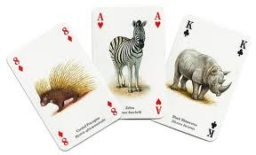


Statistics
A Basic Introduction and Review

Slide 2
Statistics Objectives
By the end of this session you will have a working understanding of the following statistical concepts:
Mean, Median, Mode
Normal Distribution Curve
Standard Deviation, Variance
Basic Statistical tests
Design of experiments
Hypothesis Testing and assessing significance
Confidence to use in Projects/Audits

Slide 3
Statistics
A measurable characteristic of a sample is called a statistic
A measurable characteristic of a population, such as a mean or standard deviation, is called a parameter
Basically counting …scientifically

Slide 4
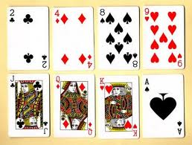
Sample Mean : “average”
Commonly called the average, often symbolised
Its value depends equally on all of the data which may include outliers.
It may be useful if the distribution of values is “not even” but skewed

Slide 5
Sample Mean : “average”
Example
Our data set is: 2, 4, 8, 9, 10, 10, 10, 11
The sample mean is calculated by taking the sum of all the data values and dividing by the total number of data values (8):
64 divided by 8 = 4

Slide 6
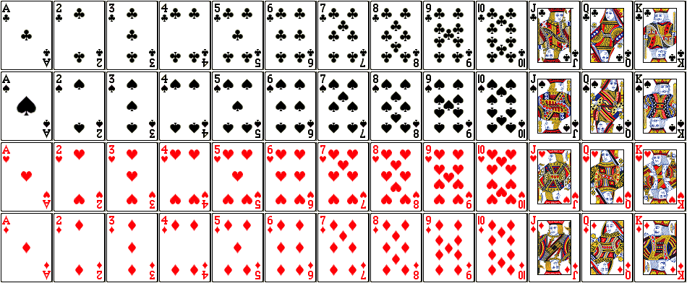
Median : “order and middle”
The median is the halfway value through the ordered data set. Below and above this value, there will be an equal number of data values.
It gives us an idea of the “middle value”
Therefore it works well for skewed data, or data with outliers

Slide 7
Median : “order and middle”
Example
Our Data-set is the first row of cards: ACE is 1, Jack, Queen and King are all 10
  What is the average value, what is the median value
  How does the mean compare to the median value
Please repeat the exercise using the new values as below:
Our Data-set is the first row of cards: ACE is 1, Jack = 100, Queen and King are 1000

Slide 8
Mode: “most common”
This is the most frequently occurring value in a set of data.
There can be more than one mode if two or more values are equally common.

Slide 9
Mode: “most common”
Example
Our Data-set is the first row of cards: ACE is 1, Jack, Queen, King are all 10
  What is the average value, what is the median value
  How does the mean compare to the median value
  What is the mode?

Slide 10

Normal Distribution: “the natural distribution”
Very easy to understand!
A continuous random variable X, taking all real values in the range is said to follow a Normal distribution with parameters µ and if it has probability density function

Slide 11
Normal Distribution: “the natural distribution
We write
This probability density function (p.d.f.) is a symmetrical, bell-shaped curve, centred at its expected value µ. The variance is .
Many distributions arising in practice can be approximated by a Normal distribution. Other random variables may be transformed to normality.
The simplest case of the normal distribution, known as the Standard Normal Distribution, has expected value zero and variance one. This is written as N(0,1).

Slide 12
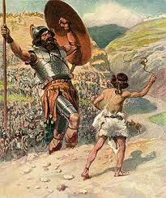
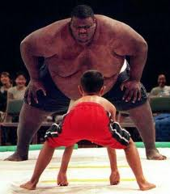
Normal Distribution: “the natural distribution”
Very easy to understand! No really!
Assume a gene for Height! (David not so tall!)

Slide 13
Normal Distribution: “the natural distribution from basic gene theory”
Assume that the gene for being Tall is Aa
So one gene from each parent is A or a
AA very tall
Aa medium height
aa shorter
Punnett Square below
 | A | a
A | AA | Aa
a | Aa | aa
Frequency Distribution
 | Aa
AA | Aa | aa
AA | Aa | aa

Slide 14
Normal Distribution: “the natural distribution from basic gene theory”
Now assume that each parent has two genes for tallness
Each parent has Aa and Aa
So input from each parent would be AA or Aa or Aa or aa
 | AA | Aa | Aa | aa
AA | AAAA | AaAA | AaAA | aaAA
Aa | AAAa | AaAa | AaAa | aaAa
Aa | AAAa | AaAa | AaAa | aaAa
aa | AAaa | Aaaa | Aaaa | aaaa

Slide 15
Frequency Distribution
AAAA | AAAa | AAaa | Aaaa | aaaa

Slide 16
Normal Distribution: “the natural distribution from basic gene theory”
Assume that there 3 genes for being Tall
AAA, Aaa, Aaa, aaa from each parent
 | AAA | AAa | AAa | Aaa | Aaa | aaa
AAA | ? | ? | ? | ? | ? | ?
AAa | ? | ? | ? | ? | ? | ?
AAa | ? | ? | ? | ? | ? | ?
Aaa | ? | ? | ? | ? | ? | ?
Aaa | ? | ? | ? | ? | ? | ?
aaa | ? | ? | ? | ? | ? | ?

Slide 17
Normal Distribution: “the natural distribution from basic gene theory”
Assume that there 3 genes for being Tall
AAA, Aaa, Aaa, aaa from each parent
 | AAA | AAa | AAa | Aaa | Aaa | aaa
AAA | AAAAAA | AAAAAa | AAAAAa | AAAAaa | AAAAaa | AAAaaa
AAa | AaaAAA | AaaAAa | AaaAAa | AaaAaa | AaaAaa | Aaaaaa
AAa | AaaAAA | AaaAAa | AaaAAa | AaaAaa | AaaAaa | Aaaaaa
Aaa | AaaAAA | AaaAAa | AaaAAa | AaaAaa | AaaAaa | Aaaaaa
Aaa | AaaAAA | AaaAAa | AaaAAa | AaaAaa | AaaAaa | Aaaaaa
aaa | aaaAAA | aaaAAa | aaaAAa | aaaAaa | aaaAaa | aaaaaa

Slide 18
Normal Distribution: “the natural distribution from basic gene theory”
AAA, Aaa, Aaa, aaa from each parent
Convert to numbers: A = 1, a =0
 | AAA | AAa | AAa | Aaa | Aaa | aaa
AAA | AAAAAA | AAAAAa | AAAAAa | AAAAaa | AAAAaa | AAAaaa
Aaa | AaaAAA | AaaAAa | AaaAAa | AaaAaa | AaaAaa | Aaaaaa
Aaa | AaaAAA | AaaAAa | AaaAAa | AaaAaa | AaaAaa | Aaaaaa
Aaa | AaaAAA | AaaAAa | AaaAAa | AaaAaa | AaaAaa | Aaaaaa
Aaa | AaaAAA | AaaAAa | AaaAAa | AaaAaa | AaaAaa | Aaaaaa
aaa | aaaAAA | aaaAAa | aaaAAa | aaaAaa | aaaAaa | aaaaaa
 | 3 | 2 | 2 | 1 | 1 | 0
3 | ? | ? | ? | ? | ? | ?
2 | ? | ? | ? | ? | ? | ?
2 | ? | ? | ? | ? | ? | ?
1 | ? | ? | ? | ? | ? | ?
1 | ? | ? | ? | ? | ? | ?
0 | ? | ? | ? | ? | ? | ?

Slide 19
Worksheet: 3 Genes for Tallness
 | 3 | 2 | 2 | 1 | 1 | 0
3
2
2
1
1
0
Then please plot a graph of the values versus the categories
Categories are 0,1,2,3,4,5,6

Slide 20
Normal Distribution: “the natural distribution from basic gene theory”
AAA, Aaa, Aaa, aaa from each parent
Convert to numbers: A = 1, a =0
 | AAA | AAa | AAa | Aaa | Aaa | aaa
AAA | AAAAAA | AAAAAa | AAAAAa | AAAAaa | AAAAaa | AAAaaa
Aaa | AaaAAA | AaaAAa | AaaAAa | AaaAaa | AaaAaa | Aaaaaa
Aaa | AaaAAA | AaaAAa | AaaAAa | AaaAaa | AaaAaa | Aaaaaa
Aaa | AaaAAA | AaaAAa | AaaAAa | AaaAaa | AaaAaa | Aaaaaa
Aaa | AaaAAA | AaaAAa | AaaAAa | AaaAaa | AaaAaa | Aaaaaa
aaa | aaaAAA | aaaAAa | aaaAAa | aaaAaa | aaaAaa | aaaaaa
 | 3 | 2 | 2 | 1 | 1 | 0
3 | 6 | 5 | 5 | 4 | 4 | 3
2 | 5 | 4 | 4 | 3 | 3 | 2
2 | 5 | 4 | 4 | 3 | 3 | 2
1 | 4 | 3 | 3 | 2 | 2 | 1
1 | 4 | 3 | 3 | 2 | 2 | 1
0 | 3 | 2 | 2 | 1 | 1 | 0

Slide 21
Normal Distribution: “the natural distribution from basic gene theory”
 | 3 | 2 | 2 | 1 | 1 | 0
3 | 6 | 5 | 5 | 4 | 4 | 3
2 | 5 | 4 | 4 | 3 | 3 | 2
2 | 5 | 4 | 4 | 3 | 3 | 2
1 | 4 | 3 | 3 | 2 | 2 | 1
1 | 4 | 3 | 3 | 2 | 2 | 1
0 | 3 | 2 | 2 | 1 | 1 | 0

Slide 22
Normal Distribution: “the natural distribution from basic gene theory”
 | AA AA | AA Aa | AA Aa | AA Aa | AA Aa | AA aa | AA aa | AA aa | AA aa | AA aa | AA aa | Aa aa | Aa aa | Aa aa | Aa aa | aa aa
AA AA | 8 | 7 | 7 | 7 | 7 | 6 | 6 | 6 | 6 | 6 | 6 | 5 | 5 | 5 | 5 | 4
AA Aa | 7 | 6 | 6 | 6 | 6 | 5 | 5 | 5 | 5 | 5 | 5 | 4 | 4 | 4 | 4 | 3
AA Aa | 7 | 6 | 6 | 6 | 6 | 5 | 5 | 5 | 5 | 5 | 5 | 4 | 4 | 4 | 4 | 3
AA Aa | 7 | 6 | 6 | 6 | 6 | 5 | 5 | 5 | 5 | 5 | 5 | 4 | 4 | 4 | 4 | 3
AA Aa | 7 | 6 | 6 | 6 | 6 | 5 | 5 | 5 | 5 | 5 | 5 | 4 | 4 | 4 | 4 | 3
AA aa | 6 | 5 | 5 | 5 | 5 | 4 | 4 | 4 | 4 | 4 | 4 | 3 | 3 | 3 | 3 | 2
AA aa | 6 | 5 | 5 | 5 | 5 | 4 | 4 | 4 | 4 | 4 | 4 | 3 | 3 | 3 | 3 | 2
AA aa | 6 | 5 | 5 | 5 | 5 | 4 | 4 | 4 | 4 | 4 | 4 | 3 | 3 | 3 | 3 | 2
AA aa | 6 | 5 | 5 | 5 | 5 | 4 | 4 | 4 | 4 | 4 | 4 | 3 | 3 | 3 | 3 | 2
AA aa | 6 | 5 | 5 | 5 | 5 | 4 | 4 | 4 | 4 | 4 | 4 | 3 | 3 | 3 | 3 | 2
AA aa | 6 | 5 | 5 | 5 | 5 | 4 | 4 | 4 | 4 | 4 | 4 | 3 | 3 | 3 | 3 | 2
Aa aa | 5 | 4 | 4 | 4 | 4 | 3 | 3 | 3 | 3 | 3 | 3 | 2 | 2 | 2 | 2 | 1
Aa aa | 5 | 4 | 4 | 4 | 4 | 3 | 3 | 3 | 3 | 3 | 3 | 2 | 2 | 2 | 2 | 1
Aa aa | 5 | 4 | 4 | 4 | 4 | 3 | 3 | 3 | 3 | 3 | 3 | 2 | 2 | 2 | 2 | 1
Aa aa | 5 | 4 | 4 | 4 | 4 | 3 | 3 | 3 | 3 | 3 | 3 | 2 | 2 | 2 | 2 | 1
aa aa | 4 | 3 | 3 | 3 | 3 | 2 | 2 | 2 | 2 | 2 | 2 | 1 | 1 | 1 | 1 | 0
Now assume that each parent has 4 genes for tallness
Each parent could give AAAA, AAAa, AAaa, Aaaa, aaaa

Slide 23
Frequency Distribution Table
Number | 1 | 8 | 24 | 56 | 68 | 56 | 24 | 8 | 1
Category | 0 | 1 | 2 | 3 | 4 | 5 | 6 | 7 | 8

Slide 24
Frequency Distribution Chart
Notice that the frequency distribution of phenotypes like the bell shaped curve 'Normal Distribution'.
For large numbers of genes or variables each gene or factor has a small additive effect, a Normal Distribution results.

Slide 25
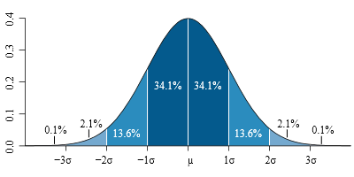
Normal Distribution: “the natural distribution from basic gene theory”
Special Charactersistics 1 :
Mean. Mode and Median are the same value
Standard Deviation is 34.1%
So 68.1% of values lie within one SD of the mean
So 95.4% of values lie within 2SD of the mean

Slide 26
The Variance
In a population, variance is the average squared deviation from the population mean, as defined by the following formula:
σ² = Σ ( X_{i} - μ )² / N
where σ² is the population variance, μ is the population mean, X_{i} is the ith element from the population, and N is the number of elements in the population.

Slide 27
The Variance
In a population, variance is the average squared deviation from the population mean:
Example: Take 11 cards (1 to 11), ACE = 1 to Picture card =11
What is the average? = 6
What is the total deviation from the mean?

Slide 28
The Variance
Card x | Mean- x | Square this
1
2
3
4
5
6
7
8
9
10
11
In a population, variance is the average squared deviation from the population mean:
Example: Take 11 cards (1 to 11
What is the average? = 6
What is the total deviation from the mean?
Work out Mean minus x
Square this
Add up
Average this
The variance is ?

Slide 29
The Variance
Card x | Mean- x | Square this
1 | -5 | 25
2 | -4 | 16
3 | -3 | 9
4 | -2 | 4
5 | -1 | 1
6 | 0 | 0
7 | 1 | 1
8 | 2 | 4
9 | 3 | 9
10 | 4 | 16
11 | 5 | 25
In a population, variance is the average squared deviation from the population mean:
Example: Take 11 cards (1 to 11
What is the average? = 6
What is the total deviation from the mean?
Work out Mean minus x
Square this
Add up
Average this (110 divided 11)
The variance is 10
    What is the SD?

Slide 30
The Standard Deviation
The standard deviation is the square root of the variance. Thus, the standard deviation of a population is:
σ = sqrt [ σ² ] = sqrt [ Σ ( X_{i} - μ )² / N ]
where σ is the population standard deviation, σ² is the population variance, μ is the population mean, X_{i} is the ith element from the population, and N is the number of elements in the population.

Slide 31
The Standard Deviation
The standard deviation is the square root of the variance. Thus, the standard deviation of a population is:
σ = sqrt [ σ² ] = sqrt [ Σ ( X_{i} - μ )² / N ]
where σ is the population standard deviation, σ² is the population variance, μ is the population mean, X_{i} is the ith element from the population, and N is the number of elements in the population.
With our 11 cards variance was 10
So the SD is ? Square root of 10? = 3.16

Slide 32
The Variance and Standard Deviation
Data
1
2
3
4
5
6
7
8
9
10
11
11 values
Mean was 6
Variance was 10
Standard deviation = 3.16

Slide 33
Special Charactersistics 2:
Additionally, every normal curve (regardless of its mean or standard deviation) conforms to the following "rule".
About 68% of the area under the curve falls within 1 standard deviation of the mean.
About 95% of the area under the curve falls within 2 standard deviations of the mean.
About 99.7% of the area under the curve falls within 3 standard deviations of the mean.
Collectively, these points are known as the empirical rule or the 68-95-99.7 rule. Clearly, given a normal distribution, most outcomes will be within 3 standard deviations of the mean.

Slide 34
Statistics
A Basic Introduction and Review
Additional Key Concepts

Slide 35
Simple Random Sampling
A sampling method is a procedure for selecting sample elements from a population. Simple random sampling refers to a sampling method that has the following properties.
  The population consists of N objects.
  The sample consists of n objects.
  All possible samples of n objects are equally likely to occur.

Slide 36
Confidence Intervals:
An important benefit of simple random sampling is that it allows researchers to use statistical methods to analyze sample results.
For example, given a simple random sample, researchers can use statistical methods to define a confidence interval around a sample mean.
Statistical analysis is not appropriate when non-random sampling methods are used.
There are many ways to obtain a simple random sample. One way would be the lottery method. Each of the N population members is assigned a unique number. The numbers are placed in a bowl and thoroughly mixed. Then, a blind-folded researcher selects n numbers. Population members having the selected numbers are included in the sample or Stat Trek!

Slide 37
Univariate vs. Bivariate Data
Statistical data are often classified according to the number of variables being studied.
Univariate data. When we conduct a study that looks at only one variable: eg, we say that average weight of school students. Since we are only working with one variable (weight), we would be working with univariate data.
Bivariate data. A study that examines the relationship between two variables eg height and weight

Slide 38
Percentiles
Assume that the elements in a data set are rank ordered from the smallest to the largest. The values that divide a rank-ordered set of elements into 100 equal parts are called percentiles.
An element having a percentile rank of P_{i} would have a greater value than i percent of all the elements in the set. Thus, the observation at the 50th percentile would be denoted P₅₀, and it would be greater than 50 percent of the observations in the set. An observation at the 50th percentile would correspond to the median value in the set.

Slide 39
The Interquartile Range (IQR)
Quartiles divide a rank-ordered data set into four equal parts. The values that divide each part are called the first, second, and third quartiles; and they are denoted by Q1, Q2, and Q3, respectively.
  Q1 is the "middle" value in the first half of the rank-ordered data set.
  Q2 is the median value in the set.
  Q3 is the "middle" value in the second half of the rank-ordered data set.

Slide 40
The Interquartile Range (IQR)
The interquartile range is equal to Q3 minus Q1.
Eg: 1, 3, 4, 5, 5, 6, 7, 11. Q1 is the middle value in the first half of the data set. Since there are an even number of data points in the first half of the data set, the middle value is the average of the two middle values; that is, Q1 = (3 + 4)/2 or Q1 = 3.5. Q3 is the middle value in the second half of the data set. Again, since the second half of the data set has an even number of observations, the middle value is the average of the two middle values; that is, Q3 = (6 + 7)/2 or Q3 = 6.5. The interquartile range is Q3 minus Q1, so IQR = 6.5 - 3.5 = 3.

Slide 41
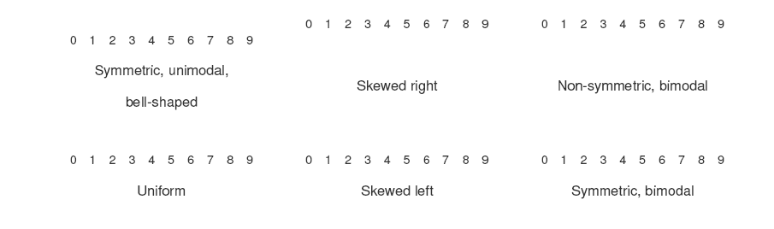
Shape of a distribution
Here are some examples of distributions and shapes.

Slide 42
Correlation coefficients
Correlation coefficients measure the strength of association between two variables. The most common correlation coefficient, called the Pearson product-moment correlation coefficient, measures the strength of the linear association between variables.

Slide 43
How to Interpret a Correlation Coefficient
The sign and the value of a correlation coefficient describe the direction and the magnitude of the relationship between two variables.
The value of a correlation coefficient ranges between -1 and 1.
The greater the absolute value of a correlation coefficient, the stronger the linear relationship.
The strongest linear relationship is indicated by a CC of -1 or 1.
The weakest linear relationship is indicated by a CC equal to 0.
A positive correlation means that if one variable gets bigger, the other variable tends to get bigger.
A negative correlation means that if one variable gets bigger, the other variable tends to get smaller.

Slide 44
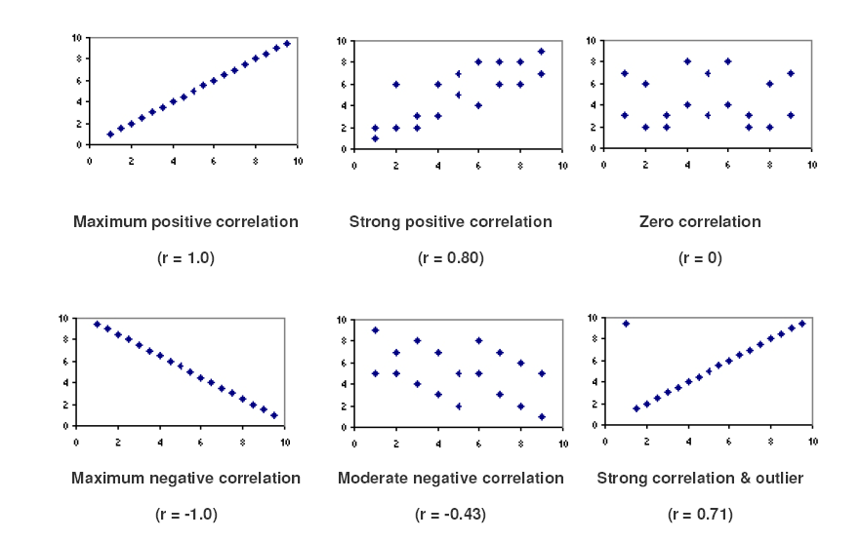
Scatterplots and Correlation Coefficients
The scatterplots below show how different patterns of data produce different degrees of correlation.

Slide 45
Several points are evident from the scatterplots.
When the slope of the line in the plot is negative, the correlation is negative; and vice versa.
The strongest correlations (r = 1.0 and r = -1.0 ) occur when data points fall exactly on a straight line.
The correlation becomes weaker as the data points become more scattered.
If the data points fall in a random pattern, the correlation is equal to zero.
Correlation is affected by outliers. Compare the first scatterplot with the last scatterplot. The single outlier in the last plot greatly reduces the correlation (from 1.00 to 0.71).

Slide 46
What is a Confidence Interval?
Statisticians use a confidence interval to describe the amount of uncertainty associated with a sample estimate of a population parameter.

Slide 47
Confidence Intervals
Statisticians use a confidence interval to express the precision and uncertainty associated with a particular sampling method. A confidence interval consists of three parts.
  A confidence level.
  A statistic.
  A margin of error.
The confidence level describes the uncertainty of a sampling method.
For example, suppose we compute an interval estimate of a population parameter. We might describe this interval estimate as a 95% confidence interval. This means that if we used the same sampling method to select different samples and compute different interval estimates, the true population parameter would fall within a range defined by the sample statistic + margin of error 95% of the time.

Slide 48
Confidence Level
The probability part of a confidence interval is called a confidence level. The confidence level describes the likelihood that a particular sampling method will produce a confidence interval that includes the true population parameter.
Here is how to interpret a confidence level. Suppose we collected all possible samples from a given population, and computed confidence intervals for each sample. Some confidence intervals would include the true population parameter; others would not. A 95% confidence level means that 95% of the intervals contain the true population parameter; a 90% confidence level means that 90% of the intervals contain the population parameter; and so on.

Slide 49
How to Interpret Confidence Intervals
Suppose that a 90% confidence interval states that the population mean is greater than 100 and less than 200. How would you interpret this statement?
Some people think this means there is a 90% chance that the population mean falls between 100 and 200. This is incorrect. Like any population parameter, the population mean is a constant, not a random variable. It does not change. The probability that a constant falls within any given range is always 0.00 or 1.00

Slide 50

What is an Experiment?
In an experiment, a researcher manipulates one or more variables, while holding all other variables constant. By noting how the manipulated variables affect a response variable, the researcher can test whether a causal relationship exists between the manipulated variables and the response variable.

Slide 51
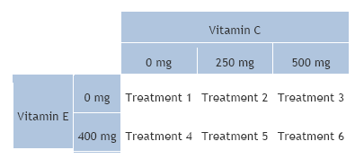
Parts of an Experiment
All experiments have independent variables, dependent variables, and experimental units.
Independent variable. An independent variable (also called a factor) is an explanatory variable manipulated by the experimenter.

Slide 52
Parts of an Experiment
Dependent variable. In the hypothetical experiment above, the researcher is looking at the effect of vitamins on health. The dependent variable in this experiment would be some measure of health (annual doctor bills, number of colds caught in a year, number of days hospitalized, etc.).
Subjects or Experimental units. The recipients of experimental treatments are called experimental units. The experimental units in an experiment could be anything - people, plants, animals, or even inanimate objects.

Slide 53
Parts of an Experiment
Dependent variable. In the hypothetical experiment above, the researcher is looking at the effect of vitamins on health. The dependent variable in this experiment would be some measure of health (annual doctor bills, number of colds caught in a year, number of days hospitalized, etc.).
Subjects or Experimental units. The recipients of experimental treatments are called experimental units. The experimental units in an experiment could be anything - people, plants, animals, or even inanimate objects.

Slide 54
Characteristics of a Well-Designed Experiment
A well-designed experiment includes design features that allow researchers to eliminate extraneous variables as an explanation for the observed relationship between the independent variable(s) and the dependent variable. Some of these features are listed below.
Overall Design: steps taken to reduce the effects of extraneous variables (i.e., variables other than the independent variable and the dependent variable).

Slide 55
Characteristics of a Well-Designed Experiment
Control group. A control group is a baseline group that receives no treatment or a neutral treatment. To assess treatment effects, the experimenter compares results in the treatment group to results in the control group.
Placebo. Often, participants in an experiment respond differently after they receive a treatment, even if the treatment is neutral. A neutral treatment that has no "real" effect on the dependent variable is called a placebo, and a participant's positive response to a placebo is called the placebo effect.

Slide 56
Placebo Effect
To control for the placebo effect, researchers often administer a neutral treatment (i.e., a placebo) to the control group. The classic example is using a sugar pill in drug research. The drug is considered effective only if participants who receive the drug have better outcomes than participants who receive the sugar pill.
Blinding. Blinding is the practice of not telling participants whether they are receiving a placebo. Often, knowledge of which groups receive placebos is also kept from people who administer or evaluate the experiment. This practice is called double blinding.
Randomization. Randomization refers to the practice of using chance methods (random number tables, flipping a coin, etc.) to assign experimental units to treatments.

Slide 57
Data Collection Methods
There are four main methods of data collection.
Census. Obtains data from every member of a population. In most studies, a census often ot practical, cost and/or time required.
Sample survey. A sample survey is a study that obtains data from a subset of a population, in order to estimate population attributes.
Experiment. Controlled study, researcher attempts to understand cause-and-effect relationships. The study is "controlled" in the sense that the researcher controls (1) how subjects are assigned to groups and (2) which treatments each group receives.
Observational study. Attempt to understand cause-and-effect relationships. Researcher is not able to control (1) how subjects are assigned to groups and/or (2) which treatments each group receives.

Slide 58
Data Collection Methods: Pros and Cons
Each method of data collection has advantages and disadvantages.
Resources. A sample survey has a big resource advantage over a census. Can provide very precise estimates of population parameters - quicker, cheaper, and with less manpower than a census.
Generalizability.Refers to the appropriateness of applying findings from a study to a larger population. Generalizability requires random selection.
Observational studies do not feature random selection; so generalizing from an observational study to a larger population can be a problem.
Cohort/Case-control/ Causal inference. Cause-and-effect relationships can be teased out when subjects are randomly assigned to groups.: eg treatment groups

Slide 59
Bias in Survey Sampling
In survey sampling, bias refers to the tendency of a sample statistic to systematically over- or under-estimate a population parameter
A good sample is representative. This means that each sample point represents the attributes of a known number of population
Bias often occurs when the survey sample does not accurately represent the population eg unrepresentative sample is called selection bias.
  Undercoverage. Undercoverage occurs when some members of the population are inadequately represented in the sample.
  Nonresponse bias. Sometimes, individuals chosen for the sample are unwilling or unable to participate in the survey.
  Voluntary response bias. Voluntary response bias occurs when sample members are self-selected volunteers

Slide 60
What is Probability?
The probability of an event refers to the likelihood that the event will occur.
Mathematically, the probability that an event will occur is expressed as a number between 0 and 1. ?probability of event A , P(A).
  If P(A) equals zero, event A will almost definitely not occur.
  If P(A) is close to zero, there is only a small chance that event A will occur.
  If P(A) equals 0.5, there is a 50-50 chance that event A will occur.
  If P(A) equals one, event A will almost definitely occur.
  If P(A) equals 0.05, there is a 1 in 20 chance that event A will occur.
Statistical significance is usually less than 1 in 20, p < 0.05
That mean that there is a less than 1 in 20 chance that the results rose by chance alone

Slide 61
Tests of Significance
Student’s t test: can be used to test the statistical difference between two means, in data that is normally distributed
Chi- test: can be used to test the difference between two proportions in data eg
Drug | Cured | Not Cured
A | 67 | 133
B | 30 | 170
Drug | Cured | Not Cured
C | 100 | 100
D | 94 | 106

Slide 62
Statistics
A Basic Introduction and Review
Additional Slides

Slide 63
Variables:
In statistics, a variable has two defining characteristics:
A variable is an attribute that describes a person, place, thing, or idea.
The value of the variable can "vary" from one entity to another.

Slide 64
Qualitative vs. Quantitative Variables
Variables can be classified as qualitative (categorical) or quantitative (numeric).
Qualitative: Names or labelsl (e.g., red, green, blue) or the breed of a dog (collie, shepherd, terrier)
Quantitative: Quantitative variables are numeric. population of countries,
In algebraic equations, quantitative variables are represented by symbols (e.g., x, y, or z).

Slide 65
Discrete vs. Continuous Variables
Quantitative variables can be further classified as discrete or continuous. If a variable can take on any value between its minimum value and its maximum value, it is called a continuous variable; otherwise, it is called a discrete variable: eg weight ? eg cost of items?

Slide 66
Populations and Samples
The main difference between populations and samples has to do with how observations are assigned to the data set.
  A population includes each element from the set of observations that can be made.
  A sample consists only of observations drawn from the population.
Depending on the sampling method, a sample can have fewer observations than the population, the same number of observations, or more observations. More than one sample can be derived from the same population.

Slide 67
Variability
Statisticians use summary measures to describe the amount of variability or spread in a set of data. The most common measures of variability are the range, the interquartile range (IQR), variance, and standard deviation.
Range: is the difference between the largest and smallest values in a set of values.
For example, consider the following numbers: 1, 3, 4, 5, 5, 6, 7, 11. For this set of numbers, the range would be 11 - 1 or 10.

Slide 68
Measures of Data Position
Statisticians often talk about the position of a value, relative to other values in a set of observations. The most common measures of position are percentiles, quartiles, and standard scores ( z-scores).

Slide 69
Quartiles
Quartiles divide a rank-ordered data set into four equal parts. The values that divide each part are called the first, second, and third quartiles; and they are denoted by Q₁, Q₂, and Q₃, respectively.
Note the relationship between quartiles and percentiles. Q₁ corresponds to P₂₅, Q₂ corresponds to P₅₀, Q₃ corresponds to P₇₅. Q₂ is the median value in the set.

Slide 70
Standard Scores (z-Scores)
A standard score (aka, a z-score) indicates how many standard deviations an element is from the mean. A standard score can be calculated from the following formula.
z = (X - μ) / σ
where z is the z-score, X is the value of the element, μ is the mean of the population, and σ is the standard deviation.

Slide 71
Here is how to interpret z-scores.
A z-score less than 0 represents an element less than the mean.
A z-score greater than 0 represents an element greater than the mean.
A z-score equal to 0 represents an element equal to the mean.
A z-score equal to 1 represents an element that is 1 standard deviation greater than the mean; a z-score equal to 2, 2 standard deviations greater than the mean; etc.
A z-score equal to -1 represents an element that is 1 standard deviation less than the mean; a z-score equal to -2, 2 standard deviations less than the mean; etc.
If the number of elements in the set is large, about 68% of the elements have a z-score between -1 and 1; about 95% have a z-score between -2 and 2; and about 99% have a z-score between -3 and 3.

Slide 72
Shape of a distribution
Symmetry. When it is graphed, a symmetric distribution can be divided at the center so that each half is a mirror image of the other.
Number of peaks. Distributions can have few or many peaks. Distributions with one clear peak are called unimodal, and distributions with two clear peaks are called bimodal. When a symmetric distribution has a single peak at the center, it is referred to as bell-shaped.
Skewness. When they are displayed graphically, some distributions have many more observations on one side of the graph than the other. Distributions with fewer observations on the right (toward higher values) are said to be skewed right; and distributions with fewer observations on the left (toward lower values) are said to be skewed left.
Uniform. When the observations in a set of data are equally spread across the range of the distribution, the distribution is called a uniform distribution. A uniform distribution has no clear peaks.

Slide 73
Student's t Distribution
The t distribution (aka, Student’s t-distribution) is a probability distribution that is used to estimate population parameters when the sample size is small and/or when the population variance is unknown.

Slide 74
Why Use the t Distribution?
According to the central limit theorem, the sampling distribution of a statistic (like a sample mean) will follow a normal distribution, as long as the sample size is sufficiently large. Therefore, when we know the standard deviation of the population, we can compute a z- score, and use the normal distribution to evaluate probabilities with the sample mean.
But sample sizes are sometimes small, and often we do not know the standard deviation of the population. When either of these problems occur, statisticians rely on the distribution of the t statistic (also known as the t score), whose values are given by:
t = [ x - μ ] / [ s / sqrt( n ) ]

Slide 75
Degrees of Freedom
There are actually many different t distributions. The particular form of the t distribution is determined by its degrees of freedom. The degrees of freedom refers to the number of independent observations in a set of data.
When estimating a mean score or a proportion from a single sample, the number of independent observations is equal to the sample size minus one. Hence, the distribution of the t statistic from samples of size 8 would be described by a t distribution having 8 - 1 or 7 degrees of freedom. Similarly, a t distribution having 15 degrees of freedom would be used with a sample of size 16.
For other applications, the degrees of freedom may be calculated differently. We will describe those computations as they come up.

Slide 76
When to Use the t Distribution
The t distribution can be used with any statistic having a bell-shaped distribution (i.e., approximately normal). The central limit theorem states that the sampling distribution of a statistic will be normal or nearly normal, if any of the following conditions apply.
The population distribution is normal.
The sampling distribution is symmetric, unimodal, without outliers and the sample size is 15 or less.
The sampling distribution is moderately skewed, unimodal, without outliers, and the sample size is between 16 and 40.
The sample size is greater than 40, without outliers.
The t distribution should not be used with small samples from populations that are not approximately normal.

Slide 77
Chi-Square Distribution
The distribution of the chi-square statistic is called the chi-square distribution. In this lesson, we learn to compute the chi-square statistic and find the probability associated with the statistic.
Suppose we conduct the following statistical experiment. We select a random sample of size n from a normal population, having a standard deviation equal to σ. We find that the standard deviation in our sample is equal to s. Given these data, we can define a statistic, called chi-square, using the following equation:
Χ² = [ ( n - 1 ) * s² ] / σ²

Slide 78
Difference Between Proportions
Statistics problems often involve comparisons between two independent sample proportions. This lesson explains how to compute probabilities associated with differences between proportions.
Suppose we have two populations with proportions equal to P₁ and P₂. Suppose further that we take all possible samples of size n₁ and n₂. And finally, suppose that the following assumptions are valid.

Slide 79
Difference Between Proportions
The size of each population is large relative to the sample drawn from the population. That is, N₁ is large relative to n₁, and N₂ is large relative to n₂. (In this context, populations are considered to be large if they are at least 10 times bigger than their sample.)
The samples from each population are big enough to justify using a normal distribution to model differences between proportions. The sample sizes will be big enough when the following conditions are met: n₁P₁ > 10, n₁(1 -P₁) > 10, n₂P₂ > 10, and n₂(1 - P₂) > 10.
The samples are independent; that is, observations in population 1 are not affected by observations in population 2, and vice versa.

Slide 80
Difference Between Means
Statistics problems often involve comparisons between two independent sample means. This lesson explains how to compute probabilities associated with differences between means.
Suppose we have two populations with means equal to μ₁ and μ₂. Suppose further that we take all possible samples of size n₁ and n₂. And finally, suppose that the following assumptions are valid.
The size of each population is large relative to the sample drawn from the population. That is, N₁ is large relative to n₁, and N₂ is large relative to n₂. (In this context, populations are considered to be large if they are at least 10 times bigger than their sample.)

Slide 81
Difference Between Means
The samples are independent; that is, observations in population 1 are not affected by observations in population 2, and vice versa.
The set of differences between sample means is normally distributed. This will be true if each population is normal or if the sample sizes are large. (Based on the central limit theorem, sample sizes of 40 are large enough).

Slide 82
What is Hypothesis Testing?
A statistical hypothesis is an assumption about a population parameter. This assumption may or may not be true. Hypothesis testing refers to the formal procedures used by statisticians to accept or reject statistical hypotheses.
There are two types of statistical hypotheses.
Null hypothesis. The null hypothesis, denoted by H₀, is usually the hypothesis that sample observations result purely from chance.
Alternative hypothesis. The alternative hypothesis, denoted by H₁ or H_{a}, is the hypothesis that sample observations are influenced by some non-random cause.

Slide 83
Can We Accept the Null Hypothesis?
Some researchers say that a hypothesis test can have one of two outcomes: you accept the null hypothesis or you reject the null hypothesis. Many statisticians, however, take issue with the notion of "accepting the null hypothesis." Instead, they say: you reject the null hypothesis or you fail to reject the null hypothesis.
Why the distinction between "acceptance" and "failure to reject?" Acceptance implies that the null hypothesis is true. Failure to reject implies that the data are not sufficiently persuasive for us to prefer the alternative hypothesis over the null hypothesis.

Slide 84


Magnesium therapy for pre-eclampsia
Magpie Trial

Slide 85


Pre-eclampsia
Multisystem disorder of pregnancy
Raised blood pressure / proteinuria
2–8% of pregnancies
Outcome: often good
A major cause of morbidity and
mortality for the woman and her
child

Slide 86
Eclampsia
One or more convulsions superimposed on pre-eclampsia
Rare in developed countries: around 1/2000
Developing countries: 1/100 to 1/1700
Pre-eclampsia and eclampsia: > 50 000 maternal deaths a year
UK: pre-eclampsia/eclampsia for 15% of maternal deaths, 2/3 related to pre-eclampsia

Slide 87
Therapy for pre-eclampsia
Anticonvulsant drugs: reduce risk of seizure, and so improve outcome
1998, Duley L et al., Systematic review of 4 trials (total 1249 women):
  Magnesium sulphate: drug of choice for pre-eclampsia/eclampsia
  Better than diazepam/phenytoin/lytic cocktail
USA: 5% of pregnant women before delivery
UK: severe preeclampsia, around 1% of deliveries

Slide 88
Magpie Trial
MAGnesium sulphate for Prevention of Eclampsia :
THE LANCET • Vol 359 • June 1, 2002

Slide 89
Magpie Trial
10141 women, not given birth or less than 24 hours postpartum
BP 140/90 mm Hg or more, proteinuria of 1+ (30 mg/dl) or more
Randomised in 33 countries
Magnesium sulphate (n=5071), placebo (n=5070).

Slide 90
Magpie Trial
Loading dose 8 ml iv (4 g magnesium sulphate, or placebo) given iv over 10–15 min.
Followed by infusion over 24 h of 2 ml/h trial (1 g/h magnesium sulphate, or placebo)
8 ml iv with 20 ml im, followed by 10 ml trial treatment (5 g magnesium sulphate, or placebo) every 4 h, for 24 h

Slide 91
Magpie Trial
Reflexes and respiration: checked at least every 30 min, urine output measured hourly
Treatment reduced by half if:
  Tendon reflexes were slow
  Respiratory rate reduced but the woman well oxygenated
  Urine output was less than 100 ml in 4 h
Blood monitoring of magnesium concentrations: not required

Slide 92
Magpie Trial Results
Data from 10110 (99.7%) of women enrolled
1201/4999 (24%) had side-effects with Mg vs 5% placebo
Mg: 58% lower risk of eclampsia (95% Confidence Interval 40-71%)
Eclampsia was 0.8% (40 women) for Mg versus 1.9% (96 women) for placebo (p < 0.05)
11 fewer women with Eclampsia for every 1000 women treated with Mg rather than placebo
Maternal Mortality reduced by 45% (NS)
Placental abruption reduced by 33%
Neonatal mortality no difference

Slide 93
Magpie Trial Conclusion
Magnesium sulphate reduces the risk of eclampsia, and it is likely that it also reduces the risk of maternal death.
At the dosage used in this trial it does not have any substantive harmful effects on the mother or child, although a quarter of women will have side-effects.

Slide 94
Magpie Trial
The lower risk of eclampsia following prophylaxis with magnesium sulphate was not associated with a clear difference in the risk of death or disability for children at 18 months.

Slide 95
Magpie Trial
The reduction in the risk of eclampsia following prophylaxis with magnesium sulphate was not associated with an excess of death or disability for the women after 2 years

Slide 96
Conclusion
Magnesium sulphate reduces the risk of eclampsia in women with Pre-eclampsia
It is likely that it also reduces the risk of maternal death
NNT (number needed to treat) to save one woman having eclampsia is 91

Slide 97
The Chisale-Francis Experiment 2013
Height | Units
 | 28
 | 27
 | 26
 | 25
 | 24
 | 23
 | 22
 | 21
 | 20
 | 19
 | 18
 | 17
 | 16
 | 15
 | 14
 | 13
 | 12
 | 11
 | 10
 | 9
 | 8
 | 7
 | 6
 | 5
 | 4
 | 3
 | 2
 | 1
In Groups measure your height in Nova units
Your weight also needs to be measured in kgs
Subjects n = 12
Use categories: 6 max by height

