Slide 1

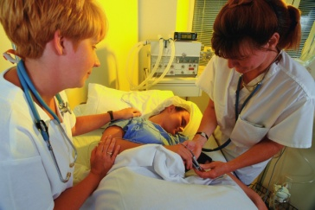
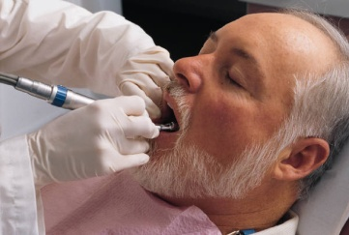


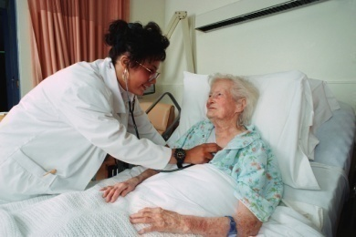
Catherine Bennett Vinod Patel
Being a Clinical Educator

Slide 2




What makes a good educational experience?
Thinking about your own experiences (good and bad)...
What makes a good educational experience?

Slide 3
Overview & learning outcomes (At the end of this session, you should be able to...)
Roles and skills of clinical teachers
Discuss the roles and skills of a clinical educator
Adult learning: How adults learn
Describe the characteristics of adult learning and the implications for your teaching practice and demonstrate practical applications in your teaching practice
The differences between teaching and learning
Discuss the differences between teaching and learning and the factors that influence learning
Encouraging active learning
Describe the benefits of active learning
Learning styles
Discuss different learning styles and the implications for clinical education

Slide 4
Clinicians as educators
Many health professionals are involved in education and training as part of their role
Traditionally, assumed that good clinical skills meant good teaching skills
More recently, acknowledged that educational skills need to be developed in the same way as other skills (e.g. clinical skills, communication skills, professionalism, leadership...)

Slide 5

General Medical Council Good Medical Practice
“15. Teaching, training, appraising and assessing doctors and students are important for the care of patients now and in the future. You should be willing to contribute to these activities.”
“16. If you are involved in teaching you must develop the skills, attitudes and practices of a competent teacher.”

Slide 6


Nursing and Midwifery Council The code: Standards of conduct, performance and ethics for nurses and midwives
“23 You must facilitate students and others to develop their competence.”
“Standards to support learning and assessment in practice”

Slide 7

Roles of the clinical teacher
What different roles do you have as a clinical teacher?
What ‘teaching activities’ do you carry out?

Slide 8
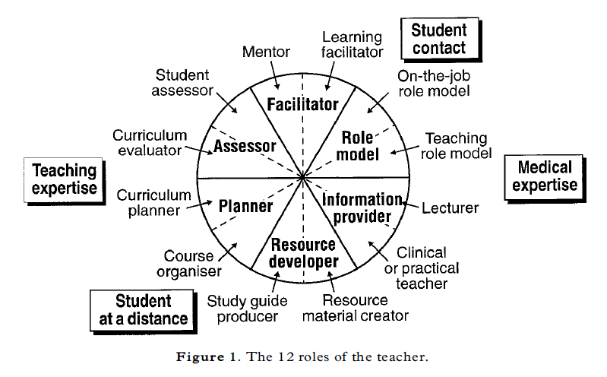
Roles of the clinical teacher
(Harden & Crosby, 2000)

Slide 9
What makes a good clinical teacher?
Medical/clinical knowledge
Clinical and technical skills/competence, clinical reasoning
Positive relationships with students and supportive learning environments
Physical environment, methods used, personality, institutional climate
Communication skills
Listening, encourage participation, rapport, questioning skills
Enthusiasm
For medicine, for teaching, generally enthusiastic
(Sutkin, Wagner, Harris & Schiffer, 2008)

Slide 10
Core teaching skills
Establishment of positive learning environment
Setting clear objectives and expectations
Provision of timely and relevant information
Effective use of questioning and other instructional methods
Appropriate role modelling
Provision of constructive feedback and objective-based evaluations [assessment]
(Copeland & Hewson, 2000)

Slide 11
What do students value?
Enthusiasm
Positive attitude towards teaching
Rapport with students and patients
Availability and accessibility
Clinical competence
Subject matter expertise
(Irby, 1994)

Slide 12
Pendleton's Rules (of feedback)
Briefly clarify any matters of fact.
1. The teacher ascertains what went well
Ask Student: what did you do well?
2. The teacher states what went well
Teacher: I thought you were good at….
3. The teacher ascertains what could be improved
Ask Student: what could you have done differently?
4. The teacher states what could be improved
Teacher: I think it would have better to have…..

Slide 13
What makes a good clinical teacher?
Teaching skills
Values, attitudes, behaviours
Knowledge of teaching & learning

Slide 14
What makes good education?
WHO?
WHY?
HOW?
WHAT Learnt?
WHAT Changed?

Slide 15
Spare Slides: reference only not used on the ETATMBA Course

Slide 16
Understanding adult learning

Slide 17
Understanding adult learning
Think about the characteristics of adult learners
Knowles – andragogy “The art and science of helping adults learn”
Five assumptions about how adults learn…

Slide 18
How do adults approach learning? (Knowles’ andragogical assumptions)
Adults…
Self-directed: Can determine own learning needs and find ways to meet them
Build on past experience: Have previous experience which provides a context for developing new knowledge and skills
Task based: Value learning that integrates with their roles and tasks
Problem-centred rather than subject-centred: Value learning that can be applied to their current authentic situations
Internally motivated: Are more motivated by internal factors such as desire to succeed and personal goals than external incentives and rewards
Knowles (1980, 1984)

Slide 19
Knowles’ seven principles of adult learning
Establish an effective learning climate
Involve learners in planning their learning
Involve learners in diagnosing their learning needs
Encourage learners to formulate their own learning objectives
Encourage learners to identify resources and strategies to accomplish their objectives
Help learners to carry out their learning plans (success motivates)
Involve learners in evaluating learning (helps develop self-directed learning and critical reflection skills)
Knowles, 1984

Slide 20
What are the implications for your teaching practice?

Slide 21
Teaching or learning?

Slide 22
Teaching or learning?
I’ve taught Spot to whistle!
I said I taught him – I didn’t say he learned!
I can’t hear anything…

Slide 23
What are the differences between teaching and learning?

Slide 24
Teacher-centred or learner-centred approach?
Teacher Centred
Teachers as knowledge centre, directing the learning process and controlling student's access to information
Students viewed as 'empty' vessels and learning is viewed as an additive process
Instruction is geared for the 'average' student and everyone is forced to progress at the same rate
Student Centred
Students are not empty vessels - they have prior knowledge and experience
Students learn in different ways and learning is an active dynamic process
Students construct their own meaning by talking, listening, writing, reading, and reflecting on content, ideas, issues and concerns
Adapted from http://www.bath.ac.uk/e-learning/student_centredness.htm

Slide 25
Models of education in medicine and healthcare
Flexnerian (traditional) model
Define fundamentals | Teach fundamentals | Test | Hope for the best!
Outcomes (competency-based ) model
Define success (outcomes) | Design measurements and standards | Develop learning activities to achieve the outcomes
Adapted from Smith, 2005

Slide 26
The learner’s journey:
Student
Competent professional delivering high quality patient care
(Adapted from McKimm & Swanwick, 2010 p7)

Slide 27
The learner’s journey: Role of the teacher - facilitating learning
Help acquire clinical knowledge and skills
Facilitate development of professional attitudes
Foster self-directed, lifelong learning
Student
Competent professional delivering high quality patient care
(Adapted from McKImm & Swanwick, 2010 p7)

Slide 28
The learning cycle: Responding to needs
Identify needs
Plan
Deliver
Evaluate
Student
Informs teaching and learning

Slide 29
Thinking about your teaching...
In what ways is your teaching teacher-centred or learner-centred?
How could you make your teaching more learner-centred?

Slide 30
Developing an active approach to learning

Slide 31
"Chinese proverb"
Tell me and I forget
Show me and I remember
Involve me and I understand

Slide 32
Developing an active approach to learning: Encouraging ‘active learning’
Focus on learning rather than teaching
Student (learner) participation
Move from students acquiring and processing knowledge to actively and critically creating meaning for themselves

Slide 33
Encouraging ‘active learning’
Improves
Engagement
Application
Retention
“Students are encouraged to think and not just recall facts they have learned.”
(Harden, 2005: 137)

Slide 34
Encouraging active learning
Suggest activities to encourage active learning in your own teaching context(s), where students interact with the subject content:
Individually
With the teacher
With other learners

Slide 35
How do we learn from (clinical) experience?
Have an experience
(Concrete experience)
Think about & analyse (Reflective observations)
Integrate with existing understanding
(Abstract conceptualisation)
Plan for next time
(Active experimentation)

Slide 36
How do we learn from (clinical) experience?
Have an experience
(Concrete experience)
Think about & analyse (Reflective observations)
Integrate with existing understanding
(Abstract conceptualisation)
Plan for next time
(Active experimentation)
Completing the cycle for learning
Kolb’s (1984) experiential learning cycle, cited in McKimm (2010)

Slide 37
Thinking about approaches to learning and learning styles

Slide 38
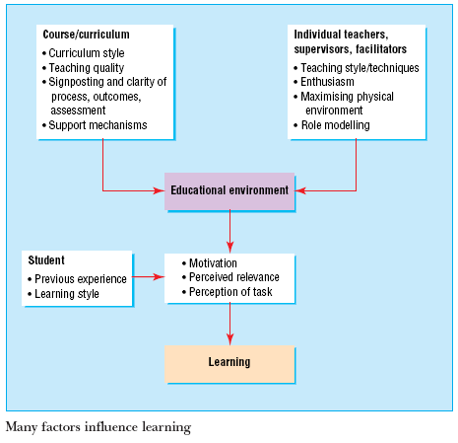
Factors influencing learning
(Hutchinson, 2003)

Slide 39
Think about how you learn…
How do you like to learn?
Are there any teaching and learning methods that you find particularly helpful or unhelpful?

Slide 40
Learning styles and approaches to learning: Overview
People learn best in different ways…
Everyone has a mix of different styles
Styles are points on a continuum, not discrete categories
Some people have a dominant learning style; some have a balanced blend
We can all learn under any style regardless of preference

Slide 41
Learning styles: Overview
More than 70 models of learning styles
We will look at 3……..

Slide 42
1. VAK: Visual – Auditory - Kinesthetic
Visual – seeing and reading
Auditory – listening and speaking
Kinesthetic – touching and doing
(Based in the psychology of child learning, 1920s on)

Slide 43
2. Entwistle’s Approaches and Study Skills Inventory for Students (ASSIST)
Deep approach
Aims to understand
Surface approach
Aims to cope with the course
Strategic approach
Aims to achieve highest grade possible
(Entwistle, McCune and Walker, 2001)

Slide 44
Defining features of approaches to learning and studying
Deep approach
Intention – to understand ideas for yourself
Relating ideas to previous knowledge and experience
Looking for patterns and underlying principles
Checking evidence and relating it to conclusions
Examining logic and argument cautiously and critically
Being aware of understanding developing while learning
Becoming actively interested in the course content

Slide 45
Defining features of approaches to learning and studying
Surface approach
Intention – to cope with course requirements
Treating the course as unrelated bits of knowledge
Memorising facts and carrying out procedures routinely
Finding difficulty in making sense of new ideas presented
Seeing little value or meaning in either courses or tasks set
Studying without reflecting on either purpose or strategy
Feeling undue pressure and worry about work

Slide 46
Defining features of approaches to learning and studying
Strategic approach
Intention – to achieve the highest possible grades
Putting consistent effort into studying
Managing time and effort effectively
Finding the right conditions and materials for studying
Monitoring the effectiveness of ways of studying
Being alert to assessment requirements and criteria
Gearing work to the perceived preferences of lecturers

Slide 47
3. Honey and Mumford’s Learning Styles Questionnaire (LSQ)
Activist
Reflector
Theorist
Pragmatist
(Honey & Mumford, 1992)

Slide 48
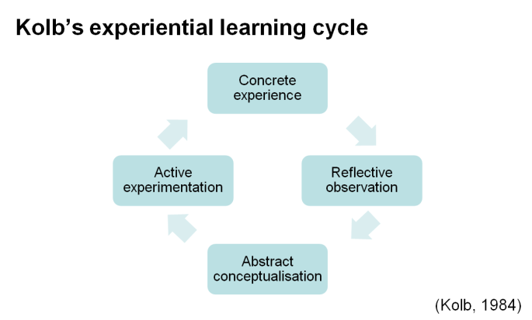
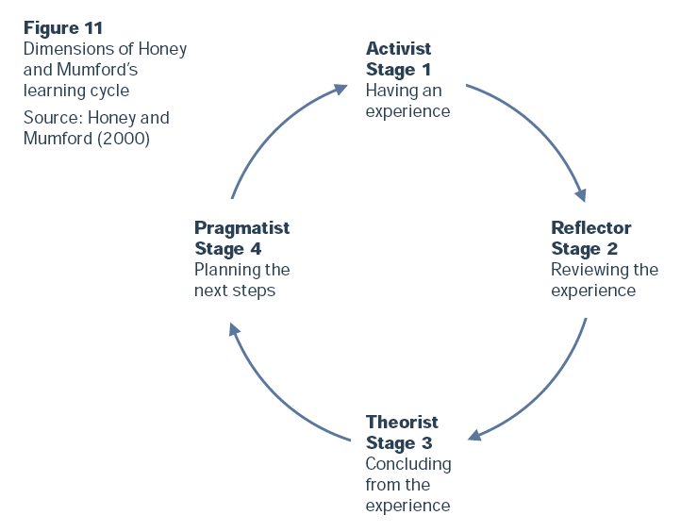
Diagram from: Learning styles and pedagogy in post-16 learning. A systematic and critical review. Coffield, Moseley, Hall & Ecclestone (2004)

Slide 49
Summary
Roles and skills of clinical teachers
Adult learning: How adults learn
The differences between teaching and learning
Encouraging active learning
Learning styles
“It's not what is poured into a student that counts, but what is planted.”
Linda Conway

Slide 50
References
Copeland, H. and Hewson, M. (2000) ‘Developing and testing an instrument to measure the effectiveness of clinical teaching in an academic medical centre’, Academic Medicine, 75, pp. 161-6.
Entwistle, N.J., McCune, V. and Walker, P. ( 2001). ‘Conceptions, Styles and Approaches Within Higher Education: Analytic Abstractions and Everyday Experience’ in Perspectives on Thinking, Learning and Cognitive Styles, Ed. Sternberg & Zhang pp. 103-136. Erlbaum, L. and Mahwah. N.J.
Harden, R. M., and Crosby, J. (2000) ‘AMEE Guide No 20: The good teacher is more than a lecturer - the twelve roles of the teacher’, Medical Teacher, 22(4), pp. 334-347.
Harden, R. M. (2005) ‘Independent learning’ In Harden RM & Dent JA (eds) A practical guide for medical teachers (2nd ed). Elsevier: Edinburgh.

Slide 51
References
Honey, P. & Mumford (1992). The Manual of Learning Styles (3rd Edn) Honey: Maidenhead.
Hutchinson, L. (2003) ‘ABC of learning and teaching: Educational environment’ BMJ 326, pp. 810.
Irby, D. (1994) ‘What clinical teachers in medicine need to know’ Academic Medicine 69 pp. 333-42.
Knowles, M. S. (1980) The modern practice of adult education: from pedagogy to andragogy (2nd ed) Cambridge Books: New York.
Knowles M. S. and associated (1984). Andragogy in action: applying modern principles of adult learning. Jossey-Bass: San Francisco, CA.
Kolb, D. A. (1984) Experiential learning: experience as the source of learning and development. Prentice Hall: Englewood Cliffs, NJ.

Slide 52
References
Merriam and Caffarella (1991) Learning in adulthood: a comprehensive guide. Jossey-Bass: San Francisco, CA.
Pask, G. (1976). Styles and strategies of learning. British J. Educ. Psychol. 46, pp. 128–148.
Smith, S. R. (2005) ‘Outcome-based curriculum’ In Harden RM & Dent JA (eds) A practical guide for medical teachers (2nd ed). Elsevier: Edinburgh.
Sutkin, G., Wagner, E., Harris, I. and Schiffer, R. (2008) ‘What Makes a Good Clinical Teacher in Medicine? A Review of the Literature’ Academic Medicine, 83(5), pp 452-466.

Slide 53
Further reading
Teaching and learning in medical education: how theory can inform practice. Kaufman D & Mann K (2010)
In Understanding Medical Education: Evidence, theory and practice. Ed Swanwick, T. Wiley-Blackwell, Chichester, West Sussex. Also available as an Understanding Medical Education booklet (ed Swanwick, T). ASME: Edinburgh.
Applying educational theory in practice. Kaufman, D (2010)
In ABC of Learning and Teaching in Medicine. Eds Cantillon P and Wood, D. BMJ Books: Chichester

