Slide 1
How to teach practical skills
Dr. Chisale Mhango FRCOG
College of Medicine/Warwick University Medical School
Notes:
Speaker’s notes:
The AAMC Project on the Clinical Education of Medical Students

Slide 2
Definition (1)
The word “clinical” is derived from the Greek ‘klinikos’, which means ‘pertaining to or around the sick bed’.
The term ‘clinical skills’ refers to those clinical examination and procedural skills commonly performed in real or simulated clinical environments.

Slide 3
Definition (2)
For the purpose of this session, “practical skills” means skills performed by hand (as in tying a knot) or with human intervention using equipment, tools or technology requiring guidance, force or movement (as in utero blood transfusion).
Practical skills primarily require physical dexterity, although an understanding of principles, processes and sequences is also essential, especially for more complex practical skills.
In many learning environments, the word “competency” has replaced the term “practical skill.” The terms are not entirely interchangeable as competencies can also include the application of knowledge and theory not associated with practical skills. But in general, the demonstration of a practical skill can also be described as demonstrating competency.

Slide 4
Teaching practical skills
Teaching practical skills requires using very precise instructions to enable the learner to follow the process and to repeat the skill.
Most often this involves using both visual clues and text or audio prompts.
It certainly requires special skills in an instructor if there are no visuals.
For distance learners, the most frequently used method for teaching practical skills is using print-based illustrations of step-by-step procedures.

Slide 5
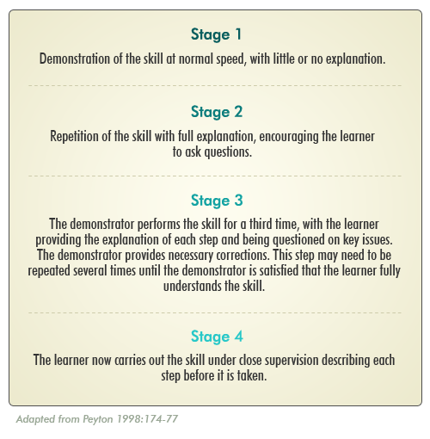
The “four-stage approach” to teaching practical skills
Notes:
This model may be expanded or reduced depending on the background skills of the learner. Video may be used in Stages 1 and 2. As with all teaching, the learner must be given constructive feedback and allowed time for practice of the skills.

Slide 6
Teaching clinical skills
“Observe, record, tabulate, communicate.
Use your five senses… Learn to see, learn to hear, learn to feel, learn to smell, and know that by practice alone you can become expert’
Sir William Osler (1849–1919)

Slide 7
Objectives of this Workshop
By the end of this session you should be able to
Reflect on how, why and where you teach clinical skills;
Relate theoretical models of teaching practical skills to your own practice; and
Plan a teaching session in different clinical environments, using real and simulated patients.

Slide 8
Writing Skills objectives
An example of a skills-based objective at the level of ‘precision’ would be:
‘At the end of the training session, learners will be able to insert a cannula into a vein accurately without causing a haematoma’.
Notes:
Speaker’s Notes:
Bloom suggested these five levels:
Imitation (observes skill and tries to reproduce it)
Manipulation (performs skill from instruction)
Precision (reproduces skill with accuracy and proportion)
Articulation (combines one or more skills in sequence with harmony and consistency)
Naturalisation (completes skilful tasks competently and automatically).
Bloom B and Kratwohl D. Taxonomy of educational objectives: the classification of educational goals: Handbook I,
Cognitive Skills Domain, Longmans-Green, New York, 1956.

Slide 9
Thinking points
Think about the clinical skills you commonly teach.
Where do you teach them?
What teaching methods do you commonly use?
How do you assess the learning of these skills?
What theoretical models, if any, do you base this teaching and learning on?

Slide 10
Where to teach clinical skills
Traditionally, clinical teaching occurred in hospital wards, outpatient settings and operating theatres. During the past 20 years, clinical skills centres, laboratories and, more recently, simulation centres with high-fidelity simulation have been introduced.
While traditional clinical settings have never been the ideal teaching and learning environments, they are becoming increasingly more difficult to use as service demands stretch goodwill and reduce opportunity.
Workplace-based learning however is vital for the acquisition of a comprehensive range of clinical skills that can be used in a variety of complex situations.

Slide 11
The planned clinical examination session
Small groups of students (two to six) are taken to the bedside, an ‘expert’ demonstrates the skills and then observes the students’ performance of the skill.
The main mistake teachers make during such planned sessions is lecturing the students while ignoring the wonderful resource that is the patient and their clinical history and signs.
These sessions must follow the simple philosophy of making the most of the patient.

Slide 12
Opportunistic teaching and learning
By definition, opportunistic teaching and learning is unpredictable but can be
maximised by setting learning outcomes or educational objectives,
pre-planning and reflection on important generic and specific educational issues that may arise.

Slide 13
Teaching and learning in simulated environments
Simulation is the reproduction of part or all of a clinical encounter through the use of manikins, computer-assisted resources and simulated patients.
Advances in learning technologies have seen a massive rise in the availability and employment of high-fidelity simulators and simulation. However, low-fidelity resources have been used successfully for many years and, like the traditional teaching environments, need to be carefully incorporated into the spectrum of learning/training.

Slide 14
Simulation:
Simulations vary in their relation (fidelity) to the real, lived experience.
allows learners to practise in a safe, protected environment
assists learners’ reflection of their strengths and weaknesses through teacher, peer and ‘patient’ feedback, including video analysis
allows teachers/staff to assess skills in an objective, reproducible manner

Slide 15
Low-fidelity simulation
Low-fidelity simulation might include using manikins to practise clinical examinations or procedures such as vaginal examination.
Manikins can also be used to rehearse the skills of simple clinical procedures such as suturing or the insertion of urinary catheters, intravenous cannulae and nasogastric tubes, taking a blood pressure or temperature.
Notes:
Speaker’s notes:
“Fidelity” may be defined as strict conformity to truth of fact.

Slide 16
How IT can assist in the teaching and learning of clinical skills
There has been a huge explosion in the availability of IT resources that can be used to help teach clinical skills. However, procedural skills are still heavily influenced by local ‘experts’ who cling on to their own local variation on the way to perform given skills.
With so many freely available web-based resources, a good starting point is to quality assure the best of these sites as you would with course books.

Slide 17
Catering to the different needs is critical for success.
A major consideration when teaching practical skills is the diversity in the preferred learning styles of learners.
Experiential learners become frustrated sitting through a lengthy explanation of a process; they just want to go and try it out.
Theorists need to understand everything in minute detail before they embark on the practical application.
Recognising different learning styles is an important factor in assisting learners to develop practical skills.

